Slide 1
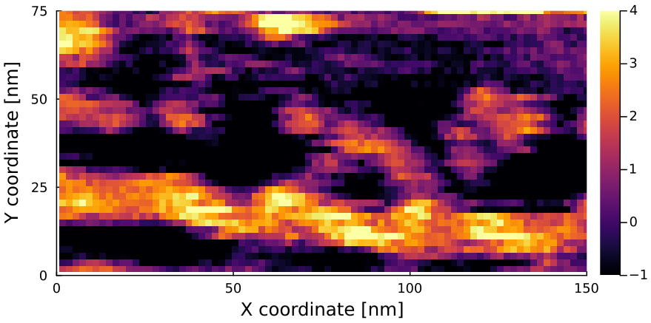
Without deconvolution
[nm]
N. Kodera, D. Yamamoto, R. Ishikawa, and T. Ando, Nature 468, 72 (2010).

Slide 2
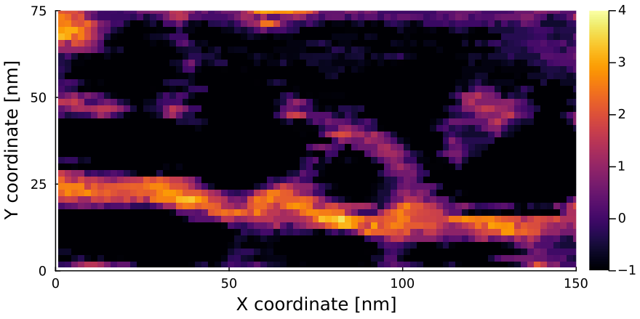
Deconvoluted image with a reconstructed tip
[nm]
N. Kodera, D. Yamamoto, R. Ishikawa, and T. Ando, Nature 468, 72 (2010).

