Slide 1
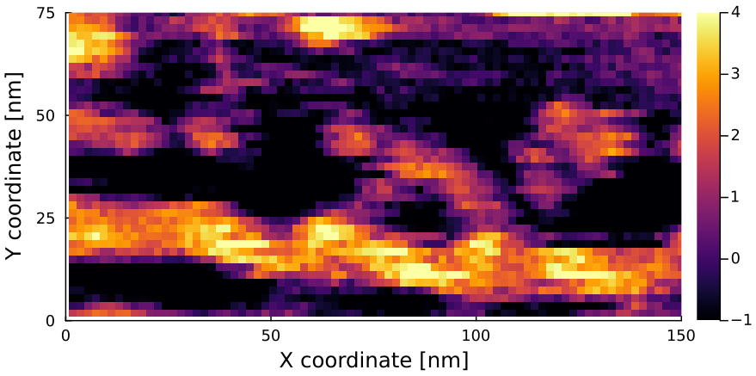
Raw data
[nm]
N. Kodera, D. Yamamoto, R. Ishikawa, and T. Ando, Nature 468, 72 (2010).

Slide 2
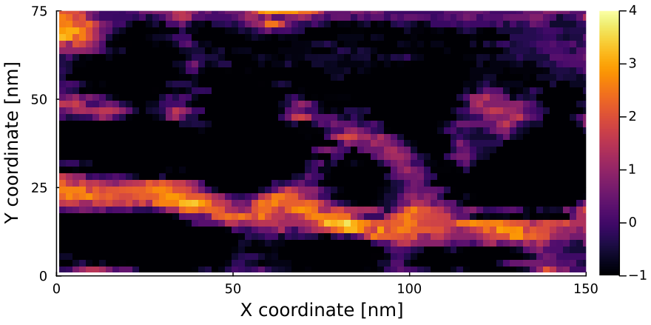
Deconvoluted with a reconstructed tip
[nm]
N. Kodera, D. Yamamoto, R. Ishikawa, and T. Ando, Nature 468, 72 (2010).

