Slide 1
MATERNA
From Mother to Mother <3

Slide 2
Who Are WE ?
the app is build for food donation , that started As a Hackathon Project provided By IBM and Materna (yap, the milk company )
It have tow different levels of users : regular user , AMOTA Volunteer
For the regular user , the system is so simple - click the add button, fill the info , and u R done !
For the AMOTA volunteers , it’s a little bit more .

Slide 3
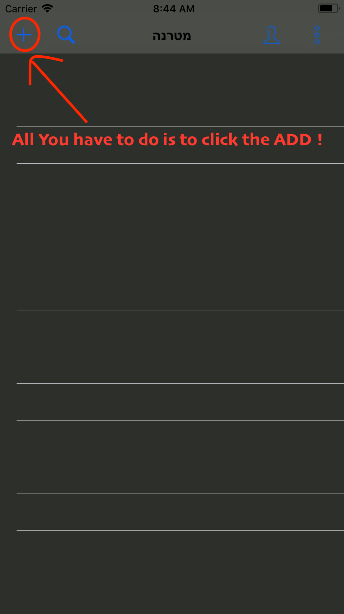
Heey Mother ☺
We make this as simple as we can !

Slide 4
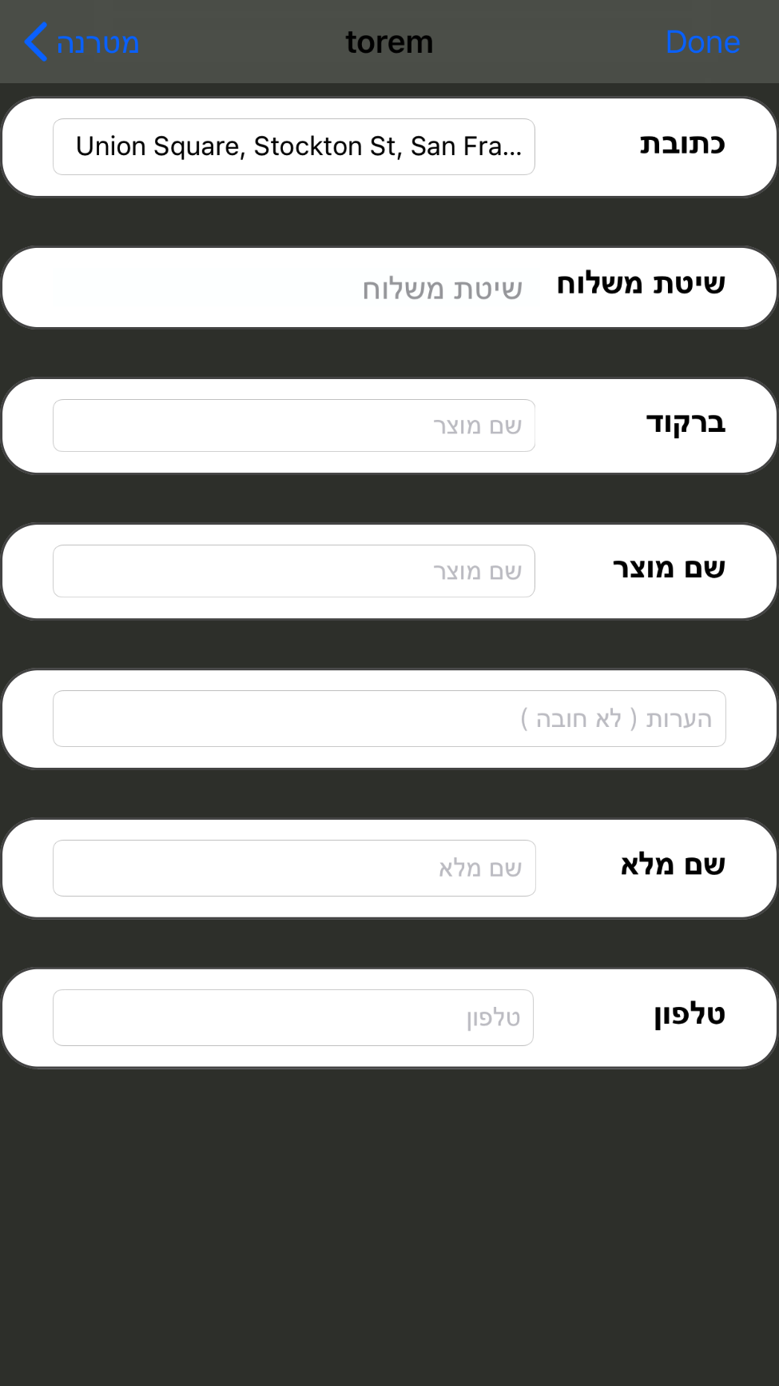
And Then … ?
The app will open your camera , all you have to do is to point it at the barCode on side of the milk can , this will avoid you filling the products info
Your address also will collected from your phone GPs
Then , we take it from here .

Slide 5
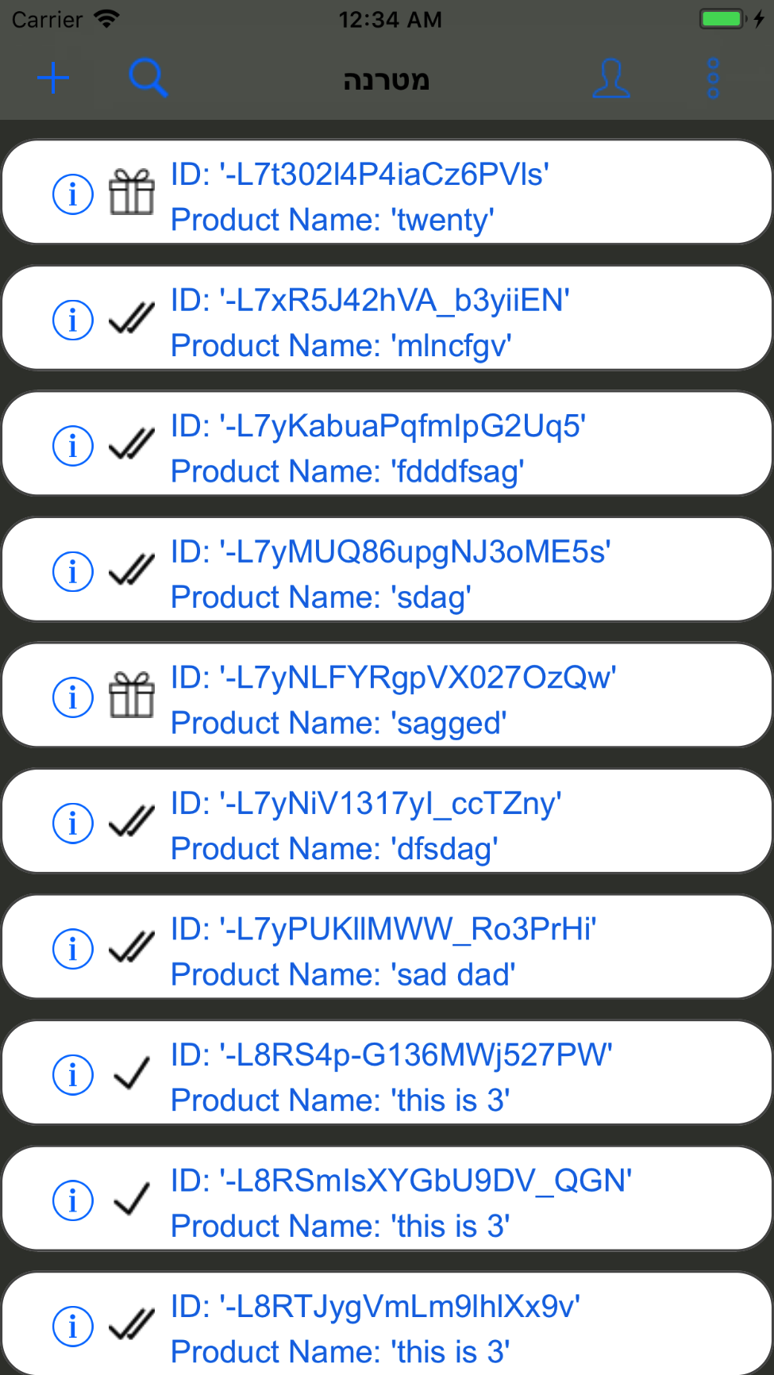
Amota Volunteer
This is going to be Your Main page , from here you will be able to manage the products .
The products are stored in the DataBase in 3 ways :
- Sent : collected by the delivery team but haven’t reach the store house yet
- Arrived : the product is in the store house .
- Given : product have sent to a needed family <3 .
As a Amota Volunteer , you will be able to change the status o each product as needed.
Every product is known by it product ID .

