Slide 1
Introduction
SE495: Software Entrepreneurship

Slide 2
Outline
Overview
Opportunities
Building a Software Startup
Developing a Software Product
Raising Capital

Slide 3
Overview

Slide 4
Overview
Software Entrepreneurship refers to the process of creating, launching, and running a software-based business or product.
Key Characteristics:
Innovation
Risk-taking
Agility
Focus on Customer needs

Slide 5

Entrepreneur
Partnership
Innovation
Business
Finance
Entrepreneur

Slide 6
Why become a software entrepreneur
Creating Something Valuable
Financial Success
Positive Impact
Your Own Boss
Challenge and Excitement

Slide 7



Types of Software Businesses
Products
Tangible, licensed software that customers can install and use on their own devices
Services
Intangible, cloud-based solutions that customers access through a web browser or mobile app
Content
Digital assets such as e-books, tutorials, and videos that teach customers how to use software or solve problems related to software

Slide 8
Opportunities

Slide 9
Identifying Opportunities in the Software Industry
Software industry is rapidly growing, with a projected value of over $500 billion by 2023
Emerging technologies such as AI, blockchain, and IoT creating new opportunities for software startups
Traditional industries such as healthcare, finance, and retail being disrupted by software, creating new opportunities for innovation

Slide 10
Importance
Saudi Arabian software market is projected to reach $1.47 billion by 2023, growing at a CAGR of 13.4% from 2020 to 2023.
Software Entrepreneurship create jobs, drives innovation, and contributes to GDP
Successful Software Entrepreneurship can gain competitive advantage and attract investors

Slide 11
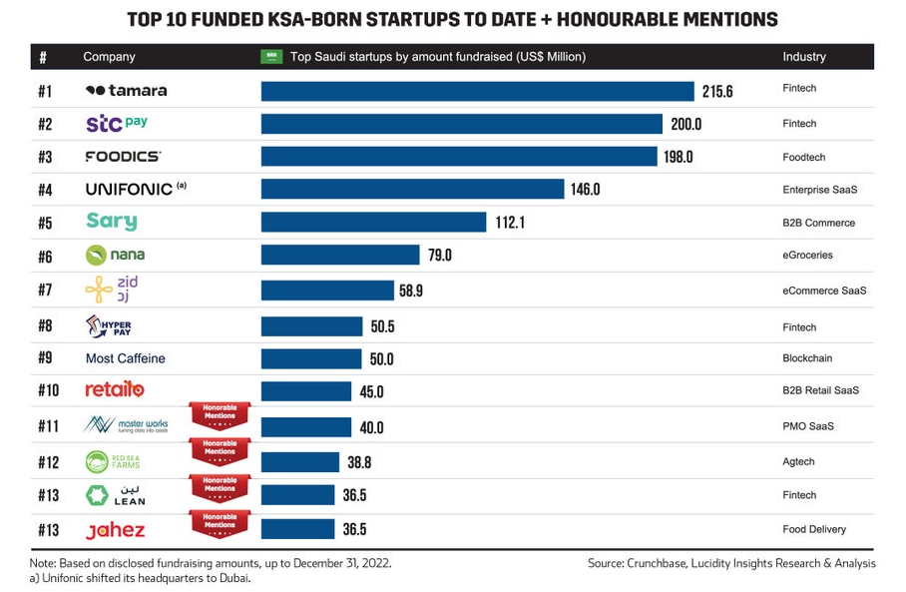

Slide 12
Understanding Market Needs and Trends
Understanding market needs and trends is key to identifying opportunities in software entrepreneurship
Importance of conducting market research and analysis to identify pain points and areas for improvement
Examples of trends and opportunities in software industry:
Cloud-based solutions
Cybersecurity and data privacy
DevOps and agile development methodologies
Platforms, Low-code and no-code

Slide 13
Building a Software Startup

Slide 14
Key Steps in Building a Software Startup
Idea generation and validation
Identifying a problem or opportunity in the market
Conducting market research and analysis
Developing a minimum viable product (MVP)
Team formation and building
Finding co-founders and building a team
Defining roles and responsibilities
Creating a company culture and vision
Product development and launch
Developing and refining the product
Conducting user testing and feedback
Launching the product and iterating based on feedback

Slide 15

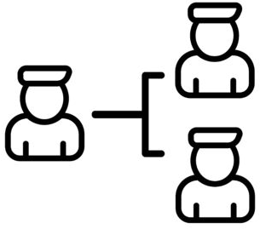
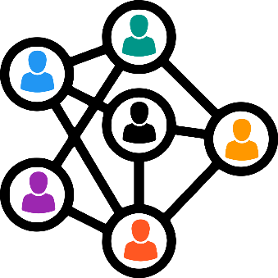
Importance of Team Building and Networking
A strong team is critical to the success of a software startup
Co-founders should complement each other in terms of skills, experience, and personality
Networking is essential for finding mentors, advisors, investors, and customers

Slide 16
Importance of Team Building and Networking
Building a strong network takes time and effort, but it can pay off in the long run
Examples of successful software startup teams:
Microsoft (Bill Gates and Paul Allen)
Google (Larry Page and Sergey Brin)
Facebook (Mark Zuckerberg, Eduardo Saverin, Andrew McCollum, Dustin Moskovitz, and Chris Hughes)

Slide 17
Tips for Building a Strong Team and Network
Finding co-founders:
Look for people you've worked with before or who have been recommended by trusted friends or colleagues
Attend industry events, conferences, and meetups to meet potential co-founders
Consider joining a startup accelerator or incubator to surround yourself with potential co-founders and mentors
Building a strong network:
Attend industry events, conferences, and meetups to meet potential mentors, advisors, investors, and customers
Join online communities and forums related to your industry to connect with others
Volunteer or take on a leadership role in industry organizations to build your reputation and network
Use social media to connect with others in your industry and build your personal brand

Slide 18
Developing a Software Product

Slide 19
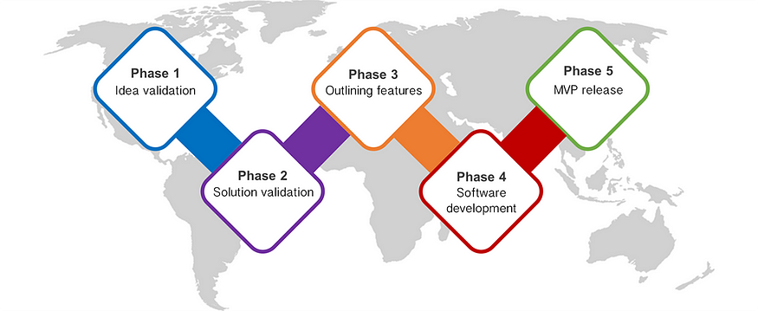
Startup Development Phases

Slide 20
Understanding Product Development Life Cycle
Requirements gathering and analysis
Design and prototyping
Implementation and coding
Testing and quality assurance
Deployment and release
Maintenance and updates

Slide 21
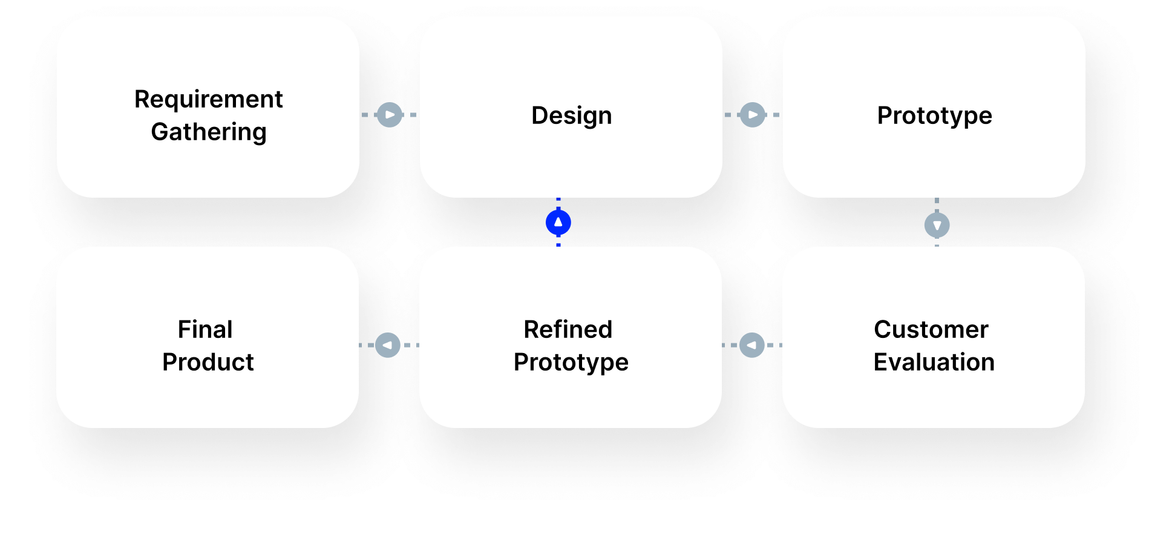
Prototype Model

Slide 22
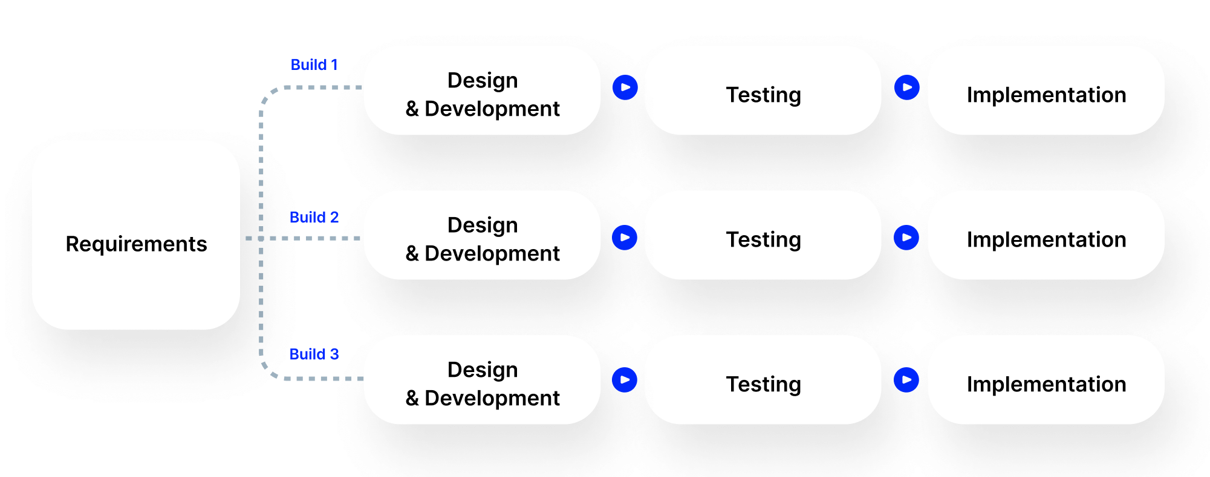
Iterative Model

Slide 23
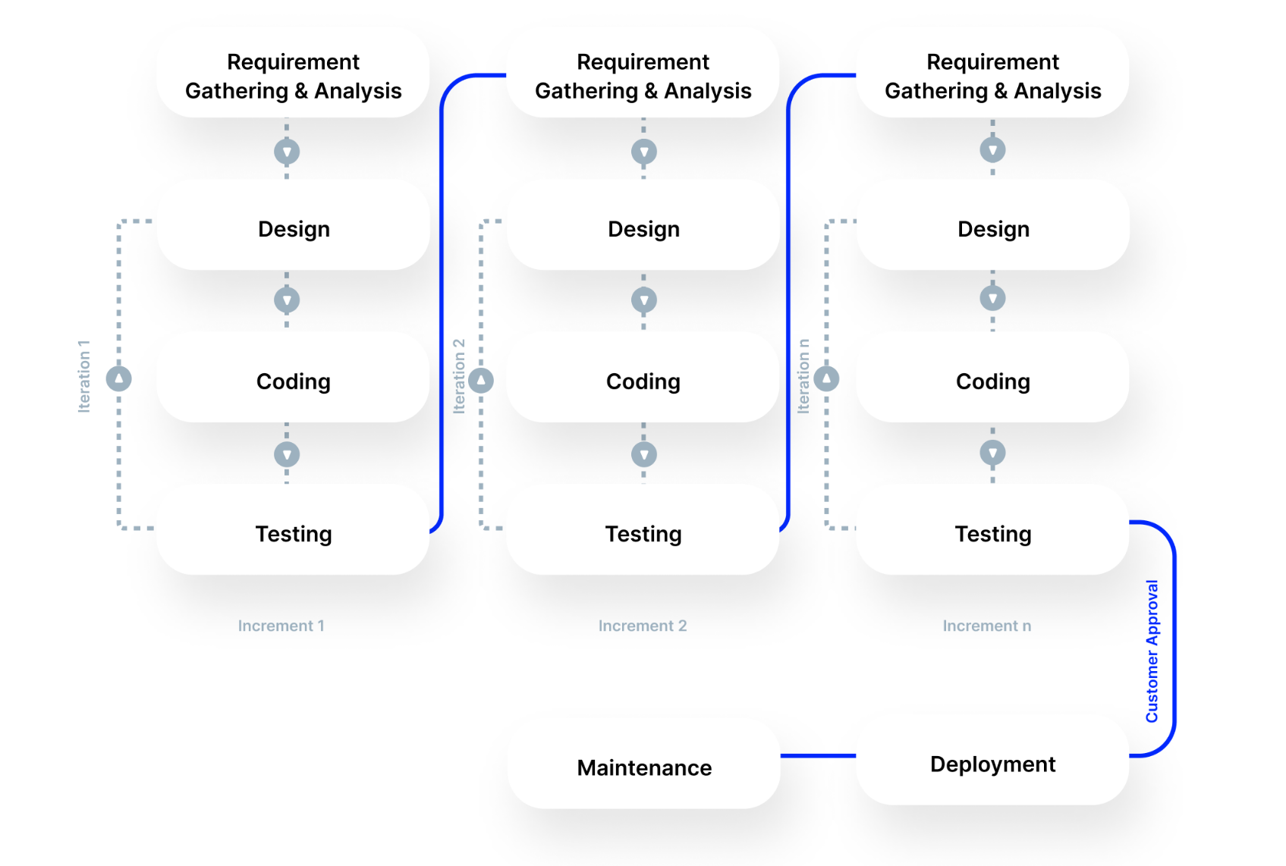
Agile Model

Slide 24
Fast Software Development for Startups
Embrace Agile Methodology
Prioritize MVP Development
Leverage Outsourcing
Emphasize User-Centric Design
Foster Continuous Integration and Delivery

Slide 25
Software entrepreneurship platforms
Software entrepreneurship platforms are online tools or services that help entrepreneurs start, grow, or scale their software businesses.
They can provide various features such as e-commerce, AI, cloud computing, blockchain, web development, and more.

Slide 26


Platforms
Offers tools, resources, and support programs for startups.
It helps startups connect with the right people, products, and best practices to grow their businesses.
Helps software entrepreneurs find and hire top remote developers from around the world. It uses AI to match the best developers with the most suitable projects.
It also handles the payments, contracts, and management of the remote teams

Slide 27


Platforms
Helps software entrepreneurs create and run their own online stores.
It offers a powerful and easy-to-use website builder, a secure and reliable hosting service, and a comprehensive set of features.
Helps software entrepreneurs sell their products or services online and offline.
It allows entrepreneurs to create a professional and mobile-friendly website, accept online payments, manage orders, and track inventory.

Slide 28
Raising Capital

Slide 29
Funding Options for Software Startups
Bootstrapping
Using personal savings or revenue from early customers to fund the business
Angel investors
Wealthy individuals who invest in exchange for equity
Venture capital (VC)
firms that invest in startups in exchange for equity and take an active role in the business

Slide 30
Funding Options for Software Startups
Crowdfunding
raising small amounts of money from a large number of people, typically through online platforms
Loans and grants
government-backed loans and grants for startups that meet certain criteria

Slide 31
Bootstrapping vs Fundraising
Bootstrapping is the process of starting a business using only the resources available to the founder(s), such as personal savings, revenue from early customers, and sweat equity.
Fundraising is the process of seeking investment from external sources, such as venture capitalists, angel investors, or crowdfunding platforms, to finance a business or project.

Slide 32
Bootstrapping vs Fundraising
Criteria | Bootstrapping | Fundraising
Ownership and Control | Full ownership and control | May have to dilute ownership and control to attract investors
Financing Amount | Personal savings, revenue from early customers, and sweat equity | Can raise larger amounts of capital from investors
Risk and Reward | Higher risk for founders, as personal assets may be at risk | Lower risk for founders, as investors take on some of the risk
Flexibility and Decision-Making | Founders have full control over decision-making and can make changes quickly | May have to answer to investors and make decisions that align with their interests
Cost | No cost, other than personal time and effort | May involve legal fees, investor expectations, and other costs
Control Over Decision-Making | Founders have full control over decision-making | May have to compromise on decision-making to align with investor interests

