Slide 1
Team
SE423: Software Project Management

Slide 2
Outline
Team Development
Building Trust
Managing Conflict
Embracing Accountability
Team Models
Managing people

Slide 3
Team Development

Slide 4
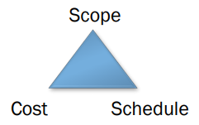
Team Development - Introduction
What are your responsibilities as a team member?
As a Project Manager?
How does Team Development relate to the Project Triangle?
What’s more important? The strength of individual team members, or the strength of the team?
What are some characteristics of a good team?

Slide 5
Quote
“Software projects fail for one of two general reasons: the project team lacks the knowledge to conduct a software project successfully, or the project team lacks the resolve to conduct a project effectively.”
- Steve C McConnell

Slide 6
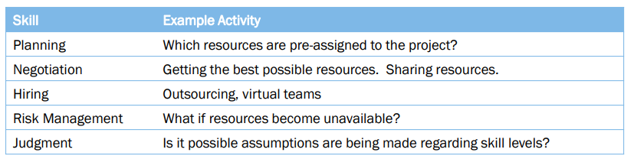
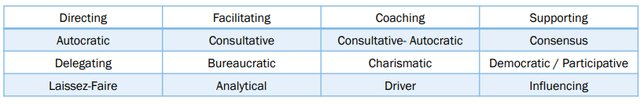
Team Skills, Influence, and Style
Skills
Types of Influence
Leadership Styles

Slide 7
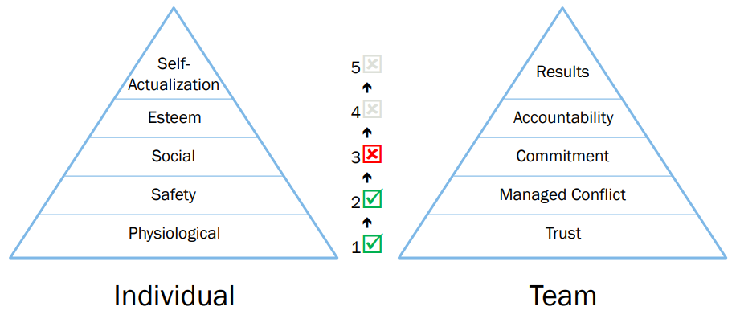
Needs and the Team
Lower level needs must be satisfied before higher level needs can be addressed

Slide 8
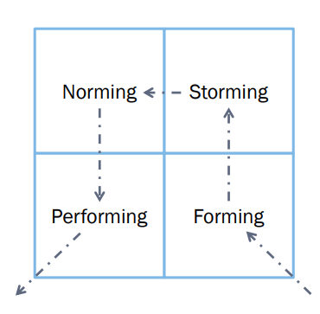
Tuckman's Model for Team Development
Forming: The group comes together and gets to initially know one another and form as a group.
Storming: A chaotic vying for leadership and trials of group processes
Norming: Eventually agreement is reached on how the group operates
Performing: The group practices its craft and becomes effective in meeting its objectives
Dissolving/Adjourning

Slide 9
Team Structure
What’s the team’s objective?
Problem resolution
Complex, poorly-defined problem
Focuses on 1-3 specific issues
Ex: fixing a showstopper defect
Sense of urgency
Creativity
New product development
Tactical execution
Carrying-out well-defined plan
Focused tasks and clear roles

Slide 10
Building Trust

Slide 11
Building Trust
Trust is the foundation of teamwork
Trust is all about vulnerability, which is difficult for most people.
Takes time.
Needs to be maintained over time.
Techniques – Behavioral profiling (like MyersBriggs). Helps to admit strengths & weaknesses.

Slide 12
Establishing a basis of trust
A solid basis for trust is earned, not granted
Most human beings in most situations are inherently wary of others
Maintain open communication within the project team– communication barriers create project risks
Be fallible. Take responsibility for making mistakes, correct them, and make it clear how you plan to avoid these mistakes in the future
Lead by example rather than by mandate. Show the team what you expect from yourself and from them
Complete all your commitments on time. If you cannot do so, give adequate notice and an explanation, not an excuse
Don’t confuse friendship with leadership

Slide 13
Managing Conflict

Slide 14
Managing Conflict
Good conflict among team members requires trust, which is all about engaging in unfiltered, passionate debate around issues.
Even among the best teams, conflict will at times be uncomfortable.
Conflict norms will vary in each team, and must be discussed and made clear.
The fear of occasional personal conflict should not deter a team from having regular, productive debate.

Slide 15
Managing Conflict – How?
Conflict Resolution Techniques
Confronting (Problem Solving)
Compromising
Withdrawal (Avoidance)
Smoothing (Accommodating)
Collaborating
Forcing
Problem Solving
Define the real/root problem
Analyze the problem
Identify Solutions
Pick a Solution
Implement a solution
Review the solution, and confirm that it solved the problem

Slide 16
Managing and resolving conﬂict
Every team encounters conﬂict–successful teams resolve conﬂicts, while unsuccessful teams force conﬂict to the background
Disagreement is not the same as conﬂict–conﬂict involves a hardening of position and associated intractability
Virtually all conﬂict can be traced to a clash between two parties
To preserve a team’s effectiveness, those outside the conﬂict must assume a neutral stance, even if they themselves agree with one of the parties to the conﬂict
One of those outside the conﬂict must take on the role of conciliator; he or she must mediate between the two parties to defuse the situation
The goal is to reduce the conﬂict to a disagreement which can then be addressed through consensus
Strive for reconciliation between the conﬂicting parties, if possible

Slide 17
Achieving Commitment
Commitment requires clarity & buy-in
Clarity requires that teams avoid assumptions and ambiguity, and end discussions with a clear understanding about what they’ve decided upon.
Buy-in does not requires consensus. Members of great teams learn to disagree with one another and still commit to a decision.

Slide 18
Embracing Accountability

Slide 19
Embracing Accountability
Accountability on a strong team occurs directly among peers.
For a culture of accountability to thrive, a leader must demonstrate a willingness to confront accountability.
Best opportunity occurs during meetings and regular review of accomplishments.

Slide 20
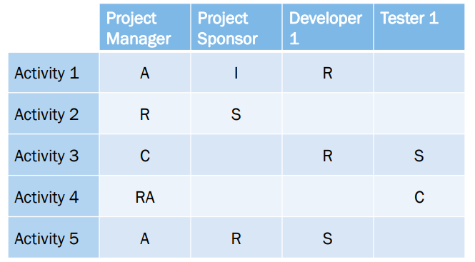
Embracing Accountability
RACI – Responsible, Accountable, (Support), Consulted, Informed

Slide 21
Responsibility Assignment Matrix
A resource planning tool
Who does What
Can be for both planning and tracking
Identify authority, accountability, responsibility
Who: can be individual, team or department
Can have totals/summary at end of row or column (ex: total Contributors on a task)

Slide 22
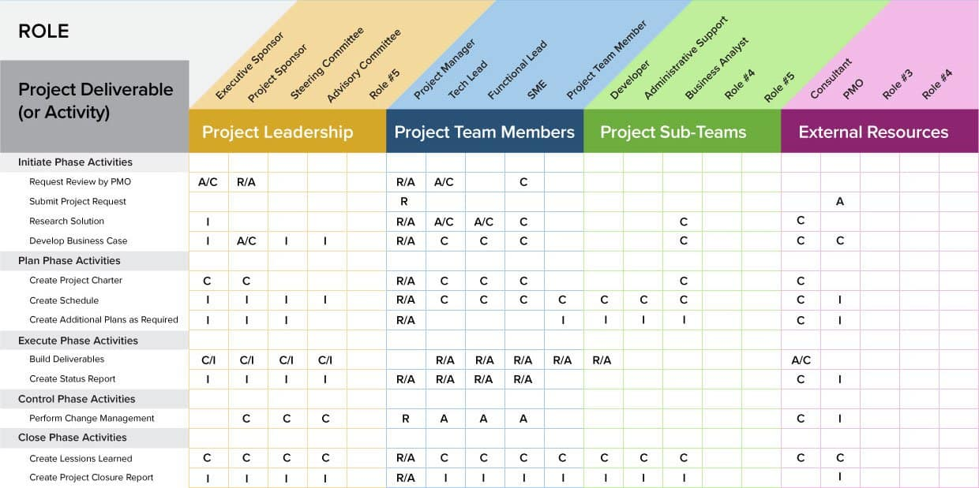
Simple RAM

Slide 23
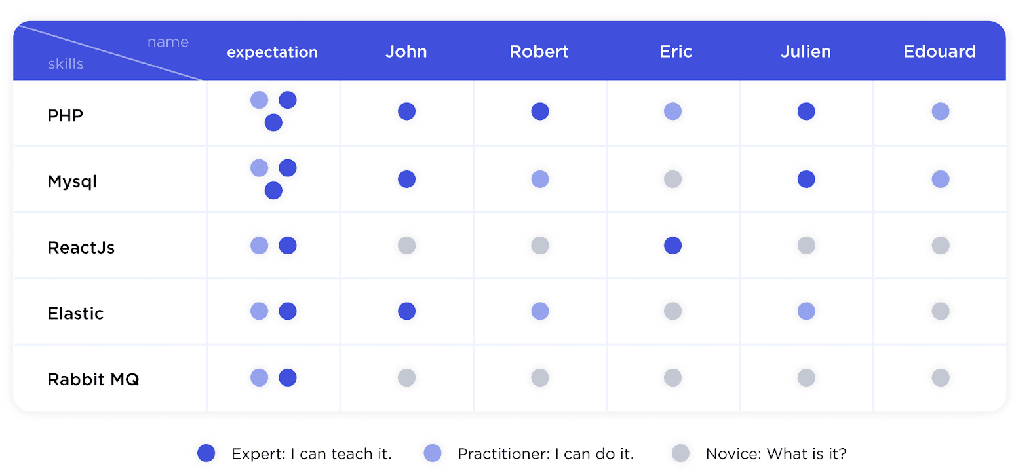
Skills Matrix
Another resource planning tool
Resources on one axis, skills on other
Skills can be high level or very specific
Cells can be X’s or numeric (ex: level, # yrs.)

Slide 24
Focusing on Results
The true measure of a great team is that it accomplishes the results it sets out to achieve.
To avoid distractions, team members must prioritize the results of the team over their individual or organizational (dept) needs.
To stay focused, team must publicly clarify their desired results and keep them visible.

Slide 25
Team Models

Slide 26
Team Models
Two early philosophies
Decentralized/democratic
Centralized/autocratic
Variation
Controlled Decentralized

Slide 27
Team Models
Business Team
Most common model
Technical lead + team (rest of team at equal status)
Hierarchical with one principal contact
Can be strong or loose hierarchy
Adaptable and general
Variation: Democratic Team
All decisions made by whole team
See Weinberg’s “egoless programming” model

Slide 28
Democratic team organization
The group acts as a whole and comes to a consensus on decisions affecting the system
The group leader serves as the external interface of the group but does not allocate specific work items
Rather, work is discussed by the group as a whole and tasks are allocated according to ability and experience
This approach is successful for groups where all members are experienced and competent
Sometimes known as self-organizing teams.

Slide 29
Agile programming groups
Agile programming groups are variants of democratic organization
In Agile programming groups, some ‘management’ decisions are devolved to group members
In XP, Programmers work in pairs and take a collective responsibility for code that is developed

Slide 30
Team Models
Chief-Programmer Team a.k.a. ‘surgical team’
From IBM in 70’s
See Brooks and Mythical Man-Month
Puts a superstar at the top
Others then specialize around him/her
Backup Programmer
Co-pilot or alter-ego
Administrator
Tool-smith
“Language lawyer”
Issues
Difficult to achieve
Ego issues: superstar and/or team
Can be appropriate for creative projects or tactical execution

Slide 31
Chief programmer teams
Consist of a kernel of specialists helped by others added to the project as required
The motivation behind their development is the wide difference in ability in different programmers
Chief programmer teams provide a supporting environment for very able programmers to be responsible for most of the system development

Slide 32
Problems
This chief programmer approach, in different forms, has undoubtedly been successful
However, it suffers from a number of problems
Talented designers and programmers are hard to find. Without exceptional people in these roles, the approach will fail
Other group members may resent the chief programmer taking the credit for success so may deliberately undermine his/her role
High project risk as the project will fail if both the chief and deputy programmer are unavailable
Organizational structures and grades may be unable to accommodate this type of group

Slide 33
Team Models
Skunk works Team
Put a bunch of talented, creative developers away from the mother ship
Off-site literally or figuratively
Pro: Creates high ownership & buy-in
Con: Little visibility into team progress
Applicable: exploratory projects needing creativity
Not on well-defined or narrow problem
SWAT Team
Highly skilled team
Skills tightly match goal
Members often work together
Ex: security swat team, Oracle performance team

Slide 34
Team Models
Large teams
Communication increases multiplicatively
Square of the number of people
50 programmers = 1200 possible paths
Communication must be formalized
Always use a hierarchy
Reduce units to optimal team sizes
Always less than 10 (seven plus or minus one)
What is the optimal team size?
4-6 developers
Tech lead + developers
Small projects inspire stronger identification
Increases cohesiveness
QA, ops, and design on top of this

Slide 35
Managing people

Slide 36
People in the process
People are an organization’s most important assets
The tasks of a manager are essentially people oriented. Unless there is some understanding of people, management will be unsuccessful

Slide 37
Management activities
Problem solving (using available people)
Motivating (people who work on a project)
Planning (what people are going to do)
Estimating (how fast people will work)
Controlling (people's activities)
Organizing (the way in which people work)

Slide 38
Motivation
An important role of a manager is to motivate the people working on a project
Motivation is a complex issue but it appears that there are different types of motivation based on
Basic needs (e.g. food, sleep, etc.)
Personal needs (e.g. respect, self-esteem)
Social needs (e.g. to be accepted as part of a group)
Maslow’s hierarchy of needs

Slide 39
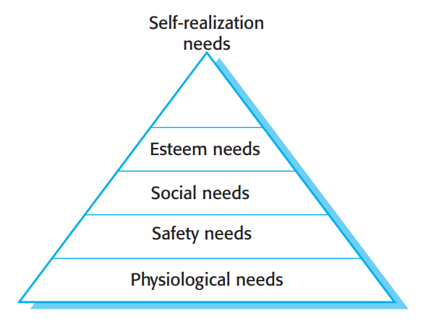
Human needs hierarchy
Notes:
http://talkingtails.wordpress.com/2007/07/23/maslow-greek-philosophy-indian-mysticism/
“Maslow’s hierarchy of needs is often depicted as a pyramid consisting of five levels: the four lower levels are grouped together as deficiency needs associated with physiological needs, while the top level is termed growth needs associated with psychological needs. While deficiency needs must be met, growth needs are the need for personal growth. The basic concept is that the higher needs in this hierarchy only come into focus once all the needs that are lower down in the pyramid are mainly or entirely satisfied. Once an individual has moved past a level, those needs will no longer be prioritized. However, if a lower set of needs is continually unmet for an extended period of time, the individual will temporarily re-prioritize those needs – dropping down to that level until those lower needs are reasonably satisfied again.”

Slide 40
Motivating people
Motivations depend on satisfying needs
It can be assumed that physiological and safety needs are satisfied
Social, esteem and self-realization (self-actualization) needs are most significant from a managerial viewpoint
If a lower set of needs is continually unmet for an extended period of time, the individual will temporarily re-prioritize those needs – dropping down to that level until those lower needs are reasonably satisfied again.

Slide 41
Need satisfaction
Social
Provide communal facilities
Allow informal communications [See Weinberg’s story about the Coke machine.]
Esteem
Recognition of achievements
Appropriate rewards
Self-realization
Training – people want to learn more
Responsibility

Slide 42
Personality types
The needs hierarchy is almost certainly an over-simplification
Motivation should also take into account different personality types:
Task-oriented
The motivation for doing the work is the work itself
Self-oriented
The work is a means to an end which is the achievement of individual goals – e.g. to get rich, to play tennis, to travel etc.
Interaction-oriented
The principal motivation is the presence and actions of co-workers. People go to work because they like to go to work

Slide 43
Motivation balance
Individual motivations are made up of elements of each class
Balance can change depending on personal circumstances and external events
However, people are not just motivated by personal factors but also by being part of a group and culture.
People go to work because they are motivated by the people that they work with

Slide 44
Group working
Most software engineering is a group activity
The development schedule for most non-trivial software projects is such that they cannot be completed by one person working alone
Group interaction is a key determinant of group performance
Flexibility in group composition is limited
Managers must do the best they can with available people

Slide 45
Time distribution
20%
Non-productive
activities
50%
Interaction with
other people
30%
Working alone

Slide 46
Group composition
Group composed of members who share the same motivation can be problematic:
Task-oriented – everyone wants to do their own thing
Self-oriented – everyone wants to be the boss
Interaction-oriented – too much chatting, not enough work
An effective group has a balance of all types
Can be difficult to achieve because most engineers are task-oriented
Need for all members to be involved in decisions that affect the group

Slide 47
Group leadership
Leadership depends on respect not titular status (titular = holding a title)
There may be both a technical and an administrative leader
Democratic leadership is more effective than autocratic leadership
A career path based on technical competence should be supported

Slide 48
Group cohesiveness
In a cohesive group, members consider the group to be more important than any individual in it
Advantages of a cohesive group are:
Group quality standards can be developed
Group members work closely together so inhibitions caused by ignorance are reduced
Team members learn from each other and get to know each other’s work
Egoless programming where members strive to improve each other’s programs can be practiced

Slide 49
Developing cohesiveness
Cohesiveness is influenced by factors such as the organizational culture and the personalities in the group
Cohesiveness can be encouraged through
Social events, such as team outings
Developing a group identity and territory
Explicit team-building activities
Openness with information is a simple way of ensuring all group members feel part of the group

Slide 50
Group loyalties
Group members tend to be loyal to cohesive groups
'Groupthink' is preservation of group irrespective of technical or organizational considerations
Management should act positively to avoid groupthink by forcing external involvement with each group

Slide 51
Group communications
Good communications are essential for effective group working
Information must be exchanged on the status of work, design decisions and changes to previous decisions
Good communications also strengthens group cohesion as it promotes understanding
Thoughts
Status of group members
Higher status members tend to dominate conversations
Personalities in groups
Too many people of the same personality type can be a problem
Sexual composition of group
Mixed-sex groups tend to communicate better
Communication channels
Communications channelled though a central coordinator tend to be ineffective

Slide 52
Group organization
Software engineering group sizes should be relatively small (< 10 members) optimal is less than seven (see previous slides)
Break big projects down into multiple smaller projects
Small teams may be organized in an informal, democratic way
Chief programmer teams try to make the most effective use of skills and experience

Slide 53
Choosing and keeping people
Choosing people to work on a project is a major managerial responsibility
Appointment decisions are usually based on
information provided by the candidate (their résumé or CV)
information gained at an interview
Interviews with potential co-workers
recommendations from other people who know the candidate
Some companies use psychological or aptitude tests
There is no agreement on whether or not these tests are actually useful

Slide 54
Staff selection factors
Factor | Explanation
Application domain experience | For a project to develop a successful system, the developers must understand the application domain
Platform experience | May be significant if low-level programming is involved. Otherwise, not usually a critical attribute.
Programming language experience | Normally only significant for short duration projects where there is insufficient time to learn a new language.
Educational background | May provide an indicator of the basic fundamentals which the candidate should know and of their ability to learn. This factor becomes increasingly irrelevant as engineers gain experience across a range of projects.
Communication ability | Very important because of need for project staff to communicate orally and in writing with other engineers, managers, and customers.
Adaptability | Adaptability may be judged by looking at the different types of experience that candidates have had. This is an important attribute as it indicates an ability to learn.
Attitude | Project staff should have a positive attitude towards their work and should be willing to learn new skills. This is an important attribute but often very difficult to assess.
Personality | Again, an important attribute but difficult to assess. Candidates must be reasonably compatible with other team members. No particular type of personality is more or less suited to software engineering.

Slide 55
Working environments
Physical workplace provision has an important effect on individual productivity and satisfaction
Comfort
Privacy [see next slide]
Facilities
Health and safety considerations must be taken into account
Lighting
Heating
Furniture

Slide 56
Environmental factors
Privacy – each engineer requires an area for uninterrupted work (see next slide)
Outside awareness – people prefer to work in natural light
Personalization – individuals adopt different working practices and like to organize their environment in different ways

Slide 57
Workspace organization
Workspaces should provide private spaces where people can work without interruption
Providing individual offices for staff has been shown to increase productivity
However, teams working together also require spaces where formal and informal meetings can be held

Slide 58
Our perspective
The phrase ‘human resources’ has its origins as an economic and corporate asset term
These origins lead to two semantic problems:
People are (to some extent) considered in the same light as inanimate resources: maximizing the ROI in human capital is the goal of HR management
People are considered (to some extent) as being uniform, interchangeable, and expendable
To improve the chances of project success, the project manager should ensure that these problems are balanced by proper ‘people skills’
Notes:
Bjarne Stroustrup, C++ Programming Language, Third Edition, ISBN 0-201-88954-4, pp. 713, 716-717 especially “interchangeable morons school of management”

Slide 59
Project environments
Physical environment
Most IT projects will not have a large, direct impact on the environment
Nevertheless, in some cases, knowledge and understanding of the physical environment may be helpful or necessary
Example: Systems that directly control water, petroleum, natural gas, etc.
Example: Transportation and emergency response systems

Slide 60
The project manager’s skills
The project manager must develop people skills in a number of related areas:
Interpersonal skills
Shaping project culture
Managing good people
Making good people better
Leadership
A complete discussion of each of these skills could span ﬁve lectures; we touch only on the most essential points in the following

Slide 61
Interpersonal skills
The project manager needs a well-developed set of interpersonal skills in order to effectively manage a project
Effective communication. We’ve already seen that good project communication is an essential part of project management. Effective communication:
Follows a deﬁned protocol
Reaches all recipients in a timely manner
Provides all the information necessary, no more or no less
Influencing the organization. The ability to get a project completed depends on the abilities of and respect for the PM and PM team
Leadership. Leadership is one of the most misunderstood concepts in project management–leadership has little to do with authority

Slide 62
Interpersonal skills
Motivation. Providing people with incentives to act in the interest of the project and overcome inevitable challenges
Motivation comes in a number of forms; studies show ﬁnancial incentives are among the least effective motivators
Negotiation and conflict management. Working with others to come to agreement and overcome differences, real or perceived
Reaching consensus and defusing conﬂict are two elements of these skills, as we have seen
Problem solving. Being able to recognize and define problems; formulate, evaluate, and make decisions regarding possible solutions
Problem solving is a skill that can be learned but requires practice: progressive elaboration helps manage the complexity of most project problems

Slide 63
Shaping project culture
The project manager must shape the project culture within the framework of the organizational culture
Understand organizational culture
Understanding the attitude of the organization toward the project and toward project management processes is essential
Organization attitudes toward real–as opposed to fanciful–project management practices varies widely
Understand each team member’s engineering and personal background
Education, experience, generation, and personality all determine what roles the person may take and how they will fit in with the rest of the team
Assess each team member’s cultural role or roles and match this to their project role

Slide 64
Shaping project culture
Match cultural and project roles to people
Representative cultural roles include:
Leader
Listener/talker
Complainer/naysayer
Expert
Charger/plodder
Significant project roles include:
Project manager. Guides the team planning and tracks progress against the plan
Team leader. Builds and maintains an effective team
Development leader. Produces a superior product
Remain non-judgmental: every cultural role has potential value for the team

Slide 65
Project environments
Cultural and social factors
Projects are planned and implemented in a social and cultural context
Some factors that will influence a project might be: economic, educational, ethical, ethnic, and religious
These factors can affect the authority of the project manager
International and political
As globalization expands, familiarity with local laws and customs is essential for effective project management
Shifting international, national, and local political factors can have dramatic influences on a project
Some mundane factors that will influence a project might be: time zone differences, holidays, travel requirements, teleconferencing capabilities

Slide 66
Shaping project culture
Monitor and manage team culture as you would manage technical issues
Make each person’s project role clear
Understand each person’s personality and make known your understanding of each person’s social role in a positive way
State and maintain your view of the team
Example: “First among equals, but if a critical situation arises, I will make the decision.”
Recognize potential cultural role problems before they have a negative impact on the team
Solve project role problems before they have a negative impact on the project

Slide 67
Project Culture
Monitor team members’ satisfaction with their role.
You will need to monitor team role satisfaction throughout the project.
It is especially important during project launch when roles can be changed easily.
Monitor the engineering task-to-people fit to make sure each person can perform the engineering task.
Role mismatches lead to project problems and schedule slip.
If you don’t review task-to-people fit, you will be unaware of each person’s ability, or lack thereof, to perform tasks.
Monitor the cultural climate of the team as a whole.
Monitor project culture by watching and listening to each team member.
Guide the cultural views of the project by your own example.
You need to be able to monitor the team culture throughout the project in order to build confident people and a confident team.

Slide 68
Managing Good People
The main problems of our work are not so much technological as sociological in nature
One of the most enlightened sources for information about managing people is:
Peopleware: Productive Projects and Teams, Third Edition, Dorset House Publishing, New York, July 2013
Most technical managers come from technical backgrounds and manage that way as if they are solving an engineering problem
Most managers do not consider individual idiosyncrasies, yet these can make or break a project

Slide 69
Managing Good People
Guidelines for Managing Good People:
Gain visibility without micromanagement.
Review process and products, not people.
Say: “This testing regime allows too many bugs to slip through to the customer; what can we do to correct this?”
Not: “You all don’t seem to know how to write unit tests properly.”
Coordinate, don’t manipulate.
Use your knowledge, not your position of power.
Channel people, don’t put dams in front of them.
Redirect misplaced energy or effort, don’t stiﬂe it
Focus on project and people needs, not your authority as manager.
This will maintain your leadership role without explicit effort

Slide 70
How NOT to manage ‘thought workers’: production line efficiency
The application of production line efﬁciency principles to thought workers can spell disaster for a project
Common errors include:
Squeeze out error – make the ‘machine’ run as smoothly as possible
Take a hard line about people goofing off on the job
Treat workers as interchangeable pieces of the machine
See Stroustrup [slide 58]
Optimize the steady state – don’t worry about start up and shut down
Standardize procedure – run by the book
Eliminate experimentation
Consider how each of these errors might impact your own work

Slide 71
Making Good People Better
Make professional development a project goal
Recognize long- and short-term development goals
Short-term goals focus on skills needed for the project
Long-term goals prepare team members for future projects
Let each team member specify personal improvement goals
Starting point: Competency framework goals such as: Technical, leadership, domain, general/personal, communication, and management
For a ﬁxed interval, have team members track their individual time expenditure in detail
This concept goes well beyond the weekly timesheet concept
This is an awareness-building activity, not a monitoring activity
The Personal Software Process (PSP) is a formal application of this idea

Slide 72
Making Good People Better
Have team members track their individual time
Goes beyond the weekly timesheet concept
One formal approach to this is the Personal Software Process (PSP) which shows developers how to:
Manage the quality of their projects
Make commitments they can meet
Improve estimating and planning
Reduce defects in their products
[See note below for more info.]
One element of PSP is to track daily time spent on all project-related tasks:
Reading
Writing
Meeting
Training
Requirements
Design
Coding
Testing
Deployment
E-mail
Phone
Notes:
Personal Software Process (PSP) methodology. Developed in 1993 by Watts S. Humphrey, the PSP is a disciplined and structured approach to developing software. By using the PSP concepts and methods in their work, engineers in almost any technical field can improve their estimating and planning skills, make commitments that they can meet, manage the quality of their work, and reduce the number of defects in their products.
Personal Software Process Body of Knowledge (PSP BOK): http://www.sei.cmu.edu/library/abstracts/reports/09sr018.cfm

Slide 73
Leadership
Leadership is the capacity to mobilize a group to solve the most challenging problems
Two types of leadership:
Technical leadership (a.k.a. authority) motivates people when the problem can be solved by known means
Adaptive leadership motivates people to solve problems that cannot be solved by known means
Requires learning on the part of the leader as well as the group
Often involves leading with good questions
Requires a deep clarity of purpose

Slide 74
Technical vs. adaptive leadership
Technical leadership | Leadership
Technically-oriented: solves problems by known means | Adaptive: approaches problems not solved by known means
Vision: personal view of outcome | Sense of purpose: big-picture view of goals
Personality: tool for motivation | Progress: tool for motivation
Based on this, the term charismatic leader is a misnomer!

Slide 75
Technical vs. adaptive leadership
The greatest challenge in choosing between technical leadership and adaptive leadership for a project is deciding if the problem can be solved by known means
Situations that might superﬁcially appear to call for technical leadership may in fact be better served by adaptive leadership
Most IT projects have a mix of known and unknown problems, probably leaning more toward the unknown
An adaptive leader can address known problems by delegation–allow one who can lead the team in solving the problem by known means do so when appropriate
Delegation under these circumstances is consistent with all the qualities of adaptive leadership

Slide 76
Working toward consensus
Consensus simply means ‘general agreement’
If possible, reach consensus on all decisions affecting the team
Simple majority rule can be detrimental on a small team in which everyone’s commitment is essential

Slide 77
Working toward consensus
Steps to reaching consensus:
Pose the problem to be solved or decision to be made
Solicit input on options for the problem or decision
Discuss and weigh pros and cons of each option
Work toward the options that have the most benefit for the project
When it is clear which option is most suitable, work with its opponents to help them buy in to it–persuade, don’t dictate
Consensus takes more time than mandate, but has huge pay-offs
Beware passive/aggressive agreement–this is simply subsumed conflict

Slide 78
Leading Good People
This is a reprise of our view of establishing a basis of trust
Be confident in yourself and the team
Maintain open communication within the project team– communication barriers create project risks
Be fallible. Take responsibility for making mistakes, correct them, and make it clear how you plan to avoid these mistakes in the future
Lead by example rather than by mandate. Show the team what you expect from yourself and from them
Utilize all the talents of your team. You can’t make the project succeed all by yourself
Complete all your commitments on time. If you cannot do so, give adequate notice and an explanation, not an excuse
Don’t confuse friendship with leadership

Slide 79
Key points
Managers must have some understanding of human factors to avoid making unrealistic demands on people
Staff selection factors include education, domain experience, adaptability and personality
Software development groups should be small and cohesive
Group communications are affected by status, group size, group organization and the sexual composition of the group
The working environment has a significant effect on productivity
Develop methods to monitor the project culture and technical status early so you can continually monitor these issues as the project progresses.

