Slide 1
Deployment
SE499: Software Design & Development Project

Slide 2
Introduction
"The process of making software available for use by end-users“
Deployment is the final step in the software development lifecycle, where the software is released to the end-users.
This involves hosting the software on a server, configuring the environment, and making sure it's accessible to the users.

Slide 3
The Role of Deployment in Software Development
Software development lifecycle: planning, design, development, testing, deployment, maintenance
Deployment's role: making software available for use, providing feedback loop for further development
Deployment's impact on software quality:
Performance
Security
Maintainability
User experience

Slide 4
Critical factors to consider
Ensures software availability and accessibility
Affects user experience and satisfaction
Impacts business operations and revenue
Security and compliance considerations
Continuous deployment and integration

Slide 5
Deployment
Proper deployment is crucial for the success of any software development project.
By understanding the importance of deployment and following best practices, you can ensure that your software is available, accessible, and secure for your end-users.

Slide 6
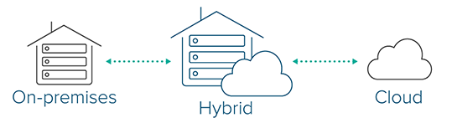
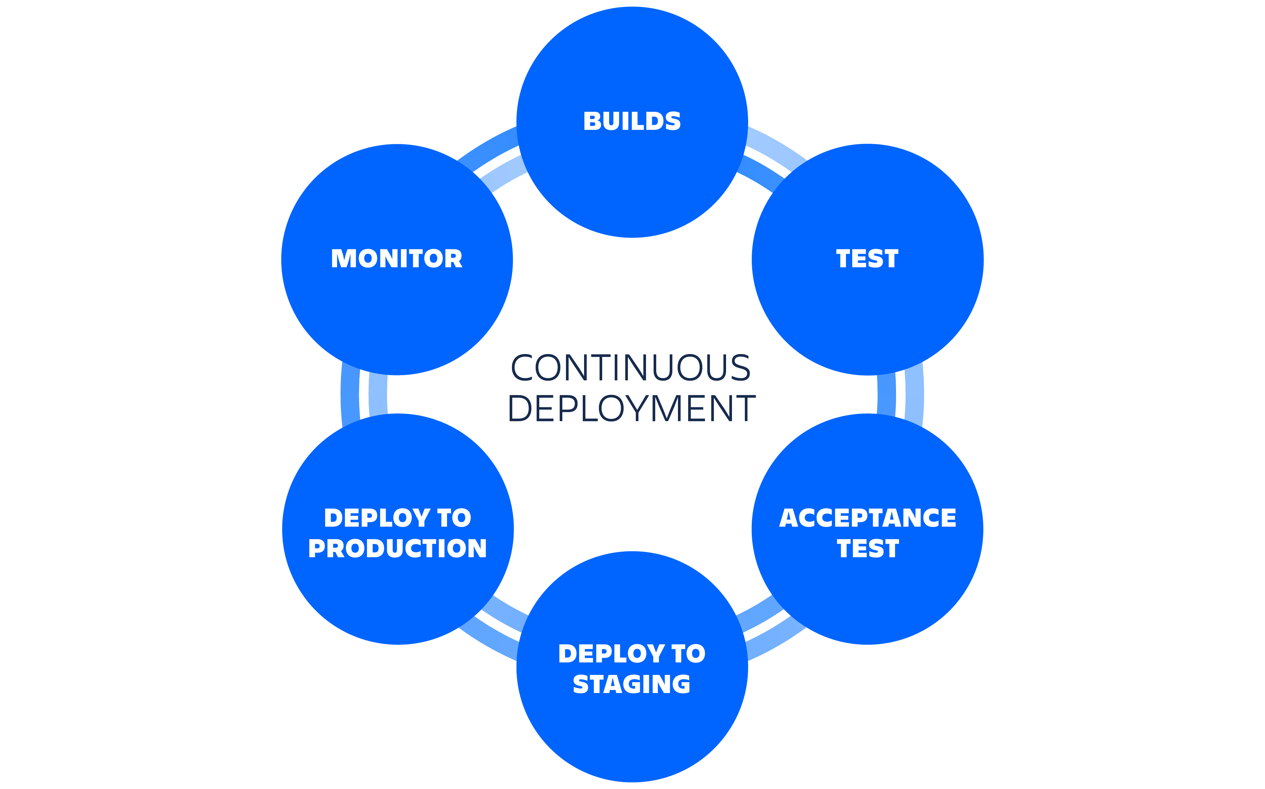
Types of Deployment
On-premise deployment
Cloud deployment
Hybrid deployment
Continuous deployment

Slide 7
Deployment Strategies
Big Bang deployment
all features are deployed at once
Phased deployment
features are deployed gradually over time
Canary deployment
features are deployed to a small group of users first, then gradually rolled out to more users

Slide 8
Deployment Best Practices
Automating deployment processes
Testing deployments thoroughly before deploying to production
Monitoring deployments for issues and performance
Documenting deployment processes and procedures

Slide 9
Tips and tricks for successful deployments
Plan and test deployments in advance
Use version control for deployment scripts
Monitor and troubleshoot deployments
Continuously improve and refine deployment processes
Document deployment procedures

Slide 10
Challenges and Risks
Downtime and outages
Security risks
Compatibility issues
Performance issues

Slide 11
Open Source
Software with source code available for anyone to study, modify, and distribute
Benefits of open source tools:
Cost-effective
Community-driven development
Flexibility and customization
Security
Quality

Slide 12
Examples of open source deployment tools
Docker
Kubernetes
Ansible
Puppet

Slide 13
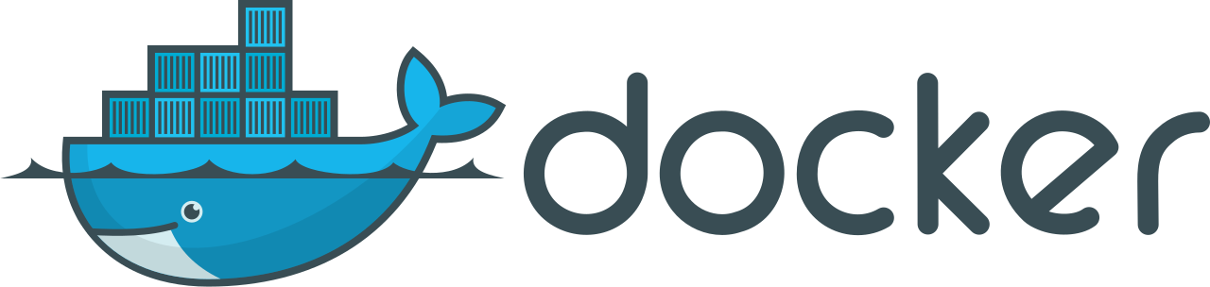
Docker is a containerization platform for applications
Developed by Solomon Hykes and his team at Docker Inc. in 2013
Allows developers to package an application and its dependencies into a lightweight, portable container
Use cases:
Developing and testing applications
Deploying web applications
Creating microservices architecture
Data science and machine learning
DevOps and continuous integration/continuous deployment (CI/CD)
Benefits:
Lightweight and portable containers
Faster development and deployment cycles
Isolation and security
Efficient resource utilization
Collaboration and reuse of images and containers

Slide 14

Kubernetes (k8s) is an open-source container orchestration platform
Developed by Google, now maintained by the Cloud Native Computing Foundation (CNCF)
Automates deployment, scaling, and management of containerized applications
Use cases:
stateless web servers
stateful databases
CI/CD pipelines
machine learning models
edge computing
Benefits:
scalability and flexibility
automated deployment and rolling updates
self-healing and fault tolerance
efficient resource utilization
platform-agnostic, multi-cloud support

Slide 15

Digital Ocean: A Cloud Provider for Students
Why Digital Ocean is a great option for student projects and deployments:
Affordable pricing
Easy to use and manage
Scalable resources
High-performance infrastructure
Seamless integration with GitHub for automated deployments
Easy setup and management of deployment workflows

Slide 16
GitHub Integration: Streamlining Deployment
Benefits of GitHub integration:
Automated deployments
Version control for deployment scripts
Collaboration and access control
Continuous integration and delivery

