Slide 1
Introduction
IS465: Data Management and Governance

Slide 2
Outline
Data Management and Governance: An Overview
Brief overview of data governance frameworks and models
Data Strategy
Dama's Data Governance Wheel

Slide 3
Data Management and Governance: An Overview

Slide 4
Why Data Matters!
FACT - Data is the most valuable asset in an organization after its people
FACT - Data is critical to the running of business functions and processes
FACT- Without constant vigilance and effort to maintain order data entropy or anarchy reins!

Slide 5
Data as an Asset
The global big data analytics market is valued at $307.52 billion.
Projections suggest that this market will reach $745.15 billion by 2030, with a compound annual growth rate (CAGR) of 13.5%.
In 2023, 91.9% of organizations achieved measurable value from data and analytics investments.
Three in five organizations are using data analytics to drive business innovation.
Data leaders are planning to increase their budgets, with 56% of them planning to do so.

Slide 6

The Data Silo Problem
Sales
Despatch
Operations
Finance
Notes:
Data Silos / Stovepipes with Departments / Applications

Slide 7
The Data ‘Centric’ Solution
CUSTOMER DATA
PRODUCT DATA
Sales
Despatch
Operations
FINANCE DATA
Finance
EMPLOYEE DATA
Notes:
Have you heard the term ‘Data Centricity? This is what it means in practice!

Slide 8
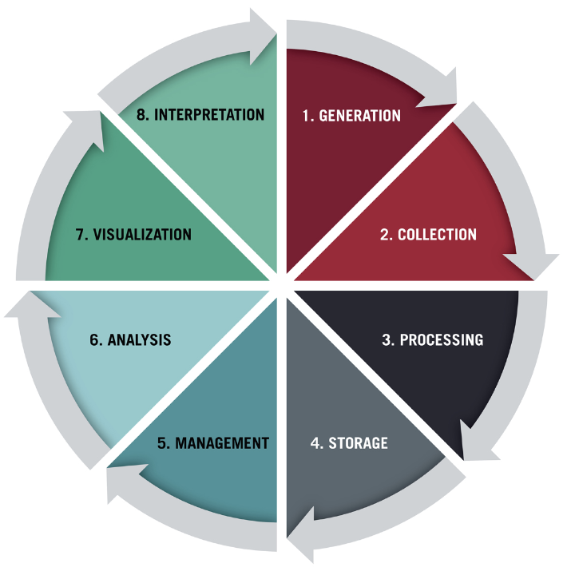
Data lifecycles
A data lifecycle refers to the different stages a unit of data undergoes, from initial collection to when it’s no longer considered useful and deleted.
It’s a continuous, policy-based process where each phase informs the next.
The different stages of the data lifecycle can vary depending on the organization

Slide 9
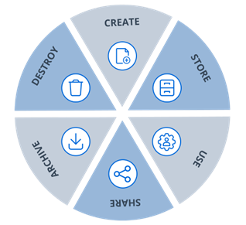
What is data lifecycle management?
Data lifecycle management (DLM) refers to the policies, tools, and internal training that helps dictate the data lifecycle.
It’s essentially the framework for managing how data is collected, cleaned, stored, used, and eventually deleted.

Slide 10
6 crucial data lifecycle stages
Though the stages in a data lifecycle can vary from one business to another, we outline six key phases you should see across the board.
Collection
Storage
Processing
Analysis
Deployment
Archiving

Slide 11
Definition and Importance
Data Management
The process of collecting, storing, organizing, and retrieving data.
Data Governance
The overall management of the availability, usability, integrity, and security of an organization's data.
Importance:
Data is a critical asset for organizations.
Data-driven decision-making is increasingly important.
Data privacy and security are critical concerns.
Data governance ensures data is accurate, complete, and accessible.

Slide 12
Data Management
The process of planning, organizing, and controlling the creation, storage, retrieval, sharing, and usage of data within an organization.
It encompasses the development and implementation of policies, procedures, and systems to manage the flow of data across various business processes, ensuring that data is accurate, complete, and accessible to authorized personnel.
Data Management
The development, execution, and supervision of plans, policies, programs, and practices that deliver, control, protect, and enhance the value of data and information assets throughout their lifecycles.

Slide 13
The 5-second elevator definition
Data governance is …
a set of guidelines for how people behave and make decisions about data

Slide 14
Master data management is often confused with data governance
Master Data Management (MDM)
Comprehensive method to link all critical data to a common point of reference
Example:
Data Governance
Formalized system for how people make decisions about acquisition, production, storage, distribution, and analysis of data
Example:
All screens, documents and systems showing a student’s address derive from a common location.
Group decides on a definition for home address and agrees on a common source field

Slide 15
Important characteristics of DG definitions
Data governance IS | Data Governance IS NOT
More about people and behavior than data A system that requires and promotes shared agreement Formal (i.e. written down) Adds value by supporting institutional mission/goals | IT’s responsibility Solved by technology Equally applied across all data assets

Slide 16
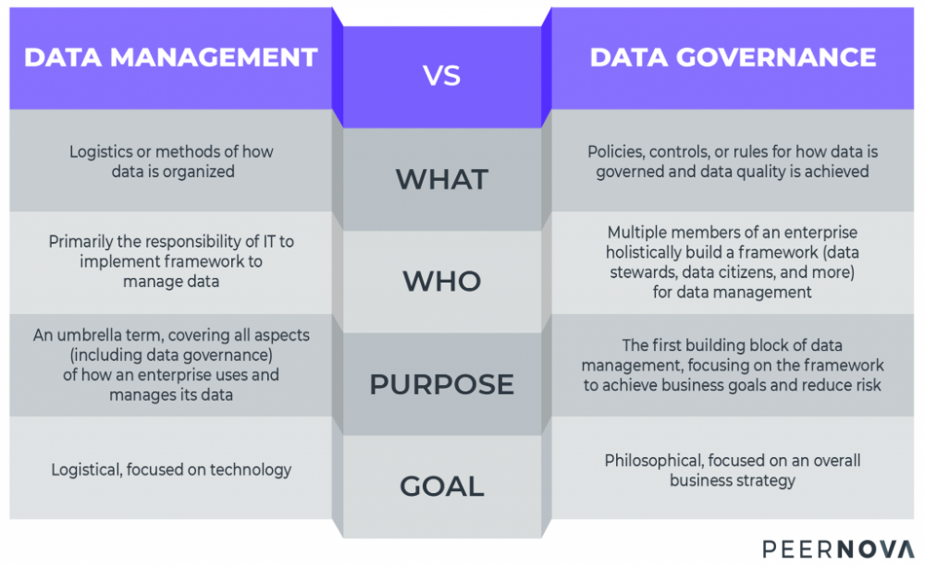
Data Management vs. Data Governance

Slide 17
Data governance vs. data management: The difference
Data Governance | Data Management
This involves policies, regulations, and procedures to manage data quality. | This refers to how the data is managed.
Refers to the application of knowledge, the development of procedures, and the formulation of theories. | Refers to the collection, organization, protection, processing, sorting, and preservation of data.
It aims to ensure the accuracy and integrity of stored data. | It aims to improve the overall quality and monetary value.
It’s a data strategy for obtaining high-quality data. | It’s a method for organizing facts in a logical way.
Philosophical and business-focused. | Logistical and tech-focused.

Slide 18
The Point of DG
Reporting & Compliance
Internal Reporting
Privacy Regulations
Analytics & Insights
360 view of the Customer
IOT
Operational Excellence
Enhance Customer Satisfaction
System Consolidation
Industry-specific Regulations
ESG Reporting
AI\ML
Global Visibility
Real Time Analytics
Reduce Operating Costs
Strategic Sourcing

Slide 19
Data governance Frameworks and Models

Slide 20
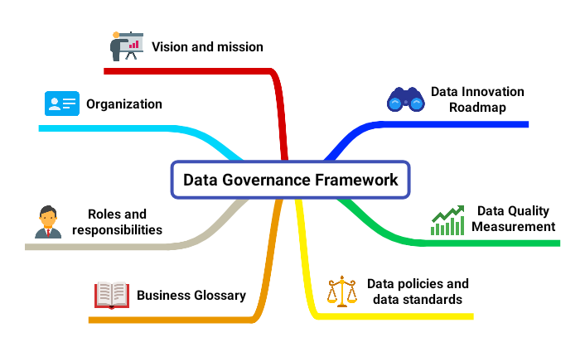
An Overview
Data governance frameworks provide a structured approach to data governance.
Data governance models provide a set of guidelines and best practices for data governance.

Slide 21
Data Governance Frameworks
A framework provides a structured approach to data governance.
Examples:
COBIT (Control Objectives for Information and Related Technology)
ITIL (Information Technology Infrastructure Library)
CMMI (Capability Maturity Model Integration)
ISO/IEC 27001 (International Organization for Standardization/International Electrotechnical Commission 27001)

Slide 22
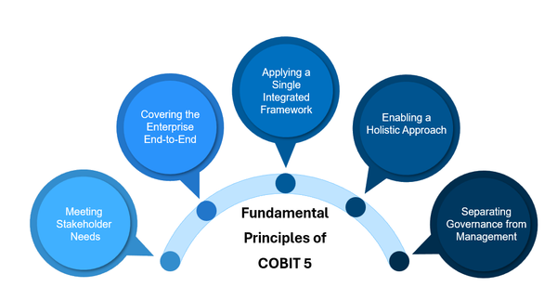
COBIT
COBIT is a framework for data governance and management.
It provides a set of best practices and guidelines for data management and governance.
COBIT is widely used and recognized globally.

Slide 23
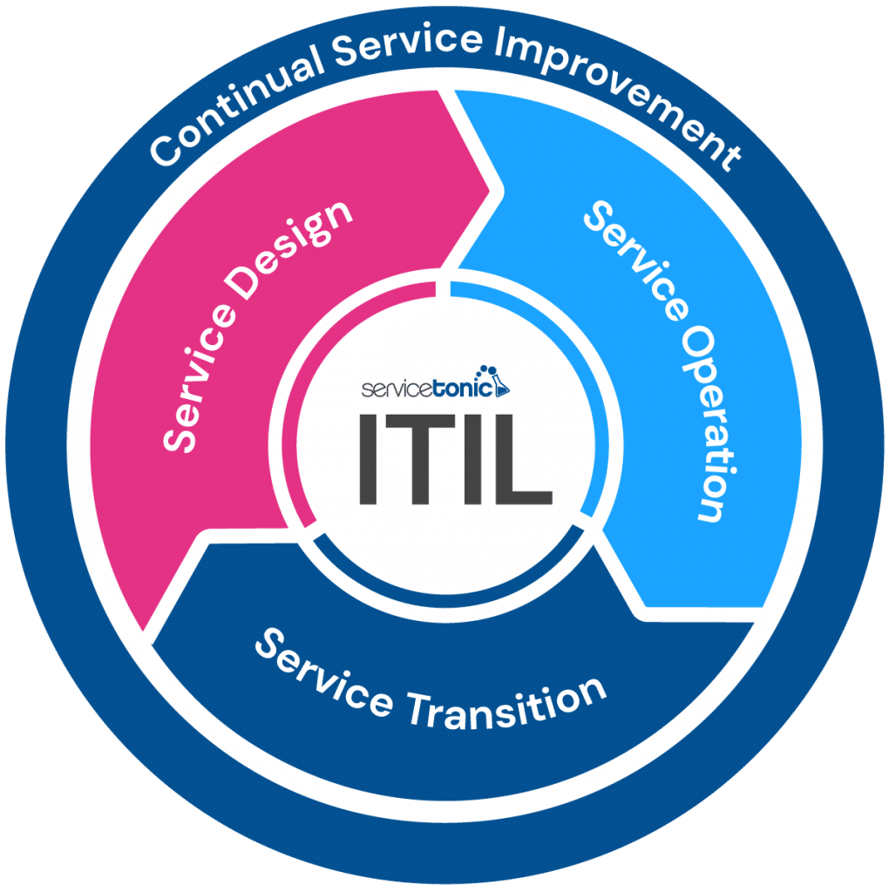
ITIL
ITIL is a framework for IT service management.
It provides a set of best practices and guidelines for IT service management.
ITIL includes data governance as a critical aspect of IT service management.

Slide 24
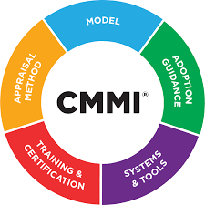
CMMI
CMMI is a framework for process improvement.
It provides a set of best practices and guidelines for process improvement.
CMMI includes data governance as a critical aspect of process improvement.

Slide 25
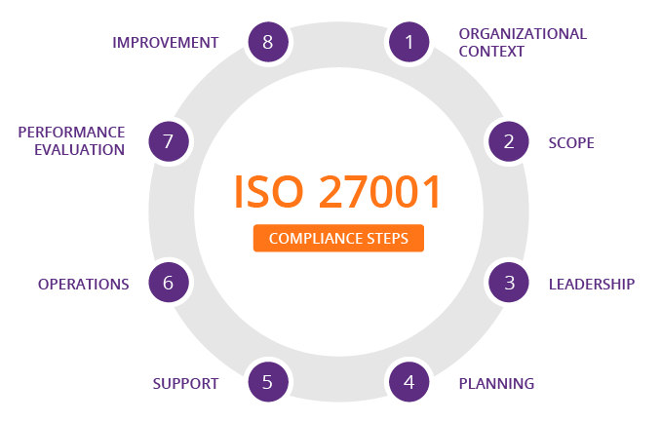
ISO/IEC 27001
ISO/IEC 27001 is a standard for information security management.
It provides a set of best practices and guidelines for information security management.
ISO/IEC 27001 includes data governance as a critical aspect of information security management.

Slide 26
Data Governance Models
A model provides a set of guidelines and best practices for data governance.
Examples:
RACI (Responsibility Assignment Matrix)
DACI (Data Governance Model)
CIDM (Data Management Maturity Model)

Slide 27
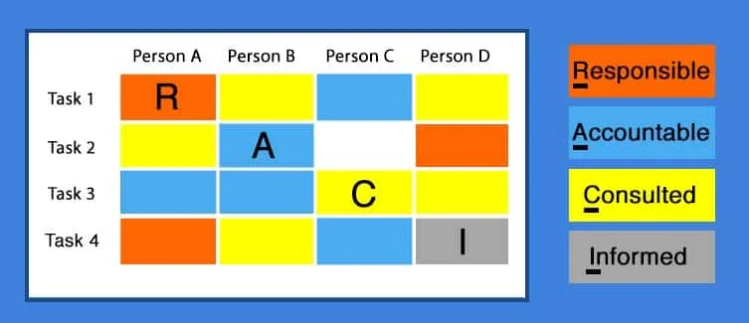
RACI (Responsibility Assignment Matrix)
A Tool for Data Governance
RACI is a tool used in data governance to assign responsibilities and clarify roles.
It helps to ensure that data is accurately, completely, and consistently managed.

Slide 28
How RACI Works
RACI is a matrix that lists all the roles and responsibilities for data management.
Each role is assigned a level of responsibility (R, A, C, or I) for each data element.
R stands for Responsible, A stands for Accountable, C stands for Consulted, and I stands for Informed.
The matrix helps to ensure that there is no confusion about who is responsible for what.

Slide 29
Benefits of RACI
RACI helps to clarify roles and responsibilities for data management.
It ensures that data is accurately, completely, and consistently managed.
RACI promotes collaboration and communication among data stakeholders.
It helps to identify and address data governance gaps.
RACI is a simple and effective tool for data governance.

Slide 30
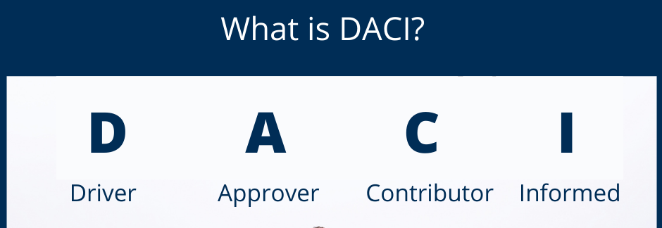
DACI (Data Governance Model)
DACI is a data governance model that provides a structured approach to data management.
It helps organizations ensure that data is accurate, complete, and accessible.

Slide 31
Key Components of DACI
Data Governance Body: A group of stakeholders responsible for overseeing data governance.
Data Governance Officer: A person responsible for implementing and maintaining data governance policies.
Data Stewards: People responsible for managing data on a day-to-day basis.
Data Users: People who use data to perform their job functions.
Data Governance Policies: Documents that outline the rules and procedures for data management.

Slide 32
Benefits of DACI
DACI helps organizations ensure that data is accurate, complete, and accessible.
It provides a clear framework for data governance roles and responsibilities.
DACI promotes collaboration and communication among data stakeholders.
It helps to identify and address data governance gaps.
DACI is a flexible and adaptable model that can be customized to fit the needs of any organization.

Slide 33
Data Management Maturity Model
A Framework for Assessing Data Management Maturity
A maturity model that assesses an organization's data management capabilities.
It helps organizations identify areas for improvement and optimize their data management practices.

Slide 34
Five Levels of Data Management Maturity
Level 1: Initial (Ad Hoc)
Level 2: Basic (Standardized)
Level 3: Intermediate (Structured)
Level 4: Advanced (Integrated)
Level 5: Optimized (Enterprise-Wide)
Description:
Each level represents a higher level of maturity and capability in data management.
Organizations can assess their current level of maturity and identify areas for improvement.

Slide 35
Benefits
Improving Data Management Maturity
Improved data quality and accuracy
Enhanced data security and compliance
Increased efficiency and productivity
Better decision-making through data-driven insights
Competitive advantage through data-driven innovation
Description:
Helps organizations optimize their data management practices, leading to various benefits.

Slide 36
Data Strategy

Slide 37
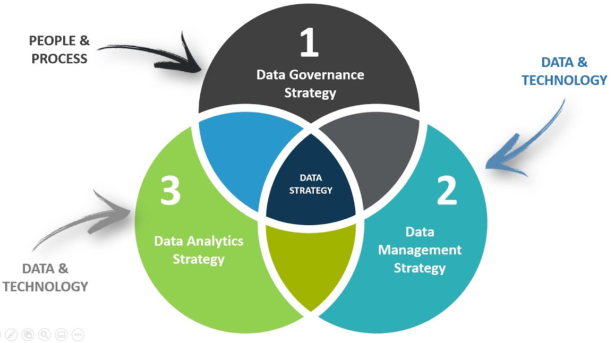
Data Strategy: Why It Matters
A data strategy is a comprehensive plan that outlines how an organization will collect, store, manage, and use data to achieve its business objectives.
It encompasses the entire data lifecycle, from data creation and collection to data storage and analysis, and provides a roadmap for how data will be used to support business decision-making and drive business success.

Slide 38
Data Strategy
A well-defined data strategy should consider the following key elements:
Data Governance
Data Architecture
Data Management
Data Analysis and Reporting
Data Integration and Interoperability
Data Security and Privacy
Data Lifecycle Management
Data Quality and Metrics
Data-Driven Culture
Continuous Improvement

Slide 39

Managing the Deluge of Data
The rapid growth of data in recent years
The challenges and opportunities presented by this growth
The need for a strategy to manage and make sense of the data

Slide 40
Benefits of a Well-Defined Data Strategy
Improved data quality and integrity
Enhanced decision-making capabilities
Increased efficiency and productivity
Better customer insights and engagement
Competitive advantage and innovation

Slide 41
Data-Driven Decision Making: The Key to Success
The importance of data-driven decision making
Examples of successful data-driven decision making in business
The benefits of using data to inform decision-making

Slide 42
Data Quality: The Pursuit of Accuracy and Completeness
The importance of data quality
Data quality dimensions
Data validation and cleansing
Data quality metrics and monitoring

Slide 43
Dama's Data Governance Wheel

Slide 44
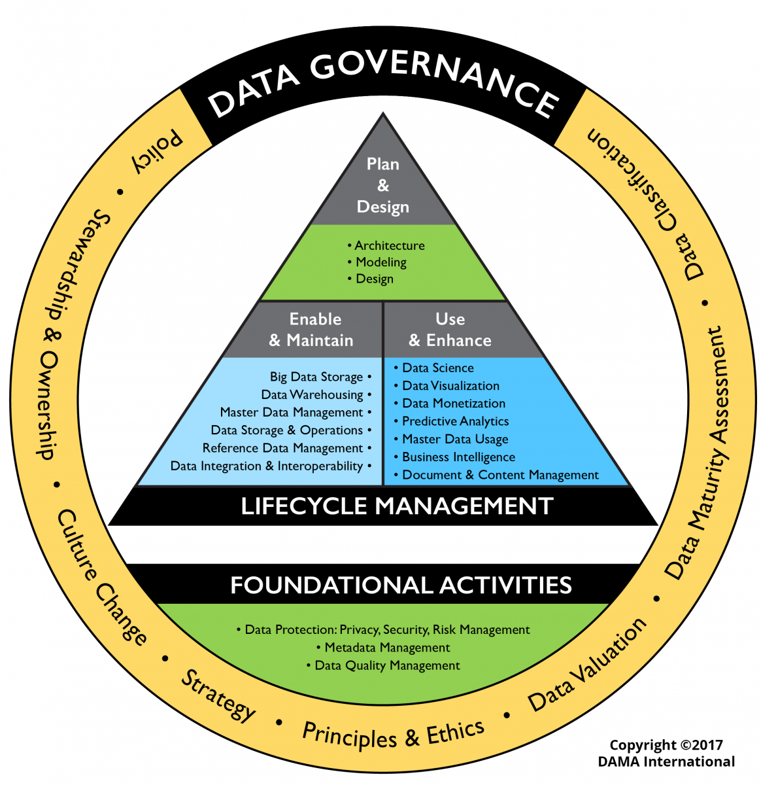

Slide 45
DAMA
The Data Management Association (DAMA)
DAMA International publishes the Data Management Body of Knowledge (DMBoK ®).
The latest version is V2.
They offer certification:
CDMP® Certification (Certified Data Management Professional®)!

Slide 46
A Framework for Effective Data Governance
Provides a structured approach to data management
Covers the entire data lifecycle
Offers a common language and framework for data management professionals

Slide 47
A Framework for Effective Data Governance
Dama's Data Governance Wheel is a framework for effective data governance.
It provides a structured approach to data governance, with 8 key components.
The wheel is divided into 8 segments, each representing a different aspect of data governance.

Slide 48
8 Components of DG
Policy
Stewardship and Ownership
Culture Change
Strategy
Principles and Ethics
Data Valuation
Data Maturity Assessment
Data Classifications

Slide 49
Lifecycle Management
Plan & Design
Architecture
Modeling
Design
Enable & Maintain
Big Data Storage
Data Warehousing
Master Data Management
Data Storage and Operations
Reference Data Management
Data Integration and Interoperability
Use & Enhance
Data Science
Data Visualization
Data Monetization
Predictive Analytics
Master Data Usage
Business Intelligence
Document and Content Management

Slide 50
Foundational Activities
Data Protection: Privacy, Security, Risk Management
Metadata Management
Data Quality Management

