Slide 1
Development
SE499: Software Design & Development Project

Slide 2
Introduction
Clean code, minimal complexity, and good readability and maintainability are critical elements of effective software development.
They help developers write code that is easy to understand, modify, and maintain, reducing the time and effort required for debugging, troubleshooting, and adding new features.

Slide 3
Benefits of Clean Code
Clean code makes it easier for developers to understand the intent of the code, which helps them to identify and fix bugs more efficiently.
It also reduces the risk of introducing new bugs during development and makes it easier to add new features and functionalities.

Slide 4
The Cost of Complexity
Complex code can lead to a range of problems, including longer development times, increased bug rates, and higher maintenance costs.
It can also make it harder for developers to understand the code, which can lead to mistakes and inefficiencies.

Slide 5
Techniques for Minimizing Complexity
There are several techniques that developers can use to minimize complexity, such as breaking up long functions, using meaningful variable names, and avoiding nested conditionals.
Developers can also use design patterns and principles, such as the Single Responsibility Principle and the Open-Closed Principle, to guide their design decisions and minimize complexity.

Slide 6
Improving Readability
Good readability is essential for effective software development.
Developers can improve readability by using meaningful variable and function names, writing clear and concise comments, and using whitespace effectively.

Slide 7
Maintainability
Maintainability is just as important as readability.
Developers can improve maintainability by writing modular code, using interfaces and abstraction, and minimizing coupling and dependencies.

Slide 8
Measurements
Types of measurements (e.g., size, effort, complexity, quality)
Why measurements are important (e.g., tracking progress, identifying issues, improving quality)

Slide 9
Code Quality
Importance of code quality (e.g., maintainability, readability, reliability)
Code quality metrics (e.g., cyclomatic complexity, Halstead complexity, cohesion)

Slide 10
Modularity
Importance of modularity (e.g., maintainability, reusability, scalability)
Techniques for improving modularity (e.g., component-based design, service-oriented architecture)

Slide 11
Complexity
Types of complexity (e.g., cognitive, structural, organizational)
Techniques for managing complexity (e.g., abstraction, encapsulation, divide and conquer)

Slide 12
Maintainability
Importance of maintainability (e.g., reducing costs, improving efficiency, enabling innovation)
Techniques for improving maintainability (e.g., modularity, abstraction, code reuse)

Slide 13
Code Efficiency
Importance of code efficiency (e.g., improving performance, reducing costs, enabling scalability)
Techniques for improving code efficiency (e.g., optimization, caching, parallel processing)

Slide 14
Testing
Importance of testing (e.g., ensuring quality, identifying defects, building confidence)
Types of testing (e.g., unit testing, integration testing, acceptance testing)

Slide 15
Incremental Development
Incremental development refers to a software development strategy in which a product is created through a sequence of little, incremental enhancements, as opposed to a single, big deployment.
Instead of developing an application in a single phase, it is built in pieces and stages over time, with each step adding new functionality or improving the functionality that already exists.

Slide 16
Incremental Development
Adaptability, flexibility, and early delivery are the main advantages of incremental development.
Incremental development enables organizations to adapt to shifting market conditions or client needs, as opposed to conventional waterfall approaches that call for extensive planning and specifications upfront.

Slide 17
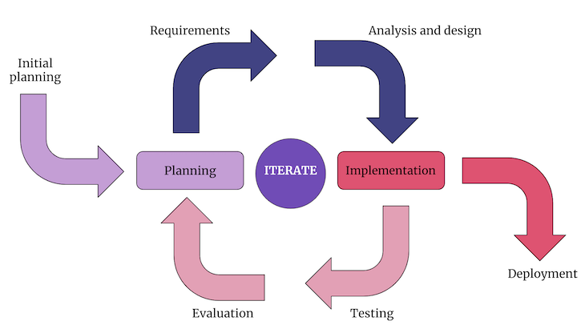
Incremental Development

Slide 18
Incremental Development
Advantages of incremental development (e.g., early delivery, reduced risk, flexibility)
Challenges of incremental development (e.g., integrating changes, managing scope)

Slide 19
Sprint Planning
Purpose of sprint planning (e.g., set goals, allocate resources, prioritize tasks)
Sprint planning process (e.g., identifying requirements, estimating effort, creating a sprint backlog)

Slide 20
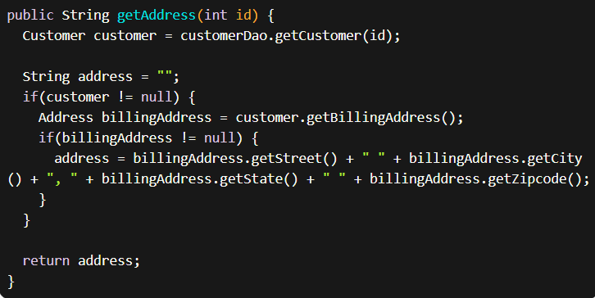
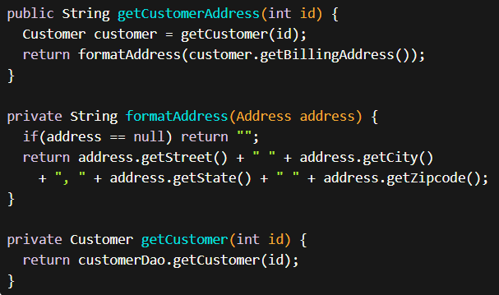

Slide 21
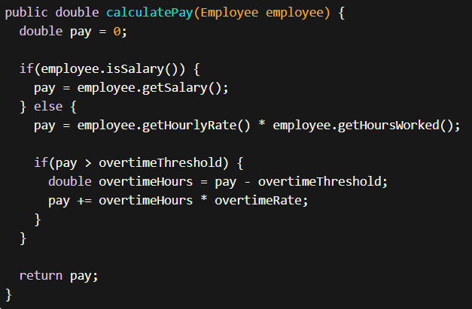
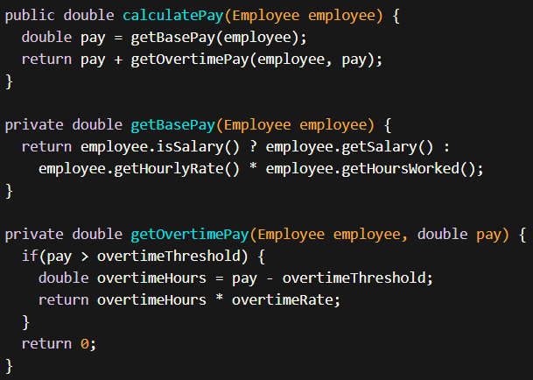

Slide 22
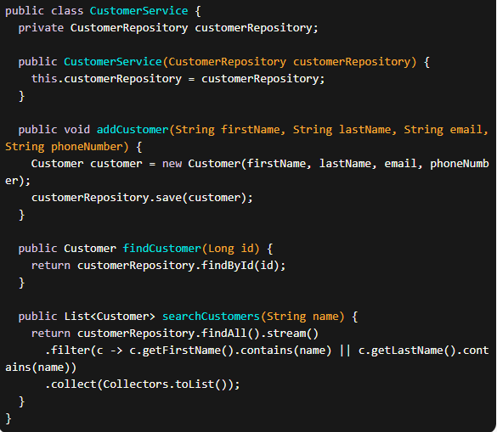
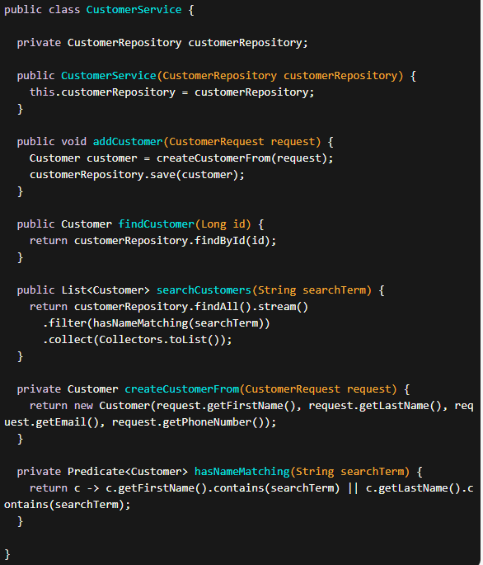

Slide 23
