Slide 1
Testing
SE499: Software Design & Development Project

Slide 2
Introduction
Testing is a crucial aspect of software development that ensures the quality and reliability of software products.
It involves evaluating software components and systems to identify defects, errors, and potential issues before deployment.
Testing helps maintain and improve the overall quality of software by identifying and fixing bugs, glitches, and errors.

Slide 3
Introduction
It ensures that the software meets the specified requirements and functions as intended.
Quality software is essential for customer satisfaction, user adoption, and building a positive reputation for the development team or organization.
Testing allows developers to detect and fix bugs early in the development process.
Early bug detection reduces the cost and effort required for bug fixing in later stages.

Slide 4
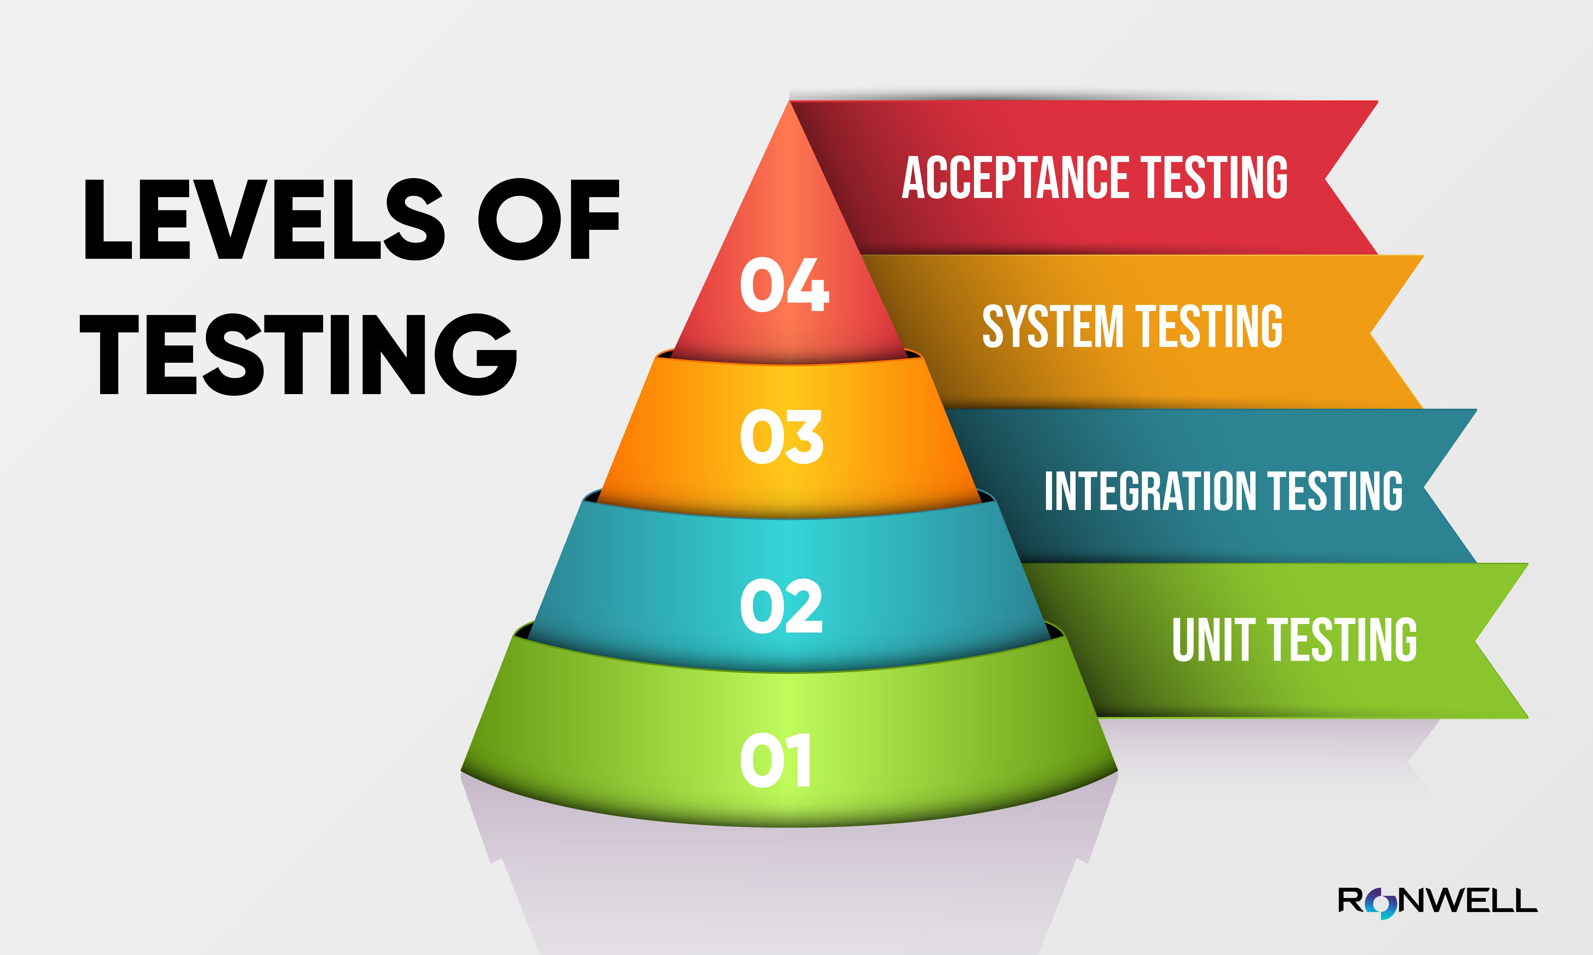

Slide 5
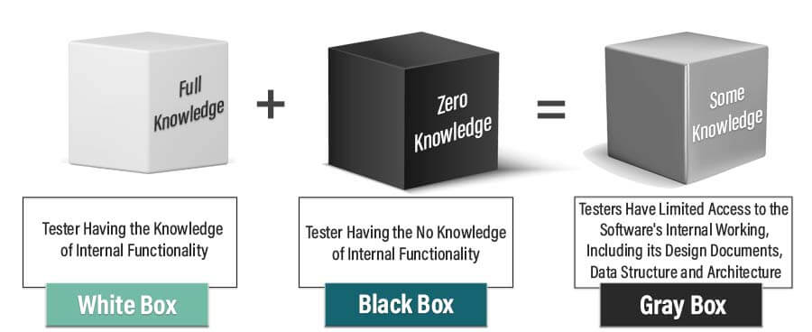
Testing Techniques

Slide 6
Test Planning and Design
Test plan
Test case
Test script
Test scenario
Test suite

Slide 7
Important Concepts
Test Data Management
Test Automation
Testing Challenges and Strategies
Challenges in testing (e.g. time constraints, complex systems, etc.)
Strategies for addressing testing challenges (e.g. risk-based testing, testing in Agile, etc.)
Testing for Security and Performance
Testing Metrics and Analysis
Best Practices for Testing

Slide 8
Testing in Agile
Role of testing in Agile development
Testing in Agile environments
Acceptance Test-Driven Development (ATDD)

Slide 9
Role of Testing in Agile Development
Testing plays a crucial role in Agile development by ensuring the quality and functionality of the software.
Testing is integrated throughout the development process, rather than being a separate phase at the end.
It helps identify defects early, enabling quick feedback and timely corrective actions.
Testers collaborate closely with developers, product owners, and other team members to ensure effective testing.

Slide 10
Testing in Agile Environments
Testing in Agile environments is characterized by short iterations or sprints.
Testers work closely with the development team to define and prioritize test cases.
Automated testing is heavily utilized to support frequent and rapid testing cycles.
Continuous integration and continuous delivery (CI/CD) pipelines are used to automate the testing and deployment processes.

Slide 11
Acceptance Test-Driven Development (ATDD)
ATDD is a practice in Agile development that involves defining acceptance criteria before coding begins.
It promotes collaboration between stakeholders, testers, and developers to clarify requirements.
Acceptance tests, written in a business-readable format, guide the development process.
ATDD helps ensure that software meets the desired business outcomes and improves customer satisfaction.

Slide 12
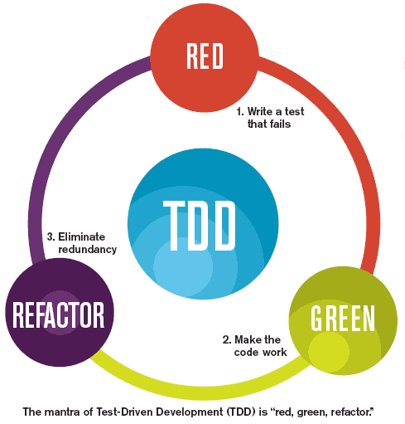
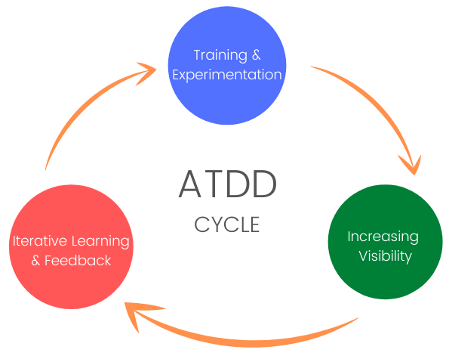
Acceptance Test-Driven Development (ATDD)

Slide 13
