Slide 1
Introduction
SE423: Software Project Management

Slide 2
Outline
Introduction
Project Management History
Project Managers
PMBOK

Slide 3
Introduction

Slide 4
What is Project Management?
Project management
The application of knowledge, skills, tools, and techniques to project activities to meet project requirements.
Project management refers to guiding the project work to deliver the intended outcomes. Project teams can achieve the outcomes using a broad range of approaches (e.g., predictive, hybrid, and adaptive).

Slide 5
Introduction
Many people and organizations today have a new or renewed interest in project management
The Project Management Institute reported that by 2027, employers will need 87.7 million individuals working in project management–oriented roles.
According to PMI’s 2021 Talent Gap report, 2.3 million new project management employees will be needed each year to meet global talent demands by 2030.

Slide 6
Introduction
The top skills employers look for in new college graduates are all related to project management: team-work, problem-solving, and verbal communications.
Organizations waste $97 million for every $1 billion spent on projects, according to PMI’s Pulse of the Profession® report.
The Saudi Smart Government Strategy is expected to set Saudi Arabia’s AI market to touch $135.2 billion by 2030, which is estimated to contribute 12.4 percent to the Kingdom’s gross domestic product.
Saudi Arabia’s government spending on technology has been valued at around $24.7 billion (SR 93 billion) by 2025, the highest in the world, accounting for 21.7 percent of national spending

Slide 7
Project Management History

Slide 8
The Project Management Profession
The profession of project management is growing at a very rapid pace
It is helpful to understand the history of the field, the role of professional societies like the Project Management Institute, and the growth in project management software

Slide 9
History of Project Management
Some people argue that building the Egyptian pyramids was a project, as was building the Great Wall of China.
Most people consider the Manhattan Project to be the first project to use “modern” project management.
This three-year, $2 billion (in 1946 dollars) project had a separate project manager and a technical manager.

Slide 10
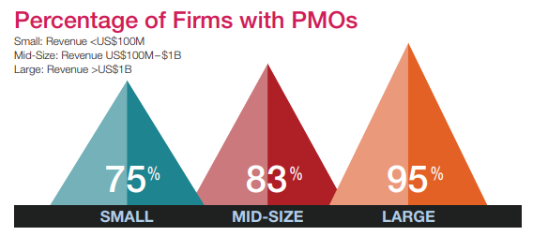
History of Project Management
In the 1990s, many companies began creating PMOs to help them handle the increasing number and complexity of projects
A Project Management Office (PMO) is an organizational group responsible for coordinating the project management function throughout an organization

Slide 11
Global Issues
Several global dynamics are forcing organizations to rethink their practices:
Talent development for project and program managers is a top concern
Basic project management techniques are core competencies
Organizations want to use more agile approaches to project management
Benefits realization of projects is a key metric

Slide 12
The Project Management Institute
The Project Management Institute (PMI) is an international professional society for project managers founded in 1969
PMI has continued to attract and retain members, reporting more than 652,000 members worldwide by late 2020
There are communities of practices in many areas, like information systems, financial services, and health care
Project management research and certification programs continue to grow

Slide 13
Project Management Certification
The Project Management Institute (PMI: http://www.pmi.org/) is the leading organization in advancing the project management profession
PMI provides certification as a Project Management Professional (PMP®)
A PMP® has documented sufficient project experience, agreed to follow a code of ethics, and passed the PMP® exam
The number of people earning PMP® certification is increasing quickly
Students can join PMI at a reduced fee and earn the Certified Associate in Project Management (CAPM) certification(see PMI for details)

Slide 14
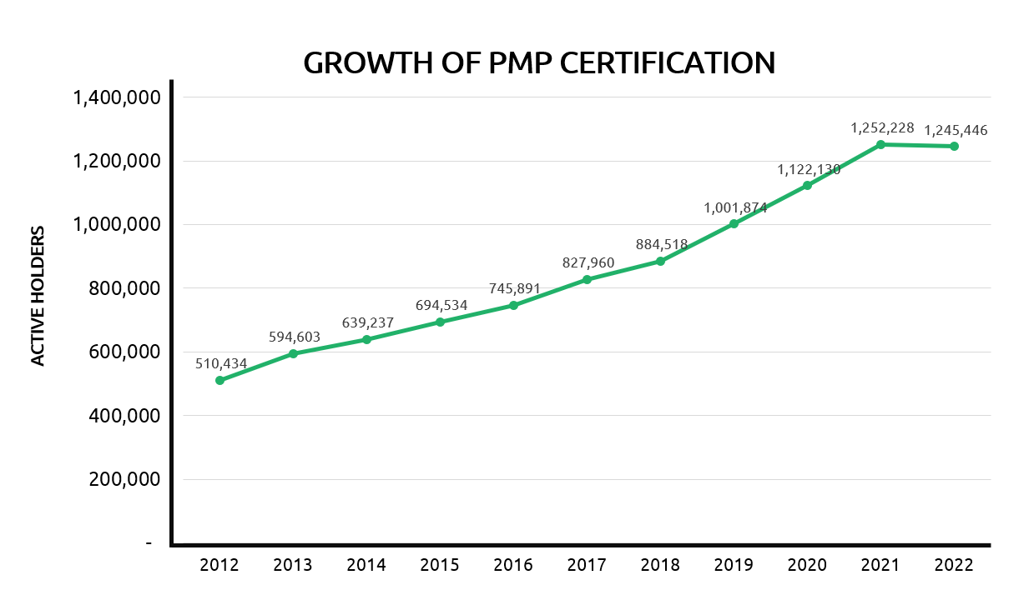
Project Management Certification

Slide 15
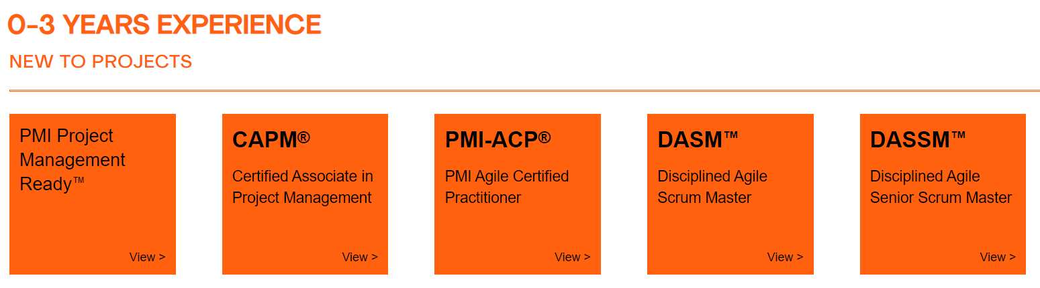
PMI Certifications

Slide 16
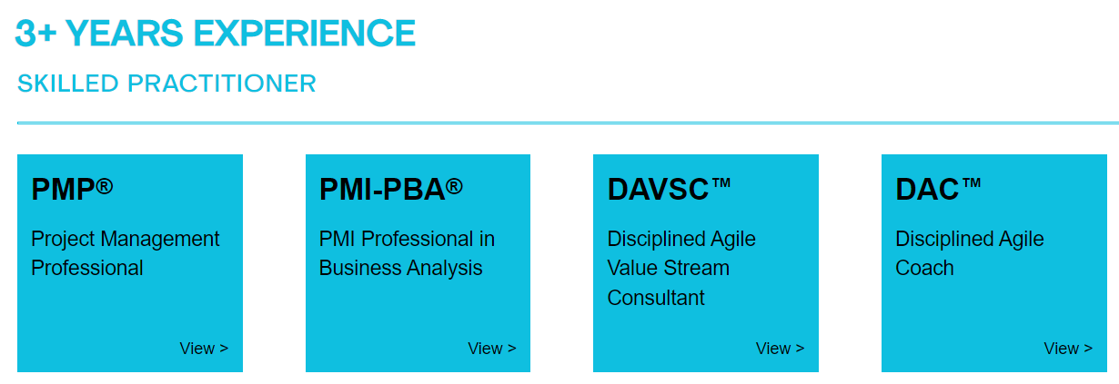
PMI Certifications

Slide 17
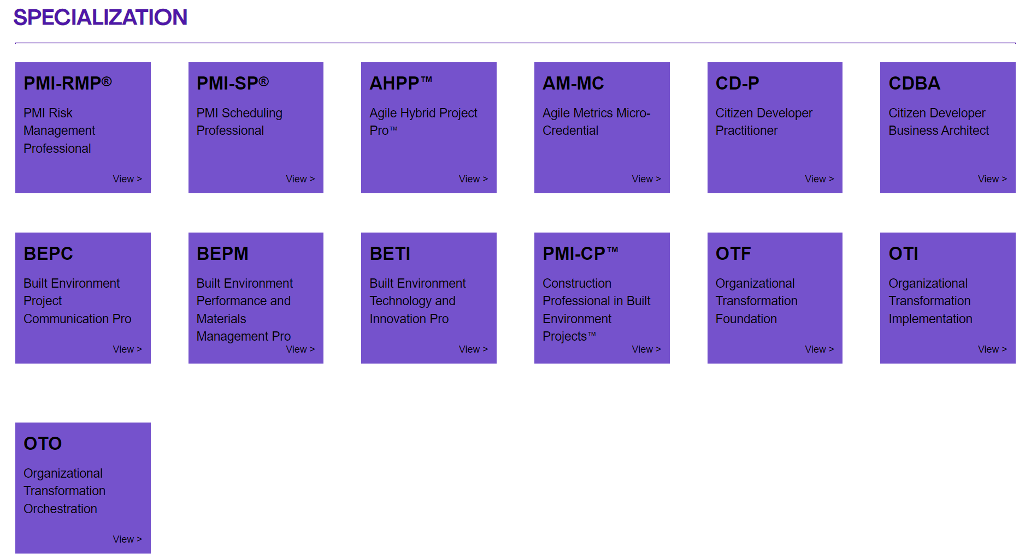
PMI Certifications

Slide 18
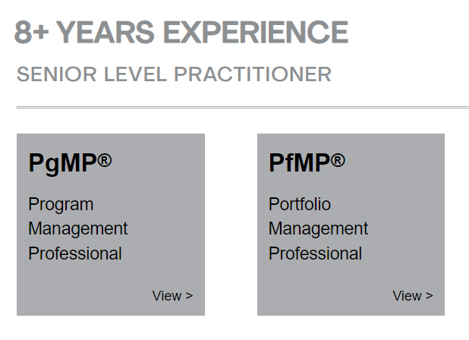
PMI Certifications

Slide 19
Ethics in Project Management
Ethics, loosely defined, is a set of principles that guide our decision making based on personal values of what is “right” and “wrong”
Project managers often face ethical dilemmas
In order to earn PMP® certification, applicants must agree to PMI’s Code of Ethics and Professional Conduct
Several questions on the PMP® exam are related to professional responsibility, including ethics

Slide 20
Project Managers

Slide 21
Project Managers
Project Managers are mainly responsible for all issues related to the software project; issues may vary depending on the project scale, some of the common issues are:
Schedule
Budget
Quality
Delivery of products
Locking in resources
Bottom line, as a project manager you will notice that most of your time is consumed chasing and collecting the status of project tasks.

Slide 22
The Project Manager
The Role of the Project Manager
Job descriptions vary, but most include responsibilities like planning, scheduling, coordinating, and working with people to achieve project goals
Remember that 97% of successful projects were led by experienced project managers, who can often help influence success factors
Skills for Project Managers
Project managers need a wide variety of skills, They should:
Be comfortable with change
Understand the organizations they work in and with
Be able to lead teams to accomplish project goals

Slide 23
Competencies for Project Managers
People skills
Leadership
Listening
Integrity, ethical behavior, consistent
Strong at building trust
Verbal communication
Strong at building teams
Conflict resolution, conflict management
Critical thinking, problem solving
Understands, balances priorities
Negotiating
Influencing the Organization
Mentoring
Process and technical expertise

Slide 24
Advantages of Using Formal Project Management
Better control of financial, physical, and human resources
Improved customer relations
Shorter development times
Lower costs and improved productivity
Higher quality and increased reliability
Higher profit margins
Better internal coordination
Positive impact on meeting strategic goals
Higher worker morale (less stress)
Less “death marches”
Less overworked personnel

Slide 25
Project Management Body of Knowledge (PMBOK)

Slide 26
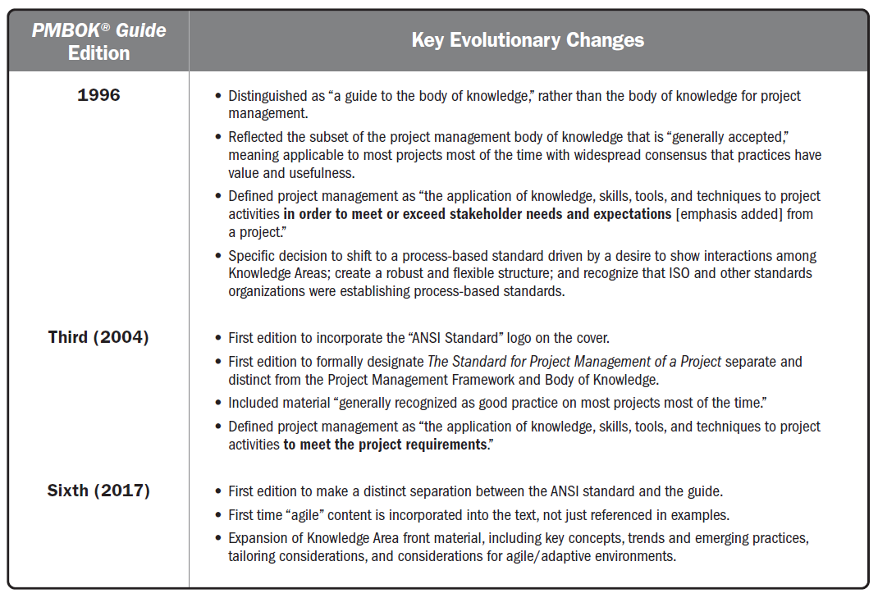
Evolution of Key Changes in the PMBOK® Guide

Slide 27
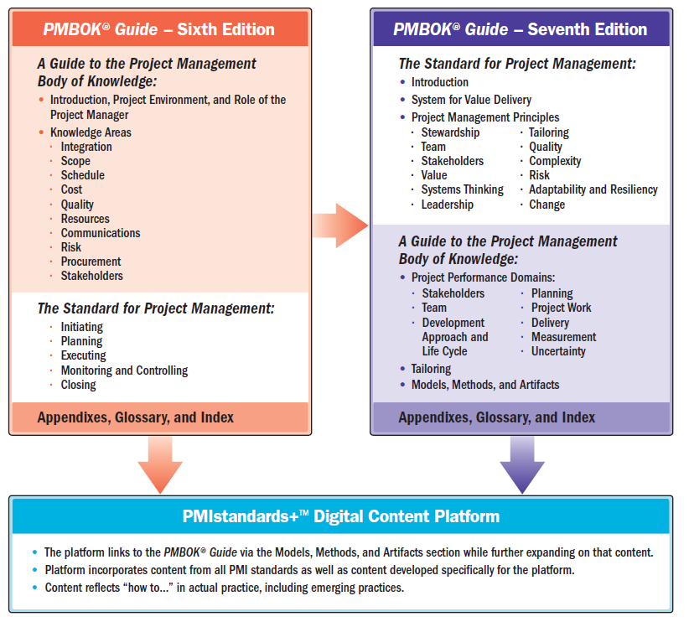

Slide 28
The Purpose of The Standard for Project Management
The Standard for Project Management provides a basis for understanding project management and how it enables intended outcomes.
This standard applies regardless of industry, location, size, or delivery approach, for example, predictive, hybrid, or adaptive. It describes the system within which projects operate, including governance, possible functions, the project environment, and considerations for the relationship between project management and product management.

Slide 29
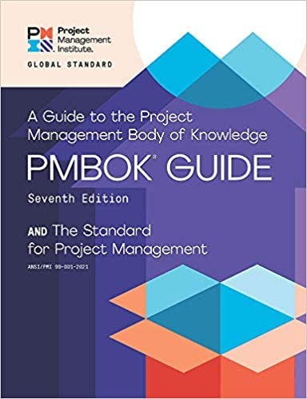
Project Management 12 Principles (PMBOK v7)
Stewardship
Team
Stakeholders
Value
Systems Thinking
Leadership
Tailoring
Quality
Complexity
Risk
Adaptability and Resiliency
Change

Slide 30
Project Management 8 Project Performance Domains (PMBOK v7)
Stakeholders
Team
Development Approach and Life Cycle
Planning
Project Work
Delivery
Measurement
Uncertainty

Slide 31
Key Terms and Concepts

Slide 32
Key Terms and Concepts
Outcome
An end result or consequence of a process or project.
Outcomes can include outputs and artifacts, but have a broader intent by focusing on the benefits and value that the project was undertaken to deliver.
Portfolio
Projects, programs, subsidiary portfolios, and operations managed as a group to achieve strategic objectives.
Product
An artifact that is produced, is quantifiable, and can be either an end item in itself or a component item.

Slide 33
Key Terms and Concepts
Program
Related projects, subsidiary programs, and program activities that are managed in a coordinated manner to obtain benefits not available from managing them individually.
Project
A temporary endeavor undertaken to create a unique product, service, or result.
The temporary nature of projects indicates a beginning and an end to the project work or a phase of the project work.
Projects can stand alone or be part of a program or portfolio.

Slide 34
Key Terms and Concepts
Project management
The application of knowledge, skills, tools, and techniques to project activities to meet project requirements.
Project management refers to guiding the project work to deliver the intended outcomes.
Project teams can achieve the outcomes using a broad range of approaches (e.g., predictive, hybrid, and adaptive).

Slide 35
Key Terms and Concepts
Project manager
The person assigned by the performing organization to lead the project team that is responsible for achieving the project objectives.
Project managers perform a variety of functions, such as facilitating the project team work to achieve the outcomes and managing the processes to deliver intended outcomes.

Slide 36
Key Terms and Concepts
Project team
A set of individuals performing the work of the project to achieve its objectives.
System for value delivery
A collection of strategic business activities aimed at building, sustaining, and/or advancing an organization.
Portfolios, programs, projects, products, and operations can all be part of an organization’s system for value delivery.

Slide 37
Key Terms and Concepts
Value
The worth, importance, or usefulness of something.
Different stakeholders perceive value in different ways.
Customers can define value as the ability to use specific features or functions of a product.
Organizations can focus on business value as determined with financial metrics, such as the benefits less the cost of achieving those benefits.
Societal value can include the contribution to groups of people, communities, or the environment.

Slide 38
A System for Value Delivery

Slide 39
A System for Value Delivery
To provide a context for value delivery, governance, project functions, the project environment, and product management.
Creating Value
Describes how projects operate within a system to produce value (organizations and stakeholders)
Organizational Governance Systems
Describes how governance supports a system for value delivery.
Functions Associated with Projects
Identifies the functions that support projects.
The Project Environment
Identifies internal and external factors that influence projects and the delivery of value.
Product Management Considerations
Identifies the ways portfolios, programs, projects, and products relate.

Slide 40
Creating Value
Projects exist within a larger system, such as a governmental agency, organization, or contractual arrangement.
Organizations create value for stakeholders. Examples of ways that projects produce value include, but are not limited to:
Creating a new product, service, or result that meets the needs of customers or end users;
Creating positive social or environmental contributions;
Improving efficiency, productivity, effectiveness, or responsiveness;
Enabling the changes needed to facilitate organizational transition to its desired future state; and
Sustaining benefits enabled by previous programs, projects, or business operations.

Slide 41
Value Delivery Components
There are various components, such as portfolios, programs, projects, products, and operations, that can be used individually and collectively to create value.
Working together, these components comprise a system for delivering value that is aligned with the organization’s strategy.
Any of the projects or programs could include products.
Operations can directly support and influence portfolios, programs, and projects, as well as other business functions, such as payroll, supply chain management, and so forth.
Portfolios, programs, and projects influence each other as well as operations.

Slide 42
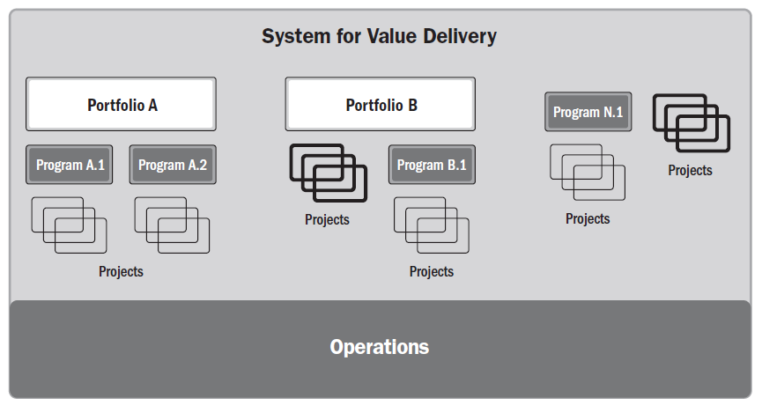
Value Delivery Components

Slide 43
Value Delivery Components
A system for value delivery is part of an organization’s internal environment that is subject to policies, procedures, methodologies, frameworks, governance structures, and so forth.
That internal environment exists within the larger external environment, which includes the economy, the competitive environment, legislative constraints, etc.

Slide 44
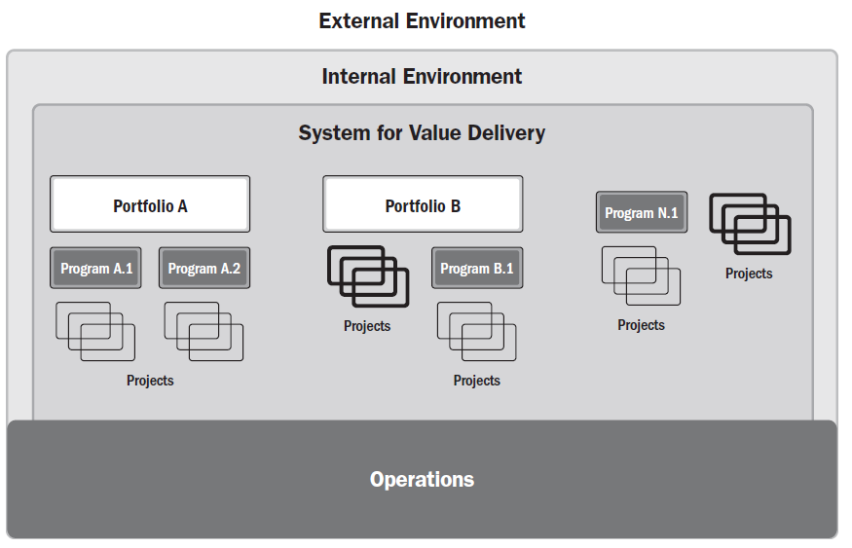
Value Delivery Components

Slide 45
Value Delivery Components
The components in a value delivery system create deliverables used to produce outcomes.
An outcome is the end result or consequence of a process or a project.
Focusing on outcomes, choices, and decisions emphasizes the long-range performance of the project.
The outcomes create benefits, which are gains realized by the organization.
Benefits, in turn, create value, which is something of worth, importance, or usefulness.

Slide 46
Information Flow
A value delivery system works most effectively when information and feedback are shared consistently among all components, keeping the system aligned with strategy and attuned to the environment.
Senior leadership shares strategic information with portfolios.
Portfolios share the desired outcomes, benefits, and value with programs and projects.
Deliverables from programs and projects are passed on to operations along with information on support and maintenance for the deliverables.

Slide 47
Information Flow
Information from operations to programs and projects suggests adjustments, fixes, and updates to deliverables.
Programs and projects provide performance information and progress on achieving the desired outcomes, benefits, and value to portfolios.
Portfolios provide evaluations on portfolio performance with senior leadership.
Additionally, operations provide information on how well the organization’s strategy is advancing.

Slide 48
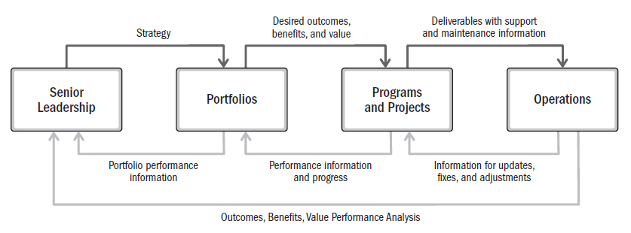
Information Flow

Slide 49
Organizational Governance Systems
The governance system works alongside the value delivery system to enable smooth workflows, manage issues, and support decision making.
Governance systems provide a framework with functions and processes that guide activities.
A governance framework can include elements of oversight, control, value assessment, integration among components, and decision-making capabilities.
Governance systems provide an integrated structure for evaluating changes, issues, and risks associated with the environment and any component in the value delivery system.

Slide 50
Organizational Governance Systems
This includes portfolio objectives, program benefits, and deliverables produced by projects.
Projects can operate within a program or portfolio or as a stand-alone activity.
In some organizations, a project management office might support programs and projects within a portfolio.
Project governance includes defining the authority to approve changes and make other business decisions related to the project.
Project governance is aligned with program and/or organizational governance.

Slide 51
Functions Associated with Projects
People drive project delivery.
They do so by fulfilling functions necessary for the project to run effectively and efficiently.
Functions related to the project can be fulfilled by one person, by a group of people, or combined into defined roles.
Coordinating a collective work effort is extremely important to the success of any project.
There are different types of coordination suitable for different contexts. Some projects benefit from decentralized coordination in which project team members self-organize and self-manage.

Slide 52
Functions Associated with Projects
Other projects benefit from centralized coordination with the leadership and guidance of a designated project manager or similar role.
Some projects with centralized coordination can also benefit from including self-organized project teams for portions of the work.
Regardless of how coordination takes place, supportive leadership models and meaningful, continuous engagements between project teams and other stakeholders underpin successful outcomes.

Slide 53
Functions Associated with Projects
Regardless of how projects are coordinated, the collective effort of the project team delivers the outcomes, benefits, and value.
The project team may be supported by additional functions depending on the deliverables, industry, organization, and other variables.
Other functions may be necessary to enable project deliverables that produce the desired outcomes.
The needs of the project, organization, and environment influence which functions are used on a project and how those functions are carried out.

Slide 54
Functions Associated with Projects
Provide oversight and coordination
Present objectives and feedback
Facilitate and support
Perform work and contribute insights
Apply expertise
Provide business direction and insight
Provide resources and direction
Maintain governance

Slide 55
The Project Environment
Projects exist and operate within internal and external environments that have varying degrees of influence on value delivery.
Internal and external environments can influence planning and other project activities.
These influences can yield a favorable, unfavorable, or neutral impact on project characteristics, stakeholders, or project teams.

Slide 56
The Project Environment
Internal Environment
Factors internal to the organization can arise from the organization itself, a portfolio, a program, another project, or a combination of these.
They include artifacts, practices, or internal knowledge.
Knowledge includes lessons learned as well as completed artifacts from previous projects. Examples include but are not limited to:
Process assets
Governance documentation
Data assets
Knowledge assets
Security and safety
Infrastructure
Information technology software
Resource availability
Employee capability

Slide 57
The Project Environment
External Environment
Factors external to the organization can enhance, constrain, or have a neutral influence on project outcomes. Examples include but are not limited to::
Marketplace conditions
Social and cultural influences and issues
Regulatory environment
Commercial databases
Academic research
Industry standards
Financial considerations
Physical environment

Slide 58
Product Management Considerations
The disciplines of portfolio, program, project, and product management are becoming more interlinked.
While portfolio, program, and product management are beyond the scope of this standard, understanding each discipline and the relationships between them provides a useful context for projects whose deliverables are products.

Slide 59
Product Management Considerations
A product is an artifact that is produced, is quantifiable, and can be either an end item itself or a component item.
Product management involves the integration of people, data, processes, and business systems to create, maintain, and develop a product or service throughout its life cycle.
The product life cycle is a series of phases that represents the evolution of a product, from introduction through growth, maturity, and to retirement.

Slide 60
Product Management Considerations
Product management may initiate programs or projects at any point in the product life cycle to create or enhance specific components, functions, or capabilities.
The initial product may begin as a deliverable of a program or project.
Throughout its life cycle, a new program or project may add or improve specific components, attributes, or capabilities that create additional value for customers and the sponsoring organization.
In some instances, a program can encompass the full life cycle of a product or service to manage the benefits and create value for the organization more directly.

Slide 61
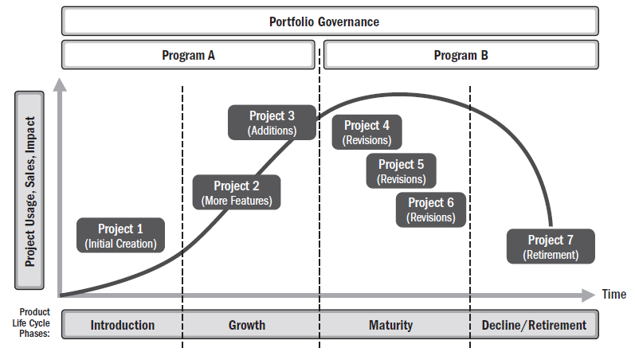
Product Management Considerations
Sample Product Life Cycle

Slide 62
Product Management Considerations
Product management can exist in different forms, including but not limited to:
Program management within a product life cycle.
This approach incorporates related projects, subsidiary programs, and program activities.
For very large or long-running products, one or more product life cycle phases may be sufficiently complex to merit a set of programs and projects working together.

Slide 63
Product Management Considerations
Product management can exist in different forms, including but not limited to:
Project management within a product life cycle.
This approach oversees development and maturing of product capabilities as an ongoing business activity.
Portfolio governance charters individual projects as needed to perform enhancements and improvements or to produce other unique outcomes.

Slide 64
Product Management Considerations
Product management can exist in different forms, including but not limited to:
Product management within a program.
This approach applies the full product life cycle within the purview and boundaries of a given program.
A series of subsidiary programs or projects will be chartered to achieve specific benefits for a product.
Those benefits can be enhanced by applying product management competencies like competitive analysis, customer acquisition, and customer advocacy.

Slide 65
Project Management Principles

Slide 66
Project Management Principles
Principles for a profession serve as foundational guidelines for strategy, decision making, and problem solving. Professional standards and methodologies are often based on principles.
In some professions, principles serve as laws or rules, and are therefore prescriptive in nature.
The principles of project management are not prescriptive in nature.
They are intended to guide the behavior of people involved in projects.
They are broadly based so there are many ways individuals and organizations can maintain alignment with the principles.
Principles can, but do not necessarily, reflect morals.

Slide 67
Project Management Principles
A code of ethics is related to morals.
A code of ethics for a profession can be adopted by an individual or profession to establish expectations for moral conduct.
The PMI Code of Ethics and Professional Conduct is based on four values that were identified as most important to the project management community:
Responsibility,
Respect,
Fairness, and
Honesty.

Slide 68
Project Management Principles
Because the principles of project management provide guidance, the degree of application and the way in which they are applied are influenced by the context of the organization, project, deliverables, project team, stakeholders, and other factors.
The principles are internally consistent, meaning that no principle contradicts any other principle.
However, in practice there may be times when the principles can overlap.
For example, guidance for navigating complexity can present information that is useful in recognizing, evaluating, and responding to system interactions or optimizing risk responses.
Principles of project management can also have areas of overlap with general management principles.
For example, both projects and business in general focus on delivering value.

Slide 69
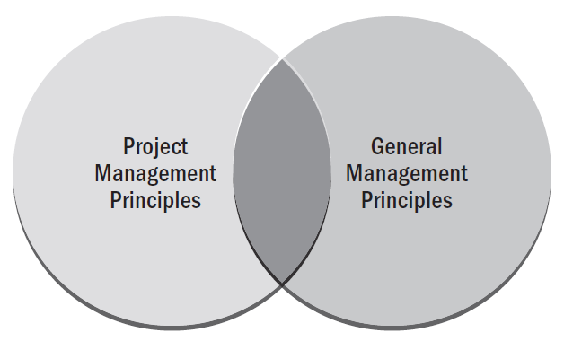
Overlap of Project Management and General Management Principles

Slide 70
Principle Statements Labels
Be a diligent, respectful, and caring steward
Create a collaborative project team environment
Effectively engage with stakeholders
Focus on value
Recognize, evaluate, and respond to system interactions
Demonstrate leadership behaviors
Tailor based on context
Build quality into processes and deliverables
Navigate complexity
Optimize risk responses
Embrace adaptability and resiliency
Enable change to achieve the envisioned future state

Slide 71
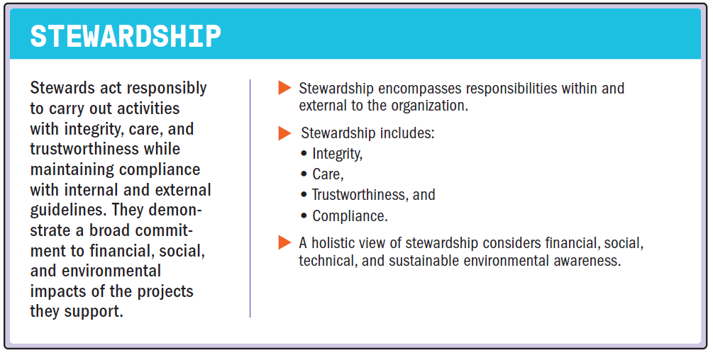
Be a Diligent, Respectful, and Caring Steward

Slide 72
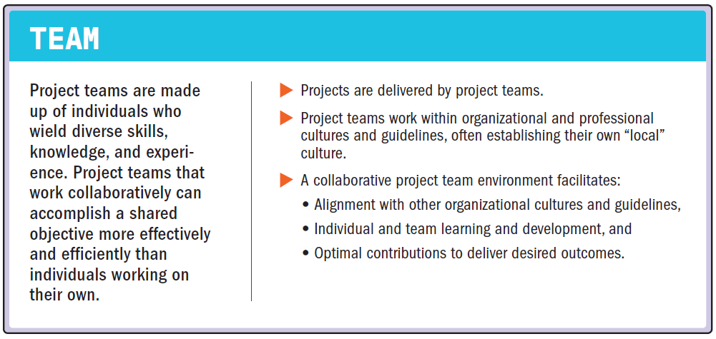
Create a Collaborative Project Team Environment

Slide 73
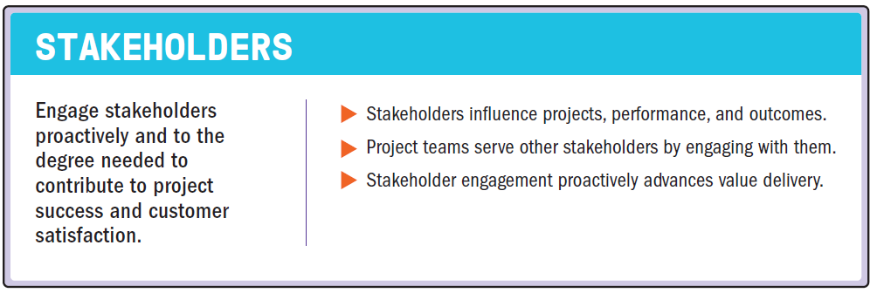
Effectively Engage with Stakeholders

Slide 74
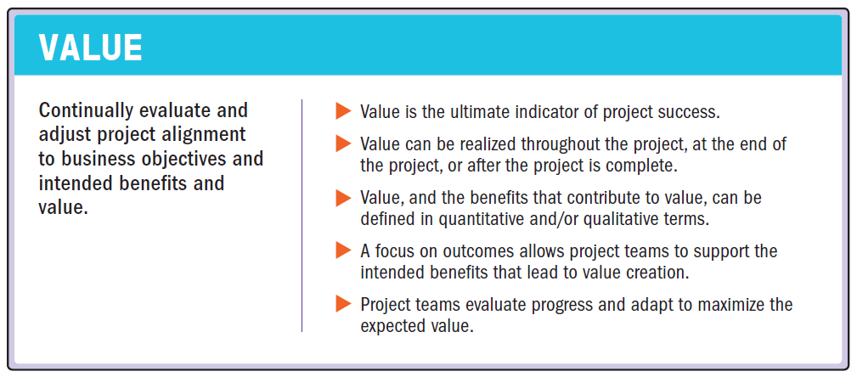
Focus on Value

Slide 75
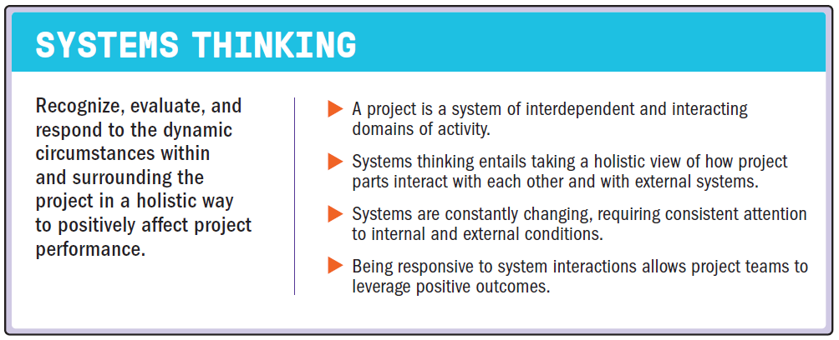
Recognize, Evaluate, and Respond to System Interactions

Slide 76
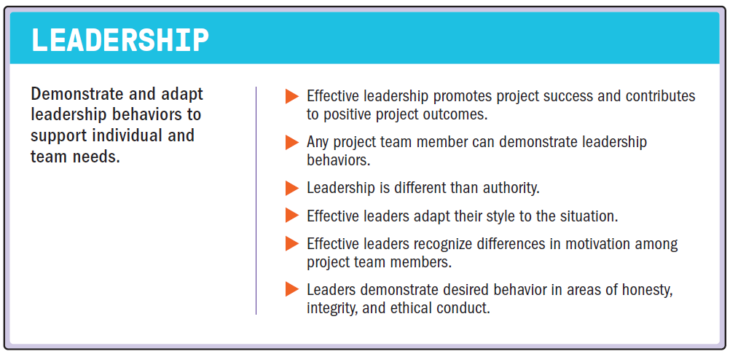
Demonstrate Leadership Behaviors

Slide 77
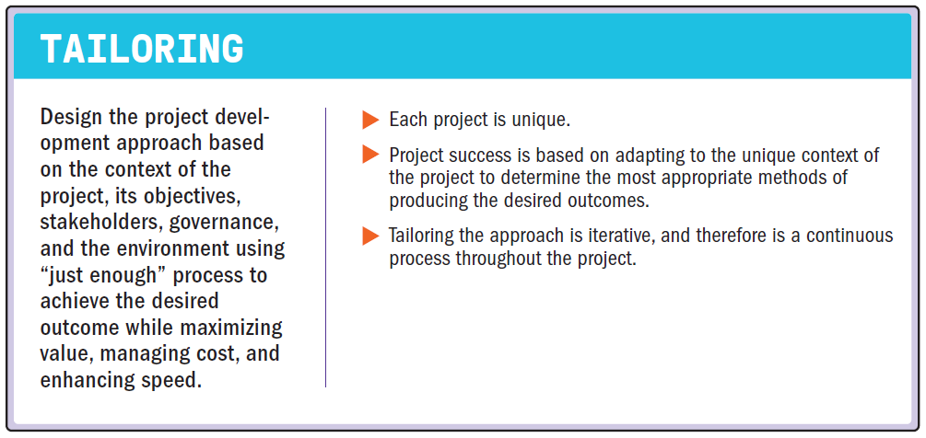
Tailor Based on Context

Slide 78
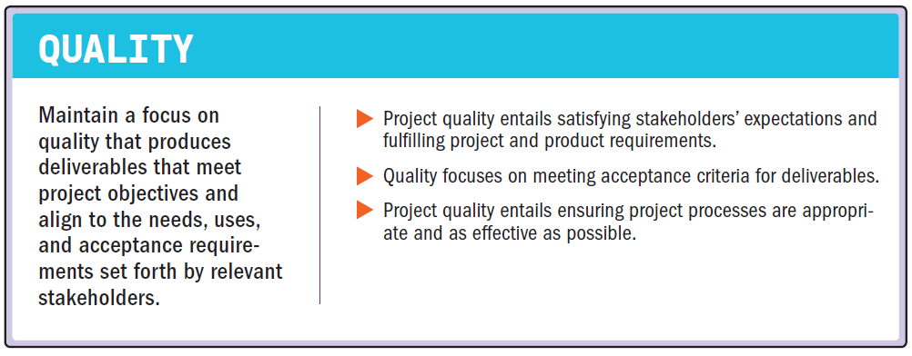
Build Quality into Processes and Deliverables

Slide 79
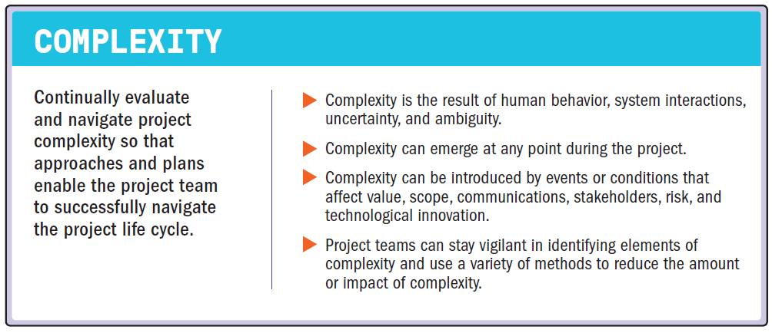
Navigate Complexity

Slide 80
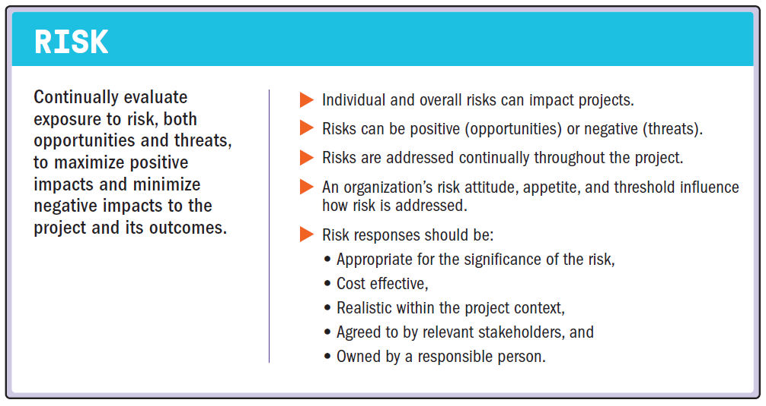
Optimize Risk Responses

Slide 81
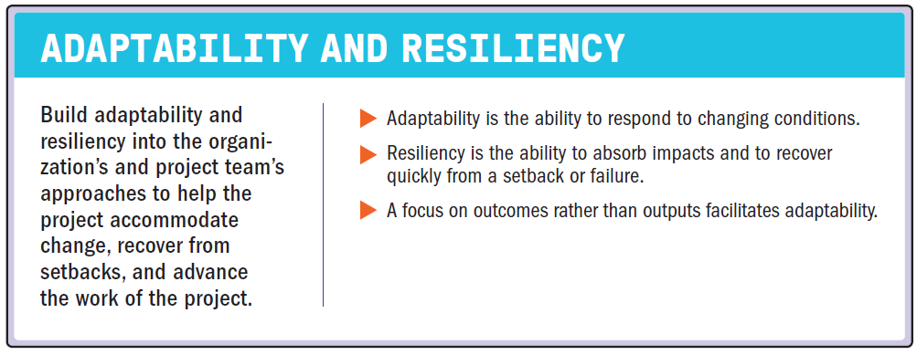
Embrace Adaptability and Resiliency

Slide 82
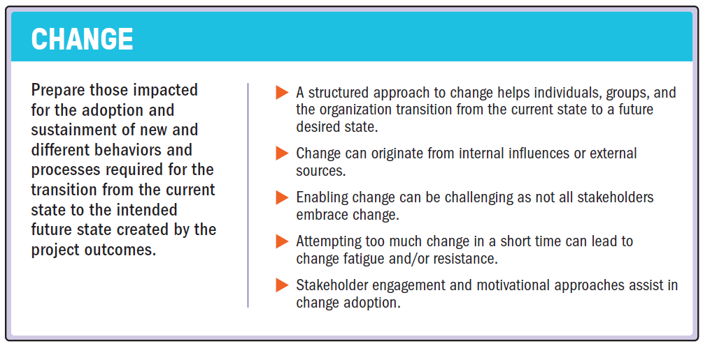
Enable Change to Achieve the Envisioned Future State

