Slide 1
The Extensible Markup Language (XML)
SE495: Software and Systems Integration

Slide 2
Outline
XML Basics
XML Processing
XML Types
Validation
XML Style Language and Transformation
XSL, XSLT, CSS, XHTML

Slide 3
XML Basics

Slide 4
The Role of XML in SOC
XML is used for representing almost all languages, protocols, and data structures in SOC: SOAP, WSDL, UDDI, ebXML, BEPL, OWL, …
WSDL Web services were also called XML services
Many internal files in .Net are in XML
Configuration files Web.config, which stores application setting, user data, security options, …
XHTML: XML version of html. .Net uses XHTML, instead of html, for the page generated from aspx page. It is a stricter version of html based on XML standard;
DataSet in ADO .Net database management uses XML to represent collection of tables;
…

Slide 5
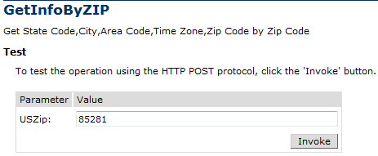
Processing DataSet from Web Services
<?xml version="1.0" encoding="utf-8" ?>
<NewDataSet>
<Table>
<CITY>Tempe</CITY>
<STATE>AZ</STATE>
<ZIP>85281</ZIP>
<AREA_CODE>602</AREA_CODE>
<TIME_ZONE>M</TIME_ZONE>
</Table>
</NewDataSet>

Slide 6
XML Extensible Markup Language
XML is of plain text and with self-describing;
It uses self-defined markup tags surrounding sentences, paragraphs, and even complete documents.
The self-defined tags provide additional information about the data they envelope.
It uses elements and attributes to provide both a logical structure and a physical structure to the document.
XML contains metadata: Data about data.
It is a meta language: a language used for defining other languages

Slide 7
XML Element, Attribute, and Document
An XML document starts with a prolog consisting of a declaration and optional references to external documents (namespaces):
<?xml version="1.0" encoding="UTF-8">
<instructor course=“Service-Oriented Computing"
<name>
<first>John</first>
<last>Doe</last>
</name>
</instructor>
The first line declares that the document follows XML version 1.0 and uses encoding method UTF-8.
The remaining lines contain data, called “elements”, stored in the XML file.

Slide 8
XML Element, Attribute, and Document
Each element is quoted by a pair of tags (opening and closing tags). Tag names are not predefined and can be chosen freely except a few restrictions. A tag must
start with a letter, an underscore, or a colon.
not start with the reserved word xml (case insensitive).
An attribute is a name = "value" equation inside the opening tag of an element.
Attribute
<instructor course="Service-Oriented Computing" officeHours="4">
<title>Professor</title>
<name>
<first>John</first>
<last>Doe</last>
</name>
</instructor>
Element
Content
There is no fixed rule what information should be stored as attributes or as child elements
Child element
Child element

Slide 9
XML Element, Attribute, and Document
There is no fixed rule what information should be stored as child elements or as attributes. However, normally
Elements are used for defining data that are integral to the document. Elements form a rooted tree.
Attributes are used for defining out-of-band data, which give “additional” information. They are stored linearly in the element.
<instructor >
<title degree= “PhD” year = “2001” school = “ASU”>Professor</title>
<name>
<first>John</first>
<last>Doe</last>
</name>
<course level = “Senior”>Service-Oriented Computing</course>
<officeHours>4</officeHours>
</instructor>

Slide 10
XML Syntax: Well-Formed XML Doc
An XML document must be written following certain syntax rules.
Must conform to XML specification at: www.w3.org/TR/REC-xml
There is a unique root element. All other elements are children or descendants of the root element.
Each element is quoted between an opening and a closing tag.
Nested tags are allowed but tags may not overlap. For example, the following is not allowed: <title>Professor<name>Doe</title></name>
Element tag name and content must meet certain restrictions.
Although not required, tag names should be self-describing and depict the true meaning of the content embedded in them.
Tag names need to be “declared” or “defined” in a definition language, e.g., in XML Schema (next lecture).

Slide 11
Attributes
Attribute values must always be in quotes. Both single and double quotes are valid. Double quotes are most common though.
Attributes are always contained within the opening tag of an element:
<course level = “senior” required = “true”>
Service-Oriented Computing
</course>
Attributes within an element must have unique names: The same attribute name can appear once only within an element. <course level = “senior” level = “graduate”> … <course> is not acceptable
Attributes are more complex to manipulate by program code than elements, as they are not a part of the tree elements

Slide 12
Special XML Empty Element Tag Convention
An empty element is an element without content or child elements:
<myElement></myElement>
which can be represented with a single tag of the form
<myElement />
Why do we need empty elements?
It can still have attributes:
<photo image =“myPhoto.jpeg” />
which is a short hand notation of
<photo image =“myPhoto.jpeg”> </photo>

Slide 13
XML Document Can be Visually Represented as a Rooted Tree
Empty element contains attribute only
An element contains child elements
Elements contain child elements
instructor
title
name
photo
course
officeHours
image=
“myPhoto.jpeg”
level1=
“senior”
level2=
“grad”
first
last
Programming
Languages
Professor
John
Doe
4
Elements contain text content
Text Content
Attribute

Slide 14
Representing Special Characters in Text Content
Five characters are reserved for markup purpose. The parsers need to differentiate them from the text content characters.
character Entity name Meaning
< lt less than
> gt greater than
& amp ampersand
' apos apostrophe, e.g., computer's keyboard
" quot quotation
Two ways to differentiate them:
Use Entity Reference for these characters
For example, to represent 0 < x < 100, you can use:
<Range> 0 &lt; x &lt; 100</Range>
Some textboxes do not take characters < and >, because the data will be stored in XML
Use Character Reference (ASCII code) for these characters
For example,
<Range> 0 &#60; x &#60; 100</Range>

Slide 15
Character and Parsed Character Data
If a piece of text has many markup characters, the reference method makes the text not readable.
<myCode>
function AND(a, b) {
if (a == “true” && b == “true”) then
{ return “true” }
else
{ return “false” }
}
</myCode>
Using Entity Reference for the special characters
<myCode>
function AND(a, b) {
if (a == &quot;true&quot; &amp;&amp; b == &quot;true&quot;) then
{ return &quot;true&quot; }
else
{ return &quot;false&quot; }
}
</myCode>

Slide 16
Using Character and Parsed Character Data
XML parsers differentiate two types of textual data:
CDATA - Character Data: Data that appears between the pair: <![CDATA[ and ]]> tags
PCDATA - Parsed Character Data: Any data that are not in CDATA tags.
Using CDATA for text with many markup characters is more readable:
<myCode>
<![CDATA[
function AND(a, b) {
if (a == “true” && b == “true”) then
{ return “true” }
else
{ return “false” }
}
]]>
</myCode>

Slide 17
Representing Special Characters in CDATA
XML parsers will ignore (not do syntax checking) on CDATA but parse PCDATA — that is, interpret it as a part of the markup language.
The practical implication is that for data between the tags <![CDATA[ and ]]>, we do not have to conform to the syntax of XML.
Outside the tags <![CDATA[ and ]]>, we must conform to the syntax of XML.

Slide 18
Whitespace in XML
XML defines four characters to be whitespace
Why would whitespace be handled differently from other characters?
Character | Unicode Value
tab | #x9
newline | #xA
carriage return | #xD
space | #x20

Slide 19
Collapsing (normalizing) or Preserving
To be discussed later
Normalization: Remove additional whitespaces
Preserving: Keep all whitespaces
Declaration in XML Document Type Definition (DTD)
<!DOCTYPE instructor [
<!ATTRIBUTE code xml:space #FIXED “preserve”>
<!EMEMENT name (first, middle?, last)>
<!EMEMENT first (#PCDATA)>
<!EMEMENT last (#PCDATA)>
<!EMEMENT course (#PCDATA)>
<!EMEMENT officeHours (#PCDATA)>
]>
If use “default”
Whitespaces will be collapsed!

Slide 20
Comments
<?xml version="1.0" encoding="UTF-8">
<myCode>
<!-- This function performs logic AND operation.
It takes two boolean variables as input
-->
function AND(a, b) {
if (a == &quot;true&quot; &amp;&amp; b == &quot;true&quot;) then
{ return &quot;true&quot; }
else
{ return &quot;false&quot; }
}
</myCode>

Slide 21
Namespaces
Namespaces provide a mechanism for qualifying (scoping) element and attribute names to avoid naming collisions.
In C++, we can use the namespace prefixes (scope resolution operator) to qualify its elements so that the elements won’t clash if used in the same document with other elements having the same names but different definitions.
<?xml version="1.0"?>
<cse:Courses
xmlns:cse="http://scidse.asu.edu/courses/cse.php"
xmlns:asu=“http://www.asu.edu/it/tempe/classrooms/"
<cse:Course>
<cse:Name>Distributed Software Development</cse:Name>
<cse:Code >CSE445</cse:Code>
<cse:Level>Senior</cse:Level>
<asu:Room asu:Image=“layout210.jpeg” >BYAC210</asu:Room>
<cse:Cap>40</cse:Cap>
</cse:Course>
XML namespace

Slide 22
Namespaces
…
<cse:Course>
<cse:Name>Introduction to Programming Languages</cse:Name>
<cse:Code >CSE240</cse:Code>
<cse:Level>Sophomore</cse:Level>
<asu:Room asu:Image=“layout110.jpeg”>BYAC110</asu:Room>
<cse:Cap>82</cse:Cap>
</cse:Course>
</cse:Courses>
Note, an element’s attributes are not automatically scoped to a namespace. In the following example, the Image attribute doesn’t belong to a namespace:
<asu:Room Image=“layout110.jpeg”></asu:Room>
However, you can use namespace prefixes to join attributes to namespaces:
<asu:Room asu:Image=“layout110.jpeg”></asu:Room>

Slide 23
XML Related Technologies
HTML
XHTML
XAML
Document
Type Definition
DTD
Schema
XML Parser
XML Query
Language
XPath
XQL
SOAP
WSDL
UDDI/ebXML
OWL
BPEL
XML-based
Protocols and Languages
XML
XSL
XSLT
XML Style and
Transformation
C#
Java Python
Processing
DOM
SAX
XML Parsers

Slide 24
XML Parsers
There are three types of parsers for extracting data from XML
DOM: Document Object Model
www.w3.org/TR/DOM-level-2-core
Read the entire document into the memory for random access -- problem: if the doc is huge.
Java DOM Parser: http://www.jdom.org/
MSXML: free MS parser that supports DOM, as well as SAX
SAX: Simple (Stream) API for XML
www.saxproject.org
Not a w3 standard
Event-based API, read the document in a stream
Developed by the Java community, and supported in all environments
XPath

Slide 25
XML Classes in .Net
The .Net FCL’s System.Xml namespace offers a variety of classes for reading and writing XML documents.
The XmlDocument class is similar to MSXML, but is simpler to use.
If you prefer a stream-based approach (SAX), you can use XmlTextReader or the schema-aware XmlvalidatingReader, instead.
A complementary class named XmlTextWriter allows you to create XML documents from scratch.

Slide 26
The XmlDocument Class in .Net
XmlNode class is the base class in .Net’s implementation of the DOM.
Each node of a DOM tree is an instance of XmlNode class, which exposes methods and properties for navigating a DOM tree, e.g., reading and writing node content, adding and removing nodes.
XmlDocument derives (inherits) from XmlNode and adds methods and properties of its own, supporting loading and saving of documents, the creation of new nodes, and other operations.
XmlDocument provides a programmatic interface to XML documents that complies with the DOM specification.
It represents a document as an upside-down rooted tree of nodes, with the root element, or document element, at the top.

Slide 27
DOM Representation of a Simple XML Doc
Courses.xml
http://venus.sod.asu.edu/WSRepository/xml/Courses.xml
Courses
Course
…
Element
names
Name
Code
Level
Room
Cap
attribute
Distributed Software Development
CSE445
Senior
BYAC270
40
Element
content
Short =“Distr Soft Dev”

Slide 28
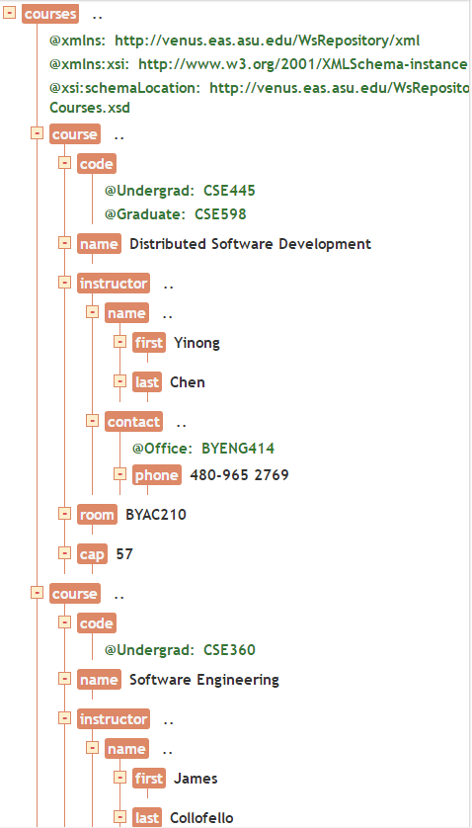
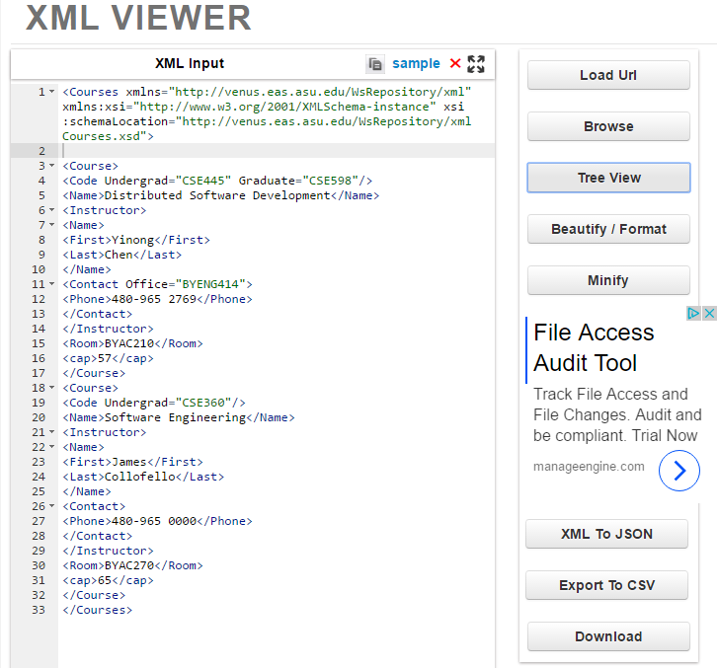
Online XML Viewer: http://codebeautify.org/xmlviewer

Slide 29
Using XmlDocument to load a Doc
The following statements create an XmlDocument object and initialize it with the contents of Courses.xml:
The method Load parsers the file “Courses.xml” and builds an in-memory tree representation.
It throws an XmlException if the document isn’t well-formed -- Doing the validation while reading.
XmlDocument xd = new XmlDocument (); //create an object
xd.Load (“Courses.xml”); // call Load method

Slide 30
Load a Doc from a Remote Site
The following statements create an XmlDocument object and initialize it with the contents of Courses.xml:
Code embedded in Web page
<%@ Page language=C# debug=“true” %>
<%@ Import Namespace=“System.Xml” %>
<SCRIPT runat=“server”>
void Page_Load(Object Sender, EventArgs e)
{
XmlDocument xd = new XmlDocument();
xd.Load(“http://venus.sod.asu.edu/WSRepository/xml/Courses.xml”);
this.Label.Text = xd.FirstChild.Name;
}
</SCRIPT>

Slide 31
Reading XML Doc and Write to Screen
void OutputNode (XmlNode node) // recursive
{
If (node == null) exit;
Console.WriteLine (“Type={0}\tName={1}\tValue={2}”,
node.NodeType, node.Name, node.Value);
if (node.HasChildNodes)
{
XmlNodeList children = node.ChildNodes;
foreach (XmlNode child in children)
OutputNode (child);
}
}
// Is it tail-recursive?
// What traversing order is used?

Slide 32
Reading XML Doc and Write to Screen (Python)
def OutputNode(node):
if node == None:
return
print("Type = {0}\tName = {1}\tValue = {2}".format(node.nodeType, node.nodeName, node.nodeValue))
if node.hasChildNodes():
children = node.childNodes
for child in children:
OutputNode(child)
// Is it tail-recursive?
// What traversing order is used?

Slide 33
Pre-Order Tree Traversing Algorithms
preorderTraverse(p)
if p ≠ null then
print(p.data);
for each child node preorderTraverse(p.nextChild);
p
root
10
8
16
inorderTraverse(p)
if p ≠ 0 then
inorderTraverse(p.left);
print(p.data);
inorderTraverse(p.right);
5
15
17
2
7
9
12
13
14
postorderTraverse(p)
if p ≠ 0 then
for each child node
postorderTraverse(p.nextChild); print(p.data);

Slide 34
Processing Data Set from Web Services
<?xml version="1.0" encoding="utf-8" ?>
<NewDataSet>
<NAME>City Info</NAME>
<Table>
<CITY>Tempe</CITY>
<STATE>AZ</STATE>
<ZIP>85281</ZIP>
<AREA_CODE>602</AREA_CODE>
<TIME_ZONE>M</TIME_ZONE>
</Table>
</NewDataSet>
preorder
postorder
postorder
City Info
Tempe
AZ
85281
602
M
M
602
85281
AZ
Tempe
City Info
Tempe
AZ
85281
602
M
City Info
or

Slide 35
.Net Classes Defined in System.Xml Namespace
XmlAttribute | Represents an attribute, with methods dealing with attributes.
XmlDocument | Represents an XML document, dealing with the overall doc.
XmlDocumentType | Represents the document type declaration.
XmlElement | Represents an element.
XmlLinkedNode | Deals with nodes immediately preceding or following this node.
XmlNamedNodeMap | Represents a collection of nodes that can be accessed by name or index.
XmlNode | Represents a single node in the XML document.
XmlNodeList | Represents an ordered collection of nodes.
XmlReader | Represents a reader that provides fast, non-cached, forward-only access to XML data.

Slide 36
Using Classes and Methods in System.Xml Namespace
System.XmlDocument
.SelectSingleNode()
System.XmlNode
.ChildNodes()
.Attributes()
System.XmlNodeList
System.XmlNamedNodeMap
.Node()
.Node()
Obtain a collection of nodes that can be accessed by name or index

Slide 37
Methods in XmlDocument Class
Attributes | Gets an XmlAttributeCollection containing the attributes of this node (inherited from XmlNode)
BaseURI | Overridden. Gets the base URI of the current node.
ChildNodes | Gets all the child nodes of the node (inherited from XmlNode)
DocumentElement | Gets the root XmlElement for the document.
DocumentType | Gets the node containing the DOCTYPE declaration.
FirstChild | Gets the first child of the node (inherited from XmlNode)
HasChildNodes | Gets a value indicating whether this node has any child nodes (inherited from XmlNode)
IsReadOnly | Overridden. Gets a value indicating whether the current node is read-only.
Item | Overloaded. Gets the specified child element (inherited from XmlNode)

Slide 38
Member Functions in XmlDocument Class (contd.)
LastChild | Gets the last child of the node (inherited from XmlNode)
NextSibling | Gets the node immediately following this node (inherited from XmlNode)
NodeType | Overridden. Gets the type of the current node.
ParentNode | Overridden. Gets the parent node of this node (for nodes that can have parents).
Prefix | Gets or sets the namespace prefix of this node (inherited from XmlNode)
PreserveWhitespace | Gets or sets a value indicating whether to preserve white space in element content.
PreviousSibling | Gets the node immediately preceding this node (inherited from XmlNode)
Schemas | Gets or sets the XmlSchemaSet object associated with this XmlDocument.
Value | Gets or sets the value of the node (inherited from XmlNode)

Slide 39
XmlNodeType Enumeration
XmlNodeType Example
Attribute <Course image=“My445.jpeg”>
CDATA <![CDATA[“This is character data”]]>
Comment <!-- This is a comment -->
Document <Courses>
Document Type <!DOCTYPE Courses SYSTEM “Courses.dtd”>
Element <Course>
Entity <!ENTITY filename “Courses.xml”>
EntityReference &lt;
Notation <!NOTATION GIF89a SYSTEM “gif”>
Processinglnstruction <?xml-stylesheet type=“text/xsl” href=“Courses.xsl”?>
Text <Code>CSE445</Code>
Whitespace <Name/>\r\n<Name/>
XmlDeclaration <?xml version=“1.0”?>

Slide 40
XML Processing

Slide 41
Put Together Example: Using DOM Model (Continued from the previous lecture)
XmlDocument docRef= new XmlDocument(); // document object
docRef.Load(“http://venus.sod.asu.edu/WSRepository/xml/Courses.xml”);
XmlNode nodeRef = docRef.DocumentRef; // node object
OutputNode(nodeRef); // Call the recursive method to traverse tree
static void OutputNode (XmlNode node) { // recursive method
If (node == null) exit;
Console.WriteLine (“Type={0}\tName={1}\tValue={2}”,
node.NodeType, node.Name, node.Value);
if (node.HasChildNodes) {
XmlNodeList children = node.ChildNodes;
foreach (XmlNode child in children)
OutputNode (child);
} }
See text section 4.2.1 for full working code

Slide 42
Using SAX Model: the XmlTextReader Class
XmlDocument allows you to move backwards, forwards, and sideways, and make changes in a in-memory document tree.
If you want simply to read XML and are less interested in the structure than its contents, you can use XmlTextReader class.
XmlTextReader, also belongs to the System.Xml namespace, provides a fast, forward-only, read-only interface to XML documents.
It is stream-based, just like reading a text file. It is more memory-efficient than XmlDocument, because it does not read the entire document into memory at one time, … but may be less time efficient, as it does not allow you to define algorithm or path.
It is easier than XmlDocument to read through a document searching for particular elements, attributes, or other content items. The recursive method is built-in!

Slide 43
Using XmlTextReader is Simple
The basic idea is to create an XmlTextReader object from a file, a URL, or other data source;
Call XmlTextReader.Read( ) repeatedly until you find the content you’re looking for or reach the end of the document;
Each call to Read( ) advances an imaginary cursor to the next node in the document (normally, in pre-order traversing);
XmlTextReader properties, such as NodeType, Name, Value, and AttributeCount, expose information about the current node;
Methods, such as GetAttribute, MoveToFirstAttribute, and MoveToNextAttribute, let you access the attributes, if any, attached to the current node.
10
8
15
5
14
17
2
7
12
13

Slide 44
Some Member Functions in XmlTextReader Class
AttributeCount | Overridden. Gets the number of attributes on the current node.
Depth | Overridden. Gets the depth of the current node to the root in the XML document.
EOF | Overridden. Gets a value indicating whether the reader is positioned at the end of the stream.
HasAttributes | Gets a value indicating whether the current node has any attributes (inherited from XmlReader)
HasValue | Overridden. Gets a value indicating whether the current node can have a Value other than String.Empty.
IsEmptyElement | Overridden. Gets a value indicating whether the current node is an empty element (for example, <MyElement/>).
Name | Overridden. Gets the qualified name of the current node.
Value | Overridden. Gets the text value of the current node.
ValueType | Gets The Common Language Runtime (CLR) type for the current node (inherited from XmlReader)

Slide 45
Read the XML Doc like Reading a Text File
XmlTextReader reader = null;
try {
reader = new XmlTextReader (“Courses.xml”);
reader.WhitespaceHandling = WhitespaceHandling.None;
while (reader.Read ()) {
Console.WriteLine (“Type={0}\tName={1}\tValue={2}”,
reader.NodeType, reader.Name, reader.Value);
}
}
finally {
if (reader != null)
reader.Close();
}
Local file is used. You can use a remote file, e.g., http://venus.sod.asu.edu/WSRepository/xml/Courses.xml

Slide 46
Also Print the Attributes
?
try {
reader = new XmlTextReader (“Courses.xml”);
while (reader.Read()) {
Console.WriteLine (“Type={0}\tName={1}\tValue={2}”,
reader.NodeType, reader.Name, reader.Value);
If (reader.AttributeCount > 0) {
while (reader.MoveToNextAttribute()) {
Console.WriteLine (“Type={0}\tName={1}\tValue={2}”,`
reader.NodeType, reader.Name, reader.Value);
}
}
}
}
finally {
if (reader != null)
reader.Close ();
}
?
What does this line of code do?
Create an unshaped object
Create a tree and load the elements of the file into the tree;
Create an object and shape the object according to the node of the file “Courses.xml”;
Load the element at the cursor into an object

Slide 47
Extracting a Particular Attribute Value (e.g. Image)
try {
XmlTextReader reader = new XmlTextReader (“Courses.xml”);
reader.Whitespacehandling = WhitespaceHandling.None;
while (reader.Read()) {
if (reader.NodeType == XmlNodeType.Element &&
reader.Name == “Course” &&
reader.AttributeCount > 0) {
while (reader.MoveToNextAttribute ())
{
if (reader.Name == “Image”) {
Console.WriteLine (reader.Value);
break;
}
}
}
}
}
finally {
if (reader != null) reader.Close ();
}
What Design Pattern?
Iteration pattern
See text section 4.2.2 for full working code

Slide 48
The XmlTextWriter Class
The XmlDocument class is more frequently used for reading and modifying existing XML documents.
XmlTextWriter is designed for creating an XML file from scratch, and it features an assortment of Write methods that emit various types of XML, including
Document
elements,
attributes,
comments,
and more.
WriteStartElement
WriteElementString
WriteElementString
WriteAttributeString
WriteElementString
What do you do if you want to create a child element here, instead of text content?
WriteEndElement
WriteStartElement

Slide 49
Example: Creating an XML Doc
try {
writer = new XmlTextWriter (“Courses.xml”, System.Text.Encoding.Unicode);
writer.Formatting = Formatting.Indented;
writer.WriteStartDocument ();
writer.WriteStartElement(“Courses”);
writer.WriteStartElement(“Course”);
writer.WriteElementString(“Name”, “SOC”);
writer.WriteElementString(“Code”, “CSE445”);
writer.WriteElementString(“Level”, “Senior”);
writer.WriteStartElement("Room");
writer.WriteAttributeString("Image","layout150.jpeg"); writer.WriteString("BYAC150");
writer.WriteEndElement();
writer.WriteElementString(“Cap”, “40”);
writer.WriteEndElement();
writer.WriteEndElement();
writer.WriteEndDocument();
}
finally { if (writer != null) writer.Close (); }
<?xml version=“l.0”
encoding “utf-16”?>
<Courses>
<Course >
<Name>SOC</Name>
<Code >CSE445</Code>
<Level>Senior</Level>
<Room Image=“layout150.jpeg”> BYAC150
</Room>
<Cap>40</Cap>
</Course>
</Courses>
See text section 4.2.3 for full working code

Slide 50
Methods in the XmlTextWriter Class
public methodClose | Overridden. Closes this stream and the underlying stream.
public methodEquals (inherited from Object) | Overloaded. Determines whether two Object instances are equal.
public methodFlush | Overridden. Flushes whatever is in the buffer to the underlying streams.
public methodGetType (inherited from Object) | Gets the Type of the current instance.
public methodWriteAttributes (inherited from XmlWriter) | When overridden in a derived class, writes out all the attributes found at the current position in the XmlReader.
public methodWriteAttributeString (inherited from XmlWriter) | Overloaded. When overridden in a derived class, writes an attribute with the specified value.
public methodWriteCData | Overridden. Writes out a <![CDATA[...]]> block containing the specified text.
public methodWriteCharEntity | Overridden. Forces the generation of a character entity for the specified Unicode character value.
public methodWriteChars | Overridden. Writes text one buffer at a time.
public methodWriteEndAttribute | Overridden. Closes the previous WriteStartAttribute call.
public methodWriteEndDocument | Overridden. Closes any open elements or attributes and puts the writer back in the Start state.
public methodWriteEndElement | Overridden. Closes one element and pops corresponding namespace scope.
public methodWriteEntityRef | Overridden. Writes out an entity reference as &name;.
public methodWriteFullEndElement | Overridden. Closes one element and pops the corresponding namespace scope.
public methodWriteStartAttribute | Overloaded. Overridden. Writes the start of an attribute.
public methodWriteStartDocument | Overloaded. Overridden. Writes the XML declaration with the version "1.0".
public methodWriteStartElement | Overloaded. Overridden. Writes the specified start tag.
public methodWriteString | Overridden. Writes the given text content.
public methodWriteWhitespace | Overridden. Writes out the given white space.

Slide 51
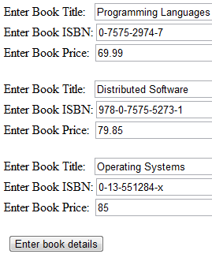
Example: Writing web data into XML File
using System.Xml;
using System.IO;
public partial class Seller : System.Web.UI.Page {
protected void Page_Load(object sender, EventArgs e) { }
protected void btnEnterBook_Click(object sender, EventArgs e) {
string title1 = txtTitle1.Text;
string isbn1 = txtIsbn1.Text;
string sPrice1 = txtPrice1.Text;
string title2 = txtTitle2.Text;
string isbn2 = txtIsbn2.Text;
string sPrice2 = txtPrice2.Text;
string title3 = txtTitle3.Text;
string isbn3 = txtIsbn3.Text;
string sPrice3 = txtPrice3.Text;
Taking data from text boxes
Taking data from text boxes

Slide 52
Code Behind the Data Enter (Writer) Page
string fLocation = Path.Combine(Request.PhysicalApplicationPath, @"App_Data\Book.xml");
if (File.Exists(fLocation)) {
File.Delete(fLocation);
}
FileStream fState = null;
try {
fState = new FileStream(fLocation, FileMode.CreateNew);
XmlTextWriter writer = new XmlTextWriter(fState, System.Text.Encoding.Unicode);
writer.Formatting = Formatting.Indented;
writer.WriteStartDocument();
writer.WriteStartElement("Books");
writer.WriteStartElement("Book");
writer.WriteElementString("Title", title1);
writer.WriteElementString("Isbn", isbn1);
writer.WriteElementString("Price", sPrice1);
writer.WriteEndElement();
// or: HttpRuntime.AppDomainAppPath
In this example, delete the file if it exists
In this example, delete the file if it exists, and create a new file. Not the best way to do it!
Open text file
Open XML file
Other modes include OpenOrCreate, Append, …

Slide 53
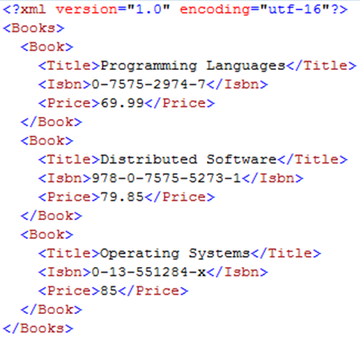
Code Behind the Data Enter (Writer) Page
XMLWriter continues to write
writer.WriteStartElement("Book");
writer.WriteElementString("Title", title2);
writer.WriteElementString("Isbn", isbn2);
writer.WriteElementString("Price", sPrice2);
writer.WriteEndElement();
writer.WriteStartElement("Book");
writer.WriteElementString("Title", title3);
writer.WriteElementString("Isbn", isbn3);
writer.WriteElementString("Price", sPrice3);
writer.WriteEndElement();
writer.WriteEndElement();
writer.WriteEndDocument();
writer.Close();
fState.Close();
}
It is necessary to close the XMLWriter and to close the file stream connection. You cannot open the file if any one is open.
It is necessary to close the XMLWriter and to close the file stream connection. You cannot open the file if any one is not closed.

Slide 54
Code Behind the Data Enter (Writer) Page
You could put them here, in case the session crashes, it allows other sessions to access the file
finally {
// writer.Close(); // fState.Close();
}
Response.Redirect("Default.aspx");
}
protected void txtIsbn_TextChanged(object sender, EventArgs e)
{
// can write an event handler to do something as user types
}
}
Making test suggestion/recommendation here

Slide 55
Another way of creating an XML File: Combining XmlDocument Class and XMLWriter
Saves all the children of the XmlDocument node through a specified XmlWriter in the following steps:
Load an XML file into memory as a tree:
XmlDocument xd = new XmlDocument();
xd.Load(“Courses.xml”);
Modify the tree, using tree operations:
insertion(), deletion(), balancing(), traversing(), etc.
Write the modified tree back using
XmlTextWriter writer = new XmlTextWriter(Courses.xml);
writer.Formatting = Formatting.Indented;
xd.WriteContentTo(writer);

Slide 56
Java Packages for XML Processing https://www.oracle.com/java/technologies/jaxp-introduction.html
Java XML Processing
JAXP
JAXB
JDOM
JAX-PRC
JAXP: Java API for XML Processing
provides a common (vendor-independent) interface for creating and using the standard SAX, DOM, and XSLT APIs
JAXB: Java Architecture for XML Binding
defines a mechanism for creating Java objects as XML (marshalling: use in other applications), and for creating Java objects from such structures (unmarshalling: use those objects in your own application).
JDOM: Java DOM
creates a tree of objects from an XML document.
JAX-RPC: API for XML-based Remote Process Calls
provides a mechanism for publishing available services in an external registry, and for consulting the registry to find those services.
Remotable and non-remotable

Slide 57
JAXP Packages
Java XML Processing
JAXP
JAXB
JDOM
JAX-PRC
There are four packages:
javax.xml.parsers
Provide common interfaces for different vendors' SAX and DOM parsers.
org.w3c.dom
Defines the Document class (a DOM), as well as classes for all of the components of a DOM.
org.xml.sax
Defines the basic SAX APIs.
javax.xml.transform
Defines the XSLT APIs that let you transform XML into other forms, e.g., HTML table, PDF. (XSLT in Lecture 17)
1
2
3
4

Slide 58
JAXP javax.xml.parsers Package http://java.sun.com/j2se/1.5.0/docs/api/
JAXP
1
2
3
4
It provides four patterns/classes for processing of XML documents
SAXParserFactory
Defines a factory API that enables applications to configure and obtain a SAX-based parser to parse XML documents.
SAXParser
Defines the API that wraps an XMLReader implementation class.
DocumentBuilderFactory
Defines a factory API that enables applications to obtain a parser that produces DOM object trees from XML documents.
DocumentBuilder
Defines the API to obtain DOM Document instances from an XML document.
A design pattern
A class in the design pattern

Slide 59
Use JAXP javax.xml.parsers Package Example
JAXP
1
2
3
4
A specific combination of factory, interface, class, and methods
Use SAXParserFactory class to create an instance (object)
It is an interface, which defines several kinds of parser() methods without the implementations
SAXReader: This is a specific SAXParser, which wraps a XMLReader. SAXReader carries on the conversation with the SAX event handlers.
Handlers
You can pass a set of handlers to the interface to provide the implementations.
DefaultHandlers
implement the ContentHandler, ErrorHandler, DTDHandler, and EntityResolver interfaces

Slide 60
Use the Classes to Process XML Document
JAXP
XML Data Consumer
1
2
3
4
node
1
node
2
node
3
SAX
DOM
Default handlers
Or from other sources
SAXParser Interface
Content Handler
SAXReader Instance, e.g., XML Reader
Error Handler
SAXParser Factory class
Events
DTD
Handler
javax.xml.parsers
Package
Entity
Handler
XML Document
Event handlers in event-driven programming

Slide 61
XML SAX Reader: org.xml.sax (Java)
JAXP
import java.io.FileReader;
import org.xml.sax.XMLReader;
import org.xml.sax.InputSource;
import org.xml.sax.helpers.XMLReaderFactory;
import org.xml.sax.helpers.DefaultHandler;
public class MySAXApp extends DefaultHandler {
public MySAXApp () { super(); } // constructor
public static void main (String args[]) throws Exception { // command inputs
XMLReader xr = XMLReaderFactory.createXMLReader();
MySAXApp handler = new MySAXApp();
xr.setContentHandler(handler); // add content hander
xr.setErrorHandler(handler); // add error hander
// Parse each file provided via the command line input
for (int i = 0; i < args.length; i++) { // get the number of file names
FileReader r = new FileReader(args[i]); // Open a file reader object
xr.parse(new InputSource(r)); // parse the file opened
} } }
1
2
3
4
SAX
DOM
No need to call handlers. Called when an event occurs.

Slide 62
DocumentBuilderFactory & DocumentBuilder
JAXP
XML Data Consumer
node
node
1
2
3
4
SAX
DOM
node
node
node
Default handlers
Or from other sources
DOMParser Interface
Content Handler
Document Builder
Error Handler
DocumentBuilder Factory class
events
DTD
Handler
javax.xml.parsers
Package
Entity
Handler
XML Document

Slide 63
Example
JAXP
https://www.tutorialspoint.com/java/xml/javax_xml_parsers_documentbuilder_inputsource.htm
1
2
3
4
public class DocumentBuilderDemo {
public static void main(String[] args) {
// create a new DocumentBuilderFactory
DocumentBuilderFactory factory = DocumentBuilderFactory.newInstance();
try { // use the factory to create a documentbuilder
DocumentBuilder builder = factory.newDocumentBuilder();
// create a new document from input source
FileInputStream fis = new FileInputStream("Courses.xml");
InputSource is = new InputSource(fis);
Document doc = builder.parse(is); // Create an in-memory tree
Element element = doc.getDocumentElement(); // get the first element
NodeList nodes = element.getChildNodes(); // get all child nodes
// print the text content of each child
for (int i = 0; i < nodes.getLength(); i++) {
System.out.println("" + nodes.item(i).getTextContent());
}
}
catch (Exception ex) {
ex.printStackTrace();
} } }
SAX
DOM
There is little difference between C3 code and Java code

Slide 64
XPath: XML Path vs File System Path
XPath, short for XML Path Language, is a language for addressing parts of an XML document.
In a file system, a path
\Courses\CSE445\Assignments
identifies the Assignments subdirectory of the directory’s CSE445, which is a subdirectory of the root directory Courses.
In an XML document, /Courses/Course identifies all elements named Course that are children of the root element Courses.
“/Courses/Course” is an XPath expression.
XPath expressions are fully described in the XPath specification found at http://www.w3.org/TR/xpath.

Slide 65
XPath Basics
Nodes: In XPath, a document is represented as a tree of nodes. A node can be an element, an attribute, or content which is text, and thus, we have
Element nodes
Attribute nodes
Text nodes, the content text of an element
An XPath expression is a path from one part of an XML document to another part of the document;
An expression consists of a sequence of nodes, functions, function return values, and variables (which hold values of nodes and functions).
The value at the termination point of an expression is the value of expression.
The value of an expression can be one of the four XPath data types:
Node-set
Boolean
Number: including both integer and floating-point numbers
String of Unicode characters
10
8
15
5
14
17
2
7
12
13

Slide 66
XPath Expressions
The most common type of expression is the location path.
/Courses/Course
which evaluates to all Course elements that are children of a root element named Courses.
/Courses/Course/@Image
which evaluates to all attributes (not elements) named Image that belong to Course elements that in turn are children of the root element Courses
The next expression evaluates to all Course elements anywhere in the document:
//Course
The // prefix is extremely useful for locating elements in a document regardless of where they are positioned.
XPath also supports wildcards.
/Courses/* Select all child elements of the element named Courses
/Courses /Course/@* Select all attributes belong to Course
Use “.” and “..” for current and parent directory, respectively, just like DOS / UNIX.

Slide 67
XPath Functions (incomplete list)
Node-set Functions
number count(node-set); // Return the number of items in the node-set
node-set id(arg); // Select elements (node set) by the unique ID of arg.
number position(); // Returns the index of the node within the parent.
String Functions
number string-length(string); // Return string length
string concat(string, string, string*); // Returns the concatenation of multiple strings.
string substring(string, number, number?); // Returns substring starting at the position specified in 2nd argument and the length specified in the 3rd argument. If 3rd argument not specified, it returns the substring to the end.
Boolean Functions
boolean(arg); // convert arg to boolean, e.g., If arg is a non-empty node-set, it is converted to true, otherwise, to false.
not(boolean ); // Returns true if argument is false, otherwise false.

Slide 68
Apply XPath for Extracting Data
Expressions are the building blocks of XPath programs.
XPath can be used to extract data from an XML file.
Used in this way, XPath becomes a query language — the XML equivalent of SQL.
The W3C has developed an official XML query language called XQuery (http://www.w3.org/TR/xquery/)
XPath is a part of the more powerful XQuery language.
XPath further discussed in Text Part 2 with XQuery

Slide 69
XPath Classes Using Framework Class Library
System.Xml.XPath namespace contains classes for putting XPath to work in managed applications:
XPathDocument creates an XPath document from an XML documents; which is based on DOM model: The entire XML file is loaded into memory for queries. XQuery does not load the entire document.
XPathNavigator provides a mechanism for performing XPath queries;
XPathNodeIterator represents node sets generated by XPath queries and lets you iterate over them
XML Database implement XPath in DB, instead of in memory – in Text Part 2 XQuery / CSE446

Slide 70
XPathDocument Class
Step 1 in performing XPath queries on XML documents is to create an XPathDocument wrapping the XML document itself;
XPathDocument dx = new XPathDocument (“Courses.xml”);
http://venus.sod.asu.edu/WSRepository/xml/Courses.xml
Step 2 is to create an XPathNavigator object:
XPathNavigator nav = dx.CreateNavigator (); which returns a set of nodes.
Step 3 will select nodes meeting given criteria.

Slide 71
XPathNodeIterator Class
Step 4 is to execute the query using different methods:
Evaluate executes any XPath expression. It returns a generic Object that can be a string, a number, a bool, or an XPathNodeIterator, depending on the expression and the type of data that it returns.
Select works with expressions that return node sets. It always returns an XPathNodeIterator representing an XPath node set. The following statement uses Select to create a node set representing all nodes that match the expression “//Course”:
XPathNodeIterator iterator = nav.Select (“//Course”);
Console.WriteLine(“Select finds {0}, nodes”, iterator.Count);
Current property exposes an XPathNavigator object that represents the current node
A family of Move methods that you can call to move any direction: up, down, or sideways.

Slide 72
XPathDemo.cs
XPathDocument is based on DOM model.
Can it be based on SAX model?
class MyApp {
static void Main () {
XPathDocument dx = new XPathDocument ("Courses.xml");
XPathNavigator nav = dx.CreateNavigator ();
XPathNodeIterator iterator = nav.Select ("/Courses/Course");
while (iterator.MoveNext ()) {
XPathNodeIterator it = iterator.Current.Select ("Name");
it.MoveNext ();
string courseName = it.Current.Value;
it = iterator.Current.Select ("Code");
it.MoveNext ();
string courseCode = it.Current.Value;
Console.WriteLine ("{0} {1}", courseName, courseCode);
}
}
}
See text section 4.3 for full working code

Slide 73
XML Types

Slide 74
Why Do We Need Type and Schema Definition?
Unique root
Tags may not overlap
Other restrictions on characters and words
What is a well-formed XML document?
<time>
<hour>12</hour>
<minute>72</minute>
<second>-5</second>
</time>
Is this a well-formed XML element?
<time>
<hour>18</hour>
<minute>59</minute>
<second>2</second>
</time>
Is this instance OK?

Slide 75
Apply Business Rules to Validate Data
<time>
<hour>18</hour>
<minute>59</minute>
<second>2</second>
</time>
XML
Rule
Validator
Valid?
Data OK
hour: integer between 0 and 23
minutes: integer between 0 and 59
second: integer between 0 and 59
1
12
Data not OK
DTD
XML Schema
Rules

Slide 76
XML Document Type Definition (DTD)
A piece of information can be encoded in an XML document in different ways.
When the information is transferred from the source to its destination, the receiver needs to know how the document is structured and need to check if the content is indeed compliant with the structure.
DTD provides organization and rules for the XML document instance, or holds information about the structure or the grammar of an XML document.
A DTD file can be defined in a separate file (external/global DTD) or within the XML document itself (internal/local DTD).

Slide 77
Syntax Definition of DTD
<!DOCTYPE root-element
[
doctype-declarations
]> It consists of the name of the root element and a list of document type declarations, each of which is:
<!ELEMENT element-name content-model>
defines a pattern that associates a content model to an element of the given name;
Content-model: You can define your content model to allow:
EMPTY: no content is allowed for the element
ANY: any content is allowed for the element (CDATA)
(#PCDATA | element-name | ...)*: parsed character data

Slide 78
Syntax Definition of DTD (contd.)
Expression over element names when defining an element:
choice: (a | b | c)
sequence: (a, b, c)
optional: a?
zero or more: b*
one or more: c+

Slide 79
Example of DTD within an XML file
, sequence
DTD
File defining the rules
<?xml version = ‘1.0’ encoding=‘utf-8’>
<!DOCTYPE instructor [
<!ELEMENT instructor (name, (course+), OfficeHours, (phone | email))>
<!ELEMENT name (first, (middle?), last)>
<!ELEMENT course (#PCDATA)>
<!ELEMENT OfficeHours (#PCDATA)>
<!ELEMENT phone (#PCDATA)>
<!ELEMENT email (#PCDATA)>
<!ELEMENT first (#PCDATA)>
<!ELEMENT middle (#PCDATA)>
<!ELEMENT last (#PCDATA)>
]>
<instructor>
<name>
<first>Yinong</first>
<last>Chen</last>
</name>
<course>Distributed Software Development</course>
<course>Introduction to Programming Languages</course>
<officeHours>4</officeHours>
<email>yinong@asu.edu</email>
</instructor>
+ at least one
? optional
| OR
XML file (Instance) complies to the DTD file
Does not support “integer”

Slide 80
Example of Using an External DTD file
<!DOCTYPE instructor [
<!ELEMENT instructor (name, (course+), OfficeHours, (phone | email))>
<!ELEMENT name (first, (middle?), last)>
<!ELEMENT course (#PCDATA)>
<!ELEMENT OfficeHours (#PCDATA)>
<!ELEMENT phone (#PCDATA)>
<!ELEMENT email (#PCDATA)>
<!ELEMENT first (#PCDATA)>
<!ELEMENT middle (#PCDATA)>
<!ELEMENT last (#PCDATA)>
]>
instructor.dtd
<?xml version = ‘1.0’ encoding=‘utf-8’>
<!DOCTYPE instructor SYSTEM “http://venus.sod.asu.edu/WSRepository/xml/instructor.dtd”>
<instructor>
<name>
<first>Yinong</first> <last>Chen</last>
</name>
<course>Distributed Software Development</course>
<officeHours>4</officeHours>
<phone>480-965 2769</phone>
</instructor>

Slide 81
Defining Attributes for an Element
instructor.dtd
<!EMEMENT course (#PCDATA)>
<!ATTLIST course level CDATA #REQUIRED
text CDATA #IMPLIED
campus CDATA “Tempe”
>
Attribute is optional, no default provided
Default value if not provides
Any data allowed
<course
level = “senior”
text = “Service-Oriented Architecture & Computing”
campus = “Downtown” >
Distributed Software Development
</course>
Must be PCDATA, see previous page

Slide 82
DTD Vocabulary (Namespace)
New vocabulary
name
course
CDATA
NMTOKEN
instructor
last
first
ID
ELEMENT
officeHours
ENTITY
#PCDATA
ATTLIST
Values for each name: must be
#PCDATA
Type
This is the vocabulary that DTD provides to define your new vocabulary

Slide 83
XML Validation Using DTD
instructor.xml
User defined
instructor.dtd
User Defined DTD
Validate
The xml document
must conform with the
rules described
in instructor.dtd

Slide 84
Case Study: HTML5 Definition
Reference: http://www.w3schools.com/html/html5_intro.asp
New semantic elements like <header>, <footer>, <article>, and <section>.
New form control attributes like number, date, time, calendar, and range.
New graphic elements like: <svg> and <canvas>.
New multimedia elements like: <audio> and <video>.
<!DOCTYPE html>
<html> <head> <meta charset="UTF-8"> <title> Doc Title </title> </head> <body> Content of the document...... </body> </html>
JavaScript and JQuery API Calls
Become a Web Application Development Language

Slide 85
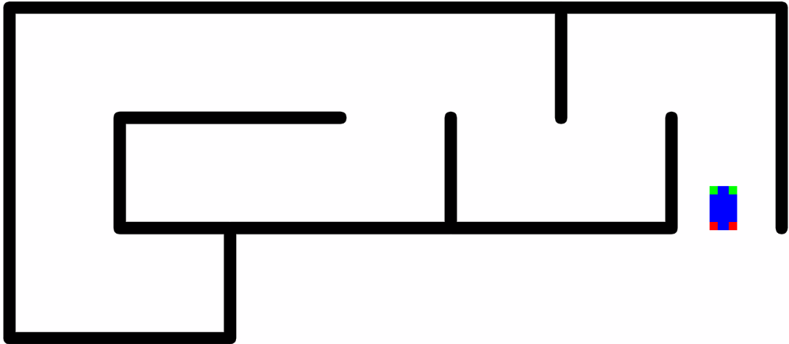
HTML5 JavaScript API Library
Reference: http://html5index.org/
Web communication protocols
Web Sockets
Messaging, and
WebRTC (Web Real-Time Communication)
Drag and Drop, Fullscreen
Canvas, SVG, WebGL
Animation Timing, Media, Pointer Lock, Web Audio
File API, File System API, Indexed DB, Offline, Web Storage Offline and Storage
Browser, Shadow DOM, Typed Arrays, Web Workers
DOM and JQuery
CSS Object Model, Selectors
ASU VIPLE Web Simulator:
https://venus.sod.asu.edu/VIPLE/Web2DSimulator/
Read text section 4.6.5 for a programming example. More examples in CSE446.

Slide 86
WebGL, Canvas, or SVG? Choose the right API
Canvas is the typical choice for most HTML5 games. It's simple and speedy, particularly for games with many objects. ASU VIPLE Web Simulator uses Canvas
SVG: While Canvas provides simplicity and speed, SVG provides flexibility. For example: Each graphic object is part of the DOM tree for flexible access, and each graphic object in the game can have one or more associated event handlers for process.
WebGL: If you’re already familiar with OpenGL, you can use WebGL for a simple 2D game. If you're not, this API is more complex than you need for a simple game.
https://msdn.microsoft.com/en-us/library/dn265058%28v=vs.85%29.aspx?f=255&MSPPError=-2147217396

Slide 87
What is XML Schema and Why?
Like DTD, XML Schema defines an XML vocabulary for expressing your data's business rules
XML Schema is a more powerful alternative to DTD that defines the structure (grammar) of an XML document. The advantages of the schema over DTD include:
DTD is not XML-based and requires separate tools for processing DTD documents, while XML Schema is XML-based. The same tools can be used for parsing and processing XML documents, as well as XML Schema documents.
XML Schema is extendable and reusable. One can easily add new types, restricting existing types, and combine existing schemas.
DTD is limited to string type of data. XML schema can define many different types similar to a typical programming language, such as integer, float, string, and structures.

Slide 88
XML Schema Definition (XSD)
In an XML document, the schema is introduced through an element with an opening tag <xsd:schema>, which is the root element, and
with a number of optional attributes, e.g., referring to the source and version:
<schema xmlns ="http://www.w3.org/2000/10/XMLSchema" version = "1.0">
This schema namespace includes elements and datatypes that can be used for constructing different schemas:
schema
element
complexType
sequence
boolean
integer
string

Slide 89
Types Defined in XML Schema W3C 2001
Forty-four (44) built-in types, in which 19 are simple (primitive) and 25 are derived complex types.
User can define further types of simple and complex
Complex types are defined using simple and complex types
Type inheritance: Extend one type from an existing type

Slide 90
Definition of New Simple Types
Use an element to define a new type with a name and an associated type
Use a single built-in type to define a new type
Use a namespace to tell where the element and type used come from.
<?xml version="1.0" encoding="UTF-8"?>
<xsd:schema xmlns:xsd=“http://www.w3.org/2001/XMLSchema”>
<xsd:element name="Title" type="xsd:string"/>
<xsd:element name="Author" type="xsd:string"/>
<xsd:element name=“Date" type="xsd:date"/>
<xsd:element name="ISBN" type="xsd:string"/>
<xsd:element name=“Publisher" type=“xsd:string "/>
</xsd:schema>
namespaces

Slide 91
Example: XML Schema of A Bookstore
root
<?xml version="1.0" encoding="UTF-8"?>
<xsd:schema xmlns:xsd="http://www.w3.org/2001/XMLSchema"
targetNamespace= "http://venus.sod.asu.edu/WSRepository/xml"
elementFormDefault="qualified" attributeFormDefault="unqualified">
<xsd:element name="Book">
<xsd:complexType>
<xsd:sequence>
<xsd:element name="Title" type="xsd:string"
minOccurs="1" maxOccurs="1"/>
<xsd:element name="Author" type="xsd:string"
minOccurs="1" maxOccurs="unbounded"/>
<xsd:element name="Year" type="xsd:integer"
minOccurs="0" maxOccurs="1"/>
<xsd:element name="ISBN" type="xsd:string"
minOccurs="0" maxOccurs="1"/>
</xsd:sequence>
</xsd:complexType>
</xsd:element>
<xsd:element name="Bookstore">
<xsd:complexType>
<xsd:sequence>
<xsd:element name="Book" minOccurs="1" maxOccurs="unbounded"/>
</xsd:sequence>
</xsd:complexType>
<xs:attribute name= “Address" type="xsd:string" use="required"/>
</xsd:element>
<xsd:element name= "First" type="xsd:string"/>
<xsd:element name= "Last" type="xsd:string"/>
</xsd:schema>
namespaces
complexType
complexType
simpleType

Slide 92
Definition of Complex Types
Use an element to define a new type with a name;
Use sub elements to define the components of the new type;
Specify the allowed number of occurrences of each component;
Use namespaces to tell where the element and types used come from;
Use different kinds of combination options.
Sequence
Choice
all

Slide 93
Definition of complexType
You can define the members of a complexType using three different options:
sequence: All members must appear in the given order
all: All members must appear (unless minOccurs= "0" ), but can be in any order
choice: Only one of the list members is allowed
<xsd:element name="Book">
<xsd:complexType>
<xsd: sequence >
<xsd:element name="Title" minOccurs="1" maxOccurs="1"/>
<xsd:element name="Author" minOccurs="1" maxOccurs="unbounded"/>
<xsd:element name=“Year" minOccurs= "0" maxOccurs="1"/>
<xsd:element name="ISBN" minOccurs= "0" maxOccurs="1"/>
</xsd: sequence >
</xsd:complexType>
all
all

Slide 94
Choice of complexType
<xsd:element name="Book">
<xsd:complexType>
<xsd:sequence>
<xsd:element name="Title" />
<xsd:element name="Author" />
<xsd:element name=“Year" />
<xsd:choice>
<xsd:element name="ISBN-10" />
<xsd:element name="ISBN-13" />
</xsd:choice>
</xsd:sequence>
</xsd:complexType>
</xsd:element name="Book">

Slide 95
Namespaces
A namespace is declared as an attribute of an element.
It binds a prefix name (qualifier) to a schema definition, and then uses that prefix wherever required;
It is not mandatory to declare namespaces at the root element; Namespaces could be declared at any element in the XML document;
The scope of a declared namespace applies to the entire content of that element;
Namespace can be overridden: An inner namespace declaration with the same prefix name (qualifier) will override the outer namespace.

Slide 96
Namespaces
schema
element
complexType
sequence
boolean
integer
string
<?xml version="1.0" encoding="UTF-8"?>
<xsd:schema
xmlns:xsd="http://www.w3.org/2001/XMLSchema"
targetNamespace="http://venus.sod.asu.edu/WSRepository/xml"
xmlns="http://venus.sod.asu.edu/WSRepository/xml/bookstore.xsd"
elementFormDefault="qualified"
attributeFormDefault="unqualified">
Inherit all names from XMLSchema, plus
types being defined in this schema
Bookstore
Book
Title
Author
Date
ISBN
Publisher
4 combinations
This is a directive to any instance documents which conform to this schema: Any elements used by the instance document must be namespace qualified. But the attributes do not need to be qualified
Define this namespace as the default namespace. The names in the default namespace do not need to be qualified

Slide 97
Target Namespace
http://www.w3.org/2001/XMLSchema
schema
element
complexType
sequence
boolean
integer
string
targetNamespace = "http://venus.sod.asu.edu/WSRepository/xml"
schema
element
complexType
sequence
boolean
integer
String
Bookstore
Book
Title
Author
Date
ISBN
Publisher
http://venus.sod.asu.edu/WSRepository/xml
merge
Bookstore
Book
Title
Author
Date
ISBN
Publisher

Slide 98
Default Namespace
It is painful to repeatedly qualify an element or attribute you wish to use from a namespace;
You can declare one default namespace;
Important: at any point in time, there can be one default namespace only;
Declaring a default namespace means that any element within the scope of the namespace will be qualified implicitly, if it is not already qualified explicitly using a prefix.
The name of the default namespace is simply xmlns
xmlns = "http://venus.sod.asu.edu/WSRepository/xml/"

Slide 99
Choice of the default namespace
<?xml version="1.0" encoding="UTF-8"?>
<schema xmlns="http://www.w3.org/2001/XMLSchema"
targetNamespace="http://venus.sod.asu.edu/WSRepository/xml/"
xmlns:bs="http://venus.sod.asu.edu/WSRepository/xml/bookstore.xsd"
elementFormDefault="qualified" attributeFormDefault="unqualified">
Define the XML Schema as the default namespace. The names in the default namespace do not need to be qualified
The bookstore namespace was the default, and it is no longer default now. The elements defined in it must be qualified by “bs”.

Slide 100
Example: XML Schema of A Bookstore
No default namespaces
<?xml version="1.0" encoding="UTF-8"?>
<xsd:schema xmlns:xsd="http://www.w3.org/2001/XMLSchema"
targetNamespace= "http://venus.sod.asu.edu/WSRepository/xml"
elementFormDefault="qualified" attributeFormDefault="unqualified">
<xsd:element name="Bookstore">
<xsd:complexType>
<xsd:sequence>
<xsd:element name="Book" minOccurs="1" maxOccurs="unbounded"/>
</xsd:sequence>
</xsd:complexType>
</xsd:element>
<xsd:element name="Book">
<xsd:complexType>
<xsd:sequence>
<xsd:element name="Title" type="xsd:string" minOccurs="1" maxOccurs="1"/>
<xsd:element name="Author" type="xsd:string" minOccurs="1" maxOccurs="unbounded"/>
<xsd:element name="Year" type="xsd:string" minOccurs="0" maxOccurs="1"/>
<xsd:element name="ISBN" type="xsd:string" minOccurs="0" maxOccurs="1"/>
<xsd:element name="Publisher" type="xsd:string" minOccurs="0" maxOccurs="1"/> </xsd:sequence>
</xsd:complexType>
</xsd:element>
<xsd:element name=“First" type="xsd:string"/>
<xsd:element name=“Last" type="xsd:string"/>
</xsd:schema>

Slide 101
Better Choice of Default Namespace
Default
namespace
<?xml version="1.0" encoding="UTF-8"?>
<schema xmlns="http://www.w3.org/2001/XMLSchema"
targetNamespace= "http://venus.sod.asu.edu/WSRepository/xml/"
xmlns:bs ="http://venus.sod.asu.edu/WSRepository/xml/bookstore.xsd"
elementFormDefault="qualified" attributeFormDefault="unqualified">
<element name="Bookstore">
<complexType>
<sequence>
<element name="Book" minOccurs="1" maxOccurs="unbounded"/>
</sequence>
</complexType>
</element>
<element name="Book">
<complexType>
<sequence>
<element name="Title" type="xsd:string" minOccurs="1" maxOccurs="1"/>
<element name="Author" type="xsd:string" minOccurs="1" maxOccurs="unbounded"/>
<element name="Year" type="xsd:string" minOccurs="0" maxOccurs="1"/>
<element name="ISBN" type="xsd:string" minOccurs="0" maxOccurs="1"/>
</sequence>
</complexType>
</element>
<element name=“First" type="string"/>
<element name=“Last" type="string"/>
<element name=“Size" type=“bs:DIN"/>
</schema>
Complex
Type
Complex
Type
Simple
Type

Slide 102
Using a Schema in an Instance
xmlns:
Default XML namespace
xsi:
XML Schema Instance
<?xml version="1.0"?>
<Bookstore xmlns ="http://venus.sod.asu.edu/WSRepository/xml/"
xmlns:bs ="http://venus.sod.asu.edu/WSRepository/xml/bookstore.xsd"
xmlns:xsi="http://www.w3.org/2001/XMLSchema-instance"
xsi:schemaLocation="http://venus.sod.asu.edu/WSRepository/xml/bookstore.xsd">
<Book>
<Title>Introduction to Programming Languages</Title>
<Author>Yinong Chen</Author>
<Author>W.T. Tsai</Author>
<Year>2014</Year>
<ISBN>978-1-4652-4700-1</ISBN>
<Size>10x8</Size>
</Book> ...
</Bookstore>
xsi
is used to define the location

Slide 103
Default Namespace and Attributes
Prefixed namespace and the default namespace do not apply to attributes within the element;
To apply a namespace to an attribute, the attribute must be explicitly qualified.
In the example below, the attribute "edition" has no namespace, whereas the attribute "cover" is associated with the namespace bs.
Default namespace
<Book xmlns = "http://venus.sod.asu.edu/WSRepository/xml/">
<Title bs: cover = "paperback" > Programming Languages </Title>
<Author>Yinong Chen</Author>
<Author>W.T. Tsai</Author>
<Year edition = "2" >2006</Year>
<ISBN>0-7575-2974-7</ISBN>
</Book>

Slide 104
Summary of XML Schema Example
schema element
complexType sequence
choice all boolean
integer string …
XML Schema Namespace
http://www.w3.org/2001/XMLSchema
schema element
complexType sequence
choice all boolean
integer string …
vocabulary
<?xml version="1.0" encoding="UTF-8"?>
<schema xmlns="http://www.w3.org/2001/XMLSchema"
targetNamespace= "http://venus.sod.asu.edu/WSRepository/xml/"
…
<element name="bookstore">
…
</element>
<element name="Book">
…
</element>
User-Defined Schema
<bookstore …>
<Book>
<Title>SOC</Title>
…
</Book>
</bookstore>
element boolean integer,
bookstore Book Title
Author Year ISBN
Publisher
Instance
vocabulary

Slide 105
Multiple Levels of Validation
bookstore.xsd
Schema doc
User defined
XMLSchema.xsd
schema-for-schemas
W3C Standard
bookstore.xml
User defined
Validate
Validate
The xml instance document
conforms with the
rules described
in bookstore.xsd and
in W3C standard
bookstore.xsd
is a valid schema
document, i.e., it
conforms with the rules
described in the
schema-for-
schemas
http://validator.w3.org/

Slide 106
Case Study http://www.nws.noaa.gov/mdl/XML/Design/MDL_XML_Design.pdf
Digital Weather Markup Language (DWML)
DWML is an XML language for supporting the exchange of the National Weather Service’s (NWS) National Digital Forecast Database (NDFD) data;
Also used in other environmental science applications. DWML site provides a definition of DWML types based on restrictions.
Weather forecast services: http://www.weather.gov/, Enter City, State names
7-day forecast data downloadable in the format of http://forecast.weather.gov/MapClick.php?lat=33.43417&lon=-112.05111&FcstType=dwml

Slide 107
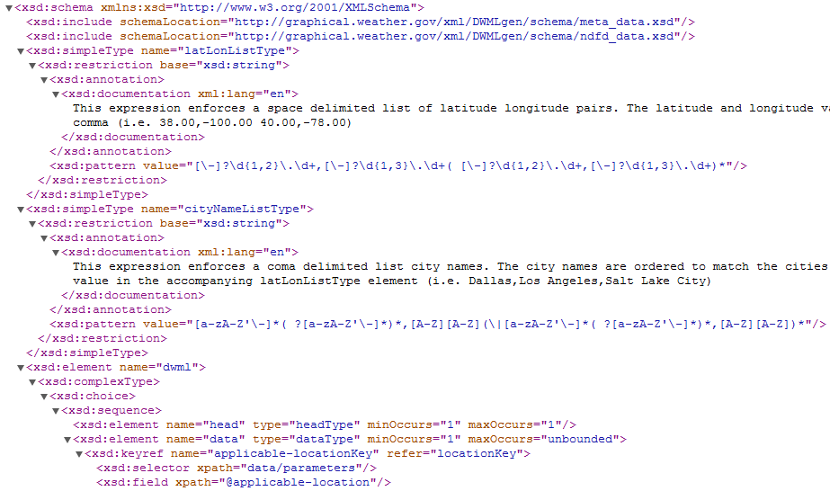
DWML XML Schema http://graphical.weather.gov/xml/DWMLgen/schema/DWML.xsd
Namespaces

Slide 108
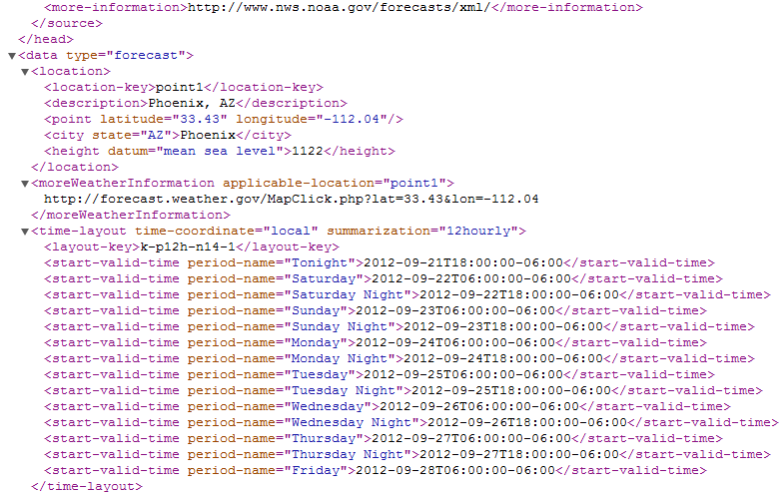
Instance of the Schema: Phoenix Seven-Day Weather Data Download http://forecast.weather.gov/MapClick.php?lat=33.43417&lon=-112.05111&FcstType=dwml

Slide 109
To Get Forecast from the URL http://forecast.weather.gov/MapClick.php?lat=33.43417&lon=-112.05111&FcstType=dwml
// The operation takes latitude and longitude as inputs, and obtain 7-day forecast
public void GetForecast(string latitude, string longitude) {
// form the URI
UriBuilder fullUri = new UriBuilder("http://forecast.weather.gov/MapClick.php");
fullUri.Query = "lat=" + latitude + "&lon=" + longitude + "&FcstType=dwml";
// initialize a new WebRequest: RESTful style service access
HttpWebRequest forecastRequest = (HttpWebRequest)WebRequest.Create(fullUri.Uri);
// set up the state object for the async request
ForecastUpdateState forecastState = new ForecastUpdateState();
forecastState.AsyncRequest = forecastRequest;
// start the asynchronous request
forecastRequest.BeginGetResponse(
new AsyncCallback(HandleForecastResponse), forecastState);
}

Slide 110
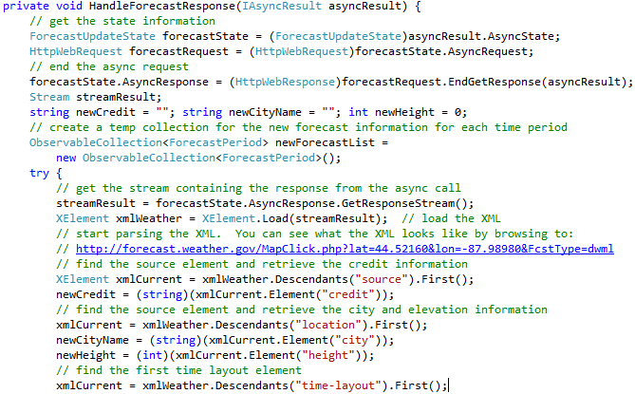
Process the Forecast Response (XML File)
Asynchronous invocation
Read Text 10.4.5: LINQ to XML Processing

Slide 111
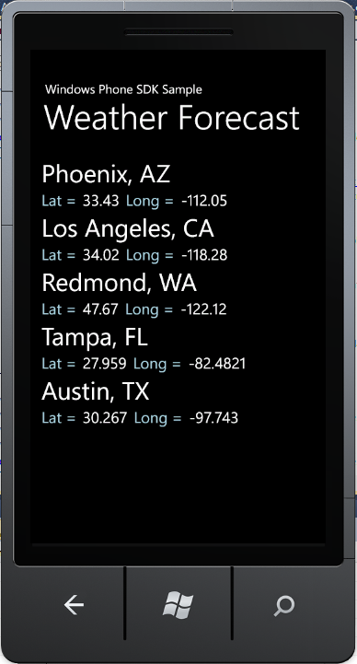
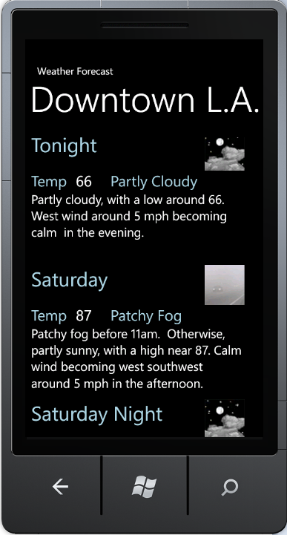
Extract and Display the Weather Info

Slide 112
Validation

Slide 113
XML Validation Using DTD and XSD
http://validator.w3.org/
XmlSchemaSet
XMLReaderSettings
XMLReader
User defined
bookstore.xsd
bookstore.dtd
bookstore.xml
User defined
Validate
The xml instance document
conforms with the
rules described
in bookstore.xsd or
bookstore.dtd

Slide 114
Validation Classes in .Net Framework
Three classes are used, and they support both DTD and XSD:
XmlSchemaSet, XMLReaderSettings, XMLReader for Validation
Use XmlSchemaSet object to hold the schemas
Link the schema set to XMLReaderSettings object
Use XmlReader to create a reader object that associates the XML file to be validated with the XMLReaderSettings object
XmlSchemaSet
to add schemas
XmlReader
Settings
XmlReader
XML Reader.Create
settings
XML File
Reader object

Slide 115
Using XmlSchemaSet Class to add schemas
using System; using System.Xml;
using System.Xml.Schema; using System.IO;
public class Sample {
public static void Main() {
// Create the XmlSchemaSet class.
XmlSchemaSet sc = new XmlSchemaSet();
// Add the schema to the collection before performing validation
sc.Add(null, "http://venus.sod.asu.edu/WSRepository/xml/Courses.xsd");
// Define the validation settings.
XmlReaderSettings settings = new XmlReaderSettings();
settings.ValidationType = ValidationType.Schema;
settings.Schemas = sc; // Association
Do not list .xsd file as a namespace of the .xml file.
Schema definition file
You could choose .DTD
settings

Slide 116
Using XmlReader.Create Method
Add an event handler
settings.ValidationEventHandler += new ValidationEventHandler(ValidationCallBack);
// Create the XmlReader object.
XmlReader reader = XmlReader.Create("http://venus.sod.asu.edu/WSRepository/xml/Courses.xml", settings);
// Parse the file.
while (reader.Read()) ; // will call event handler if invalid
Console.WriteLine("The XML file validation has completed");
}
// Display any validation errors.
private static void ValidationCallBack(object sender, ValidationEventArgs e)
{
Console.WriteLine("Validation Error: {0}", e.Message);
}
}
xmlCoursesWithErrors.xml
① XML instance file
② namespaces

Slide 117
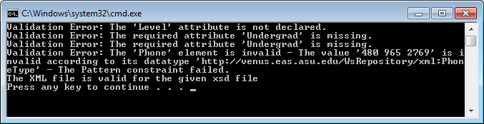

Output with Errors and Without Errors
CoursesWithErrors.xml
Courses.xsd
Courses.xml
Courses.xsd

Slide 118
XSL, XSLT CSS, XHTML

Slide 119
XSL: Extensible Stylesheet Language
http://www.w3.org/TR/xsl/
HTML: "Format without Structure"
Typesetting language
Not extensible
XML: "Structure Without Format"
Defines "elements" using "tags"
Creates hierarchical structure of information set
XSL is a set of language technologies for defining XML document transformation and presentation
XSLT: XSL Transformations
XSL Formatting Objects or XSL-FO, is a markup language for XML document formatting which is most often used for generating PDFs
XSLT is a built-in component in ESB Enterprise Service Bus

Slide 120

XSL: XSLT and XSL-FO
PDF
An XML document with a different structure
XSL-FO
Special formats
XML document
XSLT
XSLT
name | phone | ID
John | 4801234567 | 1234567890
Joe | 6022345678 | 9876543210
name | ID | phone
John | 1234567890 | 4801234567
Joe | 9876543210 | 6022345678

Slide 121
XSLT: XSL Transformations
XSL is a declarative (functional) programming language with constructs such as
if
choose-when-otherwise (switch)
for-each
XSL is Turing complete in theory, and thus can be used for programming any task, but limited in practice
Creates formatted output
<xsl:choose>
<xsl:when condition">
html statements
</xsl:when>
<xsl:when test="condition">
html statements
</xsl:when>
<xsl:otherwise>
html statements
</xsl:otherwise>
</xsl:choose>
Transforms one XML structure to another
Transforms XML to HTML: Adding HTML Format to XML Structure

Slide 122
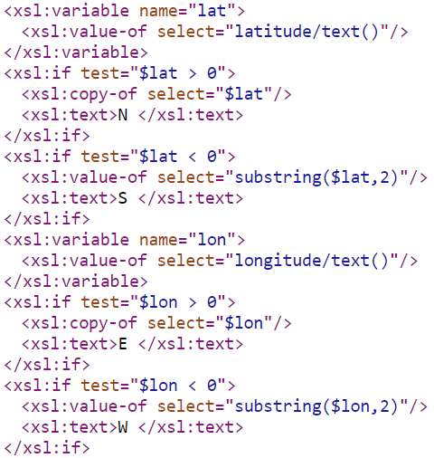
Weather.xsl that defines: variable and if
https://w1.weather.gov/xml/current_obs/latest_ob.xsl

Slide 123
XML Transformations Using a Stylesheet
Courses.xml
Courses.html
XSLT
Processor
Courses.xsl
CoursesT.xml

Slide 124
Converting XML to HTML on Client (Browser)
Put Courses.xml and Courses.xsl into a Website, e.g., in
C:\Inetpub\wwwroot (IIS virtual directory); or
http://venus.sod.asu.edu/WSRepository/xml/Courses.xml
Using the browser to convert the xml file into html by:
Test Courses.xml, with and without this line:
<?xml-stylesheet type="text/xsl" href="Courses.xsl"?>
and open the file by typing the address:
C:\Inetpub\wwwroot\Courses.xml
Repeat by adding the line
<?xml-stylesheet type="text/xsl" href="Courses.xsl"?>

Slide 125
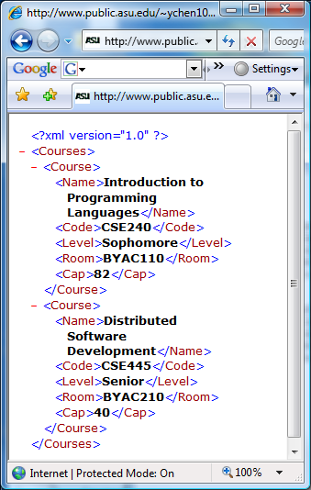
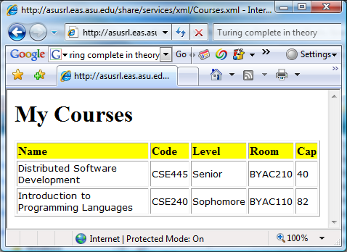
Converting XML to HTML on Client (Browser) Example: Courses.xml
<?xml version="1.0"?>
<Courses>
<Course>
<Name>Introduction to Programming Languages</Name>
<Code>CSE240</Code>
<Level>Sophomore</Level>
<Room>BYAC110</Room>
<Cap>82</Cap>
</Course>
<Course>
<Name>Distributed Software Development</Name>
<Code>CSE445</Code>
<Level>Senior</Level>
<Room>BYAC210</Room>
<Cap>40</Cap>
</Course>
</Courses>
<?xml-stylesheet type="text/xsl" href="Courses.xsl"?>

Slide 126
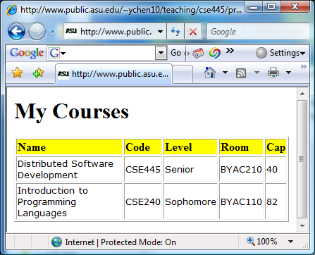


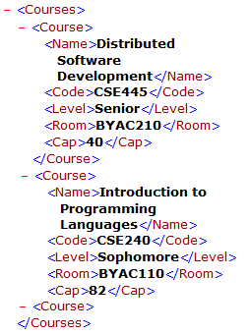
Courses.xsl that defines: for-each
<?xml version="1.0"?>
<xsl:stylesheet xmlns:xsl="http://www.w3.org/1999/XSL/Transform" version="1.0">
<xsl:template match="/">
<html> <body>
<h1>My Courses</h1>
<table border="1">
<tr bgcolor="yellow">
<td><b>Name </b></td>
<td><b>Code</b></td>
<td><b>Level</b></td>
<td><b>Room</b></td>
<td><b>Cap</b></td>
</tr>
<xsl:for-each select="Courses/Course">
<xsl:sort select="Name" />
<tr style="font-size: 10pt; font-family: verdana">
<td><xsl:value-of select="Name"/></td>
<td><xsl:value-of select="Code"/></td>
<td><xsl:value-of select="Level"/></td>
<td><xsl:value-of select="Room"/></td>
<td><xsl:value-of select="Cap"/></td>
</tr>
</xsl:for-each>
</table>
</body> </html>
</xsl:template>
</xsl:stylesheet>
Print header
Print header
Print header
Print contents

Slide 127
Another Example: Fallacies.xml: The file to be displayed
<?xml version="1.0"?>
<Fallacies>
<Fallacy>
<Number>1</Number>
<Text>The network is reliable.</Text>
<Author>Bill Joy and Tom Lyon</Author>
</Fallacy>
<Fallacy>
<Number>2</Number>
<Text>Latency is zero.</Text>
<Author>Bill Joy and Tom Lyon</Author>
</Fallacy>
<Fallacy>
<Number>3</Number>
<Text>Bandwidth is infinite.</Text>
<Author>Bill Joy and Tom Lyon</Author>
</Fallacy>
<Fallacy>
<Number>4</Number>
<Text>The network is secure.</Text>
<Author>Bill Joy and Tom Lyon</Author>
</Fallacy>
<Fallacy>
<Number>5</Number>
<Text>Topology does not change.</Text>
<Author>Peter Deutsch</Author>
</Fallacy>
<Fallacy>
<Number>6</Number>
<Text>There is one administrator.</Text>
<Author>Peter Deutsch</Author>
</Fallacy>
<Fallacy>
<Number>7</Number>
<Text>Transport cost is zero.</Text>
<Author>Peter Deutsch</Author>
</Fallacy>
<Fallacy>
<Number>8</Number>
<Text>The network is homogeneous.</Text>
<Author>James Gosling</Author>
</Fallacy>
</Fallacies>

Slide 128
Fallacies.xsl: The stylesheet file
<?xml version="1.0"?>
<xsl:stylesheet xmlns:xsl="http://www.w3.org/1999/XSL/Transform" version="1.0">
<xsl:template match="/">
<html> <body>
<h1 style="background-color: blue; color: white; font-size: 18pt; text-align: center">
Eight Fallacies in Distributed Computing
</h1>
<table border="1">
<tr style="font-size: 12pt; font-family: verdana; font-weight: bold">
<td style="text-align: center">Number</td>
<td style="text-align: center">Fallacy</td>
<td style="text-align: center">Author</td>
</tr>
<xsl:for-each select="Fallacies/Fallacy">
<xsl:sort select="Number" />
<tr style="font-size: 12pt; font-family: verdana">
<td><i><xsl:value-of select="Number"/></i></td>
<td><xsl:value-of select="Text"/></td>
<td><xsl:value-of select="Author"/></td>
</tr>
</xsl:for-each>
</table>
</body> </html>
</xsl:template>
</xsl:stylesheet>
Print header
Print contents

Slide 129
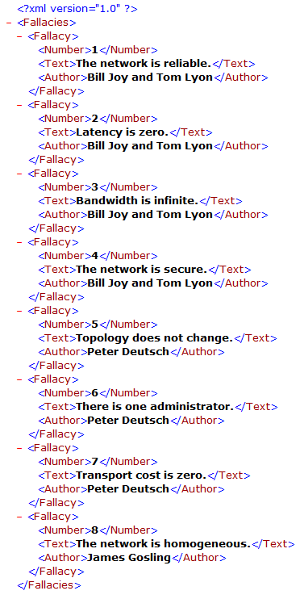
Without using the XSL File

Slide 130
Demonstration using Client Conversion
Put the two Files into a IIS virtual Directory
Using client side conversion: add a line of directive:
<?xml-stylesheet type="text/xsl" href="Fallacies.xsl"?>
after the first of prolog.
Type the address in your browser:
C:\Inetpub\wwwroot\Fallacies.xml
You can test it on your Windows IIS
OR, put them in any remote Web server, e.g.:
http://venus.sod.asu.edu/WSRepository/xml/Fallacies.xml

Slide 131
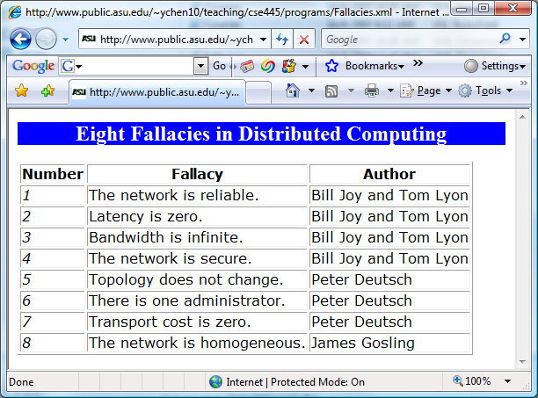
The Display of the Page

Slide 132
Converting XML to HTML on Server Side
Two potential problems with the client-side conversion:
Need to modify the xml file (to reference an xsl file)
Browser dependent
Not all browsers have an embedded XSLT processor;
Not all versions of the browser has an embedded XSLT processor.
To ensure that your page can be displayed properly, you need to write a program the conversion on the server side: Writing a .aspx file using a program to do the conversion.

Slide 133
Members of XslCompiledTransform Class
Method Name | Description
Equals | Overloaded. Determines whether two Object instances are equal. (inherited from Object)
GetHashCode | Serves as a hash function for a particular type. (inherited from Object)
GetType | Gets the Type of the current instance. (inherited from Object)
Load | Overloaded. Loads the XSLT style sheet, including style sheets referenced in xsl:include and xsl:import elements.
ReferenceEquals | Determines whether the specified Object instances are the same instance. (inherited from Object)
ToString | Returns a String that represents the current Object. (inherited from Object)
Transform | Overloaded. Transforms the XML data using the loaded XSLT style sheet.

Slide 134
Do it in C# in Console: Translate XML into html
Command line input: Fallacies.xml Fallacies.xsl
class MyXSLTApp {
static void Main(string[ ] args) {
if (args.Length < 2) {
Console.WriteLine(“Error: Files required not found");
return;
}
try {
XPathDocument doc = new XPathDocument(args[0]);
XslCompiledTransform xt = new XslCompiledTransform();
xt.Load(args[1]);
xt.Transform(doc, null, Console.Out);
}
catch (Exception ex) {
Console.WriteLine(ex.Message);
}
string x = Console.ReadLine();
}
}

Slide 135
Do it in C#: How to do it step by step?
Create a C# Console Application
Copy and Paste the C# code into the application
Build/Compile your program
Choose Visual Studio menu “Project” -> “Properties…”
Click on Debug -> Command Arguments
Enter Fallacies.xml Fallacies.xsl files as the command line arguments (See next page)
Browse to the Working directory where your Fallacies.xml and Fallacies.xsl files are located
Run the program
The html file will be generated (see following page).

Slide 136
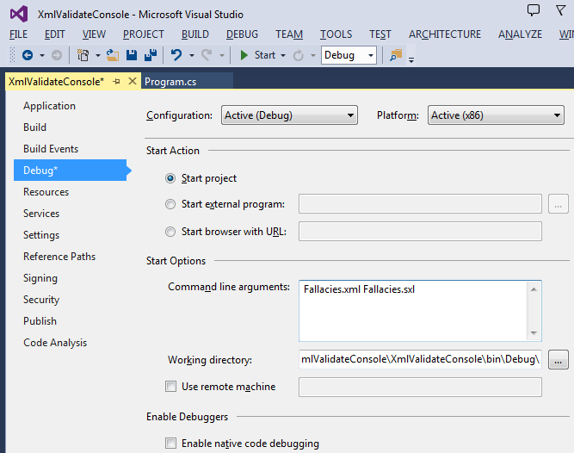
Project → Properties … Setting Up Command Line Input

Slide 137
The output of the program: html file
<html>
<body>
<h1 style="background-color: blue; color: white; font-size: 18pt; text-align: center">
Eight Fallacies in Distributed Computing
</h1>
<table border="1">
<tr style="font-size: 12pt; font-family: verdana; font-weight: bold">
<td style="text-align: center">Number</td>
<td style="text-align: center">Fallacy</td>
<td style="text-align: center">Author</td>
</tr>
<tr style="font-size: 12pt; font-family: verdana">
<td>
<i>1</i>
</td>
<td>The network is reliable.</td>
<td>Bill Joy and Tom Lyon</td>
</tr>
<tr style="font-size: 12pt; font-family: verdana">
<td>
<i>2</i>
</td>
<td>Latency is zero.</td>
<td>Bill Joy and Tom Lyon</td>
</tr>
<tr style="font-size: 12pt; font-family: verdana">
<td>
<i>3</i>
</td>
<td>Bandwidth is infinite.</td>
<td>Bill Joy and Tom Lyon</td>
</tr>
<tr style="font-size: 12pt; font-family: verdana">
<td>
<i>4</i>
</td>
<td>The network is secure.</td>
<td>Bill Joy and Tom Lyon</td>
</tr>
<tr style="font-size: 12pt; font-family: verdana">
<td>
<i>5</i>
</td>
<td>Topology does not change.</td>
<td>Peter Deutsch</td>
</tr>
<tr style="font-size: 12pt; font-family: verdana">
<td>
<i>6</i>
</td>
<td>There is one administrator.</td>
<td>Peter Deutsch</td>
</tr>
<tr style="font-size: 12pt; font-family: verdana">
<td>
<i>7</i>
</td>
<td>Transport cost is zero.</td>
<td>Peter Deutsch</td>
</tr>
<tr style="font-size: 12pt; font-family: verdana">
<td>
<i>8</i>
</td>
<td>The network is homogeneous.</td>
<td>James Gosling</td>
</tr>
</table>
</body>
</html>

Slide 138
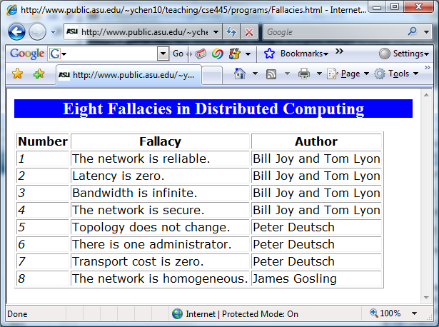
Put this html file into a Website
http://venus.sod.asu.edu/WSRepository/xml/Fallacies.html

Slide 139
Web Application: Embed C# Code in Fallacies.aspx
<%@ Page Language="C#" %>
<%@ Import Namespace="System.Xml.XPath" %>
<%@ Import Namespace="System.Xml.Xsl" %>
<%
XPathDocument doc =
new XPathDocument (Server.MapPath ("Fallacies.xml"));
XslCompiledTransform xt = new XslCompiledTransform();
xt.Load (Server.MapPath ("Fallacies.xsl"));
xt.Transform(doc, null, Response.OutputStream);
%>
Send the return value as an html stream to Web browser.

Slide 140
CSS: Cascading Style Sheets and its use in HTML and XML
In HTML, within an element tag: <link REL="STYLESHEET" TYPE="text/css" HREF="UrlOfCssStyleSheet">
In XML: As an Processing Information (PI) the prologue of an XML document: <?xml-stylesheet href="UrlOfCssStyleSheet" type="text/css"?>
Example (http://www.w3.org/Style/styling-XML.en.html):
<?xml-stylesheet href="common.css"?>
<?xml-stylesheet href="modern.css" title="Modern" media="screen"
type="text/css"?>
<?xml-stylesheet href="classic.css" alternate="yes" title="Classic"
media="screen, print" type="text/css"?>

Slide 141
CSS Language Rules
Element selected for applying the style
body
{
font-family: Arial;
color: blue;
background: yellow;
margin: 8px;
}
Style for the element
Attribute
Value

Slide 142
Example
common.css
HTML:
body
{
font-family: Tahoma, Arial, sans-serif;
font-size: 14px;
color: blue;
background: yellow;
margin: 8px;
}
h1 {
font-size: 18px;
margin-top: 14px;
margin-bottom: 6px;
border-bottom: 2px solid black
}
<link href=“common.css”
rel=“stylesheet”
type=“text/css” />
<body>
<h1>First Level Heading</h1>
One evening, just as he was getting
his flute ready and his musicians were assembled, an officer brought
him a list of the strangers who had arrived.
<h2>Second Level Heading</h2>
A new paragraph here.
</body>

Slide 143
CSS Application Example in XML Files http://www.w3.org/Style/styling-XML.en.html
Define multiple CSS files to switch the view of the page
<?xml-stylesheet href="common.css"?>
<?xml-stylesheet href="modern.css" title="Modern" media="screen"
type="text/css"?>
<?xml-stylesheet href="classic.css" alternate="yes" title="Classic"
media="screen, print" type="text/css"?>
<ARTICLE>
<HEADLINE> Fredrick the Great meets Bach </HEADLINE>
<AUTHOR>Johann Nikolaus Forkel</AUTHOR>
<PARA> One evening, just as he was getting his
<INSTRUMENT>flute</INSTRUMENT>
ready and his musicians were assembled, an officer brought him
a list of the strangers who had arrived.
</PARA>
</ARTICLE>
Define styles for the elements in .css file

Slide 144
What is XHTML (Extensible HTML)?
Problems with HTML:
It has a fixed set of tags, and thus is not extensible;
Many browser-specific tags are added.
How can these problems be addressed?
Add a document type definition file (DTD) or XSD schema
XHTML allows three different ways to add a DTD file
Strict DTD: Enforce the structure by restricting to those tags defined in the DTD;
Transitional DTD: Allow all the depreciated features/tags to be migrated into the new page;
Frameset DTD: Same as Transitional DTD, but replaced the <body> with the <frame>, which allows developers to share the frames in multiple pages.

Slide 145
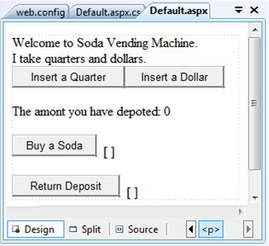
Application of XHTML in ASP .Net
<%@ Page Language="C#" AutoEventWireup="true" CodeFile="Default.aspx.cs" Inherits="_Default" %>
<!DOCTYPE html PUBLIC "-//W3C//DTD XHTML 1.0 Transitional//EN" "http://www.w3.org/TR/xhtml1/DTD/xhtml1-transitional.dtd">
<html xmlns="http://www.w3.org/1999/xhtml">
<head runat="server">
<title>Vending Machine</title>
</head>
<body>
<form id="form1" runat="server">
<div>
Welcome to Soda Vending Machine. <br />
I take quarters and dollars.<br />
</div>
<asp:Button ID="Button1" runat="server" onclick="Button1_Click"
Text="Insert a Quarter" />
<asp:Button ID="Button2" runat="server" onclick="Button2_Click"
Text="Insert a Dollar" />
<p>
The amont you have depoted:
<asp:Label ID="lblAmount" runat="server" Text="0"></asp:Label>
</p>
<asp:Button ID="btnSoda" runat="server" onclick="Button3_Click"
Text="Buy a Soda" />
<asp:Label ID="lblSoda" runat="server" Text="[ ]"></asp:Label> <br />
<br />
<asp:Button ID="btnRtn" runat="server" onclick="Button4_Click"
Text="Return Deposit" />
<asp:Label ID="lblRtn" runat="server" Text="[ ]"></asp:Label>
<br />
</form>
</body>
</html>

Slide 146
Development of Web Presentation Languages
1991 HTML
1994 HTML 2
1996 CSS 1 + JavaScript
1997 HTML 4
1998 CSS 2
2000 XHTML
2005 AJAX
2008 XAML
2009 HTML5
Animation can be programmed
JavaScript / JQuery
= XHTML + CSS + AJAX + Silverlight
= HTML + CSS + JavaScript / JQuery
Animation can be programmed

