Slide 1
Containerization
SE489: DevOps Engineering

Slide 2
Outline
Containerization?
Why we need Docker?
What is Docker?
Docker Example
Docker Case Study
Docker Components

Slide 3
Containerization?

Slide 4
Containerization?
Containerization entails placing a software component and its environment, dependencies, and configuration, into an isolated unit called a container.
This makes it possible to deploy an application consistently on any computing environment, whether on-premises or cloud-based.
A container is a standardized unit of software abstracted from the operating system.
It contains code and all its dependencies that can be transferred and run without changing one environment to another.

Slide 5
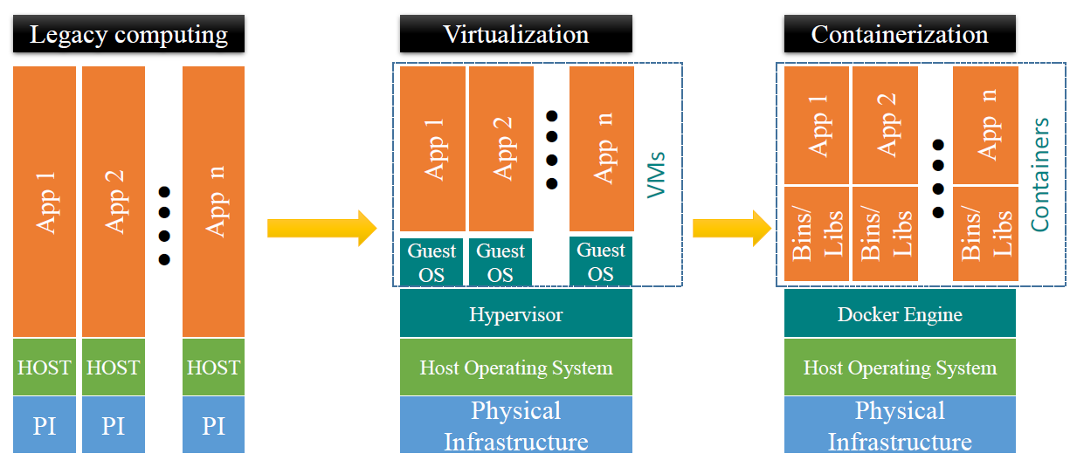
Containerization
Containerized apps share Host OS’s kernel to execute work
Workload in Containers use Host OS kernel
What we need
Lightweight
Require less memory space
Fast lunch time
better resource utilization
1000s of containers can be loaded onto a Host

Slide 6
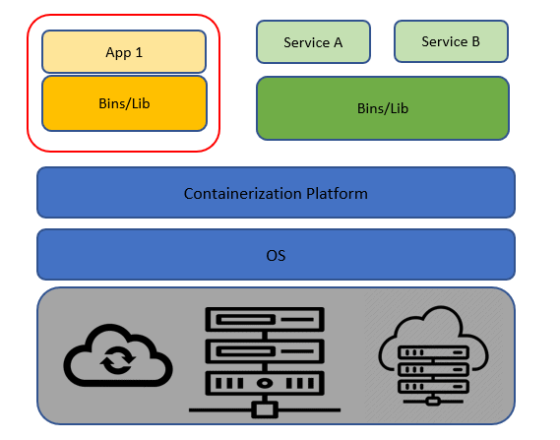
Containerization

Slide 7
Containers
What is a container?
Containers are lightweight packages of your application code together with dependencies such as specific versions of programming language runtimes and libraries required to run your software services.
Containers make it easy to share CPU, memory, storage, and network resources at the operating systems level and offer a logical packaging mechanism in which applications can be abstracted from the environment in which they actually run.

Slide 8
Containerization Benefits
Ease of Deployment
Containers are built and deployed from a local image in only a few seconds.
Scalability and Flexibility
Containerized applications are perfect for scaling both up and down.
Consistent
Since containers are standardized units, they will work in any provided environment.

Slide 9
Containerization Benefits
Portability
Not tied to or dependent upon the host operating system.
Agility
Capability to manage various kinds of changes quickly during the development process.
Security
due to isolation of applications.

Slide 10
Why Do We Need Containers?
The main advantage of containers is that they are lightweight and portable and thus helps the developer a lot in configuring and deploying their application.
There are many reasons for using Containers but only some of them are listed below:
Lightweight: Share the machine OS, they don’t need a full OS instance per application.
Portable: A package having all their dependencies with them, write the software once and run across different computing environments.
Supports CI/CD: Deployment portability/consistency across platforms and their small size.
Improves utilization: Enable developers and operators to improve CPU and memory utilization.

Slide 11
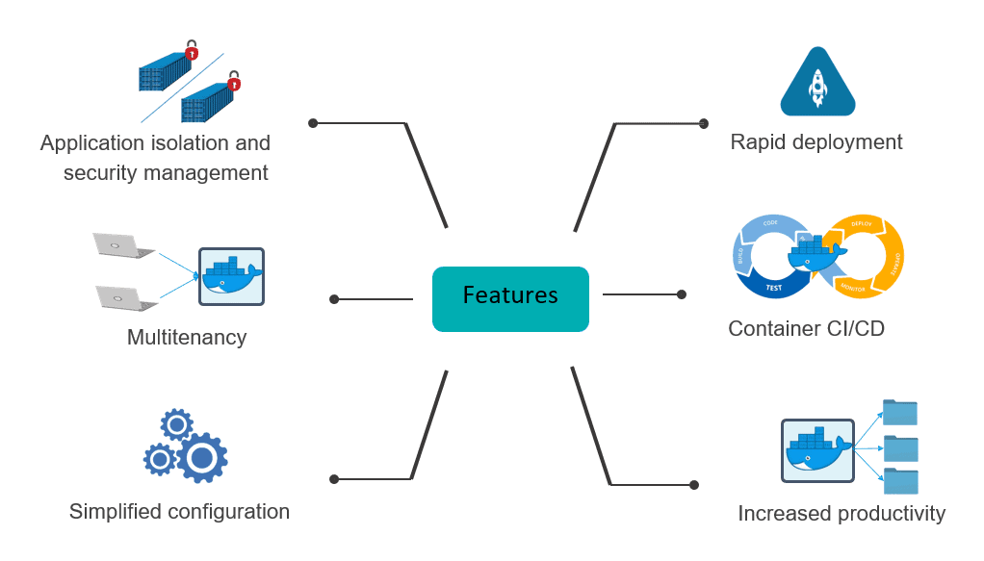
Common Features of Containers

Slide 12
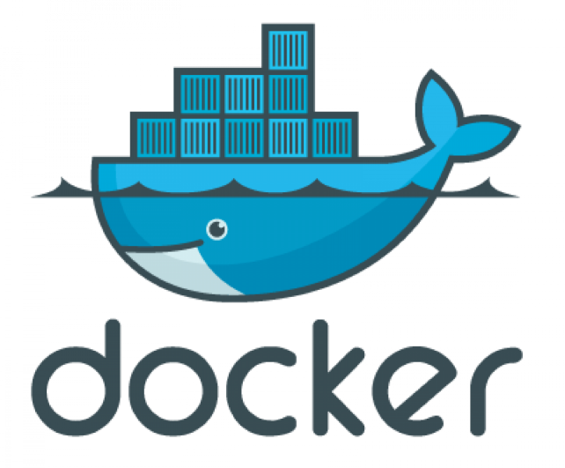
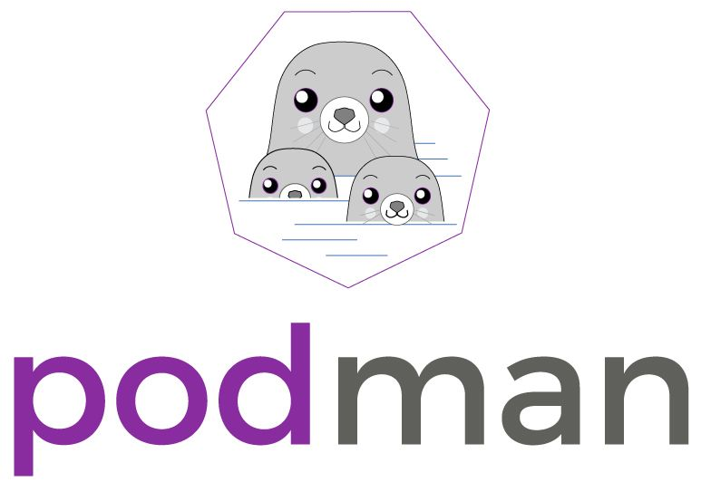


Container Tools

Slide 13
Why we need Docker?

Slide 14



Problems before Docker
An application works in developer’s machine but not in testing or production
This is due to difference in computing environment between Dev, Test, and Prod
Code works on my machine
There is some problem with the code
Development
Production

Slide 15
Problems before Docker
The idea behind microservices is that some types of applications becomes easier to build and maintain when they are broken into smaller, composable pieces that work together
Account Service
Account DB
Online Shopping Service
Product catalog
Product DB
Imagine an online shop with separate microservices for user accounts, product-catalog order processing, and shopping cart
Cart Service
Cart DB
Order Service
Order DB

Slide 16
Problems before Docker
Developing an application requires starting several microservices in one machine.
If you are starting five of those services, you are require five virtual machines.
Virtual Machines for starting multiple services
Host Machine

Slide 17
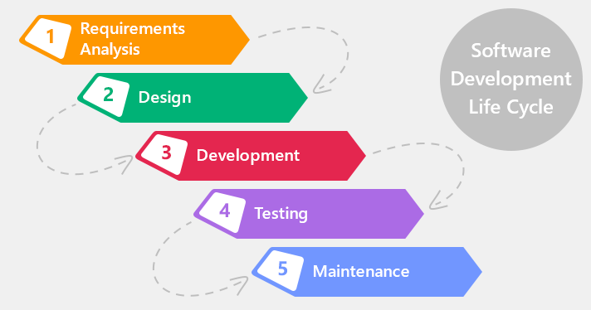
How Docker Solves these problems
You can run several microservices in the same VM by running various Docker containers for each microservice
Provide a consistent computing environment throughout the whole SDLC
Docker Containers
Virtual Machine
Host Machine

Slide 18
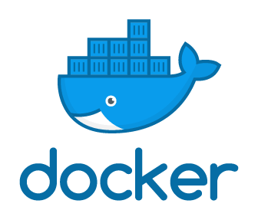
What is Docker?

Slide 19
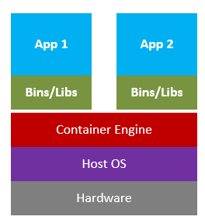
What is Docker?
Docker is a tool designed to make it easier to create, deploy, and run applications by using containers.
Docker contains are lightweight alternatives to Virtual Machines and it used the host OS.
You don’t have to pre-allocate any RAM in containers.

Slide 20
Docker in a Nutshell
Docker files builds a Docker image and that image contains all the project’s code
You can run that image to create as many Docker containers as you want
This image can be uploaded on Docker hub, from Docker hub any one can pull the image and build a container.
Container
Staging Server
Container
Docker File
Docker Hub
Image
Container
Docker Image
Docker Container
Container
Production Server
Container
Virtual Machine
Image
Container

Slide 21
Docker Example

Slide 22

Docker Example
Docker File
Git Repo
Jenkins Server
Testing
Complex requirements for a microservice are written in easy to write Docker file
Push the code to Git Repo
Staging
Production
Create complex requirements for a microservice within an easy- to-write Docker File
Push the code the Git Repository
CI server pull it down and build the exact environment that will be used in production to run the test suite without needing to configure the CI server at all.
Deploy it out to a staging environment
Roll exactly what you had in development, testing, and staging into production

Slide 23
Docker Case Study

Slide 24
Docker Case Study (Indiana University)
Problem Statement
1
2
Their environment was optimized for their legacy Java-based applications
VM
Custom Scripts
VM
VM
Applications are deployed in the VMs using scripts

Slide 25
Docker Case Study (Indiana University)
The university wanted to improve the way they architect applications, by moving to microservices based architecture
Problem Statement
3
UI
UI
Business Logic
Microservice
Microservice
Microservice
Data Access Layer
Database
Database
Database
Database
Monolithic Architecture
Microservice Architecture

Slide 26

Docker Case Study (Indiana University)
Security was needed for student’s data
Problem Statement
4

Slide 27
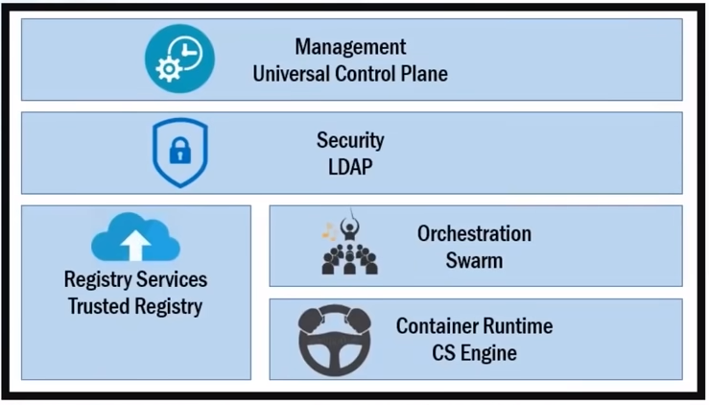
Docker Case Study (Indiana University)
Solution: Docker Data Center (DDC)

Slide 28
Docker Case Study (Indiana University)
Solution: Docker Data Center (DDC)
Helps in managing whole cluster from one place. Servers are deployed using UCP web UI, using Docker images that are stored in DTR
Host A
IT operations teams leverage Universal Control Plane to provision Docker installed software on hosts, and then deploy their applications without having to do a bunch of manual steps to setup all their infrastructure
Docker Trusted Registry
UCP Web UI
Host B
Host C
Stores the Docker images
The role-based access controls within DDC allows them to define the level of access their user have i.e. like read-only access to their containers in production

Slide 29
Docker Components

Slide 30
Docker Architecture

Slide 31
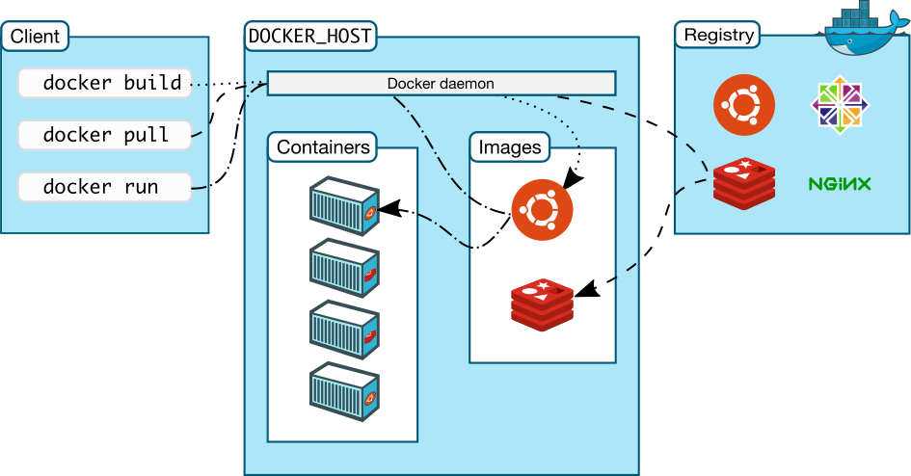
Docker Components
Docker Client
Command Line Interface (CLI)
Docker File
Text file instructions
Image
Hierarchies of files built from Docker File
Container
Running instances of an image
Registry
Image repository

Slide 32

Docker Registry
Docker Registry is a storage component for Docker images
We can store the images in either Public/Private repositories
Docker Hub is Docker’s very own cloud repository
Why use Docker Registries?
Control where your images are being stored
Integrate image storage with your in-house development workflow

Slide 33
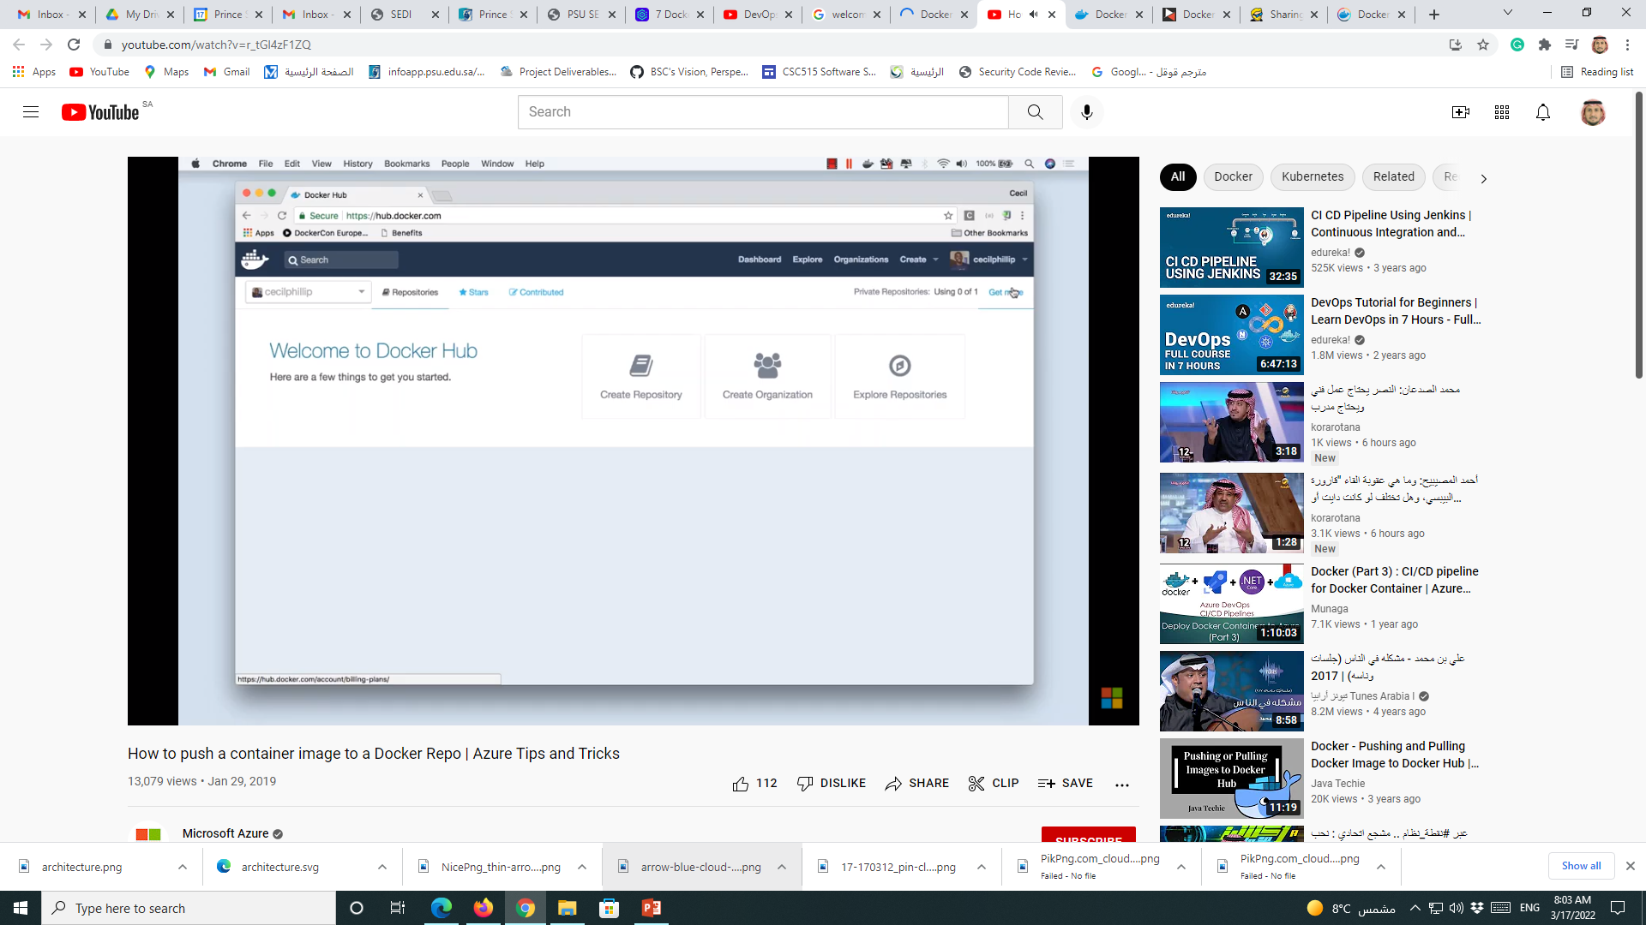
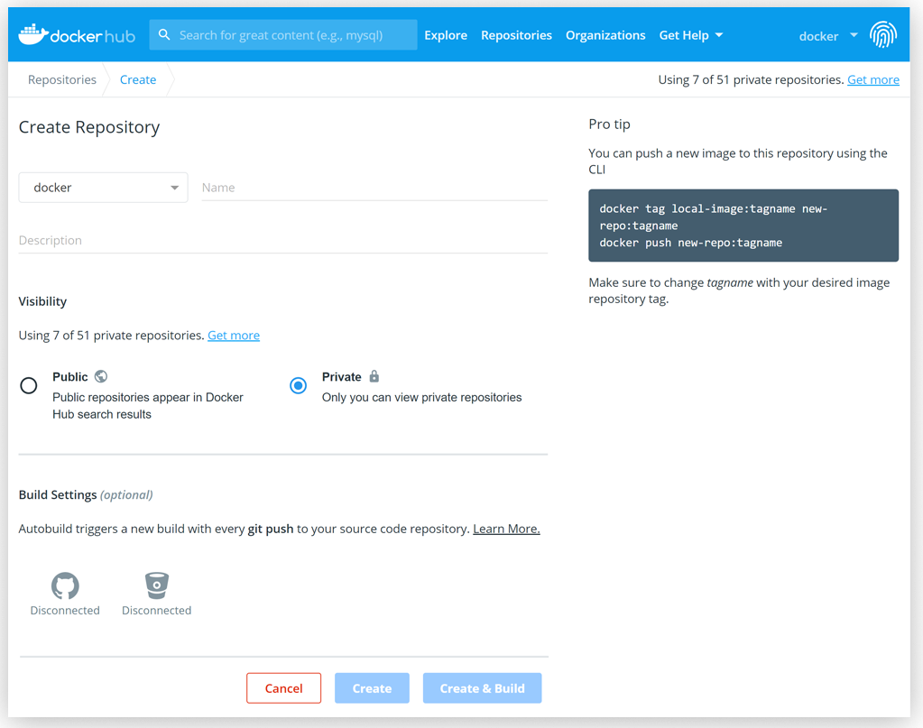
Docker Hub
Docker Hub is a service for finding and sharing container images with your team and the Docker community.
Key features
Explore the world’s largest container image repository
Share and store images in public or private repositories

Slide 34
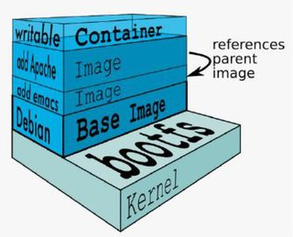
Docker Image
An image is a collection of files and some meta data
Images are comprised of multiple layers
Each image contains software you want to run
Every image contains a base layer
Layers are ready only

Slide 35
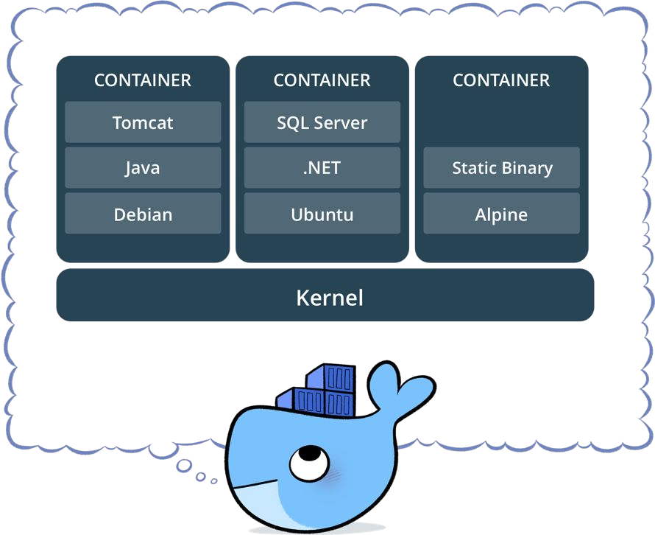
Docker Container
Standardized packaging for software and dependencies
Isolate apps from each other
Share the same OS kernel
Works for all major Linux distributions

Slide 36
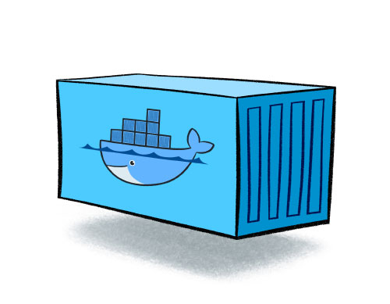
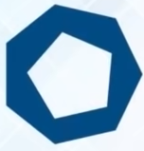
Docker Images and Containers
run
Docker Image
Docker Container
Read Only Template used to create Containers
Built by Docker Users
Stored in a Docker Hub or your local Registry
Isolated Application Platform
Contains everything needed to run the application
Built from one or more images

Slide 37
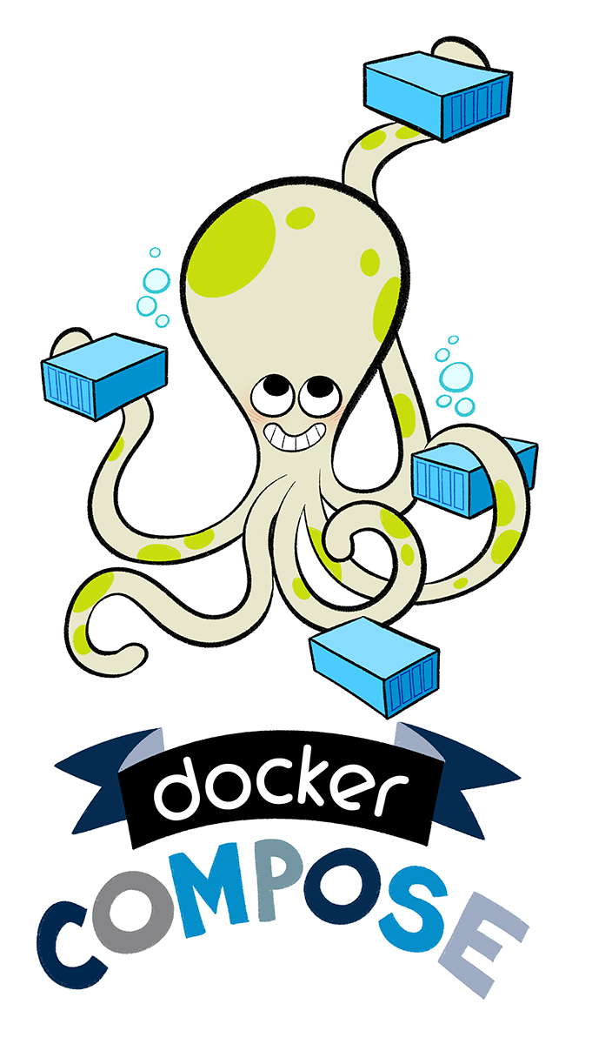
Docker Compose
Docker Compose is a tool for defining and running complex applications with Docker.
Define a multi-container application in a single file
Spin your application up in a single command

Slide 38
Docker Compose
Features
Multiple isolated environments on a single host
Preserve volume data when containers are created
Only recreate containers that have changed
Variables and moving a composition between environments
Multiple compose files

Slide 39
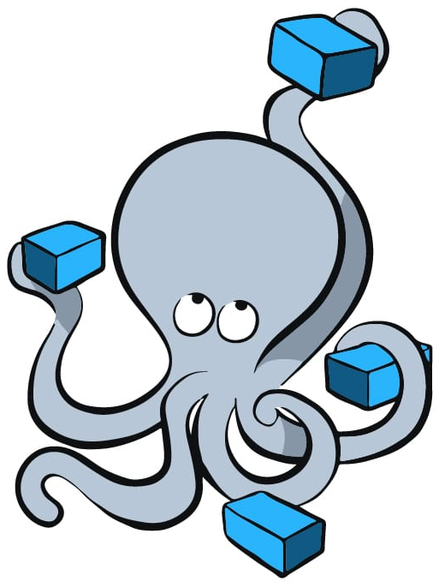
Docker Compose
Docker Compose make it easier to configure and run applications made up of multiple containers. For example, imagine being able to define three containers-one running a web app, another running postgres, and a third running redis-all in one YML file and then running those three connected containers in a single command
Web App
Docker Compose File
You can run these three containers with a single command
Containers
Postgres
Redis

Slide 40
Basic Docker Commands

Slide 41
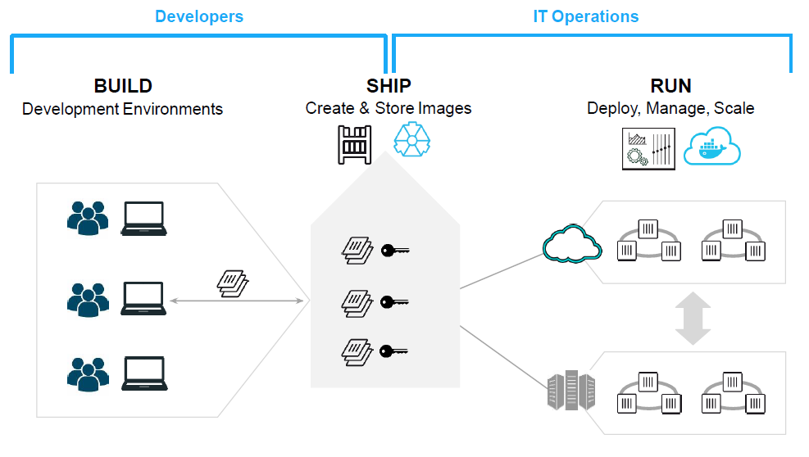
Docker – in DevOps

Slide 42
YML File
Version
Services
Build
Image
Environment
Ports
Volumes
Volumes
Networks
YML files are most commonly used as configuration files, which define a program or application's settings.
version: '3'
services:
jenkins:
image: jenkins/jenkins:lts
ports:
- “8080:8080”
- “50000:50000”
artifactory:
image: docker.bintray.io/jfrog/artifactory-oss:latest
ports:
- 8081:8081

