Slide 1
Introduction
SE499: Software Design & Development Project

Slide 2

Agile methods
Agile methods were developed in the 1990s to allow more flexibility.
These methods focus on the software rather than its documentation, develop software in a series of increments and aim to reduce process bureaucracy as much as possible.

Slide 3
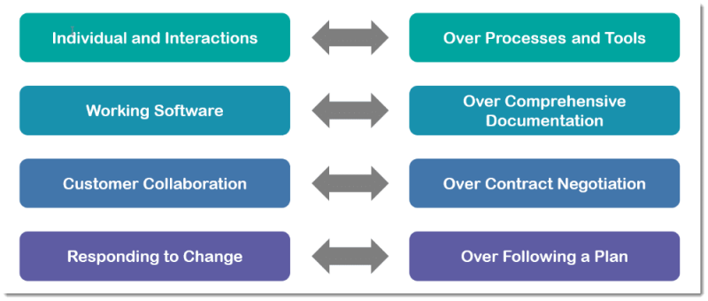
The agile manifesto

Slide 4
Incremental development
All agile methods are based around incremental development and delivery.
Product development focuses on the software features, where a feature does something for the software user.

Slide 5
Incremental development
With incremental development, you start by prioritizing the features so that the most important features are implemented first.
You only define the details of the feature being implemented in an increment.
That feature is then implemented and delivered.
Users or surrogate users can try it out and provide feedback to the development team. You then go on to define and implement the next feature of the system.

Slide 6
Incremental development

Slide 7
Incremental development activities
Choose features to be included in an increment
Using the list of features in the planned product, select those features that can be implemented in the next product increment.
Refine feature descriptions
Add detail to the feature descriptions so that the team have a common understanding of each feature and there is sufficient detail to begin implementation.
Implement and test
Implement the feature and develop automated tests for that feature that show that its behavior is consistent with its description.

Slide 8
Incremental development activities
Integrate feature and test
Integrate the developed feature with the existing system and test it to check that it works in conjunction with other features.
Deliver system increment
Deliver the system increment to the customer or product manager for checking and comments. If enough features have been implemented, release a version of the system for customer use.

Slide 9
Agile development principles
Involve the customer
Involve customers closely with the software development team. Their role is to provide and prioritize new system requirements and to evaluate each increment of the system.
Embrace change
Expect the features of the product and the details of these features to change as the development team and the product manager learn more about it. Adapt the software to cope with changes as they are made.
Develop and deliver incrementally
Always develop software products in increments. Test and evaluate each increment as it is developed and feed back required changes to the development team.

Slide 10
Agile development principles
Maintain simplicity
Focus on simplicity in both the software being developed and in the development process. Wherever possible, do what you can to eliminate complexity from the system.
Focus on people, not things
Trust the development team and do not expect everyone to always do the development process in the same way. Team members should be left to develop their own ways of working without being limited by prescriptive software processes.

Slide 11
Terminology
Product
The software product that is being developed by the team.
Product backlog
A to-do list of items such as bugs, features and product improvements that the Scrum team have not yet completed.
Sprint
A short period, typically two to four weeks, when a product increment is developed.

Slide 12
Sprints
Software is developed in sprints, which are fixed-length periods (2 - 4 weeks) in which software features are developed and delivered.
During a sprint, the team has daily meetings to review progress and to update the list of work items that are incomplete.
Sprints should produce a ‘shippable product increment’. This means that the developed software should be complete and ready to deploy.

Slide 13
Sprints

Slide 14
Product backlogs
The product backlog is a list of what needs to be done to complete the development of the product.
The items on this list are called product backlog items (PBIs).
The product backlog may include a variety of different items such as product features to be implemented, user requests, essential development activities and desirable engineering improvements.
The product backlog should always be prioritized so that the items that be implemented first are at the top of the list.

Slide 15
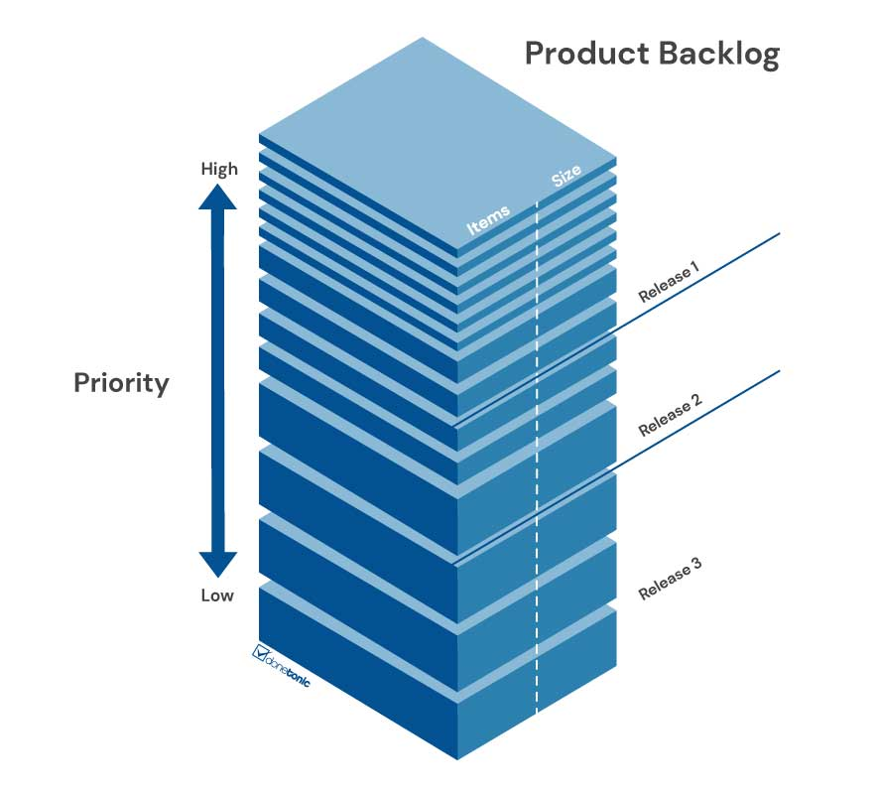

Slide 16
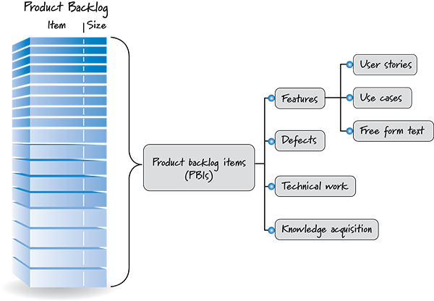
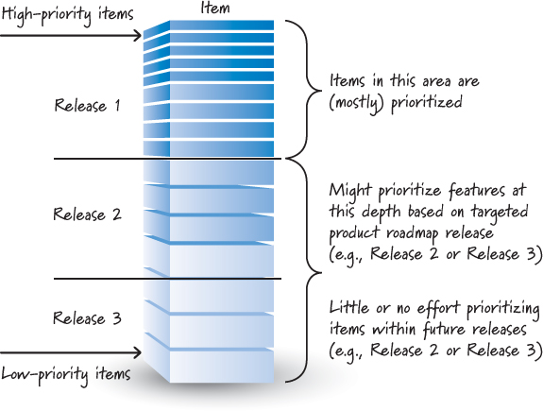

Slide 17
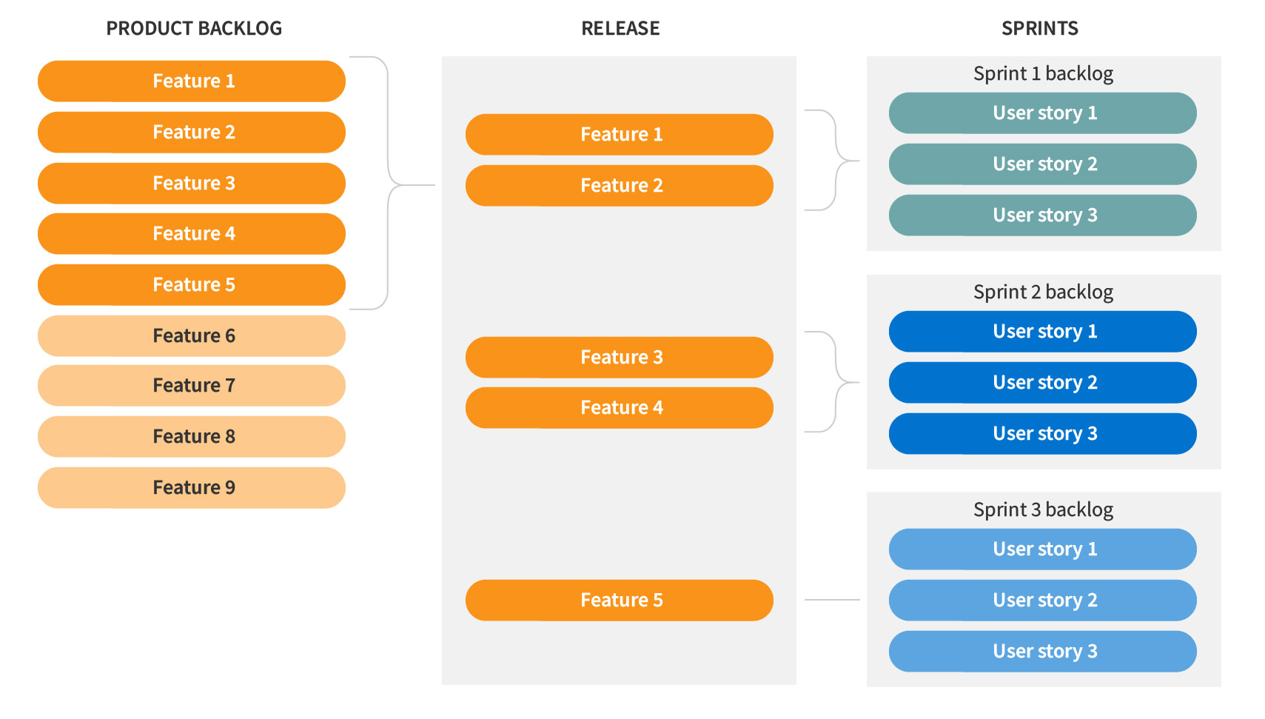

Slide 18
Examples of product backlog items
1. As a teacher, I want to be able to configure the group of tools that are available to individual classes. (feature)
2. As a parent, I want to be able to view my childrens’ work and the assessments made by their teachers. (feature)
3. As a teacher of young children, I want a pictorial interface for children with limited reading ability. (user request)

Slide 19
Examples of product backlog items
4. Establish criteria for the assessment of open source software that might be used as a basis for parts of this system. (development activity)
5. Refactor user interface code to improve understandability and performance. (engineering improvement)
6. Implement encryption for all personal user data. (engineering improvement)

Slide 20
Product backlog items
Ready for consideration
Ready for refinement
Ready for implementation

Slide 21
Product backlog activities
Refinement
Estimation
Creation
Prioritization

Slide 22
Product backlog activities

Slide 23
Project Charter
Project objectives
Main stakeholders
Project's scope
Project risks and constraints
Key performance indicators

Slide 24
Project Charter
Project Name
Project Description
Scope
Business Case
Constraints
Deliverables
KPIs (Measurable Results)
Key Stakeholders
Risks

Slide 25
SWE Project Development Practices
You will work with your team members to develop a software project.
The project experience is designed to be as close to the development of an industrial software project.
For that, you will have the opportunity to work with leading tools and technologies, for software development and collaboration.
Throughout this course, you will collaborate with your peers to design and develop features to provide value for potential users.
The instructor will serve as the client and will help in crafting the overall vision and requirements of the software project.

Slide 26
SWE Project Development Practices
Teams
We will form teams that will take care of the features of the system. The teams will be formed in the first week of class not exceeding 5 members by team.
Sprints
The project will be organized into three-week sprints and will release a new version of the system at the end of every sprint.
You will demonstrate your contributions to the project by giving a demo in class at the end of each sprint.
Demos will be informal, offering you an opportunity to give a show and tell of a feature that you built and get comments and feedback from other students.

Slide 27
SWE Project Development Practices
Testing
You will be responsible for unit testing all of the functionality you create.
The quality of your testing practices and the usage of a unit-testing framework will be a component of your grade.
Technology practices
All the team members are responsible and are expected to work on the project features.
Each student of the team will be assigned as an area expert.
The expert is expected to help other team members get up to speed, answering their questions, and researching and defining best practices.
a Wiki page on Github has to be maintained explaining the basics of how to get started, addressing frequently asked questions, and documenting best practices.

Slide 28
SWE Project Development Practices
Technology practices
Area expert will ultimately be responsible for making project team members as productive as possible.
For tools, this may include making sure students are aware of features and know how to use features to accomplish common activities (e.g., creating a personal branch on Github).
For technologies, this may include setting guidelines and coding standards, offering example code snippets, or explaining how something works.

Slide 29
SWE Project Development Practices
Class meetings
You will meet weekly for team discussions (although you should also discuss and collaborate outside class meetings).
Common discussion topics include:
tool and technology best practices,
features and requirements
architecture and design, and
planning the next sprint.
We need to agree on a time for the class.

Slide 30
Reports
At the end of each sprint, you will show your progress in an informal demo and a report.
You will also submit a assessment of your peer’s work.
You will use these mechanisms to show your progress.
Your grade for each sprint will be assessed on the following aspects:
Value of designed and implemented features contributed to the project
Quality of code contributed
Responsiveness and helpfulness in answering questions on your tool or technology on Slack
Documentation of tool or technology best practices on the Github wiki

Slide 31
Reports
Sprint reports will document your progress and achievements for the sprint.
The reports should go to the point explaining the main points of your progress in the sprint.
Each sprint report will be a slide deck with 6 slides, explaining:
Progress and Planning:
1. What the team did since the last sprint,
2. What the team plans to achieve for the next sprint,
3. Obstacles that the team expects to encounter and how they will solve them,
Reflection:
4. What the team did and worked really well,
5. What the team tried and didn’t work very well, and
6. What the team will do differently for next sprint.

Slide 32
Reports
Technology Progress Reports (1 per student):
Technology wikis are live documents that will evolve throughout the semester.
You will be expected to make some progress on the wikis for every sprint, as well as regularly answer questions about your technology.
At the end of each sprint, you will submit a technology progress report explaining your progress on your commandment of the technology.
The report will be free form and will consist of a single slide.
Example of things that you may want to report are: updates on the technology wiki, research done on best practices on your technology, or questions answered to your peers.
This report will not be part of your Sprint Demo.

Slide 33
Reports
Peer Assessments (1 per student):
At the end of each sprint, each student will submit a peer assessment, filling in the Peer Assessment Form.

