Slide 1
Testing
SE499: Software Design & Development Project

Slide 2
Introduction
Testing is a crucial aspect of software development that ensures the quality and reliability of software products.
It involves evaluating software components and systems to identify defects, errors, and potential issues before deployment.
Testing helps maintain and improve the overall quality of software by identifying and fixing bugs, glitches, and errors.

Slide 3
Introduction
It ensures that the software meets the specified requirements and functions as intended.
Quality software is essential for customer satisfaction, user adoption, and building a positive reputation for the development team or organization.
Testing allows developers to detect and fix bugs early in the development process.
Early bug detection reduces the cost and effort required for bug fixing in later stages.

Slide 4
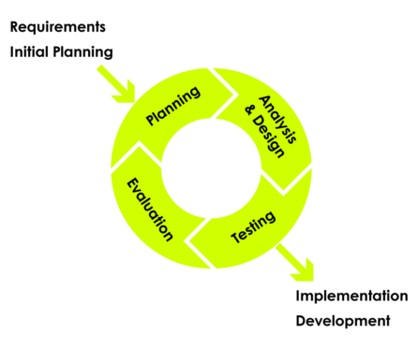
Iterative Design: A Key to Successful Software Development
Satisfying User Requirements while Maintaining Quality Attributes"
User requirements are the foundation of software development
Quality attributes are critical for software success
Iterative design is a powerful approach for satisfying user requirements while maintaining quality attributes

Slide 5
Benefits of Iterative Design
Improving Software Quality and User Satisfaction
Allows for early detection and correction of defects
Enables continuous improvement and refinement of software
Promotes collaboration and communication between developers and stakeholders
Helps ensure that software meets user needs and expectations
Supports evolutionary development and adaptation to changing requirements

Slide 6
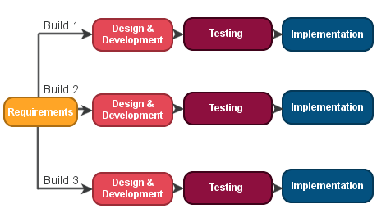
Iterative Testing: Ensuring Software Quality
A Crucial Step in Software Development
Testing is a critical aspect of software development
Iterative testing ensures quality at every stage
Established testing techniques provide a framework for success

Slide 7
Improving Software Quality and Reducing Risk
Identifies defects early, reducing the risk of downstream problems
Provides continuous feedback to developers, improving quality
Enables testing of complex systems in smaller, manageable parts
Reduces the likelihood of introducing major bugs or issues
Helps ensure that software meets user needs and expectations

Slide 8
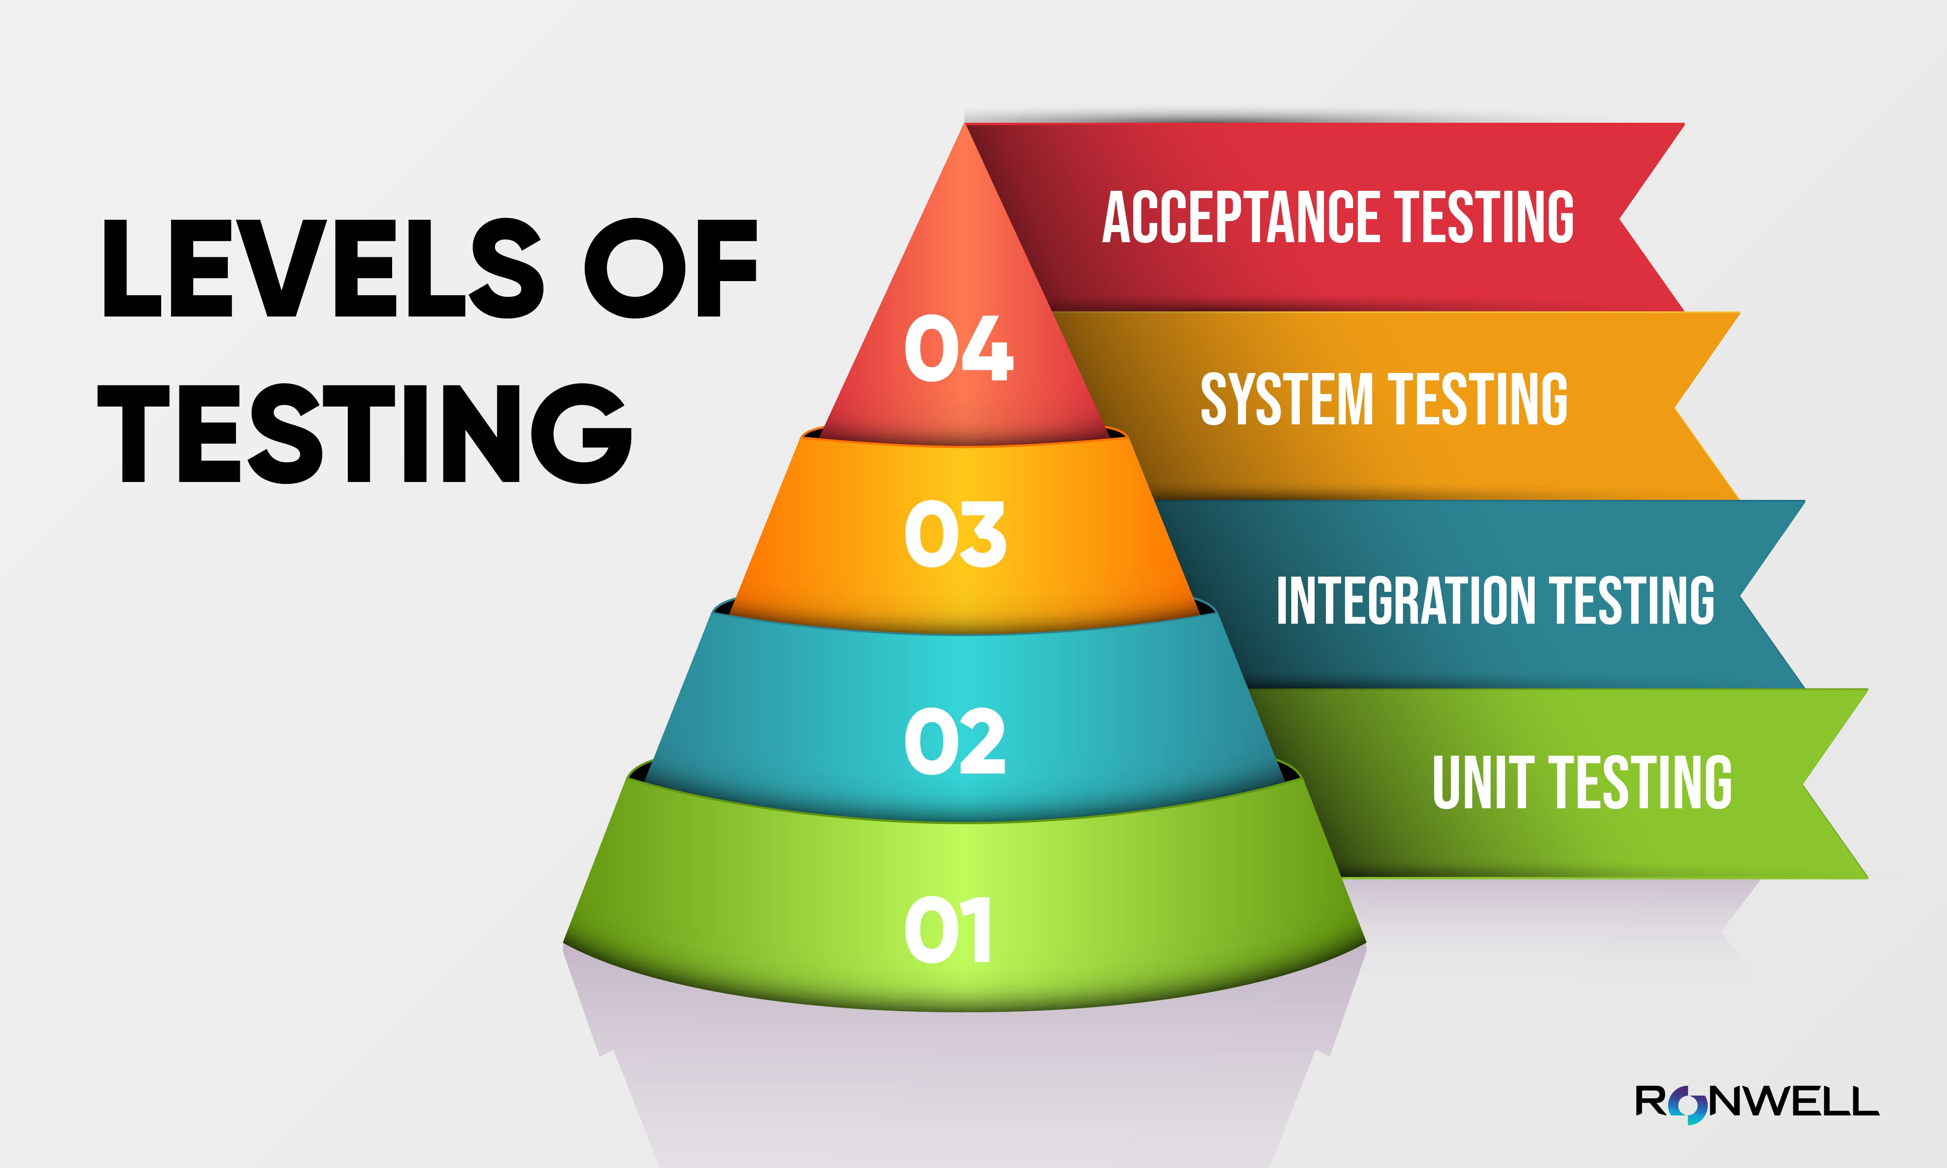

Slide 9
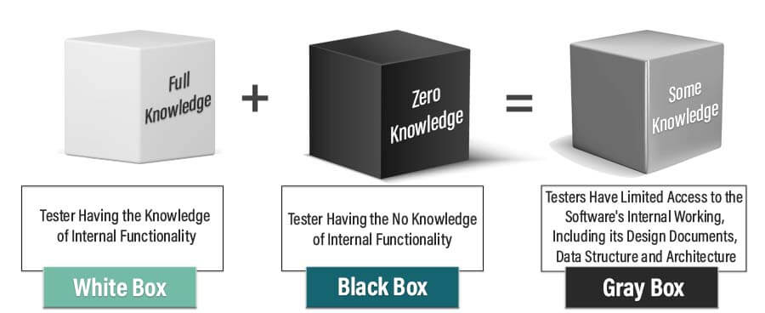
Testing Techniques

Slide 10
Test Planning and Design
Test plan
Test case
Test script
Test scenario
Test suite

Slide 11
Important Concepts
Test Data Management
Test Automation
Testing Challenges and Strategies
Challenges in testing (e.g. time constraints, complex systems, etc.)
Strategies for addressing testing challenges (e.g. risk-based testing, testing in Agile, etc.)
Testing for Security and Performance
Testing Metrics and Analysis
Best Practices for Testing

Slide 12
Testing in Agile
Role of testing in Agile development
Testing in Agile environments
Acceptance Test-Driven Development (ATDD)

Slide 13
Role of Testing in Agile Development
Testing plays a crucial role in Agile development by ensuring the quality and functionality of the software.
Testing is integrated throughout the development process, rather than being a separate phase at the end.
It helps identify defects early, enabling quick feedback and timely corrective actions.
Testers collaborate closely with developers, product owners, and other team members to ensure effective testing.

Slide 14
Testing in Agile Environments
Testing in Agile environments is characterized by short iterations or sprints.
Testers work closely with the development team to define and prioritize test cases.
Automated testing is heavily utilized to support frequent and rapid testing cycles.
Continuous integration and continuous delivery (CI/CD) pipelines are used to automate the testing and deployment processes.

Slide 15
Acceptance Test-Driven Development (ATDD)
ATDD is a practice in Agile development that involves defining acceptance criteria before coding begins.
It promotes collaboration between stakeholders, testers, and developers to clarify requirements.
Acceptance tests, written in a business-readable format, guide the development process.
ATDD helps ensure that software meets the desired business outcomes and improves customer satisfaction.

Slide 16
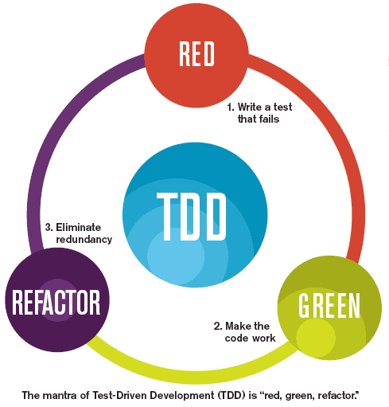
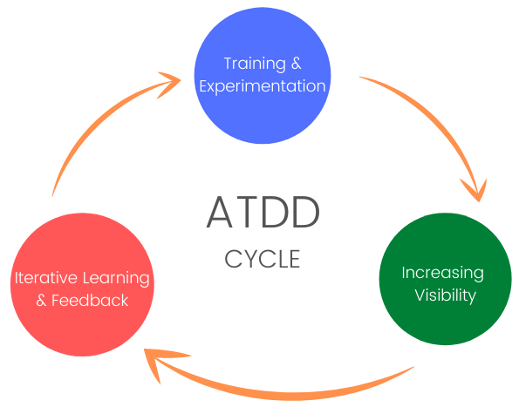
Acceptance Test-Driven Development (ATDD)

Slide 17
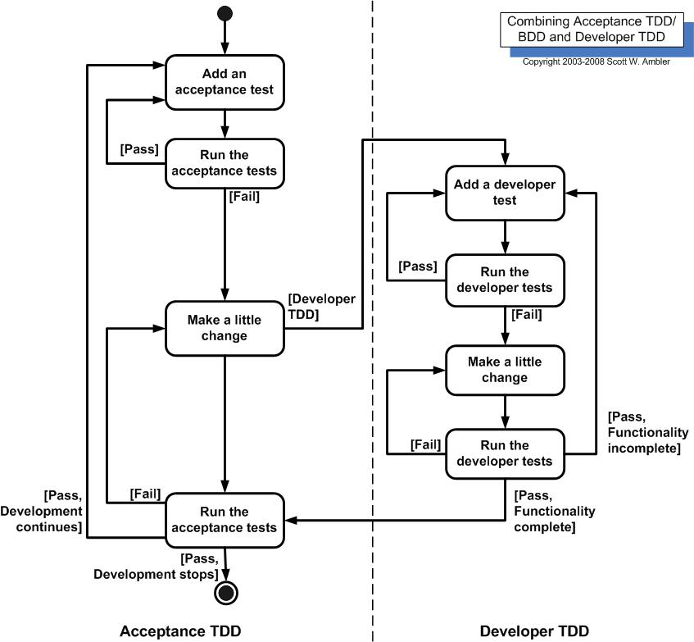

Slide 18
Reporting Iterative Testing Results
Communicating Test Progress and Findings
Test summary reports: provide an overview of testing progress and results
Test detailed reports: include detailed information on test cases, test results, and defects
Defect reports: track and report on defects found during testing
Test coverage reports: show the percentage of tested requirements and code coverage
Testing metrics: track and analyze testing metrics, such as test case execution time and defect density

Slide 19
Challenges and Solutions for Iterative Testing
Challenges:
Time constraints and tight deadlines
Frequent changes in requirements and priorities
Lack of documentation and resources
Inadequate communication and collaboration
Solutions:
Prioritize testing and allocate sufficient time and resources
Use automated testing tools and continuous integration
Collaborate with developers and stakeholders for clear requirements
Use agile testing methodologies and iterative testing approaches

Slide 20
Best Practices for Iterative Testing
Start testing early and continue throughout the development cycle
Use automated testing tools and frameworks for efficiency
Test small and often, focusing on high-risk features
Collaborate with developers and stakeholders for clear requirements
Establish clear testing goals and metrics
Continuously monitor and improve testing processes

