Slide 1
Development
SE499: Software Design & Development Project

Slide 2
Incremental Development
Incremental development refers to a software development strategy in which a product is created through a sequence of little, incremental enhancements, as opposed to a single, big deployment.
Instead of developing an application in a single phase, it is built in pieces and stages over time, with each step adding new functionality or improving the functionality that already exists.

Slide 3
Incremental Development
Adaptability, flexibility, and early delivery are the main advantages of incremental development.
Incremental development enables organizations to adapt to shifting market conditions or client needs, as opposed to conventional waterfall approaches that call for extensive planning and specifications upfront.

Slide 4
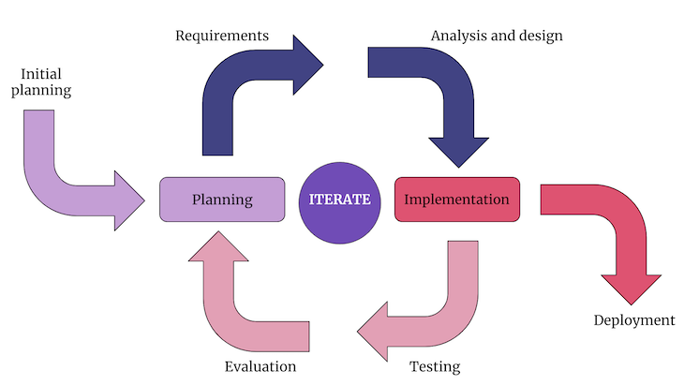
Incremental Development

Slide 5
Incremental Development
Advantages of incremental development (e.g., early delivery, reduced risk, flexibility)
Challenges of incremental development (e.g., integrating changes, managing scope)

Slide 6
Sprint Planning
Purpose of sprint planning (e.g., set goals, allocate resources, prioritize tasks)
Sprint planning process (e.g., identifying requirements, estimating effort, creating a sprint backlog)

Slide 7
Measurements
Types of measurements (e.g., size, effort, complexity, quality)
Why measurements are important (e.g., tracking progress, identifying issues, improving quality)

Slide 8
Code Quality
Importance of code quality (e.g., maintainability, readability, reliability)
Code quality metrics (e.g., cyclomatic complexity, Halstead complexity, cohesion)

Slide 9
Modularity
Importance of modularity (e.g., maintainability, reusability, scalability)
Techniques for improving modularity (e.g., component-based design, service-oriented architecture)

Slide 10
Complexity
Types of complexity (e.g., cognitive, structural, organizational)
Techniques for managing complexity (e.g., abstraction, encapsulation, divide and conquer)

Slide 11
Maintainability
Importance of maintainability (e.g., reducing costs, improving efficiency, enabling innovation)
Techniques for improving maintainability (e.g., modularity, abstraction, code reuse)

Slide 12
Code Efficiency
Importance of code efficiency (e.g., improving performance, reducing costs, enabling scalability)
Techniques for improving code efficiency (e.g., optimization, caching, parallel processing)

Slide 13
Testing
Importance of testing (e.g., ensuring quality, identifying defects, building confidence)
Types of testing (e.g., unit testing, integration testing, acceptance testing)

