Slide 1
Enterprise Resource Planning (ERP)
SE495: Software and Systems Integration

Slide 2
Outline
Introduction
Integration Types
Integration Models
Integrated system vs. Legacy System
Integration type
Integration Architecture

Slide 3
What is ERP?
Enterprise Resource Planning (ERP) refers to a business process management software that optimizes the processes of an organization by providing a system of integrated and centralized applications that help manage and automate a wide range of business operations including accounting, human resources, sales and inventory management.

Slide 4
Background
Enterprise resource planning (ERP) systems are meant to automate, standardize, and integrate their business processes for effective planning and control.
A key feature of ERP systems is the comprehensive database that serves as a single source of the truth.
In practice, this means that employees in all departments can look to the ERP system for the information they need and work from the same data.

Slide 5
ERP Essentials
Enterprise resource planning (ERP) systems are business systems that integrate and streamline data across the company into one complete system that supports the needs of the entire enterprise.
ERP systems are designed to enhance all aspects of key operations, such as purchasing, accounting, manufacturing, and sales, by taking processes and functions that were previously disjointed and supported by various legacy systems, or older, standalone, disparate business systems, and seamlessly integrating and coordinating them.
The foundation of an ERP system is a well- structured database that serves the operational and decision-making needs of the entire enterprise.

Slide 6
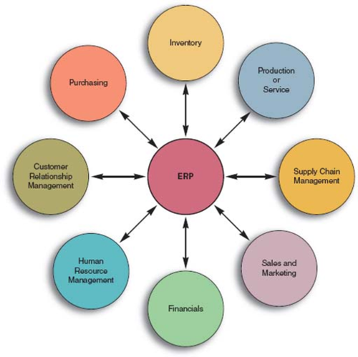
ERP

Slide 7
ERP
ERP systems are:
Cross-functional (more than one functional area)
process- centered (organization’s business processes)
A business process is a collection of activities that together add value.
Business processes span multiple departments and in many cases traverse the boundaries of the organization, sharing information with partners, suppliers, and customers.

Slide 8
Business Processes
Two of the major business processes that most companies have, and which ERP systems support, are
“perform order management”
“procure materials and services.”
Other key processes that

Slide 9
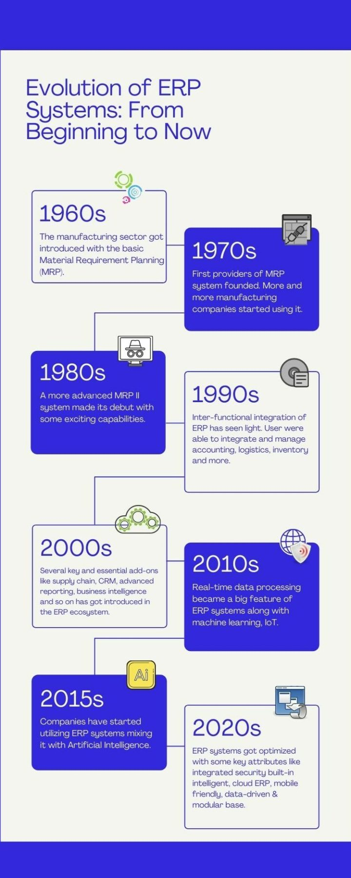
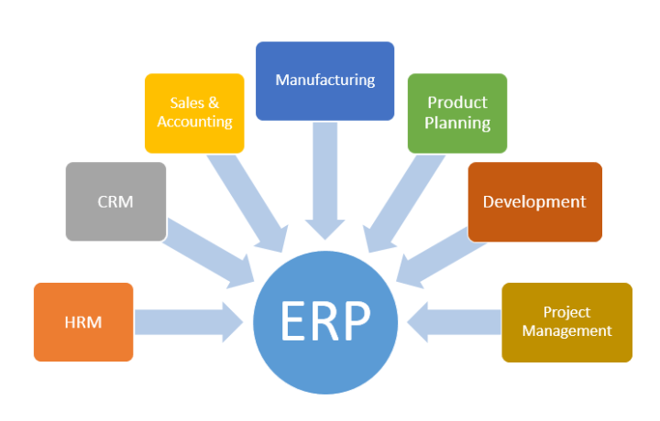
Evolution of ERP Systems

Slide 10
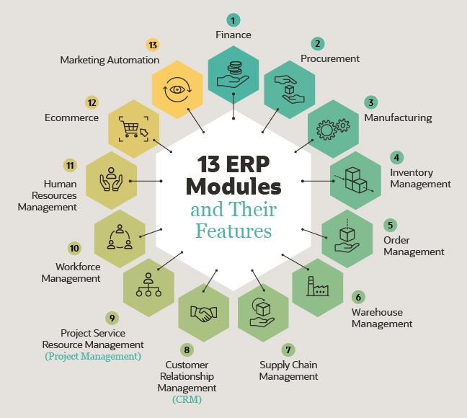
ERP Modules

Slide 11
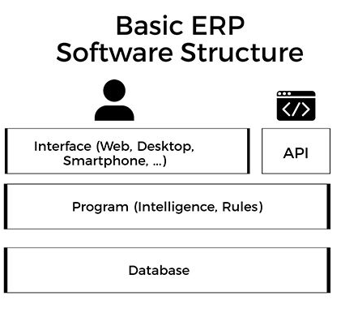
The Technical of ERP Systems
The singular interface ties everything together to provide a seamless user experience as users go between the different business processes.
ERP has several layers that work together.
One of the main technical layers of an ERP system is the database.
The database is where all of a companies data about customers, accounting, inventory, and more, will be stored.
The program layer will house the intelligence or brain of the ERP software, it contains all the rules and logistics of the ERP
The final layer is the API which is the way your ERP will communicate with other software.

