Slide 1
Stakeholders
SE423: Software Project Management

Slide 2
Outline
Stakeholder Management
Communication
Stakeholders Communication

Slide 3
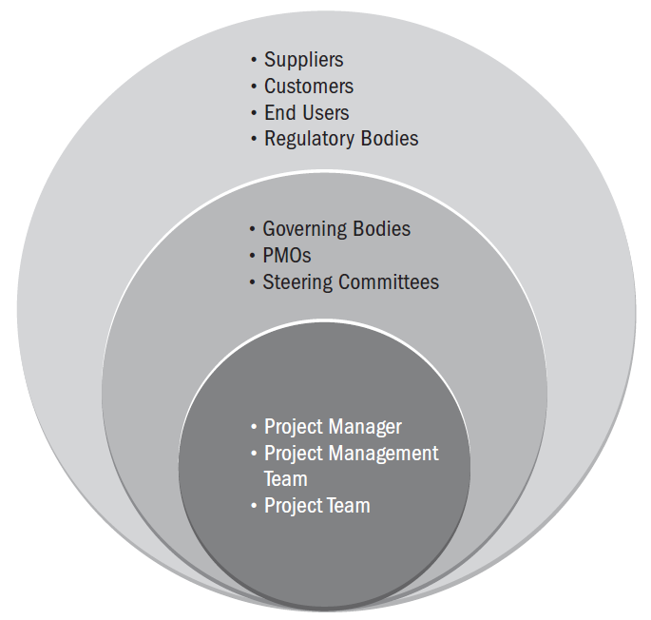
Examples of Project Stakeholders

Slide 4
Stakeholder Management

Slide 5
Introduction
Stakeholder Management is the process of developing appropriate management strategies for all project stakeholders
The process goal is to effectively engage stakeholders throughout the project life cycle
It analyzes their needs, interests, and potential impact on project success
The process provides a plan for interacting with project stakeholders with the project's interests as its goal

Slide 6
Stakeholder Management
Inputs
Project charter
Procurement documents
Enterprise environmental factors
Organizational process assets
Tools & Techniques
Stakeholder analysis
Expert judgment
Meetings
Outputs
Stakeholder register
Stakeholder management plan

Slide 7
Stakeholder register
The stakeholder register is the primary output from the Identify Stakeholders process. For each stakeholder, the register contains:
Name
Position in organization
Location
Role in project
Contact information
List of stakeholder’s major requirements
List of stakeholder’s main expectations
Potential inﬂuence on the project
Phase in the lifecycle of most interest
A stakeholder classiﬁcation. This may include internal/external; supporter/neutral/resister; and high/medium/low inﬂuence/power/ impact/interest

Slide 8
Stakeholders
Stakeholder engagement levels can be classiﬁed as:
Unaware. Unaware of project and its potential impacts
Resistant. Aware of project and its potential impacts and resistant to the changes anticipated by the project
Neutral. Aware of project and neither supportive nor resistant
Supportive. Aware of project and its potential impacts and supportive of the changes anticipated by the project
Leading. Aware of project and its potential impacts and actively engaged in ensuring the project’s success

Slide 9
Stakeholder management plan
The stakeholder management plan identiﬁes the management strategies required to effectively engage stakeholders
The stakeholder management plan supplements the information in the stakeholder register with:
Desired and current engagement levels of key stakeholders
Scope and impact of change (due to project) to stakeholders
Identiﬁed interrelationships and potential overlap between stakeholders
Stakeholder communication requirements
Information to be distributed to stakeholders, including language, format, content, and level of detail

Slide 10
Stakeholder management plan
The stakeholder management plan supplements the information in the stakeholder register with (cont’d):
Reason for the distribution of that information and the expected impact on stakeholder engagement
Time frame and frequency for the distribution of required information to stakeholders
Method for updating and reﬁning the stakeholder management plan as the project progresses and develops
The stakeholder management plan contains sensitive information—appropriate precautions are needed to safeguard its information and prevent its inappropriate disclosure

Slide 11
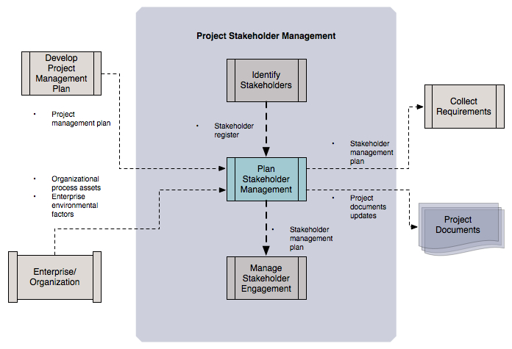
Stakeholder management plan
Adapted from Figure 13-6 PMBOK Guide, 5th Edition

Slide 12
Useful if conditions warrant
From the agile perspective, identifying stakeholders is a valuable process: the more inclusive your understanding of stakeholders, the better
Agile promotes the idea that transparency is the best policy
Agile utilizes information radiators: information tools (e.g., a project wiki) that make project information—including progress and impediments—visible to all interested stakeholders
This minimizes the chances for miscommunication and effectively short-circuits the rumor mill

Slide 13
Useful if conditions warrant
In some cases Stakeholder Management advocates tailoring information access and ﬂow to the individual stakeholder
Though this approach may be warranted in some situations—volatile, highly-politicized project, for example—it is not without its risks:
“Project managers should be aware of the sensitive nature of the stakeholder management plan and take appropriate precautions. For example, information on stakeholders who are resistant to the project can be potentially damaging, and due consideration should be given regarding the distribution of such information.”*
Analogies:
Private- vs. public-key encryption mechanisms
Proprietary vs. open-source software security
*From Ch. 13.2.3.1, PMBOK Guide, 5th Edition

Slide 14
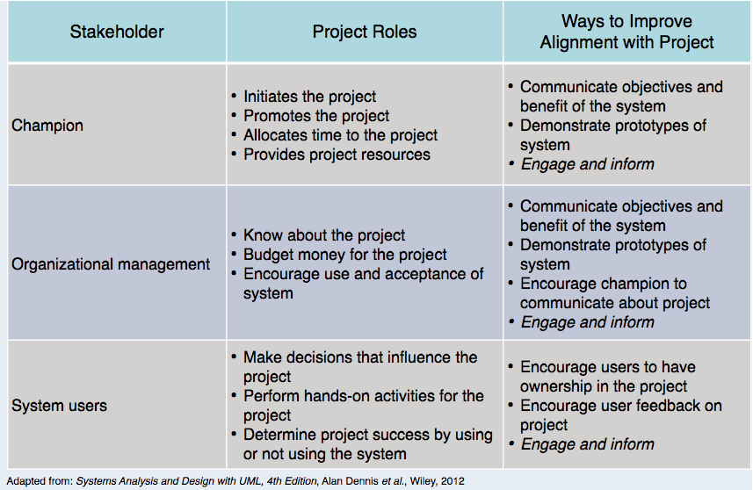
Important Stakeholders

Slide 15
The Need for Stakeholder Reporting
DevOps and Agile needs proper tooling, particularly around reporting to key stakeholders, to be really successful.
As DevOps has evolved a complex tool chain has emerged to help manage Agile projects.
Because agile processes are iterative it is sometimes difficult for stakeholders to really understand what is happening in projects or whether projects are on time and on budget.

Slide 16
The Need for Stakeholder Reporting
These stakeholders include not only Dev and Ops but management, product management, marketing, sales, finance etc.
The problem is increased when stakeholders need to look across multiple projects.
Business value metrics dashboards provide managers with real-time automated reporting on best-practice KPIs.
Customers can set targets and automate KPI reporting in order to understand the agile processes that need to be improved.

Slide 17
Communication

Slide 18
Communication
Communication planning overlaps with stakeholder identification, analysis, prioritization, and engagement.
Communication is the most important factor in engaging with stakeholders effectively.

Slide 19
Communication
Planning communication for the project entails considering the following:
Who needs information?
What information does each stakeholder need?
Why should information be shared with stakeholders?
What is the best way to provide information?
When and how often is information needed?
Who has the information needed?
There may be different categories of information, such as internal and external, sensitive and public, or general and detailed.
Analyzing the stakeholders, information needs, and categories of information provides the foundation for establishing the communications processes and plans for the project.

Slide 20
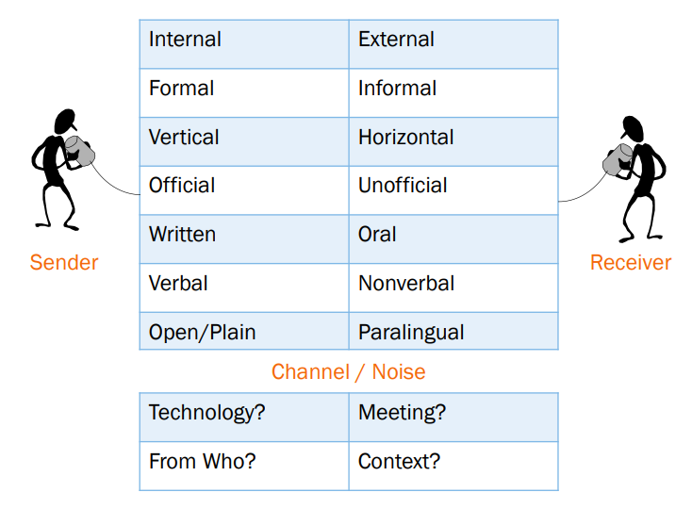
Types of Communication

Slide 21
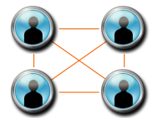
Communication Concepts
Interactive vs. Push vs. Pull Communication
Meeting Success
Good advanced notice / Time limit for the meeting
Regular but not too frequent
Clear purpose and agenda announced beforehand
Assign deliverables/action items from the meeting w/ clear time limits and distribution channels
Document and publish meeting minutes
Communication Channels
# Communication Channels
Communication Blockers
# Communication Channels | $$\frac{N (N −1)}{2}$$ | N = the number of people

Slide 22
Plan Communications
Consider: culture, expectations, technology, methods, established policies and procedures
Plan to Communicate: Who, when, what channel, and with what frequency
Plan to Communicate: What
Type | Examples
Project Documents | Charter, PM Plan
Schedule/Resources | WBS, Resource needs, Meeting Schedule, Work Assignments (upcoming and current)
Status | General Status, Impacts to/from other projects, Performance Reports
Risks | New Risks, Uncertainties, Realized Risks (problems)
Change Control | Scope changes, CCB communications

Slide 23

Ethical Responsibility
As a PM or Team Member, communication is at the heart of ethical and honest behavior and responsibility.
Try to understand the truth
Be careful – your perception of the truth may be false
Seek the whole truth
Be truthful in all communications
Communicate honestly, even if the project is in trouble
Create an environment where others tell the truth
Telling the truth consistently lets project team members know that only the truth is acceptable

Slide 24
Professional Responsibility
Only accept assignments you are qualified to complete
Lack of qualification presents a major risk to the project
Protect proprietary information, Report unethical behavior and violations
Maintain an attitude of mutual cooperation
Consider other projects and operational work when asking for resources
Protect reputations of your team members as it relates to project work
Ask what communication method is favored by your stakeholders/team
Be direct in dealing with conflict
Openly discuss conflict with the other party, not behind their back
Continuously look for conflicts of interest and disclose them
Treat the search and resolution of conflicts of interest like risks

Slide 25
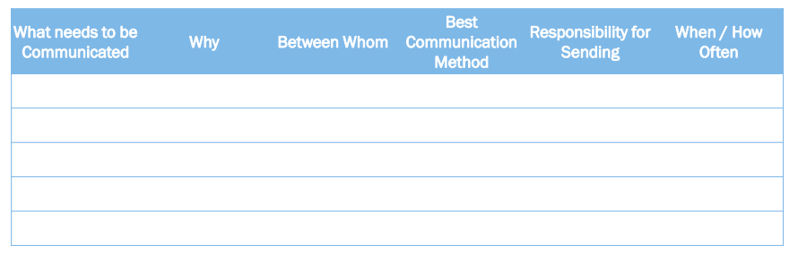
Communication Management Plan
Primary output of Plan Communications

Slide 26
Stakeholders Communication

Slide 27
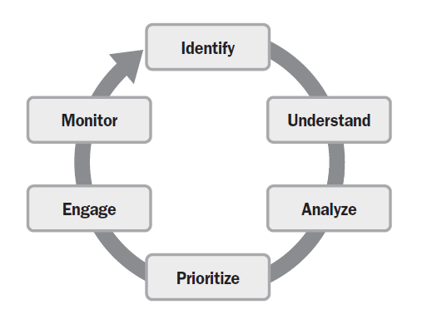
Stakeholder Engagement
Identify your stakeholders
Understand your stakeholders
Analyze your stakeholders
Prioritize your stakeholders
Engage your stakeholders
Monitor your stakeholders

Slide 28
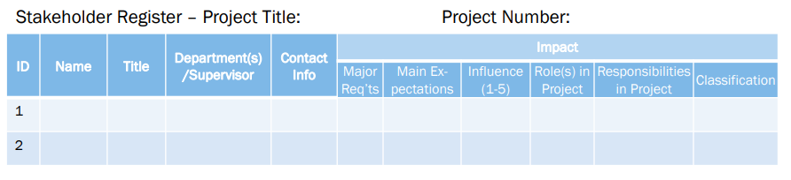
Identify Stakeholders
Analyze Stakeholders continuously
Create and Maintain a Stakeholder Register
Create and execute a Stakeholder Management Strategy

Slide 29
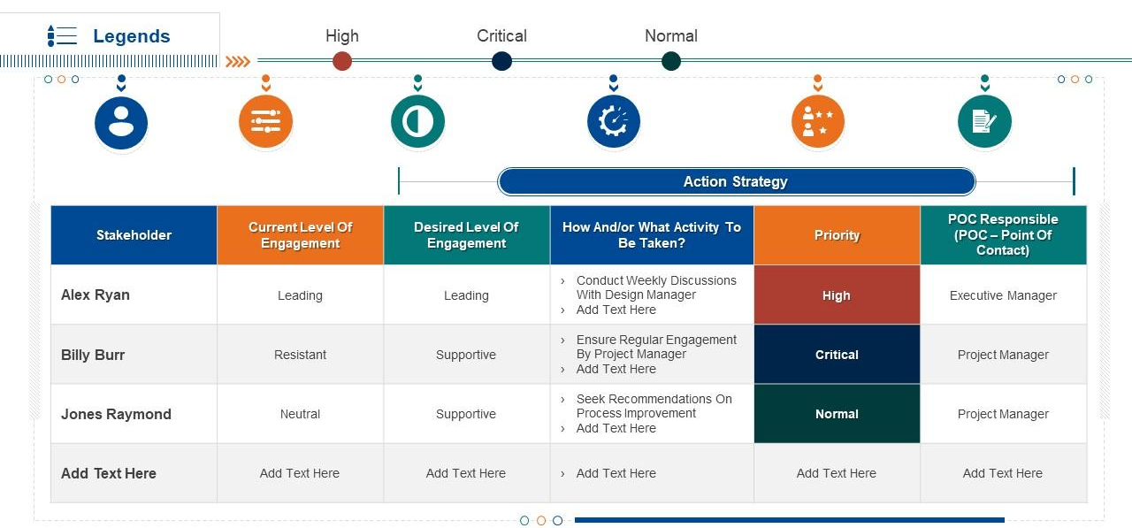
Project Stakeholder Management

Slide 30
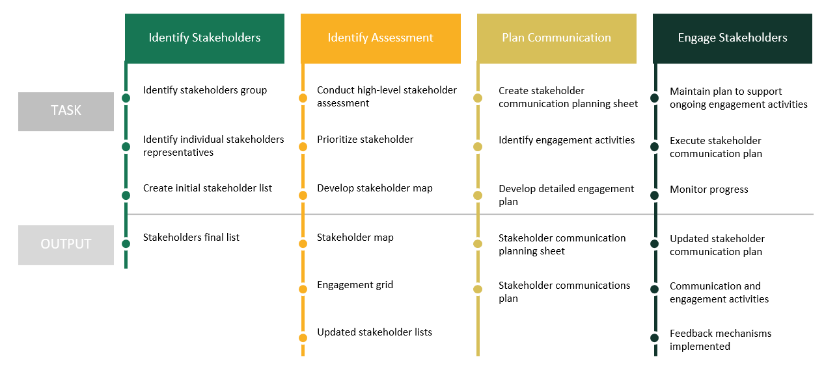
Stakeholder Engagement Plan

Slide 31
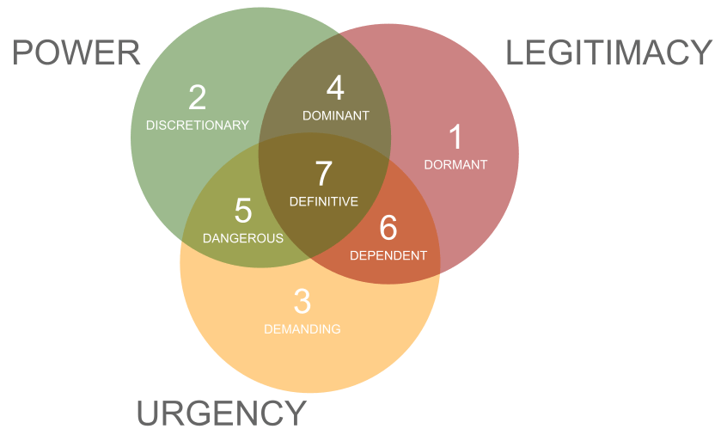
Common Stakeholder Mapping Models
Salience Model

Slide 32
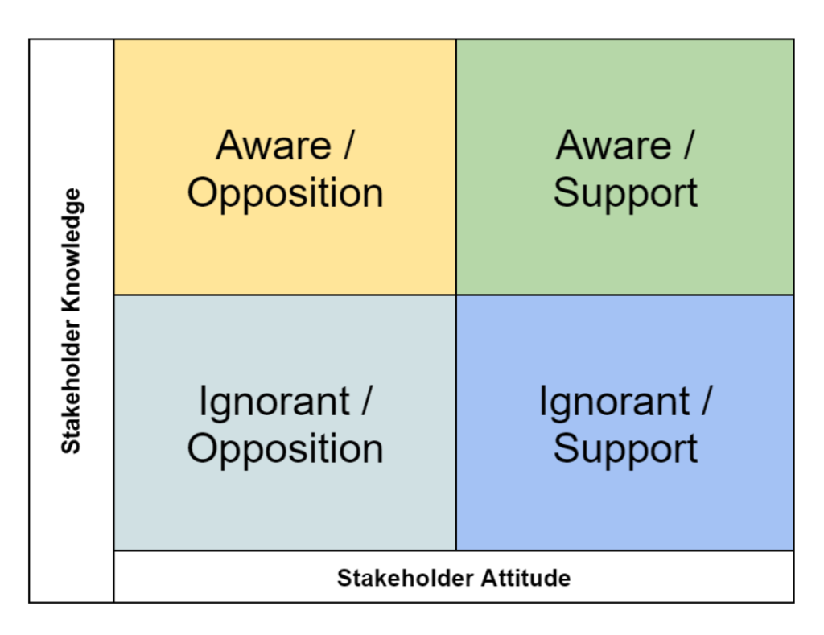
Common Stakeholder Mapping Models
Stakeholder Knowledge Base Chart

Slide 33
Stakeholder Knowledge Base Chart
Aware / Opposition
These stakeholders may be a risk and require management.
Aware / Support
These stakeholders are worth keeping informed so they can continue to champion your project or work.
Ignorant / Opposition
Increasing the understanding of these stakeholders may help to change their attitude.
Ignorant / Support
Engaging with these stakeholders will help to keep them onboard and strengthen their support.

Slide 34
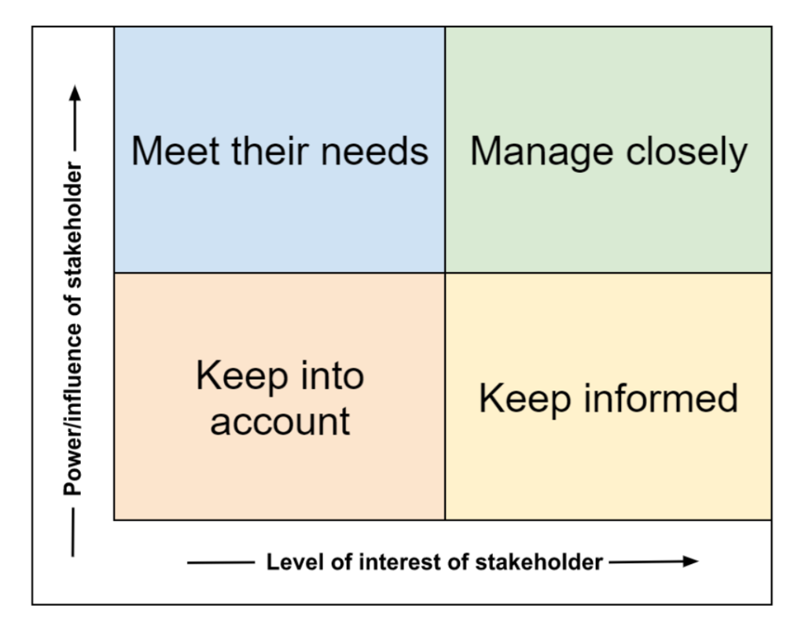
Common Stakeholder Mapping Models
Power/Interest Grid

Slide 35
Power/Interest Grid
High power / high interest
Manage closely, regularly engage, and manage expectations
High power / low interest
Meet their needs, keep them satisfied, and actively consult
Low power / low interest
Monitor and provide information as needed
Low power / high interest
Keep informed and maintain interest

Slide 36
Stakeholder Engagement
Engage
Stakeholder engagement entails working collaboratively with stakeholders to introduce the project, elicit their requirements, manage expectations, resolve issues, negotiate, prioritize, problem solve, and make decisions.
Engaging stakeholders requires the application of soft skills, such as active listening, interpersonal skills, and conflict management, as well as leadership skills such as establishing the vision and critical thinking.

Slide 37
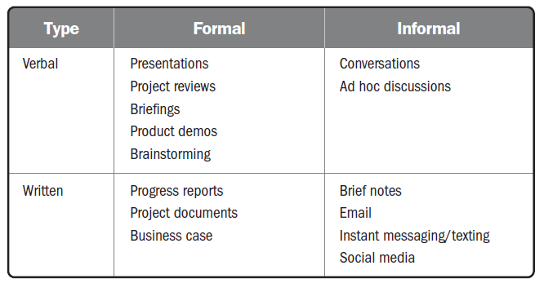
Stakeholder Engagement
Engage

Slide 38
Stakeholder Engagement
Engage
Communication methods include push, pull, and interactive communication:
Push
Sent to stakeholders such as memos, emails, status reports, voice mail, and so forth.
One-way communications with individual stakeholders or groups of stakeholders.
Inhibits the ability to immediately gauge reaction and assess understanding; therefore, it should be used deliberately.

Slide 39
Stakeholder Engagement
Engage
Communication methods include push, pull, and interactive communication:
Pull
Information sought by the stakeholder, such as a project team member going to an intranet to find communication policies or templates, running internet searches, and using online repositories.
Pulling information is used for indirect sensing of stakeholder concerns.

Slide 40
Stakeholder Engagement
Engage
With all forms of communication, quick feedback loops provide useful information to:
Confirm the degree to which the stakeholder(s) heard the message.
Determine if stakeholders agree with the message.
Identify nuanced or other unintended messages the recipient detected.
Gain other helpful insights.

Slide 41
Manage Stakeholders Expectations
Items that may need regular communication
Schedule, Budget, Forecasts
Risk Register, Issue Log, Change Log
Items outside of the control of the project that affect the project
Involves the application of Communication Methods, Interpersonal Skills, and Management Skills to manage expectations of people important to the project.

Slide 42
Performance Report Types
Status Report – Where is the project is against the performance measurement baseline?
Progress Report – What has been accomplished?
Trend Report – Is performance improving or deteriorating?
Forecasting Report – What are the predictions for the future?
Variance Report – How do the actual results compare to the baselines?
Earned Value Report – Where is the project in pure Earned Value/Cost Management terms?
Lessons Learned – What information could be useful for future projects?

Slide 43
Making Reports and Metrics Useful
Collecting information, analyzing it, packaging it, and sending it to Stakeholders.
Level of Detail
Appropriate communication channel
Don’t let reports prevent you from managing the project
Are measurements against a consistent baseline
Truthful with accurate metrics
All three sides of the project triangle plus quality
Can and should be enhanced with forecasts
Get feedback
Use multiple types of reports

Slide 44
Conclusion
Communication concepts must be applied to both stakeholder and team communication
Communication is not effective unless it is ethical and honest
Stakeholder Expectation Management starts with understanding each stakeholder, then deciding what communication is best for them
Make reports and metrics useful by viewing them from the Stakeholder’s perspective

