Slide 1
DevSecOps
SE489: DevOps Engineering

Slide 2
Outline
What is DevSecOps?
What are the benefits of DevSecOps?
DevSecOps Best Practices
DevSecOps Toolchain
Traits of successful DevSecOps practices
Tools of The Trade
Other Ops

Slide 3
What is DevSecOps?

Slide 4
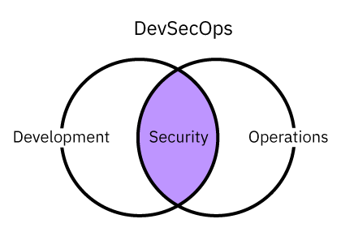
What is DevSecOps?
DevSecOps is the practice of integrating security testing at every stage of the software development process.
It includes tools and processes that encourage collaboration between developers, security specialists, and operation teams to build software that is both efficient and secure.
DevSecOps brings cultural transformation that makes security a shared responsibility for everyone who is building the software.

Slide 5
What is DevSecOps?
DevSecOps builds on the ideas of DevOps by applying security practices throughout the software development lifecycle to ship more secure code faster.
Through collaboration, automation, and continuous improvement, DevSecOps offers a set of practices that help companies embed security into their work to build more secure, high-quality software at scale.

Slide 6
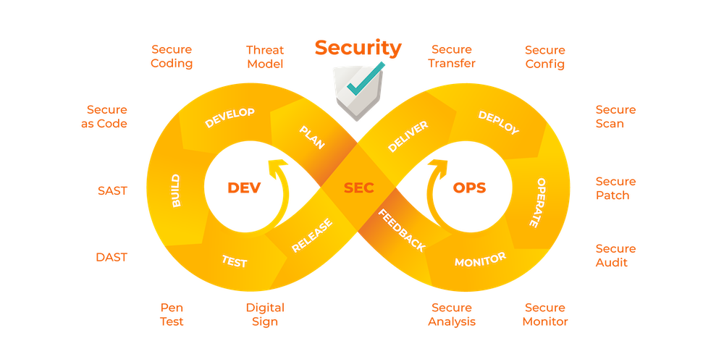
What is DevSecOps?
Effort to strive for “Secure by Default”
Integrate Security via tools
Create Security as Code culture
Promote cross skilling

Slide 7
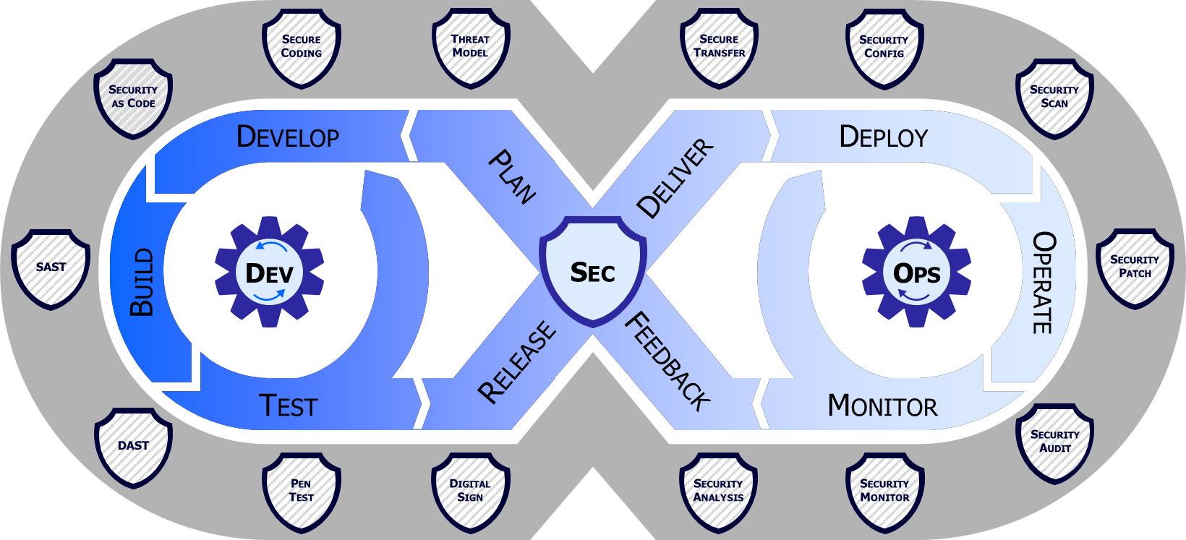
DevSecOps

Slide 8
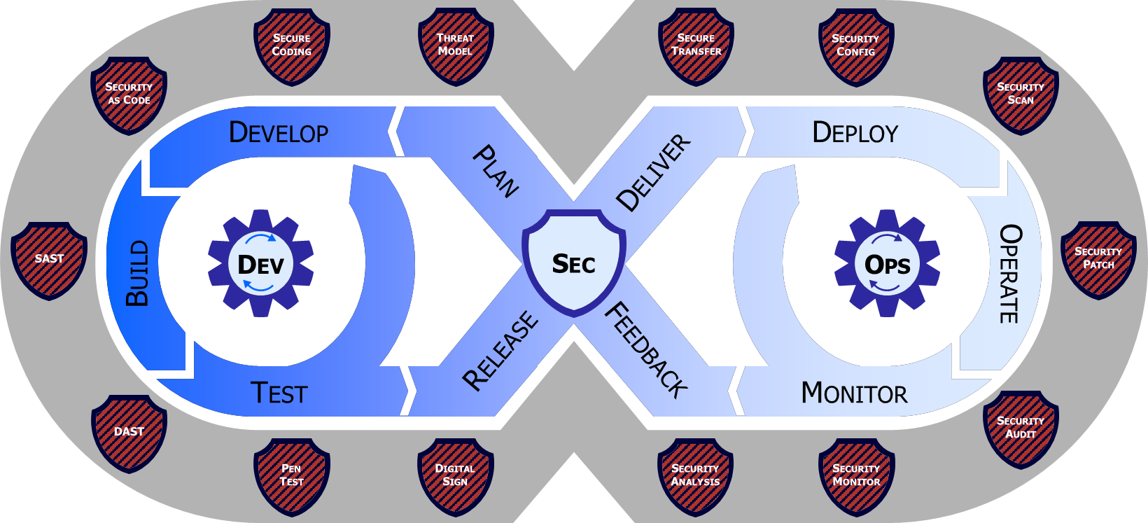
DevSecOps Process
Continuous Operations
Continuous Deployment
Continuous Delivery
Continuous Integration
Continuous Build
Plan
Develop
Build
Test
Release & Deliver
Deploy
Operate
Cybersecurity Automation (Scanning, Testing, & Validating)
Monitor
Legend
Control Gate
Risk Determination
Feedback Loop
Compliance, Effectiveness, ThreatCon, Malicious Detection

Slide 9
What does DevSecOps stand for?
DevSecOps stands for development, security, and operations. It is an extension of the DevOps practice. Each term defines different roles and responsibilities of software teams when they are building software applications.
Development
Development is the process of planning, coding, building, and testing the application.
Security
Security means introducing security earlier in the software development cycle.
For example, programmers ensure that the code is free of security vulnerabilities, and security practitioners test the software further before the company releases it.
Operations
The operations team releases, monitors, and fixes any issues that arise from the software.

Slide 10
What are the benefits of DevSecOps?

Slide 11
Why do we need DevSecOps?
DevOps moves at rapid pace, traditional security just can’t keep up
DevSecOps makes it easier to manage rapid pace of development & large scale secure deployments
DevSecOps allows for much smoother scaling of process
Security as part of process is the only way to ensure safety

Slide 12
What are the benefits of DevSecOps?
Catch software vulnerabilities early
Focus on security controls through the entire development process.
Conduct checks at each stage.
Software teams can detect security issues at earlier stages and reduce the cost and time of fixing vulnerabilities.
Reduce time to market
Automate security tests and reduce human errors.
Prevents the security assessment from being a bottleneck in the development process.
Ensure regulatory compliance
Comply with regulatory requirements by adopting professional security practices and technologies.
Identify data protection and security requirements in the system.
Build a security-aware culture
Awareness of security best practices when developing an application.
Being proactive in spotting potential security issues in the code, modules, or other technologies.
Develop new features securely
Encourages flexible collaboration between the development, operation, and security teams.
Share the same understanding of software security and use common tools to automate assessment and reporting.

Slide 13
DevSecOps Advantages
Reduced risk of data breaches
Make code secure by design.
A combination of secure coding cultural practices, secure developer environments, and automated security tests throughout the SDLC help reduce security vulnerabilities.
Improved compliance
Use automation to enforce code compliance and integrate policy enforcement.
Greater confidence in dependencies
The modern technology stack depends heavily on third-party code, often from public package repositories. DevSecOps practitioners frequently leverage tooling and automated tests to identify potential issues before a software release.
Value gets to end users faster
By creating a security-first culture and applying automated checks, DevSecOps reduces the need for distinct security reviews that slow down code deployments.

Slide 14
DevSecOps Best Practices

Slide 15
DevSecOps best practices
Create a DevSecOps culture
Everyone is responsible for security.
Open culture where each individual works together to build the best and most secure product possible.
Design security into the product
Design security into products from the initial planning stages to deployed production-level code.
Security work is planned alongside feature work, and practitioners are provided security knowledge and testing throughout each stage of their development work.
Build a threat modeling practice
Model potential threats during the planning phase and design your infrastructure and the application’s architecture to mitigate those issues.
Periodic penetration testing, where a trusted person attempts to break into your system, can help unveil weaknesses you may miss in your threat models.
Automate for speed and security
Automated testing is used throughout the SDLC to ensure the right security checks happen at the right time.
More time to focus on building the core product while ensuring security requirements are met.

Slide 16
DevSecOps best practices
Plan security checkpoints in your product development
Identify transition points in your SDLC where the risk profile changes.
Approach security failures as learning opportunities
Turn security incidents into learning opportunities.
Leverage audit logs, build incident reports, and model malicious behavior to improve tooling, testing, and processes to further secure your applications and systems.
Stay on top of dependencies
Understanding and mitigating the potential threats from dependencies is critical to your product’s security.
Apply threat modeling and automated testing to your dependencies and to your in-house code.
Build your analytics and reporting capabilities
Real-time alerts, system analytics, and proactive threat monitoring.
Reporting dashboards and alerts highlight problems early.

Slide 17
DevSecOps best practices
Companies use the following approaches to support digital transformation with DevSecOps.
Shift left
Checking for vulnerabilities in the earlier stages of software development.
Prevent undetected security issues when they build the application.
Shift right
The importance of focusing on security after the application is deployed.
Some vulnerabilities might escape earlier security checks and become apparent only when customers use the software.
Use automated security tools
Integrate security scanning tools into the CI/CD process.
Prevent security evaluations from slowing down development.
Promote security awareness
Security awareness is essential in building secure software.
Every team member must share the responsibility of protecting software users from security threats.

Slide 18
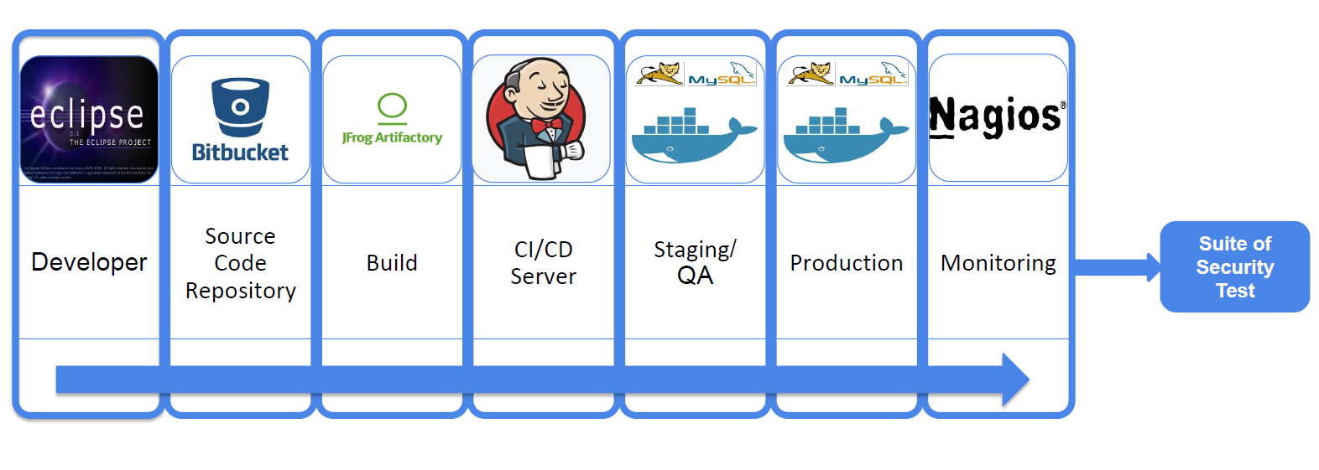
Shifting Left saves cost & time

Slide 19
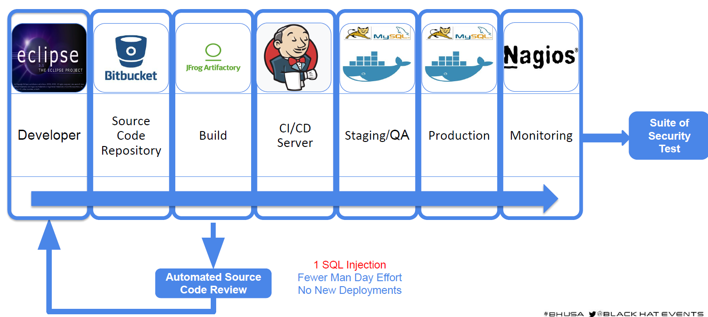
Shifting Left saves cost & time

Slide 20
How do we do DevSecOps?
DevSecOps is Automation + Cultural Changes
Integrate security tools into your DevOps Pipeline
Enable cultural changes to embrace DevSecOps

Slide 21
How does DevSecOps work?
Successful implementation of the DevSecOps practice consists of the following components.
Code analysis
Investigating the source code of an application for vulnerabilities and ensuring that it follows security best practices.
Change management
Track, manage, and report on changes related to the software or requirements. This prevents inadvertent security vulnerabilities due to a software change.
Compliance management
Complying with regulatory requirements (HIPAA, FedRAMP, and PCI).
Threat modeling
Investigate security issues that might arise before and after deploying the application. They fix any known issues and release an updated version of the application.
Security training
Security training involves training software developers and operations teams with the latest security guidelines.

Slide 22
DevSecOps culture
People
Remove the barriers between different disciplines and build a naturally collaborative environment where each person shares responsibility for a product’s security and quality.
Process
Security should be an integral part of each person’s work.
Automated security evaluations, security-focused unit testing, widespread monitoring, and defensive coding create rapid feedback loops where vulnerabilities are surfaced earlier in the product life cycle and can be fixed faster.
Products
Building the right toolchain in CI/CD to automate the identification of security issues.
Dependency scanning, static and dynamic application security testing, and automated policy enforcement tools are often used to help build security into every stage of the SDLC.
Governance
Continuous improvement is central to DevSecOps and it requires creating a culture of measurement that enables practitioners to identify opportunities to refine processes and tooling.

Slide 23
DevSecOps Toolchain

Slide 24
DevSecOps pipeline stages
Plan
In a DevSecOps practice, security starts at the planning stage in the SDLC pipeline.
This can include analyzing potential security threats and determining how to combat them with threat modeling.
It can also involve designing security into your products proactively to ensure it’s baked into the work from the beginning with key data hygiene and other security decisions taken up front.
Code
At the coding stage in a DevSecOps pipeline, it’s important to create a culture of defensive programming with policies that help practitioners proactively navigate security and compliance issues.
This could be as simple as specifying rules for how to handle particularly risky aspects of code, such as NULLs, or involve broader guidelines on areas such as input validation.

Slide 25
DevSecOps pipeline stages
Build
In the build stage, a typical DevSecOps pipeline will include automated security checks to catch vulnerabilities in source code before they hit the main branch.
This can involve using pre-commit hooks to run static application security testing (SAST) tools where any potential issues in code will stop the build, much like a failed test, and provide time to fix any potential vulnerabilities in proprietary source code before work can progress.
It should also include software composition analysis (SCA) tools to track open source components in the codebase and detect any vulnerabilities in dependencies.

Slide 26
DevSecOps pipeline stages
Test
The test stage of a DevSecOps pipeline is a key point where practitioners will develop a testing strategy and automated testing suite to catch any potential security vulnerabilities or issues.
This commonly includes using unit tests at a base level to look for security issues such as the way in which the application deals with unexpected or malformed input.
It can also include dynamic application security tests to find vulnerabilities in the application when run. This way, the test phase becomes as much as security as it does functionality.
A good tip at this stage is to integrate dynamic application security testing (DAST) into the DevSecOps pipeline.

Slide 27
DevSecOps pipeline stages
Release
In the release stage, a DevSecOps pipeline will often include additional automated security testing and vulnerability scanning to catch issues that might not have been apparent in earlier stages.
Some organizations will also deploy the principle of least privilege where each person and tool has access only to precisely what they need.

Slide 28
DevSecOps pipeline stages
Deploy
At the deployment stage, a DevSecOps practitioner will work to ensure that code makes it to production only if it has passed security checks at each previous stage.
This can involve applying automated tests to application code and the underlying infrastructure used to run the software in production to catch any run-time security concerns.
Operate and monitor:
In the operations and monitoring stages of a DevSecOps pipeline, organizations will often use application-level and infrastructure metrics to identify unusual activity that could indicate a security breach.
When an incident occurs, use logging and other instrumentation can be used to pinpoint the issue and understand its impact.

Slide 29
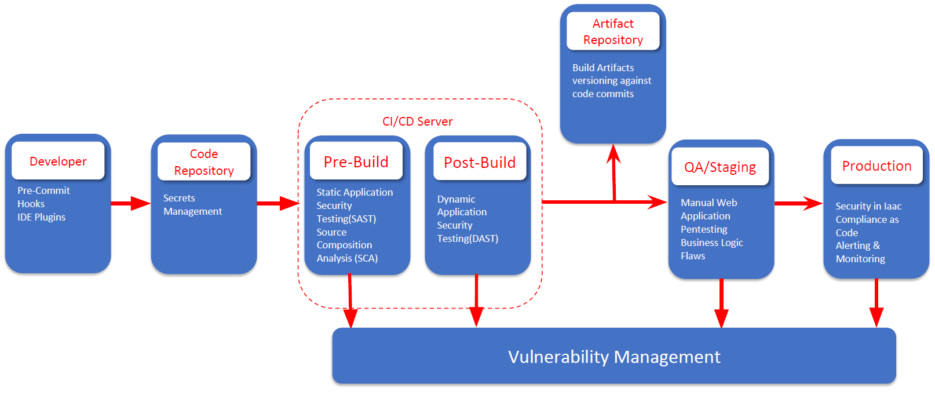
Injecting Sec in DevOps

Slide 30
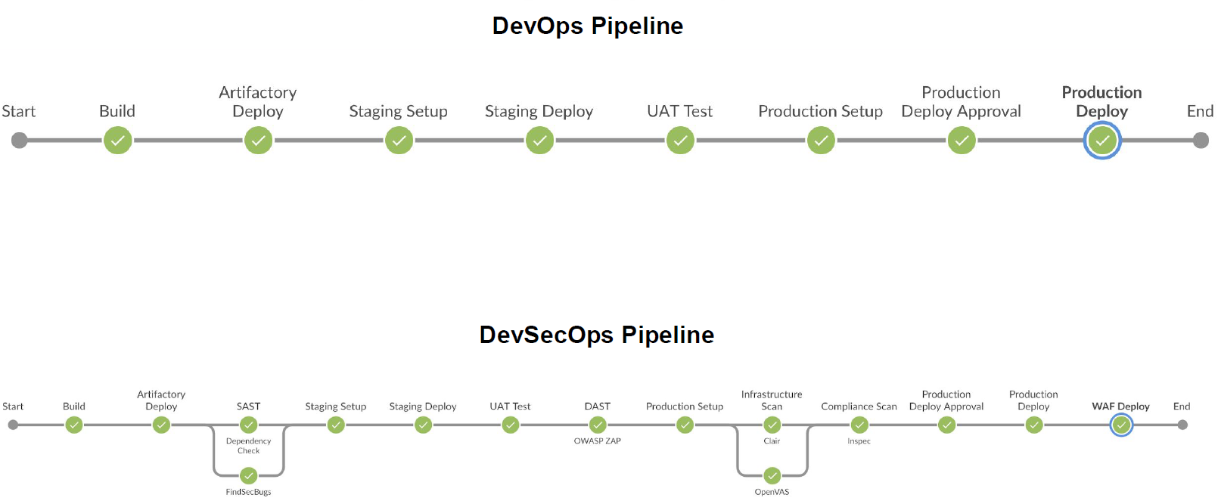
DevOps ---> DevSecOps

Slide 31
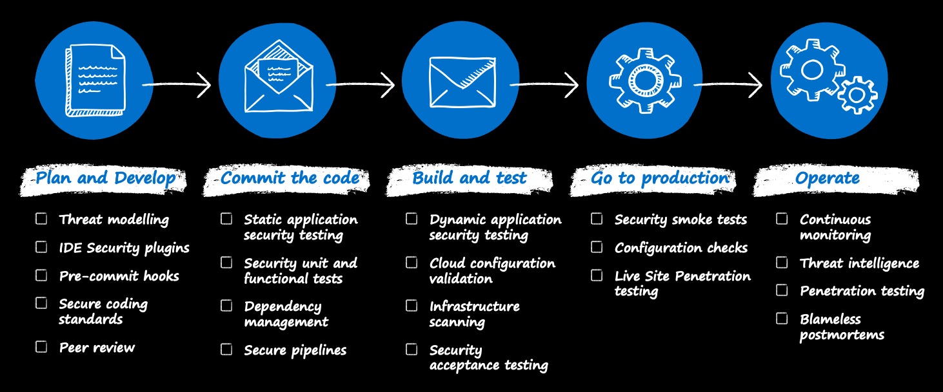
DevSecOps Toolchain

Slide 32
IDE Security Plugin
IDE Plugin's provide quick actionable pointer to developers
It is useful to stop silly security blunders
Work on pure Regex-based approach
If developers want they can circumvent this step hence use it like a defense in depth but don't fully rely on it

Slide 33
Pre-Commit Hooks
Sensitive information such as the access keys, access tokens, SSH keys etc. are often erroneously leaked due to accidental git commits
Pre-commit hooks can be installed on developer’s workstations to avoid the same
Work on pure Regex-based approach for filtering sensitive data
If developers want they can circumvent this step hence use it like a defense in depth but don't fully rely on it

Slide 34
DevSecOps Toolchain
Plan | Build | Test | Deploy | Observe
IriusRisk (TM) Jira Slack | OWASP Dependency-Check SonarQube SourceClear Snyk | BDD Automated Security Tests JBroFuzz OWASP ZAP IBM AppScan SecApp suite | Osquery Tripwire Chaos Monkey tool Ansible Puppet Docker | Imperva RASP Alert Logic Halo

Slide 35
DevSecOps automation principles
Automation should be strategic
Use automation to facilitate speed and quality across the SDLC. But just as being strategic is important in a DevOps practice, it’s equally—if not more—important to be strategic about how and when automation is applied in a DevSecOps environment.
Let people focus on being creative
Automate repetitive tasks wherever possible. That way, people can save their time and mental energy for more involved work while checks are applied more consistently and at scale.
Systematize code review
Use tools such as static application security testing to automate elements of your code review.
Human-led code review is still important though and it’s critical to ensure your code review checklist covers security issues specific to your technology stack.
Create a feedback cycle so each time a new information becomes available you build it into the checklist.

Slide 36
DevSecOps toolchain
Automated security tests on commits and merges
A basic goal of any DevSecOps practice is to catch issues in code before they can do harm by triggering automatic scans using pre-commit and merge triggers. Some of the scans organizations might implement include:
Code scanning: Often called static application security testing, this evaluates code at rest—in other words, without having to run it—to discover code that could lead to a vulnerability.
Vulnerability scanning: Dynamic application scanning tools build and deploy the application to a sandboxed environment and then observe how it responds to known security threats.
Secret scanning: Even with the most stringent policies, secrets occasionally make it into a commit. Secret scanning tools are used to catch them before the commit is made. These also pair with SCA tools, which are used to detect any vulnerabilities in open source dependencies within a given codebase.

Slide 37
DevSecOps toolchain
Configuration management
In DevSecOps, a general rule is it’s best to remove the uncertainty from systems configuration—and this is often accomplished by adopting infrastructure as code. Tools such as Docker, Terraform, and Ansible use YAML and similar configuration files that can be automatically scanned for issues, committed to version control, and rolled out automatically to multiple instances of a service.

Slide 38
DevSecOps toolchain
Container orchestration
In some environments, organizations may adopt a microservices architecture to better support complex, cloud-native applications. This requires maintaining multiple containers and scaling them as needed and securely—and that involves container orchestration tools. Just like configuration management tools, container orchestration tooling will often use YAML configuration files to dictate interactions between containers.

Slide 39
DevSecOps toolchain
Runtime verification
Also known as runtime application self-protection tools, these tools will actively monitor and/or direct threats towards your application as it runs with reports highlighting any vulnerabilities.
Continuous monitoring and reporting
One of the simplest yet highly effective aspects of DevSecOps tooling is measurement—and that involves logging everything at the application and infrastructure level. The best tools will provide real-time intelligence when something goes wrong and include a reporting system so you can catch issues early. Outbound data from an unexpected port, for example, could indicate a compromise but without monitoring and reporting it might go undetected.

Slide 40
What are common DevSecOps tools?
Static application security testing
Static application security testing (SAST) tools analyze and find vulnerabilities in proprietary source code.
Software composition analysis
Software composition analysis (SCA) is the process of automating visibility into open-source software (OSS) use for the purpose of risk management, security, and license compliance.
Interactive application security testing
DevSecOps teams use interactive application security testing (IAST) tools to evaluate an application’s potential vulnerabilities in the production environment. IAST consists of special security monitors that run from within the application.
Dynamic application security testing
Dynamic application security testing (DAST) tools mimic hackers by testing the application's security from outside the network.

Slide 41
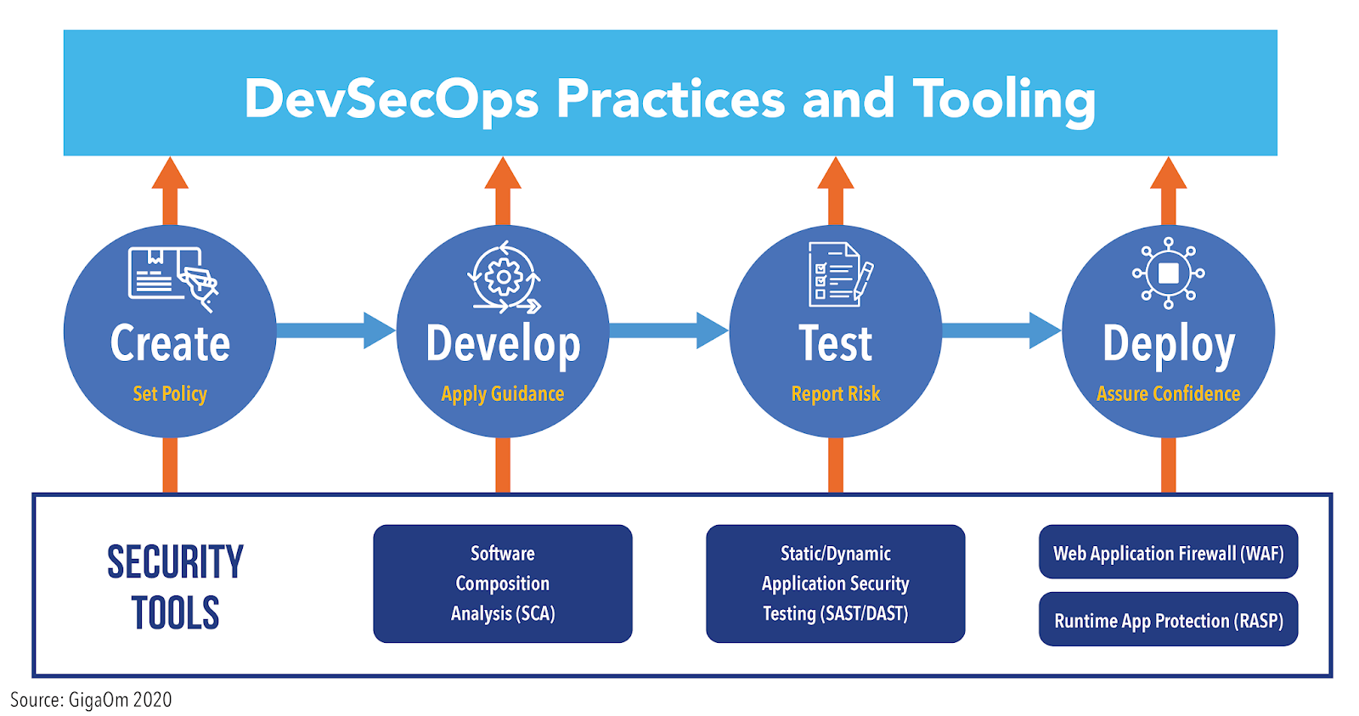
What are common DevSecOps tools?

Slide 42
Static Analysis Security Testing (SAST)
White-box security testing using automated tools
Useful for weeding out low-hanging fruits like SQL Injection, Cross-Site Scripting, insecure libraries etc
Tool by default configured with generic setting, needs manual oversight for managing false-positives

Slide 43
SAST
Static application security testing, also known as white-box testing, is a method, or tool, by which you can test code without running it.
Examples:
GitHub code scanning
Contrast CodeSec
Klocwork
SpectralOps
CodeSweep
Bandit

Slide 44
Software Composition Analysis (SCA)
We don’t write software's, we build on frameworks
Biggest portion of software is now third party libraries
Major languages provide module managements
PIP, NPM, Gems, go get, perl cpan, php packager and more
Software Composition Analysis performs checks to identify vulnerable/outdated 3rd party libraries

Slide 45
SCA
Software composition analysis (SCA) is an automated process that identifies the open source software in a codebase.
This analysis is performed to evaluate security, license compliance, and code quality.
Examples:
WhiteSource
Black Duck
GitHub Security
Snyk

Slide 46
IAST
Interactive application security testing (IAST) is an application security testing method that tests your application for vulnerabilities in execution, while the app is actually being used (either by a real user or an automated test runner).
Examples:
Contrast Community Edition (CE)
Invicti
Acunetix
Hdiv Detection (IAST)
Seeker IAST

Slide 47
Dynamic Analysis Security Testing (DAST)
Black/Grey-box security testing using automated tools
SAST may not get full picture without application deployment
DAST will help in picking out deployment specific issues
Results from DAST and SAST can be compared to weed out false-positives
Tools may need prior set of configuration settings to give good results

Slide 48
DAST
DAST (Dynamic Application Security Testing) is a type of testing that looks for security vulnerabilities by safely exploiting a running application from the outside.
This type of testing is not dependent on the framework or programming language used.
Examples:
Indusface WAS
Astra Pentest
PortSwigger
Detectify
AppCheck Ltd
AppScan
MisterScanner

Slide 49
Security in Infrastructure as Code
Infrastructure as a code allows you to document and version control the infra
It also allows you to perform audit on the infrastructure
Docker / K8s infra relies on base images
Environment is as secure as the base image
Base images need to be minimal in nature and need to be assessed to identify inherited vulnerabilities

Slide 50
Compliance as Code
Compliance could be industry standard (PCI DSS, HIPAA, SOX) or org specific
Compliance is essentially a set of rules and hence can be converted into written test cases
Having written code format this can again be version controlled

Slide 51
Vulnerability Management
All the tools discussed above result in report fatigue
Every tool has a different style of presentation
A central dashboard is required to normalize the data
Vulnerability Management System can then be integrated to bug tracking systems to allow devs to work on items

Slide 52
Alerting and Monitoring
Monitoring is needed for two end goals
Understand if our security controls are effective
What and where we need to improve
To test Security control effectiveness:
When did an attack occur
Was it blocked or not
What level of access was achieved
What data was bought in and bought out

Slide 53
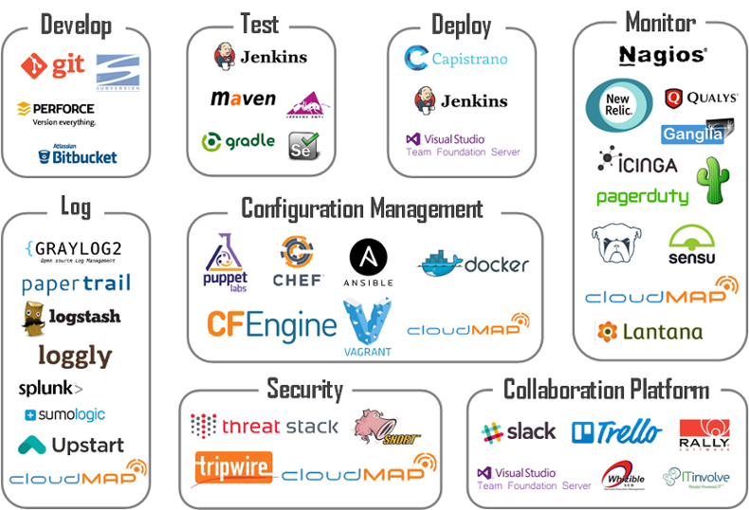
Final Look

Slide 54
Traits of successful DevSecOps practices

Slide 55
Traits of successful DevSecOps practices
If the goals of DevSecOps are
to release better software faster, and
to detect and respond to software flaws in production faster and more efficiently
What are the capabilities you should cultivate to achieve them?
What key performance indicators (KPIs) should you use to measure the quality of your DevSecOps initiatives?

Slide 56
Strong DevSecOps program characteristics
Security awareness and ownership
Everyone involved with development and operations should be aware of security fundamentals and have a sense of ownership in the results.
“security is everyone’s responsibility”.
Automated operation
To align with the high degree of automation present in most CI/CD tool chains, your DevSecOps security tooling needs to run with complete automation — no manual steps, no configurations, no custom scripts.
It needs to provide information about the security of your application even when your developers might want to avoid running a security test for fear that it would slow them down.

Slide 57
Strong DevSecOps program characteristics
Fast results
Your security tooling needs to produce results in near-real-time because speed is a high priority for modern DevOps teams.
Wide scope
Your security tooling should function across all types of compute environments including containers, Kubernetes, serverless, PaaS, hybrid clouds, and multiclouds. No blind spots. No silos.
Also, your security tooling needs to provide information about all types of applications — including applications that are mostly based on open-source software, as well as applications that you purchased from a third party, for which you have no source code at all.

Slide 58
Strong DevSecOps program characteristics
Shift-left and shift-right
Much has been written about the benefits of conducting security assessments early in the software development lifecycle (“shift left”), before vulnerabilities find their way into production.
However, DevSecOps also needs to extend to production environments (“shift right”) for four reasons:
Production is where most attacks happen.
Scanning source code can’t give you the same rich insights you can get by observing the application when it is running in production.
Some applications you run in production may not have run through your dev environment, so they never had a chance to be scanned by security tools in your dev environment.
To detect new zero-day vulnerabilities, you need to monitor existing applications in your production environment.

Slide 59
Strong DevSecOps program characteristics
Accuracy
Automation is important, but you also need accuracy and quality.
To achieve DevSecOps efficiency, you need security tests that eliminate false positives and false negatives, and provide useful information to your remediation team.
Developer acceptance
Everything about your DevSecOps program needs to be accepted by the people who will be developing the software, running the tests, scanning for vulnerabilities, and remediating the security issues that are found.

Slide 60
Cultural Aspect
Automation alone will not solve the problems
Encourage security mindset especially if outside sec team
Cultivate/Identify common goals for greater good
Build allies (security champions) in company
Focus on collaboration and inclusive culture
Avoid Blame Game

Slide 61
Security Champion
Bridge between Dev, Sec and Ops teams
Single Person per team
Everyone provided with similar cross skilling opportunities
Incentivize other teams to collaborate with Sec team
Internal Bug bounties
Sponsor Interactions (Parties / get-togethers)
Sponsor cross skilling trainings for other teams

Slide 62
Tools of The Trade

Slide 63
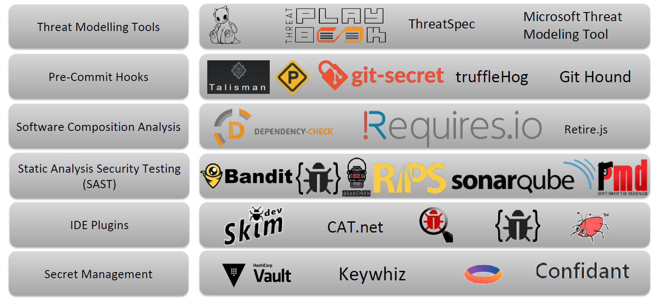
Tools of The Trade

Slide 64
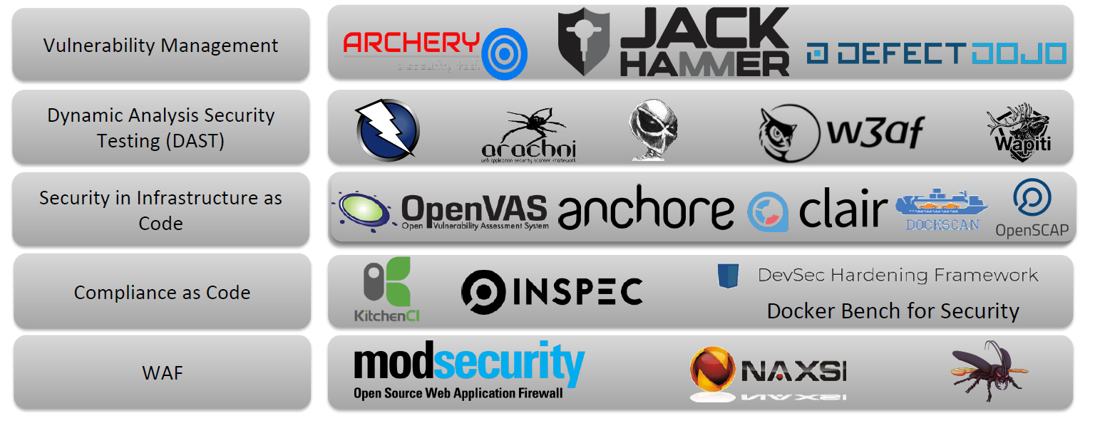
Tools of The Trade

Slide 65
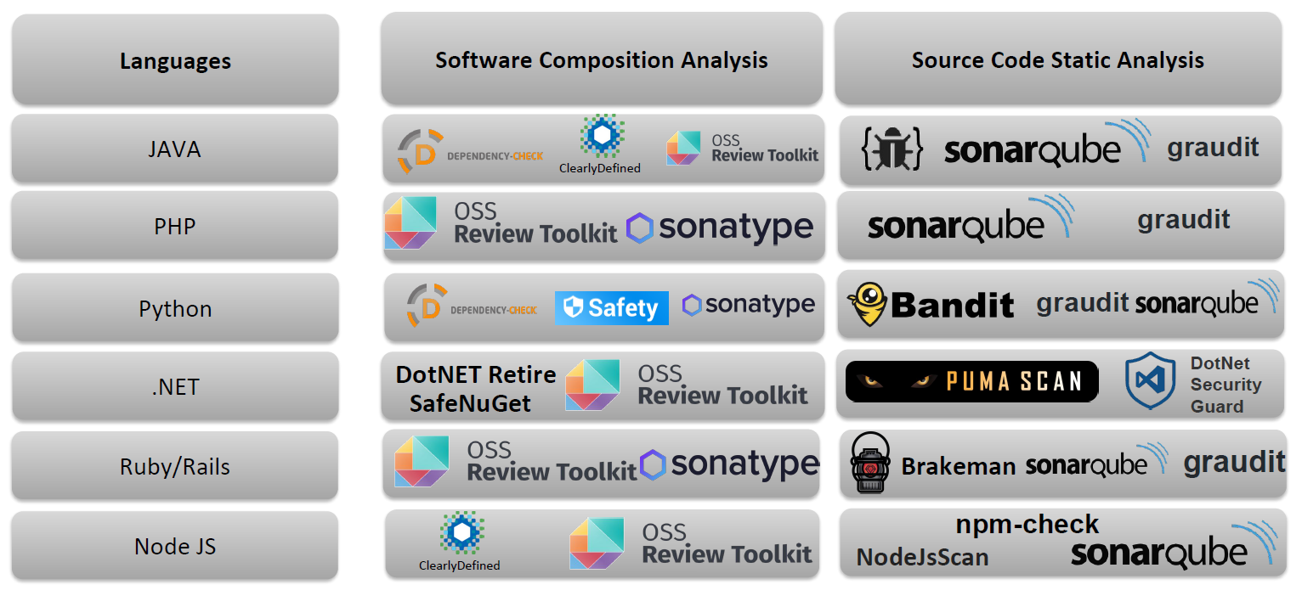
Language Specific Tools

Slide 66
Other Ops

Slide 67
Other Ops
The following terms are practices that aim to improve the efficiency and effectiveness of various operational workflows by leveraging automation, integration, and best practices.
FinOps
DataOps
MLOps
AIOps

Slide 68
FinOps
FinOps, or Financial Operations, is a set of practices that aims to optimize cloud spending in order to reduce costs and improve financial accountability.
FinOps involves a combination of cultural, organizational, and technical practices that enable organizations to better understand and optimize their cloud spending.

Slide 69
FinOps
FinOps is a relatively new practice that has emerged in response to the growing use of cloud computing services.
Cloud spending can be difficult to track and optimize, especially in large organizations with multiple cloud accounts and services.
FinOps aims to bridge the gap between finance and technology teams by establishing clear accountability for cloud spending and implementing best practices for cloud cost optimization.

Slide 70
DataOps
DataOps is a set of practices that aim to improve the speed, quality, and reliability of data analytics.
DataOps involves the automation of data pipelines, the use of agile methodologies, and the integration of data science and engineering teams.

Slide 71
DataOps
DataOps is an extension of DevOps that focuses specifically on data analytics workflows.
The goal of DataOps is to improve the quality and reliability of data analytics by streamlining data pipelines, improving collaboration between data science and engineering teams, and implementing agile methodologies for data analytics.

Slide 72
MLOps
MLOps, or Machine Learning Operations, is a set of practices that aims to improve the efficiency and effectiveness of machine learning workflows.
MLOps involves the automation of machine learning pipelines, the integration of machine learning and software engineering teams, and the development of tools and processes for managing machine learning models.

Slide 73
MLOps
MLOps is a relatively new field that has emerged in response to the growing use of machine learning in various industries.
MLOps aims to address the challenges of managing machine learning models at scale by automating the machine learning pipeline, integrating machine learning and software engineering teams, and implementing best practices for machine learning model management.

Slide 74
AIOps
AIOps, or Artificial Intelligence for IT Operations, is a set of practices that aims to improve the efficiency and reliability of IT operations using artificial intelligence and machine learning.
AIOps involves the automation of IT operations workflows, the integration of IT operations and data science teams, and the development of tools and processes for managing IT infrastructure.

Slide 75
AIOps
AIOps is a practice that uses artificial intelligence and machine learning to improve IT operations.
AIOps aims to enhance the reliability and efficiency of IT operations by automating IT workflows, detecting and resolving incidents more quickly, and identifying trends and patterns in IT data that might be difficult for humans to detect.

