Slide 1
Estimation
SE423: Software Project Management

Slide 2
Outline
Software Engineering

Slide 3
Estimation

Slide 4
Estimations
Very difficult to do, but needed often
Created, used or refined during
Strategic planning
Feasibility study and/or SOW
Proposals
Vendor and sub-contractor evaluation
Project planning (iteratively)
Basic process
Estimate the size of the product
Estimate the effort (person-months)
Estimate the schedule
NOTE: Not all of these steps are always explicitly performed

Slide 5
Estimations
Remember, an “exact estimate” is an oxymoron
Estimate how long will it take you to get home from class tonight
On what basis did you do that?
Experience right?
Likely as an “average” probability
For most software projects there is no such ‘average’
Most software estimations are off by 25-100%

Slide 6
Estimation
Target vs. Committed Dates
Target: Proposed by business or marketing
Do not commit to this too soon!
Committed: Team agrees to this
After you’ve developed a schedule
Size:
Small projects (10-99 FPs), variance of 7% from post-requirements estimates
Medium (100-999 FPs), 22% variance
Large (1000-9999 FPs) 38% variance
Very large (> 10K FPs) 51% variance

Slide 7
Basic Estimation Process
Created, used or refined during
Strategic planning
Feasibility study and/or SOW
Proposals
Vendor and sub-contractor evaluation
Project planning (iteratively)
Basic process
Estimate the size of the product
Estimate the effort (man-months)
Estimate the schedule
NOTE: Not all of these steps are always explicitly performed

Slide 8
Estimations
Remember, an “exact estimate” is an oxymoron
Estimate how long will it take you to get home from class today
On what basis did you do that?
Experience right?
Likely as an “average” probability
For most software projects there is no such ‘average’

Slide 9
Estimation
Target vs. Committed Dates
Target: Proposed by business or marketing
Do not commit to this too soon!
Committed dates: Team agrees to this

Slide 10
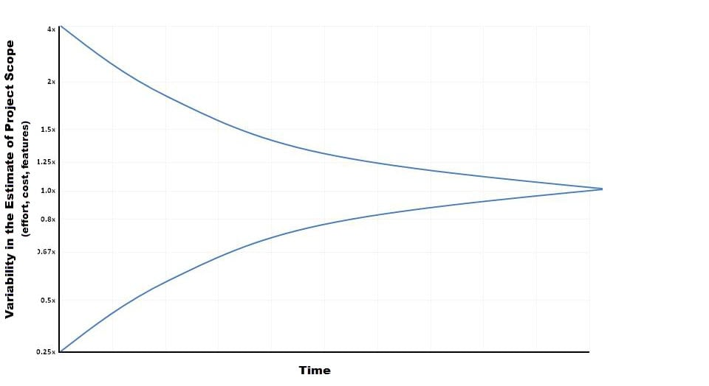
Cone of Uncertainty

Slide 11
Estimation Methodologies

Slide 12
Estimation Methodologies
Expert Judgment
Top-down
Bottom-up
Analogy
Priced to Win (request for quote – RFQ)
Parametric or Algorithmic Method
Using formulas and equations

Slide 13
Expert Judgment
Use somebody who has recent experience on a similar project
You get a “guesstimate”
Accuracy depends on their ‘real’ expertise
Comparable application(s) must be accurately chosen

Slide 14
Top-down Estimation
Based on overall characteristics of project
Some of the others can be “types” of top-down (Analogy, Expert Judgment, and Algorithmic methods)
Advantages
Easy to calculate
Effective early on (like initial cost estimates)
Disadvantages
Some models are questionable or may not fit
Less accurate because it doesn’t look at details

Slide 15
Bottom-up Estimation
Create WBS – Work Breakdown Structure, identify individual tasks to be done.
Add from the bottom-up
Advantages
Works well if activities well understood
Disadvantages
Specific activities not always known
More time consuming

Slide 16
Estimation by Analogy
Use past project
Must be sufficiently similar (technology, type, organization)
Find comparable attributes (ex: # of inputs/outputs)
Advantages
Based on actual historical data
Disadvantages
Difficulty ‘matching’ project types
Prior data may have been mis-measured
How to measure differences – no two exactly same

Slide 17
Priced to Win
Just follow other estimates
Save on doing full estimate
Needs information on other estimates (or prices)
Purchaser must closely watch trade-offs
Priced to lose?

Slide 18
Algorithmic Measures
Lines of Code (LOC)
Function points
Feature points or object points
Other possible
Number of bubbles on a DFD
Number of ERD entities
Number of processes on a structure chart
LOC and function points most common (of the algorithmic approaches)
Majority of projects use none of the above

Slide 19
Wideband Delphi
Group consensus approach
Rand Corp. used orig. Delphi approach in the 1940’s to predict future technologies
Present experts with a problem and response form
Conduct group discussion, collect anonymous opinions, then feedback
Conduct another discussion & iterate until consensus
Advantages
Easy, inexpensive, utilizes expertise of several people
Does not require historical data
Disadvantages
Difficult to repeat
May fail to reach consensus, reach wrong one, or all may have same bias

Slide 20
Code-based Estimates
LOC Advantages
Commonly understood metric
Permits specific comparison
Actuals easily measured
LOC Disadvantages
Difficult to estimate early in cycle
Counts vary by language
Many costs not considered (ex: requirements)
Programmers may be rewarded based on this
Can use: # defects/# LOC
Code generators produce excess code

Slide 21
LOC Estimates Issues
How do you know how many in advance?
What about different languages?
What about programmer style?
Stat: avg. programmer productivity: 3,000 LOC/yr
Most algorithmic approaches are more effective after requirements (or have to be after)

Slide 22
Function Points
Software size should be measured by number & complexity of functions it performs
More methodical than LOC counts
House analogy
House's Square Feet ~= Software LOC
# Bedrooms & Baths ~= Function points
Former is size only, latter is size & function
Four basic steps

Slide 23
Function Point Process
Count # of business functions per category
Categories: outputs, inputs, db inquiries, files or data structures, and interfaces
Establish Complexity Factor for each and apply
Simple, Average, Complex
Set a weighting multiplier for each (0 –>15)
This results in the “unadjusted function-point total”
Compute an “influence multiplier” and apply
It ranges from 0.65 to 1.35; is based on 14 factors
Results in “function point total”
This can be used in comparative estimates
[This is covered in detail in SE 468. See the SE 468 reading list for more information].

Slide 24
Effort Estimation
Now that you know the “size”, determine the “effort” needed to build it
Various models: empirical, mathematical, subjective
Expressed in units of duration
person-months (or ‘staff-months’ now)
Efficiency/productivity of people
Motivation
Ability of team
Application experience
Range of personnel

Slide 25
Duration
What is the duration? The duration of a project is the elapsed time in business working days, not including weekends, holidays, or other nonworking days.
Duration is different from work effort.
Work effort is labor required to complete an activity. That labor can be consecutive or nonconsecutive hours.
Duration is work effort divided by number of people doing the work:
Or, work effort is the duration multiplied by the number of people doing the work
E.g. five people reviewing a document; the duration may be 10 hours but the work effort is 50 staff-hours

Slide 26
Duration
When we talk about estimates and duration, there are two types of time that are not the same:
Labor Time
Clock time
For example, if we estimate that a task would require 40 hours of labor to complete, then in a normal business setting we need at least 50 business hours, Why?

Slide 27
Duration
Your average business day may include few of the following activities or perhaps a number of each:
Meetings – non-project related
Phone calls
E-mails
Coffee breaks
Lunches
Friendly chat with your teammates
The duration of the activity is the clock time or “Elapsed time” that we want to estimate.
Productivity is usually 50-75% of a business day

Slide 28
Variation in Activity Duration
Since we cannot know what factors will be effective when work is underway on an activity, we cannot know exactly how long it will take.
One of the goals in estimating the activity duration is to define the activity to a level of granularity that estimates have a narrow variance; the estimate is as good as you can get it at the planning stages of the project.
There are several causes of variation in the actual activity duration:
Varying skill levels – see Journal Exercise
Unexpected events
Efficiency of work time
Mistakes and Misunderstandings
Let's look at these in a bit more detail …

Slide 29
Causes of Variation
Causes of Variation in the Actual Activity Duration
Varying skill levels. Our estimate of the activity duration is based on average skilled engineer. We may get a higher or lower skilled engineer assigned to the activity, causing the actual duration to vary from the planned duration.
Unexpected events. Random acts of nature, vendor delays, traffic jams, power failures, etc.
Efficiency of work time. Every time a worker is interrupted it takes more time to get up to the level of productivity prior to the time of the interruption. These interruptions may have little or substantial impact on the worker's productivity
Mistakes and Misunderstandings. In organizations that have a documented process, rework may have its toll on the actual activity duration.

Slide 30
Estimation Issues
Quality estimations needed early but information is limited
Precise estimation data available at end but not needed
Or is it? What about the next project?
Should have determined just how accurate your original estimate was.
Best estimates are based on past experience
Politics of estimation:
You may anticipate a “cut” by upper management
For many software projects there is little or no data for estimation
Technologies change
Historical data unavailable
Wide variance in project experiences/types
Subjective nature of software estimation

Slide 31
Over and Under Estimation
Over estimation issues
The project will not be funded
Conservative estimates guaranteeing 100% success may mean funding probability of zero.
Parkinson's Law: Work expands to take the time allowed
Danger of feature and scope creep
Be aware of “double-padding”: team member + manager
Under estimation issues
Quality issues (short changing key phases like testing)
Inability to meet deadlines
Morale and other team motivation issues

Slide 32
Activity Resource Estimating

Slide 33
Introduction
Resource estimating is concerned with who/what, how much, and when
Who/what
Resource requirements of people or equipment
Matching the right resources to activities
May be generic (n Java programmers) or resource-specific (Richard Parker as senior architect)
How much. Amount of resource(s) needed for activity
When. When the resource will be needed for activities

Slide 34
Introduction
Controlling factors in resource estimating
Enterprise environment. May be defined by constraints and assumptions identified in Project Scope Statement
Organization policy. How the organization allocates and manages resources from within and from without
Note: Enterprise environment and organization policy may be closely-coupled
Resource availability. When the resource will be available for activities and whether dedicated or part-time

Slide 35
Estimating tools
Expert judgment. One of the most effective tools for estimating. May be used in conjunction with other tools
Alternative analysis. Examines different approaches to applying resources, such as in-house development vs. contracting vs. COTS
Published estimating data. May be available in-house in form of historical project data or may be available from outside sources (e.g. unclassified U.S. Government-funded projects)

Slide 36
Estimating tools
Project management software. PM software can provide automated assistance in defining resources, calendars, rates, etc.
Bottom-up estimating
Use if activity is a natural work package but still complex
Decompose activity into more manageable (estimable) pieces
Adhere to 100% rule: sum of activities should exactly equal work package (mind the scope!)
Example: Architectural quality and cost/benefit analysis (ATAM and CBAM)

Slide 37
Sidebar: Personal Software Process (PSP)
All the estimating tools in the world won't help if you don't have good estimates
Historical data has its limits – sometimes you need to estimate completely new activities
PSP is a highly-disciplined approach to software engineering (in this context, any software development)
PSP includes techniques in:
Time management and tracking through use of a design notebook and logs
Product planning, size measurement and estimation
Basic project scheduling and planning
Managing defects and product quality
Goal is to have developers who can provide accurate and meaningful estimation data
See SEI at CMU: http://www.sei.cmu.edu/tsp/tools/bok/

Slide 38
Activity Resource Estimating Output
Activity resource requirements
Identify what and how much of resource(s) are needed for each activity in a work package
Activity resource requirements are summed to provide estimate for entire work package
Resource calendar
Documents working and non-working days
Resource-specific holidays may be identified
Requested changes
Activity resource estimating process may generate requests for changes to activity list
Processed within the Integrated Change Control process

Slide 39
Activity Duration Estimating

Slide 40
Introduction
Focuses on estimating the number of work periods needed to complete individual schedule activities
Estimates originate from person or groups most familiar with the type of work needed in the activity
Estimate is progressively elaborated: duration estimates are improved as project progresses
Activity duration output
Quantitative activity duration estimates, including range of possible values

Slide 41
Introduction
Controlling factors in duration estimating
Historical data. If available, enterprise- or industry-specific historical data can be used as starting point for estimates
Activity resource requirements. The type and number of resources applied to an activity must account for
Resource qualifications
Quantity-quality productivity trade-offs: putting more people on a task may reduce productivity
Resource calendars. Must account for full/part time commitments

Slide 42
Sidebar: A useful rule of thumb
Keep all times in the same units
Don't mix increments
Example: Schedule everything in hours, then convert to days and fractions as a last step
Note: Most PM software tools enforce this rule by using a uniform time unit and increment

Slide 43
Estimating tools
Expert judgment. As in resource estimating, one of the most effective tools for estimating. May be used in conjunction with other tools
Analogous estimating. Estimation based on similar activities performed in a previous project
Most useful if both activity and project are more similar than different
Document similarities and differences
Example: Developing the database schema for a project in the same domain and of similar scope

Slide 44
Estimating tools
Reserve analysis. Contingency or time reserves can be added to schedule to allow for schedule risks
Contingency reserves may be used or adjusted as more precise project information becomes available
Aka buffer time. Do not confuse with slack time.
Three-point estimating techniques use a mathematical combination of three different estimates: Most likely, Optimistic, and Pessimistic
There are variations in defining each of these estimates among different techniques

Slide 45
Three Point Estimating
Used whenever there is a potential variance in an estimate. Assumes a Gaussian distribution of estimates.
Duration
Effort
Size
Three-point estimating techniques use a mathematical combination of three different estimates:
Get estimates from experts: Most likely, Optimistic, and Pessimistic
Compute an average: (Optimistic + 4(Likely)+ Pessimistic)/6
See Appendix: PERT Estimation Technique for more details and a worked example.

Slide 46
Example: Estimation of LOC
CAD program to represent mechanical parts
Estimated LOC = (Optimistic + 4(Likely)+ Pessimistic)/6
Major Software Functions | ID | Opt-imistic | Most Likely | Pess-imistic | Estimated LOC
User interface and control facilities | UICF | 1,500 | 2,300 | 3,100 | 2,300
Two-dimensional geometric analysis | 2DGA | 3,800 | 5,200 | 7,200 | 5,300
Three-dimensional geometric analysis | 3DGA | 4,600 | 6,900 | 8,600 | 6,800
Database management | DBM | 1,600 | 3,500 | 4,500 | 3,350
Computer graphics display features | CGDF | 3,700 | 5,000 | 6,000 | 4,950
Peripheral control | PC | 1,400 | 2,200 | 2,400 | 2,100
Design analysis modules | DAM | 7,200 | 8,300 | 10,000 | 8,400
Estimated lines of code |  | 23,800 | 33,400 | 41,800 | 33,200

Slide 50
Function Points
Software size measured by number & complexity of functions it performs
More methodical than LOC counts
House analogy
House’s Square Feet ~= Software LOC
# Bedrooms & Baths ~= Function points
Former is size only, latter is size & function
Six basic steps

Slide 51
Code Reuse and Estimation
Does not come for free
Code types: New, Modified, Reused
If code is more than 50% modified, it’s “new”
Reuse factors have wide range
Reused code takes 30% effort of new
Modified is 60% of new
Integration effort with reused code almost as expensive as with new code

Slide 52
Estimation for Agile
Each user scenario is considered separately
The scenario is decomposed into a set of engineering tasks
Each task is estimated separately
May use historical data, empirical model, or experience
Scenario volume can be estimated (LOC, FP, use-case count, etc.)
Total scenario estimate computed
Sum estimates for each task
Translate volume estimate to effort using historical data
The effort estimates for all scenarios in the increment are summed to get an increment estimate

Slide 53
Effort Estimation
Now that you know the “size”, determine the “effort” needed to build it
Various models: empirical, mathematical, subjective
Expressed in units of duration
Man-months (or ‘staff-months’)

Slide 54
COnstructive COst Model (COCOMO)
Barry Boehm – 1980’s
COnstructive COst MOdel
Input – LOC, Output - Person Months
Allows for the type of application, size, and “Cost Drivers”
Cost drivers using High/Med/Low & include
Motivation, Ability of team, Application experience, etc.
Biggest weakness?
Requires input of a product size estimate in LOC

Slide 55
Estimation Issues
Quality estimations needed early but information is limited
Precise estimation data available at end but not needed
Or is it? What about the next project?
Best estimates are based on past experience
Politics of estimation:
You may anticipate a “cut” by upper management
For many software projects there is little or none
Technologies change
Historical data unavailable
Wide variance in project experiences/types
Subjective nature of software estimation

Slide 56
Over and Under Estimation
Over estimation issues
The project will not be funded
Conservative estimates guaranteeing 100% success may mean funding probability of zero.
Parkinson’s Law: Work expands to take the time allowed
Danger of feature and scope creep
Be aware of “double-padding”: team member + manager
Under estimation issues
Quality issues (short changing key phases like testing)
Inability to meet deadlines
Morale and other team motivation issues

Slide 57
Know Your Deadlines
Are they ‘Real Deadlines’?
Tied to an external event
Have to be met for project to be a success
Ex: end of financial year, contractual deadline, Y2K
Or ‘Artificial Deadlines’?
Set by arbitrary authority
May have some flexibility (if pushed)

Slide 58
Estimation Presentation
How you present the estimation can have huge impact
Techniques
Plus-or-minus qualifiers
6 months +/-1 month
Ranges
6-8 months
Risk Quantification
+/- with added information
+1 month of new tools not working as expected
-2 weeks for less delay in hiring new developers
Cases
Best / Planned / Current / Worst cases
Coarse Dates
Q3 02
Confidence Factors
April 1 – 10% probability, July 1 – 50%, etc.

Slide 59
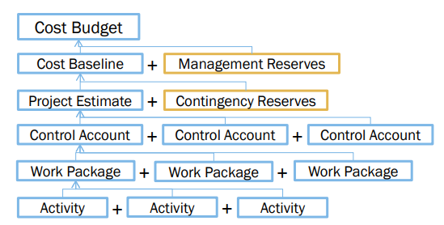
Final Estimates
For Time or Cost Estimates:
Aggregation into larger units (Work Packages, Control Accounts, etc.)
Perform Risk Analysis to calculate Contingency Reserves (Controlled by PM)
Add Management Reserves: Set aside to cover unforeseen risks or changes (Total company funds available – requires Change Control activities to access)

Slide 60
Estimation Guidelines
Estimate iteratively!
Process of gradual refinement
Make your best estimates at each planning stage
Refine estimates and adjust plans iteratively
Plans and decisions can be refined in response
Balance: too many revisions vs. too few

Slide 61
Other Estimation Factors
Account for resource experience or skill
Up to a point
Often needed more on the “low” end, such as for a new or junior person
Allow for “non-project” time & common tasks
Meetings, phone calls, web surfing, sick days
There are commercial ‘estimation tools’ available
They typically require configuration based on past data

Slide 62
Other Estimation Notes
Remember: “manage expectations”
Parkinson’s Law
“Work expands to fill the time available”
The Student Syndrome
Procrastination until the last minute (cram)

Slide 63
Function Points

Slide 64
Function Points Process
Count # of business functions per category
Categories: outputs, inputs, db inquiries, files or data structures, and interfaces
Establish Complexity Factor for each and apply
Simple, Average, Complex
Set a weighting multiplier for each (0->15)
This results in the “unadjusted function-point total”
Compute an “influence multiplier” and apply
It ranges from 0.65 to 1.35; is based on 14 factors
Results in “function point total”
This can be used in comparative estimates

Slide 65
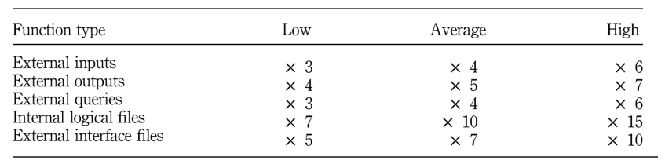
Function Points Estimation
Each function is divided into one of five categories, then multiplied by the appropriate number below

Slide 66
What is COCOMO?
COnstructive COst MOdel
An algorithmic software cost estimation model
Developed by Barry W. Boehm
Uses a basic regression formula with parameters that are derived from historical project data and current project characteristics

Slide 67
Basic COCOMO – Effort Applied
E = a(KLOC)^{b}
Where
E is the Effort in staff months
a and b are coefficients to be determined
KLOC is thousands of lines of code

Slide 68
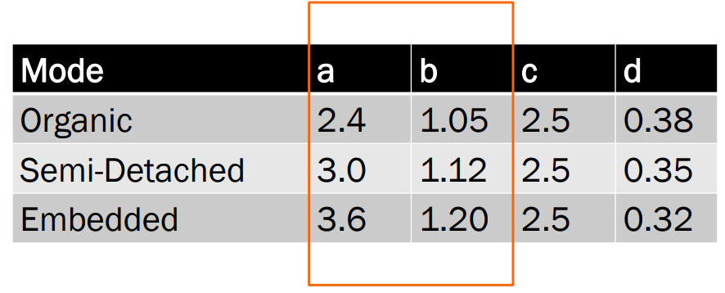
Basic COCOMO – More Constants

Slide 69
Basic COCOMO – The Modes
Organic
2-50 KLOC, small, stable, little innovation
Semi-detached
50-300 KLOC, medium-sized, average abilities, medium timeconstraints
Embedded
> 300 KLOC, large project team, complex, innovative, severe constraints

Slide 70
Basic COCOMO – Example
Suppose size is 200 KLOC
Organic
2.4(200)1.05= 626 staff-months
Semi-Detached
3.0(200)1.12= 1,133 staff-months
Embedded
3.6(200)1.20= 2,077 staff-months

Slide 71
Basic COCOMO – Development Time
TDEV = c(E)^{d}
Where
TDEV is time for development
c and d are constants to be determined
E is the effort

Slide 72
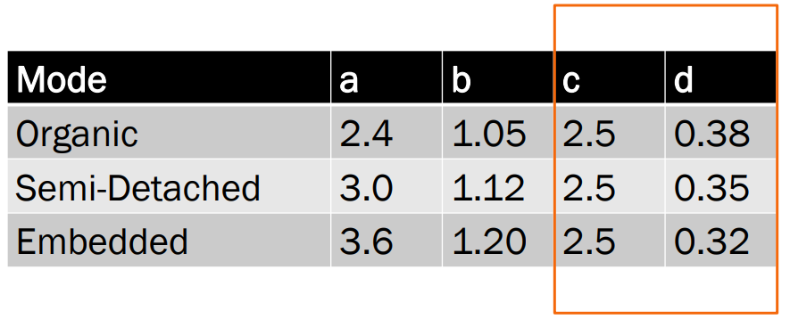
Basic COCOMO – More Constants

Slide 73
Basic COCOMO – Example
Suppose size is 200 KLOC
Organic
E = 626 staff months
TDEV = 2.5(626)0.38= 29 months
Semi-Detached
E = 1,133
TDEV = 2.5(1133)0.35= 29 months
Embedded
E = 2077
TDEV = 2.5(2077)0.32= 29 months

Slide 74
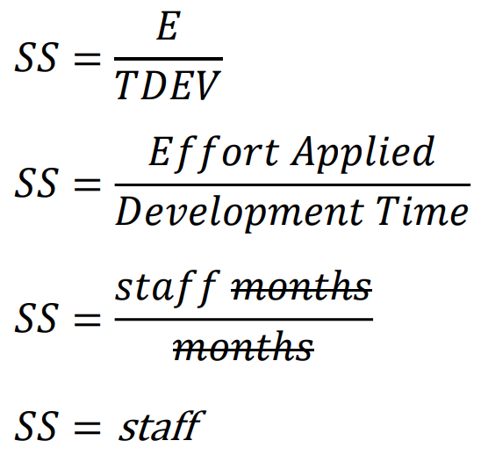
Basic COCOMO – Average Staff Size

Slide 75
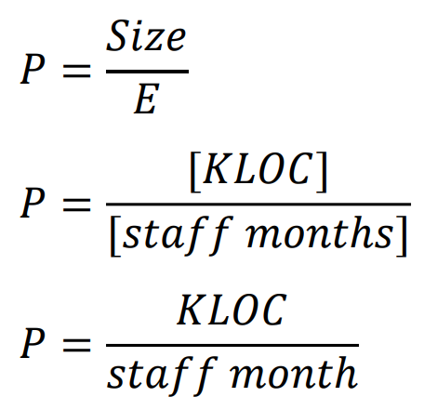
Basic COCOMO – Productivity

Slide 76
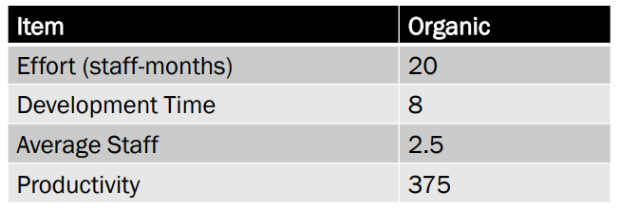
COCOMO Complete Example - Organic
Suppose an organic project has 7.5 KLOC,
Effort 2.4(7.5)1.05= 20 staff–months
Development time 2.5(20)0.38= 8 months
Average staff 20 / 8 = 2.5 staff
Productivity 7,500 LOC / 20 staff-months = 375 LOC / staff-month

Slide 77
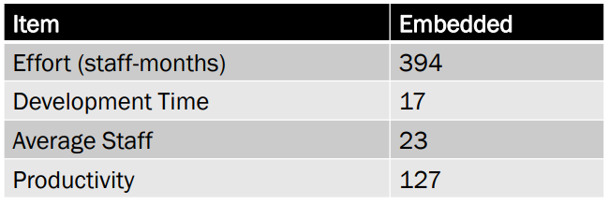
COCOMO Complete Example - Embedded
Suppose an embedded project has 50 KLOC,
Effort 3.6(50)1.20= 394 staff–months
Development time 2.5(394)0.32= 17 months
Average staff 394 / 17 = 23 staff
Productivity 50,000 LOC / 394 staff-months = 127 LOC / staff-month

Slide 78
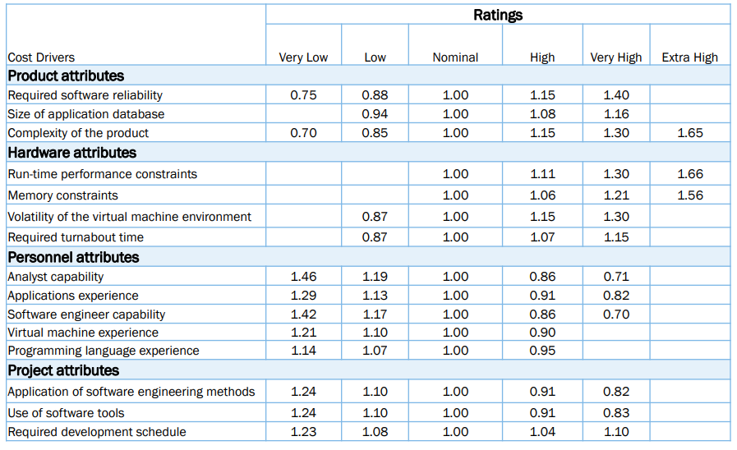
Intermediate COCOMO – Cost Drivers

Slide 79
Intermediate COCOMO – Effort
E = a(KLOC)^{b} x C
Where
E is the Effort
a and b are constants as before
KLOC is thousands of lines of code
C is the effort adjusted factor

Slide 80
Intermediate COCOMO – Cost Drivers
Intermediate COCOMO introduces Cost Drivers
They are used because
they are statistically significant to the cost of the project; and
they are not correlated to the project size (KLOC)
To obtain multiplier
Determine each number using the grid
Multiply them – the product is C

Slide 81
COCOMO Advantages
Based on history
Repeatable
Unique adjustment factors
Has different modes
Works well on similar projects
Highly calibrated
Well-documented
Easy to use

Slide 82
COCOMO Limitations
Ignores requirements volatility
Ignores documentation
Ignores customer’s “skill”
Oversimplifies security
Ignores software safety
Ignores personnel turnover
Ignores many hardware issues
Personnel experience may be obsolete
Must know the cost drivers
Must be able to predict project size

