Slide 1
Quality
SE423: Software Project Management

Slide 2
Outline
Software Engineering

Slide 3
Software Engineering

Slide 4
Software Quality
A definition of quality should emphasize three important points:
Software requirements are the foundation from which quality is measured. Lack of conformance to requirement is lack of quality.
Specified standards define a set of development criteria that guide the manner in which software is engineered. If the criteria are not followed, lack of quality will almost surely result.
There is a set of implicit requirements that often goes unmentioned (e.g. good maintainability). If software conforms to its explicit requirements but fails to meet implicit requirements, software quality is suspect.

Slide 5
Software Testing
The purpose of software testing is to assess and evaluate the quality of work performed at each step of the software development process.
Although it sometimes seems that way, the purpose of testing is NOT to use up all the remaining budget or schedule resources at the end of a development effort.
The goal of testing is to ensure that the software performs as intended, and to improve software quality, reliability and maintainability.
Software testing is a full-life-cycle assessment of quality

Slide 6
Quality and Testing
A good development process, tools, methods, and people go far in providing quality products
Testing is one aspect of assuring software quality
It is a measure of quality, it does not deliver quality
“Quality cannot be tested into a product”
Software Quality Assurance includes
Software engineering process improvement
Prevent the insertion of defects
Fault tolerant software design
Tolerate the existence of defects
All aspects of software verification and validation
Including testing

Slide 7
Errors, Defects, Faults and Failures
Failures are usually a result of system errors (which turn into defects) that are derived from faults in the system
However, faults do not necessarily result in system failures
The faulty system state may be transient and ‘corrected’ before an error arises
Errors do not necessarily lead to system failures
The error can be corrected by built-in error detection and recovery
The failure can be protected against by built-in protection facilities
For example, protect system resources from system errors

Slide 8
Build Time VS Run Time
Defect prevention and reduction
Fault detection and containment
Human (developer) Error
Software Defect (bug)
Build time
System
Fault
System
Failure
Run time
Latent (dormant) defect

Slide 9
Verification VS Validation
Verification:
“Are we building the product right?”
The software should conform to its design
Validation:
“Are we building the right product?”
Validate requirements
“Did we build the right product?”
Validate implementation
The software should do what the user really requires
V&V: Build the right product and build it right!

Slide 10
The V&V Process
V&V is a whole life-cycle process
V & V must be applied at each stage in the software process
V&V has two principal objectives
The discovery of defects in a system
The assessment of whether or not the system is usable in an operational situation

Slide 11
Static and Dynamic V&V Activities
Software testing:
Concerned with exercising and observing product behavior
Dynamic V&V
Software inspections:
Concerned with studying software product artifacts to discover defects
Static V&V
May be supplemented by tool-based (semi-automated) document and code analysis

Slide 12
V&V Confidence
Depends on:
System’s purpose
Criticality of software function
Mission critical (organization depends on it)
Safety critical
Societal impact
User expectations
Marketing environment
Cost-benefit trade-offs
High confidence is expensive. Is it necessary?

Slide 13
How Do you plan for V&V
At each stage of the software development process, there are activities that should be done which will help develop the testing plans and test cases
Remember: V&V is expensive.
Plan to do it right the first time!

Slide 14
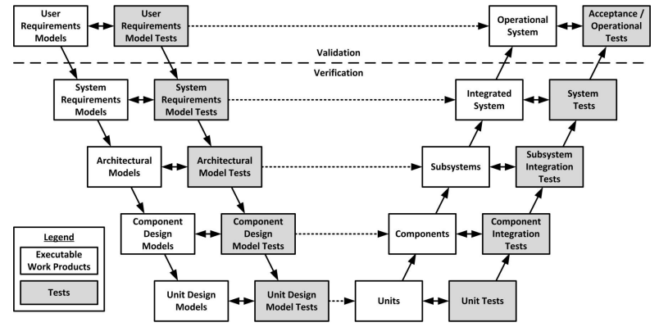
The V Model
Plan and develop tests throughout the life cycle
Implement tests when there is an implementation ready to test
Iterative and incremental: Repeat “V” at each iteration

Slide 16
Quality Assurance
Quality as a System and a Process

Slide 17
Goal of Quality Assurance
Quality assurance (QA) activities strive to ensure:
Few, if any, defects remain in the software system when it is delivered
Remaining defects will cause minimal disruptions or damages

Slide 18
Planning Quality
The following need to be considered: Scope, Stakeholders, Risks, Internal and External Environmental Factors, Process
Project-specific standards and procedures are created
Based on quality standards for each deliverable
Includes how PM activities themselves should be done
Plans/Project must comply with external standards (CISG, ISO 9000, OSHA, etc)
Plans/Project must comply with organizational standards
Plans/Project must meet the customer’s quality standards
Tracking / Proof may be needed (metrics, measurements, etc.)

Slide 19
QA Techniques Classification
Defect Prevention
Remove (human) error sources
Block defects from being injected into software artifacts
Defect Reduction
Detect defects
Inspection
Testing
Remove defects
Debugging—iterate on the software engineering activity
Rework requirements, design, code, etc.
Defect Containment
Fault tolerance
Fault containment

Slide 20
Defect Prevention
Remove the root causes of errors
Education and training address human misconceptions that cause errors
Domain and product knowledge
Software engineering process
Technology knowledge
Formal methods can help identify and correct imprecise specifications, designs and implementations
Standards conformance, use of best practices and patterns can help prevent fault injection

Slide 21
Defect Reduction
Discover and remove defects
Inspection: direct fault detection
requirements, design, code, manuals, test cases
Testing: failure observation and fault isolation
Execute the software and observe failures
Use execution history/records to analyze and locate fault(s) and defect(s) causing the failure

Slide 22
Defect Reduction - Issues with Testing
Need implemented software to execute
Need software instrumentation, execution history to:
isolate faults
trace to defects
Impossible to test everything
Expensive to test most things
Risk of too much and not enough testing
Use project risks to guide investment

Slide 23
Defect Reduction - Testing Sweet Spot
Quantity
Number of missed defects
Cost of testing
Amount of Testing
Under-testing
Optimal Amount of Testing
Over-testing

Slide 24
Defect Reduction - Risk
Denotes a potential negative impact that may arise from some present process or from some future event.
What is your risk exposure to a defect that is hidden?
Likelihood of defect existence
Likelihood of failure occurrence
Impact if failure occurs
Risk exposure determines ...
Testing priority
Testing depth
What to test and not to test

Slide 25
Defect Containment
Software fault tolerance
Safety-critical or mission-critical software often must be fault tolerant
The system can continue in operation in spite of a fault occurrence
Techniques: exception handling, recovery blocks
Software failure containment
Fault detection and isolation
Techniques:
safety interlocks,
physical containment (barriers),
disaster planning, etc.

Slide 26
Example
Input to Software Development
Software System
Faults
Usage Scenarios and Results
Failures
Error
Sources
e1
e2
e3
e4
f1
f2
x1
Failure
Containment
f3
x2
e5
f4
e6
Error
Removal
Fault
Removal
Failure
Prevention
a b
“a” causes “b” defect barrier/remover
Legend
a
a
removal of “a”
presence of “a”

Slide 28
Quality Control
"Quality must be built in at the design stage. It may be too late once plans are on their way."
– W. Edwards Deming
Notes:
Deming, W. Edwards. Out of the Crisis, MIT Center for Advanced Engineering Study, 1992.
Dr. Deming was invited to participate in the reconstruction of Japan after World War II. His goal was to not repeat the mistakes made by American corporations. In the 1940s, many of America's manufacturers started to adopt statistical quality control processes, but these efforts only solved individual problems. Quality Control departments were created to track quality using control charts and statistics. However, this action took quality control away from everyone else. Deming felt this was wrong, as "quality control is everyone's job." Instead, quality control departments were now putting out fires, rather than focusing on process improvements.

Slide 29
Perform quality control
Perform quality control is concerned with monitoring specific project results for compliance with quality standards
Performed throughout project
May also include taking control actions to correct causes of quality problems
Perform quality assurance is the process that provides the framework of activities and standards for performing quality control

Slide 30
Role of the SQA Group – I
Form a Software Quality Assurance Group
Prepares an SQA plan for a project.
The plan identifies
evaluations to be performed
audits and reviews to be performed
standards that are applicable to the project
procedures for error reporting and tracking
procedures for change management
documents to be produced by the SQA group
amount of feedback provided to the software project team
Participates in the development of the project’s software process description.
The SQA group reviews the process description for compliance with organizational policy, internal software standards, externally imposed standards (e.g., ISO-9001), and other parts of the software project plan.

Slide 31
Role of the SQA Group – II
Reviews software engineering activities to verify compliance with the defined software process.
identifies, documents, and tracks deviations from the process and verifies that corrections have been made.
Audits designated software work products to verify compliance with those defined as part of the software process.
reviews selected work products; identifies, documents, and tracks deviations; verifies that corrections have been made
periodically reports the results of its work to the project manager.
Ensures that deviations in software work and work products are documented and handled according to a documented procedure.
Records any noncompliance and reports to senior management.
Noncompliance items are tracked until they are resolved.

Slide 32
Software Quality Assurance
The area of Software Quality Assurance can be broken down into a number of smaller areas such as
quality of planning,
formal technical reviews,
Testing
and
training.
Here we take a look at Formal Technical Review methods and Testing ...

Slide 33
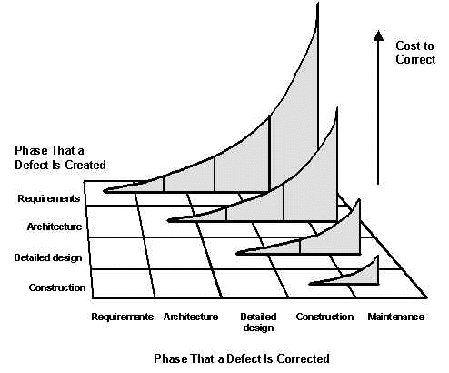
Formal Technical Reviews
Software quality assurance activity performed by software engineers to:
Uncover errors in function, logic, implementation.
Verify that the software meets requirements.
Represented using correct standards.
Achieve uniformity.
Manage projects.
Walkthroughs
Inspections (Code Reading)
Round-robin reviews
[See notes and next slides for description/discussion of the above terms.]
Notes:
http://www.stevemcconnell.com/articles/art04.htm
The least formal and most common kind of review is the walkthrough, which is any meeting at which two or more developers review technical work with the purpose of improving its quality. Walkthroughs are useful to rapid development because you can use them to detect defects earlier than you can with testing.
Code reading is a somewhat more formal review process than a walkthrough but nominally applies only to code. In code reading, the author of the code hands out source listings to two or more reviewers. The reviewers read the code and report any errors to the code's author. Inspections are the most formal kind of technical review, and they have been found to be extremely effective in detecting defects throughout a project. Developers are trained in the use of inspection techniques and play specific roles during the inspection process. The "moderator" hands out the material to be inspected before the inspection meeting. The "reviewers" examine the material before the meeting and use checklists to stimulate their reviews. During the inspection meeting, the "author" paraphrases the material, the reviewers identify errors, and the "scribe" records the errors. After the meeting, the moderator produces an inspection report that describes each defect and indicates what will be done about it. Throughout the inspection process you gather data about defects, hours spent correcting defects, and hours spent on inspections so that you can analyze the effectiveness of your software-development process and improve it.
http://alumnus.caltech.edu/~leif/OO/ReviewTraining.html
Round Robin Each reviewer gets to present their comments on the product. The reviewers present one comment at a time. The person to the left of the leader starts, the reviewer to their left goes next, and so on, around the table (telephonic attendees are assigned an arbitrary order).

Slide 34
Formal Technical Reviews
Walkthroughs
The least formal and most common kind of review is the walkthrough, which is any meeting at which two or more developers review technical work with the purpose of improving its quality.
Walkthroughs are useful to rapid development because you can use them to detect defects earlier than you can with testing.
Notes:
http://www.stevemcconnell.com/articles/art04.htm
The least formal and most common kind of review is the walkthrough, which is any meeting at which two or more developers review technical work with the purpose of improving its quality. Walkthroughs are useful to rapid development because you can use them to detect defects earlier than you can with testing.
Code reading is a somewhat more formal review process than a walkthrough but nominally applies only to code. In code reading, the author of the code hands out source listings to two or more reviewers. The reviewers read the code and report any errors to the code's author. Inspections are the most formal kind of technical review, and they have been found to be extremely effective in detecting defects throughout a project. Developers are trained in the use of inspection techniques and play specific roles during the inspection process. The "moderator" hands out the material to be inspected before the inspection meeting. The "reviewers" examine the material before the meeting and use checklists to stimulate their reviews. During the inspection meeting, the "author" paraphrases the material, the reviewers identify errors, and the "scribe" records the errors. After the meeting, the moderator produces an inspection report that describes each defect and indicates what will be done about it. Throughout the inspection process you gather data about defects, hours spent correcting defects, and hours spent on inspections so that you can analyze the effectiveness of your software-development process and improve it.
http://alumnus.caltech.edu/~leif/OO/ReviewTraining.html
Round Robin Each reviewer gets to present their comments on the product. The reviewers present one comment at a time. The person to the left of the leader starts, the reviewer to their left goes next, and so on, around the table (telephonic attendees are assigned an arbitrary order).

Slide 35
Formal Technical Reviews
Inspections and Code Reading
Code reading is a somewhat more formal review process than a walkthrough but nominally applies only to code.
In code reading, the author of the code hands out source listings to two or more reviewers. The reviewers read the code and report any errors to the code's author.
Notes:
http://www.stevemcconnell.com/articles/art04.htm
The least formal and most common kind of review is the walkthrough, which is any meeting at which two or more developers review technical work with the purpose of improving its quality. Walkthroughs are useful to rapid development because you can use them to detect defects earlier than you can with testing.
Code reading is a somewhat more formal review process than a walkthrough but nominally applies only to code. In code reading, the author of the code hands out source listings to two or more reviewers. The reviewers read the code and report any errors to the code's author. Inspections are the most formal kind of technical review, and they have been found to be extremely effective in detecting defects throughout a project. Developers are trained in the use of inspection techniques and play specific roles during the inspection process. The "moderator" hands out the material to be inspected before the inspection meeting. The "reviewers" examine the material before the meeting and use checklists to stimulate their reviews. During the inspection meeting, the "author" paraphrases the material, the reviewers identify errors, and the "scribe" records the errors. After the meeting, the moderator produces an inspection report that describes each defect and indicates what will be done about it. Throughout the inspection process you gather data about defects, hours spent correcting defects, and hours spent on inspections so that you can analyze the effectiveness of your software-development process and improve it.
http://alumnus.caltech.edu/~leif/OO/ReviewTraining.html
Round Robin Each reviewer gets to present their comments on the product. The reviewers present one comment at a time. The person to the left of the leader starts, the reviewer to their left goes next, and so on, around the table (telephonic attendees are assigned an arbitrary order).

Slide 36
Formal Technical Reviews
Inspections and Code Reading
Inspections are the most formal kind of technical review, and they have been found to be extremely effective in detecting defects throughout a project.
Developers are trained in the use of inspection techniques and play specific roles during the inspection process.
The "moderator” hands out the material to be inspected before the inspection meeting.
The "reviewers" examine the material before the meeting and use checklists to stimulate their reviews.
During the inspection meeting, the "author" paraphrases the material, the reviewers identify errors, and the "scribe" records the errors.
After the meeting, the moderator produces an inspection report that describes each defect and indicates what will be done about it.
Throughout the inspection process you gather data about defects, hours spent correcting defects, and hours spent on inspections so that you can analyze the effectiveness of your software-development process and improve it.
Notes:
http://www.stevemcconnell.com/articles/art04.htm
The least formal and most common kind of review is the walkthrough, which is any meeting at which two or more developers review technical work with the purpose of improving its quality. Walkthroughs are useful to rapid development because you can use them to detect defects earlier than you can with testing.
Code reading is a somewhat more formal review process than a walkthrough but nominally applies only to code. In code reading, the author of the code hands out source listings to two or more reviewers. The reviewers read the code and report any errors to the code's author. Inspections are the most formal kind of technical review, and they have been found to be extremely effective in detecting defects throughout a project. Developers are trained in the use of inspection techniques and play specific roles during the inspection process. The "moderator" hands out the material to be inspected before the inspection meeting. The "reviewers" examine the material before the meeting and use checklists to stimulate their reviews. During the inspection meeting, the "author" paraphrases the material, the reviewers identify errors, and the "scribe" records the errors. After the meeting, the moderator produces an inspection report that describes each defect and indicates what will be done about it. Throughout the inspection process you gather data about defects, hours spent correcting defects, and hours spent on inspections so that you can analyze the effectiveness of your software-development process and improve it.
http://alumnus.caltech.edu/~leif/OO/ReviewTraining.html
Round Robin Each reviewer gets to present their comments on the product. The reviewers present one comment at a time. The person to the left of the leader starts, the reviewer to their left goes next, and so on, around the table (telephonic attendees are assigned an arbitrary order).

Slide 37
Formal Technical Reviews
Round-robin reviews Each reviewer gets to present their comments on the product. The reviewers present one comment at a time. The person to the left of the leader starts, the reviewer to their left goes next, and so on, around the table (telephonic attendees are assigned an arbitrary order).
More discussion on Reviews: Round-Robin ReviewTraining Plan <http://alumnus.caltech.edu/~leif/OO/ReviewTraining.html>
Notes:
http://www.stevemcconnell.com/articles/art04.htm
The least formal and most common kind of review is the walkthrough, which is any meeting at which two or more developers review technical work with the purpose of improving its quality. Walkthroughs are useful to rapid development because you can use them to detect defects earlier than you can with testing.
Code reading is a somewhat more formal review process than a walkthrough but nominally applies only to code. In code reading, the author of the code hands out source listings to two or more reviewers. The reviewers read the code and report any errors to the code's author. Inspections are the most formal kind of technical review, and they have been found to be extremely effective in detecting defects throughout a project. Developers are trained in the use of inspection techniques and play specific roles during the inspection process. The "moderator" hands out the material to be inspected before the inspection meeting. The "reviewers" examine the material before the meeting and use checklists to stimulate their reviews. During the inspection meeting, the "author" paraphrases the material, the reviewers identify errors, and the "scribe" records the errors. After the meeting, the moderator produces an inspection report that describes each defect and indicates what will be done about it. Throughout the inspection process you gather data about defects, hours spent correcting defects, and hours spent on inspections so that you can analyze the effectiveness of your software-development process and improve it.
http://alumnus.caltech.edu/~leif/OO/ReviewTraining.html
Round Robin Each reviewer gets to present their comments on the product. The reviewers present one comment at a time. The person to the left of the leader starts, the reviewer to their left goes next, and so on, around the table (telephonic attendees are assigned an arbitrary order).

Slide 38
“QA” & Testing
Testing “Phases”
Unit
Integration
System
User Acceptance Testing
Testing Types
Black-box
White-box
Static vs. Dynamic Testing
Automated Testing
Pros and cons
Defect tracking
Integration: 2 types
Top down
Bottom up

Slide 39
Defect Rates
In general, defect rate is the number of defects over the opportunities for errors during a specified time frame
Defect rate found during formal machine testing is usually positively correlated with defect rate experienced in the field
Tracking defects and rates allow us to determine the quality of the product and how mature it is.

Slide 40
Defect Metrics
Open Bugs (outstanding defects)
Ranked by severity
Open Rates
How many new bugs over a period of time
Close Rates
How many closed (fixed or resolved) over that same period
Ex: 10 bugs/day
Change Rate
Number of times the same issue updated
Fix Failed Counts
Fixes that didn’t really fix (still open)
One measure of “vibration” in project

Slide 41
Defect Metrics
Why do we measure defects? Why do we track the defect count when monitoring the execution of software projects? What does this tell us?
Defect counts indicate how well the system is implemented and how effectively testing is finding defects.
Low defect counts may mean that testing is not uncovering defects.
Defect counts that continue to be high over time may indicate a larger problem,
inaccurate requirements, incomplete design and coding, premature testing, lack of application knowledge, or inadequately trained team.
Defect trends provide a basis for deciding on when testing has completed. When the number of defects found falls dramatically, given a constant level of testing, the product is becoming stable and moving to the next phase is feasible. Look at the next slide.
[See also notes.]
Notes:
We track defect count when monitoring the execution of the software projects to analyze how well our system which we have implemented is working; i.e. the system efficiency. We all know that the main goal of testing is not to make the entire code bug free ( its impossible) rather the goal is to identify and reduce the number of defects or errors as much as possible so that the task can be identified as "complete".
Tracking the defect count helps us ensure that the testing phase was conducted properly and completely. If, during counting, more defects are founds, it might indicate issues such as incomplete design task , testing phase not conducted properly, unskilled workforce etc. Thus, once the team obtains a certain number of defects at a constant rate after improving the above mentioned causes of errors, then they can assign the task to be complete and can move on to next task.

Slide 42
The Rayleigh Distribution
If we graph defects over time they will show a Rayleigh distribution
R_{c} =
k is a constant representing the time at which defects peak.
Note the tail to the distribution.
We see this same curve in other areas as well. Specifically in reliability and quality.
t
e^{-t2/2k2}
k²
Defect frequency
k
Time
Notes:
Schach p 254.

Slide 43
Basic tools of quality
Cause-and-effect (fishbone, Ishikawa) diagram
Shows the relationship between the effects of problems and their causes
See lecture 6 slide 50-52 and PMP Study Guide, p. 261
Process flowcharts
Graphical representation of a project process that can help identify where problems occur
Example on lecture 6 slide 53

Slide 44
Basic tools of quality
Control chart
Maps the variation of a project variable (e.g. number of defects) as a function of time relative to a baseline value and within boundaries of ±3σ
Baseline may be established after sufficient project variable data are available
Acceptable upper and lower boundaries of variable values are called the Upper Control Limit (UCL) and Lower Control Limit (LCL), respectively

Slide 45
Basic tools of quality
Control Chart
Upper Control Limit
+3σ
+2σ
+1σ
Number of Defects
Baseline value
-1σ
-2σ
-3σ
Lower Control Limit
Baseline establishment
Time

Slide 46
Histogram
A graphic representation of frequency counts of a sample or population
X-axis lists the unit intervals of a parameter like defect severity level and Y-axis contains frequency counts
Purpose is to show the distribution characteristics of the parameter

Slide 47
Pareto Diagram
A frequency bar chart in descending order by types of problems or defects
X-axis is usually the defect cause and Y-axis is the defect count
Identifies the few causes that account for the majority of defects
Commonly see a 80-20 pattern -- 80% of the defects from 20% of the causes

Slide 48
Basic tools of quality
12
100
10
75
6
8
Number of Defects
Number of Defects
% of Defects
4
6
50
2
4
25
2
Team A
Team B
Team C
Team D
Histogram
Team C
Team A
Team B
Team D
Pareto Chart

Slide 49
Run Charts
Tracks the performance of the parameter of interest over time
X-axis is time and Y-axis is the value of the parameter
Best used for trend analysis
Especially useful if historical data is available for comparisons with the current trend
Frequently used for project management
A run chart is a more general version of a control chart: it is mostly used for trend analysis rather than project control decisions. Look for patterns.

Slide 50
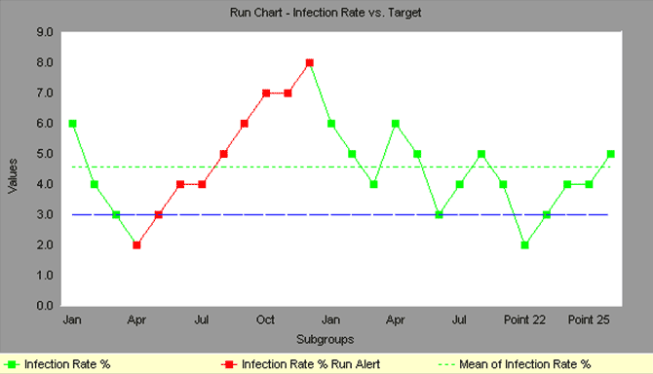
Run Chart
Notes:
Run Charts, also known as line graphs, display process performance over time. Run Charts Six Sigma, as sometimes they called, are one of the primary quality tools used in process improvement.
Upward and downward trends, cycles, and large aberrations may be spotted and investigated further. In a run chart, events, shown on the y axis, are graphed against a time period on the x axis.
For example, a run chart in a hospital might plot the number of patient transfer delays against the time of day or day of the week. The results might show that there are more delays at noon than at 3 p.m. Investigating this phenomenon could point to potential improvement needs.
Run charts can also be used to track improvements that have been put into place, checking to determine their success. For example, a Before/After chart can be displayed as a run chart.
Also, an average line can be added to a run chart to clarify movement of the data away from the average.

Slide 51
Scatter Diagram
Vividly portrays the relationship of two variables, if any.
For a cause-effect relationship, the X-axis is the independent variable and the Y-axis is for the dependent variable
Each point represents an observation of both variables
x-y plot showing the relationship between two project variables
Aid in looking for relationships between two variables
A mathematical equation representing relationship between variables can be found using regression analysis (simple or multivariate)
Scatter plots are useful for finding direct or indirect relationships which can then be used to analyze/improve quality.
Correlation is not causation!!

Slide 52
Project Duration Scatter Diagram
Notes:
Quickly see if two variables are related.
Go for quick and dirty numbers.
Correlation is not causality. A relationship does not indicate a direct connection only that Variable 1 influences Variable 2 - there may be a deeper connection.
Find the relationship quickly!

Slide 53
Change Management
"It is not necessary to change. Survival is not mandatory."
– W. Edwards Deming
Notes:
Deming, W. Edwards. Out of the Crisis, MIT Center for Advanced Engineering Study, 1992.
Dr. Deming was invited to participate in the reconstruction of Japan after World War II. His goal was to not repeat the mistakes made by American corporations. In the 1940s, many of America's manufacturers started to adopt statistical quality control processes, but these efforts only solved individual problems. Quality Control departments were created to track quality using control charts and statistics. However, this action took quality control away from everyone else. Deming felt this was wrong, as "quality control is everyone's job." Instead, quality control departments were now putting out fires, rather than focusing on process improvements.

Slide 54
Integrated Change Control
Integrated Change Control is a project management integration knowledge area process concerned with project change requests
The Perform Integrated Change Control process is carried out from project inception through completion
All changes must be carefully controlled to maintain the integrity and consistency of the project plan
Change control encompasses review, evaluation, approval/rejection, and managing and coordinating approved changes

Slide 55
Integrated change control
Recognizes that projects will often require changes to the established project plan
All changes must be carefully controlled to maintain the integrity and consistency of the project plan
Integrated change control encompasses all aspects of change to the project:
Reviewing and approving requested changes
Managing the changes when they actually occur
Controlling elements of the project management plan (scope, cost, budget, schedule, and quality) in response to changes
Controlling changes to requirements, design, code and documentation.

Slide 56
Change or Configuration Control
Configuration Management Plan
Change & Version control
Items:
Code (source for product)
Documents: requirements, design, test plans, user guides
Plans and data bases (MS project, etc.)
Scripts for testing
Software development plan and other process documents

Slide 57
Integrated Change Control
In some projects, the Integrated Change Control process includes a change control board (CCB)
The CCB is a formally chartered group responsible for reviewing, evaluating, approving, delaying, or rejecting changes to the project, and for recording and communicating such decisions
Note that changes have a potentially greater impact in CPM scheduling:
Changes on the critical path have greatest impact while those off the critical path have less
Changes in CCM scheduling require adjustments to buffers
The same responses to change are needed, but the impact to the schedule may be less severe than in CPM

Slide 58
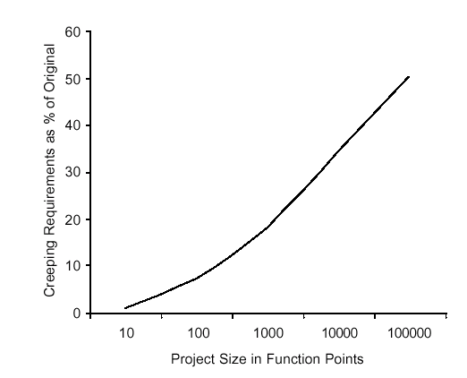
Change Control
Average project has 25% requirements change
Overly detailed specs. or prolonged requirements phase are not the answer
Sources of change
Change control is a process
Change Control Board (CCB)
Structure, process, triage

Slide 59
Control the Change – I
Need for change is recognized
Change request is submitted as a “request for change” (RFC) or engineering change order (ECO)
Developer or PM team evaluates: impact and desirability
Change report is generated
Change control authority (CCB) makes a decision to either:
Deny request.
Change request is denied
User is informed
Proceed
If change is approved:
Request is queued for action. ECO (Engineering Change Order) is generated.
Individuals assigned to configuration objects.
Objects checked out and change made.
Change audited.
Baseline established.
If it is a Software Configuration Item (SCI)
Perform SQA and testing activities
Check-in the changed objects

Slide 60
Control the Change – II
For Software Configuration Items (SCI)
Promote SCI for inclusion in next release
Rebuild appropriate version
Include all changes in release
Review/audit the change
Perform Verification and Validation [testing activities]
Distribute new version

Slide 61
Control the Change – III
Use a change management system (COTS) and a change tracking system.
Ideal if they are integrated: aka Comprehensive Software Change Management
SCM (Source code management)
Perforce – multi-platform client/server solution
ClearCase (IBM/Rational)
Subversion
CVS
Issue/defect tracking software
Perforce – multi-platform client/server solution
ClearQuest (IBM/Rational) offers comprehensive software change management

Slide 62
Agile Perspective:
Integrated Change Control

Slide 63
Integrated change control
The agile change control process is not controlled by a change review board and the project manager
Product changes are owned and managed by the customer
Process changes are owned by the team
The project manager facilitates collaborative discussion of changes between the customer and the team
Integrated Change Control maps to ‘continuous backlog management’ in an agile project

Slide 64
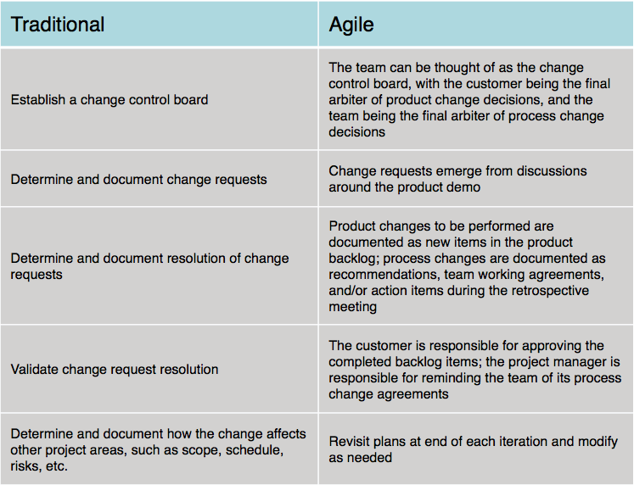
Summary comparison

Slide 65
Stakeholder Management

Slide 66
Introduction
Stakeholder Management is the process of developing appropriate management strategies for all project stakeholders
The process goal is to effectively engage stakeholders throughout the project life cycle
It analyzes their needs, interests, and potential impact on project success
The process provides a plan for interacting with project stakeholders with the project's interests as its goal

Slide 67
Stakeholder Management
Inputs
Project charter
Procurement documents
Enterprise environmental factors
Organizational process assets
Tools & Techniques
Stakeholder analysis
Expert judgment
Meetings
Outputs
Stakeholder register
Stakeholder management plan

Slide 68
Stakeholder register
The stakeholder register is the primary output from the Identify Stakeholders process. For each stakeholder, the register contains:
Name
Position in organization
Location
Role in project
Contact information
List of stakeholder’s major requirements
List of stakeholder’s main expectations
Potential inﬂuence on the project
Phase in the lifecycle of most interest
A stakeholder classiﬁcation. This may include internal/external; supporter/neutral/resister; and high/medium/low inﬂuence/power/ impact/interest

Slide 69
Stakeholders
Stakeholder engagement levels can be classiﬁed as:
Unaware. Unaware of project and its potential impacts
Resistant. Aware of project and its potential impacts and resistant to the changes anticipated by the project
Neutral. Aware of project and neither supportive nor resistant
Supportive. Aware of project and its potential impacts and supportive of the changes anticipated by the project
Leading. Aware of project and its potential impacts and actively engaged in ensuring the project’s success

Slide 70
Stakeholder management plan
The stakeholder management plan identiﬁes the management strategies required to effectively engage stakeholders
The stakeholder management plan supplements the information in the stakeholder register with:
Desired and current engagement levels of key stakeholders
Scope and impact of change (due to project) to stakeholders
Identiﬁed interrelationships and potential overlap between stakeholders
Stakeholder communication requirements
Information to be distributed to stakeholders, including language, format, content, and level of detail

Slide 71
Stakeholder management plan
The stakeholder management plan supplements the information in the stakeholder register with (cont’d):
Reason for the distribution of that information and the expected impact on stakeholder engagement
Time frame and frequency for the distribution of required information to stakeholders
Method for updating and reﬁning the stakeholder management plan as the project progresses and develops
The stakeholder management plan contains sensitive information—appropriate precautions are needed to safeguard its information and prevent its inappropriate disclosure

Slide 72
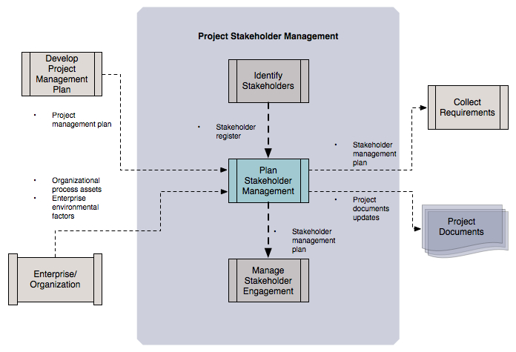
Stakeholder management plan
Adapted from Figure 13-6 PMBOK Guide, 5th Edition

Slide 73
Useful if conditions warrant
From the agile perspective, identifying stakeholders is a valuable process: the more inclusive your understanding of stakeholders, the better
Agile promotes the idea that transparency is the best policy
Agile utilizes information radiators: information tools (e.g., a project wiki) that make project information—including progress and impediments—visible to all interested stakeholders
This minimizes the chances for miscommunication and effectively short-circuits the rumor mill

Slide 74
Useful if conditions warrant
In some cases Stakeholder Management advocates tailoring information access and ﬂow to the individual stakeholder
Though this approach may be warranted in some situations—volatile, highly-politicized project, for example—it is not without its risks:
“Project managers should be aware of the sensitive nature of the stakeholder management plan and take appropriate precautions. For example, information on stakeholders who are resistant to the project can be potentially damaging, and due consideration should be given regarding the distribution of such information.”*
Analogies:
Private- vs. public-key encryption mechanisms
Proprietary vs. open-source software security
*From Ch. 13.2.3.1, PMBOK Guide, 5th Edition

Slide 75
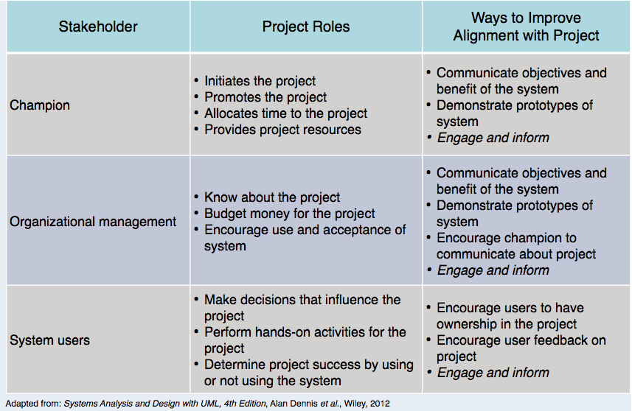
Sidebar: Important stakeholders

Slide 76
Final Stages

Slide 77
Other Final Steps
Roll-Out
Release Check-List
Training
More than just end-users
Users, systems ops, maintenance developers, sales
Documentation
Many types: End-user, sales & marketing, operations, design
Migration
Moving users from existing system to your new one
Maintenance and Support
We’ll discuss each of these …

Slide 78
Rollout
Create a “Release Checklist”
Avoid activities falling through the cracks
Activities by Group:
Engineering, QA, Documentation, Operations
Possibly sign-off signatures
Roll-out: Must have a plan for the process
Often on a given day (ex: a Sat.)
Must be a very detailed plan

Slide 79
Shipping Details
Packaging (if commercial product)
Marketing collateral
Security mechanisms (if commercial product)
Licensing
Plan
Mechanism

Slide 80
Installation
Scripts
Uninstall (if not Web-based)
If you need to install your software (as on PCs):
Don’t underestimate:
Time this takes to develop
Importance of a “first impression”
Or, if “custom” software you’re reselling
Installation at site is often a “mini-project”

Slide 81
Training
Often more than just end-users
Users
Sales & Marketing staff
System operators
Maintenance engineers (possibly)
Sales engineers (possibly)
(Technical) Support staff

Slide 82
Documentation
Must be ready by ship-date
Final user documentation
On-line help
Updates to other
Operations documentation
Development documentation
Sales and marketing material
Web site
Test reports
Release notes

Slide 83
Migration
Migration is the process of moving from the old application/system to the new
Migration Plan
Back-out Plan
Data Conversion

Slide 84
Migration Plan
Includes
Description of environment (computers, DBs, interfaces)
Description of existing data needed
Description of operational constraints (ex: when can we move to the new system? Weekends only? Last week of month only?)
List of affected organizations and contacts
Plan of steps to be taken
Does it require a service interruption?
If so, when does this happen? A weekend?
Training?
Is there a help-desk?
If so, do they have “scripts” or new material?

Slide 85
Migration Strategies
Communication with customers is crucial
Importance of 2-way communication
What is happening, when, and why
“Why” should remind them of the benefits
Not too much detail or too little
Where do customers go for more information?
Minimize intrusiveness
Find-out about customer’s key dates
When does the system absolutely need to be stable?
Know about their important deadline dates
They must buy-into the approach!

Slide 86
Migration Strategies
Considerations:
Level of business disruption
Degree of latitude in “production” date
How much internal opposition to system is there?
If higher, perhaps a longer ‘adjustment’ period
Your comfort level of system quality
If questionable, may want to mitigate risk

Slide 87
Migration Strategies
Flash-Cut migration
Straight-move from old system to new
Immediate Replacement
Fastest approach
Still want a back-out plan
Requires strong planning and testing
Parallel Operation
Mitigates risk
Parallel to either existing manual or system process
Cut occurs once new system “burned-in”
Staged migration
Replace one part of existing system at a time

Slide 88
Flash-Cut
Immediate Replacement
Ex: new corporate-wide calendar system
Requires very careful planning & testing
Still try to get some users to “try” it first if possible
Develop a back-out plan

Slide 89
Cutover
Criteria: What conditions must be met prior?
Responsibility: Who decides?
Operations: Who ‘owns’ it once it’s live?
Rehearsals: Sometimes used.

Slide 90
Back-Out Plan
Especially important for “conversions”
Customers already have expectations and needs as defined by their existing system
Must be able to restore customer’s service ASAP
May mean running both simultaneously “just in case”
Leave it in place for awhile (more than a day!)
When to fall-back?
Mgmt: sooner, Tech: one-more-fix
Set a time limit (ex: 3 hours of start)
Data recovery and migration back to old system

Slide 91
Data Conversion
Most systems need this step
Most PMs forget this
Impacts both completely new and replacement systems
The “data” often more valuable than the “system”
Data Conversion Areas
Data Sources:
Where does it come from?
Do you need to modify data on the way in?
Is it accurate?
Process Controls:
Does it happen all at once?
How do you guarantee it’s been done correctly?
Completion:
How do you handle any ‘exceptions’?
Do you make backups? Can you restart?

Slide 92
Parallel Operation
Multiple variations of this method
An “adoption” period
See telephone industry with new area codes
Both work for a period of time
Strategies
Avoid flash-cuts if possible
Start with test subjects

Slide 93
Concluding Software Projects
Seems simple, often isn’t
Potential Issues
Last-minute change requests
“One more feature”
Disputes of fulfillment of all requirements
Often “interpretation” issues
Keeping the team motivated
Difficult transition to maintenance

Slide 94
Maintenance Phase
Need a support plan and a maintenance plan [should be part of project plan]
The “No respect” phase
Less “glamorous”
Lack of enthusiasm
Pressure to make fixes quickly
For “production” problems
Software can become “hacked” “patchwork” over time
Finding a support & test platform can be difficult
Often the forgotten child until fixes are needed

Slide 95
Maintenance Phase
Compare to hardware maintenance
Not to keep state same; but changes to state
Fixes and enhancements
Configuration control is very important
Fixing the “right” version; tracking branches
Project management not always carried over
Smaller team
Often not a ‘dedicated team’
Drawn from developers with other main tasks

Slide 96
Maintenance Phase
Contracts, remember those?
Always consider the maintenance phase here
Often via a “labor hours” contract
Time & materials in a “direct” scenario
Otherwise via “maintenance contract”
Percentage of software license fee
Ex: 20% of original cost per year
Corp. budget if internal/IS projects
Often annual/monthly “maintenance” allocations

Slide 97
Project in Trouble
A student asked: “What if the project cannot meet the schedule?”
Level with the sponsor
Move some features/requirements to a second phase
Use Resource Leveling Techniques
Fast tracking – two activities in parallel
Activity shifting – Move start/end dates forward or backward
Activity splitting – Break an activity into two or more pieces
Activity stretching – Use less of a given resource continuously
Resource substitution – Assign a different resource
Allocating overtime – Work resources longer
Re-evaluate tasks: effort and need

Slide 98
Project Recovery
How to save a “drowning project”
3 Approaches
Cut the size of the software
Increase process productivity
Slip the schedule, proceed with damage control
Opportunity for decisive leadership action
Not a time to ‘just cut corners’
Be realistic (not foolish)
Timing: politically important
Not too early, not “too” late

Slide 99
Project Recovery
First Steps
Assess situation
Is there a hard deadline, what’s negotiable, etc.
Don’t do what’s been done already
Ask team what needs to be done
People Steps
Morale; focus; re-assign
Restore morale
Sacrifice a sacred cow [See note]
Dress code, off-site, catered meals, etc.
Cleanup personnel problems
Focus people’s time
Remove non-essential work
Reassign tasks and responsibilities
Notes:
Sacrifice a sacred cow
This really does sound like a manifestation of the Hawthorne Effect - it's a short duration change to the worker environment, it enhances productivity because the worker is 'getting something special' - and since it's happening during a crisis the short duration of the effect works well within the scenario.
"...But Mayo says it is to do with the fact that the workers felt better in the situation, because of the sympathy and interest of the observers. He does say that this experiment is about testing overall effect, not testing factors separately. He also discusses it not really as an experimenter effect but as a management effect: how management can make workers perform differently because they feel differently. A lot to do with feeling free, not feeling supervised but more in control as a group. The experimental manipulations were important in convincing the workers to feel this way: that conditions were really different. The experiment was repeated with similar effects on mica splitting workers..."
In any event, hoisting the jolly roger might be going a bit too far (for you Mac aficionados out there).

Slide 100
Project Recovery
Process Steps
Fix classic mistakes
Inadequate design, shortchanged activities, etc.?
Create “Miniature Milestones”
Small (in day(s)), binary, exhaustive
Boosts morale: getting things done!
Track progress meticulously
Recalibrate after a short time
Manage risk painstakingly

Slide 101
Project Recovery
Product Steps
Stabilize the requirements
Raise the bar on change requests
Trim the feature set (see feature set control)
Determine priorities, cut the low ones
“Take out the garbage”
Find error-prone modules; re-design
Get to a known, stable state & build from there

Slide 102
Feature Set Control
Minimal Specification
Requirements Scrubbing
Versioned Development
Effective Change Control
Feature Cuts

Slide 103
Project Success

Slide 104
Think Small
Keep requirements tight & focused
One milestone at a time
Smaller, incremental chunks
As simple as possible but no simpler

Slide 105
Process Spectrum
Too much medicine can kill the patient
Process Spectrum
Chaos
Bureaucracy
Balance is crucial

Slide 106
Miscellaneous
You are not Santa Claus
Learn to say “No”
Be polite but firm
The Value of Versions
“We will put that in phase 2”
An Ounce of Prevention
Paralysis
Analysis Paralysis
Over-process
Nothing gets finished
65% of software professionals have experienced this
Paralysis Paranoia
Fear of over-process = process avoidance

Slide 107
Miscellaneous
MBWA – Management by Walk About
Shows you’re actually involved day-to-day
Recognizes individuals may say more 1-on-1
Allows spontaneity
Finds personnel problems sooner
Delegate
Don’t be a “Control Freak”
You need to be the “hub” but not everything
Project Home Page
Give your project an intranet page
Central repository for project status, documents and other resources

Slide 108
Success Metrics
On schedule
Requires good: plan; estimation; control
Within budget
Again: planning, estimation & control
According to requirements
Importance of good requirements
Perception & negotiation critical
High quality. May or may not be same as item 3
Only real measure:
Is the customer happy?
Customer satisfaction!!

Slide 109
Success Rates
By Industry
Best: Retail
Tight cost controls in general
Worst: Government
Least cost controls
By Size
Smaller is better: cost, duration, team

Slide 110
Why Do Projects Succeed?
How to identify a project’s success potential
What metrics could you look at?
Project size
Project duration
Project team size
Review assignment 1

Slide 111
Why Do Projects Succeed?
Executive support
User involvement
Experienced project manager
Clear business objectives
Minimized scope
Standard software infrastructure
Firm basic requirements
Formal methodology
Reliable estimates
Standish Group “CHAOS 2001: A Recipe for Success”

Slide 112
Why Executive Support?
Top management can help to:
Secure adequate resources
Get approval for unique project needs in a timely manner
Receive cooperation from people throughout the organization
Provide leadership guidance

Slide 113
State of the Practice in Software Management
Factors that may influence the success or failure of the software projects could be:
Social Factors
Technology
Notes:
113

Slide 114
State of the Practice in Software Management
Technologies on Unsuccessful Projects
No historical software measurement data
Failure to use automated estimating tool
Failure to use automated planning tool
Failure to monitor progress or milestones
Failure to use effective architecture
Failure to use effective development methods
Failure to use design reviews
Failure to use code inspections
Failure to include formal risk management
Informal, inadequate testing
Manual design and specification
More than 30% creep in user requirements
Technologies on Successful Projects
Accurate software measurement
Early use of estimating tools
Continuous use of planning tool
Formal progress reporting
Formal architecture planning
Formal development methods
Formal design reviews
Formal code inspections
Formal risk management
Formal testing methods
Automated design and specification
Automated configuration control
Less than 10% creep in requirements
Notes:
114

Slide 115
State of the Practice in Software Management
Social factors on Successful Projects
Realistic schedule pressure
Executive understanding of estimates
Cooperation with clients
Congruent management goals
Excellent team communications
Experienced senior executives
Capable Project management
Capable technical staff
Specialists used for critical tasks: quality assurance, testing, planning, estimating
Social Factors on Unsuccessful Projects
Excessive schedule pressure
Executive rejection of estimates
Severe friction with clients
Divisive corporate politics
Poor team communications
Naïve senior executives
Project management malpractice
Unqualified technical staff
Generalists used for critical tasks: quality assurance, testing, planning, estimating
Notes:
115

Slide 116
How to ensure a project fails
Do the same things you did on the last project. Over and over and over.
Don't listen to your experts. After all the last project worked out okay (mostly)
Don't measure progress with metrics. The only thing that counts is "did you meet the delivery date?".
Set delivery dates with the customer but not with the developers. Developers can meet any schedule we ask for.
Don't use new tools. Keep using the ones we used ten, twenty years ago.
Spend your time making sure people do it your way.
Office politics and vendettas are more important than the project.

Slide 118
Measurement and Metrics

Slide 119
Measurement and Metrics
“Not everything that can be counted counts, and not everything that counts can be counted.”
- Albert Einstein

Slide 120
Why Measurement and Metrics?
Software measurement is concerned with deriving a quantitative (numeric) value for an attribute of a software product or process (largely qualitative)
This allows for objective comparisons between techniques and processes
Although some companies have introduced measurement programs, the systematic use of measurement is still uncommon
There are few standards in this area

Slide 121
Definitions
Measure
provides a quantitative indication of the size of some product or process attribute
Measurement
the act of obtaining a measure
Metric
a quantitative measure of the degree to which a system, component, or process possesses a given attribute

Slide 122
Software Metric
Any type of measurement which relates to a software system, process or related documentation
Lines of code in a program, number of person-days required to develop a component
Allow the software and the software process to be quantified
Measures of the software process or product
May be used to predict product attributes or to control the software process

Slide 123
Categories
Product
Assess the quality of the design and construction of the software product being built.
Process & Project
Quantitative measures that enable software engineers to gain insight into the efficiency of the software process and the projects conducted using the process framework

Slide 124
Process Metrics
Private process metrics (e.g., defect rates by individual or module) are only known to by the individual or team concerned.
Public process metrics enable organizations to make strategic changes to improve the software process.
Metrics should not be used to evaluate the performance of individuals.
Statistical software process improvement helps and organization to discover where they are strong and where they are weak

Slide 125
Product Metrics
A quality metric should be a predictor of product quality
Classes of product metric
Dynamic metrics which are collected by measurements made of a program in execution
Static metrics which are collected by measurements made of the system representations
Dynamic metrics help assess efficiency and reliability; Static metrics help assess complexity, understandability and maintainability

Slide 126
Project Metrics
A software team can use software project metrics to adapt project workflow and technical activities
Project metrics are used to avoid development schedule delays, to mitigate potential risks, and to assess product quality on an on-going basis
Every project should measure its inputs (resources), outputs (deliverables), and results (effectiveness of deliverables)

Slide 127
Metrics Assumptions
A software property can be measured
The relationship exists between what we can measure and what we want to know
This relationship has been formalized and validated
It may be difficult to relate what can be measured to desirable quality attributes

Slide 128
Integrating Metrics with Process
Many software developers do not collect measures.
Without measurement it is impossible to determine whether a process is improving or not
Baseline metrics data should be collected from a large, representative sampling of past software projects
Getting this historic project data is very difficult, if the previous developers did not collect data in an on-going manner

Slide 129
Software Measurement
Direct measures of a software engineering process include cost and effort
Direct measures of the product include lines of code (LOC), execution speed, memory size, defects reported over some time period
Indirect product measures examine the quality of the software product itself (e.g., functionality, complexity, efficiency, reliability, maintainability)

Slide 130
The Measurement Process
A software measurement process may be part of a quality control process
Data collected during this process should be maintained as an organizational resource
Once a measurement database has been established, comparisons across projects become possible

Slide 131
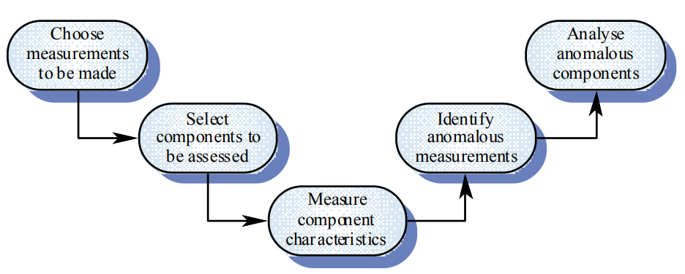
Product Measurement Process

Slide 132
Data Collection
A metrics program should be based on a set of product and process data
Data should be collected immediately (not in retrospect) and, if possible, automatically
Three types of automatic data collection
Static product analysis
Dynamic product analysis
Process data collation

Slide 133
Data Accuracy
Don’t collect unnecessary data
The questions to be answered should be decided in advance and the required data identified
Tell people why the data is being collected
It should not be part of personnel evaluation
Don’t rely on memory
Collect data when it is generated not after a project has finished

Slide 134
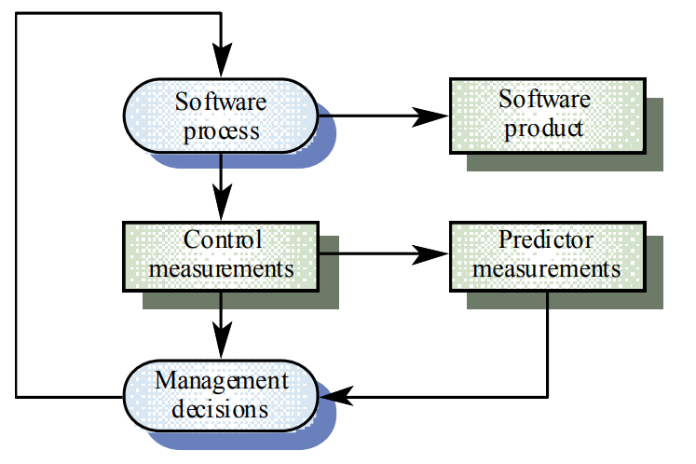
What Are Metrics For?

Slide 135
Analysis
It is not always obvious what data means
Analyzing collected data is very difficult
Professional statisticians should be consulted if available
Data analysis must take local circumstances into account

Slide 136
Metric Types with Examples
Size-oriented metrics
Defects, human effort, Line of Code LOC
Function-oriented metrics
Function points
Web Engineering
Number of static Web pages (Nsp), Number of dynamic Web pages (Ndp), Customization index: C = Nsp / (Ndp + Nsp)
Product metrics
Cyclomatic complexity, Fan in/Fan-out

