Slide 1
Enterprise Resource Planning (ERP)
SE495: Software and Systems Integration

Slide 2
Outline
What is ERP?
ERP Essentials
ERP Modules
Business Processes
Benefits and Features of ERP Systems
ERP integration
Business Process Modeling

Slide 3
What is ERP?
Enterprise Resource Planning (ERP) refers to a business process management software that optimizes the processes of an organization by providing a system of integrated and centralized applications that help manage and automate a wide range of business operations including accounting, human resources, sales and inventory management.

Slide 4
Background
Enterprise resource planning (ERP) systems are meant to automate, standardize, and integrate their business processes for effective planning and control.
A key feature of ERP systems is the comprehensive database that serves as a single source of the truth.
In practice, this means that employees in all departments can look to the ERP system for the information they need and work from the same data.

Slide 5
ERP Essentials
Enterprise resource planning (ERP) systems are business systems that integrate and streamline data across the company into one complete system that supports the needs of the entire enterprise.
ERP systems are designed to enhance all aspects of key operations, such as purchasing, accounting, manufacturing, and sales, by taking processes and functions that were previously disjointed and supported by various legacy systems, or older, standalone, disparate business systems, and seamlessly integrating and coordinating them.
The foundation of an ERP system is a well- structured database that serves the operational and decision-making needs of the entire enterprise.

Slide 6
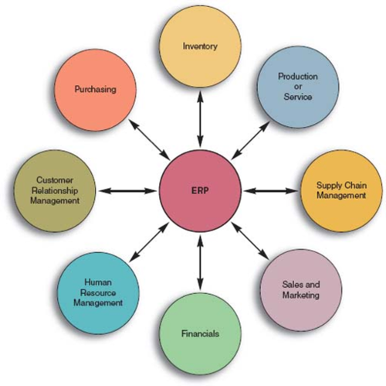
ERP

Slide 7
ERP
ERP systems are:
Cross-functional (more than one functional area)
process- centered (organization’s business processes)
A business process is a collection of activities that together add value.
Business processes span multiple departments and in many cases traverse the boundaries of the organization, sharing information with partners, suppliers, and customers.

Slide 8
Business Processes
A business process is a process that is focused on achieving a goal for a business.
A business process comprises a sequence of steps that flow in a specific order to achieve a desired outcome.
Processes are something that businesses go through every day in order to accomplish their mission.
Two of the major business processes that most companies have, and which ERP systems support, are
“perform order management”
“procure materials and services.”
Other key processes that

Slide 9
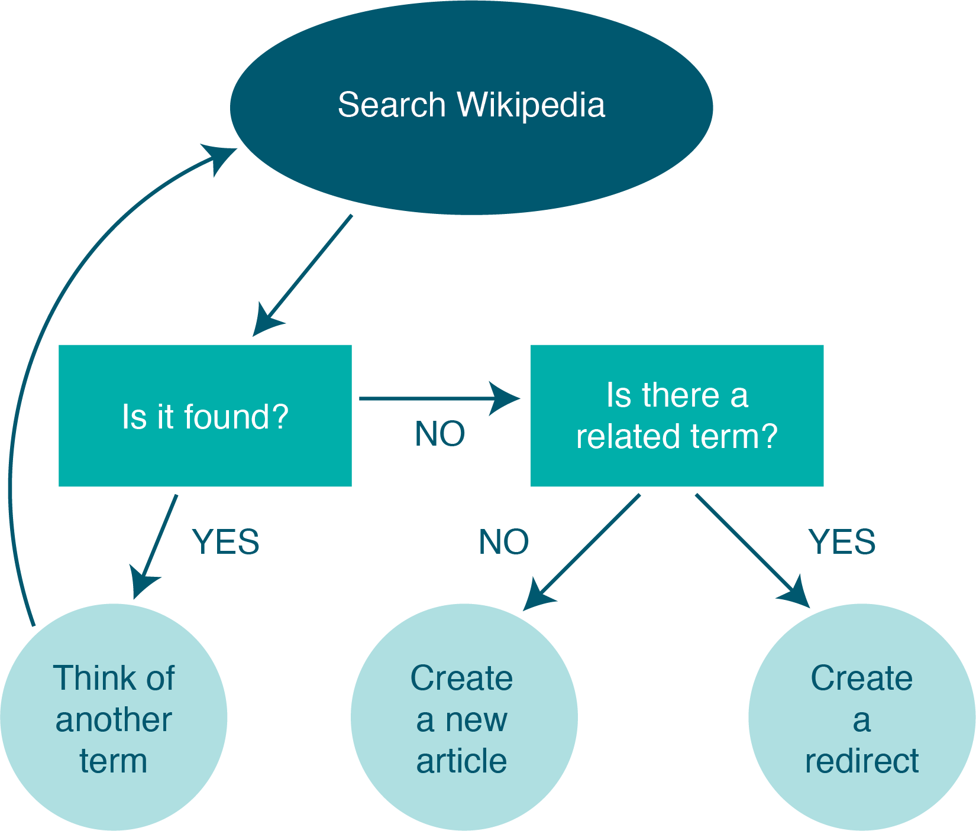
Managing Business Process Documentation
As organizations begin to document their processes, it becomes an administrative responsibility to keep track of them.
As processes change and improve, it is important to know which processes are the most recent.

Slide 10
Business Process Management
Business process management (BPM) can be thought of as an intentional effort to plan, document, implement, and distribute an organization’s business processes with the support of information technology.
BPM is more than just automating some simple steps.

Slide 11
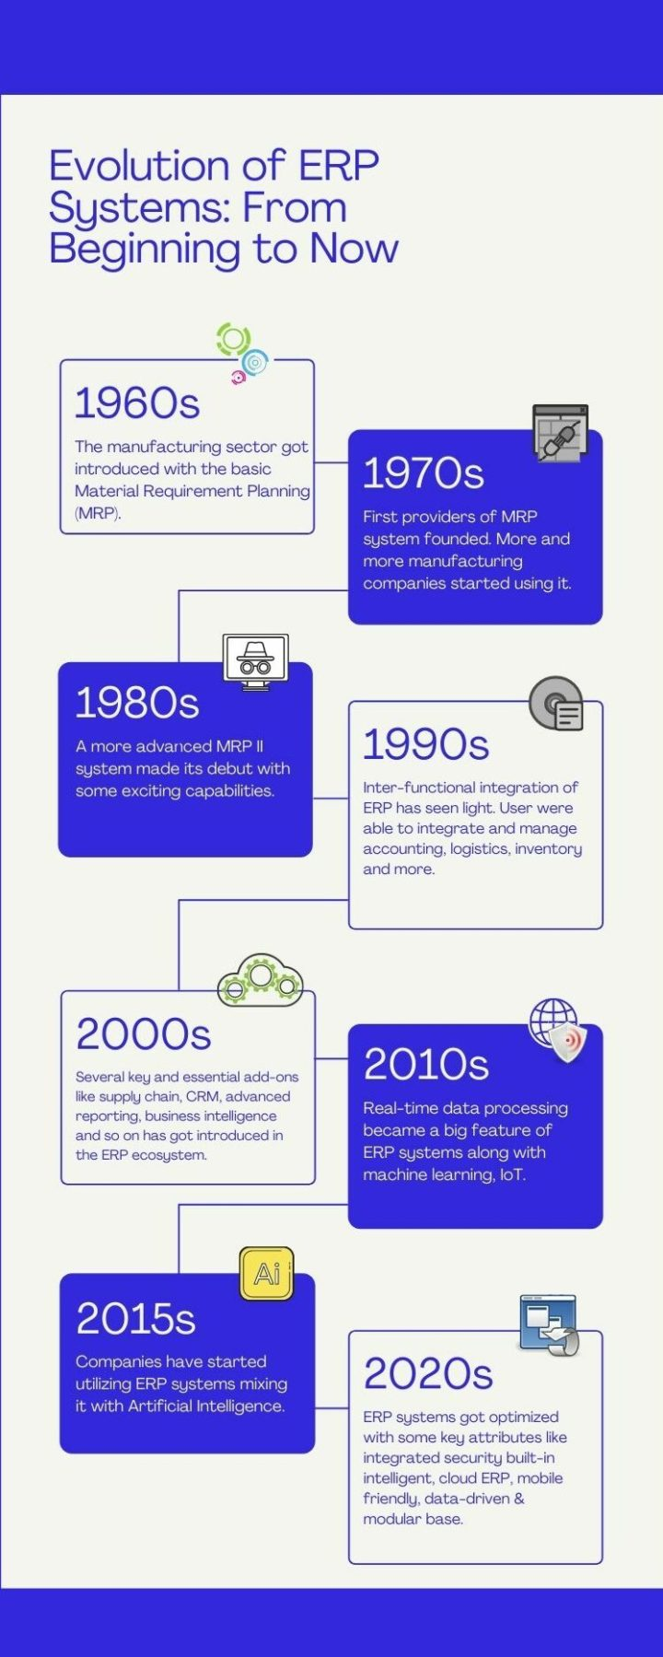
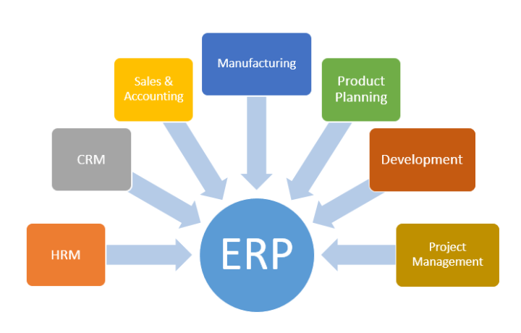
Evolution of ERP Systems

Slide 12
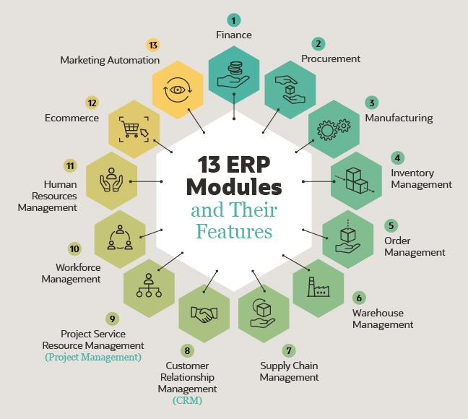
ERP Modules

Slide 13
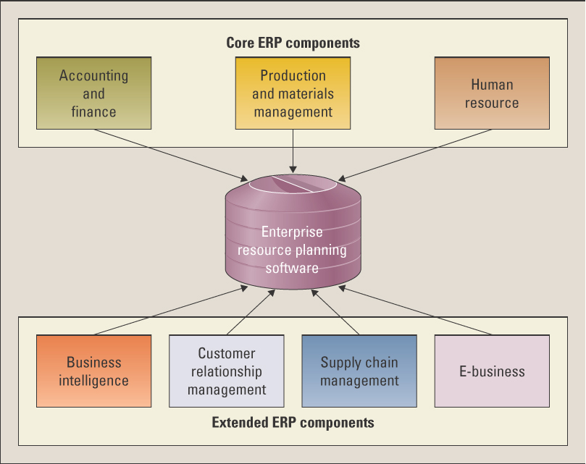
Core Components

Slide 14
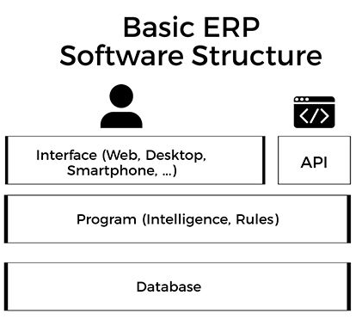
The Technical of ERP Systems
The singular interface ties everything together to provide a seamless user experience as users go between the different business processes.
ERP has several layers that work together.
One of the main technical layers of an ERP system is the database.
The database is where all of a companies data about customers, accounting, inventory, and more, will be stored.
The program layer will house the intelligence or brain of the ERP software, it contains all the rules and logistics of the ERP
The final layer is the API which is the way your ERP will communicate with other software.

Slide 15
12 Benefits of ERP Systems
Cost savings
Workflow visibility
Reporting/analytics
Business insights/intelligence
Regulatory compliance & data security
Risk management
Data security
Collaboration
Scalability
Flexibility
Customization
Customer & partner management

Slide 16
5 Key Features of ERP Systems
Common database
Consistent UX/UI
Business process integration
Automation
Data analysis

Slide 17
Types of ERP Deployment Models
On-premises ERP
Cloud-based ERP
Hybrid ERP
Open-source ERP

Slide 18
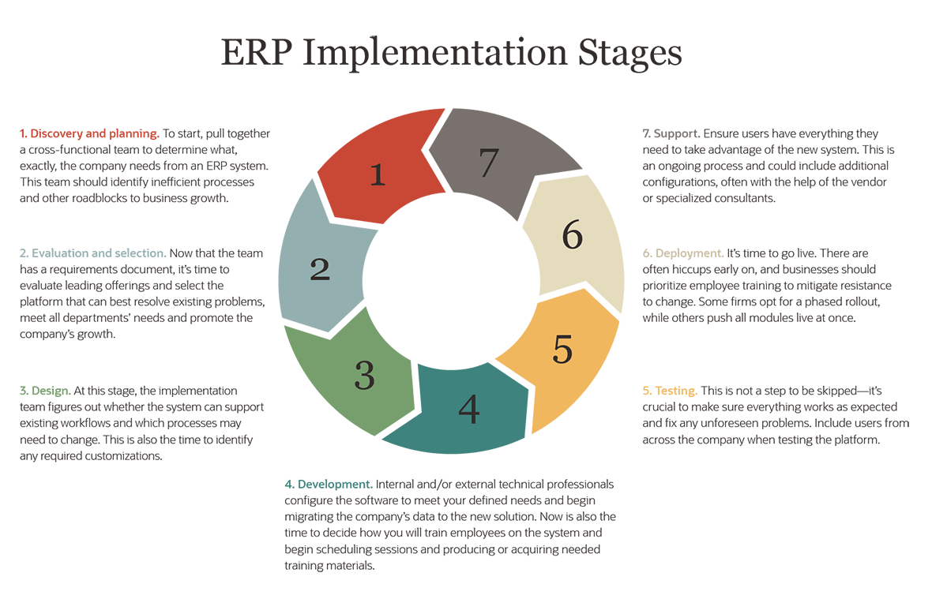

Slide 19
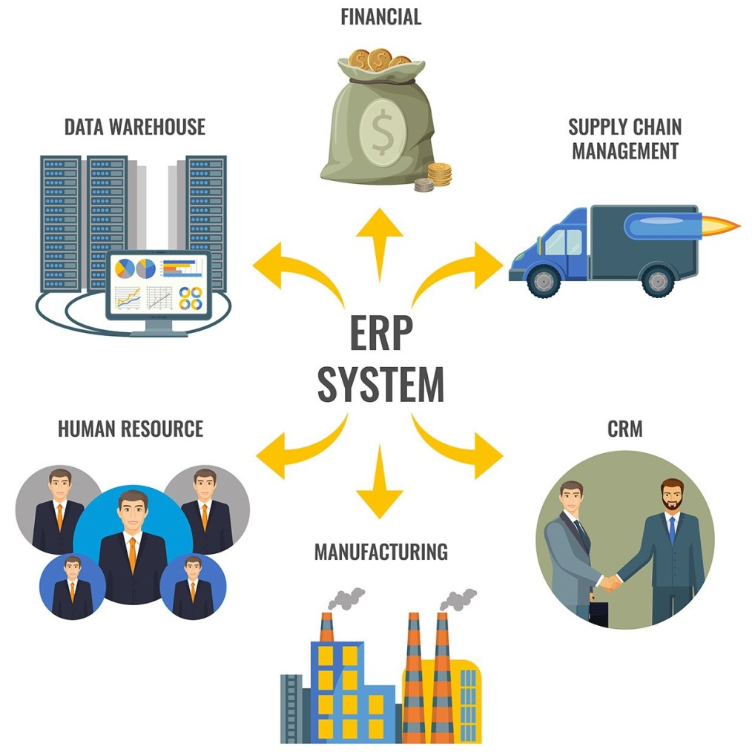
What is an ERP integration?
An ERP integration is the method of connecting your ERP software with other systems.
The integration allows for the flow of information between your systems.
It’s a way of automating business processes and improving productivity across the enterprise.

Slide 20
ERP Integration Methods
The most common integration methods include:
Custom integrations
building core integration through APIs.
Vendor-built or native integrations
Out-of-the-box integrations that allow you to connect specific applications.
Integration Platform as a Service (iPaaS
a cloud-based solution that builds and deploys integrations.

Slide 21
Benefits of ERP integration
Upgraded legacy systems
Centralized data
Automated processes
Better customer experiences

Slide 22
ERP Integration Best Practices
Clean Up Data Before Integration
Analyze Integration Requirements Carefully
Security First

Slide 23
Business Process Modeling

Slide 24
Introduction
Business process modeling gives organizations a simple way to understand and optimize workflows by creating data-driven visual representations of key business processes.
Most enterprises have a pretty good idea of the various business processes powering their daily operations.
However, when they need to ensure that those processes consistently drive optimal outcomes, “a pretty good idea” isn’t enough.

Slide 25
What is business process modeling?
A business process model is a graphical representation of a business process or workflow and its related sub-processes.
Process modeling generates comprehensive, quantitative activity diagrams and flowcharts containing critical insights into the functioning of a given process, including the following:
Events and activities that occur within a workflow
Who owns or initiates those events and activities
Decision points and the different paths workflows can take based on their outcomes
Devices involved in the process
Timelines of the overall process and each step in the process
Success and failure rates of the process

Slide 26
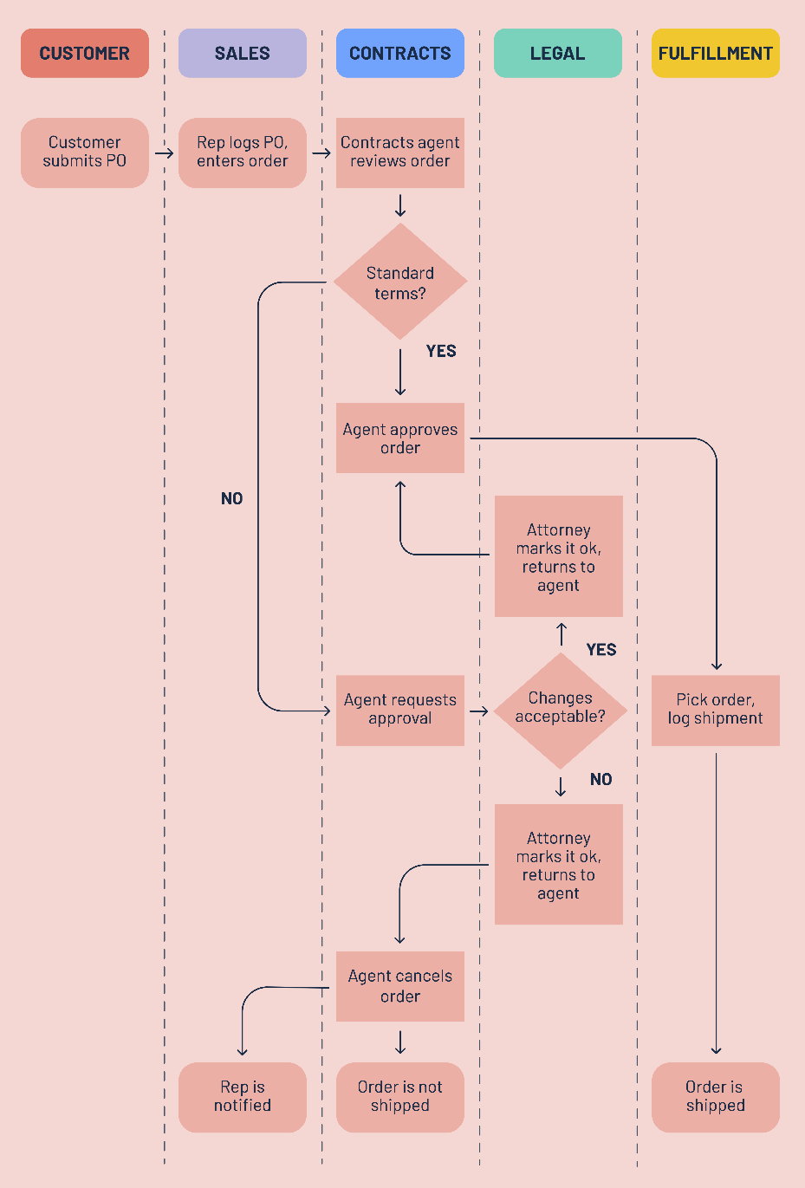
Business process modeling types
Business process modeling notation (BPMN)

Slide 27
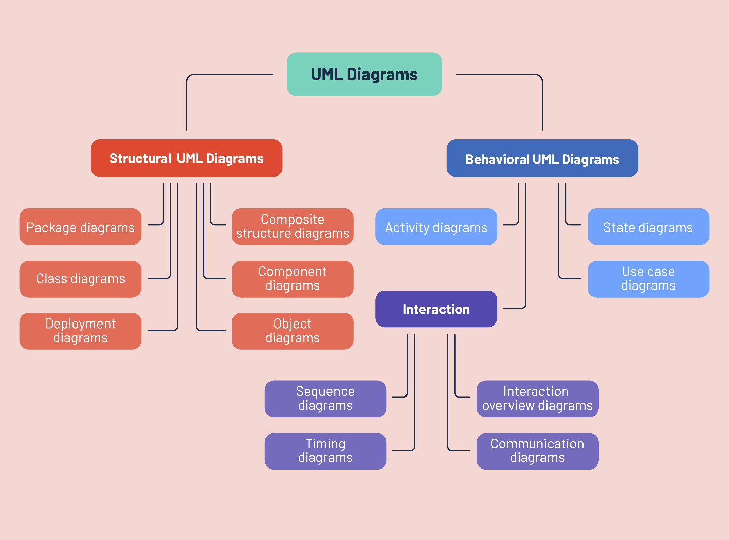
Business process modeling types
Unified Modeling Language (UML)

Slide 28
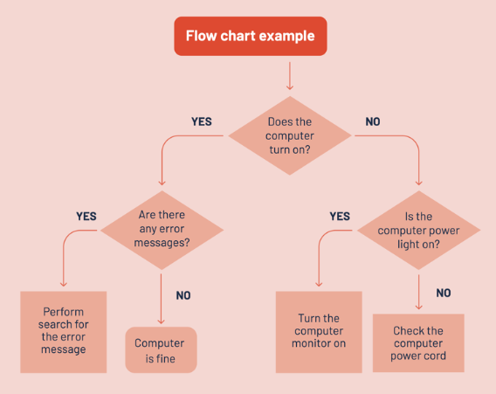
Business process modeling types
Flowchart model

Slide 29
Key aspects of business process modeling
Process models are not made manually.
Rather, they are produced by data-mining algorithms that use the data contained within event logs to construct models of the workflows as they exist.
Because process models are based on quantitative data, they offer genuinely objective views of workflows as they exist in practice, including key data, metrics or events that may have otherwise gone unnoticed.
For example, by creating a model of its new account creation process, a software company might discover that a significant number of customers are abandoning the sign-up process because it takes too long.
A model could even help the company pinpoint the exact stage at which these drop-offs occur.

Slide 30
Key aspects of business process modeling
Process models are typically rendered using one of two standardized styles of graphical business process notation: Business Process Modeling Notation (BPMN) — also called Business Process Model and Notation — or Unified Modeling Language (UML).
Within these notation systems, certain visual elements have universally recognized meanings when used in a process model.
Whether an organization uses UML diagrams or BPMN diagrams, these standardized notation methodologies allow process models to be easily shared and read by anyone:
Arrows represent sequence flows
Diamonds represent decision points or gateways
Ovals represent beginnings and endpoints of processes
Rectangles represent specific activities within a workflow
Swimlanes are used to identify who owns which components of a process

Slide 31
Key aspects of business process modeling
Business process models shouldn’t be confused with process maps, another common type of business process diagram.
Process maps are based on employee reports, are created manually and provide higher-level views of workflows.
Process models are data-driven deep dives that present more objective views of workflows.

Slide 32
Business process modeling use cases
Gaining 360-degree insight into processes
Control flow
Organization
Time
Case
Optimizing and standardizing processes
Assessing new processes
Analyzing resource usage
Communicating processes

Slide 33
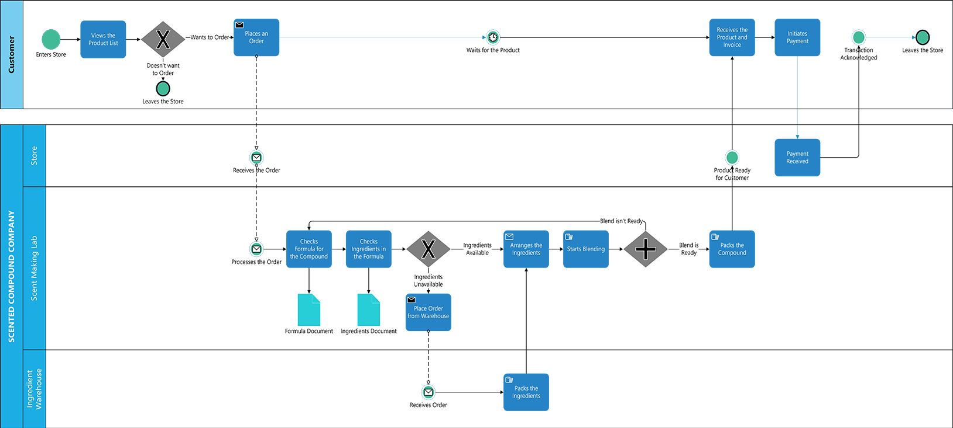
The benefits of business process modeling
Access and utilize quantitative process data
Streamline and accelerate process automation
Keep operation costs down

Slide 34
Business process modeling challenges
Model-reality divide
Business process modeling can result in a gap between how the stakeholders plan a process and what the actual practice is.
Possible miscommunication
Business analysts need actionable information to be efficient in their practices.
Loss of innovation
When employees work with a management-driven approach to process modeling, it hinders the knowledge they gain from working on the process.
Lack of process accuracy
Some industry experts argue that process modeling is highly dependent on design and can sometimes fail to capture accuracy.

Slide 35
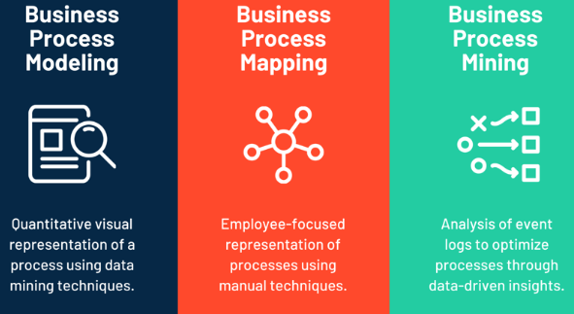
Process modeling vs. process mapping vs. process mining

