Slide 1
Introduction
SE423: Software Project Management

Slide 2
Outline
Why DevOps?
What is DevOps?
DevOps: The Three Way
DevOps Tools and Stages
DevOps Use Case

Slide 3
Why DevOps?

Slide 4

Waterfall Model
Distinct goals for each phase of Development
After each step is finished, there is no way to go back
Linear/Sequential

Slide 6
Software Engineering
What do the following have in common?
Civil Engineering
Mechanical Engineering
Industrial Engineering
Chemical Engineering
Electrical Engineering
Software Engineering
They all have common themes:
Product Design
Process Creation and Refinement
Project Activity

Slide 7


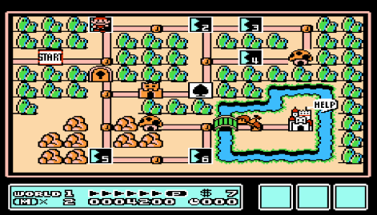

What does “Well Engineered” Mean?
Quality Factors:
Usability
Reliability
Safety
Well constructed
Use of technology
Aesthetically pleasing
Also consider:
Costs (within budget)
Schedule (on time)
Maintainability

Slide 8
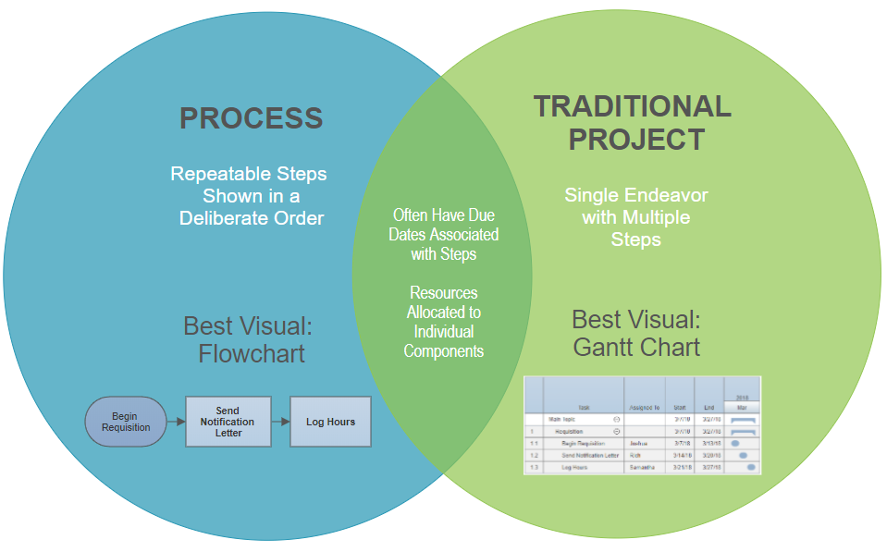
Process and Project Management
“A process is a series of steps involving activities, constraints and resources that produce an intended output of some kind.”
Processes need to be appropriate both for the type of development organization and the type of application being developed.

Slide 9

Successful Projects
What makes a project successful?
Avoiding Mistakes
Strong Teams
Managing Risks
Proper Planning
Understanding Good Methodology
Good Estimation (Looking ahead)
Good Perspective (Looking Back –
Measurement & Metrics)
Proper Testing
Results and a Happy Customer

Slide 10
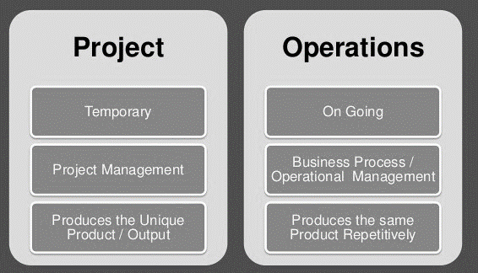
Project vs Operational
Projects
Have a Beginning and End
Have Unique Goals/Objectives
Are not ‘Business as Usual’
Operational Work
Most ongoing work
Often completed projects are handed off to ‘operations’
‘Business as Usual’
Each has very different management techniques, although some core skills and competencies are the same

Slide 11
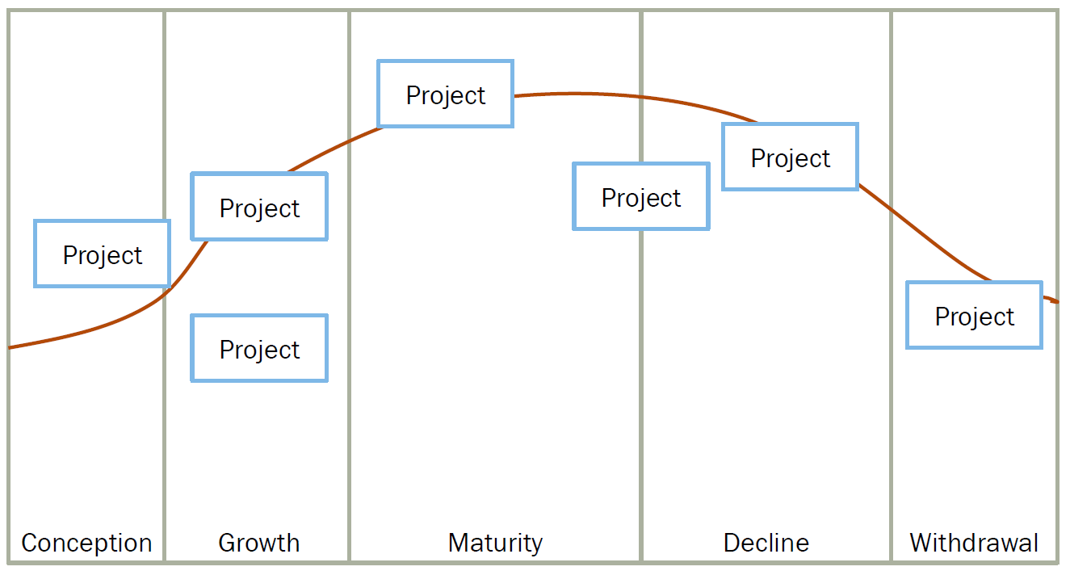
Product Lifecycle

Slide 12
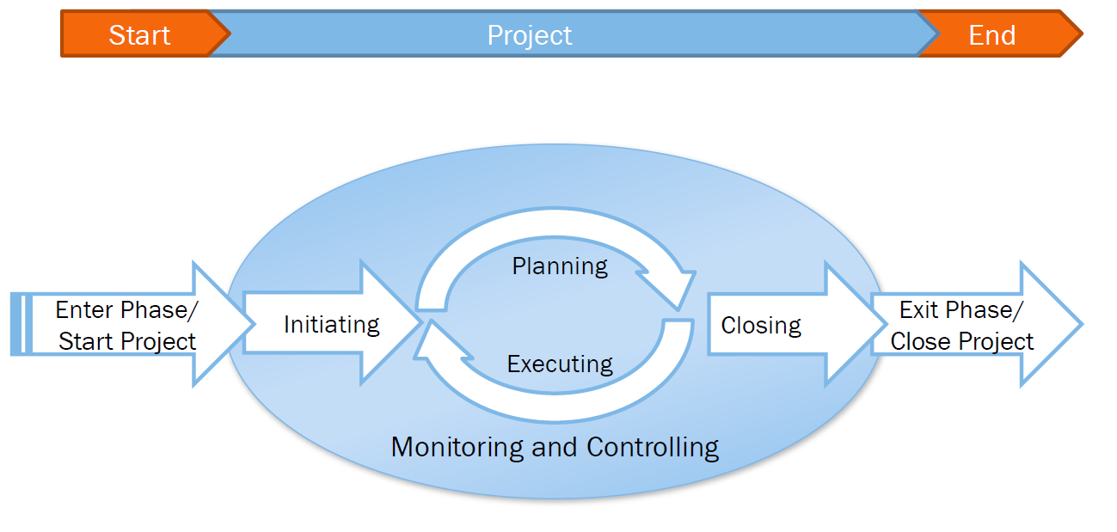
Project Lifecycle

Slide 13
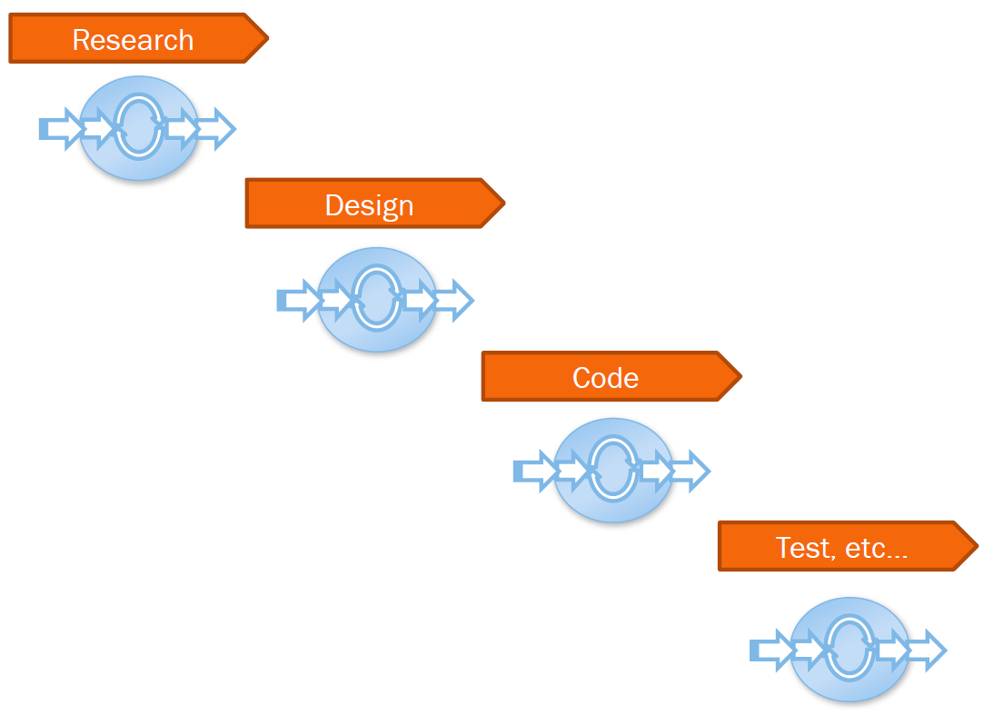
Project Lifecycle

Slide 14
Project Terms
Project Sponsor
Stakeholders
Scope
Project Charter
Project Management Office (PMO)
Postmortem

Slide 15
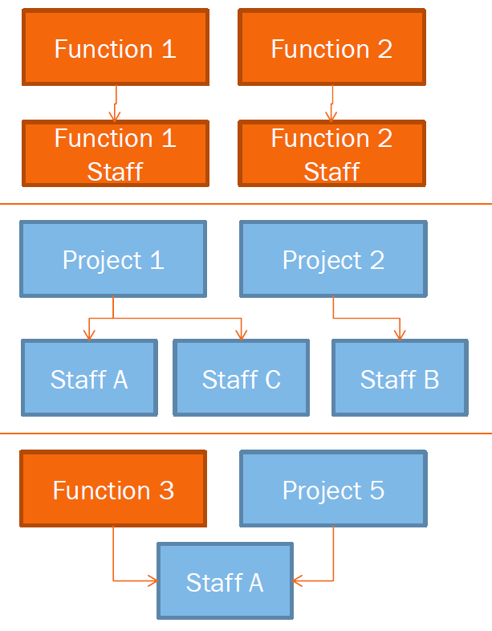
Organizational Structure
Functional
Most Common “Classic”
Grouped by specialization
Team members have both departmental and project work
Projectized
Project is king
Staff are moved from project to project
Matrix
The two types mixed
Two bosses, Project Boss and Functional Boss

Slide 16
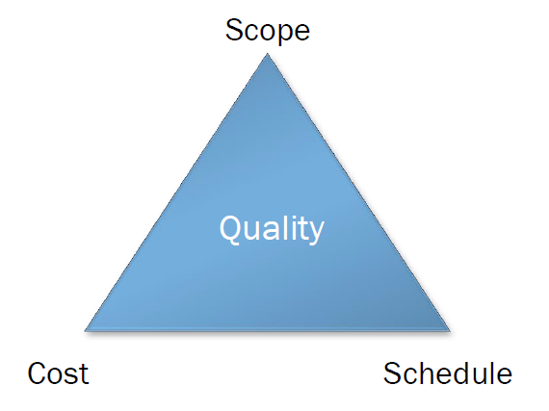
The Project Triangle
Good, Fast, Cheap – Pick 2
Quality, Resources, Schedule

Slide 17
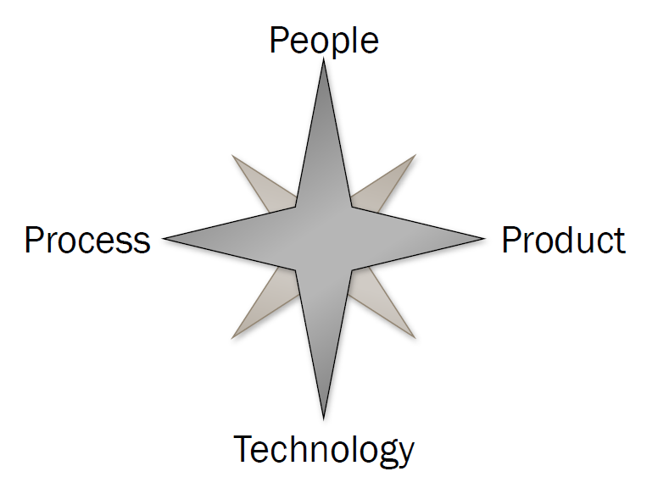
Project Dimensions

Slide 18
What is Project Management?
A Discipline
Planning, Organizing, Motivating, and Controlling resources to achieve defined goals.
Requires the Development of Distinct Technical and Management Skills
Projects
Have a Beginning and End
Have Unique Goals/Objectives
Are Not Business as Usual

Slide 19
Managing Engineering Process
Traditional Engineering
Developing Schedules
Establishing Budgets
Securing & Allocating Resources
Managing Risks
Tracking Progress
Coordinating Teams (often across organizational boundaries)
Software Engineering
Formulate the problem
Design, Modeling, Prototyping
Evaluate different solutions / trade-offs
Detailed Technical Specifications
Construction or Manufacturing
Testing / Evaluation
Delivery & Maintenance

Slide 20
How Do Projects Succeed?
Executive support
Experienced project manager
Clear business objectives and priorities
Minimized scope
Standardized infrastructure
Firm basic requirements
Predictable costs
Communication between parties
Formal methodology
Reliable estimates

Slide 22
Thought for the day
"The first 90% of a project takes 90% of the time, the last 10% takes the other 90%."

Slide 23
What is a project?
What’s a project?
PMI definition
A project is a temporary endeavor undertaken to create a unique product or service
Better: A sequence of connected and related activities (requirement engineering, system engineering, coding, testing, documentation, controlling, …) that must be completed by a specific time, within budget, and according to specification.
Progressively elaborated
With repetitive elements
A project manager
Analogy: conductor, coach, captain
Notes:
Temporary:
can be years
Result can be lasting
Team can be temporary
Finite duration
Ex: thousands of buildings, but each is unique
Scope should be constant even as elaboration happens

Slide 24
Project vs. Program Management
What’s a ‘program’?
Mostly differences of scale
Often a number of related projects
Longer than projects
Definitions vary
Example: Program Manager for MS Office
Includes projects: Spelling, drawing, Word, Xcel, PowerPoint, etc.

Slide 25
Project characteristics
A project is unique
A Project creates unique deliverables: product, service, or result
Even technically-identical projects are distinctly unique, due to internal or external contingent factors
Projects are temporary
Every project has a deﬁnite beginning and a deﬁnite end
Project end may be reached through success, qualiﬁed success, failure, or redundancy
Projects need not be of short duration, but they are of ﬁnite duration

Slide 26
Project characteristics
Projects have customer-speciﬁed performance criteria
The customer deﬁnes these criteria in the form of requirements
We will see that requirements are one of the most critical characteristics of a project that contributes to its success or failure
Projects consume resources
Personnel resources
Physical resources
Monetary resources

Slide 27
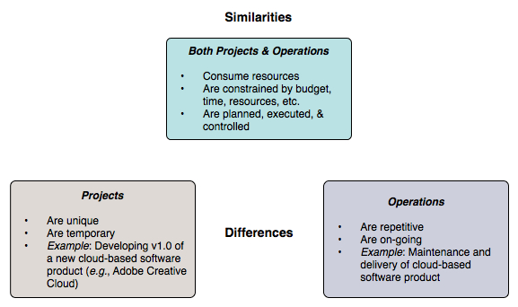
Projects vs. operations/production

Slide 28
Characteristics of IT (Information Technology)
IT encompasses all forms of technology used to create, store, exchange, and use information in various forms
‘Information’ includes conventional data, voice, images, multimedia, etc.
Of central importance are computer, software, and communications technologies
Virtually all signiﬁcant projects are now distributed: networks of computers communicate only via message passing
Distribution poses additional challenges in IT projects: reliability, availability, security, and information synchronization

Slide 29
How do IT projects differ from ‘ordinary’ projects?
IT products and services possess greater complexity
IT products and services are intrinsically complex by nature
Computing + communication + diverse data ⇒ complexity
IT projects have tight schedules
Tight schedules are the norm in IT development
Scheduling is aggravated by a pervasive ‘rush to market’ mentality
IT is an integral part of enterprise infrastructure
IT is no longer an auxiliary element of the enterprise
A business’ success is often critically dependent upon IT support
IT is permeated by quickly-changing technology
Technology evolves (and may even become obsolete) during the lifetime of a major project

Slide 30
Project characteristics
Four characteristics of projects:
finite time
people assigned
clear roles and responsibilities
things to deliver
Have you ever had this feeling about a project?
not enough time
too few people
people not sure what they should be doing
too much to do

Slide 31
How Are Software Projects Different?
Consists of hardware and software.
Software is [usually] custom written and one-of-a-kind.
Hard to determine progress. [One can see how far the Freedom Tower (World Trade Center) has progressed. One cannot see how far a piece of software has progressed]
Difficult to estimate schedule.
Difficult to determine cost.

Slide 32
What is Project Management?
Project management is “the application of knowledge, skills, tools and techniques to project activities to meet project requirements” (PMBOK® Guide, Fifth Edition, 2013)
Software Project Management is the art to define, plan, execute, and monitor the activities that will bring software products to existence.
Project managers strive to meet the triple constraint by balancing project scope, time, and cost goals

Slide 33
Project management processes
Regardless of the type of project lifecycle, project management encompasses the following process groups, shown with some representative tasks:
Initiating/Define – Scope the project; Charter the project; identify stakeholders
Planning – Develop the project plan. Collect requirements; identify schedule; plan scope, cost, quality, human resource, risk, and procurement management
Executing – Launch the plan. Direct and manage project work; perform quality assurance; manage and develop project team; conduct procurements
Monitoring and Controlling – Monitor project progress. Monitor and control project work; manage scope change; monitor and control schedule; control quality; control risks; control procurements
Closing – Close out the project: Close project; close procurements
Notes:
For some lifecycle types, some of the tasks are irrelevant or appear a radically different form; e.g., scope management in an adaptive (agile) lifecycle vs. predictive (conventional linear) lifecycle

Slide 34
Software Project
Quality Engineering Principle:
The quality of the software system is controlled by the quality of the process used to produce that software.
Quality Management Principle:
Document the process
Measure the process
Improve the process based on the measurement

Slide 35
Software Development Process
What is the software development process?
A process is a set of documented procedures, methods, practices, and tools used to produce a software product.
The process will answer the following:
What to do? Tasks/activities
How to do it? Procedure/practice
When to do it? Sequence of activities
What are the artifacts? (input/output)

Slide 36
Software Project
If the programmer and designer follow the process, then the artifacts they produce will be
Predictable
Based on the requirements
Easy to maintain and control
Consistent with the writing style
Of acceptable quality
Within acceptable milestones
By following the process, we will be able to know precisely what/how/when/where it happened !

Slide 37
Software Processes
Software Process is an overloaded term
Metaprocess: an organization’s policies, procedures, and practices for pursuing a software-intensive line of business; the focus is on organizational economics, and long-term strategies.
Macroprocess: the project’s policies, procedures, and practices for producing a complete software product within certain cost, schedule, and quality constraints.
Microprocess: a project team’s policies, procedures, and practices for achieving an artifact of the software process.

Slide 38
Core project management activities
Identify requirements
Address the various needs, concerns, and expectations of the stakeholders in the project
Establish active, effective, collaborative communications among the stakeholders
Manage stakeholders towards meeting project requirements and creating project deliverables
Balance the competing project constraints, including: scope, quality, schedule, budget, resources, and risks

Slide 39
Software Project Trade-offs
What is the goal?
Balance the main three (other 2 constraints scope and resource) … in order to:
Stay within the budget (cost)
Deliver on time to gain market share (time)
Exceed customer satisfaction (quality)
The time/scheduling hypocrisy
What can you tell me about the next project, you ask?
It is due on June 1st tells your manager
We hold deadlines too dearly. Of course, time to market is critical
But what generally happens on projects when you hit that deadline?

Slide 40
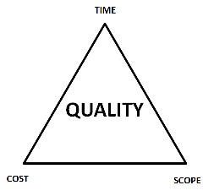
What makes a project successful?
Successful project management means meeting all three goals (scope, time, cost) – and satisfying the project’s sponsor.
Trade-off Triangle
Project constraints: Fast, cheap, good. Choose two. Also stated as: “On-time, on-budget, high-quality. Choose two.”
Reality often ignored in project planning
Know which of these are fixed & variable for every project
Time
Cost
Scope

Slide 41
Success Metrics
On schedule
Requires good: plan; estimation; control
Within budget
Again: planning, estimation & control
According to requirements
Importance of good requirements
Perception & negotiation critical
High quality. May or may not be same as item 3
Only real measure:
Is the customer happy?
Customer satisfaction!!

Slide 42
Factors in Project Success & Failure

Slide 43
Software Crisis
Many software-related failures: auto-pilot systems, air traffic control systems, banking systems, IRS.
On January 15, 1990, the AT&T long-distance telephone network broke down, interrupting long-distance telephone services in US for over 8 hours. [Missing break in a switch statement.]
On June 4, 1996, the maiden flight of the new and improved Ariane 5 rocket exploded 37 seconds after lift-off.
On June 8, 2001, a software problem caused the NYSE to shut down the entire trading floor for over an hour.
Many, many, many more.

Slide 44
What is the problem?
Software Projects have a terrible track record
A 1995 Standish Group study (CHAOS) [see notes] found that only 16.2% of IT projects were successful in meeting scope, time, and cost goals (on-time & on-budget) [Things have improved a bit since.]
Over 31% of IT projects were canceled [never seeing completion], costing over $81 billion in the U.S. alone
They never worked
Too late for the market window
Most projects are
Late in delivery
Missing functionality
Have major defects (bugs)
Did not do what the customer wanted
Hard to maintain and support
Notes:
According to the Standish Group ¹, in 1995, U.S. government and businesses spent approximately $81 billion on canceled software projects, and another $59 billion for budget overruns. Their survey claimed that in the United States, only about one-sixth of all projects were completed on time and within budget, nearly one third of all projects were canceled outright, and well over half were considered "challenged." Of the challenged or canceled projects, the average project was 189 percent over budget, 222 percent behind schedule, and contained only 61 percent of the originally specified features.
See the new paper: Phillip G. Armour, "Twenty Percent: Planning to fail on software projects", CACM, Vol. 50, No. 6 (June 2007), p 21-23. (D2L > Documents)
The. Standish Group, "Chaos," 1995, http://www.standishgroup.com/chaos.html.

Slide 45
The Standish Group’s CHAOS Report (2001)
Standish compiles and publishes a periodic survey on the success and failure rates of IT projects
These statistics date from 2001–however, based on more recent complementary reports, these numbers have remained fairly stable over the years:
Average IT project schedule overrun: 163%
Average IT project cost overrun: 145%
Actual deliverable functionality compared to plan: 67%
IT projects judged a success: 26%
Lost value from marginal and failed projects: $75 billion

Slide 46
Why do IT projects fail?
Requirements, requirements, requirements
Requirements are unclear, incomplete, or the project management methodology does not accommodate changing requirements effectively
Lack of user involvement
A disengaged or absentee user (~customer) is an invitation for project problems or outright failure
Often the result of a lack of business and IT integration
Unrealistic expectations (including unrealistic time frame expectations)
Closely related to/result of ‘Lack of user involvement’
“How hard can it be?” attitude of business and technical management
Overly optimistic ‘can do’ attitude at all levels
It is the project management team's responsibility to educate users in the realities of the project

Slide 47
Why do IT projects fail?
Lack of planning
You cannot achieve any goal without planning
Proper approach to planning in a complex project must be adaptive: big planning up front is a waste of time and gives a false sense of security
Related issues: Perceived rush to get started; overconﬁdence
Unclear (or lack of) vision and/or objectives
The project vision must be established as one of the ﬁrst steps in project planning
The vision for a project should be short, concise, and laser-sharp: the ‘elevator statement’ format is most effective

Slide 48
Why do IT projects fail?
36 Classic Mistakes
AntiPatterns [see lecture 9]
Seductive Appeal: good reason for decisions at the time
Types
People-Related
Process-Related
Product-Related
Technology-Related
Gilligan’s Island
Notes:
Seductive: good reason for decisions at the time
We’ll visit these throughout course
Gilligan’s Island: new scheme, get off island, seems to work, then fails
Being aware can help prevent
Class discussion

Slide 49
People-Related Mistakes Part 1
Undermined motivation
Weak personnel
Weak vs. Junior
Uncontrolled problem employees
Heroics
Adding people to a late project
Lack of match between people and needs
Incompetent or over competent
Culture clash
Notes:
Motivation: studies show has largest impact
Don’t undermine Morale
2nd greatest influence on productivity
Junior != bad
Uncontrolled: most common developer complaint about their managers
Heroics. Company hostage.
“Can-do”, “how high” attitudes
Brooks, reading assignment

Slide 50
People-Related Mistakes Part 2
Noisy, crowded offices
Customer-Developer friction
Unrealistic expectations
Lack of user input
Politics over substance
Lack of effective project sponsorship
Lack of stakeholder buy-in
Wishful thinking
Notes:
60%of developers feel unsatisfactory environment: need quite and privacy
real offices
Friction: classic differing viewpoints
Results in ‘poor communication’
Passive-aggressive
User input: Survey: number 1 reason for success
W/O input: guessing
Realistic Expectations: 1 of top 5 reasons for success of in-house projects
Perception woe
Politics
Managing-up
Sponsor: a must, no power
All players must buy-in
Wishful
Cognitive dissonance
Closing your eyes and hoping
McConnell: maybe causes the most problems in software development

Slide 51
Process-Related Mistakes Part 1
Optimistic schedules
Omitting necessary tasks from estimates
Planning to catch-up later
Code-like-hell programming
Insufficient risk management
Contractor failure
Insufficient planning
Abandonment of plan under pressure
Notes:
Similar to wishful thinking
Puts unnecessary pressure
Missing tasks
Often 20-30% of a schedule
Catch-up later
How many times have you seen a project catch-up?
Only by all-nighters
Like hell
“Entrepreneurial” approach
Management controls
Need to be able to track
We’ll cover lots of these
PMI
See catch-up later
Risk Mgmt:
Risks will manage you
Contractor: late, poor quality, or fails to meet specifications
Requires lots of management
Insufficient planning: “if you don’t care where you’re going, any plan will do”
Abandonment
Out the window
Fall into code-and-fix mode

Slide 52
Process-Related Mistakes Part 2
Wasted time during fuzzy front end
Shortchanged upstream activities
Inadequate design
Shortchanged quality assurance
Insufficient management controls
Frequent convergence
Notes:
fuzzy: before sign-off
Upstream:
Lack of analysis and design
10 to 100 times more costly
5 hrs vs. 50
Design:
Seen schedules w/o it at all
QA:
Seems easy to compress
1 day QA == 3 to 10 later
Convergence
Waste of time

Slide 53
Product-Related Mistakes
Requirements gold-plating
Gilding the lily
Feature creep
Developer gold-plating
Beware the pet project
Push-me, pull-me negotiation
Slip schedule + add features
Research-oriented development
Notes:
Gold
Gilding the lily
Performance is required more often than need be
Feature creep
25% average change in req.
Dev. Gold
Nifty new technology
Pet project
Push-me
Slip schedule + add features
Research vs. Development

Slide 54
Technology-Related Mistakes
Silver-bullet syndrome
Overestimated savings from new tools and methods
Fad warning
Switching tools in mid-project
Lack of automated source-code control
Notes:
who’s heard of ‘silver bullet’ (not the beer)
Software savings on SCM
Jones: 10% month, I see more

Slide 55
What Helps Projects Succeed?*
Executive support
User involvement
Experienced project manager
Clear business objectives
Minimized scope
Standard software infrastructure
Firm basic requirements
Formal methodology
Reliable estimates
Other criteria, such as small milestones, proper planning, competent staff, and ownership

Slide 56
Four Project Dimensions
Four Project Dimensions (The 4 P's)
People — the most important element of a successful project
Product — the software to be built
Process — the set of framework activities and software engineering tasks to get the job done
Project — all work required to make the product a reality
Notes:
Peopleware issues
10-to-1 difference in Dev productivity
Teams 3 or 5 to 1 diff
Process
Dev basics, risk mgmt, QA, lifecycle planning, customer orientation
Product
Most tangible dimension

Slide 57
People
“It’s always a people problem”
– Gerald Weinberg, “The Secrets of Consulting”
Developer productivity: 10-to-1 range
Teams 3 (or 5) to 1 difference
Improvements:
Team selection
Team organization
Motivation
Other success factors
Matching people to tasks
Career development
Balance: individual and team
Clear communication
Notes:
Teams: 5-to-1 range

Slide 58
Product
The “tangible” dimension
Product size management
Product characteristics and requirements
Feature creep management

Slide 59
Process
Is process stifling?
2 Types: Management & Technical
Development fundamentals
Quality assurance
Risk management
Lifecycle planning
Avoid abuse by neglect
Customer orientation
Process maturity improvement
Rework avoidance
Goals
cut time-to-market
Improve quality
Notes:
cut time-to-market
Improve quality

Slide 60
Technology
Often the least important dimension
Language and tool selection
Value and cost of reuse

Slide 61
Planning
Determine requirements
Determine resources
Select lifecycle model
Determine product features strategy
Tracking
Cost, effort, schedule
Planned vs. Actual
How to handle when things go off plan?

Slide 62
Measurements
To date and projected
Cost
Schedule
Effort
Product features
Alternatives
Earned value analysis
Defect rates
Productivity (ex: SLOC)
Complexity (ex: function points)

Slide 63
Technical Fundamentals
Assumed Software Development Life Cycle (SDLC)
Requirements
Analysis
Design
Construction
Quality Assurance (aka Testing)
Deployment

Slide 64
Software Project Management
Fundamentals

Slide 65
Formal Project Management
Advantages of Using Formal Project Management
Better control of financial, physical, and human resources
Improved customer relations
Shorter development times
Lower costs
Higher quality and increased reliability
Higher profit margins
Improved productivity
Better internal coordination
Higher worker morale (less stress)
Less “death marches”
Less overworked personnel

Slide 66
Getting organized
So, … now what?
Who is involved?
Stakeholders
What do they want done?
Charter, vision, requirements
Who do we have available to do the work?
Resources and staffing
How do we do this?
Project planning, WBS
How much will it cost
Estimating
When will it be finished?
Scheduling
What can possibly go wrong?
Risk Management

Slide 67
Summary of essential points
Projects and operations have both similarities and differences
Complex projects exhibit highly contingent behavior, are unpredictable, and face complex risks
Virtually all IT projects should be considered complex projects
Complex project management requires integration of signiﬁcant sociological, psychological, and technical skills
The factors contributing to project success and failure are reasonably well-known
This course discusses ways to achieve project success factors

Slide 69
Introduction (1 of 3)
Many people and organizations today have a new or renewed interest in project management
Worldwide IT spending was $3.5 trillion in 2017, a 2.4 percent increase from 2016 spending
The Project Management Institute reported that the number of jobs reached almost 66 million in 2017. By 2027, employers will need 87.7 million individuals working in project management–oriented roles

Slide 70
Introduction (2 of 3)
In 2017, the average annual salary (without bonuses) for someone in the project management profession was $112,000 in the U.S. and $130,866 in Switzerland
The top skills employers look for in new college graduates are all related to project management: team-work, problem-solving, and verbal communications
Organizations waste $97 million for every $1 billion spent on projects, according to PMI’s Pulse of the Profession® report

Slide 71
Introduction (3 of 3)
Advantages of Using Formal Project Management:
Better control of financial, physical, and human resources
Improved customer relations
Shorter development times
Lower costs and improved productivity
Higher quality and increased reliability
Higher profit margins
Better internal coordination
Positive impact on meeting strategic goals
Higher worker morale

Slide 72
What Went Wrong?
IT Projects have a terrible track record, as described in the What Went Wrong?
A 1995 Standish Group study (CHAOS) found that only 16.2% of IT projects were successful in meeting scope, time, and cost goals; over 31% of IT projects were canceled before completion
A PricewaterhouseCoopers study found that over half of all projects fail and only 2.5% of corporations consistently meet their targets for scope, time, and cost goals for all types of project

Slide 73
What Is a Project?
A project is “a temporary endeavor undertaken to create a unique product, service, or result” (PMBOK® Guide, Sixth Edition, 2017)
Operations is work done to sustain the business
Projects end when their objectives have been reached or the project has been terminated

Slide 74
Examples of IT Projects (1 of 2)
A team of students creates a smartphone application and sells it online
A company develops a driverless car
A government group develops a system to track child immunizations
A global bank acquires other financial institutions and needs to consolidate systems and procedures

Slide 75
Examples of IT Projects (2 of 2)
Top Strategic Technologies for 2018 (Gartner)
Artificial Intelligence (AI) Foundation
Intelligent Things
Cloud to the Edge
Immersive Experience

Slide 76
Media Snapshot
Gartner predicted that by 2014, there would be more than 70 billion mobile application downloads every year, but it was almost double
Facebook is by far the most downloaded app, and the most popular category of all apps continues to be games
As of March 2017, Android users could download 2.8 million different apps, and Apple users could download 2.2 million

Slide 77
Project Attributes
A project
has a unique purpose
is temporary
drives change and enable value creation
is developed using progressive elaboration
requires resources, often from various areas
should have a primary customer or sponsor
The project sponsor usually provides the direction and funding for the project
involves uncertainty
Project managers work with project sponsors, team, and other people involved in a project to achieve project goals

Slide 78
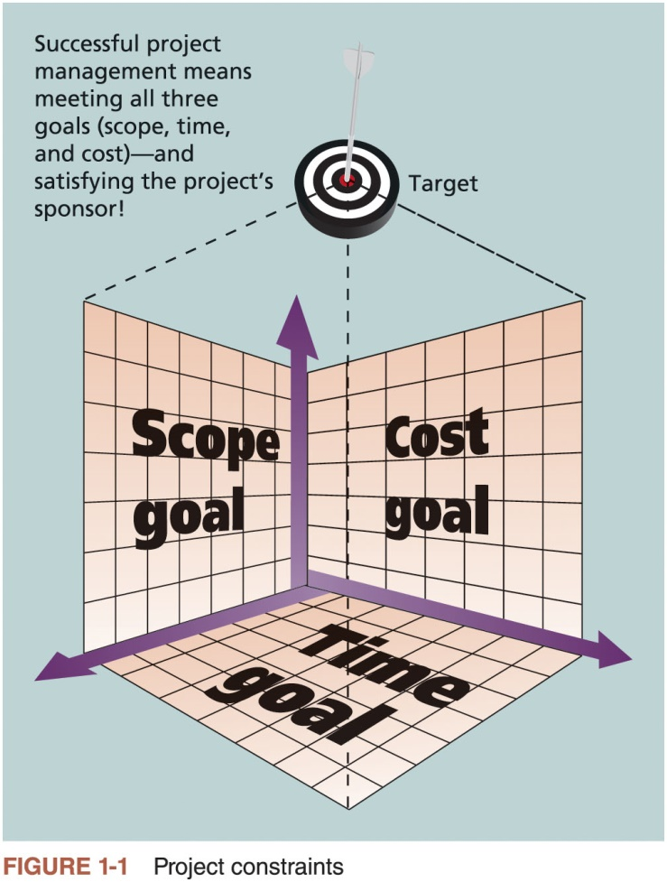
Project Constraints

Slide 79
What is Project Management? (1 of 2)
Project management is “the application of knowledge, skills, tools and techniques to project activities to meet project requirements” (PMBOK® Guide, Sixth Edition, 2017)
Project managers strive to meet the triple constraint (project scope, time, and cost goals) and also facilitate the entire process to meet the needs and expectations of project stakeholders

Slide 80
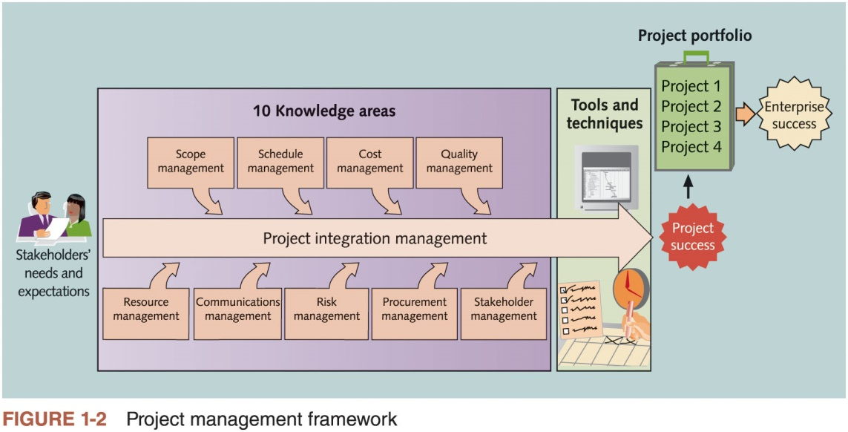
What is Project Management? (2 of 2)

Slide 81
Project Stakeholders
Stakeholders are the people involved in or affected by project activities
Stakeholders include
the project sponsor
banks and other financial institutions
the project manager
the project team
support staff
suppliers
opponents to the project

Slide 82
Project Management Knowledge Areas
Knowledge areas describe the key competencies that project managers must develop
Project managers must have knowledge and skills in all 10 knowledge areas (scope, schedule, cost, quality, resource, communications, risk, procurement, stakeholder, and project integration management)
This text includes an entire chapter on each knowledge area

Slide 83
Project Management Tools and Techniques (1 of 2)
Project management tools and techniques assist project managers and their teams in various aspects of project management
Some specific ones include
Project charter, scope statement, and WBS (scope)
Gantt charts, network diagrams, critical path analysis, critical chain scheduling (time)
Cost estimates and earned value management (cost)
See Table 1-1 for many more

Slide 84
Project Management Tools and Techniques (2 of 2)
PMBOK® Guide – Sixth Edition lists tools and techniques based on their purpose:
Data gathering
Data analysis
Data representation
Decision making
Communication
Interpersonal and team skills
Ungrouped

Slide 85
What Went Right?
The Standish Group’s CHAOS studies show improvements in the statistics for IT projects:
The number of successful projects was 29% in 2015
62% of small projects were successful, 6% of large, 9% of medium, and 21% of moderate size
39% of all agile projects were successful compared to 11% of waterfall projects

Slide 86
Project Success (1 of 4)
There are several ways to define project success:
The project met scope, time, and cost goals
The project satisfied the customer/sponsor
The results of the project met its main objective, such as making or saving a certain amount of money, providing a good return on investment, or simply making the sponsors happy

Slide 87
Project Success (2 of 4)
Factors of Success | Points
Executive sponsorship | 15
Emotional maturity | 15
User involvement | 15
Optimization | 15
Skilled resources | 10
Agile processes | 7
Modest execution | 6
Project management expertise | 5
Clear business objectives | 4
Source: The Standish Group, CHAOS Manifesto 2015 (2015)
Table 1-2 What Helps Projects Succeed?

Slide 88
Project Success (3 of 4)
Top three reasons why federal technology projects succeed
Adequate funding
Staff expertise
Engagement from all stakeholders

Slide 89
Project Success (4 of 4)
Research findings show that companies that excel in project delivery capability:
Use an integrated toolbox
Grow project leaders
Develop a streamlined project delivery process
Measure project health using metrics, like customer satisfaction or return on investment

Slide 90
Program and Project Portfolio Management
About one-quarter of the world’s gross domestic product is spent on projects
Two important concepts that help projects meet enterprise goals:
Use of programs
Project portfolio management

Slide 91
Programs
A program is “a group of related projects managed in a coordinated manner to obtain benefits and control not available from managing them individually” (PMBOK® Guide — Sixth Edition, 2017)
Examples of common programs in the IT field include infrastructure, applications development, and user support
A program manager provides leadership and direction for the project managers heading the projects within the program

Slide 92
Project Portfolio Management (1 of 2)
As part of project portfolio management, organizations group and manage projects and programs as a portfolio of investments that contribute to the entire enterprise’s success
Portfolio managers help their organizations make wise investment decisions by helping to select and analyze projects from a strategic perspective

Slide 93
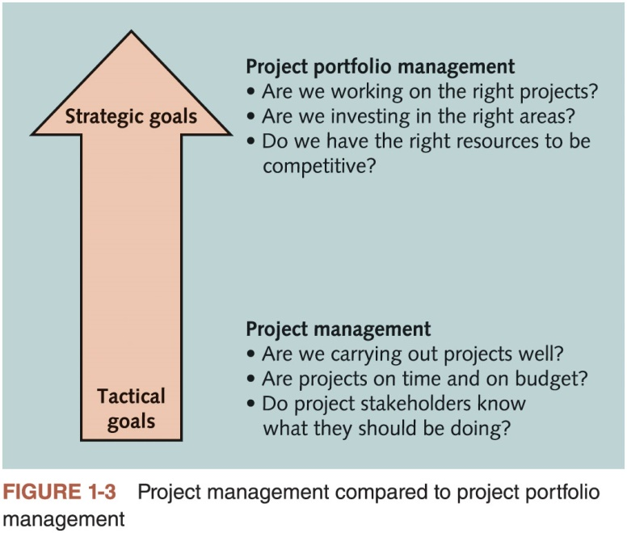
Project Portfolio Management (2 of 2)

Slide 94
Best Practice
A best practice is “an optimal way recognized by industry to achieve a stated goal or objective”*
Robert Butrick suggests that organizations need to follow basic principles of project management, including these two mentioned earlier in this chapter:
Make sure your projects are driven by your strategy. Be able to demonstrate how each project you undertake fits your business strategy, and screen out unwanted projects as soon as possible
Engage your stakeholders. Ignoring stakeholders often leads to project failure. Be sure to engage stakeholders at all stages of a project, and encourage teamwork and commitment at all times

Slide 95
Organizational Project Management (1 of 2)
Organizational project management
Framework in which portfolio, program, and project management are integrated with organizational enablers in order to achieve strategic objectives

Slide 96
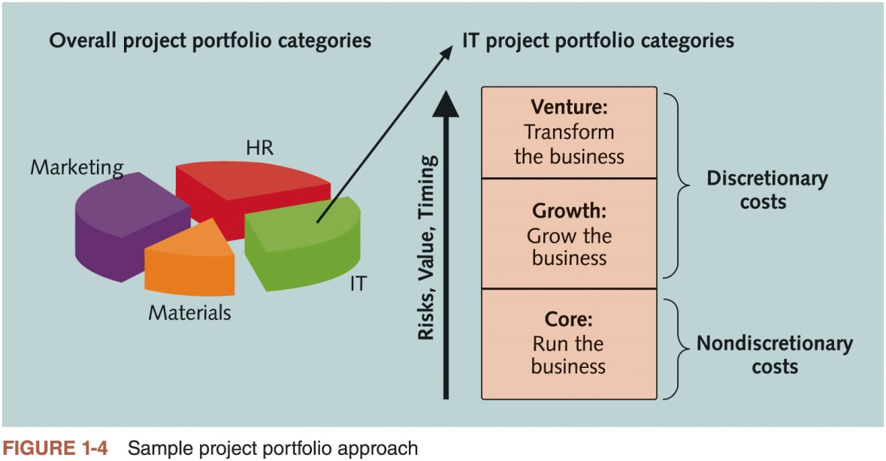
Organizational Project Management (2 of 2)
Notes:
Image shows that the costs of Core IT projects are nondiscretionary, which means that the company has no choice in whether to fund them.

Slide 97
The Role of the Project Manager
Project managers must work closely with the other stakeholders on a project, especially the sponsor and project team
They are also more effective if they are familiar with the 10 project management knowledge areas
And the various tools and techniques related to project management

Slide 98
Project Manager Job Description
Job descriptions vary, but most include responsibilities like planning, scheduling, coordinating, and working with people to achieve project goals
Project management is a skill needed in every major IT field, from database administrator to network specialist to technical writer

Slide 99
Advice for Young Professionals
A few questions to ask yourself to know if you would be a good project manager
Do you get frustrated by bad bosses? Do you think you could do a better job?
Are you interested in understanding the big picture of how organizations work and how your individual work or your project fits in?
Have you had other leadership roles, such as being a team captain, president of a club, or entrepreneur of a small business? Did you enjoy it? Did others think you did a good job?
Are you good at mentoring others? Do people ask you for help in developing their skills or your advice on what to do?

Slide 100
Suggested Skills for Project Managers (1 of 2)
The Project Management Body of Knowledge
Application area knowledge, standards, and regulations
Project environment knowledge
General management knowledge and skills
Soft skills or human relations skills

Slide 101
Suggested Skills for Project Managers (2 of 2)
Six traits of highly effective project managers as follows:
Be a strategic business partner
Encourage and recognize valuable contributions
Respect and motivate stakeholders
Be fully vested in success
Stress integrity and accountability
Work in the gray/Be able to deal with ambiguity

Slide 102
PMI Talent Triangle® and the Importance of Leadership Skills*
The talent triangle includes:
Technical project management skills
Strategic and business management skills
Leadership skills
Leadership styles include:
Laissez-faire
Transactional
Servant leader
Transformational
Charismatic
Interactional

Slide 103
Careers for IT Project Managers (1 of 2)
In a 2017 survey, IT executives listed the “ten hot tech skills” they planned to hire for in 2017
Project management was second only to full-stack software development
Even if you choose to stay in a technical role, you still need project management knowledge and skills to help your team and organization

Slide 104
Careers for IT Project Managers (2 of 2)
1. | Full-stack software development
2. | Project management
3. | Cyber-security
4. | Networking
5. | User experience/user interface (UX/UI) design
6. | Quality assurance (QA)/testing
7. | Cloud engineering
8. | Big data
9. | Machine learning/artificial intelligence
10. | DevOps
Source: Sharon Florentine, “10 IT skills that employers need in 2017,” CIO from IDG (February 1, 2017).
Table 1-4 Ten hot tech skills for 2017

Slide 105
The Project Management Profession
The profession of project management is growing at a very rapid pace
It is helpful to understand the history of the field, the role of professional societies like the Project Management Institute, and the growth in project management software

Slide 106
History of Project Management (1 of 4)
Some people argue that building the Egyptian pyramids was a project, as was building the Great Wall of China
Most people consider the Manhattan Project to be the first project to use “modern” project management
This three-year, $2 billion (in 1946 dollars) project had a separate project manager and a technical manager

Slide 107
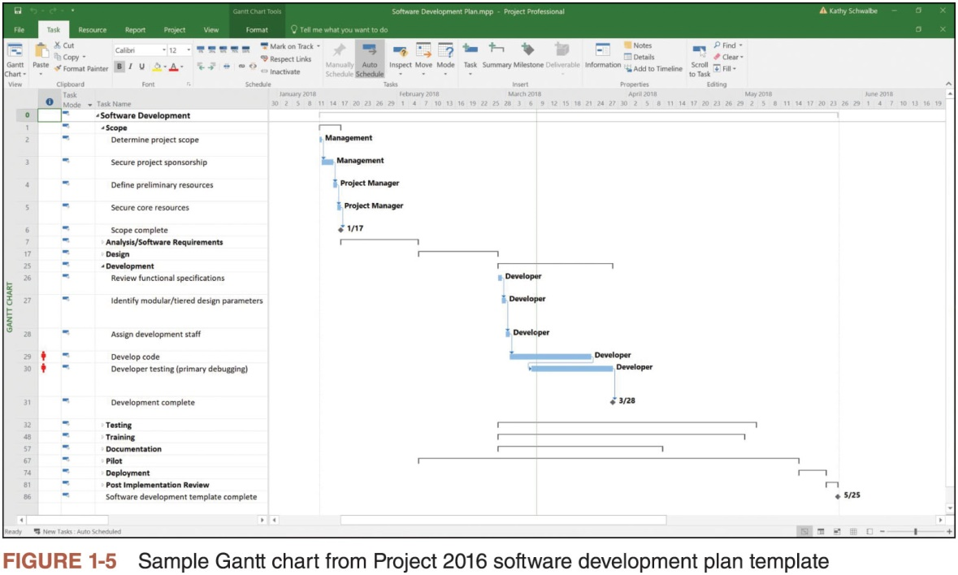
History of Project Management (2 of 4)

Slide 108
History of Project Management (3 of 4)
In the 1990s, many companies began creating PMOs to help them handle the increasing number and complexity of projects
A Project Management Office (PMO) is an organizational group responsible for coordinating the project management function throughout an organization

Slide 109
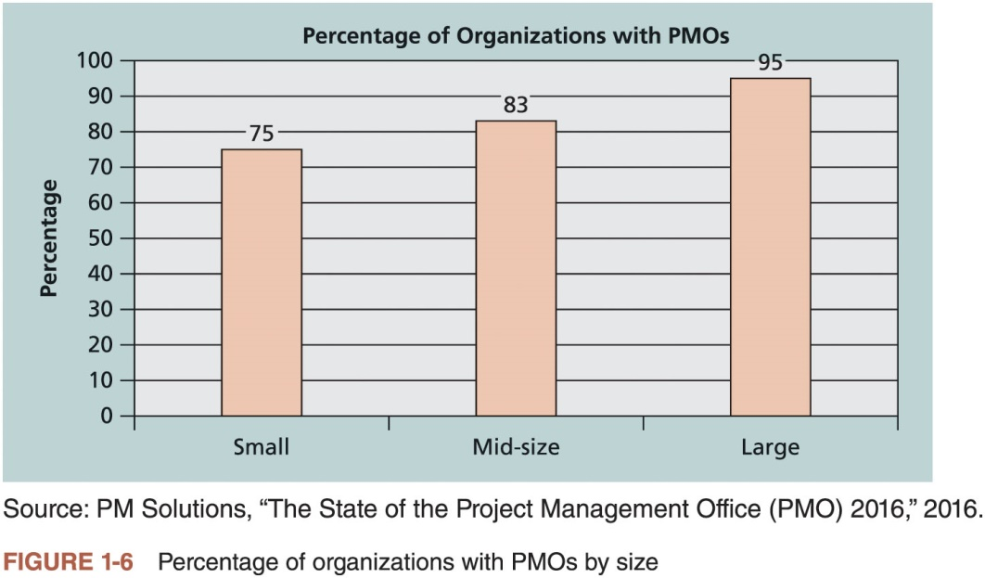
History of Project Management (4 of 4)

Slide 110
Global Issues
Several global dynamics are forcing organizations to rethink their practices:
Talent development for project and program managers is a top concern
Basic project management techniques are core competencies
Organizations want to use more agile approaches to project management
Benefits realization of projects is a key metric

Slide 111
The Project Management Institute
The Project Management Institute (PMI) is an international professional society for project managers founded in 1969
PMI has continued to attract and retain members, reporting more than 500,000 members worldwide by late 2017
There are communities of practices in many areas, like information systems, financial services, and health care
Project management research and certification programs continue to grow

Slide 112
PMI Student Membership
Students can join PMI at a reduced fee and earn the Certified Associate in Project Management (CAPM) certification(see PMI for details)

Slide 113
Project Management Certification (1 of 2)
PMI provides certification as a Project Management Professional (PMP®)
A PMP® has documented sufficient project experience, agreed to follow a code of ethics, and passed the PMP® exam
The number of people earning PMP® certification is increasing quickly

Slide 114
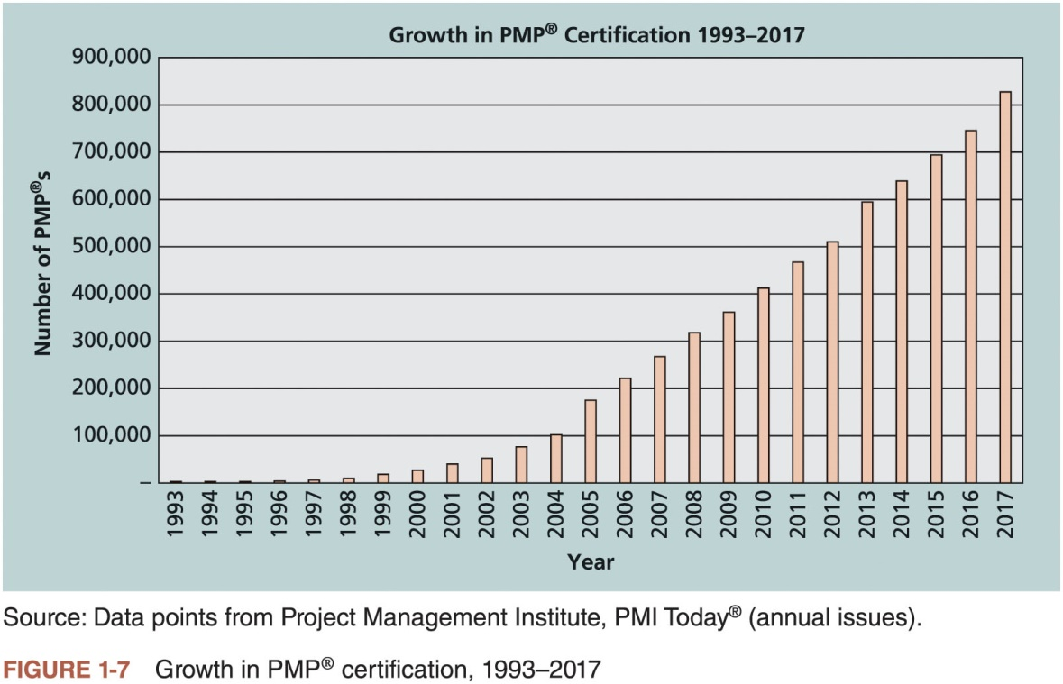
Project Management Certification (2 of 2)

Slide 115
Ethics in Project Management
Ethics, loosely defined, is a set of principles that guide our decision making based on personal values of what is “right” and “wrong”
Project managers often face ethical dilemmas
In order to earn PMP® certification, applicants must agree to PMI’s Code of Ethics and Professional Conduct
Several questions on the PMP® exam are related to professional responsibility, including ethics

Slide 116
Project Management Software*
There are hundreds of different products to assist in performing project management
Three main categories of tools:
Low-end tools: Handle single or smaller projects well, cost under $200 per user
Midrange tools: Handle multiple projects and users, cost $200-$1,000 per user, Microsoft Project is still the most popular
High-end tools: Also called enterprise project management software, often licensed on a per-user basis
Several free or open-source tools are also available

Slide 117
Chapter Summary
A project is a temporary endeavor undertaken to create a unique product, service, or result
Project management is the application of knowledge, skills, tools, and techniques to project activities to meet project requirements
A program is a group of related projects managed in a coordinated way
Project portfolio management involves organizing and managing projects and programs as a portfolio of investments
Project managers play a key role in helping projects and organizations succeed
The project management profession continues to grow and mature

