Slide 1
SDAIA ACADEMY · DATA SCIENTIST TRACK · SDA-DSC-212
Time Series Analysis
and Forecasting
تحليل السلاسل الزمنية والتنبؤ
Respect the arrow of time — so every accuracy number you report
would survive contact with the future.
LEVEL
Specialist
DURATION
3 days × 5 hours = 15 hours
AUDIENCE
Data scientists & analysts working with temporal data
PREREQUISITES
SDA-DSC-111 · SDA-DSC-211 recommended
ASSESSMENT
Forecasting project with backtest report
Notes:
Welcome. Set the frame in one sentence before anything else: this course is not 'more machine learning, but on dates'. It is a discipline about one thing — never letting the future touch the past. Everything for three days advances one artefact, a national load-forecasting service called Tayyar.

Slide 2
OPENING · WHY THIS COURSE EXISTS
A model that was right until it mattered
What the report said
What had actually happened
A gradient-boosted model scored 0.6% MAPE in validation
It beat the incumbent by a wide margin on every chart
It was promoted to production the following week
Live accuracy collapsed to roughly 4% within days
A rolling-mean feature used a CENTRED window
"The average of the past 24 hours" silently contained the target hour
One .shift(1) fixed it — honest accuracy rose to 2.1%
Worse on paper. Real in production.
This failure has a thousand faces and one cause: information from the future reached a model that will never have it. Detecting, preventing and measuring that is the entire content of the next three days.
Notes:
Tell this as a story, not a slide. Ask the room: has anyone shipped a model whose live accuracy did not match its validation accuracy? Almost every hand goes up. Then name the mechanism. Do NOT yet explain what .shift(1) does — Module 4 earns that. Right now they only need to believe the problem is real.

Slide 3
HOUR 1 · WHAT MAKES A TIME SERIES DIFFERENT
Order is the signal
An ordinary supervised-learning row is exchangeable — shuffle the dataset and nothing is lost. A time series is the opposite. Three consequences follow, and each of them bites anyone who treats a series like a normal table.
1
2
3
Autocorrelation
Temporal leakage
Non-stationarity
Today is correlated with yesterday. Observations are not independent, so error bars, CV folds and significance tests computed under an i.i.d. assumption are simply wrong.
Any information from the future — a random-split test point, a global mean, a peeking feature — inflates measured accuracy and evaporates in production. This is THE recurring failure of the field.
Mean, variance and seasonal shape drift. A model trained on last year's level will confidently forecast a level that no longer exists.
The one non-negotiable rule of this course: every feature, every split, every scaler must be computable using only data that existed at the forecast origin.
Notes:
Land 'exchangeable' with a physical demo: shuffle a deck of cards and ask whether anything was lost, then shuffle a sentence's words. The three consequences are the spine of the whole course — Module 2 attacks autocorrelation and non-stationarity, Modules 4 and 6 attack leakage.

Slide 4
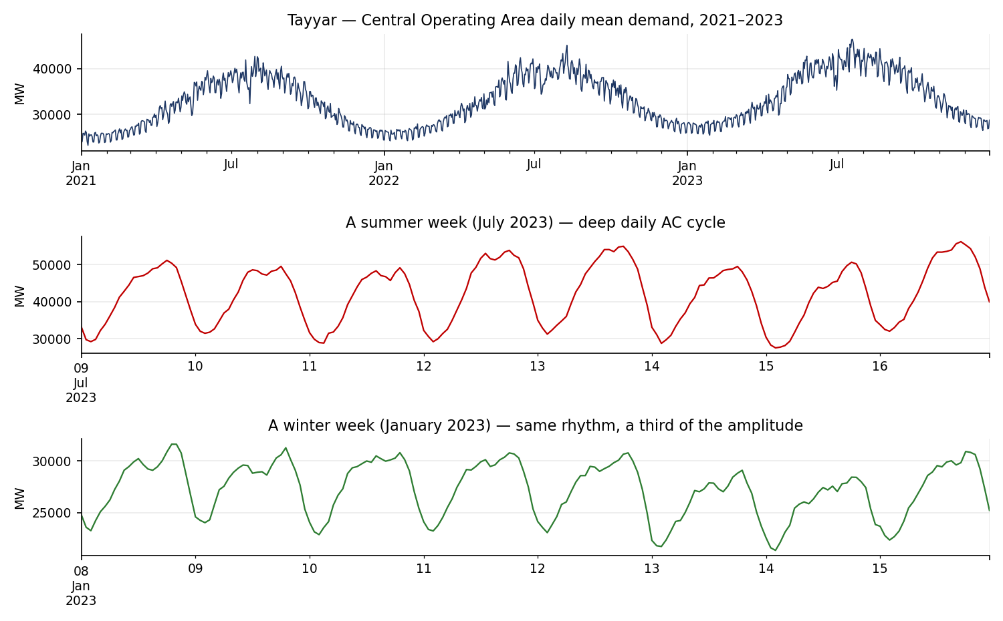
THE GOLDEN THREAD
Tayyar (تيّار)
A national day-ahead load-forecasting service for the Central Operating Area of the Saudi grid. Three years of hourly demand, and one series that carries every lesson in this course.
✓
Growth trend
economic expansion, ≈ +3% a year
✓
Daily cycle
air-conditioning load, period 24
✓
Weekly rhythm
the Friday–Saturday weekend dip
✓
Annual peak
a fierce Riyadh summer, 47 °C afternoons
The decision the service exists to answer
✓
Calendar shocks
Ramadan, the two Eids, National Day
“At 14:00 today, how much generation capacity should the operator prepare for each hour tomorrow?”
✓
Structural break
a large industrial customer connects
Notes:
Emphasise that this is operational, not statistical. A 1% day-ahead error on a 55,000 MW peak is about 550 MW — a mid-size gas turbine held spinning for nothing, or missing when needed. Every lab advances THIS service; nobody builds a throwaway airline-passengers model.

Slide 5
COURSE LEARNING OUTCOMES
What you will be able to do on Thursday
LO1
Analyse trend, seasonality and autocorrelation structure in time series
M1 · M2
LO2
Develop classical forecasting models including ARIMA and exponential smoothing
M3
LO3
Implement ML and gradient-boosting approaches with engineered temporal features
M4
LO4
Design backtesting frameworks with proper time-based validation
M6
LO5
Evaluate forecasts using scale-appropriate accuracy and uncertainty metrics
M5 · M6
LO6
Compare model families to select the right approach per use case
M7
Assessed by: 7 lab checkpoints (30%) · two practical assessments (20%) · a 10-question quiz (10%) · the capstone backtest report (40%).
Notes:
Read LO4 and LO5 aloud slowly — those two are what distinguish this course from a modelling tutorial. Point out that LO2 and LO3 are only half the grade between them; the evidence is the other half.

Slide 6
DELIVERY PLAN
Three days, one deliverable
DAY 1
DAY 2
DAY 3
Seeing the signal
Building forecasts
Trust and selection
M1 Structure & decomposition
M2 Stationarity & autocorrelation
M3 ARIMA & exponential smoothing
M4 Feature-based ML forecasting
M5 Probabilistic forecasting (start)
M5 Intervals & calibration
M6 Backtesting & evaluation
M7 Case study + capstone
50% theory / 50% lab
45% theory / 55% lab
35% theory / 65% lab
END OF DAY
END OF DAY
END OF DAY
Clean hourly series + decomposition panel + stationarity report
SARIMAX, ETS and a LightGBM forecaster, all producing 24 h forecasts
Rolling-origin backtest report, calibrated intervals, model decision
Each hour = 50 minutes of instruction + 10 minutes buffer. The long break is scheduled around Dhuhr.
SDA-DSC-212
Notes:
Point at Day 3 and say plainly: the backtest report is the deliverable and the thesis made visible. If a cohort falls behind, compress Module 6 theory — never the backtest lab.

Slide 7
DAY 1 · HOURS 1–5
Seeing the Signal
Before anyone fits a model, they must see the series. Module 1 teaches what a series is made of; Module 2 teaches how to test whether a classical model may touch it.
MODULE 1
Time-Series Structure and Decomposition
LO1
MODULE 2
Stationarity and Autocorrelation
LO1 · LO2
Notes:
Day 1 has no forecasting in it at all, and that is deliberate. Say so — participants who expect to fit a model in hour 2 need to know why they are not going to.

Slide 8
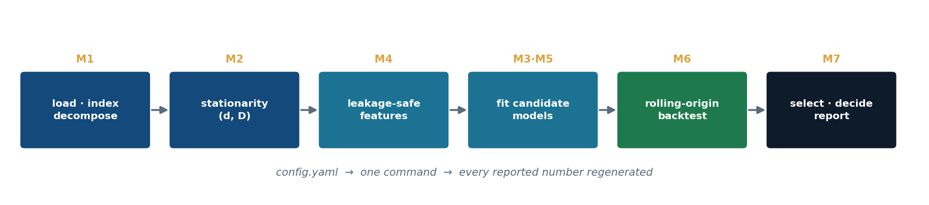
MODULE 1 · DAY 1, HOURS 2–3 · LO1
Time-Series Structure
and Decomposition
Where this module sits in the pipeline you will build
Before anyone fits a model, they must see the series. Decomposition is both a diagnostic — what structure exists? — and a modelling strategy: forecast the parts, recombine.
1.1
Construct a correct, gap-free DatetimeIndex with explicit frequency and timezone
1.2
Distinguish trend, seasonal and remainder; choose additive vs multiplicative
1.3
Apply STL and classical decomposition, including multiple seasonalities
1.4
Resample and aggregate without introducing temporal artefacts
1.5
Read a decomposition to specify what a downstream model must capture
Notes:
Business relevance in one line: a demand planner who cannot separate 'sales are trending up' from 'it is simply summer' will over-order every June and blame the model. Decomposition is the shared vocabulary between the data scientist and the decision-maker.

Slide 9
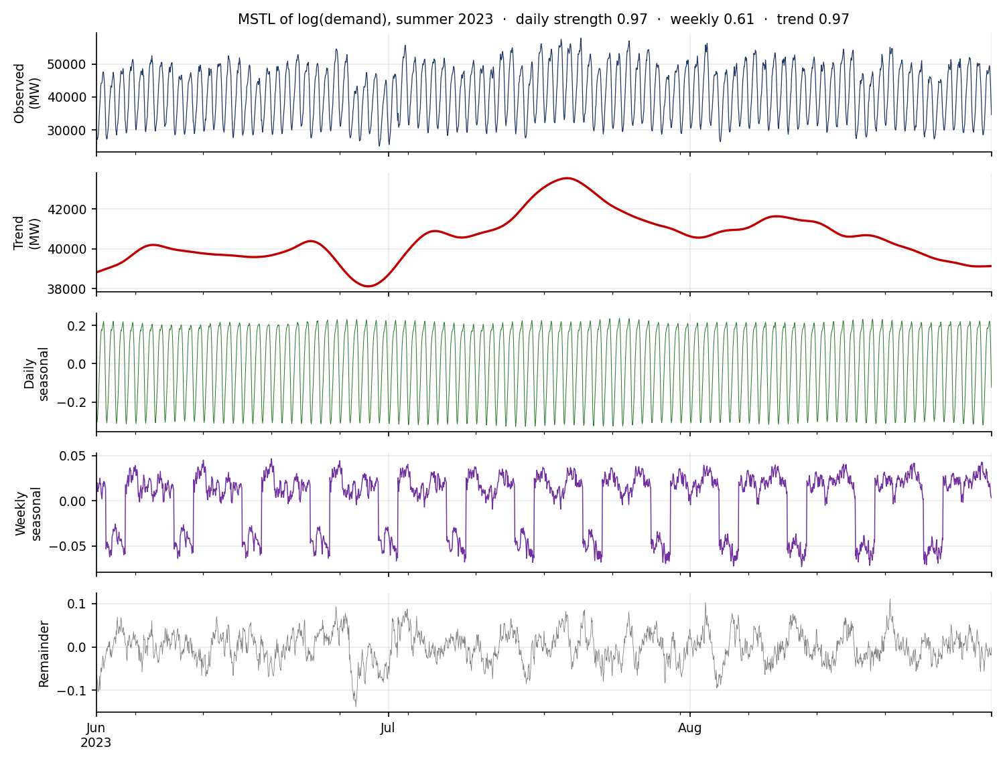
M1 · THE ADDITIVE MODEL
Every series is three things at once
y_{t} = T_{t} + S_{t} + R_{t}
trend the long-run level
seasonality the repeating pattern of known period
remainder what neither explains — where a covariate hides
Multiplicative when the swing grows with the level
y = T × S × R ⟺ log y = log T + log S + log R
Decide on evidence, not on taste: correlate the per-cycle level with the per-cycle amplitude. On Tayyar that correlation is 0.937, so the series is modelled multiplicatively — as log(demand).
MSTL on log(demand), summer 2023 — the observed line separated into trend, the daily and weekly seasonal components, and the remainder.
Zero or negative values must be inspected before any log transform — a sensor dropout will silently produce NaN.
M1
Notes:
Demonstrate live: plot the summer week and the winter week from the previous figure on the same axis. The amplitude difference is the whole argument for multiplicative. Then show that the level/swing correlation makes it a measurement rather than an opinion.

Slide 10
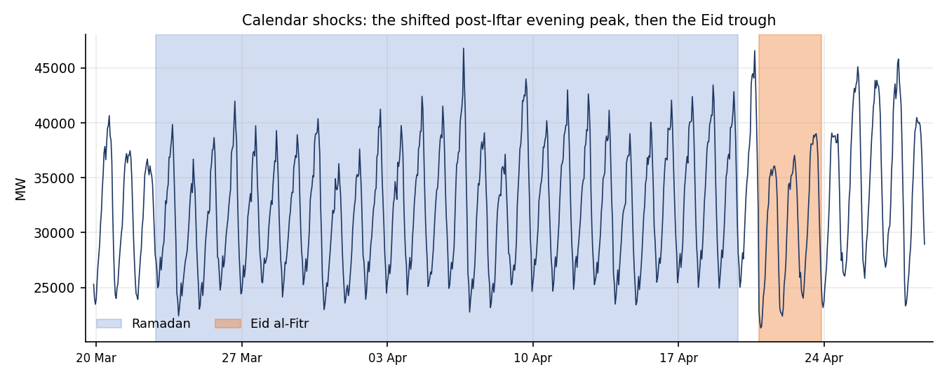
M1 · SEASONAL AND TREND STRENGTH
Decomposition is a measurement, not a picture
Fₛ = 1 − Var(R) / Var(S + R)
Fₜ = 1 − Var(R) / Var(T + R)
Hyndman's strength measures, both in [0, 1]. Near 1 means the component dominates what a model must capture; near 0 means you can ignore it.
0.97
Daily (m = 24)
The air-conditioning cycle. The dominant structure — any model that misses it is not a candidate.
0.61
Weekly (m = 168)
What the remainder is telling you
The Friday–Saturday weekend dip. Real, but secondary — a calendar feature can carry it.
The evening peak shifts later through Ramadan — a fasting-and-Iftar pattern no fixed 24-hour seasonal shape can absorb
Eid produces a deep multi-day trough that looks, to a naive model, exactly like a weekend that will not end
A summer heatwave shows up as remainder, not seasonality — that is the signature of a missing covariate: temperature
0.97
Trend
Economic growth plus a step change when a large industrial customer connected.
Notes:
The card-sort activity fits here (10 min): give pairs cards reading temperature, hour-of-day, Ramadan, economic growth, sensor noise, and have them sort into seasonal component / trend / exogenous covariate / remainder. The argument about temperature is the productive one.

Slide 11
M1 · INDEXING, FREQUENCY AND GAPS
The one line that turns a silent gap into a visible one
df = pd.read_csv(path, parse_dates=["timestamp"])
df = df.drop_duplicates(subset="timestamp", keep="last") # 19 duplicates
df = df.sort_values("timestamp").set_index("timestamp")
df.index = df.index.tz_localize("Asia/Riyadh",
ambiguous="infer", nonexistent="shift_forward")
df = df.asfreq("h") # <- the line that reveals the gaps
df.loc[df["demand_mw"] == 0, "demand_mw"] = pd.NA # sensor dropouts
assert df.index.is_monotonic_increasing and df.index.is_unique
assert df.index.freq is not None # frequency must be DECLARED
What the cleaned load reports
rows in the raw file
26,235
rows after asfreq("h")
26,280
missing hours materialised
71
longest single gap
5 hours
short gaps interpolated
66
The raw file contains 26,235 rows and the clean series contains 26,280. The missing hours were never in the file — absent, not null. Skip asfreq and every seasonal index downstream is quietly misaligned, and the STL seasonal shape smears.
Common mistakes this slide prevents
Instructor demo
Resampling with .sum() where the question needs .mean() — the trend inflates 24×
Using period = 12 for the daily cycle of an hourly series (it is 24 — observations per cycle)
Log-transforming a series containing a zero from a sensor dropout
Load and decompose live in under 8 minutes
Deliberately SKIP asfreq once; show the seasonal shape smear on branch sim-gap
Then fix it — the fix is one line, and that is the point
Notes:
Let a pair discover the silent row loss themselves — do not pre-warn them. It is the highest-value teachable moment on Day 1. sim-gap removes 48 hours of telemetry without a marker.

Slide 12
HANDS-ON LAB 1 · 50 MINUTES · PAIRS
Load, index and decompose the Tayyar series
git checkout lab1-start
EXPECTED OUTPUT
5
Load the raw CSV. Confirm the duplicate and out-of-order timestamps. Note the row count BEFORE cleaning.
$ python -m tayyar.analysis.run_decompose
Loaded 26,280 hourly rows | 71 missing hours materialised
(longest gap: 5h)
Imputed 66 short gaps; 1 long gap (5h) flagged
Transform: multiplicative (level/swing corr = 0.94)
-> modelling log(demand)
Seasonal strength daily=0.97 weekly=0.61
Trend strength 0.97 | growth +3.4% then +5.5% YoY
Wrote decomposition_panel.png, FINDINGS.md
10
Implement load_demand: de-duplicate, sort, localise to Asia/Riyadh, asfreq("h"). Report gap rows and the longest gap.
10
Impute gaps ≤ 3 h by time interpolation; flag longer gaps. Plot one summer week and one winter week; describe each in a sentence.
10
Decide additive vs multiplicative with additive_or_multiplicative. Justify from the amplitude plot. Log-transform if multiplicative.
Run MSTL for daily + weekly seasonality. Compute seasonal_strength for each. Produce the four-panel figure.
Troubleshooting
10
Index not monotonic in STL
drop_duplicates + sort before set_index
5
Write three bullets in FINDINGS.md: dominant seasonality, trend direction, remainder behaviour. Commit.
ValueError: freq not set
you skipped asfreq("h")
NaNs after log transform
a zero demand — inspect the dropout first
Fast finishers: overlay the annual seasonal shape for 2021 against 2023 and observe the deepening summer peak — the motivation for STL's evolving seasonality.
Seasonal component looks flat
wrong period: hourly daily cycle = 24, not 12
Notes:
Circulate. The pairs who skip task 1 and go straight to the clean loader are the ones who will not understand why asfreq matters — let them hit it, then ask them to count their rows.

Slide 13
M1 · CASE STUDY · FACILITATE, DON'T LECTURE
Demand planning at a national grid operator
Discussion questions
The situation
“Shabakah”, the operations-planning unit of a national grid operator, must publish a day-ahead load forecast every afternoon. Reserve margins — how much spare generation to keep spinning — are sized off that forecast.
1
Why might daily-max and daily-mean forecasts need different models?
2
Which structure should be a model component, and which an exogenous covariate?
A 1% day-ahead error on a 55,000 MW peak is about 550 MW — a mid-size gas turbine held in reserve for nothing, or missing when needed.
3
How would you detect that this year's summer seasonality is deepening rather than a one-off heatwave?
Constraints that shape every later decision
Hourly telemetry with occasional sensor gaps
A strict afternoon publication deadline — the pipeline must run in minutes
The forecast must be explainable to control-room engineers who distrust black boxes
Friday–Saturday weekend and Hijri holidays handled correctly
4
What is the cost asymmetry of over- versus under-forecasting here — and how should it shape evaluation?
Checkpoint before Module 2: every pair should hold a tz-aware hourly series with a declared frequency, a documented gap policy, and an MSTL panel with reported strengths.
Notes:
Question 4 is the one to protect time for — it plants Module 6. Under-forecasting risks load-shedding, a headline; over-forecasting burns fuel, merely expensive. Symmetric MAE does not know that.

Slide 14
MODULE 2 · DAY 1, HOURS 4–5 · LO1 · LO2
Stationarity and
Autocorrelation
Weak stationarity
Three things constant over time:
Classical models assume stationarity. Diagnose it, transform to it, then read autocorrelation to fingerprint the model. Mistaking a trend for a stationary mean is the single most expensive analytical error in demand and economic forecasting.
▪ the mean
▪ the variance
▪ the autocovariance at each lag k
(depends on the gap, not the position)
2.1
Define weak stationarity and identify sources of non-stationarity
ARIMA estimates ONE parameter set and assumes it holds throughout.
2.2
Apply and reconcile ADF and KPSS tests
2.3
Apply regular and seasonal differencing to achieve stationarity
2.4
Compute and interpret ACF and PACF
2.5
Translate ACF/PACF signatures into candidate ARIMA orders
Notes:
Tayyar has all three sources of non-stationarity: a growth trend, multi-period seasonality, and summer-amplified variance. Fix order matters: stabilise variance first (the log from Module 1), then difference.

Slide 15
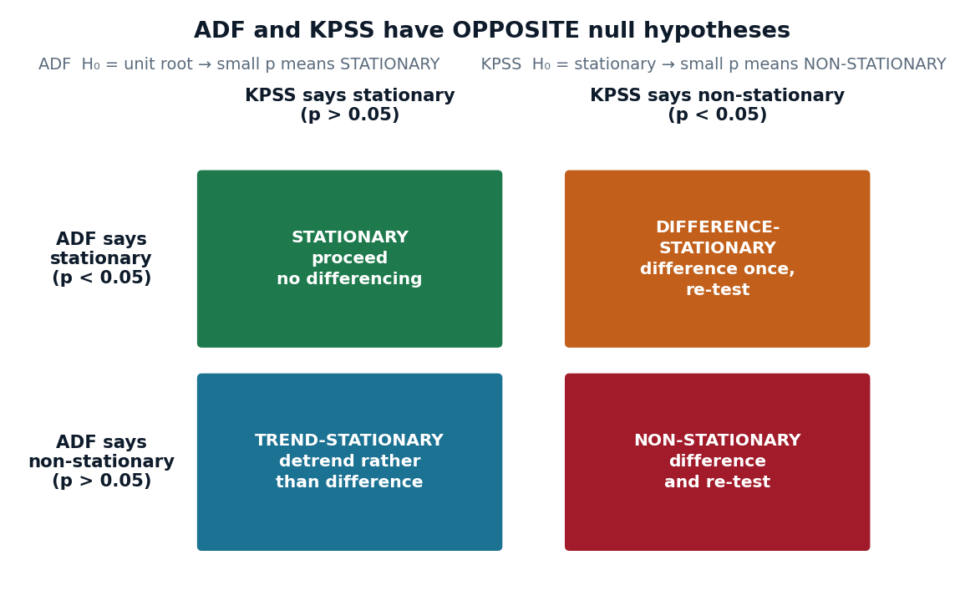
M2 · TESTING STATIONARITY
Two tests, opposite nulls — and the disagreement is the information
adf_stat, adf_p, *_ = adfuller(s, autolag="AIC")
kpss_stat, kpss_p, *_ = kpss(s, regression="c", nlags="auto")
adf_stationary = adf_p < 0.05 # reject the unit root
kpss_stationary = kpss_p > 0.05 # fail to reject stationarity
verdict, action = RECONCILE[(adf_stationary, kpss_stationary)]
What Tayyar reports
Series | ADF p | KPSS p | Verdict
log(demand), level | 0.0263 | 0.01 | difference-stationary
after D = 1, m = 24 | 0.00 | 0.1 | stationary
The result that surprises people
One SEASONAL difference at lag 24 was enough. No regular difference was needed at all: D = 1, d = 0. Difference as little as possible — over-differencing injects artificial negative autocorrelation and inflates variance.
Mistakes to plant and catch: reading ADF's null backwards ("p > 0.05 so it's stationary") · differencing before stabilising variance · reading the ACF of a non-stationary series and calling its slow decay a high AR order.
Notes:
Run the verdict-reconciliation drill here (10 min): call out p-value pairs and have the room say the reconciled verdict aloud. Quiz them cold — the nulls being backwards is the single most common error on Day 1.

Slide 16
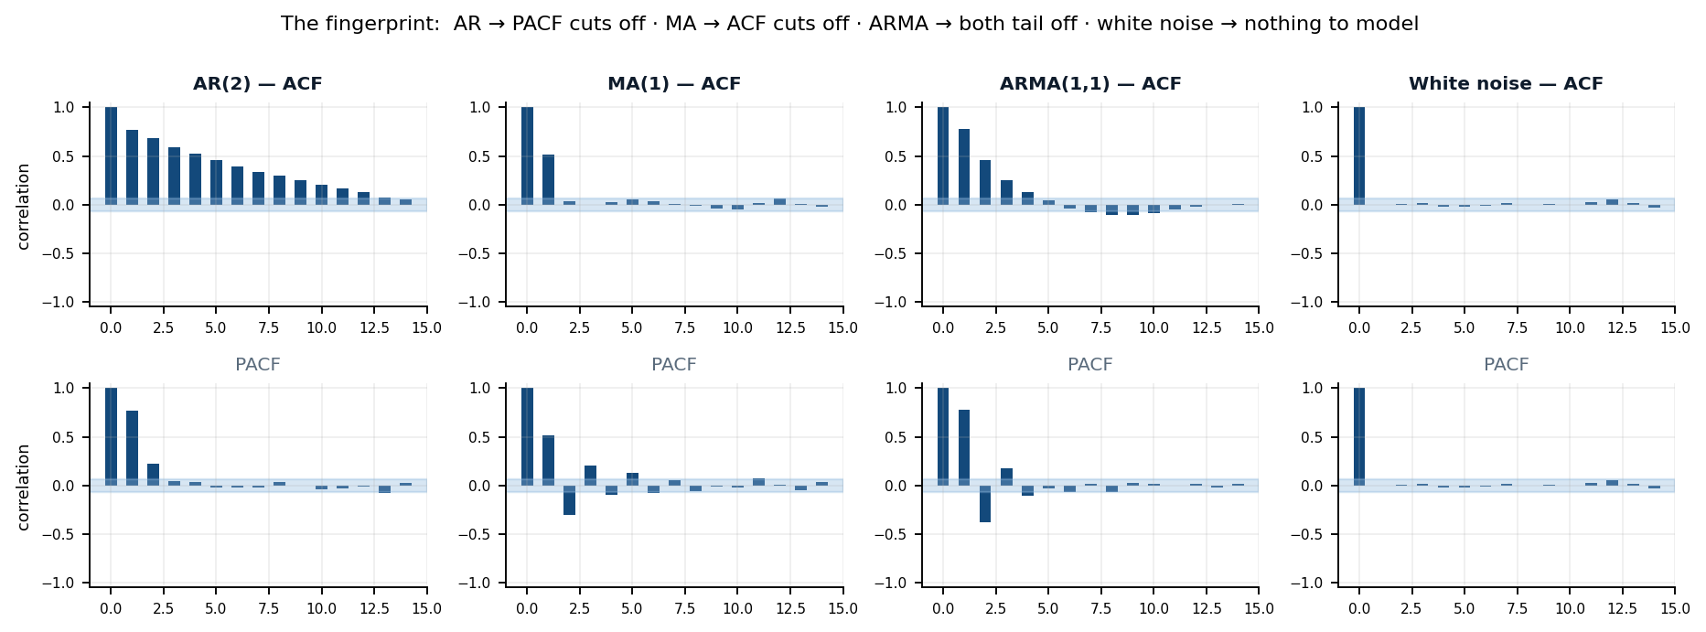
M2 · READING ACF AND PACF
The correlogram is a fingerprint, not a decoration
ACF | PACF | Read as | In practice
tails off (geometric decay) | cuts off after lag p | AR(p) | PACF gives the order
cuts off after lag q | tails off | MA(q) | ACF gives the order
tails off | tails off | ARMA(p, q) | use AICc / BIC to choose
slow, near-linear decay | large spike at lag 1 | NOT stationary | difference before reading further
spikes at m, 2m, 3m … | spike at lag m | seasonal terms | set P, Q and m
“Cuts off” means it drops inside the ±1.96/√n band. Default lags = 20 never reaches lag 24 — set lags ≥ 2m or the seasonal spike is invisible.
Notes:
Run the ACF/PACF speed round: six anonymised correlogram pairs, 30 seconds each, teams call the model class and order. It is the fastest way to make the fingerprint table stick.

Slide 17
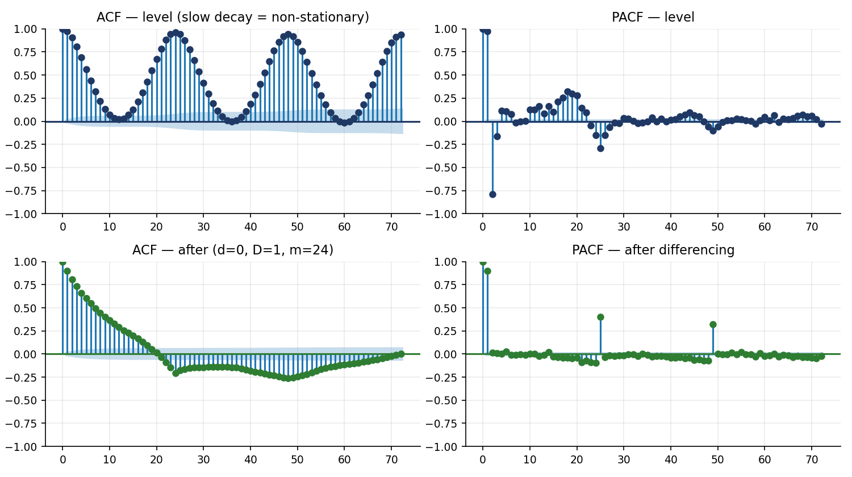
HANDS-ON LAB 2 · 50 MINUTES · PAIRS
The stationarity report
git checkout lab2-start
8
Run stationarity_report on raw log-demand. Interpret ADF and KPSS TOGETHER. Record the verdict and predict the differencing needed.
10
choose_differencing(m=24) — seasonal FIRST, then regular. Re-run the report to confirm stationarity was actually reached.
10
Plot before and after. Check the lag-1 ACF for the over-differencing signature (strongly negative, < −0.5). Reduce d if you see it.
12
ACF/PACF with lags ≥ 60. Annotate the seasonal spike at lag 24. Read candidate (p, q) and seasonal (P, Q).
$ python -m tayyar.analysis.run_stationarity
Raw log-demand : ADF p=0.026 KPSS p=0.01
-> difference-stationary
Suggested : seasonal first, m=24
After D=1, d=0 : ADF p=0.00 KPSS p=0.10 -> stationary
ACF/PACF : PACF cuts near lag 2-5; ACF spike at 24
Candidates : SARIMA(2,0,1)(1,1,1)[24]
SARIMA(1,0,2)(0,1,1)[24]
Wrote acf_pacf.png, STATIONARITY.md
10
Write STATIONARITY.md: verdict, chosen (d, D), and 2–3 candidate SARIMA orders with justification. Commit.
Debugging branch sim-overdiff differences twice where once suffices. Diagnose it from the lag-1 ACF near −0.6, then fix it.
Notes:
Watch for pairs who difference until ADF is happy and stop thinking. Ask them to look at the lag-1 ACF. Also warn about the statsmodels 'p-value greater than 0.1' KPSS warning — it is expected, and means p > 0.1.

Slide 18
DAY 2 · HOURS 1–5
Building Forecasts
Three model families, in the order a practitioner should try them: the free baseline, the classical models a control room will accept, and the feature-based ML model that wins when the covariates are rich.
MODULE 3
ARIMA and Exponential Smoothing
LO2 · LO3
MODULE 4
Feature-Based ML Forecasting
LO3 · LO4
MODULE 5
Probabilistic Forecasts and Intervals (starts)
LO5
Notes:
Pair rotation today: put a strong-statistics participant with a strong-ML participant. The M3 to M4 bridge is exactly where that skill transfer pays off.

Slide 19
MODULE 3 · DAY 2, HOURS 1–2 · LO2 · LO3
ARIMA and
Exponential Smoothing
SARIMA(p, d, q)(P, D, Q)ₘ
AR(p)
y depends on its own p past values
The classical families remain the model to beat in regulated and safety-critical settings — because they can be explained. “The forecast rose because the level term updated and the summer seasonal factor kicked in” is accepted by a control-room engineer. “The gradient boosting said so” is not.
I(d)
d differences to reach stationarity
MA(q)
y depends on the last q shocks
3.1
Specify and fit ARIMA/SARIMA models with justified orders
(P,D,Q)ₘ
the same three, at the seasonal period m
3.2
Incorporate exogenous regressors with SARIMAX
3.3
Select an exponential-smoothing / ETS specification from the taxonomy
3.4
Diagnose model adequacy from residuals
3.5
Compare ARIMA and ETS and choose per situation
Notes:
Flag the practical constraint early: m = 24 (let alone 168) makes the state space large and estimation slow. Practitioners model a daily-aggregated series with m = 7 and leave sub-daily structure to the ML route. That wall is deliberate and teachable.

Slide 20
M3 · ORDER SELECTION AND THE m = 24 WALL
Where classical methods strain — and what to do about it
The wall
Order selection
ETS taxonomy
auto_arima with m = 24 on 26,000 hourly points runs for minutes and may never converge. This is not a bug in your code.
AR order from the PACF cut-off, MA from the ACF
Minimise AICc (small samples) or BIC (parsimony)
auto_arima proposes; the analyst disposes
NEVER compare AIC across different d — different targets
(Error, Trend, Seasonal), each ∈ {None, Additive, Multiplicative}
SES → level only, flat forecast
Holt → + trend (damp it)
Holt-Winters → + seasonality
→ Model the DAILY series with m = 7.
→ Leave sub-daily structure to Module 4.
Damped trend is almost always the safer production choice.
Exogenous regressors must be known at forecast time
Residual diagnostics are mandatory, not optional
def make_exog(df):
out["cdd"] = np.clip(df["temp_c"] - 21.0, 0, None) # cooling
out["hdd"] = np.clip(14.0 - df["temp_c"], 0, None)
for c in ("is_weekend", "is_ramadan", "is_eid"):
out[c] = df[c].astype(int)
res = fit_sarimax(y, exog, order=(2,1,1),
seasonal_order=(1,1,1,7))
fc = res.get_forecast(steps=28, exog=exog_future)
# exog_future is REQUIRED
Ljung-Box: H₀ = residuals independent. p < 0.05 means autocorrelation remains and the model is under-specified — raise an order
Residual mean ≈ 0 (no bias) and roughly constant variance (the transform worked)
Approximate normality — matters for INTERVAL validity more than for the point forecast
An un-diagnosed auto_arima result is a liability, not a model
Temperature qualifies only because a day-ahead weather forecast exists. Use the FORECAST, not the realised value — otherwise you have built a leak that looks like skill.
On Tayyar's daily-max series the fitted SARIMAX still shows Ljung-Box p ≈ 0.00 — structure remains. Say so out loud: this is what an honest diagnostic looks like, and it is why the ML route exists.
Notes:
Do not hide the failing Ljung-Box. Participants trust a course that shows its own model failing a test it taught. Explain that a daily-max series compresses away the sub-daily structure that would satisfy the diagnostic.

Slide 21
M3 · LAB 3 AND THE ANSWER IT PRODUCES
Does the temperature regressor actually pay for itself?
Model (daily peak, 28-day hold-out) | MAE (MW) | MAPE | MASE | Bias (MW) | Verdict
SARIMAX + temperature + calendar | 666 | 2.05% | 0.333 | +37 | best point accuracy
SARIMA, no exogenous regressors | 686 | 2.14% | 0.342 | +142 | temperature is worth ≈ 20 MW of MAE
ETS(A, Ad, A) — damped trend | 869 | 2.68% | 0.433 | +782 | no covariates, fits in seconds
Seasonal-naive (the free baseline) | 2609 | 8.12% | 1.302 | +2534 | what everything must beat
Read the bias column, not only the error column. The no-exogenous model drifts +142 MW high; adding temperature pulls that to +37 MW. A biased forecast is a systematic reserve error every single day.
Watch for
LAB 3 · 50 min · git checkout lab3-start
Classical baselines: SARIMAX and ETS
Symptom | What it really is
auto_arima runs for minutes | m = 24 on hourly — switch to the daily series, m = 7
Ljung-Box p < 0.05 | under-specified; raise an order and refit
Forecast diverges to absurd values | un-damped Holt trend — set damped_trend=True
get_forecast raises on exog | supply exactly `steps` rows of future regressors
Multiplicative ETS fails | the series contains a zero (a sensor dropout)
5′ Aggregate to daily; build the exog frame from ksa_calendar.csv; hold out the last 28 days
12′ Select the SARIMA order at m = 7; confirm Ljung-Box; raise the order and refit if it fails
10′ Fit ETS with damped trend; read the smoothing parameters from the summary
10′ Forecast 28 days both ways with 90% intervals; SARIMAX needs the FUTURE exog rows
8′ Compute MAE / MAPE / MASE and coverage; run plot_diagnostics
5′ Commit the baselines
Notes:
The interactive here is 'explain it to the control room' (10 min): each participant writes ONE sentence explaining the SARIMAX forecast to a non-statistician, then reads it aloud. Ruthlessly cut any sentence containing the word 'parameter'.

Slide 22
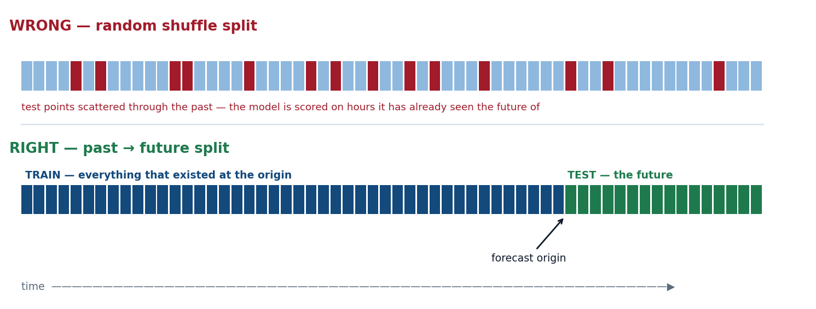
MODULE 4 · DAY 2, HOURS 3–4 · LO3 · LO4
Feature-Based
ML Forecasting
THE ONLY SPLIT THAT MEANS ANYTHING
Reduce forecasting to supervised learning and a great deal becomes easy: nonlinear weather response, interactions, many covariates, many series. The catch — hammered throughout this module — is that every convenience of ML forecasting is also a fresh way to leak the future.
4.1
Reduce a forecasting task to a supervised feature matrix without leakage
4.2
Engineer lag, rolling-window, calendar and Fourier features
4.3
Train and tune gradient-boosting models for forecasting
4.4
Choose recursive versus direct multi-step strategies
4.5
Interpret feature importance and compare against classical baselines
Notes:
Open this module by putting the leakage-smell poster on the wall and telling the room you will point at it every time a shuffle appears. Everything else in Module 4 is technique; this is ethics.

Slide 23
M4 · LEAKAGE-SAFE FEATURE ENGINEERING
Five families, one rule
Every feature must be computable at the forecast origin using only the past. That single rule generates all five families and rejects everything else.
Lags
Choose them from the ACF, not from a guess
def add_rolling_features(df, col, windows=(24, 168)):
base = out[col].shift(1) # <-- the leakage guard
for w in windows:
r = base.rolling(w, center=False) # NEVER center=True
out[f"{col}_rmean{w}"] = r.mean()
out[f"{col}_rstd{w}"] = r.std()
def assert_no_leakage(df, target="demand_mw"):
"""A. no feature correlates ~1.0 with the target
B. shuffling the FUTURE must not change any past feature"""
... -> assert_no_leakage: PASS (44 features checked)
y at 1, 2, 3, 24, 25, 48, 168, 336 hours ago
Rolling windows
The window must END before the target — .shift(1) first
mean · std · min · max over the past 24 h and 168 h
Calendar
KSA weekend is Fri(4) + Sat(5) in pandas dayofweek
hour, day-of-week, month, is_weekend, Ramadan, Eid
Fourier terms
Encodes daily + weekly + annual jointly, in few columns
k sin/cos pairs per period: 24, 168, 8766
Trees cannot extrapolate
Exogenous
Only if a FORECAST of it exists at origin time
A gradient-boosted model can never forecast a demand higher than any it has seen. Mitigate by modelling a differenced or relative target so the level trend is handled outside the trees — or accept it and keep a classical model in the candidate set.
cooling and heating degrees, temp interactions
Notes:
Run 'what does this feature see?' (10 min): show eight candidate features one at a time, class votes leak or safe with thumbs. Include one genuinely ambiguous case — temperature — and let the argument happen.

Slide 24
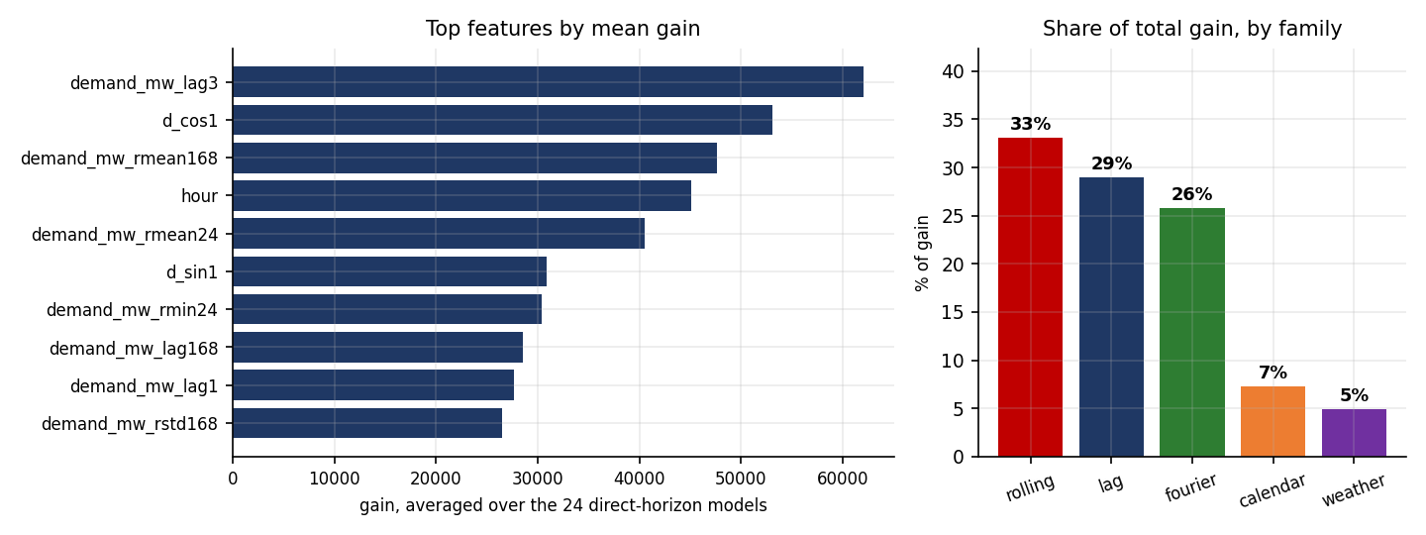
M4 · MULTI-STEP STRATEGY
Twenty-four models, or one model twenty-four times?
RECURSIVE
DIRECT · what Tayyar uses
One model for one step. Feed its own predictions back in as lags.
One model per horizon h, each trained on the target y shifted −h.
Compact — a single model to train, tune and serve
Errors compound: by h = 24 the lags are predictions of predictions
Predicted lags have a different distribution from real lags
No compounding — h = 24 is predicted directly from origin features
H models to train, and no guarantee of coherence across horizons
At a 24-hour day-ahead horizon this is where recursive chains fall apart
class DirectLGBMForecaster:
def fit(self, X, y):
for h in range(1, self.horizon + 1):
yh = y.shift(-h) # the target is h steps AHEAD
ok = yh.notna() & X.notna().all(axis=1)
self.models_[h] = lgb.LGBMRegressor(**self.params)
.fit(X[ok], yh[ok])
Decision rule: short horizons with strong autocorrelation → recursive. Longer horizons, or any compounding risk → direct.
Importance is associational, never causal. “hour_of_day is 9% of the gain” is a description of the model, not a claim about the grid.
Notes:
The importance-by-family roll-up is the useful version for a control room: rolling statistics 33%, lags 29%, Fourier terms 26%, calendar 7%, weather 5%. That is a sentence an engineer can act on.

Slide 25
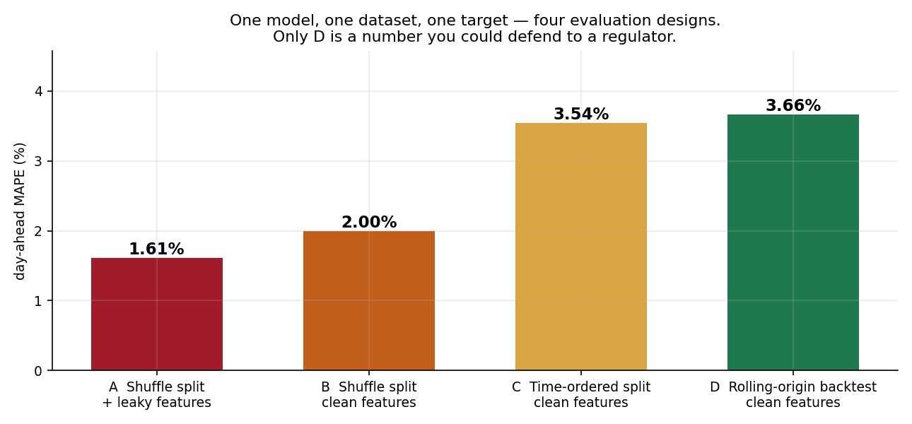
M4 · THE MEASUREMENT THAT MATTERS
One model. One dataset. One target. Four evaluation designs.
A
Shuffle split + leaky features
1.61%
A centred rolling window and a "known" exogenous value that is not. This is the number that gets a model promoted.
B
Shuffle split, clean features
2.00%
The split alone still leaks: test hours sit between training hours.
C
Time-ordered split, clean
3.54%
Honest, but a single split is a sample of one.
D
Rolling-origin backtest
3.66%
Eight origins, refit at each. This is the only number you could defend.
The leaked design reports a model that is 2.3× more accurate than the same model actually is. Nothing in the code errored. Nothing in the notebook looked wrong. The only defence is a measurement protocol that makes it structurally impossible — which is Module 6.
Notes:
This is the single most important slide in the course. Do not rush it. Ask the room which of the four numbers they have personally reported in a project. Then ask what would have caught it. Practical Assessment 2 is exactly this exercise, unassisted.

Slide 26
M4 · HANDS-ON LAB 4 · 50 MINUTES
Build the forecaster — and find the two planted leaks first
git checkout lab4-start
$ python -m tayyar.models.run_lgbm
Leak check: PASS (44 features, none reference t or the future)
Direct H=24 trained (24 models) in 11.4s
Test (28d, hourly) LightGBM: MAE=719 MW MAPE=2.33%
Baseline compare seasonal-naive: MAE=1244 MW MAPE=4.12%
Top features: demand_lag3, d_cos1, roll_mean_168, hour, roll_mean_24
By family: rolling 33% | lags 29% | fourier 26% | calendar 7% | weather 5%
Wrote forecast_lgbm.png, importance.png, LEAKS.md
5
The starter ships a train_test_split(shuffle=True) AND a centred rolling feature. Find both before writing any new code. Record them in LEAKS.md.
12
Build lags (chosen from the Lab 2 ACF), rolling windows with .shift(1), calendar flags, and Fourier terms for daily + weekly. Verify with assert_no_leakage.
12
Direct targets for H = 24. Split BY TIME — last 28 days is test. Train one LightGBM per horizon.
Troubleshooting
8
Forecast the test window day by day. Compute MAE and MAPE. Overlay the actuals and the Lab 3 SARIMAX baseline.
Symptom | Cause
MAPE suspiciously below 0.7% | a leak survives — re-run assert_no_leakage
Model under-forecasts a heat spike | trees cannot extrapolate — model a differenced target
Most rows dropped, tiny training set | long lags create leading NaNs; expected
Weekend flag on wrong days | KSA weekend is Fri(4) / Sat(5), Mon = 0
8
Build the feature-importance table and interpret the top five aloud.
5
Commit: feat(models): leakage-safe LightGBM direct forecaster
Protect this lab's full 50 minutes. It and Lab 6 are the two most overrun-prone sessions in the course — and they carry the two ideas the whole course exists to teach.
Notes:
Run this as a race: first pair to find both leaks and name them precisely wins. It converts a dry debugging task into the moment they will remember six months later.

Slide 27
MODULE 5 · DAY 2 HOUR 5 → DAY 3 HOUR 1 · LO5
Probabilistic Forecasts
and Intervals
The module ethic
Report uncertainty —
and then prove it is honest.
A point forecast is a lie by omission. Two forecasts can share a mean of 50,000 MW while one is near-certain and the other spans ±8,000 MW — completely different reserve decisions. Forecast the distribution, and let the decision pick the quantile it needs.
The reserve margin is sized off the UPPER bound of the day-ahead forecast, not the mean. The interval is not a caveat attached to the product. The interval IS the product.
5.1
Frame decisions as quantile problems, not mean problems
5.2
Produce prediction intervals from classical and ML models
5.3
Train quantile models with the pinball loss
5.4
Apply split-conformal prediction for distribution-free coverage
5.5
Evaluate on coverage, sharpness and pinball — and diagnose miscalibration
Notes:
Open with the two-forecasts-same-mean example on the whiteboard before any slide content. Ask which one the control room should act on. The answer — 'you cannot tell from the mean' — is the module in one line.

Slide 28
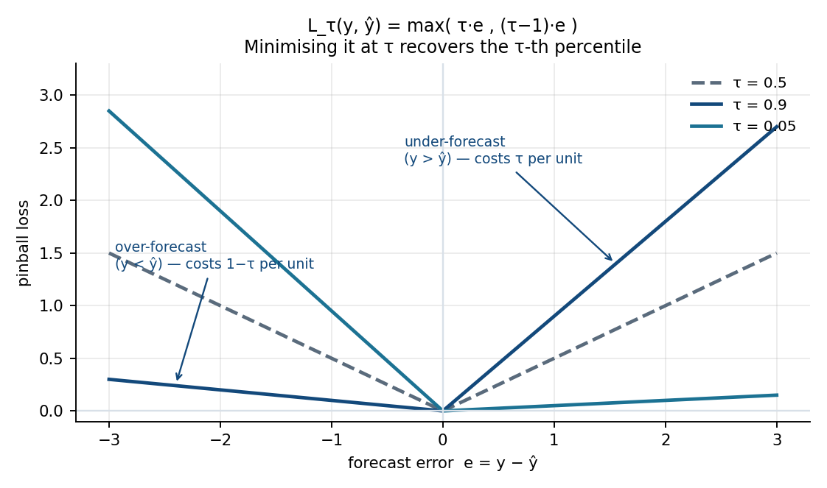
M5 · PINBALL LOSS AND THE TWO KINDS OF INTERVAL
The loss that produces a quantile
Confidence interval
Uncertainty about a PARAMETER — where the mean level sits. Narrower. Almost never what a forecast decision needs, and shipping one where a prediction interval belongs is the most common interval bug in production.
Prediction interval
Uncertainty about a future OBSERVATION — parameter uncertainty plus irreducible noise. Always wider. This is what forecasting wants, every time.
Classical models give these analytically — but on the assumption of constant variance. Tayyar's summer heteroskedasticity breaks exactly that assumption.
def pinball_loss(y_true, q_pred, tau):
d = np.asarray(y_true) - np.asarray(q_pred)
return np.mean(np.maximum(tau * d, (tau - 1) * d))
# LightGBM fits it directly, one model per quantile:
lgb.LGBMRegressor(objective="quantile", alpha=0.95)
out[qcols] = np.sort(out[qcols].to_numpy(), axis=1) # de-cross q95 < q50
Independently-fitted quantile models can cross — a predicted q95 below the q50 is an incoherent distribution. Repair by sorting per row, or fit with a monotone constraint. Never by ignoring it.
Notes:
Run the elicitation drill (10 min): three decisions — reserve margin, SKU stocking, staff roster — each with a stated cost asymmetry. Teams name the quantile each decision should consume and defend it. Nobody picks the mean twice.

Slide 29
M5 · SPLIT-CONFORMAL PREDICTION AND CQR
Coverage you can actually promise
1
Split
2
Score
3
Quantile
4
Widen
Hold out a calibration window the model never trained on — respecting time.
→
On calibration, compute the nonconformity score. For CQR that is max(lo − y, y − hi): how far the truth fell OUTSIDE the band.
→
Take q̂ = the ⌈(n+1)(1−α)⌉-th smallest score. The finite-sample correction is the +1.
→
Ship [lo − q̂, hi + q̂]. Marginal coverage ≥ 1 − α is then guaranteed under exchangeability.
def conformal_quantile(scores, alpha=0.10):
n = len(scores)
k = int(np.ceil((n + 1) * (1 - alpha))) # the finite-sample +1
return float(np.sort(scores)[min(max(k, 1), n) - 1])
class CQR:
def calibrate(self, y_cal, lo_cal, hi_cal):
self.qhat_ = conformal_quantile(
np.maximum(lo_cal - y_cal, y_cal - hi_cal))
def interval(self, lo, hi):
return lo - self.qhat_, hi + self.qhat_
What conformal does NOT give you
CONDITIONAL coverage. The guarantee is marginal — 90% on average across all hours
Protection when exchangeability fails. Calibrating on July and testing in December over-covers, because the residuals are not exchangeable across regimes
A pass on monitoring. Coverage drifts; recalibrate on a rolling recent window and persist q̂ with the model
For strongly autocorrelated series use adaptive conformal (ACI) or EnbPI, which update q̂ online as coverage errors accumulate.
Notes:
Make the exchangeability point concretely: we deliberately calibrate on October and test on November-December. If you calibrate on peak summer and test in winter the interval over-covers to 0.99 and is useless. That is a real failure mode, not a footnote.

Slide 30
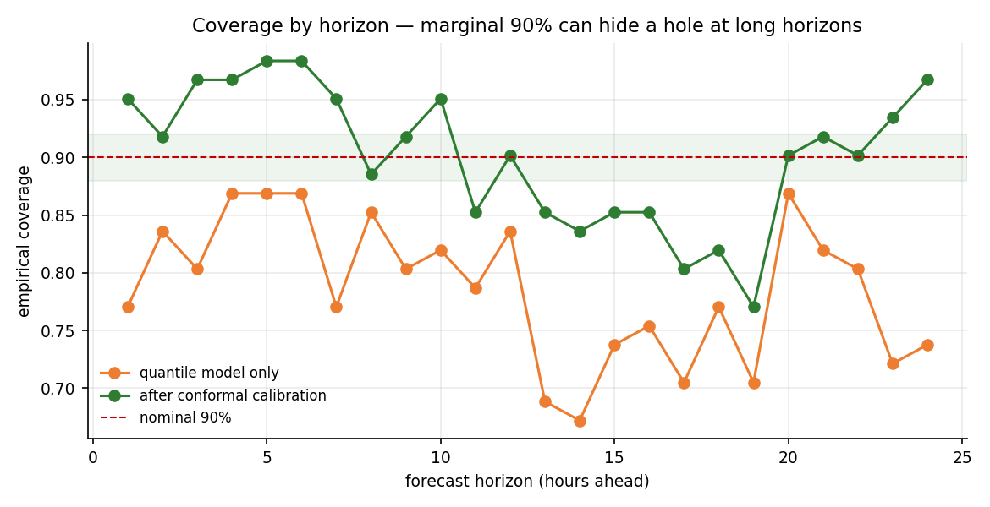
M5 · THE RESULT THAT CHANGES A DECISION
90% on average can hide 85% on the afternoons that matter
 | Coverage | Mean width | Verdict
Quantile model only | 0.786 | 2418 MW | under-covers by 11 points
└ peak hours 12:00–18:00 | 0.738 | 3046 MW | worst exactly where it matters
After CQR calibration | 0.902 | 3235 MW | hits nominal 90%
└ peak hours 12:00–18:00 | 0.845 | 3863 MW | STILL 5 points short
└ all other hours | 0.925 | 2976 MW | over-covers, subsidising the peak
What you tell operations
Report marginal AND conditional coverage. Ship both, or ship neither.
“The 90% interval holds 90% of the time overall, and 85% of the time on summer afternoons — the hours you actually size reserve for. Here is the adaptive-conformal fix, and here is the margin to add until it ships.”
Coverage is the FIRST metric to drift when a model goes stale — before point error degrades
Among calibrated methods, the sharper interval wins. Among un-calibrated ones, sharpness is meaningless
Winkler / interval score combines both: width plus a penalty for every miss
Notes:
Run the 'coverage courtroom' (15 min): one pair defends their interval's 90% claim, another cross-examines using the held-out conditional numbers. It teaches the difference between marginal and conditional better than any slide can.

Slide 31
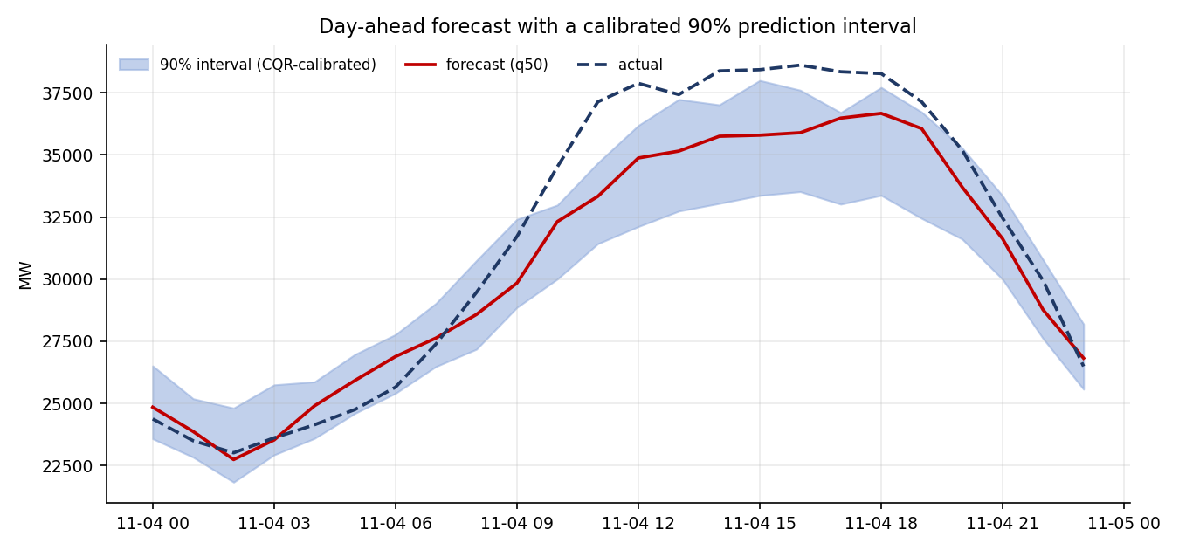
M5 · HANDS-ON LAB 5 · 50 MINUTES · SPANS DAY 2 → DAY 3
Calibrated day-ahead intervals
git checkout lab5-start
5
The starter reports a CONFIDENCE interval and estimates coverage on the training set. Find both bugs.
10
Reuse the Lab 4 features. Split train / calibration / test by time. Fit quantiles τ ∈ {0.05, 0.50, 0.95}. Repair crossing.
10
Coverage and mean width of the raw band on test. Expect it BELOW 90%.
10
Calibrate with CQR on the held-out window; re-apply; coverage should snap to ≈ 0.90.
10
Add the analytic SARIMAX interval. Build the method × coverage × width × pinball table. Plot all three over one hot week.
The band is not decoration — it is the number operations sizes reserve from.
5
Recommend one method in INTERVALS.md and commit.
$ python -m tayyar.models.run_intervals
Test window: 61 days hourly | calibration: the 31 days before it
LGBM quantile raw : coverage=0.786 width=2418 MW pinball=190
LGBM quantile + CQR: coverage=0.902 width=3235 MW pinball=181
q-hat = 409 MW (the calibration correction)
Conditional (12:00-18:00): 0.845 <- report this, always
Recommendation: CQR — the only method reaching nominal coverage;
flag the peak-hour gap and propose ACI as the fix
Wrote intervals_hotweek.png, coverage_table.csv, INTERVALS.md
Troubleshooting: coverage ≈ 1.0 with a huge width → alpha confused (0.10 is the tail, not 0.90) · q95 < q50 → crossing, sort the row · CQR barely changes anything → you calibrated on the training set · coverage fine but the decision still fails on hot days → marginal, not conditional.
Notes:
This lab is deliberately split across the day boundary. End Day 2 after task 3 — with the room holding an interval that visibly under-covers. They will think about it overnight, and the CQR fix on Day 3 morning lands much harder.

Slide 32
DAY 3 · HOURS 1–5
Trust and Selection
Two days of building produce candidate models. Today produces the only thing anyone outside the room will read: evidence that one of them deserves to run tomorrow afternoon.
MODULE 5
Intervals and calibration (finish)
LO5
MODULE 6
Backtesting and Forecast Evaluation
LO4 · LO5
MODULE 7
Forecasting Case Study and Selection
LO6
CAPSTONE
Tayyar — a backtested day-ahead service
40%
Notes:
Day 3 afternoon is deliberately light on new theory so the backtest and capstone get uninterrupted build time. Guard that. Cut discussion, never build time.

Slide 33
MODULE 6 · DAY 3, HOURS 2–3 · LO4 · LO5 · LO6
Backtesting and
Forecast Evaluation
Why one split is not evidence
A single split estimates skill from ONE realisation of the future. Test-week luck flips rankings.
A backtest repeats the evaluation over many origins and yields a distribution of skill, not a point estimate.
This is where “respect the arrow of time” stops being a principle and becomes a measurement protocol. The backtest report is this course's headline artefact — the deliverable a grid operator, a demand planner or a workforce planner actually commissions.
6.1
Design rolling-origin and expanding-window backtests without temporal leakage
6.2
Select scale-appropriate point metrics and explain each one's failure mode
6.3
Evaluate probabilistic forecasts with pinball loss and empirical coverage
6.4
Compare models statistically with the Diebold-Mariano test
6.5
Assemble a reproducible backtest report driving a model-selection decision
Notes:
The real-world walkthrough for this module: a team celebrated a 0.3-point MAPE win, then a 90-origin backtest showed MASE 0.98 and Diebold-Mariano p = 0.41. The 'win' was noise — and the per-origin breakdown showed the ML model lost on every Eid week.

Slide 34
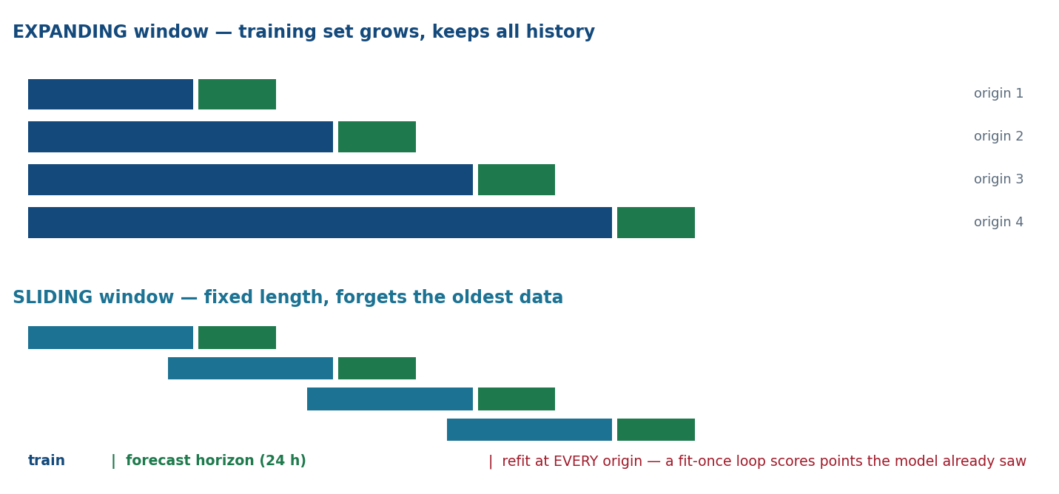
M6 · HOW TO MEASURE A FORECAST
Two schemes, five metrics, one protocol
The two rules that make it a backtest rather than theatre
REFIT at every origin. A fit-once loop scores points the model already trained on — the tell is MASE ≈ 0
Every feature at origin t uses only data ≤ t. Leave a GAP if any feature straddles the boundary
Expanding when the process is stable and more data always helps; sliding when it drifts (a new industrial load, a tariff change)
sktime's ExpandingWindowSplitter with strategy="refit" does this correctly — hand-rolled loops are where leaks creep back in
Metric | What it is | Strength | Fails when
MAE | mean |y − ŷ| | same units, robust | not comparable across series of different scale
RMSE | √ mean (y − ŷ)² | penalises large misses | dominated by outliers; scale-bound
MAPE | mean |y − ŷ| / |y| | scale-free, intuitive | explodes near zero; asymmetric — over-forecasts capped at 100%
sMAPE | symmetric percentage | bounded | still unstable near zero; awkward to interpret
MASE | MAE / MAE of seasonal-naive | scale-free, symmetric, defined at zero | needs a sensible baseline period m
Pinball | the quantile loss, averaged | a PROPER score — rewards honest calibration | only meaningful for a probabilistic forecast
MASE < 1 beats the free seasonal-naive baseline · MASE = 1 ties it · MASE > 1 means you should have shipped the baseline. Always report MASE alongside a percentage metric — the percentage is what a planner feels, the MASE is what makes it comparable.
Notes:
Run 'baseline first' (10 min): every pair hand-computes the seasonal-naive error for one day before touching a model. That single number is what everything else must beat, and computing it by hand makes MASE intuitive rather than formulaic.

Slide 35
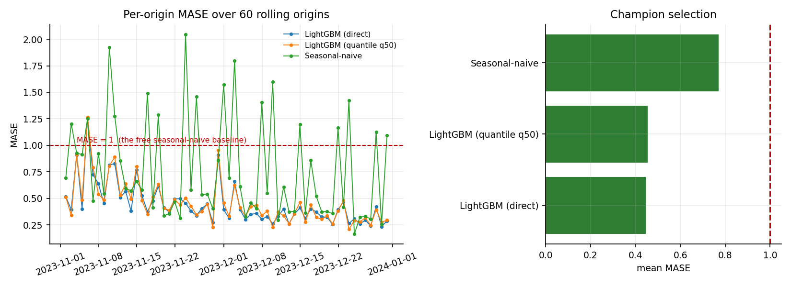
M6 · THE TAYYAR BACKTEST
Sixty origins, refit at each — this is what evidence looks like
Model | MASE | MAE (MW) | MAPE | vs baseline
LightGBM, direct H = 24 | 0.445 | 719 | 2.33% | −42% error
LightGBM quantile, q50 | 0.455 | 735 | 2.38% | −41% error
Seasonal-naive (free) | 0.770 | 1244 | 4.12% | the baseline
Read the denominator. Seasonal-naive scores MASE 0.77, not 1.00, because the MASE scale is its in-sample error over a full year — including volatile summer — while these origins are autumn. Know what you divide by.
Is the difference real, or did it get lucky?
The decision rule
d = |e_A| − |e_B| # the loss differential series
lrv = Newey-West long-run variance of d (h−1 autocovariance lags)
DM = mean(d) / sqrt(lrv / n), then the Harvey-Leybourne-Newbold
small-sample correction
LightGBM vs seasonal-naive : DM = -6.75 p = 0.000 -> SIGNIFICANT
LightGBM vs quantile q50 : DM = -1.901 p = 0.058 -> NOT significant
A non-significant Diebold-Mariano result tells you to ship the SIMPLER or CHEAPER model — you cannot distinguish them.
Here the two LightGBM variants are statistically indistinguishable (p = 0.058), so the quantile model wins on grounds that have nothing to do with accuracy: it also produces the interval.
Statistical significance gates model promotion. A 0.1% MAE “win” that fails DM does not justify shipping the added complexity — and the per-origin breakdown is what tells you WHICH weeks the champion loses.
Notes:
Run 'significance debate' (15 min): show two models' per-origin errors, have the class predict the DM verdict by eye, then run it. They are wrong often enough to make the point permanently.

Slide 36
HANDS-ON LAB 6 · 50 MINUTES · THE COURSE'S HEADLINE DELIVERABLE
The rolling-origin backtest report
git checkout lab6-start
5
The starter “backtests” by fitting once on all data and then scoring past points. Find the leak. Note it in BACKTEST.md.
$ python -m tayyar.eval.run_backtest
Backtest: expanding window, 60 origins, fh=24h, refit each origin
Model MASE MAE(MW) MAPE coverage pinball
seasonal-naive 0.77 1244 4.12% - -
ETS(A,Ad,A) 0.62 998 3.24% 0.87 221
SARIMAX + temp 0.55 889 2.86% 0.90 198
LightGBM + CQR 0.45 719 2.33% 0.90 181 <- champion
DM (LightGBM vs SARIMAX): dm=-6.75 p=0.000 -> significant
Champion: LightGBM + CQR. Loses on Eid origins -> naive fallback.
Wrote backtest_table.csv, error_by_origin.png, BACKTEST.md
12
Configure the splitter: initial window 1 year, step 1 week, horizon 24 h. Run all four families. Confirm ≥ 50 origins.
10
Aggregate per-origin errors: mean AND spread of MAE, MAPE, MASE. Every model reported relative to seasonal-naive.
8
Add probabilistic scoring for the two interval models — mean pinball and empirical coverage across origins.
10
Run Diebold-Mariano on the top two point models. Record the significance. Decide the champion and state the rule you applied.
5
Write BACKTEST.md: table, DM verdict, champion, and the conditions under which the champion loses. Commit.
Troubleshooting
Every model MASE ≈ 0
scored in-sample — use strategy="refit"
The backtest is the product. Fixed splits, fixed seeds, pinned dependencies — that is what makes the report evidence rather than anecdote.
MAPE = 4000% on one origin
near-zero demand; prefer MASE
Only three origins produced
step too large or initial window too big
Backtest runs for minutes
expected — cache naive/ETS, parallelise folds
Notes:
Run the shared leaderboard for this lab — MASE, coverage and pinball on a projector. The competitive element gets pairs to the finish line, and the leaderboard becomes the Module 7 discussion material.

Slide 37
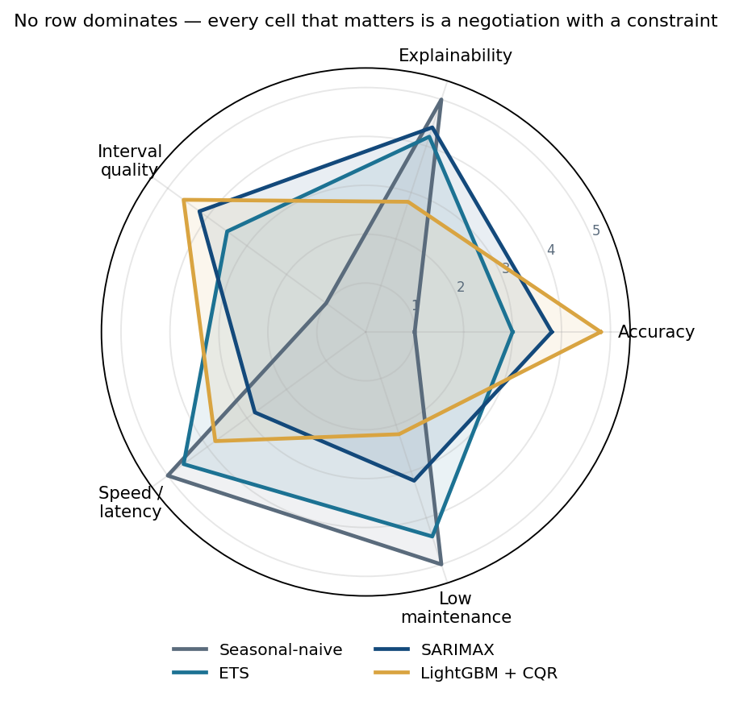
MODULE 7 · DAY 3, HOUR 4 · LO6 (INTEGRATES LO1–LO5)
Forecasting Case Study
and Model Selection
The output of this module is not a model. It is a recommendation with evidence — and its own stated limits. Model selection is a function of the use case, not a leaderboard.
7.1
Integrate decomposition, models, intervals and backtesting into one reproducible pipeline
7.2
Select a model family under multi-dimensional real-world constraints
7.3
Weigh accuracy against explainability, latency, compute and maintenance cost
7.4
Defend a recommendation from backtest and significance evidence
7.5
Communicate a forecast and its uncertainty to non-technical decision-makers
Notes:
The walkthrough: a unit ran a bake-off, LightGBM won on MASE, promoted full stop. Two months later a control-room engineer refused to act on a forecast he could not interrogate during an unusual load event, and the team fell back to spreadsheets. The failure was not the model — it was a selection that weighted accuracy 100% and explainability 0%.

Slide 38
M7 · THE MODEL-FAMILY TRADE-OFF SPACE
No row dominates
Family | Accuracy | Explainability | Interval quality | Compute / latency | Maintenance | Best when
Seasonal-naive | low | total | none (add conformal) | trivial | none | a baseline, or a stable calendar-driven series
ETS | medium | high | analytic, decent | very fast | low (automated) | many series, no covariates, interpretability needed
SARIMAX | medium-high | high — a component story | analytic, native | moderate (slow at large m) | medium | covariates plus explainability required
LightGBM + CQR | high | medium — importance only | calibrated and sharp | fast to train, needs a feature store | higher (a pipeline) | rich covariates, scale, nonlinear interactions
Six constraints that override accuracy
Deadline / latency
Explainability
An afternoon publication window caps fit + forecast time — this alone rules out refitting a large-m SARIMA per origin at serve time.
Regulatory or control-room acceptance can require a component story, promoting SARIMAX or ETS at a real accuracy cost.
Cost asymmetry
Maintenance
If under-forecasting is far costlier, selection should optimise a quantile or asymmetric loss — not symmetric MAE.
A feature pipeline is a standing liability. A thin accuracy gain loses on total cost of ownership.
Serve-time data
Adoption
A covariate model needs FUTURE covariates. No temperature forecast, no SARIMAX-with-temperature.
The winning model is the one people will actually use during an unusual event at 02:00.
Notes:
Ask the room which constraint they have personally seen override a model choice. Nearly everyone names either the deadline or the explainability one, and that shared experience is what makes the decision record feel necessary rather than bureaucratic.

Slide 39
M7 · CONSTRAINT-DRIVEN SELECTION
Same series, same backtest, three different champions
SCENARIO A
SCENARIO B
SCENARIO C
Regulator
Internal dispatch
Four operating areas
weights acc / explain / latency / maint
weights acc / explain / latency / maint
weights acc / explain / latency / maint
0.3 / 0.4 / 0.2 / 0.1
0.6 / 0.1 / 0.2 / 0.1
0.3 / 0.1 / 0.2 / 0.4
CHAMPION
CHAMPION
CHAMPION
SARIMAX + temperature
LightGBM + CQR
Global LightGBM or ETS
Decisive constraint: explainability + deadline
Decisive constraint: accuracy, DM-significant
Decisive constraint: maintenance
The published number must be defensible component by component. LightGBM is disqualified on serve-time feature-store dependency.
MASE 0.45, significantly better than the runner-up. Nobody outside the team reads the number.
Four hand-tuned models is four standing liabilities. A 0.2% accuracy loss buys three fewer models to maintain.
A decision record is six things, and none of them is a leaderboard position
1
the decision and its cost function
2
the candidates and the constraints applied
3
the stated weights
4
the recommendation with its DM evidence
5
the FLIP-CONDITIONS — what would have to change
6
the monitoring contract and the fallback
A recommendation includes its own limits. State where the model loses and what you monitor — that candour is what earns adoption. A report that names the Eid weeks and ships a fallback should score above a silent, marginally sharper submission.
Notes:
Lab 7 is exactly this slide, done by the participants with their own backtest numbers. If a cohort is running behind, reduce it to two scenarios and demo the third — but never drop the decision record.

Slide 40
M7 · COMMUNICATING THE FORECAST
Lead with the decision, not the model
WHAT NOT TO SEND
WHAT TO SEND
“The p95 is 52,400 MW. MASE is 0.45 and marginal coverage is 0.90 on the held-out window.”
“Set spinning reserve to 52,400 MW. Expected peak is 49,900 MW at 15:00; the 2,500 MW gap is the honest uncertainty and it is widest on hot days. This covers all but about 5% of afternoons.”
Every number is correct. Not one of them is a decision.
RESERVE BRIEF — Tayyar day-ahead load forecast
Issued 2023-11-14 14:00 for the 24 hours beginning 2023-11-15 00:00
Expected peak demand 41,850 MW at 15:00
90% upper bound (p95) 43,470 MW
Recommended spinning reserve 1,620 MW
= the p95 peak minus the expected peak: what we would need
if tomorrow lands at the top of the interval.
Confidence: over the last 60 backtested days this interval
contained the actual demand 90% of the time (target 90%).
Where this forecast is weakest: Eid weeks, and summer
afternoons where conditional coverage falls to 0.85.
Fallback: the seasonal-naive forecast, which handles the
holiday shift correctly. Monitored weekly on MASE + coverage.
Four rules
Lead with the decision, not the model
Show the interval as risk, not as hedging — its width IS the honest uncertainty, and narrowing it dishonestly costs load-shedding
Name the known weaknesses and the fallback. Trust survives the first miss only if you predicted it
Feature importance is a story, never a causal claim
Notes:
Run the communication drill (10 min): give them the jargon version on the left and have them rewrite it in two decision-language sentences. Read the best one aloud. Then ask a participant to play the control-room engineer and push back.

Slide 41
FINAL CAPSTONE PROJECT · 40% OF THE COURSE GRADE
Tayyar — a backtested
day-ahead forecasting service
The operations-planning unit has asked for a production-ready day-ahead pipeline for the Central Operating Area, plus a backtest report it can put in front of the regulator and the control room.
The repository IS the evidence: a stranger should clone it, run one command, and reproduce every number in your report.
Notes:
Everything they built in Labs 1 to 7 is a component. The capstone is the integration plus one extension of their own.

Slide 42
CAPSTONE · SCOPE
Seven mandatory requirements, one extension
1
Clean, reproducible pipeline
A src/tayyar package running end to end from a committed config. Fixed splits and seeds, pinned dependencies, one command regenerates every reported number.
CHOOSE ONE EXTENSION
LO1
▪ Multi-area global model across all four operating areas, backtested per area
2
Decomposition & diagnostics
tz-aware hourly index with explicit frequency and gap policy. MSTL with reported daily and weekly strengths. Stationarity report with (d, D) justified.
LO1
3
At least three model families
Seasonal-naive baseline, one classical model (SARIMAX with temperature, or ETS), one feature-based ML model. All leakage-safe and reproducible.
▪ Adaptive conformal (ACI / EnbPI) — show improved CONDITIONAL summer-afternoon coverage
LO2 LO3
4
Calibrated probabilistic forecast
A 90% day-ahead interval with empirical coverage in 0.88–0.92 on the held-out window. Coverage reported marginally AND by hour-of-day.
LO5
▪ Weather-uncertainty propagation: widen the interval for temperature-forecast error
5
Rolling-origin backtest
≥ 50 origins, refit each origin, 24 h horizon, no leakage. MASE, a % metric, coverage and pinball per model, with a per-origin breakdown flagging Eid and heatwave weeks.
LO4
▪ Automated retraining trigger, with a test proving it fires on injected drift
6
Model-selection decision
DECISION_RECORD.md: one production model recommended with a Diebold-Mariano test over the runner-up, stated constraints and weights, flip-conditions, a fallback, and a monitoring contract.
LO6
Report & communication
BACKTEST_REPORT.md an operator would accept — the table, the decision, the known limits — plus a decision-language reserve brief with no unexplained jargon.
▪ Champion / challenger harness that continuously re-evaluates against the incumbent
7
LO5 LO6
The extension adds up to +5 bonus, capped at 100, and only if mandatory scope scores ≥ 80. Pass ≥ 70. Distinction ≥ 90.
Notes:
Read requirement 4's coverage band aloud and mean it — 0.88 to 0.92 is a gate, not guidance. It is the single requirement most submissions miss, because they calibrate on the wrong window.

Slide 43
CAPSTONE · RUBRIC AND ANTI-PATTERN FLAGS
How it is graded — and what caps a criterion at 70%
Criterion | Wt | 90–100% | < 70%
Data, index & decomposition | 12 | Correct tz-aware frequency, gap policy, MSTL with justified strengths and transform | Broken index, silent gaps, wrong period
Stationarity & modelling rigour | 15 | ADF + KPSS reconciled, minimal differencing, ≥ 3 families all leak-safe and diagnosed | Leakage present, no baseline, or invalid AIC comparisons
Feature engineering (leakage-safe) | 15 | assert_no_leakage PASS; lags from the ACF; .shift(1) rolling; Hijri calendar correct | Shuffle split or centred window survives; future exog used
Probabilistic calibration | 15 | Coverage 0.88–0.92 marginal AND conditional; CQR justified; sharpest at target | Confidence where a prediction interval belongs; coverage off target
Backtesting validity | 18 | ≥ 50 origins, refit each, no leak, MASE + coverage + pinball + breakdown | Fit-once or in-sample scoring; a single split; no baseline
Model selection & evidence | 15 | DM-significant choice, weights stated, flip-conditions + fallback + monitoring | Lowest-MAE pick with no significance test and no stated limits
Report, brief & reproducibility | 10 | One-command reproduction; decision-language brief; auditor-ready | Irreproducible; jargon-only; numbers not regenerable
Anti-pattern flags — any one of these caps its criterion at 70%
✕ train_test_split(shuffle=True), anywhere
✕ a centred rolling feature
✕ a "backtest" that scores in-sample
✕ MAPE reported without MASE or a baseline
✕ a champion declared on a sub-1% gap with no Diebold-Mariano test
✕ a confidence interval where a prediction interval is required
Grade from the repository and its reproducibility FIRST — clone it, run the one command, check the numbers regenerate — then the demo. Verify one calibration claim live: ask for empirical coverage on the held-out window, broken down by hour-of-day.
Notes:
Reward candour explicitly. A submission that names where the model loses and ships a fallback should outscore a silent, marginally sharper one. Say this to the room before they start, so it changes what they build.

Slide 44
ASSESSMENT PACKAGE
Milestones, gates and the rest of the grade
Capstone milestones
The rest of the grade
Clean series + decomposition + stationarity report
End Day 1
30%
Lab completion (7 labs)
M-A
GATE: index / gaps / strengths spot-check
checkpoint commits + expected outputs
Classical + ML models producing 24 h forecasts
End Day 2
20%
PA-1 + PA-2
M-B
GATE: leak check PASS; forecast vs actual plotted
artefacts + diagnosis notes
Calibrated 90% interval
Day 3 H1
10%
Quiz (10 of 20 questions)
M-C
GATE: coverage 0.88–0.92 on the held-out window
15 minutes, closed book
Rolling-origin backtest + DM selection
Day 3 H3
40%
Capstone
M-D
GATE: ≥ 50 origins, no leak, champion chosen
rubric, repository-first
Decision record + extension + demo
Day 3 H5
PA-1 (Day 1, 30 min): clean a messy CSV and fix a broken decompose script.
PA-2 (Day 2, 30 min): a notebook reports 0.6% MAPE. Find and fix BOTH planted leaks, then report the honest post-fix accuracy.
M-E
GATE: rubric scoring
Forecasting badge requires ≥ 70 overall AND capstone ≥ 70 AND zero academic-integrity flags. Identical backtest tables or decision records across repositories are checked — the backtest must reproduce from each repository's own config.
Notes:
Collect repository URLs at the END of Day 3 Hour 4, not Hour 5 — that gives you the gap to spot-check backtest results before the demos begin.

Slide 45
WRAP-UP · DAY 3, FINAL 15 MINUTES
Every capstone requirement traces to a module
M1
M2
M3
M4
M5
M6
M7
Decomposition
Stationarity
Classical models
Leakage-safe features
Calibrated intervals
Rolling-origin backtest
Selection & decision record
Respect the arrow of time, so every reported accuracy number would survive contact with the future. The leakage-safe features, the time-aware backtest and the calibrated intervals are three faces of that one discipline.
Where this goes next
Collect before anyone leaves
SDA-DSC-311 builds directly on this pipeline
SDA-DSC-213 Experimentation & Causal Inference is the sibling skill — what actually WORKS, which forecasting alone cannot answer
The Forecasting badge is issued within 5 working days of collecting the repositories
Repository URLs
BACKTEST_REPORT.md
DECISION_RECORD.md
BENCHMARKS.md filled from their own runs
Notes:
Close on the thesis one last time, then the forward pointer. The five discussion prompts in the instructor guide are good material if you finish early — prompt 5 in particular: 'if the repository is the audit evidence for an accuracy claim, what does YOUR current backtest testify?'

Slide 46
SDA-DSC-212
A forecast's accuracy claim
must survive contact
with the future.
The backtest is that survival, made auditable.
SDAIA Academy · Capacity Building Sector · Data Scientist Track
Notes:
Thank the room, then hand back the one thing they take away: not a model, a protocol.

