Slide 1
SDAIA ACADEMY
Experimentation and Causal Inference
Expert Track · Science Portfolio · P6.1.04 · Competency DSC-C04 · 4 Days / 20 Training Hours
PRESENTED BY
SDAIA Academy · Capacity Building Sector · 2026
Notes:
2 min - Course opening, title slide
Do not read the metadata aloud; the room can see it. Use the minute to set the promise: by Thursday everyone here will have produced a causal estimate they can defend to a sceptical stakeholder, not just a p-value. Introduce yourself with one experiment you personally got wrong, because it buys credibility cheaply and signals a course about judgment rather than formulas. Flag that one synthetic case, the Injaz (إنجاز) digital-government services platform, runs through every lab and the capstone.
ASK: Who has watched a decision get made on a number they privately did not trust? Most hands go up, and that discomfort is the week's motivation.
WATCH FOR: Participants expecting a tools course. Say plainly that roughly 80 percent of an estimate's credibility is fixed before any model is fit.
LINK: Injaz datasets appear first in Lab 1 and return through the capstone.

Slide 2
COURSE AT A GLANCE
Programme Profile
P6.1.04
Expert
20 hrs
Course code · Science Portfolio
Level · Professional persona
4 days × 5 hours
DSC-C04
SF-3, DS-1
5 Labs
Experimentation & Causal competency
Prerequisites required
Hands-on + capstone project
INSIGHT This is an applied, code-forward course. Roughly 45% of contact time is spent in labs, discussions, and a capstone that produces a defensible causal analysis.
ACADEMY OF EXCELLENCE · OVERVIEW
02 / 268
Notes:
3 min - Course at a glance, opening block
The number worth dwelling on is 45 percent of contact time in labs. This is a code-forward course, and anyone planning to watch passively should learn that now rather than on Wednesday. Explain what expert level means here: SF-3 and DS-1 are assumed, so nobody re-teaches hypothesis testing or pandas, and the Day 3 pace is unforgiving. Every day ends in graded hands-on work, so a working Python environment is not optional.
ASK: Who has a Colab or local Jupyter environment running right now? Anyone without one should fix it during the first break, not during Lab 1.
WATCH FOR: The assumption that labs are optional enrichment around the lectures. Labs and the capstone together carry 70 percent of the composite score.
LINK: Assessment weights are on the certification slide; Lab 1 starts in Day 1 Hour 5.

Slide 3
WELCOME
From Correlation to Credible Causes
Most data science answers “what is associated with what.” This course teaches you to answer the harder, higher-value question: “what happens if we intervene?”
DESIGN DISCIPLINE
80/20
The business stakes
Pricing, product, policy, and health decisions all hinge on causal claims. Getting them wrong is expensive and, sometimes, harmful.
The scientific core
Roughly 80% of the credibility of a causal estimate is decided by design and identification — before any model is fit. This course front-loads that 80%.
We ground every method in the potential-outcomes framework so estimates carry an explicit, testable interpretation.
The practitioner's craft
Design first, estimate second, quantify uncertainty always — and know exactly which assumption each conclusion rests on.
ACADEMY OF EXCELLENCE · OVERVIEW
03 / 268
Notes:
4 min - Welcome, the argument slide for the week
This is where you make the case for the whole course, so let the 80/20 claim land rather than skimming it. The argument: credibility is decided by design and identification before any estimator is chosen, and a beautifully fitted model on a confounded comparison is a confident wrong answer. Give the instance they meet today: the Injaz guided uploader looks like plus 19.3 points in self-selected data and plus 5.0 once assignment is randomised. The modelling was never the problem.
ASK: Where in your own workflow is the design decision actually made, and does a data scientist sit in that meeting? Usually not, and that habit is what this course is trying to change.
WATCH FOR: Polite agreement with no behaviour change. Push for a named decision at their organisation that currently rests on an observational comparison.
LINK: The plus 19.3 versus plus 5.0 contrast is the headline figure of Hour 2 and of Lab 1.

Slide 4
LEARNING OUTCOMES
What You Will Be Able to Do (1 of 2)
On completion, participants will be able to:
LO1
Formalise causal questions
Express a decision as an estimand in the potential-outcomes framework and distinguish ATE, ATT, ITT, LATE, and CATE.
LO2
State and defend identification assumptions
Articulate SUTVA, ignorability, positivity, and exclusion, and test or probe each against data and domain knowledge.
LO3
Design randomized experiments
Select and justify a randomization scheme, compute power and minimum detectable effect, and pre-register an analysis plan.
LO4
Run and analyse A/B tests end-to-end
Estimate effects with valid inference, handle peeking, multiple testing, and guardrail metrics in a production-style workflow.
ACADEMY OF EXCELLENCE · OVERVIEW
04 / 268
Notes:
3 min - Learning outcomes, first half
Read these as a contract, not a list, and point at how each is assessed: LO1 and LO2 by the capstone's estimand and assumptions section, LO3 by the power calculation participants must justify, LO4 by Lab 2. Say LO2 is the outcome experienced practitioners most underestimate. Almost everyone can fit a matching model; very few can state in one sentence which assumption their number dies on when a director pushes back.
ASK: Which of these four can you already do today? Hands go up for LO4 and stay down for LO2, which is precisely the gap the course targets.
WATCH FOR: Treating ITT and LATE as jargon to memorise. They are the difference between what a rollout actually delivers and what the feature does to those who use it.
LINK: LO1 estimands are covered in Hour 2 today; LO3 power and MDE land in Day 2 Hour 4.

Slide 5
LEARNING OUTCOMES
What You Will Be Able to Do (2 of 2)
LO5
Estimate effects from observational data
Apply regression, matching, propensity-score, IPW, and doubly-robust estimators, reasoning about confounding with DAGs.
LO6
Apply quasi-experimental designs
Use difference-in-differences, synthetic control, instrumental variables, and regression discontinuity, checking each design's assumptions.
LO7
Quantify and communicate uncertainty
Produce valid standard errors and intervals (analytic, robust, clustered, bootstrap, randomization-based) and run sensitivity analysis.
LO8
Diagnose bias and limits of generalisation
Identify threats to internal and external validity, and judge when sampling and design limitations make a claim unsafe to act on.
ACADEMY OF EXCELLENCE · OVERVIEW
05 / 268
Notes:
3 min - Learning outcomes, second half
These are the Day 3 and Day 4 outcomes, where the course gets hard, so preview the shape. LO5 and LO6 look like a toolbox, but frame them as the ladder of evidence will: each method buys an answer with a different, less testable assumption. LO7 separates a defensible analysis from a plausible one, since clustered and bootstrap standard errors routinely move an interval across zero. LO8 stops a valid estimate being generalised to a population it was never about.
ASK: Which of these do you already produce in your reports? Standard errors usually yes, sensitivity analysis almost never, and that is the honest gap in the room.
WATCH FOR: The idea that doubly-robust methods remove the need for assumptions. They relax which working model must be correct, not whether confounding was measured.
LINK: LO7 opens Day 4, where clustering widens a standard error from 0.00166 to 0.00267.

Slide 6
PREREQUISITES & AUDIENCE
Who This Course Is For
PREREQUISITES
TARGET AUDIENCE
Assumed Foundations
Ideal Participants
SF-3 — Statistical foundations: probability, distributions, estimation, hypothesis testing, confidence intervals.
Data scientists and ML practitioners moving from prediction to decision-making.
DS-1 — Applied data science: Python, pandas/NumPy, data wrangling, and fitting basic regression models.
Experimentation / growth analysts owning A/B testing platforms.
Comfort reading mathematical notation (expectations, conditional probability).
Research and policy analysts working with observational and administrative data.
Ability to run a Jupyter/Colab notebook and interpret model output.
Applied economists and quantitative researchers in enterprise settings.
ACADEMY OF EXCELLENCE · OVERVIEW
06 / 268
Notes:
3 min - Prerequisites and audience
Use this slide diagnostically rather than decoratively. Ask for hands on the two prerequisites separately, because the failure modes differ: someone shaky on conditional expectation will struggle in Hour 2 today, while someone shaky on pandas will struggle from Lab 1 onward but can be paired with a stronger neighbour. Then name the audience mix out loud. Experimentation analysts and administrative-data analysts want different things from Day 3, and acknowledging the split early lets you calibrate which examples you lean on all week.
ASK: Who works mostly with experiment data and who mostly with observational or administrative data? Use the answer to decide how much air to give Day 3 material.
WATCH FOR: Strong machine-learning practitioners assuming causal inference is a special case of prediction. The prediction versus causation contrast later this hour exists for them.
LINK: Pair the weakest coders with stronger ones before Lab 1 in Hour 5.

Slide 7
OVERVIEW
Four-Day Roadmap
01
Day 1 — Foundations & Potential Outcomes
02
Day 2 — Randomized Experiments & A/B Testing
Causal thinking, the Neyman–Rubin model, estimands, identification assumptions, and why randomization works.
Design of experiments, randomization vs. design-based inference, regression estimation, power, and production A/B testing.
03
Day 3 — Observational & Quasi-Experiments
04
Day 4 — Uncertainty, Bias & Capstone
Confounding and DAGs, matching / propensity / IPW / doubly-robust, DiD, synthetic control, IV, and RDD.
Uncertainty quantification, bias taxonomy, sensitivity and external validity, real-world cases, and the capstone.
ACADEMY OF EXCELLENCE · OVERVIEW
07 / 268
Notes:
3 min - Four-day roadmap
Give the logic of the sequence, not its contents. Day 1 builds the language, Day 2 uses the one design that makes the assumptions true by construction, Day 3 gives that up and works down the ladder of evidence, and Day 4 asks how wrong you could be and still be right. Days 3 and 4 are not a grab bag: every method there fills in the same missing counterfactual column that Hour 2 introduces today.
ASK: If you could only take one day away, which does your job need most? Most say Day 3, and the answer is that Day 1 is what makes Day 3 usable.
WATCH FOR: People planning to treat Day 1 as revision they can half-attend. The estimand vocabulary from Hour 2 is used relentlessly for three more days.
LINK: The ladder of evidence figure at the end of today's Hour 4 previews the Day 3 sequence.

Slide 8
HOW WE WORK
Learning Model & Cadence
Each 5-hour day mixes concept, worked examples, and hands-on practice on a roughly 55/45 split.
01
Concept blocks
Short, rigorous segments that introduce a framework and immediately anchor it in a worked numerical or code example.
02
Hands-on labs
One substantial Python lab per day plus a final capstone; you leave with runnable notebooks and reusable code.
03
Structured discussions
Facilitated critique of designs and results — ‘which assumption breaks here?’ — to build professional judgment.
04
Checks & assessment
Pre-test, daily knowledge checks, and a post-test, plus a rubric-scored capstone deliverable.
ACADEMY OF EXCELLENCE · OVERVIEW
08 / 268
Notes:
3 min - Learning model and cadence
Set expectations for how the room runs. The 55/45 split means half of every day is participants typing, and the discussions are deliberate practice at the skill that matters most on the job: saying aloud which assumption a colleague's design depends on. Tell them the knowledge checks are formative and low stakes, meant to surface a misconception in front of forty people so it dies quickly, not to rank anyone.
ASK: What would make a discussion useful for you here, your own live problem or a clean worked case? Steer toward the live one, since the Day 1 discussion asks for exactly that.
WATCH FOR: Silence in discussions when participants sit near their own managers. Seed the first one by describing a flawed design of your own before asking for theirs.
LINK: The Day 1 Hour 5 discussion asks each pair to bring a real question from their work.

Slide 9
ASSESSMENT & CERTIFICATION
How You Are Evaluated
Certification requires a passing composite score and the minimum attendance threshold.
Component | Format | Weight | Purpose
Pre-test | 10 MCQ, diagnostic (ungraded) | 0% | Baseline & pacing
Daily knowledge checks | 4 × short MCQ / applied items | 20% | Formative, per-day mastery
Labs 1–4 | Notebook submissions, rubric-scored | 30% | Applied skill
Capstone project | Design + estimate + report + defense | 40% | Integrated competency
Post-test | 20 MCQ, summative | 10% | Knowledge gain
ACADEMY OF EXCELLENCE · OVERVIEW
09 / 268
Notes:
3 min - Assessment and certification
Walk the weights quickly, then say what actually fails people. It is rarely the post-test. It is a capstone that reports a statistically significant lift and recommends shipping without ever checking the effect against the practical significance threshold. Say now that the capstone data is built so the confidence interval straddles that threshold, so the defensible verdict is hold or extend, and that concluding p is under 0.05 so ship it will be marked down however clean the notebook is.
ASK: What is the practical significance threshold for the last experiment your team ran? Most rooms cannot answer, which is exactly the habit the capstone rubric targets.
WATCH FOR: Optimising for the post-test. It is 10 percent of the score, while applied work is 70 percent.
LINK: The capstone uses injaz_autofill_ab.csv, 70,000 users, a true lift of plus 1.4 points against a 1.0 point threshold.

Slide 10
DAY 1
Foundations & the Potential Outcomes Framework
Causal thinking, counterfactuals, the Neyman–Rubin model, estimands and identification, and the logic of randomization.
ACADEMY OF EXCELLENCE · DAY 1
10 / 268
Notes:
1 min - Day 1 divider
Divider, one sentence and move on. Say that today buys no techniques at all: no matching, no difference-in-differences, no models. Today builds the language that makes those techniques arguable, and by Hour 5 the room will have watched a plus 19.3 point effect collapse to plus 5.0 with nothing changed except how treatment was assigned.
ASK: How many of you expected to be fitting models before lunch? Set the expectation that today's payoff is vocabulary and design instinct, not code.
WATCH FOR: Impatience from practitioners who want code immediately. Promise that Hour 5 is a lab and that Days 2 to 4 are mostly code.
LINK: Hour 5 is Lab 1, the simulator that produces the plus 19.3 versus plus 5.0 contrast.

Slide 11
DAY 1 · HOUR 1
Three Kinds of Questions
Pearl's ‘ladder of causation’ separates three rungs. Data science lives mostly on the first; decisions demand the second and third.
KEY DISTINCTION
Conditioning (seeing) filters the world as it is. Intervening (doing) changes the world. Confusing the two is the root of most causal errors in analytics.
Association — seeing
P(Y | X): what does observing X tell me about Y? Prediction, correlation, and most supervised ML live here.
Intervention — doing
P(Y | do(X)): what happens to Y if I set X? This is the language of experiments and policy.
Counterfactual — imagining
What would this unit's Y have been had X been different? The deepest rung, and the basis of individual effects.
ACADEMY OF EXCELLENCE · DAY 1 · FOUNDATIONS
11 / 268
Notes:
4 min - Day 1 Hour 1, opening concept
The ladder earns four minutes because it hands the room vocabulary for a fight they already have with stakeholders. Make rungs one and two collide: a churn model showing that users who contact support churn more is rung one and perfectly true, while removing support access to reduce churn is a rung two claim the model never supported. Stress the key distinction: conditioning filters the world as it is, intervening changes it, and nearly every analytics error is that confusion.
ASK: Give me a rung one finding from your dashboard that someone has treated as rung two. Steer toward cases where the correlated variable is a symptom rather than a cause.
WATCH FOR: The idea that rung three is just rung two with better data. Counterfactuals are about a specific unit's unrealised world, which no experiment on other units recovers.
LINK: Rung three is formalised as Y(1) and Y(0) in Hour 2.

Slide 12
DAY 1 · HOUR 1
Why Correlation Is Not Causation
An observed association between treatment and outcome can arise from several distinct data-generating stories — only one of which is a causal effect.
Reverse causation
Y may cause X rather than the reverse (e.g. sicker patients receive more treatment).
Confounding
A common cause drives both X and Y, manufacturing association without any direct effect.
Selection
Conditioning on how units entered the sample can create or distort association (collider bias).
Chance
Finite samples produce spurious associations; more data narrows, but never removes, this on its own.
ACADEMY OF EXCELLENCE · DAY 1 · FOUNDATIONS
12 / 268
Notes:
4 min - Day 1 Hour 1, the four rival stories
The value here is that all four stories produce an identical scatter plot, so no amount of staring at the data distinguishes them. Take reverse causation seriously, since sicker patients receiving more treatment is the cleanest picture anyone has. Then make the closing point: only the chance story is fixed by more data. Confounding and selection converge cheerfully on the wrong number at any sample size, which is what the cost slide quantifies next.
ASK: For the last association your team reported, which of these four did you rule out, and how? The honest answer is that ruling them out required knowledge from outside the dataset.
WATCH FOR: Collapsing selection bias into confounding. Selection is created by conditioning on how units entered the sample, and it can appear even when treatment was randomised.
LINK: Collider and selection bias return on Day 3, where conditioning flips a correlation from 0.00 to minus 0.20.

Slide 13
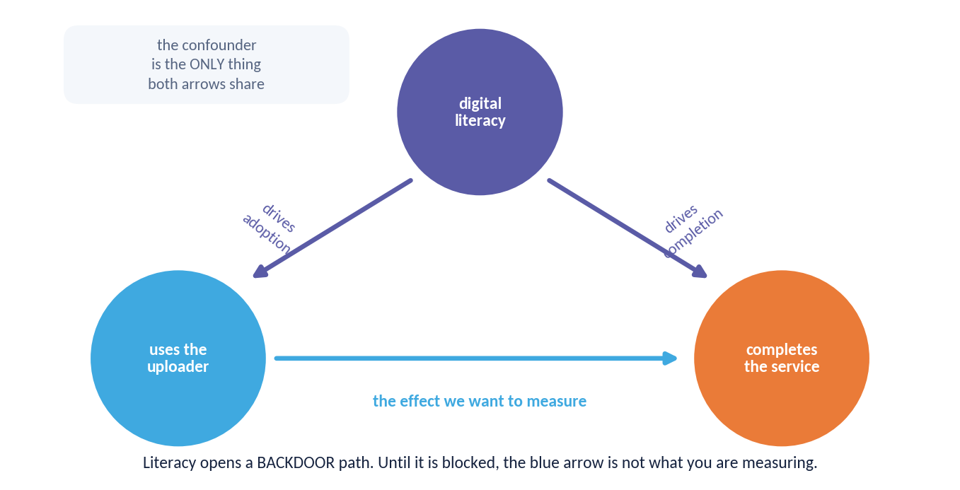
DAY 1 · HOUR 1
The Shape of a Confounded Comparison
One variable drives both the supposed cause and the effect. Until that path is blocked, the association you measure is not the effect you want.
WHAT TO SEE
Two arrows leave digital literacy — one to adoption, one to completion. That shared origin is the entire problem.
Blocking the backdoor path is what every method on Days 3 and 4 is trying to do. Randomisation does it by design; everything else does it by assumption.
ACADEMY OF EXCELLENCE · DAY 1 · FOUNDATIONS
13 / 268
Notes:
4 min - Day 1 Hour 1, figure walk
Walk it in three moves. Point first at digital literacy and trace the two arrows leaving it: that shared origin, not the treatment arrow, is the entire problem. Point second at the treatment to outcome arrow as the only quantity we want. Point third at the backdoor path and name it an open channel manufacturing association. Then land the sentence that carries the week: randomisation closes that path by design, every other method closes it by assumption.
ASK: If we could measure digital literacy perfectly, would adjusting for it be enough? Only if it is the sole common cause, and nothing in the data can verify that.
WATCH FOR: Someone proposing to control for support calls because it correlates with everything. It is a mediator on the causal path and must never enter the adjustment set.
LINK: The Day 3 DAG lab gives the minimal adjustment set for this question as digital_literacy and device_age.

Slide 14
DAY 1 · HOUR 1
The Cost of Getting It Wrong
~50%
10×
∞
of naive observational ‘effects’ that fail to replicate in later randomized trials, across several review studies
typical gap between a headline A/B lift and its true effect when peeking and multiple testing go unmanaged
bias that no sample size can fix if the design is confounded — more data converges to the wrong number
INSIGHT Bias is a property of design and identification, not of sample size. This is why we spend Day 1 on design before touching estimation.
ACADEMY OF EXCELLENCE · DAY 1 · FOUNDATIONS
14 / 268
Notes:
3 min - Day 1 Hour 1, why design beats sample size
Three numbers, and the third is the one to defend properly. Explain the infinity symbol literally: with a confounded design the estimator converges, and it converges on a number that is not the effect. That is qualitatively different from noise, and it is why sample size cannot buy credibility. Quote the 50 percent replication figure carefully as coming from review studies across several fields, not a single trial, because someone will ask.
ASK: What is your organisation's default response to a contested result? If the answer is collect more data, this slide is the counter-argument to have ready.
WATCH FOR: Treating bias and variance as two sizes of the same problem. Ask what happens to each as n grows: variance vanishes, bias does not move at all.
LINK: The Hour 5 figure shows exactly this, with both curves converging, one on plus 5.0 and one on plus 19.3.

Slide 15
DAY 1 · HOUR 1
A Motivating Example: Does the Feature Help?
A product team ships a new onboarding flow. Users who saw it retain at 62%; users who didn't, 48%. Is the flow worth +14 points?
WE WILL RETURN TO THIS
By end of Day 2 you will estimate this effect from a randomized test; by Day 3, from observational data when a test is impossible.
The tempting read
‘The flow raises retention by 14 points’ — a causal claim from a purely observational comparison.
The lurking problem
Who saw the new flow? Newer cohorts, power users, or a specific platform? Any of these confounds the comparison.
The disciplined move
Define the target quantity precisely, list what must be true to identify it, then choose a design that makes it credible.
ACADEMY OF EXCELLENCE · DAY 1 · FOUNDATIONS
15 / 268
Notes:
4 min - Day 1 Hour 1, the running example
This example is the spine of the next two days, so do not resolve it. Let the room sit with the 14 point gap and push them to generate the confounders themselves: newer cohorts, power users, platform, marketing exposure. The disciplined move at the bottom is the real content. Define the target quantity, list what must be true, then choose a design. A good analyst's first response here is a question about assignment, not a request for the data.
ASK: What single variable would you most want to know before believing the 14 points? Steer toward anything predicting both exposure to the flow and retention.
WATCH FOR: Immediate jumps to regression with controls. Ask which controls, and whether any of them were measured before the flow shipped.
LINK: The same question is answered from a randomised test on Day 2 and from observational data on Day 3.

Slide 16
DAY 1 · HOUR 1
The Causal Inference Workflow
Every credible analysis in this course follows the same five-step spine.
1
Question → estimand
Translate the decision into a precisely defined causal quantity (whose effect, of what, on whom, on which outcome).
2
Identification
State the assumptions under which that estimand equals something computable from observed data.
3
Estimation
Choose an estimator; fit it; the estimator is only as good as the identification behind it.
4
Inference
Quantify uncertainty honestly — the right standard error for the design, not a default.
5
Sensitivity
Ask how far the assumptions could be wrong before the conclusion flips; report it.
ACADEMY OF EXCELLENCE · DAY 1 · FOUNDATIONS
16 / 268
Notes:
4 min - Day 1 Hour 1, the five-step spine
Give the room the spine and tell them it becomes the checklist for every remaining analysis, including the capstone rubric. The step that disappears in practice is step two: teams jump from a business question straight to a model, and identification becomes an afterthought in the discussion section. Emphasise that step three is downstream of step two, so a fancier estimator can never repair a broken identification argument.
ASK: Which of these five steps does your current reporting template actually contain? Most templates have steps three and four only, and that omission is the gap.
WATCH FOR: Reading step one as writing a hypothesis. An estimand names whose effect, of what, on whom, on which outcome, and a hypothesis rarely does all four.
LINK: The capstone deliverable is scored against exactly these five steps.

Slide 17
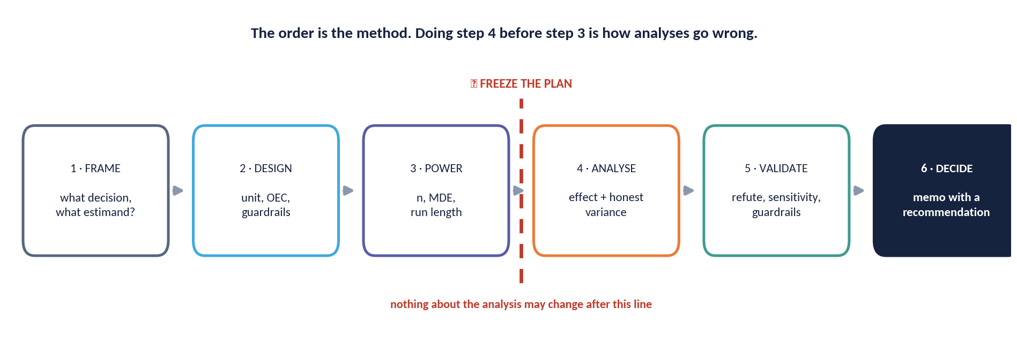
DAY 1 · HOUR 1
The Order Is the Method
Six steps, and one hard gate. An analysis that reorders them is not a faster analysis — it is a different, weaker one.
THE GATE — Freeze the plan before you look at outcomes.
ACADEMY OF EXCELLENCE · DAY 1 · FOUNDATIONS
17 / 268
Notes:
4 min - Day 1 Hour 1, figure walk
Walk the six steps quickly, then stop at the gate and spend your time there. The gate is the claim that freezing the analysis plan before you see outcomes is not bureaucracy, it is what makes a p-value mean what it says. Point at everything after the gate and note that each decision is now constrained. Close by naming the reordering people actually do: run the test, look, then choose the metric and the cut that make it significant.
ASK: How many looks do you take at the data before an experiment ends, and what do you do with them? Freeze there; the honest answer is many looks and no adjustment.
WATCH FOR: The belief that pre-registration forbids exploration. It separates confirmatory from exploratory analysis, it does not ban the second.
LINK: Day 2 Hour 4 prices this: false-positive rates of 5, 9, 14, 19 and 25 percent at 1, 2, 5, 10 and 20 looks.

Slide 18
DAY 1 · HOUR 1
Terminology We Will Use Precisely
Sloppy vocabulary produces sloppy causal claims. We fix definitions now.
Unit — the entity that may receive treatment (user, patient, store, region).
Treatment / exposure (T or D) — the intervention whose effect we want; often binary but can be multi-valued or continuous.
Outcome (Y) — the measured result we care about after treatment.
Covariates (X) — pre-treatment characteristics; never post-treatment variables in the adjustment set.
Estimand — the true quantity we target; Estimator — the procedure; Estimate — the number it returns.
ACADEMY OF EXCELLENCE · DAY 1 · FOUNDATIONS
18 / 268
Notes:
3 min - Day 1 Hour 1, vocabulary
This slide is cheap to skim and expensive to skip. The distinction that pays off all week is estimand, estimator, estimate, meaning the true quantity, the procedure and the number, because most confused arguments about experiments are two people using one word for all three. The other load-bearing line is that covariates are pre-treatment characteristics only. Make the room say that back to you, because it is violated constantly in production feature pipelines where nobody records when a column was computed.
ASK: Take a model you have shipped. Were any of its features measured after the treatment or exposure occurred? In production pipelines the answer is almost always yes.
WATCH FOR: Treating the unit as obvious. A user, a session and a device are three different units producing three different estimands and three different standard errors.
LINK: The good controls and bad controls slide in Hour 3 makes the pre-treatment rule precise.

Slide 19
“
No causes in, no causes out. You cannot extract a causal conclusion from data without a causal assumption you brought to it.
The identification principle
A recurring theme throughout this course
ACADEMY OF EXCELLENCE · DAY 1 · FOUNDATIONS
19 / 268
Notes:
2 min - Day 1 Hour 1, quote slide
Two minutes, no more, but do not skip it, because this is the sentence the course keeps returning to. No statistical procedure converts association into causation. Something causal must be brought from outside the data: a randomisation you performed, a DAG you will defend in front of domain experts, or an instrument you argue is as good as random. The corollary is uncomfortable: if a method seems to need no causal assumption, you have not found it yet.
ASK: For your last causal claim, what did you bring to the data? If nobody can name it, that claim was association wearing causal language.
WATCH FOR: The idea that flexible machine learning weakens this. Flexible estimators help with functional form and never with identification.
LINK: Ignorability in Hour 3 is precisely such an assumption, and it is untestable.

Slide 20
DAY 1 · HOUR 1
What Makes a Question Causal
A causal question always implies a hypothetical manipulation — even when we can only observe.
The manipulation test
If you cannot describe how, in principle, treatment could be set, the causal question is ill-posed (‘the effect of race’ vs. ‘the effect of a name on a résumé’).
Well-defined interventions
Precisely specifying the intervention removes ambiguity in the estimand and its interpretation.
Consistency with SUTVA
One version of treatment, no interference — both introduced formally in Hour 3.
ACADEMY OF EXCELLENCE · DAY 1 · FOUNDATIONS
20 / 268
Notes:
4 min - Day 1 Hour 1, well-defined interventions
The manipulation test is the usable content: if you cannot describe how treatment could in principle be set, the question is ill-posed. Handle the race example precisely. The effect of race is not well defined as an intervention, while the effect of a name on a CV in a callback audit is, and that reframing is what made the actual studies possible. Then push the room to apply the test to their own vague questions.
ASK: State the intervention behind the effect of digital maturity. If nobody in the room can, the question needs rewriting before any data is collected.
WATCH FOR: Hearing this as a claim that such questions are unimportant. They are important and badly posed, and those are different problems with different fixes.
LINK: SUTVA and consistency in Hour 3 formalise what one version of treatment means.

Slide 21
DAY 1 · HOUR 1
Prediction vs. Causation: A Working Contrast
PREDICTIVE MODELLING
CAUSAL MODELLING
Optimises Fit
Optimises Interpretation
Goal: minimise out-of-sample loss on Y.
Goal: recover the effect of intervening on T.
Any feature that improves prediction is welcome — including post-treatment ones.
Adjustment set is chosen by causal structure, not by fit.
Success = accuracy / AUC / calibration.
Success = unbiased, correctly-uncertain effect.
A great predictor can be a terrible basis for a decision.
Adding the ‘wrong’ control can inject bias, not reduce it.
ACADEMY OF EXCELLENCE · DAY 1 · FOUNDATIONS
21 / 268
Notes:
4 min - Day 1 Hour 1, the contrast that matters
This is the slide the strong machine-learning people need. The sharpest line: any feature improving prediction is welcome, including post-treatment ones, so a churn model may legitimately use last week's support tickets and that same feature destroys a causal estimate. Say the adjustment set is chosen by causal structure, never by cross-validation, and that variable selection by fit is a common way a competent modeller produces a biased effect.
ASK: Would you drop a control that increases your validation error? For prediction yes, for causal estimation the question is irrelevant, and that reversal is the whole slide.
WATCH FOR: The claim that a high R-squared means confounding has been handled. Fit says nothing about whether the backdoor path is closed.
LINK: The Day 3 collider demonstration shows a control that improves fit and flips a correlation from 0.00 to minus 0.20.

Slide 22
DAY 1 · HOUR 1
Quick Check: Causal or Predictive?
Classify each. We debrief live before moving to potential outcomes.
Q1
‘Which customers are most likely to churn next month?’
A) Predictive B) Causal
Q2
‘Will offering this discount reduce churn?’
A) Predictive B) Causal
Q3
‘What retention would we see if we had never launched the flow?’
A) Predictive B) Counterfactual
ACADEMY OF EXCELLENCE · DAY 1 · FOUNDATIONS
22 / 268
Notes:
5 min - Day 1 Hour 1, knowledge check
Run this on hands or in the chat, then debrief each item. Q1 is predictive: nothing is being set, we are ranking units by likelihood. Q2 is causal, because offering the discount is a manipulation and the question concerns the world after it. Q3 is counterfactual rather than merely causal, since it asks about a world for units that actually did experience the launch, which no experiment on future users can reach.
ASK: For Q3, could an A/B test starting today answer it? No, because it asks about the past for a specific population, which is why rung three sits above rung two.
WATCH FOR: Q2 answered as predictive because a model would be used to produce the number. The tool never makes a question causal; the target quantity does.
LINK: Q3 is the counterfactual language formalised in Hour 2 as Y(0) for the treated units.

Slide 23
DAY 1 · HOUR 2
The Potential Outcomes Framework
The Neyman–Rubin causal model: counterfactual outcomes, individual and average effects, and the fundamental problem.
ACADEMY OF EXCELLENCE · DAY 1
23 / 268
Notes:
1 min - Day 1 Hour 2 divider
One minute only. Say that everything so far has been intuition and the next hour turns it into arithmetic. Frame the Neyman-Rubin model as the move that converts philosophical arguments about causation into a missing-data problem with a specific missing column, which is what allows the rest of the course to be taught as a sequence of methods rather than a debate.
ASK: Nothing new here. Take one leftover question from Hour 1 instead, answer it briefly, and move.
WATCH FOR: Letting the divider run long. The worked example and the bias decomposition both need their full five minutes later in this hour.
LINK: The estimands introduced here are used every day for the rest of the week.

Slide 24
DAY 1 · HOUR 2
Potential Outcomes: The Core Idea
Each unit i carries two potential outcomes: Yᵢ(1) if treated and Yᵢ(0) if not. Both exist in principle; we observe only one.
THE UNIT TABLE
Y(1),Y(0)
Individual treatment effect
τᵢ = Yᵢ(1) − Yᵢ(0). The causal effect for unit i is a contrast between two states of the same unit.
The observed outcome
Imagine a spreadsheet with both columns filled in. Reality hands you one cell per row and hides the other. Every method is a strategy for the hidden column.
Yᵢ = Tᵢ·Yᵢ(1) + (1−Tᵢ)·Yᵢ(0). Treatment selects which potential outcome we get to see.
Counterfactual = missing data
The unobserved potential outcome is a missing value; causal inference is, formally, a missing-data problem.
ACADEMY OF EXCELLENCE · DAY 1 · POTENTIAL OUTCOMES
24 / 268
Notes:
4 min - Day 1 Hour 2, core notation
The unit table is the mental image to install, so spend your time there rather than on the notation. Draw a spreadsheet with a Y(1) column and a Y(0) column, then physically cover one cell in each row. Reality hands you one cell per row and hides the other. Say that this reframing is the discipline's central trick: causal inference becomes missing-data imputation, and every method over the next three days is a different strategy for the hidden column.
ASK: For the treated units, which column is missing? Y(0). Then ask who could plausibly stand in for it, because that is the entire design question in one line.
WATCH FOR: Reading Y(1) as the treated group's outcome. Y(1) is defined for every unit, including those never treated, and that is the whole point of the notation.
LINK: The two-worlds figure on the next slide makes the covered cell visual.

Slide 25
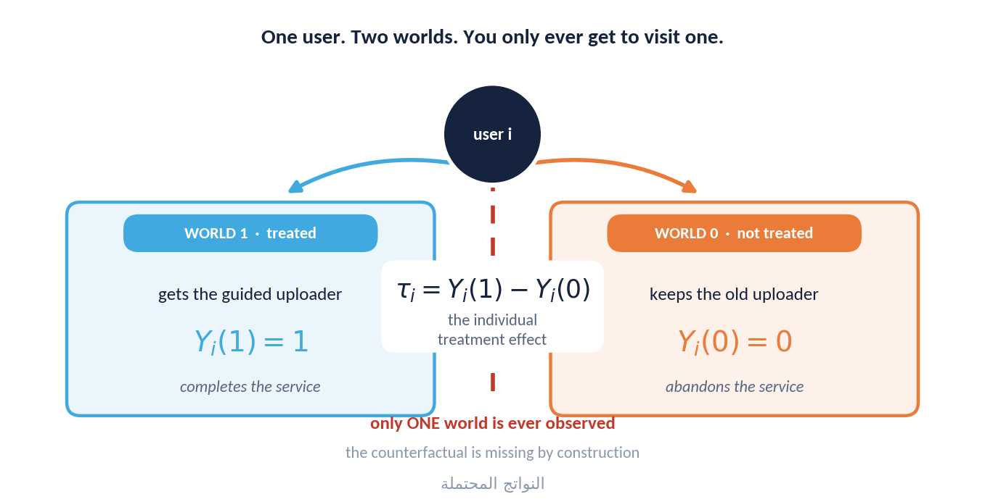
DAY 1 · HOUR 2
The Two Worlds You Cannot Both Visit
Every unit carries two potential outcomes. Exactly one of them ever happens; the other is a counterfactual that no amount of data can recover.
WHY IT MATTERS
The individual effect τᵢ is not merely hard to measure — it is undefined in the data.
This is why causal inference is a missing-data problem, and why the entire discipline is about when a treated group may legitimately stand in for a control group's missing world.
ACADEMY OF EXCELLENCE · DAY 1 · POTENTIAL OUTCOMES
25 / 268
Notes:
4 min - Day 1 Hour 2, figure walk
Point first at a single unit and its two branches, and say both are real quantities of that unit. Point second at the greyed-out branch and name it the counterfactual. Point third at the arithmetic that would give tau for that unit, noting it needs a cell that is unmeasurable rather than merely unmeasured. Then land the panel sentence about when one group may legitimately stand in for another group's missing world.
ASK: What would it take to observe both cells for one person? Time travel or a perfect clone, and saying that out loud makes the concept stick better than the notation does.
WATCH FOR: Someone offering before-and-after on the same unit as the solution. Freeze there, because the pre-period unit is a different unit at a different time.
LINK: That before-and-after instinct is exactly what difference-in-differences has to defend on Day 3.

Slide 26
DAY 1 · HOUR 2
The Fundamental Problem of Causal Inference
We can never observe both Yᵢ(1) and Yᵢ(0) for the same unit at the same time. Individual effects are, in general, unobservable.
CONSEQUENCE
Everything that follows — randomization, matching, DiD, IV — is a device for filling in the missing counterfactual, on average, credibly.
Holland's statement
For any unit we see the factual outcome and lose the counterfactual — so τᵢ is never directly measured.
Why averages rescue us
While τᵢ is hidden, the average effect over a population can be identified under the right design.
The switch of target
We shift from the impossible (individual) to the feasible (population or subgroup) causal quantity.
ACADEMY OF EXCELLENCE · DAY 1 · POTENTIAL OUTCOMES
26 / 268
Notes:
4 min - Day 1 Hour 2, the impossibility and the pivot
The pivot here is the switch of target, and present it as a concession rather than a triumph. We wanted individual effects, we cannot have them, so we settle for averages over populations or subgroups because those can be identified under a design. Say explicitly that this is why personalisation is hard: CATE estimation claws back as much of the individual level as the data supports and never reaches the individual effect.
ASK: If we can never know any individual effect, how does a doctor decide for one patient? Through a conditional average over people like them, and the room should feel the compromise in that.
WATCH FOR: The belief that a large enough dataset eventually reveals individual effects. It is a logical impossibility, not a sample-size problem.
LINK: CATE appears on the estimands slide next and returns in Day 2 Hour 3.

Slide 27
DAY 1 · HOUR 2
A Family of Causal Estimands
Different decisions target different averages. Naming the estimand is step one.
ATE
Average Treatment Effect
E[Y(1) − Y(0)] over the whole population. ‘If everyone were treated vs. no one.’
ATT
Effect on the Treated
E[Y(1) − Y(0) | T = 1]. ‘For those who actually got it, how much did it help?’ Often the policy-relevant one.
CATE
Conditional / Heterogeneous
τ(x) = E[Y(1) − Y(0) | X = x]. Effects that vary by subgroup — the basis of targeting and personalisation.
ITT
Intention-to-Treat
Effect of being assigned treatment, regardless of compliance. What a real rollout can actually deliver.
ACADEMY OF EXCELLENCE · DAY 1 · POTENTIAL OUTCOMES
27 / 268
Notes:
5 min - Day 1 Hour 2, the estimand family
Five minutes, because this vocabulary is used for three more days. Anchor each estimand on a decision rather than a formula: ATE for whether to roll out to everyone, ATT for whether the programme helped those who took it, CATE for whom to target, ITT for what a rollout actually delivers once people ignore things. Make ITT concrete: only 62 percent of assigned Injaz users ever trigger the uploader, so the assigned-population number is necessarily smaller.
ASK: A minister asks whether the training programme worked. Which estimand? ATT, because the question is about those who actually enrolled, not a hypothetical universal rollout.
WATCH FOR: Choosing ATE by default because it sounds the most general. The policy-relevant quantity is usually ATT or ITT.
LINK: Day 2 shows plus 2.2 points among triggered users diluting to plus 1.3 across all assigned users.

Slide 28
DAY 1 · HOUR 2
A Worked Numerical Example
Six users, hypothetical full potential-outcomes table. Retention days under treatment Y(1) and control Y(0).
TRUE VS. NAIVE
4.2 vs 11.3
The full (oracle) table
Y(1) = [30,25,40,22,35,28]; Y(0) = [24,26,31,20,27,25]. True ATE = mean(Y(1)−Y(0)) = +4.17 days.
What we actually see
Selection into treatment inflated the naive estimate 2.7×. Randomization is what would have made the naive difference honest.
If units 1,3,5 are treated and 2,4,6 control, we observe only [30,·,40,·,35,·] and [·,26,·,20,·,25].
The naive difference
Mean(treated) − mean(control) = 35 − 23.7 = +11.3 — far above the true +4.17 because treated units were healthier to begin with.
ACADEMY OF EXCELLENCE · DAY 1 · POTENTIAL OUTCOMES
28 / 268
Notes:
5 min - Day 1 Hour 2, worked arithmetic
Do this arithmetic live on the board rather than reading it. Compute the oracle ATE of plus 4.17 days, then cover the counterfactual cells and compute 35 minus 23.7, giving plus 11.3. With six units that gap is not noise; it follows systematically from units one, three and five having higher Y(0) before anything happened. Say the ratio aloud: selection inflated the estimate 2.7 times, and no estimator on the observed cells can detect that.
ASK: Which number on this slide could you never compute in real life? The oracle ATE, because it uses cells that do not exist outside a simulation.
WATCH FOR: Participants trying to rescue the naive estimate by controlling for something. Nothing is measured here to control for, which is precisely the point.
LINK: Lab 1 in Hour 5 is this example at N equal to 5,000, giving plus 5.0 true against plus 19.3 naive.

Slide 29
DAY 1 · HOUR 2
Selection Bias, Made Precise
The naive difference decomposes cleanly, exposing exactly what randomization removes.
READ IT ALOUD
Observed gap = real effect on the treated + how different the groups already were. Design is the fight to zero out the second term.
The decomposition
E[Y|T=1] − E[Y|T=0] = ATT + { E[Y(0)|T=1] − E[Y(0)|T=0] }.
The bias term
The braces are baseline (selection) bias: how treated and control units would have differed even without treatment.
The escape
If treatment is independent of potential outcomes, that term is zero and the naive difference equals the ATE.
ACADEMY OF EXCELLENCE · DAY 1 · POTENTIAL OUTCOMES
29 / 268
Notes:
5 min - Day 1 Hour 2, the decomposition
This is the most important algebra of Day 1, so write it out and read the braces aloud in words: the observed gap equals the real effect on the treated plus how different the groups already were. Stress that the bias term is a contrast of Y(0) between groups, a quantity about the world without treatment, which is why it leaves no trace in the data. Every design in the course argues that term is zero or bounds it.
ASK: In the six-user example, what was the bias term numerically? About plus 7.1 days, the difference between the naive 11.3 and the true 4.17.
WATCH FOR: Reading the braces as an error term that averages out. It is a systematic baseline difference and it does not shrink with sample size.
LINK: The next figure gives the same decomposition for Injaz: plus 19.3 naive equals plus 5.0 effect plus roughly 14 points of selection.

Slide 30
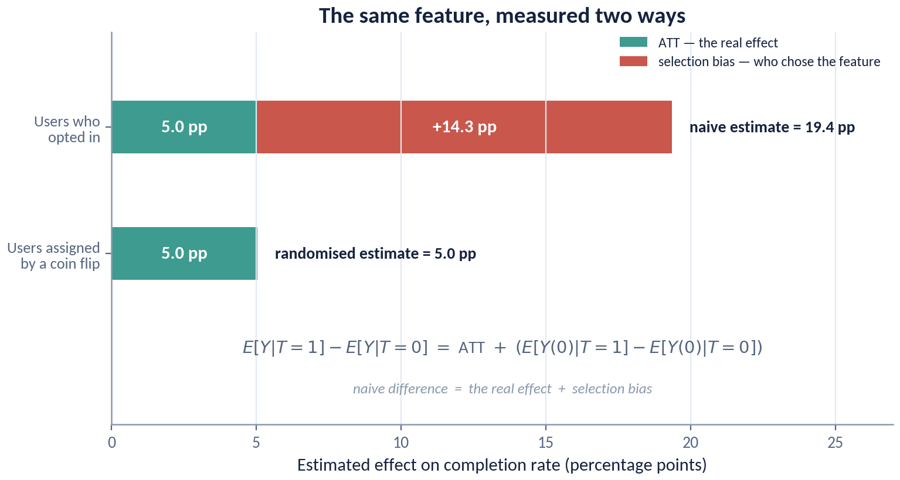
DAY 1 · HOUR 2
Where the Extra 14 Points Came From
The same feature, the same platform, the same outcome metric — measured once with self-selection and once with a coin flip.
READ IT ALOUD
The naive difference is not a noisy version of the truth. It is the truth PLUS a second quantity that has nothing to do with the feature.
Selection bias here is nearly three times the real effect. A team acting on the red bar would have credited the uploader with work that digital literacy did on its own.
ACADEMY OF EXCELLENCE · DAY 1 · POTENTIAL OUTCOMES
30 / 268
Notes:
4 min - Day 1 Hour 2, figure walk
Point first at the self-selected bar at plus 19.3 and let the room enjoy it, because that is the number a product team would celebrate. Point second at the randomised bar at plus 5.0, sitting on the true plus 5.0. Point third at the gap and name it the bias term from the previous slide, roughly 14 points belonging to digital literacy rather than to the uploader. Then read the panel line aloud.
ASK: Which bar would appear in a launch deck, and who in the organisation would have questioned it? Freeze on the fact that nothing in the data itself separates them.
WATCH FOR: The reflex that a bigger sample would have separated the bars. Both estimates are precise; one of them is precisely wrong.
LINK: Participants reproduce both bars themselves in Lab 1 this afternoon.

Slide 31
DAY 1 · HOUR 2
Potential Outcomes: Common Misreadings
Precision here prevents errors everywhere downstream.
Y(1) and Y(0) are defined for every unit — including units that were never treated. They are not ‘the treated group’s outcome.’
The effect τᵢ is a within-unit contrast, not a between-group difference.
‘No effect for the average’ (ATE = 0) does not mean ‘no effect for anyone’ — positive and negative CATEs can cancel.
Potential outcomes are fixed attributes of a unit under an intervention; randomness enters through which one we observe.
ACADEMY OF EXCELLENCE · DAY 1 · POTENTIAL OUTCOMES
31 / 268
Notes:
4 min - Day 1 Hour 2, misreadings to kill early
Take these one at a time and ask why each is wrong before explaining. The one causing most downstream damage is the third: an ATE of zero gets reported as no effect when positive and negative subgroup effects have simply cancelled, and that becomes a decision to withhold a feature from the people it helps. The fourth matters for the simulation-minded: potential outcomes are fixed attributes, and randomness enters only through which one we see.
ASK: If the ATE is zero but the CATE for new users is plus 5 points, what is the right decision? Ship to new users only, and the aggregate test would never have told you.
WATCH FOR: Confusing the within-unit contrast with a between-group difference. They coincide only when the groups are exchangeable, which is what randomisation buys you.
LINK: Heterogeneous effects and CATE estimation are covered in Day 2 Hour 3.

Slide 32
DAY 1 · HOUR 2
Knowledge Check: Estimands
Q1
A regulator asks: ‘Among firms that adopted the standard, how much did emissions fall because of it?’ Which estimand?
A) ATE B) ATT C) CATE D) ITT
Q2
You want to personalise a promotion by customer segment. Which estimand do you need?
A) ATE B) ATT C) CATE D) ITT
Q3
In a trial with imperfect compliance, the effect of assignment (not uptake) is the:
A) ATT B) LATE C) ITT D) CATE
ACADEMY OF EXCELLENCE · DAY 1 · POTENTIAL OUTCOMES
32 / 268
Notes:
5 min - Day 1 Hour 2, knowledge check
The answers are B, C and C. Q1 is ATT, because among firms that adopted is explicit conditioning on treatment status; ATE tempts because regulators talk as though the answer generalises to non-adopters. Q2 is CATE, since personalisation needs effects that vary with X, and ATE tempts because it is what people routinely compute. Q3 is ITT, the effect of assignment rather than uptake, with LATE as the strong distractor.
ASK: For Q1, what would change if the regulator instead asked what would happen if all firms adopted? It becomes ATE, and the two answers can differ substantially.
WATCH FOR: Q3 answered as ATT. ATT conditions on actually receiving treatment, which in a compliance setting is a self-selected subgroup rather than the assigned one.
LINK: LATE and compliance return in the Day 3 instrumental-variables session, where the true LATE is plus 8.0 points.

Slide 33
DAY 1 · HOUR 3
Identification: The Assumptions That Do the Work
SUTVA, ignorability / unconfoundedness, positivity / overlap, and consistency — what must hold for an estimand to be recoverable.
ACADEMY OF EXCELLENCE · DAY 1
33 / 268
Notes:
1 min - Day 1 Hour 3 divider
One minute. Frame the hour as the answer to a question the room should already feel: we have named quantities we cannot observe, so under what conditions can observed data recover them. Say that the four assumptions coming next are not technicalities to nod through. They are where every methodological argument in these participants' professional lives actually takes place.
ASK: Nothing here. Move straight into A1 to A4 to protect the time, since good controls and the knowledge check each need a full five minutes.
WATCH FOR: Letting a divider absorb three minutes. This hour is the densest of Day 1.
LINK: These four assumptions become the checklist for every method on Days 3 and 4.

Slide 34
DAY 1 · HOUR 3
The Identification Assumptions
An estimand is identified when it can be written as a function of the observed-data distribution. These are the standard sufficient conditions.
A1
SUTVA
Stable Unit Treatment Value: no interference between units, and a single well-defined version of treatment.
A2
Ignorability / unconfoundedness
{Y(1),Y(0)} ⊥ T | X. Given covariates, treatment is as-good-as-random.
A3
Positivity / overlap
0 < P(T=1 | X=x) < 1 for all x. Every covariate profile could, in principle, be in either arm.
A4
Consistency
The observed Y equals the potential outcome for the treatment actually received: Y = Y(T).
ACADEMY OF EXCELLENCE · DAY 1 · IDENTIFICATION
34 / 268
Notes:
5 min - Day 1 Hour 3, the assumption set
Define identified first, as meaning the estimand can be written as a function of the observed-data distribution, because that line separates identification from estimation cleanly and most participants have never heard it stated. Then present A1 to A4 as a set that must hold jointly, and highlight the asymmetry that matters in practice: in a randomised experiment A2 holds by design and A3 by construction, so all the arguing is about A1 and A4. In observational work all four are contestable.
ASK: Which of these four does randomisation not give you for free? SUTVA and consistency, which is why interference can ruin a perfectly randomised test.
WATCH FOR: Treating identification as a statistical property to be tested. It is an assumption set, and no goodness-of-fit statistic speaks to it at all.
LINK: SUTVA gets its own slide next; positivity diagnostics return in the Day 3 propensity-score lab.

Slide 35
DAY 1 · HOUR 3
SUTVA in Depth
Two hidden clauses that quietly break many real analyses.
MARKETPLACE WARNING
In two-sided platforms, treating buyers changes the environment for control buyers. Naive user-level A/B tests can be badly biased by interference.
No interference
Unit i's outcome is unaffected by unit j's treatment. Violated by network effects, marketplaces, epidemics, and word-of-mouth.
One version of treatment
‘The’ treatment is well-defined; there are not hidden variants delivering different effects under the same label.
When it breaks
Cluster-randomize, or model spillovers explicitly (partial interference, exposure mapping). We treat this on Day 2 and Day 4.
ACADEMY OF EXCELLENCE · DAY 1 · IDENTIFICATION
35 / 268
Notes:
4 min - Day 1 Hour 3, SUTVA in depth
The two clauses fail in different ways and both are common. No interference dies in marketplaces, social products and anything with word of mouth, because treating one side changes the environment the control side experiences, so the control group stops measuring the untreated world. One version of treatment dies quietly whenever a feature ships inconsistently across platforms or regions and then gets analysed under a single label. Say that the marketplace warning is not hypothetical: user-level tests on two-sided platforms can be biased in a direction that flatters the treatment.
ASK: Which of your products has interference you currently ignore? Anything with shared inventory, shared supply, queues or social features qualifies.
WATCH FOR: Assuming randomisation fixes interference. Randomisation controls assignment, while interference is about outcomes depending on other units' assignment.
LINK: The spillover and cannibalisation figure in Day 2 Hour 1 shows both failure shapes.

Slide 36
DAY 1 · HOUR 3
Ignorability: The Load-Bearing Wall
Unconfoundedness says that, conditional on measured covariates, assignment carries no information about the potential outcomes.
In randomized trials
It holds by design and requires no covariates — randomization guarantees {Y(1),Y(0)} ⊥ T.
In observational studies
It is an assumption, not a fact. It holds only if X captures every common cause of T and Y (‘no unmeasured confounding’).
Why it is untestable
The data cannot reveal a confounder you never measured. This is why observational causal claims need sensitivity analysis (Day 4).
ACADEMY OF EXCELLENCE · DAY 1 · IDENTIFICATION
36 / 268
Notes:
4 min - Day 1 Hour 3, the load-bearing wall
The line to land is that ignorability is a fact in a randomised trial and an assumption everywhere else, untestable in principle rather than merely hard to test. Push on why: a confounder you never measured leaves no signature in the data, so balance checks on measured covariates are reassurance, not evidence. That is why Day 4 spends an hour on sensitivity analysis, quantifying how wrong the assumption could be before the conclusion flips.
ASK: For the Injaz training programme, what unmeasured driver of both enrolment and outcome worries you most? Motivation is the usual answer, and it is absent from every administrative dataset.
WATCH FOR: Balance tables offered as proof of unconfoundedness. They demonstrate only that the covariates you happened to measure are balanced.
LINK: Rosenbaum bounds on Day 4 give that training programme a gamma of about 1.2, meaning moderately fragile.

Slide 37
DAY 1 · HOUR 3
Positivity / Overlap
You cannot estimate a counterfactual for a covariate region where one arm never appears.
OVERLAP CHECK
0<e(x)<1
Structural violation
A rule forbids treatment for some group (e.g. under-18s never eligible). No data can fill that counterfactual.
Practical violation
The propensity score e(x)=P(T=1|X=x) must stay away from 0 and 1. Its distribution by arm is your first diagnostic in any observational study.
Overlap is technically present but propensity scores near 0 or 1 create extreme weights and unstable estimates.
Diagnostics
Plot the propensity-score distributions by arm; trim, restrict to common support, or redefine the estimand (e.g. ATT, ATO).
ACADEMY OF EXCELLENCE · DAY 1 · IDENTIFICATION
37 / 268
Notes:
4 min - Day 1 Hour 3, overlap
Separate the two failure modes clearly, because the remedies differ. A structural violation means no data can ever fill that counterfactual, and the honest response is to redefine the estimand to a population where both arms exist. A practical violation is about propensity scores near zero or one producing enormous weights, where a handful of units end up dominating the estimate. Point at the diagnostic line: overlaid propensity distributions by arm are the first plot in any observational analysis, produced before any effect is computed.
ASK: If under-18s are legally ineligible, what is the effect of treatment on under-18s? Undefined, and the correct move is to change the estimand rather than extrapolate into that region.
WATCH FOR: Trimming presented as harmless data cleaning. Trimming changes the population the estimate refers to, and that change must be reported.
LINK: The Day 3 matching lab plots these distributions and trims to common support.

Slide 38
DAY 1 · HOUR 3
Good Controls, Bad Controls
‘Add more controls’ is not neutral. What you adjust for is a causal decision, and some adjustments create bias.
Confounder — adjust
A common cause of T and Y. Adjusting removes backdoor bias. This is the good case.
Mediator — do not adjust
On the causal path T → M → Y. Adjusting blocks part of the very effect you want to measure.
Collider — do not adjust
A common effect of two variables. Conditioning on it opens a spurious path (selection bias).
Post-treatment — never adjust
Anything measured after treatment risks being a mediator or collider. Keep the adjustment set pre-treatment.
ACADEMY OF EXCELLENCE · DAY 1 · IDENTIFICATION
38 / 268
Notes:
5 min - Day 1 Hour 3, the control-selection rules
This is the highest-value five minutes of the hour, because it contradicts a habit almost everyone has. Adding controls is not neutral: a confounder removes bias, a mediator removes part of the effect you wanted, and a collider creates bias where none existed. The practical rule is the last box, keep the adjustment set strictly pre-treatment, and in a production feature store it takes real work to know when each variable was computed.
ASK: For the uploader question, should support_calls be a control? No. Support calls happen after the feature and sit on the causal path, so adjusting erases part of the effect.
WATCH FOR: The kitchen-sink instinct of throwing everything in and letting regularisation sort it out. Regularisation selects on fit, and collider bias is invisible to fit.
LINK: The Day 3 DAG lab gives the minimal adjustment set here as digital_literacy and device_age only.

Slide 39
DAY 1 · HOUR 3
From Estimand to Estimator: The Bridge
Under A1–A4, the ATE becomes computable from observed data.
Adjustment (g-formula): ATE = Eₓ[ E[Y | T=1, X] − E[Y | T=0, X] ]. Average the covariate-specific gaps.
Weighting (IPW): re-weight units by 1/P(T | X) to build a pseudo-population where T is independent of X.
Both are valid under the same assumptions; they differ in what they model (outcome vs. treatment).
Doubly-robust estimators combine them and stay consistent if either model is right — covered on Day 3.
ACADEMY OF EXCELLENCE · DAY 1 · IDENTIFICATION
39 / 268
Notes:
4 min - Day 1 Hour 3, the bridge to estimation
The point is that identification comes first and then two different estimators become available for the same target. The g-formula models the outcome, IPW models the treatment, and under A1 to A4 both are consistent for the same ATE. That means a disagreement between them is diagnostic information about model misspecification rather than a coin flip. Preview doubly-robust honestly: it protects you against getting one of the two working models wrong, and never against an unmeasured confounder.
ASK: If your g-formula and IPW estimates differ by a factor of two, what have you learned? That at least one working model is wrong, and it is worth investigating before reporting either.
WATCH FOR: Hearing doubly robust as twice as safe against confounding. It is robustness to model form only, and the identification assumptions are untouched.
LINK: Both estimators and the doubly-robust combination are implemented in the Day 3 lab.

Slide 40
DAY 1 · HOUR 3
Knowledge Check: Assumptions
Q1
A viral referral program means treated users recruit control users. Which assumption is threatened?
A) SUTVA B) Positivity C) Consistency D) Ignorability
Q2
No one over age 65 was ever eligible for the treatment. This is a violation of:
A) SUTVA B) Positivity C) Ignorability D) Consistency
Q3
You suspect an unmeasured driver of both uptake and outcome. Which assumption is at risk, and is it testable?
A) Ignorability; untestable B) Positivity; testable C) SUTVA; testable D) Consistency; untestable
ACADEMY OF EXCELLENCE · DAY 1 · IDENTIFICATION
40 / 268
Notes:
5 min - Day 1 Hour 3, knowledge check
The answers are A, B and A. Q1 is SUTVA, since treated users recruiting control users means one unit's assignment changes another unit's outcome; ignorability tempts people because the referral feels like confounding, but assignment itself was still random. Q2 is positivity and specifically a structural violation, because the over-65 group has propensity exactly zero. Q3 is ignorability and it is untestable, and that second half is the part participants drop.
ASK: In Q2, what is the right fix? Redefine the estimand to the eligible population rather than extrapolating to a group that could never have received treatment.
WATCH FOR: Q1 answered as ignorability. Ask what was randomised: assignment was fine, and it is the outcome that depends on other units' assignment.
LINK: Cluster randomisation on Day 2 is the standard design response to the situation in Q1.

Slide 41
DAY 1 · HOUR 4
Why Randomization Works
Randomization as the mechanism that guarantees ignorability, balances all confounders in expectation, and licenses design-based inference.
ACADEMY OF EXCELLENCE · DAY 1
41 / 268
Notes:
1 min - Day 1 Hour 4 divider
One minute. Frame this hour as the payoff for Hour 3. Randomisation is the single design that makes the load-bearing assumption true by construction rather than by argument, and understanding exactly why is what lets you judge how far the quasi-experimental methods on Day 3 fall short of it.
ASK: Nothing here. Move on and protect the time, since Fisher and the knowledge check both need five minutes.
WATCH FOR: Nothing specific; simply keep the divider short so the hour does not overrun into the lab.
LINK: The ladder of evidence figure at the end of this hour sets up Days 3 and 4.

Slide 42
DAY 1 · HOUR 4
What Randomization Buys You
Random assignment is the single most powerful tool in the course because it makes the load-bearing assumptions true by construction.
THE MAGIC
⊥
Ignorability for free
Because assignment is independent of everything, {Y(1),Y(0)} ⊥ T holds without any covariates.
Balance in expectation
Independence of assignment from potential outcomes is what turns an ordinary group difference into a causal effect. Everything else is bookkeeping.
Measured and unmeasured covariates are balanced across arms on average — including confounders you never thought of.
A valid comparison
The control group becomes an unbiased stand-in for the treated group's missing Y(0), so the naive difference is the ATE.
ACADEMY OF EXCELLENCE · DAY 1 · RANDOMIZATION
42 / 268
Notes:
4 min - Day 1 Hour 4, what randomisation guarantees
Three benefits, and they are not independent, because ignorability without covariates is exactly what makes the naive difference in means unbiased for the ATE. The line to dwell on is balance of unmeasured covariates. Randomisation balances confounders nobody has thought of, which is a guarantee no observational method can offer at any sample size. Say that this is why a well-run experiment on 5,000 users beats an observational study on five million rows.
ASK: What does randomisation not protect you from? Interference, non-compliance, bad measurement and peeking, all of which Day 2 is devoted to.
WATCH FOR: The impression that random assignment makes the analysis trivial. Assignment is one line of code; the design decisions around it fill all of tomorrow.
LINK: Lab 1 shows the naive plus 19.3 becoming plus 5.0 once assignment is randomised.

Slide 43
DAY 1 · HOUR 4
Balance: In Expectation, Not Every Time
Randomization balances covariates on average across hypothetical repetitions — any single experiment can still show chance imbalance.
DO NOT ‘FIX’ BY DISCARDING
Never drop units to force balance after the fact — that breaks randomization. Design balance in up front, or adjust with pre-treatment covariates.
Expected balance
Over many re-randomizations, arm means of any covariate converge; there is no systematic difference.
Realised imbalance
In one draw, a covariate can differ by chance, especially in small samples.
Remedies
Stratify or block on strong predictors before randomizing; adjust for pre-treatment covariates in analysis (Day 2).
ACADEMY OF EXCELLENCE · DAY 1 · RANDOMIZATION
43 / 268
Notes:
4 min - Day 1 Hour 4, expectation versus realisation
The subtlety here has operational consequences. Randomisation guarantees balance across hypothetical repetitions, not within the single draw you ran, so a covariate can differ noticeably with nothing having gone wrong. The rule at the bottom is violated regularly: never drop units to force balance after seeing assignment, because that conditions on realised assignment and destroys what you paid for. Block in advance, or adjust with pre-treatment covariates.
ASK: Your randomised test shows treatment three years older on average. What do you do? Adjust for age as a pre-treatment covariate, or accept it, but never re-randomise after seeing outcomes.
WATCH FOR: Balance-test p-values used as a pass-fail gate. Under a valid randomisation, one covariate in twenty fails at the 5 percent level by construction.
LINK: Blocking and stratification are Day 2 Hour 1; covariate adjustment and CUPED are Day 2 Hour 3.

Slide 44
DAY 1 · HOUR 4
Design-Based vs. Model-Based Inference
Two philosophies for where the randomness in your standard error comes from.
01
Design-based (Neyman / Fisher)
Randomness is the assignment mechanism itself. Potential outcomes are fixed; only T is random. No outcome model required.
02
Model-based (super-population)
Units are a random sample from a population; inference targets a population parameter through an assumed model.
03
Why it matters
The two can give different standard errors. Design-based inference is the most assumption-light and is our default for experiments.
ACADEMY OF EXCELLENCE · DAY 1 · RANDOMIZATION
44 / 268
Notes:
4 min - Day 1 Hour 4, where the randomness lives
This slide answers a question most practitioners have never been asked: where does the randomness in your standard error come from. In design-based inference the potential outcomes are fixed and only assignment is random, so there is no outcome model, no super-population and no distributional assumption. Model-based inference treats units as a sample from a population. The two can give genuinely different standard errors, and design-based is our default because it assumes least.
ASK: If you ran the experiment on your entire user base, what is the sampling frame for a model-based standard error? There is no obvious one, which is when design-based reasoning is cleaner.
WATCH FOR: Assuming the standard error printed by a regression package is design-based. Default OLS standard errors are model-based and assume homoscedasticity.
LINK: Day 2 Hour 2 implements both; Day 4 adds robust, clustered and bootstrap alternatives.

Slide 45
DAY 1 · HOUR 4
Fisher's Sharp Null & Randomization Inference
A test that needs no distributional assumptions — only the randomization you actually performed.
EXACTNESS
Exact p
The sharp null
H₀: Yᵢ(1) = Yᵢ(0) for every unit — zero effect for everyone, not just on average.
The trick
No CLT, no normality, no large-n. The reference distribution is generated by permuting treatment labels — the same randomness you used to assign.
Under the sharp null, both potential outcomes are known for all units, so we can recompute the statistic under every possible re-assignment.
The p-value
It is the fraction of re-randomizations giving a statistic as extreme as observed — exact, finite-sample valid.
ACADEMY OF EXCELLENCE · DAY 1 · RANDOMIZATION
45 / 268
Notes:
5 min - Day 1 Hour 4, randomisation inference
Build the mechanism slowly, because most participants have met it only as a black-box permutation test. Under the sharp null every unit's two potential outcomes are equal, so the missing column is filled in by assumption, so the statistic can be recomputed under every assignment the randomisation could have produced. The p-value is a counting exercise over that set. Emphasise exact: no central limit theorem, no normality, valid at any sample size.
ASK: Why must the null be sharp rather than an average null? Because only zero effect for every unit lets you impute the missing potential outcome for every unit.
WATCH FOR: Confusing this with the bootstrap. Permuting treatment labels reuses the actual assignment mechanism, while the bootstrap resamples units from the data.
LINK: Lab 1 step six asks for a randomisation-inference p-value from 1,000 label permutations.

Slide 46
DAY 1 · HOUR 4
Neyman's Approach: Unbiased ATE & Variance
Where Fisher tests a sharp null, Neyman estimates the average effect and its sampling variance.
Unbiased estimator
The difference in arm means is an unbiased estimator of the (sample) ATE under complete randomization.
Conservative variance
The classic Neyman variance is conservative because the covariance of potential outcomes is unidentified.
Practical upshot
Report the difference in means with a design-based (often robust) standard error; it is honest and light on assumptions.
ACADEMY OF EXCELLENCE · DAY 1 · RANDOMIZATION
46 / 268
Notes:
4 min - Day 1 Hour 4, Neyman's estimator
Position Neyman against Fisher rather than merely after him: Fisher tests whether there is any effect at all, Neyman estimates the average effect and its sampling variance. The technical point worth making is why the classic variance is conservative. The covariance between Y(1) and Y(0) is never identified, because the two are never observed together, so the formula substitutes a worst case. Practically your intervals come out slightly too wide, which is the acceptable direction in which to be wrong.
ASK: Is a conservative variance a problem? Only if you are marginally underpowered, since it costs you some true positives and never produces false ones.
WATCH FOR: The expectation that Fisher and Neyman must agree. They test different nulls, and disagreement is informative when effects are heterogeneous.
LINK: Day 2 Hour 2 runs both on the 80,000-user Injaz experiment data.

Slide 47
DAY 1 · HOUR 4
When You Cannot Randomize
Randomization is the gold standard, but real constraints often forbid it. This is the entire motivation for Days 3–4.
Ethics — you cannot randomly assign harmful exposures or withhold known benefits.
Feasibility — some treatments cannot be manipulated at the unit level (macro policy, prices set market-wide).
Cost & time — experiments can be slow or expensive relative to abundant observational data.
History — the question is about something that already happened and cannot be re-run.
The response: quasi-experiments that borrow the logic of randomization from natural or as-if-random variation.
ACADEMY OF EXCELLENCE · DAY 1 · RANDOMIZATION
47 / 268
Notes:
3 min - Day 1 Hour 4, the motivation for Days 3 and 4
Three minutes, framed as motivation rather than content. The four constraints are real and worth grounding: you cannot randomise a harmful exposure, you cannot randomise a national policy at unit level, and you cannot re-run a rollout that already happened. Then make the pivot that carries the second half of the course. Quasi-experiments do not escape the need for randomness; they hunt for variation that is plausibly as good as random and argue for it.
ASK: Which of these four constraints blocks the experiment you most want to run? Cost and history are the usual answers in government analytics.
WATCH FOR: Treating observational work as second class. A well-argued natural experiment beats a badly run randomised test with 40 percent attrition.
LINK: The regional reminder rollout on Day 3 is exactly this: 13 regions activating in periods 10, 13, 16 and 19.

Slide 48
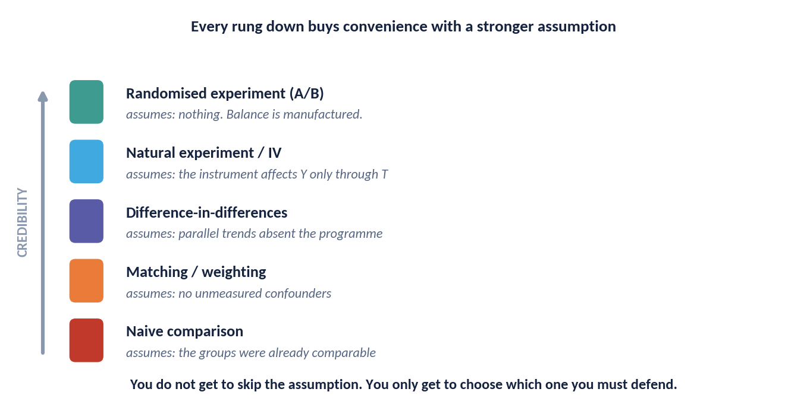
DAY 1 · HOUR 4
The Ladder of Evidence
When a coin flip is impossible, you climb down. Each rung is easier to run and buys its answer with a stronger, less testable assumption.
THE POINT
You never escape the assumption. You only choose which one you will have to defend in the room.
Days 3 and 4 work down this ladder. For each method, learn the assumption first and the estimator second — the estimator is the easy part.
ACADEMY OF EXCELLENCE · DAY 1 · RANDOMIZATION
48 / 268
Notes:
4 min - Day 1 Hour 4, figure walk
Walk down the ladder rung by rung and at each one name the assumption rather than the method. Randomised at the top assumes little beyond SUTVA. Natural experiments assume the as-if-random claim. Difference-in-differences assumes parallel trends. Matching and propensity methods assume no unmeasured confounding, which is the strongest and least testable of the set. Then point out that the ladder runs opposite to convenience: the studies easiest to run rest on the assumptions hardest to defend.
ASK: Which rung was your last analysis on, and could you state its assumption in one sentence to a non-technical director? Freeze there, because that sentence is what the capstone defence asks for.
WATCH FOR: Reading the lower rungs as invalid. They are valid conditional on an assumption, and the work is arguing that assumption rather than apologising for the method.
LINK: Days 3 and 4 work down this ladder in order, method by method.

Slide 49
DAY 1 · HOUR 4
Knowledge Check: Randomization
Q1
Randomization guarantees balance of unmeasured confounders …
A) exactly, in every sample B) in expectation, across repetitions C) only if n is large D) never
Q2
Fisher's randomization test is valid because it relies on:
A) Normality of Y B) The CLT C) The assignment mechanism D) A correct outcome model
Q3
The sharp null hypothesis states that the treatment effect is zero for:
A) the average unit B) every unit C) the treated only D) large samples only
ACADEMY OF EXCELLENCE · DAY 1 · RANDOMIZATION
49 / 268
Notes:
5 min - Day 1 Hour 4, knowledge check
The answers are B, C and B. Q1 is in expectation across repetitions; option A tempts anyone who has heard randomisation described as guaranteeing balance, and option C tempts people conflating balance with large-sample consistency. Q2 is the assignment mechanism, and the entire point of Fisher's test is that it needs neither normality nor the central limit theorem, so both distributional distractors are worth discussing. Q3 is every unit, and the average distractor is the single most common misreading in the deck.
ASK: Why does the Q3 distinction matter in practice? Because rejecting the sharp null tells you somebody was affected, not that the average effect is non-zero.
WATCH FOR: Q1 answered as only if n is large. Unbiasedness holds at any sample size; it is precision that improves as n grows.
LINK: Both tests are implemented in Lab 1 this hour and again in Day 2 Hour 2.

Slide 50
DAY 1 · HOUR 5
Lab 1 & Consolidation
Simulate potential outcomes, feel the fundamental problem, and see randomization repair selection bias — in code.
ACADEMY OF EXCELLENCE · DAY 1
50 / 268
Notes:
1 min - Day 1 Hour 5 divider
One minute. Set the frame for the lab: participants build a world in which they own the full potential-outcomes table, so for once the truth is knowable and every estimator can be scored against it. That is the only setting in which you can see bias directly rather than infer its existence from an argument.
ASK: Nothing here. Use the minute for logistics: environment check, notebook location, and pairing anyone who is still struggling to run code.
WATCH FOR: Environment problems eating lab time. Anyone without a working notebook should already have been paired at the break.
LINK: Lab 1 is the guided-uploader simulator: true ATE plus 5.0 points, naive plus 19.3 points.

Slide 51
DAY 1 · HANDS-ON LAB 1
Simulating the Counterfactual World
STEPS
OBJECTIVE
Generate N=5,000 units with a confounder X and true Y(0), Y(1) as functions of X plus noise.
1
Build a synthetic population where you control the full potential-outcomes table, then experience why the naive estimate misleads and how randomization fixes it.
2
Compute the oracle ATE from the full potential-outcomes table.
3
Induce selection: let P(T=1) increase with X; compute the naive difference in means.
DELIVERABLE
4
Re-assign T completely at random; recompute the difference in means.
A notebook that reports true ATE, naive (selection-biased) estimate, and randomized estimate with a design-based standard error.
5
Compare all three; plot covariate balance before and after randomization.
6
Add a randomization-inference p-value via 1,000 label permutations.
ACADEMY OF EXCELLENCE · DAY 1 · LAB
51 / 268
Notes:
5 min - Day 1 Hour 5, lab brief
Brief the objective and the deliverable, then let them work; walking all six steps will consume the hour. Flag the two sticking points. Step three needs the selection probability to depend on the same X that drives Y(0), or nothing is confounded and the lab has no lesson. Step six must permute treatment labels only, holding outcomes fixed. The three numbers to write down are true ATE, naive estimate and randomised estimate.
ASK: Before you run it, predict the sign and rough size of the naive bias. Predicting first is what makes the resulting 14 point gap memorable rather than merely observed.
WATCH FOR: Participants regenerating outcomes after re-randomising, which quietly destroys the comparison. The potential outcomes are fixed; only T is allowed to change.
LINK: Expected results are plus 5.0 true, plus 19.3 naive and plus 5.0 randomised, debriefed on the next slide.

Slide 52
DAY 1 · HOUR 5
Lab 1 Debrief: What You Should See
The numbers are engineered to make the lesson unmistakable.
Naive ≠ truth
The selection-biased estimate is systematically off, and more data does not fix it — it converges to the biased value.
Randomized ≈ truth
The randomized estimate centres on the true ATE, with a spread that shrinks as n grows.
Balance is visible
Covariate distributions overlap after randomization and diverge under selection — the diagnostic you will use all week.
ACADEMY OF EXCELLENCE · DAY 1 · LAB
52 / 268
Notes:
4 min - Day 1 Hour 5, lab debrief
Collect numbers from three tables before you show anything. The randomised estimates will scatter around plus 5.0 while the naive ones cluster tightly near plus 19.3, and the room seeing that pattern in their own results is worth more than your summary of it. The key observation is the asymmetry: the randomised estimate is noisy but centred, and the naive estimate is precise and wrong. Then move to the balance plot and name it as the diagnostic they will use for the rest of the week.
ASK: Whose naive estimate came closest to plus 5.0? Almost certainly nobody, and that is the point, because the errors do not vary around the truth.
WATCH FOR: Relief that someone's randomised estimate was not exactly 5.0. Unbiased means centred over repetitions, not correct in any single draw.
LINK: The next figure runs this same simulation at every sample size from 100 to 20,000.

Slide 53
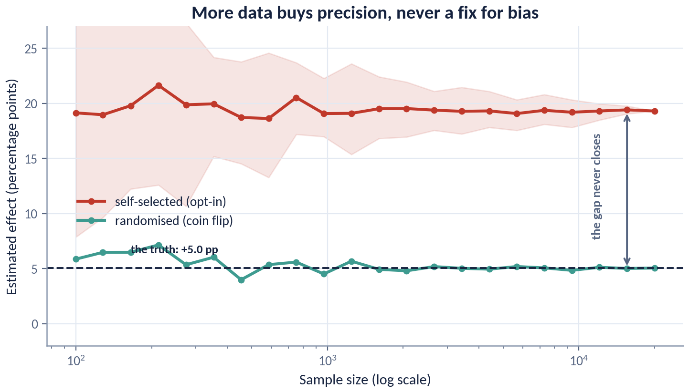
DAY 1 · HOUR 5
Big Data Does Not Fix a Biased Design
The same simulation run at every sample size from 100 to 20,000, averaged over 40 draws at each point.
THE PUNCHLINE
The randomised line converges on the truth. The self-selected line converges too — on the wrong number.
More data shrinks the shaded band, not the gap. If a stakeholder answers a design objection with 'but we have millions of rows', this is the slide.
ACADEMY OF EXCELLENCE · DAY 1 · LAB
53 / 268
Notes:
4 min - Day 1 Hour 5, figure walk
Point first at the left edge, where both lines are noisy and the bands wide, so nothing is distinguishable. Point second at the bands narrowing as n grows toward 20,000, which is variance behaving as everyone expects. Point third at the two centres, one settling on plus 5.0 and one on plus 19.3, and say the gap never moves. Freeze there. Keep this slide for the stakeholder who answers a design objection with the size of the warehouse.
ASK: At what sample size would the self-selected line reach the truth? Never, and getting the room to say never out loud is the whole objective of this figure.
WATCH FOR: Reading the narrowing band as improving accuracy. Precision improves and accuracy does not, so more data simply makes you more confident in the wrong number.
LINK: This is the visual form of the Hour 2 decomposition, where the bias term does not depend on n.

Slide 54
DAY 1 · HOUR 5
Discussion: Bring a Question From Your Work
In pairs, translate a real question from your context into the framework. We surface a few to the room.
State the decision, the treatment, the outcome, and the population.
Name the estimand (ATE, ATT, CATE, or ITT) and justify the choice.
List the most plausible confounders and whether you can measure them.
Decide: could you randomize? If not, what natural variation might stand in?
ACADEMY OF EXCELLENCE · DAY 1 · DISCUSSION
54 / 268
Notes:
10 min - Day 1 Hour 5, paired discussion
Ten minutes in pairs, then surface three examples to the room. Give the four prompts in order and insist on the estimand step, because that is where vagueness shows: most real questions arrive as does X work and have to be pushed into whose effect, of what, on whom, on which outcome. When you surface examples, deliberately pick one that could be randomised and one that clearly cannot, so the room sees both branches of the week ahead.
ASK: For your question, could you randomise? If not, what natural variation exists: a staggered rollout, an eligibility cutoff, or a distance constraint? Those three are DiD, RDD and IV in disguise.
WATCH FOR: Pairs choosing a comfortable question whose answer they already know. Push them toward the contested one their organisation is currently arguing about.
LINK: Questions raised here should be recycled as capstone candidates on Day 4.

Slide 55
DAY 1 · WRAP
Day 1 in One Slide
The mental model that carries the whole course.
TOMORROW
Day 2: we design real experiments — randomization schemes, power and MDE, regression estimation, and production A/B testing.
Causal ≠ predictive
Intervention questions need counterfactual reasoning, not just correlation.
Potential outcomes
Effects are within-unit contrasts; the missing counterfactual is the whole problem.
Identification first
SUTVA, ignorability, positivity, consistency decide credibility before any estimator.
Randomization is the benchmark
It makes ignorability true by design; quasi-experiments approximate it.
ACADEMY OF EXCELLENCE · DAY 1 · SUMMARY
55 / 268
Notes:
4 min - Day 1 wrap
Close on the four ideas, but get the room to supply them rather than reading them out. Test identification first hardest: ask what the order of the five workflow steps was and why estimation only comes third. Then give the honest bridge to tomorrow. Today was the only setting in which the assumptions can be made true by design, and from Day 3 onward every method is an argument for approximating what randomisation hands you for free.
ASK: In one sentence, why did the naive estimate fail in Lab 1? Because treated and control units differed in Y(0) before any treatment, which is the Hour 2 decomposition.
WATCH FOR: People leaving with methods anxiety because they learned no techniques. Name it directly: today was language and design, and it is what makes tomorrow's techniques arguable.
LINK: Day 2 opens with design of experiments and ends with a full production A/B analysis in Lab 2.

Slide 56
DAY 2
Randomized Experiments & A/B Testing
Design of experiments, randomization vs. design-based inference, regression estimation of effects, power and MDE, and production A/B testing.
ACADEMY OF EXCELLENCE · DAY 2
56 / 268
Notes:
1 min - Day 2 divider
One minute. Frame the day as moving from why randomisation works to how to run one without ruining it. Warn the room that most of today concerns the ways a technically valid randomisation still produces a wrong answer: the wrong unit of assignment, peeking at interim results, dilution by users who never trigger the feature, and interference between units. Every one of those failures survives a perfectly clean p-value.
ASK: Nothing here. Go straight to the overview slide, because Hour 1 is dense and includes three figures.
WATCH FOR: Letting this run long. Hour 1 has eleven slides to get through before the first break.
LINK: Lab 2 in Hour 5 uses injaz_experiment_results.csv with 80,000 users.

Slide 57
DAY 2 · OVERVIEW
Today's Five Hours
01
Hour 1 — Design of Experiments
02
Hour 2 — Inference for Experiments
Randomization schemes: complete, block, stratified, cluster, and factorial designs.
Randomization (Fisher) and design-based (Neyman) inference in practice.
03
Hour 3 — Regression & Covariate Adjustment
04
Hour 4 — A/B Testing in Production
Regression estimators, CUPED variance reduction, and heterogeneous effects (CATE).
Hypotheses, power/MDE, sequential testing, peeking, multiplicity, guardrails.
05
Hour 5 — Lab 2 & Discussion
Run and analyse a full A/B test; diagnose common failure modes.
ACADEMY OF EXCELLENCE · DAY 2
57 / 268
Notes:
3 min - Day 2 overview
Give the arc rather than the list. Hours 1 and 2 are design and valid inference, Hour 3 is how to get more precision from the same sample, and Hour 4 is the catalogue of ways production experiments go wrong. Preview two numbers so the room knows it becomes concrete: CUPED buys a 13.5 percent variance reduction on the course data at a pre-post correlation of 0.37, and peeking twenty times turns a 5 percent false-positive rate into 25 percent.
ASK: Which of these five hours matches a problem you have right now? Use the answer to decide where to slow down and where to move briskly.
WATCH FOR: Experienced A/B practitioners assuming Hour 1 is revision. The randomisation-unit material catches out most production teams.
LINK: Lab 2 in Hour 5 pulls all five hours together on the 80,000-user Injaz experiment.

Slide 58
DAY 2 · HOUR 1
The Anatomy of an Experiment
Before choosing a scheme, fix the design vocabulary that determines what your estimate means.
Unit of randomization
The level at which treatment is assigned (user, session, cluster). It must match the level of interference and of the decision.
Treatment arms
Control plus one or more variants; more arms split power and multiply comparisons.
Randomization scheme
The probabilistic rule mapping units to arms — the source of all causal validity.
Primary & guardrail metrics
One pre-specified success metric, plus metrics that must not degrade (latency, revenue, complaints).
ACADEMY OF EXCELLENCE · DAY 2 · DESIGN
58 / 268
Notes:
4 min - Day 2 Hour 1, design vocabulary
The vocabulary here decides what an estimate means, so treat it as design rather than admin. Emphasise that the unit of randomisation must match both where interference stops and the level at which the decision will actually be made, and that adding arms is not free because power splits and comparisons multiply. Guardrail metrics deserve a moment of their own: a feature that lifts completions while degrading latency or raising complaints is not a win, and guardrails must be pre-specified or they become post-hoc excuses.
ASK: Name a guardrail metric for the Injaz guided uploader. Support-call volume and time-to-complete are the good answers, since both catch a feature that shifts effort onto users.
WATCH FOR: Multiple primary metrics. If everything is primary, the experiment has an unmanaged multiple-comparison problem before a single user is enrolled.
LINK: The Injaz design figure on the next slide makes all six of these decisions concrete.

Slide 59
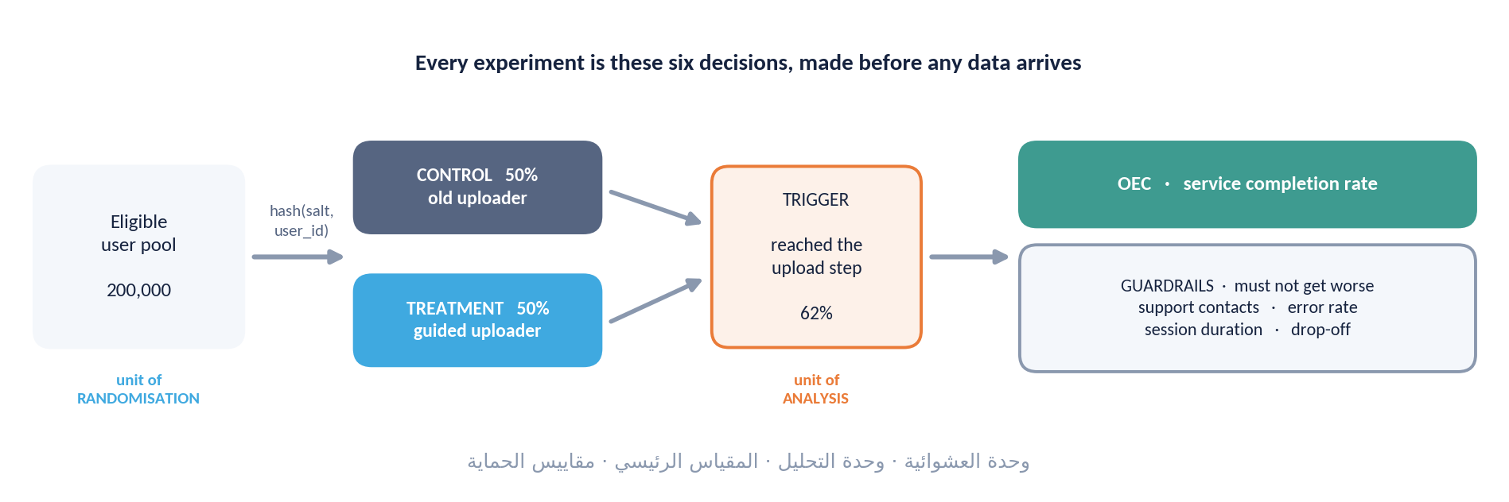
DAY 2 · HOUR 1
The Anatomy of an Injaz Experiment
Six decisions, all of them made before a single row of data exists. Every ambiguity left here becomes an argument after the results land.
WATCH THE SPLIT — The unit of RANDOMISATION and the unit of ANALYSIS are different boxes, and confusing them is the most common silent error in industry A/B testing.
ACADEMY OF EXCELLENCE · DAY 2 · DESIGN
59 / 268
Notes:
4 min - Day 2 Hour 1, figure walk
Walk the six boxes in order, repeating at each that the decision is made before any data exists. Point first at the randomisation unit box, second at the analysis unit box, third at the gap between them, because that gap is where the warning lives. The concrete failure: assign by user, analyse by session, and the standard error treats every session as independent information, which it is not. Ambiguity left here becomes an argument after results land.
ASK: If we randomise by user but the metric is per session, what is the analysis unit? The user, with sessions aggregated or standard errors clustered, and never raw sessions.
WATCH FOR: The assumption that this only matters for small experiments. At 80,000 users a bad clustering choice produces confidently wrong intervals.
LINK: Day 4 sizes the error: session-level SE 0.00166 against user-clustered 0.00267, about 1.6 times wider.

Slide 60
DAY 2 · HOUR 1
A Menu of Randomization Schemes
Each buys a different mix of balance, power, and operational simplicity.
01
Complete randomization
Each unit independently assigned. Simplest; can leave chance imbalance in small samples.
02
Block / stratified
Randomize within strata of a strong pre-treatment predictor to guarantee balance and cut variance.
03
Cluster randomization
Assign whole groups (stores, classrooms, regions) when interference or delivery forces it — at a power cost.
04
Factorial
Cross two or more treatments to estimate main effects and interactions in one experiment.
ACADEMY OF EXCELLENCE · DAY 2 · DESIGN
60 / 268
Notes:
4 min - Day 2 Hour 1, the scheme menu
Present these as a decision with trade-offs rather than four equal options. Complete randomisation is the default and is fine at large n. Blocking is nearly free precision whenever you have a strong pre-treatment predictor. Cluster randomisation is what you do when interference or delivery forces your hand, and it costs power. Factorial is what you use when you have more questions than traffic. The choice is driven by interference first, then variance, then operational reality, and in that order.
ASK: You have 2,000 users and one covariate that predicts the outcome well. Which scheme? Block on it, because the variance win is largest exactly where chance imbalance is most likely.
WATCH FOR: Choosing cluster randomisation because it is easier to implement. If interference does not require it, you are paying a power tax for nothing.
LINK: Each of the next three slides takes one of these schemes in depth.

Slide 61
DAY 2 · HOUR 1
Blocking & Stratification: Balance by Design
‘Block what you can, randomize what you cannot.’ Stratifying on strong predictors removes chance imbalance before it happens.
VARIANCE WIN
↓ SE
How it works
Partition units into strata (e.g. by prior activity), then randomize independently within each stratum.
Why it helps
Blocking on a covariate that explains a share ρ² of outcome variance shrinks the effect's variance by roughly that fraction — often a large, cheap gain.
It forces covariate balance and reduces sampling variance of the effect estimate — tighter intervals for free.
Analysis must match design
Include stratum indicators (or stratum-fixed effects) in the analysis, or you understate precision.
ACADEMY OF EXCELLENCE · DAY 2 · DESIGN
61 / 268
Notes:
4 min - Day 2 Hour 1, blocking
The idea worth teaching is that you can spend knowledge instead of sample size. Stratifying on a strong pre-treatment predictor removes chance imbalance before it can occur, and the variance reduction is roughly the share of outcome variance that predictor explains. The line people skip is the third: if you block in the design you must include stratum indicators in the analysis, or you paid for precision and then discarded it.
ASK: What is the best blocking variable for an Injaz completion experiment? Prior-period completion, because past behaviour is almost always the strongest predictor of future behaviour.
WATCH FOR: Blocking on a post-treatment variable or on the outcome itself. The blocking variable must be known before assignment, with no exceptions.
LINK: CUPED in Hour 3 is the same idea applied in analysis rather than design, worth 13.5 percent variance reduction at rho equal to 0.37.

Slide 62
DAY 2 · HOUR 1
Cluster Randomization & Its Price
Sometimes you must treat groups, not individuals — but correlated units within a cluster carry less information than independent ones.
COMMON MISTAKE
Randomizing by cluster but analysing as if by individual dramatically understates uncertainty — a frequent source of false ‘wins’.
When it is required
Interference within groups, or treatments delivered at group level (a store layout, a regional campaign).
The design effect
Effective sample size falls by a factor 1 + (m−1)ρ, where m is cluster size and ρ the intra-cluster correlation.
Consequences
You need more clusters (not just more units), and you must cluster your standard errors (Day 4).
ACADEMY OF EXCELLENCE · DAY 2 · DESIGN
62 / 268
Notes:
4 min - Day 2 Hour 1, the price of clusters
Make the design effect concrete with numbers rather than with the formula alone. With clusters of 50 and an intra-cluster correlation of 0.05, the multiplier is 1 plus 49 times 0.05, roughly 3.5, so 10,000 users carry about the information of 2,900 independent ones. That is why the answer to an underpowered cluster trial is more clusters, not more people inside them. The common-mistake box is the real content: randomise by cluster, analyse by individual, and you will manufacture wins.
ASK: You have 12 regions and 2 million users. What limits your power? The 12, and no amount of user volume inside those regions changes it.
WATCH FOR: Treating a small intra-cluster correlation as negligible. Multiplied by a large cluster size, even 0.02 becomes a substantial penalty.
LINK: The regional panel on Day 3 has exactly this shape, with 13 regions and only 4 never-treated.

Slide 63
DAY 2 · HOUR 1
Factorial Designs: More Answers per Experiment
Crossing treatments lets you learn about several interventions — and their interactions — at once.
2×2 example
Test a new headline (on/off) crossed with a new price (old/new): four cells, two main effects, one interaction.
Efficiency
Main effects use the whole sample, so factorial can be far cheaper than separate experiments.
Watch interactions
If effects are strongly non-additive, main effects alone mislead — pre-specify which interactions matter.
ACADEMY OF EXCELLENCE · DAY 2 · DESIGN
63 / 268
Notes:
3 min - Day 2 Hour 1, factorial designs
The efficiency claim is what to defend. Main effects use the whole sample, so a two-by-two costs roughly what a single test costs while answering two questions. The catch is the interaction: if the new headline only works at the new price, main effects give an answer true on average and wrong in every cell. Interactions need far more sample, so if the interaction is the question, power for it rather than for main effects.
ASK: When is a factorial design a bad idea? When you expect the treatments to interact strongly and cannot afford the sample needed to estimate that interaction.
WATCH FOR: Assuming a two-by-two gives you two experiments free at full power. It gives two main effects cheaply; the interaction is expensive.
LINK: The multiple-comparisons material in Hour 4 applies directly to the extra cells and arms.

Slide 64
DAY 2 · HOUR 1
Randomization Unit vs. Analysis Unit
A subtle but decisive choice that shapes both bias and variance.
Randomize at the level where interference stops — if users influence each other, user-level tests leak.
Session-level randomization gives power but breaks if the same user appears in both arms (contamination).
The analysis unit should be at or above the randomization unit; never analyse finer than you assigned.
Repeated observations per unit require clustered or aggregated inference to avoid fake precision.
ACADEMY OF EXCELLENCE · DAY 2 · DESIGN
64 / 268
Notes:
4 min - Day 2 Hour 1, unit of assignment versus unit of analysis
This is where experienced practitioners get caught, so slow down. The rule is one sentence, never analyse finer than you assigned, and the reason is that repeated observations from one unit are not independent draws. Session-level randomisation looks attractive because it multiplies the sample, but the moment a user returns they are in both arms, contamination is guaranteed, and the estimate becomes a blend of treated and untreated experience. The contamination problem and the fake-precision problem are separate failures, and both apply.
ASK: How would you detect contamination after the fact? Count the users appearing in both arms; on a returning-user product that number is large and almost never checked.
WATCH FOR: The belief that clustered standard errors repair session-level randomisation. Clustering fixes the standard error, not the contaminated point estimate.
LINK: The next figure gives the three-question procedure for choosing the unit.

Slide 65
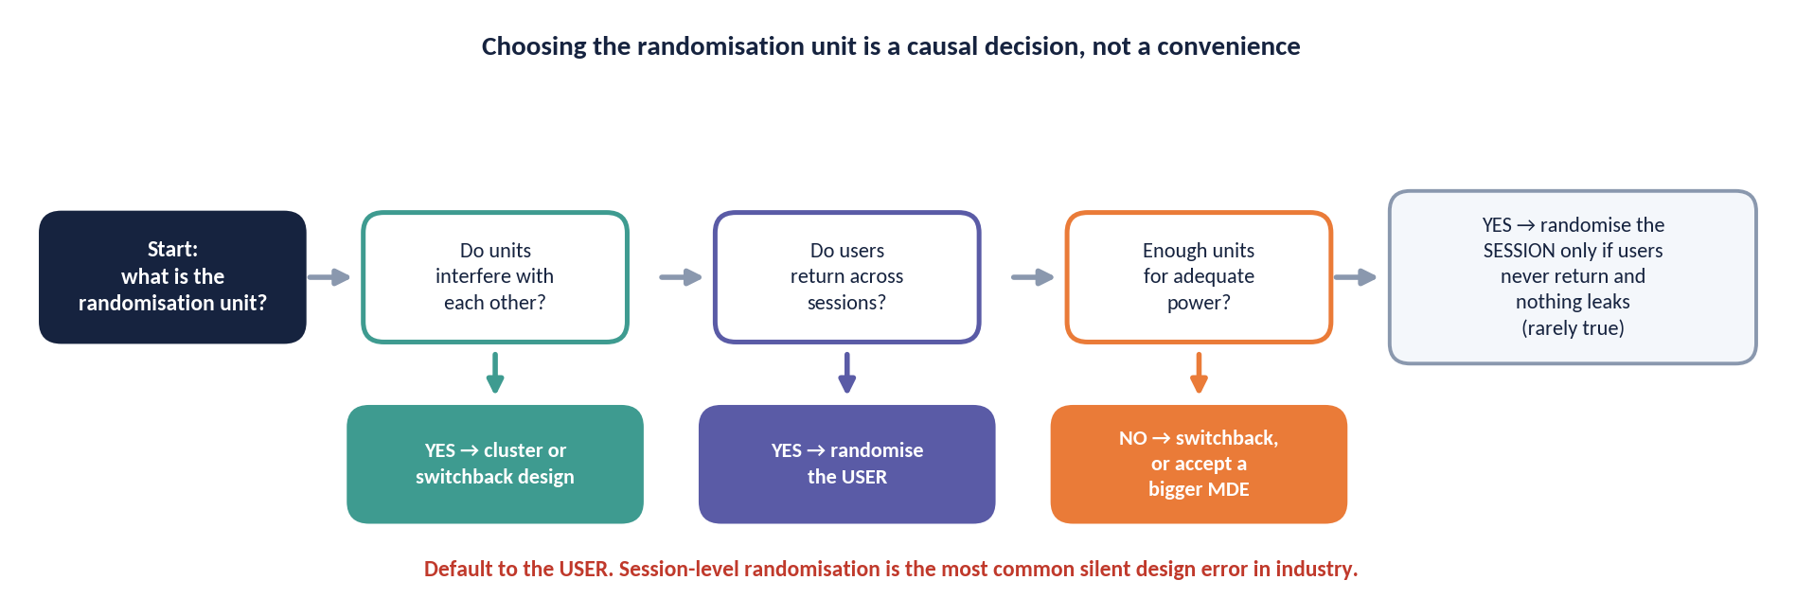
DAY 2 · HOUR 1
Choosing the Randomisation Unit
Three questions decide it, and they must be answered in this order. The convenient answer and the correct answer are rarely the same.
DEFAULT TO USER — Session-level randomisation is tempting because it maximises the sample. It is also wrong whenever users return, because the same person lands in both arms.
ACADEMY OF EXCELLENCE · DAY 2 · DESIGN
65 / 268
Notes:
4 min - Day 2 Hour 1, figure walk
Walk the three questions in order and insist on that order. Point first at the interference question, because that constraint dominates everything else. Point second at the returning-user question, which is what kills session-level assignment on a services platform where people come back across the year. Point third at the decision question, since you assign at or above the level at which the rollout will be decided. Then read the default aloud: user-level unless something forces you higher, because session-level buys sample and sells validity.
ASK: For the Injaz uploader, session or user? User, because filers return across the year and the decision is whether to give a person the uploader.
WATCH FOR: Answering question two before question one. If interference exists at region level, the returning-user question is irrelevant to the choice.
LINK: Lab 2 analyses the Injaz experiment at user level; the clustering consequences arrive on Day 4.

Slide 66
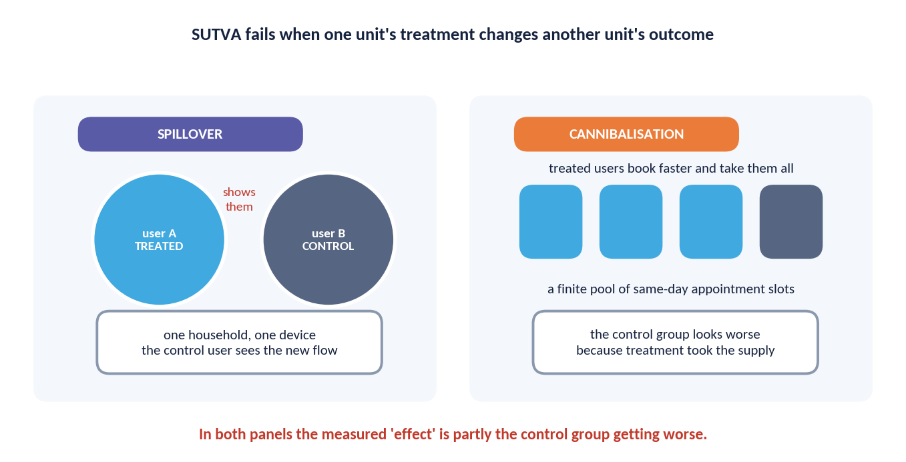
DAY 2 · HOUR 1
When One Unit's Treatment Reaches Another
SUTVA is the quiet assumption behind every A/B test: your outcome does not depend on anyone else's assignment. Two ways it breaks in production.
THE TELL
In both panels, the measured 'effect' is partly the control group getting WORSE — which flatters the treatment for free.
Spillover inflates a null feature; cannibalisation invents a winner out of a fixed supply. Both are design problems and neither shows up in a p-value.
ACADEMY OF EXCELLENCE · DAY 2 · DESIGN
66 / 268
Notes:
4 min - Day 2 Hour 1, figure walk
Two panels, two failure shapes. In the spillover panel point first at the treatment bar, then at the control bar moving too, because the control group is contaminated and no longer measures the untreated world. In the cannibalisation panel point at the fixed total: the treatment arm's gain came out of the control arm's pocket, so a full rollout delivers nothing. Read the panel line aloud, because neither failure appears in a p-value.
ASK: Which of these two would a perfectly executed A/B test detect? Neither, and that is the freeze point of this figure.
WATCH FOR: Suggesting a bigger sample or a longer runtime as the fix. Both are design failures, and the remedies are a different randomisation unit, cluster assignment or a switchback.
LINK: This is the SUTVA no-interference clause from Day 1 Hour 3, now in production form.

Slide 67
DAY 2 · HOUR 1
Knowledge Check: Design Choices
Q1
A campaign is delivered per city and neighbours may hear about it. Best design?
A) Complete B) Cluster (by city) C) Factorial D) Session-level
Q2
You have one covariate that strongly predicts the outcome. To cut variance you should:
A) Add more arms B) Stratify on it C) Ignore it D) Drop imbalanced units
Q3
Analysing a cluster-randomized test at the individual level will typically:
A) Overstate SE B) Understate SE C) Be unbiased D) Fix imbalance
ACADEMY OF EXCELLENCE · DAY 2 · DESIGN
67 / 268
Notes:
5 min - Day 2 Hour 1, knowledge check
The answers are B, B and B. Q1 is cluster by city, because the treatment is delivered per city and neighbours hear about it; complete randomisation tempts anyone optimising for power and violates SUTVA outright. Q2 is stratify, since adding arms costs power, ignoring the covariate wastes free precision, and dropping imbalanced units is the dangerous distractor. Q3 is understate the standard error, which is why cluster-randomised tests analysed at individual level generate a steady stream of false wins.
ASK: In Q3, is the point estimate also wrong? Usually not badly. The estimate is roughly fine and the uncertainty is fiction, which is what makes this error so hard to catch.
WATCH FOR: Q2 answered as drop imbalanced units. It feels intuitive, it conditions on the realised assignment, and it destroys the property randomisation bought you.
LINK: The Day 4 clustering example quantifies Q3 at 1.6 times wider standard errors.

Slide 68
DAY 2 · HOUR 2
Inference for Experiments
Turning a design into an estimate with honest uncertainty: randomization inference and Neyman's design-based standard errors.
ACADEMY OF EXCELLENCE · DAY 2
68 / 268
Notes:
1 min · opens Day 2 Hour 2.
Frame the transition rather than reading the subtitle. Hour 1 gave them a design; this hour turns a design into a number with an honest interval, and the argument throughout is that the design, not a distributional assumption, licenses the inference. They will meet two traditions answering different questions, and the practical payoff is knowing which standard error to write in a report.
ASK: Where does the randomness in a p-value come from here? Steer to: the assignment mechanism we controlled, not sampling from a population.
WATCH FOR: participants who assume a t-test is the default and everything else exotic; in design-based thinking it is the reverse.
LINK: Lab 2 uses these standard errors on the Injaz A/B data.

Slide 69
DAY 2 · HOUR 2
Randomization Inference in Practice
The permutation logic from Day 1, operationalised as a repeatable procedure.
ASSUMPTION COST
Minimal
Choose a test statistic
Difference in means, difference in ranks, or a studentised statistic — pick before seeing the data.
Permute the labels
Randomization inference imports no distributional assumptions and respects your exact design — including blocks and clusters — by permuting the way you assigned.
Reassign treatment respecting the actual design (e.g. within blocks) many times; recompute the statistic each time.
Read off significance
The p-value is the share of permutations at least as extreme as observed; invert for confidence intervals.
ACADEMY OF EXCELLENCE · DAY 2 · INFERENCE
69 / 268
Notes:
4 min · first content slide of the inference hour.
The point to land is that permutation is not a fallback for small samples, it is the inference that matches the design exactly. Say plainly that if you permute freely when you assigned within blocks, you are testing a design you did not run and your p-value is wrong. Note that inverting the test over candidate effects yields a confidence interval, so this is not testing only.
ASK: We blocked by region. What exactly do we shuffle? Steer to: labels within each region, never across regions.
WATCH FOR: the claim that permutation needs normality; it needs nothing but random assignment.
LINK: revisits the Day 1 permutation demonstration; returns in the Lab 3 design check.

Slide 70
DAY 2 · HOUR 2
Neyman's Design-Based Standard Error
For estimation (not just testing), Neyman gives an unbiased ATE and a variance derived from the assignment.
The estimator
τ̂ = ȳ₁ − ȳ₀, the difference in arm means — unbiased for the ATE under complete randomization.
The variance
Var = S₁²/n₁ + S₀²/n₀ (conservative), estimated from within-arm sample variances.
Equivalence
Under complete randomization this matches a heteroskedasticity-robust (HC2) standard error from a regression of Y on T.
ACADEMY OF EXCELLENCE · DAY 2 · INFERENCE
70 / 268
Notes:
5 min · pairs directly with the previous slide.
Neyman derives the variance from the assignment mechanism, so nothing assumes normal outcomes or equal arm variances. Name the conservative part: the covariance of the two potential outcomes is unidentifiable, so the interval is slightly wide, and that direction is the safe one. The HC2 equivalence is the useful line, because a regression of Y on T with HC2 errors is not a shortcut but the same estimator, which is how they will compute it in the labs.
ASK: Why can we never estimate the variance of the individual treatment effect? Steer to: we never observe both potential outcomes for the same user.
WATCH FOR: default OLS standard errors, then puzzlement at intervals that look too narrow when arm variances differ.
LINK: the regression-as-estimator slide in Hour 3.

Slide 71
DAY 2 · HOUR 2
Fisher vs. Neyman
FISHER
NEYMAN
Randomization Test
Design-Based Estimation
Targets the sharp null: no effect for any unit.
Targets the average effect (ATE).
Produces an exact p-value by permutation.
VS
Gives an estimate plus a (conservative) SE.
No estimate of effect size on its own.
Tests the weaker null of zero average effect.
Ideal for small samples and clean significance.
Ideal when you need an effect size and interval.
ACADEMY OF EXCELLENCE · DAY 2 · INFERENCE
71 / 268
Notes:
4 min · comparison slide; do not read the columns.
Make the difference concrete through the nulls. Fisher's sharp null says no user was affected at all; Neyman's says the average effect is zero, a weaker claim that permits effects which cancel. Rejecting Fisher tells you something happened somewhere; rejecting Neyman tells you the average moved and hands you an interval a product owner can act on. Neyman dominates in production, but Fisher is the honest choice for a forty-unit pilot.
ASK: A treatment helps half the users and harms the other half equally. Which null is false? Steer to: Fisher's sharp null is false, Neyman's average null is true.
WATCH FOR: treating these as rival schools rather than answers to two different questions.
LINK: the Lab 2 Injaz analysis reports the Neyman estimate.

Slide 72
DAY 2 · HOUR 2
Reading an Experiment's Result Honestly
A result is a triple: point estimate, interval, and the assumptions behind both.
Effect size, in context
Report the estimate in the metric's real units and as a relative lift; statistical and practical significance differ.
Interval, not just p
A confidence (or compatibility) interval communicates precision and the range of effects the data can't rule out.
Assumptions ledger
State the randomization unit, the SE type, and any adjustment — so a reader can judge credibility.
ACADEMY OF EXCELLENCE · DAY 2 · INFERENCE
72 / 268
Notes:
4 min · the report-writing slide of this hour.
Insist that a result is never a p-value alone: estimate in real units, interval, and the assumptions behind both travel together. Use the course numbers so it bites. A plus 2.2 pp lift on the guided uploader means little until you say 2.2 pp on a 55 percent baseline, roughly four percent relative, applying to triggered users only. The assumptions ledger always gets dropped, yet naming the randomization unit and the standard-error type is what lets a reviewer catch a clustering error.
ASK: What three things must every readout in your team contain? Steer to: estimate, interval, and the design and standard-error assumptions.
WATCH FOR: relative lift quoted without the baseline, which makes tiny absolute effects sound enormous.
LINK: the capstone, where plus 1.4 pp is judged against a 1.0 pp threshold.

Slide 73
DAY 2 · HOUR 2
Interpreting p-values Without the Usual Errors
Even experts slip here; we state the correct readings explicitly.
A p-value is P(data at least this extreme | null), not P(null | data).
‘p > 0.05’ is not evidence of no effect — absence of evidence ≠ evidence of absence.
A tiny p on a huge sample can accompany a trivial, non-actionable effect.
The confidence interval usually carries more decision-relevant information than the p-value alone.
ACADEMY OF EXCELLENCE · DAY 2 · INFERENCE
73 / 268
Notes:
5 min · the misconception slide; slow down here.
Expert audiences nod at these and violate them in the next meeting, so make each one cost something. For the inversion, ask what a five percent error rate is a rate of. For the p above 0.05 error, show that a wide interval around zero and a tight interval around zero are completely different findings sharing a p-value. For the large-sample case, note that with 80,000 Injaz users a 0.1 pp difference can be significant and worth nothing.
ASK: Our test returns p equals 0.31. What do we tell the product owner? Steer to: the data are compatible with no effect and with effects out to the interval's edge, so report the interval.
WATCH FOR: the null is 31 percent likely, the most common expert-level slip.
LINK: the peeking slides, where the five percent promise is broken by procedure.

Slide 74
DAY 2 · HOUR 2
Knowledge Check: Inference
Q1
You need an effect size with an interval, not just a test. Use:
A) Fisher's sharp-null test B) Neyman estimation C) A chi-square test D) None
Q2
Under complete randomization, the Neyman SE for ȳ₁−ȳ₀ corresponds to which regression SE?
A) Classical OLS B) HC2 robust C) Clustered D) Bootstrap only
Q3
‘p = 0.20, so the treatment has no effect.’ This statement is:
A) Correct B) Incorrect — confuses no evidence with no effect C) Correct if n large D) Correct if randomized
ACADEMY OF EXCELLENCE · DAY 2 · INFERENCE
74 / 268
Notes:
6 min · knowledge check closing Hour 2. Poll first, then explain.
Q1 is B: Neyman gives an estimate with a standard error, while A tests the sharp null and produces no effect size. Q2 is B, HC2, and this is the one people miss, because classical OLS errors assume a homoskedasticity that a binary treatment with unequal arm variances violates; clustered is right only when assignment was clustered. Q3 is B; A and C are the absence-of-evidence fallacy, and D offers randomization, which fixes bias rather than the logic of an inconclusive p-value.
ASK: Who answered clustered on Q2, and what would make that correct? Steer to: assignment at a group level, which is a design fact rather than a data fact.
WATCH FOR: strong participants defending C on Q3 by conflating power with interpretation.

Slide 75
DAY 2 · HOUR 3
Regression, Adjustment & Heterogeneity
Regression estimators for experiments, covariate adjustment and CUPED for variance reduction, and estimating effects that vary (CATE).
ACADEMY OF EXCELLENCE · DAY 2
75 / 268
Notes:
1 min · opens Day 2 Hour 3.
One sentence of framing. Hour 2 gave an honest but noisy estimate; this hour is about precision and resolution, first shrinking the interval without moving the point estimate, then refusing to report one average when the effect differs across users. Flag the through-line now: everything safe here is pre-treatment and everything dangerous is post-treatment.
ASK: Randomization already gave us an unbiased estimate, so why touch covariates? Steer to: not for bias but for variance, because the same data can buy a tighter interval.
WATCH FOR: participants expecting adjustment to change the answer; a large move is a signal about imbalance, not a success.
LINK: the CUPED figure two slides on, and Lab 2 step 4.

Slide 76
DAY 2 · HOUR 3
Regression as an Estimator of Treatment Effects
In a randomized experiment, a regression of Y on T recovers the ATE — and adding pre-treatment covariates can sharpen it.
ADJUST ONLY PRE-TREATMENT
Covariate adjustment is safe only for variables fixed before treatment. Adjusting for anything post-treatment reintroduces bias.
Simple regression
Y = α + τ·T + ε. The coefficient τ̂ equals the difference in means; use robust (HC2) SEs.
Covariate adjustment
Y = α + τ·T + Xβ + ε. Under randomization this leaves τ̂ unbiased and usually reduces its variance.
Lin's estimator
Interact T with centred covariates to guarantee no loss of efficiency and correct finite-sample behaviour.
ACADEMY OF EXCELLENCE · DAY 2 · REGRESSION
76 / 268
Notes:
5 min · the workhorse slide of the hour.
Regression inside an experiment is not a modelling exercise: the model can be wrong and the treatment coefficient is still unbiased, because randomization rather than functional form does the identification. That is a different stance from predictive modelling and worth saying aloud to data scientists. Cover Lin's estimator honestly, since plain adjustment can lose efficiency in small samples and interacting treatment with centred covariates removes that worry. Then hammer the box: pre-treatment covariates only.
ASK: Can I adjust for support calls made during the experiment? Steer to: no, that is post-treatment and is itself affected by the treatment.
WATCH FOR: adding covariates until the coefficient looks nicer, which is specification search rather than adjustment.
LINK: the mediator discussion on the Day 3 Injaz DAG.

Slide 77
DAY 2 · HOUR 3
CUPED: Variance Reduction With Pre-Period Data
Controlled-experiment Using Pre-Existing Data uses each unit's pre-treatment metric to strip out noise, tightening the estimate.
EFFECTIVE N
up to 2×
The idea
Regress the outcome on a strongly correlated pre-period covariate and analyse the residual variation instead.
The payoff
A pre-period metric correlated 0.7 with the outcome can roughly halve variance — equivalent to doubling the sample at no extra cost.
Variance falls by roughly the squared pre/post correlation — the same power as a much larger sample.
The guarantee
Because the covariate is pre-treatment, CUPED leaves the effect estimate unbiased; it only removes noise.
ACADEMY OF EXCELLENCE · DAY 2 · REGRESSION
77 / 268
Notes:
5 min · the variance-reduction idea, before the real-data figure.
Sell this as the highest-return technique in the deck: one join to a pre-period table buys sample size. State the mechanism aloud, that you analyse the outcome minus theta times the pre-period metric, and because that metric cannot respond to a treatment which had not launched, the expectation is untouched. Set expectations before the next slide: the two-times figure here needs a correlation of 0.7, optimistic for most government-service metrics.
ASK: Which pre-period metric would you use for the uploader test? Steer to: the same user's pre-period completion rate, since the same metric measured earlier is almost always strongest.
WATCH FOR: enthusiasm for many covariates; the gain comes from correlation with the outcome, not covariate count.
LINK: the next slide shows the real correlation of 0.37 on course data.

Slide 78
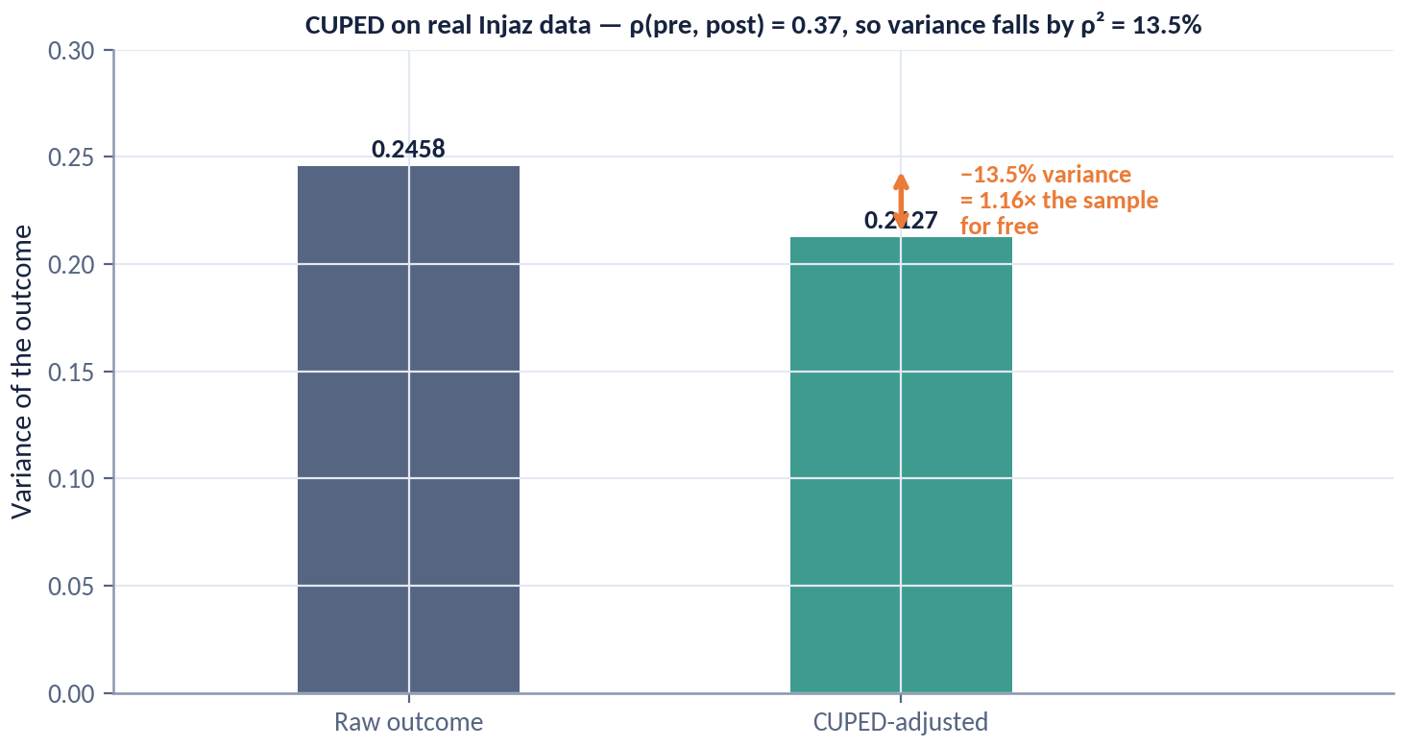
DAY 2 · HOUR 3
CUPED on Real Injaz Data
The pre-experiment completion rate correlates 0.37 with the post-period outcome. Variance falls by ρ² — and the sample you did not have to collect is free.
THE ONE RULE
The covariate must be measured BEFORE assignment. A pre-period variable cannot be affected by a treatment that had not happened yet, which is the whole safety argument.
Adjust on a post-treatment variable and you are no longer reducing variance — you are removing part of the effect.
ACADEMY OF EXCELLENCE · DAY 2 · REGRESSION
78 / 268
Notes:
4 min · figure; walk it, do not summarise it.
Point first at the correlation, 0.37, a realistic number rather than a textbook one. Second at the variance reduction it buys: about 13.5 percent, roughly 1.16 times the sample for free, not the doubling promised on the previous slide. Say that gap out loud, because it stops them promising a doubling to a product owner. Third at the effect estimate being essentially unchanged while the interval narrows, which is the entire safety argument.
ASK: Is a 13.5 percent variance reduction worth the engineering? Steer to: yes, it is a week of traffic you never have to buy, and it compounds across every future test.
WATCH FOR: someone proposing a post-launch engagement covariate, which silently removes part of the effect.
LINK: Lab 2 step 4 reproduces this comparison.

Slide 79
DAY 2 · HOUR 3
Heterogeneous Effects: Beyond the Average
The ATE hides winners and losers. CATE estimation asks: for whom does the treatment work, and by how much?
Why it matters
Targeting, personalisation, and fairness all require knowing how τ(x) varies across subgroups.
Pre-specify or penalise
Testing many subgroups invites false discoveries; pre-register hypotheses or use methods built for search.
Modern estimators
Causal forests, meta-learners (S/T/X-learners), and doubly-robust learners estimate τ(x) with valid uncertainty.
ACADEMY OF EXCELLENCE · DAY 2 · REGRESSION
79 / 268
Notes:
4 min · the pivot from precision to resolution.
Motivate this with the uploader: a plus 5.0 pp average almost certainly hides a large effect for low digital-literacy users and close to nothing for users who already file confidently. That is exactly the segment a government platform wants to reach, so heterogeneity is a policy question. Separate three things people merge: descriptive subgroup differences, causal effect modification, and the value of a targeting policy. Only the last justifies a rollout decision.
ASK: Which subgroup has the highest completion rate after treatment, and which has the largest treatment effect? Steer to: usually different groups, and only the second should drive targeting.
WATCH FOR: subgroup analysis collapsing into who converts most, the classic targeting error.
LINK: Day 4's policy-learning and fairness material builds on tau of x.

Slide 80
DAY 2 · HOUR 3
Meta-Learners for CATE
A vocabulary of practical estimators you can build on top of any ML model.
S
S-learner
One model with treatment as a feature; predict with T=1 and T=0 and difference. Simple; can under-detect small effects.
T
T-learner
Separate models per arm; difference their predictions. Flexible; can be noisy with imbalanced arms.
X
X-learner
Uses imputed effects and propensity weighting; strong when arms are very unequal in size.
DR
DR / R-learner
Doubly-robust and residual-based learners with better theoretical guarantees for the effect surface.
ACADEMY OF EXCELLENCE · DAY 2 · REGRESSION
80 / 268
Notes:
5 min · vocabulary slide; keep it practical.
Give each learner a failure mode rather than a definition. The S-learner's regulariser shrinks the treatment coefficient toward zero, so the one-to-two pp effects this course lives in get flattened. The T-learner fits two models whose independent noise adds, producing a jagged effect surface. The X-learner exists for the ninety-ten split, which is what a cautious government rollout looks like. DR and R learners are the library default because they come with usable confidence intervals.
ASK: We ramped to five percent of traffic. Which learner, and why? Steer to: the X-learner, because it borrows the large control arm to impute treated effects.
WATCH FOR: assuming better AUC or lower prediction error means a better effect estimate; the target is the difference, not the level.
LINK: doubly-robust estimation returns on Day 3.

Slide 81
DAY 2 · HOUR 3
Guarding Against False Subgroup Findings
Heterogeneity analysis is where credible experiments quietly go wrong.
The garden of forking paths
Enough subgroups guarantee a ‘significant’ one by chance; each looks compelling in isolation.
Discipline
Pre-register a small set of hypotheses; treat the rest as exploratory and correct for multiplicity.
Validate
Confirm promising CATEs in a held-out slice or a follow-up experiment before acting.
ACADEMY OF EXCELLENCE · DAY 2 · REGRESSION
81 / 268
Notes:
4 min · the discipline slide; where credible experiments quietly go wrong.
Make the arithmetic explicit. Twenty independent subgroup tests at five percent give roughly a sixty-four percent chance of at least one significant result, and the winner always arrives with a plausible story attached. Say clearly that the story is not evidence, because it was generated after seeing the number. Then give the protocol they can enforce: a short pre-registered list, everything else labelled exploratory, and a confirmatory follow-up before any targeting rule ships.
ASK: The effect is plus 8 pp in one region and flat elsewhere, and nobody pre-registered region. What do you write? Steer to: an exploratory hypothesis for a follow-up, never a recommendation.
WATCH FOR: but it makes sense offered as a defence; plausibility is what lets false findings survive.
LINK: multiple-testing corrections in Hour 4, and the capstone verdict.

Slide 82
DAY 2 · HOUR 3
Knowledge Check: Adjustment & CATE
Q1
CUPED reduces variance without bias because the adjustment variable is:
A) An outcome B) Post-treatment C) Pre-treatment D) The treatment
Q2
Which learner is designed to handle very unequal arm sizes?
A) S-learner B) T-learner C) X-learner D) OLS
Q3
Reporting the single most significant subgroup out of 20 unplanned tests risks:
A) Underpowering B) Multiplicity / false discovery C) Confounding D) Non-compliance
ACADEMY OF EXCELLENCE · DAY 2 · REGRESSION
82 / 268
Notes:
6 min · knowledge check closing Hour 3.
Q1 is C, pre-treatment, the single fact from CUPED worth remembering; A and B are the exact errors that turn variance reduction into bias. Q2 is C, the X-learner, built for very unequal arms; T tempts because it also fits per arm, but with a tiny treated arm its treated-side model is the noisiest thing in the room. Q3 is B; A is wrong because the problem is too many tests rather than too few units, and C tempts people because confounding is the default explanation for any surprise, yet this design was randomised.
ASK: Would Bonferroni have saved the Q3 analysis? Steer to: only if the family had been declared before looking.
WATCH FOR: answering A on Q1 by confusing the pre-period metric with the outcome; they are one variable at two times.

Slide 83
DAY 2 · HOUR 4
A/B Testing in Production
From hypothesis to decision: power and MDE, sample-size planning, sequential testing and peeking, multiple comparisons, and guardrail metrics.
ACADEMY OF EXCELLENCE · DAY 2
83 / 268
Notes:
1 min · opens Day 2 Hour 4, the most practical hour of the day.
Frame it as the hour where statistics meets an organisation. Everything so far assumed the experiment ran cleanly; this hour covers the decisions taken before launch that determine whether it can, and the failure modes that quietly invalidate results afterwards. Give them the spine so they can navigate: power and MDE, sample size into a date, peeking, multiplicity and guardrails, then the failure catalogue.
ASK: What is the most common reason an A/B test produces an untrustworthy answer in your organisation? Steer to: something decided, or not decided, before launch.
WATCH FOR: an audience expecting more estimator theory; say up front that this hour is deliberately operational.
LINK: Lab 2 implements the power calculation and peeking simulation from this hour.

Slide 84
DAY 2 · HOUR 4
The A/B Testing Lifecycle
A trustworthy experiment is decided mostly before it launches.
1
Hypothesis & metric
A directional, pre-registered claim on one primary metric, with guardrails named up front.
2
Power & sample size
Fix α, target power, and the minimum detectable effect; compute the required n and runtime.
3
Randomize & instrument
Assign at the right unit, verify the split (A/A test), and log clean exposure and outcome data.
4
Analyse & decide
Estimate with valid inference at the pre-set horizon; check guardrails; ship, iterate, or stop.
ACADEMY OF EXCELLENCE · DAY 2 · A/B TESTING
84 / 268
Notes:
3 min · the map for the hour.
Use this to place the failure modes, not to describe a process everyone recognises. The claim is that steps one and two decide whether step four can be honest, and that almost every disaster later in this hour is a step-one or step-two omission surfacing weeks later. Point out that the A/A test in step three is the cheapest insurance in the lifecycle, catching broken assignment and exposure logging before a decision depends on them.
ASK: Which of the four steps is most often skipped? Steer to: the guardrails in step one, usually named only after something regresses in production.
WATCH FOR: teams treating pre-registration as bureaucracy; reframe it as what makes their result defensible to an auditor.
LINK: Lab 2 walks these steps in order; the capstone repeats them on the autofill test.

Slide 85
DAY 2 · HOUR 4
Power, MDE & Sample Size
Four quantities are locked together; choose three and the fourth follows.
SCALING LAW
n ∝ 1/δ²
The quartet
Significance α, power 1−β, minimum detectable effect (MDE), and sample size n move as one system.
MDE intuition
Detecting effects half as large costs about four times the sample. This is why chasing tiny lifts is so expensive — and why variance reduction pays.
MDE ≈ (z_{α/2}+z_{β})·σ·√(1/n₁ + 1/n₀). Halving the MDE roughly quadruples the required n.
Plan before you run
Decide the horizon in advance; an underpowered test that ‘finds nothing’ is uninformative, not reassuring.
ACADEMY OF EXCELLENCE · DAY 2 · A/B TESTING
85 / 268
Notes:
4 min · the core planning slide.
The teaching point is the word locked. Product owners believe all four quantities are negotiable at once; they are not, and your job is to make the trade visible in the room. Use the Injaz numbers rather than symbols: at a 55 percent baseline, five percent significance and eighty percent power, plus 2.0 pp needs about 9,700 per arm, plus 1.0 pp about 38,800, plus 0.5 pp about 155,000. Then say that an underpowered test which finds nothing has told you nothing.
ASK: We have 20,000 users a week and want an answer in two weeks. What MDE can we honestly promise? Steer to: work backwards from n to MDE and state it before launch.
WATCH FOR: let us just run it and see, which is how underpowered tests get relabelled exploratory.
LINK: the next three figures make the scaling and runtime concrete.

Slide 86
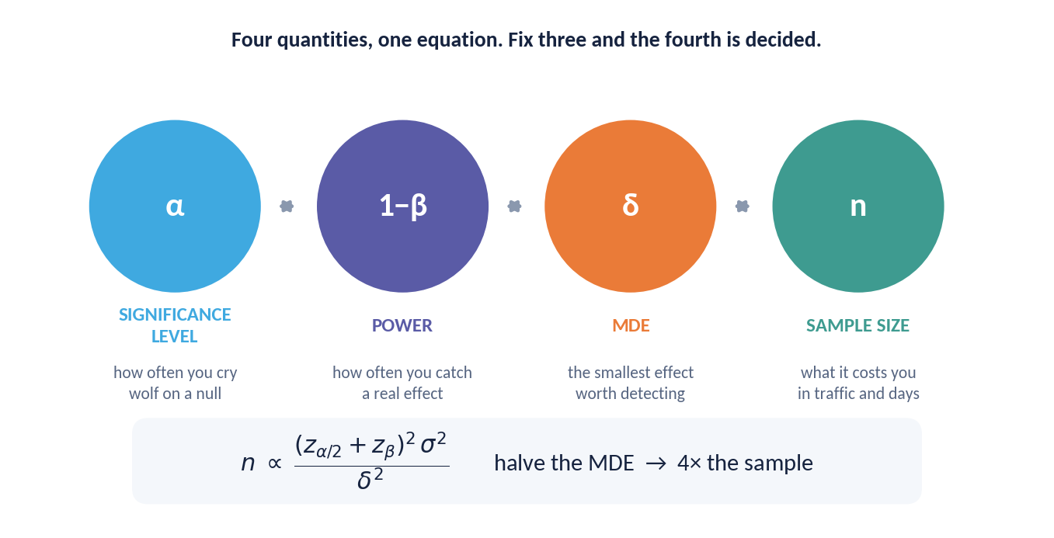
DAY 2 · HOUR 4
Four Quantities, One Equation
Significance, power, minimum detectable effect and sample size are bound together. Fix any three and the fourth is no longer yours to choose.
THE ASYMMETRY
The relationship is quadratic in the MDE and only linear in the rest.
That is why ambition is the expensive knob: halving the effect you want to detect quadruples the traffic you need. Negotiate the MDE early, in the room, with the product owner present.
ACADEMY OF EXCELLENCE · DAY 2 · A/B TESTING
86 / 268
Notes:
3 min · figure; a diagram, not a chart to read values from.
Point first at the four nodes and say you may fix any three. Second at the MDE term, which enters squared while significance and power enter only through z-values, so ambition is the expensive knob. Third at sigma in the numerator, because that is exactly where CUPED buys sample size. Freeze on the panel: the MDE conversation belongs in the room with the product owner before launch, not in the readout afterwards.
ASK: If the product owner insists on detecting half the effect, what may you offer in exchange? Steer to: four times the traffic, longer runtime, lower power, or a smaller sigma through CUPED.
WATCH FOR: buying precision by raising alpha, which trades away a false-positive risk they will own later.
LINK: the sample-size curve on the next figure.

Slide 87
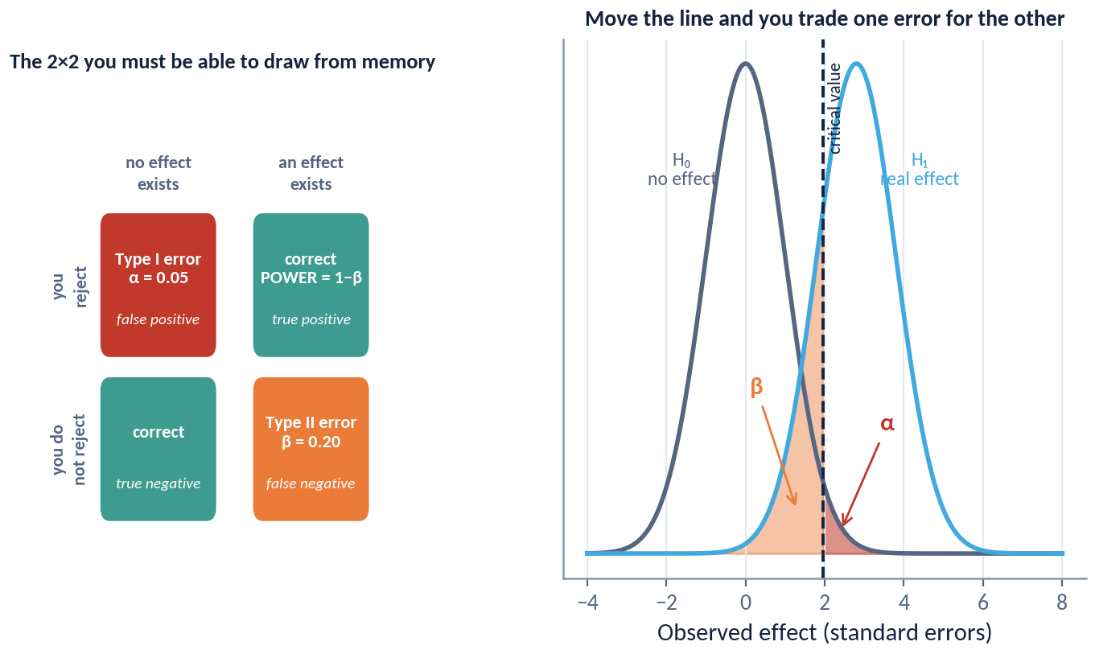
DAY 2 · HOUR 4
Type I, Type II, and What Power Actually Is
Two error types, one threshold, and a trade you cannot escape — only place deliberately.
SAY IT PRECISELY
'This test is 80% powered' is an incomplete sentence. Power is always power AGAINST A SPECIFIC EFFECT SIZE.
Moving the critical value does not reduce error; it moves error from one cell of the table to the other. Which error costs more is a business question, not a statistical one.
ACADEMY OF EXCELLENCE · DAY 2 · A/B TESTING
87 / 268
Notes:
3 min · figure; the two-by-two error table.
Walk the four cells and name each in context: shipping a feature that does nothing, missing a real plus 2 pp improvement, and the two correct decisions. Point second at the threshold and show that sliding it moves probability between the error cells rather than reducing error. Freeze on the panel, because eighty percent powered is an incomplete sentence, and asking powered against what is the fastest way to expose an unplanned test.
ASK: Which error costs more for the uploader rollout, shipping a null feature or missing a real one? Steer to: it depends on the cost of the change, and that judgement belongs to the business.
WATCH FOR: treating alpha of 0.05 and power of 0.8 as laws; they are conventions to be argued per test.
LINK: the multiplicity slide, where the same alpha is spent many times.

Slide 88
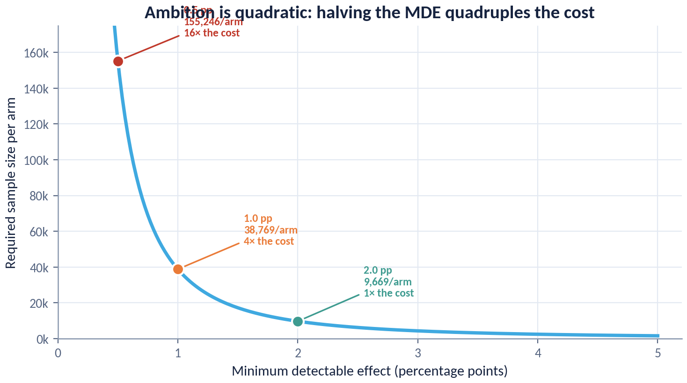
DAY 2 · HOUR 4
Ambition Is Quadratic
Required sample per arm against the minimum detectable effect, at a 55% baseline, 5% significance and 80% power.
THE THREE POINTS
2.0 pp costs roughly 9,700 per arm. 1.0 pp costs four times that. 0.5 pp costs sixteen times.
Print this and put it on the wall. It ends the 'can we just detect a small improvement too?' conversation in about ten seconds.
ACADEMY OF EXCELLENCE · DAY 2 · A/B TESTING
88 / 268
Notes:
4 min · figure; the most quotable chart in the day.
Point first at 2.0 pp, about 9,700 per arm, a test Injaz can run in roughly a week. Second at 1.0 pp, four times that at about 38,800. Third at 0.5 pp, sixteen times, about 155,000 per arm, which for most services is not a test but a proposal. Let the curve's shape argue before you say anything, then read the panel line about ending the conversation in ten seconds.
ASK: A stakeholder wants 0.5 pp instead of 2.0 pp. What is the honest answer? Steer to: sixteen times the sample, so either accept a much longer runtime or change the question.
WATCH FOR: reading the curve as a soft trade-off; it is quadratic and intuition underestimates the cost.
LINK: the runtime figure next turns these numbers into dates.

Slide 89
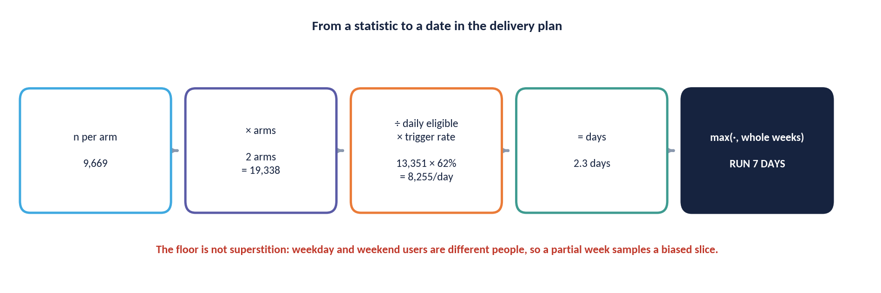
DAY 2 · HOUR 4
From a Sample Size to a Date
A number of users is not a plan. Four multiplications turn it into a commitment the delivery team can hold you to.
THE FLOOR — Round up to whole weeks. Weekday and weekend users are different people with different completion rates, so stopping mid-week samples a biased slice of the population.
ACADEMY OF EXCELLENCE · DAY 2 · A/B TESTING
89 / 268
Notes:
3 min · figure; the operational translation of a sample size.
Walk the chain: required n per arm, times two arms, divided by daily eligible traffic, divided by the fraction actually exposed. The forgotten step is the last one. In the uploader test only 62 percent of assigned users ever trigger the feature, so the exposed denominator is far smaller and the runtime correspondingly longer. Then defend the floor: round up to whole weeks, because weekday and weekend users differ and stopping on a Wednesday hands you a biased slice.
ASK: 9,700 per arm and 4,000 eligible users a day. What date do you commit to? Steer to: about five days of traffic, which rounds up to one full week.
WATCH FOR: dividing by total platform traffic rather than eligible and exposed traffic, which understates runtime badly.
LINK: the same trigger-rate dilution reappears in Lab 2.

Slide 90
DAY 2 · HOUR 4
The Peeking Problem
Repeatedly checking a fixed-horizon test and stopping at the first ‘significant’ moment inflates the false-positive rate dramatically.
THE FIX
Use methods designed for continuous monitoring: sequential tests, alpha-spending / group-sequential boundaries, or always-valid confidence sequences.
Why it happens
Each look is another chance for noise to cross the threshold; the nominal 5% becomes far higher with continuous monitoring.
The scale of it
Unrestricted peeking can push the true false-positive rate from 5% to 20–30% or more.
Do not ‘stop when green’
A fixed-horizon p-value is only valid at the pre-planned sample size, checked once.
ACADEMY OF EXCELLENCE · DAY 2 · A/B TESTING
90 / 268
Notes:
4 min · the ethics-of-procedure slide.
State it as a property of the procedure, not the person: an analyst who looks daily and stops at the first green result has changed the test, because the nominal five percent was a promise about one look at a pre-declared sample size. Preview the numbers so the next figure lands: under a true null the course simulations give five percent at one look, nine at two, fourteen at five, nineteen at ten and twenty-five at twenty looks. The fix is not to stop looking but to use inference designed for looking.
ASK: Is it acceptable to monitor daily for guardrail breaches? Steer to: yes, monitoring for harm is a different decision from stopping for a win.
WATCH FOR: the belief that peeking only costs power; it inflates the false-positive rate directly.
LINK: the peeking figure next, and Lab 2 steps 5 and 6.

Slide 91
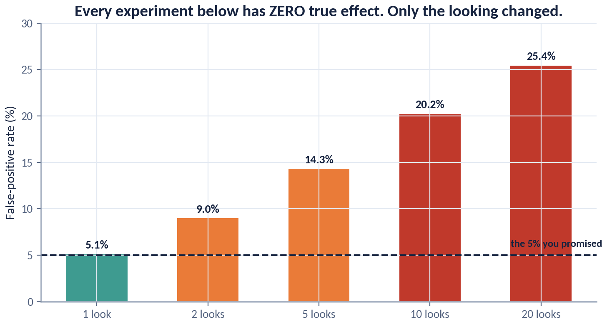
DAY 2 · HOUR 4
What Peeking Costs You
Two thousand simulated experiments, every one of them with a true effect of exactly zero. The only thing that changes between bars is how often someone looked.
NO EFFECT EXISTS
Every 'significant' result on this chart is false. At twenty looks, one experiment in four declares a winner that does not exist.
This is not a warning about impatience. It is arithmetic: each look is another chance to cross the line, and the 5% you promised was for ONE look.
ACADEMY OF EXCELLENCE · DAY 2 · A/B TESTING
91 / 268
Notes:
4 min · figure; the emotional centre of the hour.
Say the setup before pointing anywhere: two thousand simulated experiments, every one with a true effect of exactly zero. Point at the one-look bar at five percent, then walk right through nine, fourteen, nineteen and twenty-five percent at twenty looks. Freeze there and say it plainly, that every significant result on this chart is false and one experiment in four has declared a winner that does not exist. Repeat the panel line: this is arithmetic, not impatience.
ASK: Your team has a live dashboard anyone can open. What is the real mitigation? Steer to: pre-committing the decision rule and putting always-valid intervals on the dashboard.
WATCH FOR: our effects are real so this does not apply; under a true effect peeking biases the estimate upward instead.
LINK: Lab 2 step 5 reproduces these numbers.

Slide 92
DAY 2 · HOUR 4
Valid Ways to Look Early
You can monitor continuously — with the right machinery.
01
Group-sequential / alpha spending
Pre-plan a few interim looks and spend the error budget across them (O'Brien–Fleming, Pocock).
02
Sequential probability ratio (SPRT)
Accumulate evidence and stop when a likelihood-ratio boundary is crossed — efficient for early stops.
03
Always-valid inference
Confidence sequences / e-values remain valid under continuous peeking at any stopping time.
04
Bayesian monitoring
Track the posterior and decision loss; valid if priors and the decision rule are set in advance.
ACADEMY OF EXCELLENCE · DAY 2 · A/B TESTING
92 / 268
Notes:
3 min · the constructive answer after the scare.
The framing that helps is a budget: alpha is a fixed five percent you may spend across looks however you pre-commit. Group-sequential spends it at a few planned interims and suits regulated or slow-moving rollouts. SPRT and always-valid confidence sequences let you look continuously at the cost of wider intervals, and naming that cost is the honest part. Bayesian monitoring is valid when the prior and the decision loss are fixed in advance, which is the step teams skip.
ASK: Which fits a dashboard anyone can refresh at any moment? Steer to: always-valid confidence sequences, because validity holds at any stopping time including an unplanned one.
WATCH FOR: the idea that sequential methods are free; they buy early stopping by widening the interval at every look.
LINK: Lab 2 step 6 returns the error rate to nominal.

Slide 93
DAY 2 · HOUR 4
Multiple Testing & Guardrails
Many metrics, many variants, many segments — each comparison is a fresh chance for a false positive.
Control the error rate
Bonferroni for strict family-wise control; Benjamini–Hochberg to control the false discovery rate when tests are many.
One primary metric
Pre-designate a single decision metric; everything else is secondary or guardrail, not a second bite at the apple.
Guardrail metrics
Latency, revenue, error rate, complaints — a winning primary metric does not ship if a guardrail degrades.
ACADEMY OF EXCELLENCE · DAY 2 · A/B TESTING
93 / 268
Notes:
3 min · connects Hour 3's subgroup discipline to production practice.
The useful distinction is between the two error rates. Bonferroni controls the chance of any false positive, which is what you want when one false claim would be costly, such as a public statement. Benjamini-Hochberg controls the expected share of false positives among discoveries, which suits screening many metrics. Then make guardrails operational: a guardrail is not a metric you hope stays flat, it is a metric with a pre-agreed threshold that blocks a ship decision even when the primary wins.
ASK: Latency regresses forty milliseconds while completions rise two pp. Who decides? Steer to: the decision belonged in the analysis plan before launch.
WATCH FOR: promoting a secondary metric to primary after the fact because the primary came out flat.
LINK: the correction-family figure next, and the capstone verdict.

Slide 94
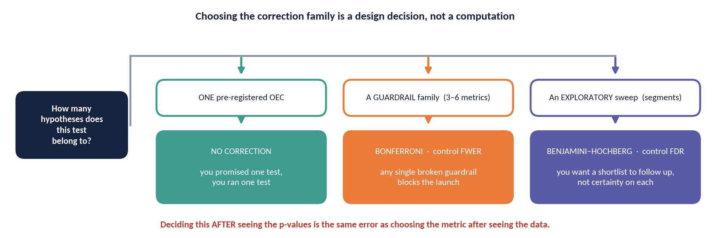
DAY 2 · HOUR 4
Choosing the Correction Family
Bonferroni or Benjamini–Hochberg is not a preference. It follows from what kind of question the test belongs to.
DECIDE FIRST — The family is part of the frozen analysis plan.
ACADEMY OF EXCELLENCE · DAY 2 · A/B TESTING
94 / 268
Notes:
3 min · figure; a decision aid rather than a formula.
Point first at the branch question, which is what kind of claim this family of tests supports. Second at the family-wise branch, naming a real case: a small confirmatory set where one false claim would be published or acted on, so Bonferroni's strictness is the right price. Third at the false-discovery branch, dozens of exploratory metrics screened for the next experiment, where Bonferroni leaves no power at all. Freeze on the panel: the family belongs in the frozen analysis plan.
ASK: We track sixty metrics on every test. Bonferroni across all sixty? Steer to: no, one primary, a few guardrails, and Benjamini-Hochberg over the exploratory remainder.
WATCH FOR: correcting metrics that were never going to drive a decision, which only hides real effects.
LINK: the subgroup discipline slide in Hour 3.

Slide 95
DAY 2 · HOUR 4
A Field Guide to A/B Test Failure Modes
The defects that turn confident ‘wins’ into losses in production.
Sample-ratio mismatch — the arms are not split as intended, signalling a broken assignment or logging pipeline.
Peeking / early stopping — monitoring a fixed-horizon test and stopping on the first green.
Interference — treated units affect control units (marketplaces, social graphs), biasing the contrast.
Novelty & primacy effects — short-term reactions that fade, so a two-day lift misrepresents the steady state.
Simpson's paradox — an aggregate result reverses within every segment because of shifting mix.
Winner's curse — the shipped variant's true effect is smaller than the estimate that got it shipped.
ACADEMY OF EXCELLENCE · DAY 2 · A/B TESTING
95 / 268
Notes:
3 min · the checklist participants will photograph.
Do not read six bullets; assign weight. Sample-ratio mismatch and peeking invalidate a result outright and each gets its own treatment here. Interference matters most for Injaz features touching shared queues or household accounts. Novelty explains why a two-day lift is not a result, since a change to a familiar government form generates curiosity traffic that decays. Simpson's paradox and the winner's curse are both mix problems, and the second explains why shipped effects routinely underperform their estimate.
ASK: Which of these six would your current review process actually catch? Steer to: usually only SRM, and only if someone checks the split.
WATCH FOR: interference dismissed as a marketplace-only concern; shared-resource and referral effects occur in government services too.
LINK: the SRM figure next; winner's curse returns on Day 4.

Slide 96
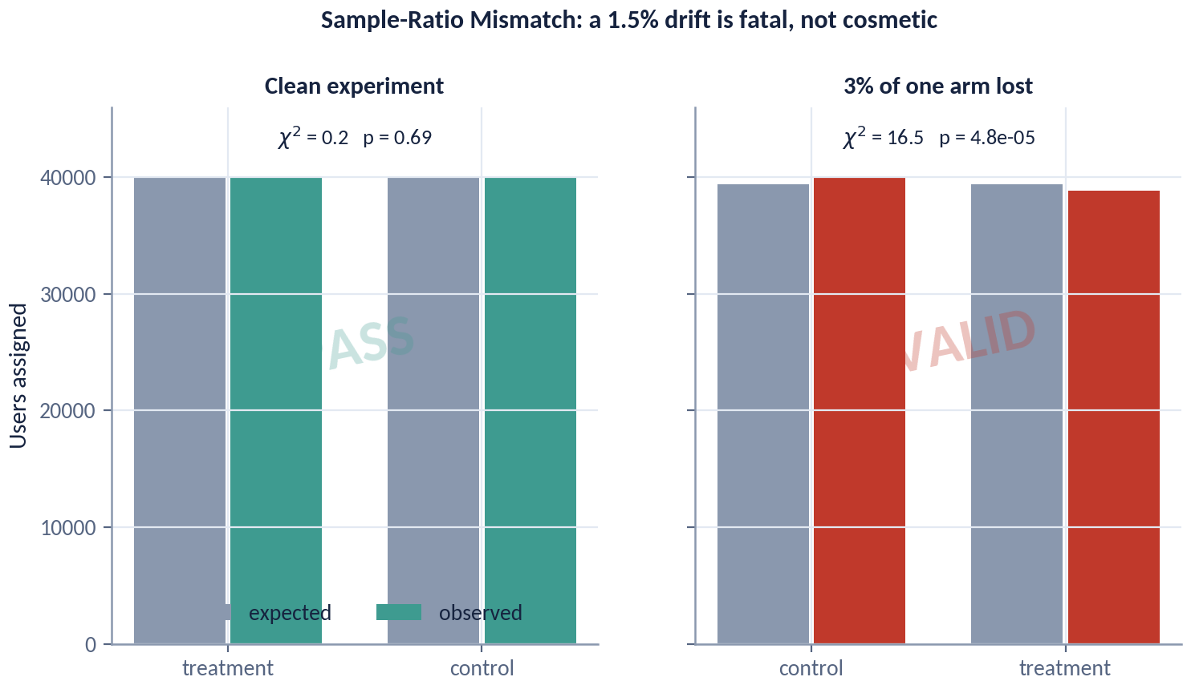
DAY 2 · HOUR 4
Sample-Ratio Mismatch: the Go / No-Go Gate
The same Injaz experiment, before and after 3% of one arm is silently lost to a logging bug.
NOT A ROUNDING ERROR
A 1.5% drift produces p ≈ 3 × 10⁻⁵. Units did not go missing at random, so the comparison is no longer a randomised one.
The correct response is never 'adjust and continue'. It is: find the bug, fix it, rerun. An experiment that fails SRM must be reported as invalid, not as a result.
ACADEMY OF EXCELLENCE · DAY 2 · A/B TESTING
96 / 268
Notes:
4 min · figure; the go/no-go gate of the hour.
Walk it in three moves. First the healthy panel, where the split sits at the intended ratio and the chi-square is unremarkable. Second the damaged panel, where three percent of one arm was lost to a logging bug and the observed share drifts about 1.5 percent, which looks like nothing. Third the statistic: chi-square about 16.5, p about five times ten to the minus five. The gap between how small it looks and how impossible it is under random assignment is the whole lesson.
ASK: The arms come out 50.8 to 49.2 on two million users. Ship or stop? Steer to: run the test, because at that size even small drift is decisive evidence.
WATCH FOR: the instinct to reweight the arms and continue; the missing users are selected, so no adjustment restores randomisation.
LINK: Lab 2 step 3 runs this check.

Slide 97
DAY 2 · HOUR 4
Knowledge Check: Production A/B
Q1
Halving the minimum detectable effect changes required sample size by roughly:
A) ×2 B) ×4 C) ÷2 D) no change
Q2
You want to monitor continuously and stop early when justified. Use:
A) Fixed-horizon p B) Always-valid / sequential C) Larger α D) Peeking
Q3
The arms come out 55/45 instead of 50/50. This is a:
A) Guardrail win B) Sample-ratio mismatch C) Novelty effect D) Power gain
ACADEMY OF EXCELLENCE · DAY 2 · A/B TESTING
97 / 268
Notes:
5 min · knowledge check closing Hour 4.
Q1 is B, roughly four times, because n scales with one over the squared effect, the 9,700 to 38,800 jump on the earlier figure; A is the linear guess and is why this question exists. Q2 is B; A is exactly the invalid procedure, C trades away the error rate they promised, and D names the problem as a solution. Q3 is B, sample-ratio mismatch; C tempts because novelty is the other explanation people reach for when numbers look odd, yet novelty affects outcomes rather than the split.
ASK: What is the first thing you do after detecting SRM? Steer to: stop and find the bug, because the experiment is invalid rather than adjustable.
WATCH FOR: answering A on Q1 from linear intuition; send them back to the figure rather than correcting directly.

Slide 98
DAY 2 · HOUR 5
Lab 2 & Discussion
Design, run on simulated traffic, and analyse a complete A/B test — including the failure modes that catch practitioners out.
ACADEMY OF EXCELLENCE · DAY 2
98 / 268
Notes:
1 min · opens Day 2 Hour 5.
Keep this to a sentence and move. The lab is deliberately end to end rather than a single technique: they plan a test, simulate its traffic, analyse it correctly, then break it twice on purpose. The last two steps are the point, because watching their own peeking simulation climb is far more persuasive than any slide you can show them.
ASK: Before we start, what must be fixed before any data are generated? Steer to: the analysis plan, meaning alpha, power, MDE, the primary metric and the horizon.
WATCH FOR: participants jumping to step four because estimation feels like the real work; the planning steps are what this lab tests.
LINK: the lab2 notebook in course_assets, with helpers in causal_utils.

Slide 99
DAY 2 · HANDS-ON LAB 2
An A/B Test, End to End
STEPS
OBJECTIVE
Set α, power, and MDE; compute required n and expected runtime for a conversion metric.
1
Plan an experiment with a real power calculation, simulate its traffic, estimate the effect with valid inference, and demonstrate why peeking and CUPED matter.
2
Simulate a data-generating process with a pre-period covariate correlated with the outcome.
3
Run an A/A test to confirm the pipeline and check sample-ratio balance.
DELIVERABLE
4
Estimate the effect two ways: simple difference and CUPED-adjusted; compare the SEs.
A notebook containing a power/MDE plan, an A/A sanity check, a CUPED-adjusted effect with a robust SE, and a peeking simulation quantifying inflated error.
5
Simulate 1,000 experiments with daily peeking; measure the realised false-positive rate.
6
Repeat under an always-valid boundary; show the error rate return to nominal.
ACADEMY OF EXCELLENCE · DAY 2 · LAB
99 / 268
Notes:
5 min · brief the lab, then release the room.
Read the deliverable rather than the steps, which are in the notebook. Set expected numbers so groups self-check as they go: the power calculation should land near 9,700 per arm for a 2.0 pp MDE at a 55 percent baseline, CUPED at a correlation near 0.37 should cut variance about 13.5 percent, and daily peeking should push the false-positive rate from five percent toward twenty or twenty-five. Tell them the A/A step is not a formality, because if it fails nothing downstream is interpretable.
ASK: What will you do if your A/A test comes back significant? Steer to: check split and simulation logic, but remember one A/A in twenty is significant by chance, so repeat first.
WATCH FOR: teams reporting the CUPED point estimate as an improvement; CUPED moves the interval, not the effect.
LINK: the lab2 notebook and the peeking figure.

Slide 100
DAY 2 · HOUR 5
Lab 2 Debrief
Three quantitative takeaways you will carry into every experiment.
CUPED is a free lunch
The adjusted SE is visibly smaller for the same data — real power gained from data you already had.
Peeking is not benign
The naive daily-peek procedure shows a false-positive rate several times the nominal 5%.
Always-valid restores trust
Under the sequential boundary, you keep the ability to stop early without paying in false positives.
ACADEMY OF EXCELLENCE · DAY 2 · LAB
100 / 268
Notes:
4 min · debrief; collect numbers from the room before you talk.
Ask two or three groups for their CUPED standard errors and realised peeking rates and put them on the board, because the spread across groups is itself instructive. Then land the takeaways with real magnitudes: about 13.5 percent variance reduction from a correlation of 0.37, roughly 1.16 times the sample for free; a daily-peeking false-positive rate near twenty percent at ten looks; and nominal error restored under the sequential boundary at the price of a wider interval.
ASK: Which of the three would change something in your team next week? Steer to: CUPED, because it is a data-engineering task with no statistical negotiation.
WATCH FOR: groups whose peeking rate came out near five percent, which usually means they peeked but never stopped early.
LINK: the capstone, where both techniques reappear.

Slide 101
DAY 2 · HOUR 5
Discussion: Auditing an Experiment
In groups, you receive a one-page ‘experiment report’ and must find the flaws.
Is the randomization unit right for the interference structure?
Was the horizon pre-set, or does the analysis smell of peeking?
Is the primary metric singular, and are guardrails reported?
Do the standard errors match the design (robust / clustered)?
Are subgroup claims pre-registered or fished?
ACADEMY OF EXCELLENCE · DAY 2 · DISCUSSION
101 / 268
Notes:
8 min · group discussion; the last teaching block of Day 2.
Run it as a timed audit: five minutes in groups, then one flaw per group so nobody repeats. The report is seeded with defects matching the five prompts, so let groups find them. The two most often missed are the standard-error mismatch, session-level errors reported for a user-level randomisation, which on course data is 0.00166 against 0.00267 and so 1.6 times too narrow, and unregistered subgroup claims wrapped in a plausible story.
ASK: Which single flaw would you refuse to sign off on? Steer to: SRM or a peeked stop, because both make the result invalid rather than merely weak.
WATCH FOR: groups grading writing quality instead of validity; redirect them to the five prompts.
LINK: the failure-mode field guide in Hour 4.

Slide 102
DAY 2 · WRAP
Day 2 in One Slide
You can now run a defensible experiment from design to decision.
TOMORROW
Day 3: when you cannot randomize — confounding, DAGs, matching/propensity/IPW, and quasi-experiments (DiD, synthetic control, IV, RDD).
Design decides validity
Randomization unit, scheme, and blocking set the credibility and precision before any data arrive.
Inference must match design
Randomization and design-based methods give honest uncertainty; robust/clustered SEs are the default.
Adjust and reduce variance
Pre-treatment covariates and CUPED sharpen estimates without bias; CATE reveals for-whom effects.
Production discipline
Power/MDE up front, no peeking without valid methods, control multiplicity, protect guardrails.
ACADEMY OF EXCELLENCE · DAY 2 · SUMMARY
102 / 268
Notes:
3 min · closes Day 2.
Recap by decision rather than topic. The four boxes are four questions they can now answer in any design review: what is the randomization unit, does the standard error match it, can we buy precision from pre-period data, and was the horizon fixed before launch. If a team answers those four honestly, most of Hour 4's failure modes cannot survive review. Then set up tomorrow: everything today rested on an assignment mechanism you controlled, and that guarantee now disappears.
ASK: Which single practice from today would most have improved your last experiment? Steer to: usually the pre-registered horizon, because it is free and forecloses peeking.
WATCH FOR: participants leaving with CUPED as the headline; the headline is that design determines validity and inference must match design.
LINK: Day 3 opens with confounding and DAGs.

Slide 103
DAY 3
Observational Data & Quasi-Experiments
Confounding and DAGs, adjustment via matching / propensity / IPW / doubly-robust, and the four workhorse quasi-experimental designs.
ACADEMY OF EXCELLENCE · DAY 3
103 / 268
Notes:
1 min · Day 3 title slide.
Mark the change of regime in one sentence: for two days randomisation did the identification work for free, and from here on you argue for it. Day 3 is not a bag of tricks but one question asked four ways, namely what would have happened to these units without the treatment, and every method today is a different bet about where to find that counterfactual.
ASK: What did randomisation actually give us that we now have to reconstruct? Steer to: balance on everything, measured and unmeasured alike.
WATCH FOR: an expectation that observational methods are second class; they are the only option for most policy questions, which is why the standard of argument must be higher.
LINK: the Injaz training-programme and regional-rollout datasets carry today's examples.

Slide 104
DAY 3 · OVERVIEW
Today's Five Hours
01
Hour 1 — Confounding & DAGs
02
Hour 2 — Adjustment Estimators
Backdoor criterion, colliders, and choosing an adjustment set that identifies the effect.
Regression, matching, propensity scores, IPW, and doubly-robust estimation.
03
Hour 3 — Difference-in-Differences
04
Hour 4 — IV & RDD
Parallel trends, two-way fixed effects, event studies, and synthetic control.
Instrumental variables, LATE, and sharp/fuzzy regression discontinuity.
05
Hour 5 — Lab 3 & Discussion
Estimate an effect four ways on the same observational dataset and reconcile them.
ACADEMY OF EXCELLENCE · DAY 3
104 / 268
Notes:
2 min · agenda slide; place the day, then move on.
Give each hour a one-line purpose rather than reading the list. Hour 1 decides what to adjust for, Hour 2 does the adjusting, and Hours 3 and 4 stop adjusting altogether and exploit timing or thresholds instead. Plant the real dividing line now: Hours 1 and 2 assume you have measured the confounders, while Hours 3 and 4 are designs for when you have not.
ASK: Which hour would you reach for if the confounder you care about cannot be measured at all? Steer to: Hour 3 or 4, because DiD, synthetic control, IV and RDD sidestep measurement rather than requiring it.
WATCH FOR: reading the list as increasing sophistication; these are different bets, not a ladder.
LINK: Lab 3 estimates one effect four ways and reconciles the differences.

Slide 105
DAY 3 · HOUR 1
The Observational Challenge
Without randomization, treatment and control differ for reasons other than treatment. Our whole task is to reconstruct the missing balance.
FRAMING
An observational study is an experiment you did not run. The methods below are attempts to recover, from data, the balance that randomization would have given for free.
The core threat
Confounding — common causes of treatment and outcome — makes the naive comparison a biased estimate of the effect.
The identification bet
We assume unconfoundedness given a covariate set X, then adjust. The bet is that X blocks every backdoor.
The honesty tax
Because unconfoundedness is untestable, every observational estimate must be paired with a sensitivity analysis (Day 4).
ACADEMY OF EXCELLENCE · DAY 3 · CONFOUNDING
105 / 268
Notes:
3 min · sets the frame for the whole day.
Make the training programme concrete before any theory. In the Injaz data the naive enrolled versus not-enrolled difference is plus 11.5 pp while the true effect on the treated is plus 6.0 pp, so roughly five points of the headline is selection: motivated users enrol and would have improved anyway. Then name the honesty tax. Unconfoundedness is untestable, so an observational estimate without a sensitivity analysis is an incomplete deliverable rather than a finished one.
ASK: What would have to be true about the covariates for the naive comparison to be correct? Steer to: every common cause of enrolling and improving is measured and adjusted for.
WATCH FOR: we have hundreds of features so we are fine; unconfoundedness is about the right variables, not many of them.
LINK: matching recovers plus 6.5 pp in Lab 3; sensitivity analysis is Day 4.

Slide 106
DAY 3 · HOUR 1
DAGs: Drawing Your Assumptions
A causal diagram makes your beliefs about the data-generating process explicit — and tells you exactly what to adjust for.
Nodes and arrows
Variables are nodes; a directed arrow X→Y encodes ‘X can directly cause Y’. Absence of an arrow is also an assumption.
Paths carry association
Association flows along paths; causal paths (T→…→Y) are what we want, backdoor paths are what we must block.
The payoff
The graph turns ‘which controls?’ from guesswork into a rule you can check.
ACADEMY OF EXCELLENCE · DAY 3 · CONFOUNDING
106 / 268
Notes:
3 min · introduces the tool.
The selling point for data scientists is that a DAG converts an argument about controls into a rule anyone can check. Emphasise the line that is easy to skip, that the absent arrows are the assumptions. Anyone can draw a graph with every arrow present, so the content lies in what you rule out, and that is a domain claim you must defend. A DAG is not fitted from data, which is why it belongs in the analysis plan and is reviewed by someone who knows the service.
ASK: Who in your organisation is qualified to say an arrow does not exist? Steer to: the operational owner of the service, not the analyst.
WATCH FOR: attempts to learn the DAG from data; causal discovery has uses, but identification does not rest on it here.
LINK: the Injaz uploader DAG appears in full later this hour.

Slide 107
DAY 3 · HOUR 1
Three Elementary Structures
Every DAG is built from three junction types, each behaving differently under conditioning.
→
Chain (mediator): T → M → Y
M transmits the effect. Conditioning on M blocks part of the causal effect — usually do not adjust.
‹
Fork (confounder): T ← X → Y
X is a common cause and opens a backdoor. Conditioning on X blocks the bias — adjust.
›
Collider: T → C ← Y
C is a common effect; the path is blocked by default. Conditioning on C opens spurious association — do not adjust.
ACADEMY OF EXCELLENCE · DAY 3 · CONFOUNDING
107 / 268
Notes:
4 min · the mechanical core of the hour.
Spend the time here, because everything later depends on these rules being automatic. Give each a concrete Injaz reading. Digital literacy is a fork causing both uploader use and completion, so adjust. Support calls sit between uploader and completion as a chain, so adjusting removes part of the effect. Session completion is a common effect of both, so adjusting opens a closed path. Repeat the inversion until it sticks.
ASK: Which of the three do you block by doing nothing at all? Steer to: the collider, where inaction is the correct action.
WATCH FOR: the instinct that more controls can only help, which is right for prediction and wrong for causal estimation.
LINK: the junctions figure next, and the collider demonstration later this hour.

Slide 108
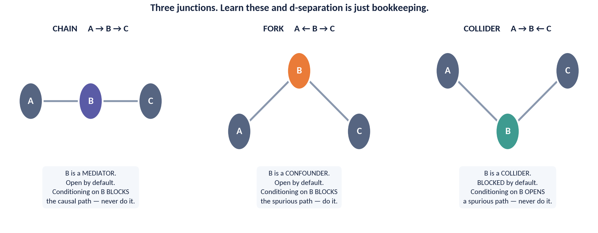
DAY 3 · HOUR 1
The Three Junctions
Every path in every DAG is built from these three shapes. Learn the conditioning rule for each and d-separation becomes bookkeeping.
THE INVERSION — Chains and forks are OPEN until you condition; colliders are BLOCKED until you condition.
ACADEMY OF EXCELLENCE · DAY 3 · CONFOUNDING
108 / 268
Notes:
4 min · figure; three panels, one rule each.
Walk left to right and give the conditioning verdict before the mechanism, because the verdict is what they need in a meeting. Chain: open, do not adjust, or you remove effect. Fork: open, adjust, and you remove bias. Collider: already blocked, do not adjust, or you create bias. Then point at the inversion line and have them repeat it, since that sentence makes d-separation mechanical. A real graph is only these shapes chained together.
ASK: A path runs through a collider you have not conditioned on. Is it carrying association? Steer to: no, it is blocked and needs no action.
WATCH FOR: colliders read as variables to avoid; the collider is harmless, conditioning on it is the error.
LINK: the backdoor criterion next formalises all three cases.

Slide 109
DAY 3 · HOUR 1
The Backdoor Criterion
A precise rule for choosing an adjustment set that identifies the causal effect of T on Y.
THE RULE
Backdoor
Block all backdoor paths
A backdoor path starts with an arrow into T. A valid adjustment set blocks every such path.
Open no colliders
Find a set Z that (1) blocks every backdoor path from T to Y and (2) contains no descendant of T. Then adjusting for Z identifies the effect.
The set must not condition on a collider (or its descendant) that would open a new spurious path.
Include no descendants of T
Never adjust for anything caused by treatment — that risks mediator or collider bias.
ACADEMY OF EXCELLENCE · DAY 3 · CONFOUNDING
109 / 268
Notes:
4 min · the rule the rest of the day depends on.
Present it as a procedure a reviewer can run, not a theorem. Define a backdoor path physically, one that leaves treatment against the arrow, and note that only those carry confounding. The second condition is the one people violate: no descendants of treatment, which rules out mediators and anything measured after treatment began. Say honestly that the criterion is sufficient rather than necessary, but that failing it is a reason to redraw the graph.
ASK: Is age a valid adjustment for the uploader question? Steer to: only if it causes both uptake and completion and is not a descendant of treatment, so draw it before answering.
WATCH FOR: adjust for everything pre-treatment offered as a safe default; pre-treatment colliders and instruments both do damage.
LINK: the derived Injaz adjustment set on the next slide.

Slide 110
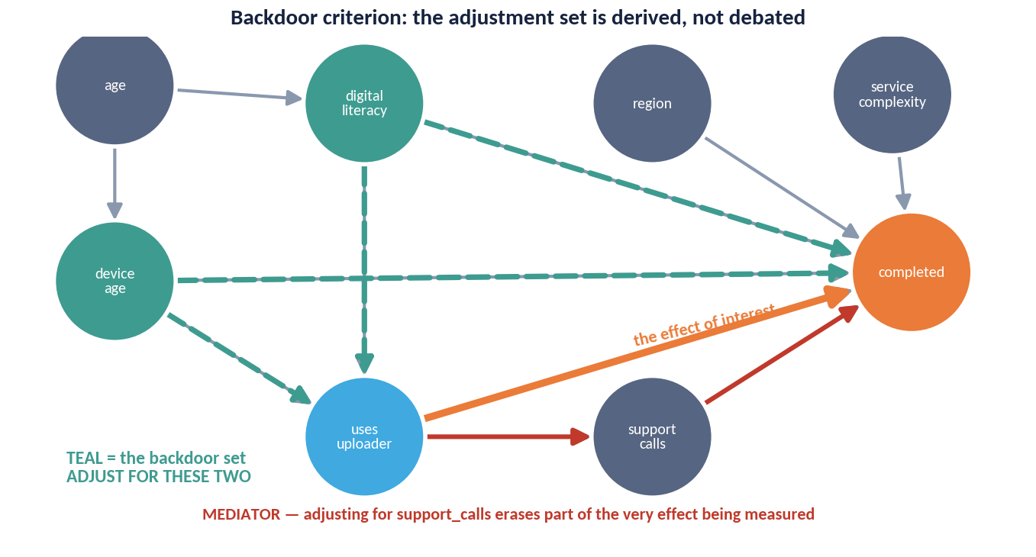
DAY 3 · HOUR 1
Deriving the Adjustment Set
The defended graph for the Injaz uploader question, with every backdoor path traced and the adjustment set derived rather than argued about.
TWO IN, ONE OUT
Digital literacy and device age block every backdoor path — that is the whole adjustment set.
Support calls is a MEDIATOR: it sits on the causal path. Controlling for it removes part of the very effect being measured, and it is the single most common bad control in practice.
ACADEMY OF EXCELLENCE · DAY 3 · CONFOUNDING
110 / 268
Notes:
4 min · figure; the payoff of the hour.
Trace the graph rather than presenting the answer. Point at treatment and outcome, then walk each backdoor path aloud and show which variable closes it: digital literacy closes one, device age the other, and that exhausts the backdoors, so the minimal adjustment set is exactly those two. Then point at support calls and slow down. It lies on the causal path, so controlling for it removes part of the effect being measured, and it is the most common bad control precisely because it improves model fit.
ASK: Adding support calls raises the R-squared and shrinks the effect. What happened? Steer to: you conditioned away a mechanism rather than improving the estimate.
WATCH FOR: controlling for support calls to isolate a direct effect; that is a different estimand needing mediation methods.
LINK: Lab 3 uses exactly this adjustment set.

Slide 111
DAY 3 · HOUR 1
Collider Bias in the Wild
The most counter-intuitive error: adding a ‘sensible’ control that manufactures a correlation from nothing.
Selection is conditioning
Studying only hospitalised patients, or only funded startups, conditions on a collider — and can invent associations.
The classic example
Among the hospitalised, two independent diseases can appear negatively correlated purely from the selection.
The lesson
‘Control for everything’ is dangerous advice. Structure, not statistical fit, decides the adjustment set.
ACADEMY OF EXCELLENCE · DAY 3 · CONFOUNDING
111 / 268
Notes:
3 min · the counter-intuitive case, in words before the picture.
Lead with selection rather than regression, because that is how it reaches them: every filtered dataset is a conditioning statement. Only users who completed a session, only funded startups, only hospitalised patients, and in each case the filter is a common effect, so restricting to it manufactures correlations between independent causes. No regression was written in any of those examples; the damage happened in the WHERE clause.
ASK: Our analysis uses only users who completed onboarding. What have we conditioned on? Steer to: a variable caused by both the treatment and the outcome's drivers, which is a collider.
WATCH FOR: participants who accept this in theory and then defend their own active-users filter as a data-quality decision.
LINK: the collider simulation next moves the correlation from 0.00 to minus 0.20.

Slide 112
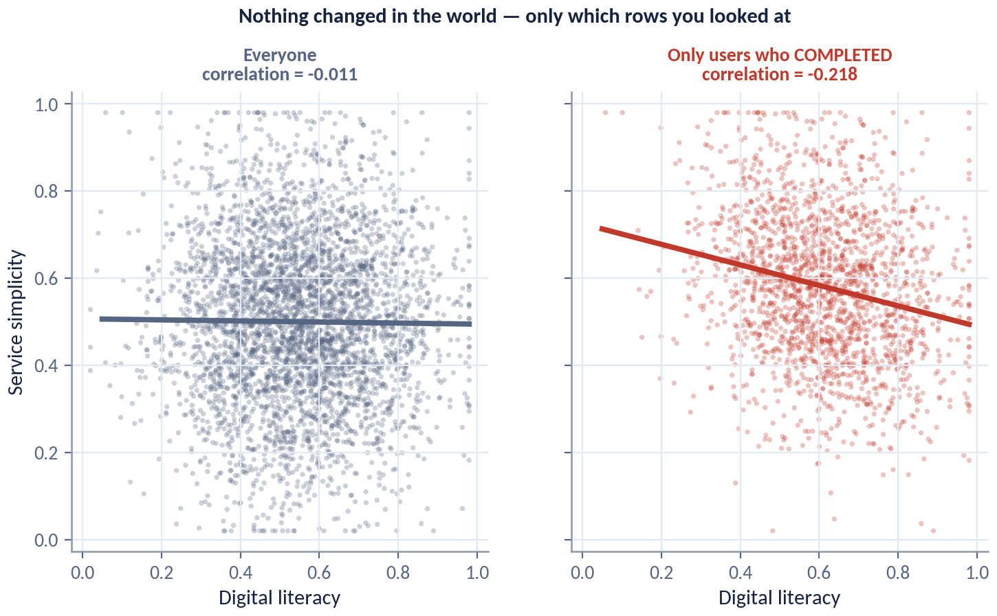
DAY 3 · HOUR 1
Collider Bias, Made Visible
Two genuinely independent variables, plotted twice. Nothing about the world changed between the panels — only which rows were included.
SELECTION IS CONDITIONING
Restricting to completed sessions IS conditioning on a collider, whether or not anyone wrote a regression.
Every filtered dataset, every 'we only analysed active users', every survivorship-shaped sample is this picture. Ask what the filter is a descendant of.
ACADEMY OF EXCELLENCE · DAY 3 · CONFOUNDING
112 / 268
Notes:
4 min · figure; two panels, and only the row filter differs.
Point first at the left panel, two independently generated variables, correlation about zero, a formless cloud. Second at the right panel, where only completed sessions are kept, and read the correlation off at about minus 0.20. Then say the sentence that lands it, that nothing about the world changed and only which rows were included did. Third at the selection boundary, since the negative slope is a geometric consequence of keeping the upper-right region.
ASK: Where else in your pipeline does a filter like this live? Steer to: active-user definitions, survivorship windows, and any complete-cases-only step.
WATCH FOR: blaming a data problem or a bug; the data here are perfect and the sampling is the problem.
LINK: collider_sim.parquet in the course data.

Slide 113
DAY 3 · HOUR 1
Building a Defensible Adjustment Set
A practical procedure you can run on any observational question.
Draw the DAG from domain knowledge before looking at correlations.
List backdoor paths from T to Y; find a set that blocks them all.
Exclude mediators, colliders, and any post-treatment variable.
Confirm the chosen covariates are all measured — unmeasured confounders break identification.
Record the graph with the analysis; it is the assumption your estimate rests on.
ACADEMY OF EXCELLENCE · DAY 3 · CONFOUNDING
113 / 268
Notes:
3 min · procedural summary of the hour.
Frame the order as load bearing. The DAG is drawn before looking at correlations, because otherwise the data choose the graph and a graph chosen to fit is no longer an assumption. The measurement check in step four ends most projects honestly: if the confounder is unmeasured, no estimator rescues you and you should say so in writing. Shipping the graph with the analysis lets a reviewer attack the assumption instead of guessing at it.
ASK: What do you do when the DAG says you need income and income is not in the warehouse? Steer to: report non-identifiability, then propose a design such as an instrument or a discontinuity.
WATCH FOR: quietly substituting a proxy; a noisy proxy leaves residual confounding of unknown size.
LINK: the identification verdict figure next.

Slide 114
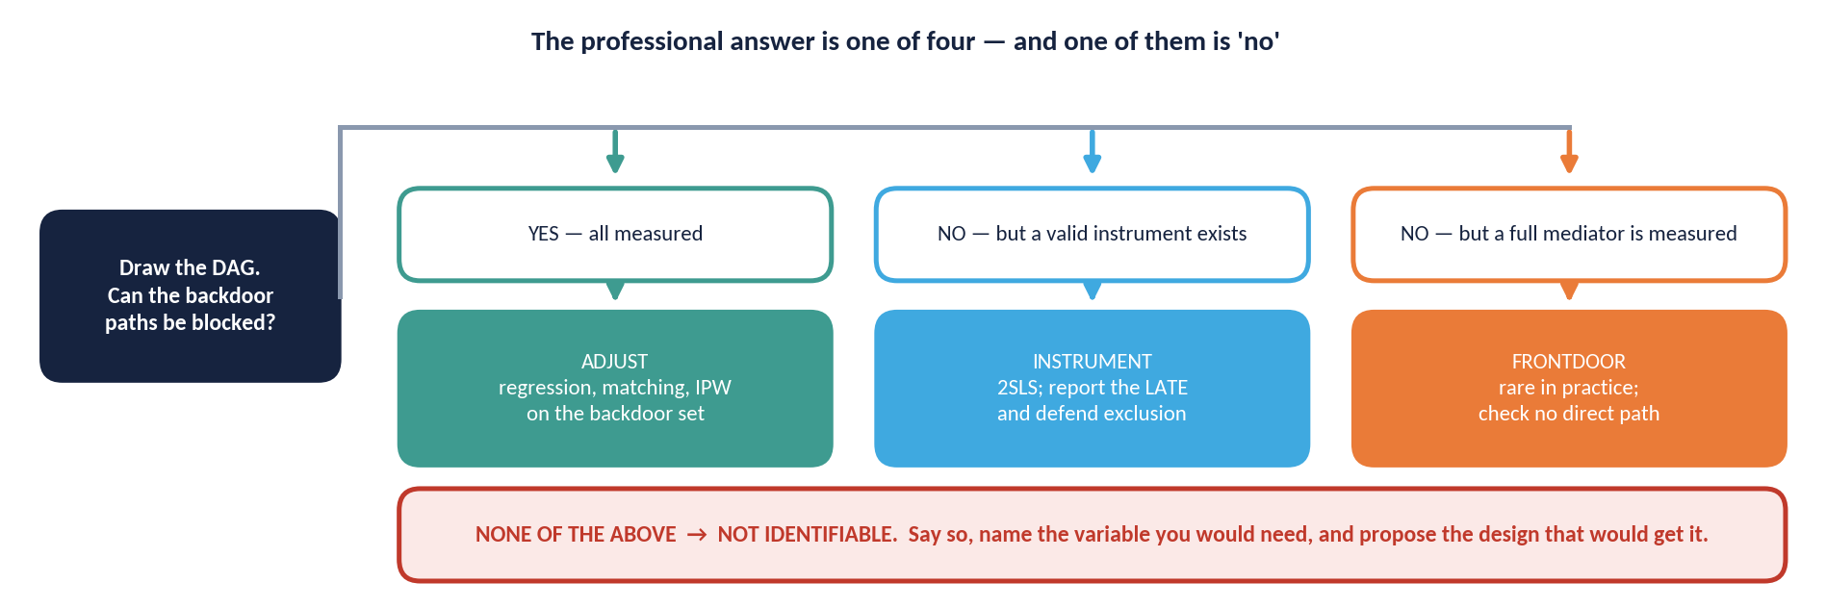
DAY 3 · HOUR 1
The Identification Verdict
Four possible professional answers to 'can we estimate this?' — and the fourth one is the mark of a specialist, not a failure.
SAY THE FOURTH — 'Not identifiable from these variables' is a complete, defensible, senior answer — provided you name the variable you would need and propose the design that would get it.
ACADEMY OF EXCELLENCE · DAY 3 · CONFOUNDING
114 / 268
Notes:
3 min · figure; a professional-judgement slide, not a technical one.
Walk the four verdicts in ascending difficulty with an Injaz example each: identified with the measured set, identified only under a stronger assumption, identified by a different design, and not identifiable from these variables. Spend the time on the fourth. In most organisations the analyst who says it is heard as unhelpful, so it only works paired with two specifics, the variable that would be needed and the design that would obtain it.
ASK: When did you last write that a question cannot be answered with these data? Steer to: rarely, and that is a cultural problem worth naming.
WATCH FOR: the fourth verdict read as failure; it is the only answer that protects the organisation from acting on a biased number.
LINK: Day 4's sensitivity analysis quantifies the second verdict.

Slide 115
DAY 3 · HOUR 1
Knowledge Check: DAGs
Q1
In T ← X → Y, the variable X is a:
A) Mediator B) Confounder C) Collider D) Instrument
Q2
Conditioning on a collider tends to:
A) Remove bias B) Open a spurious path C) Have no effect D) Improve overlap
Q3
A valid backdoor adjustment set must never contain:
A) A confounder B) A pre-treatment covariate C) A descendant of T D) A blocking variable
ACADEMY OF EXCELLENCE · DAY 3 · CONFOUNDING
115 / 268
Notes:
5 min · knowledge check closing Hour 1.
Q1 is B, a confounder, which is the fork; A tempts anyone reading arrows without attending to direction. Q2 is B, opens a spurious path, and A is the exact inversion and the most instructive wrong answer, since it comes from the habit that conditioning removes bias. Q3 is C, a descendant of treatment; B tempts people who half-remember that some pre-treatment variables are bad controls, but the criterion's explicit prohibition is on descendants.
ASK: Name a real filter in your own data that conditions on a collider. Steer to: any completion, retention or survival filter applied after treatment could have started.
WATCH FOR: confident answers of A on Q2; treat that as the signal to re-run the three-junctions inversion before moving into Hour 2.

Slide 116
DAY 3 · HOUR 2
Adjustment Estimators
Turning an identifying assumption into a number: regression, matching, propensity scores, inverse-probability weighting, and doubly-robust estimation.
ACADEMY OF EXCELLENCE · DAY 3
116 / 268
Notes:
1 min · opens Day 3 Hour 2.
One sentence: Hour 1 decided what to adjust for, and this hour is only about how. The estimators differ in what they model, the outcome, the treatment, or both, and their real differences show up in how they fail rather than in the estimand they target. Flag that overlap and balance diagnostics come before any point estimate, because every estimator here will confidently return a number where no comparable units exist.
ASK: If four estimators target the same quantity, why does the choice matter? Steer to: each depends on a different model being right, and the doubly-robust one needs only one of two.
WATCH FOR: an expectation that you will rank them; the answer is a sensible default plus diagnostics.
LINK: Lab 3 runs matching, IPW and a doubly-robust estimator on the same data.

Slide 117
DAY 3 · HOUR 2
Four Ways to Adjust
All target the same estimand under unconfoundedness; they differ in what they model and how they fail.
01
Outcome regression (g-formula)
Model E[Y|T,X]; predict both potential outcomes and average their difference. Fails if the outcome model is misspecified.
02
Matching
Pair treated and control units with similar X; compare within pairs. Transparent but sensitive to the distance metric and overlap.
03
Propensity-score methods
Model e(x)=P(T=1|X); match, stratify, or weight on it to collapse many covariates into one balancing score.
04
IPW
Weight units by 1/e(x) or 1/(1−e(x)) to rebuild a pseudo-population where T ⊥ X. Fails if the treatment model is wrong.
ACADEMY OF EXCELLENCE · DAY 3 · ADJUSTMENT
117 / 268
Notes:
5 min · the map of the hour.
Give each method its failure mode rather than its definition, because failure is what distinguishes them. Outcome regression fails silently under misspecification and extrapolates into regions with no controls. Matching is the easiest to defend in a policy meeting but discards units and so quietly changes the estimand. Propensity methods collapse many covariates into one score, a diagnostic gift. IPW rebuilds a pseudo-population and fails when the treatment model is wrong or propensities approach zero or one.
ASK: Which would you take into a meeting with a non-technical director? Steer to: matching, because we compared similar people survives translation.
WATCH FOR: expecting these to agree closely; on the Injaz data they differ, and reconciling them is the point of Lab 3.
LINK: Lab 3 estimates the training-programme effect four ways.

Slide 118
DAY 3 · HOUR 2
The Propensity Score
Rosenbaum & Rubin's key result: if adjusting for X suffices, adjusting for the scalar e(x) suffices too.
DIAGNOSTIC FIRST
Always plot the propensity distributions by arm and check standardized mean differences after adjustment — balance, not the model's AUC, is the goal.
Balancing property
Within a level of the propensity score, treated and control units have the same distribution of X — mimicking a mini-experiment.
Dimension reduction
It replaces a high-dimensional matching problem with a one-dimensional one — easier to diagnose and visualise.
It is a means, not an end
Judge it by covariate balance achieved, not by how well it predicts treatment. A perfect classifier destroys overlap.
ACADEMY OF EXCELLENCE · DAY 3 · ADJUSTMENT
118 / 268
Notes:
5 min · the central theoretical result of the hour.
Make the balancing property concrete: within a stratum of the propensity score, treated and untreated units share the same covariate distribution, so each stratum behaves like a small randomised experiment. Then spend real time on the third box, because it inverts a machine-learning instinct. A propensity model with excellent discrimination is bad news: predictable treatment means regions with no comparable controls. Judge by balance achieved; matching takes the worst absolute standardised difference from 0.57 to 0.03 on this data.
ASK: My propensity model has an AUC of 0.95. Good news or bad? Steer to: bad, because near deterministic treatment means no overlap.
WATCH FOR: tuning the propensity model for predictive accuracy, the most common misuse.
LINK: the overlap figure next; balance diagnostics in Lab 3.

Slide 119
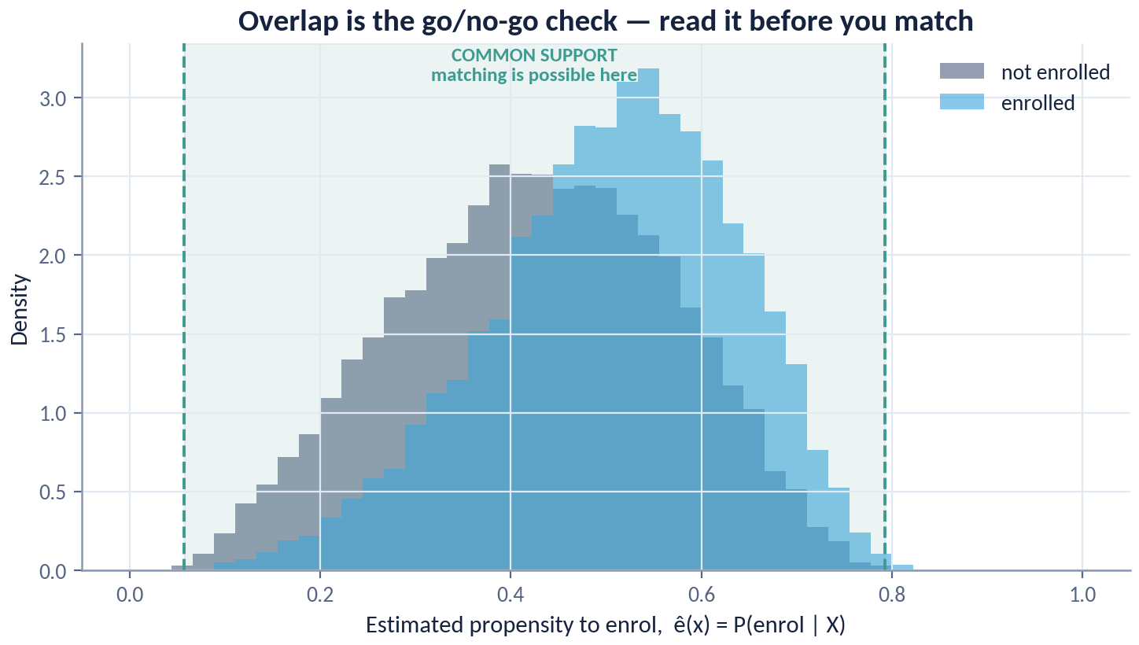
DAY 3 · HOUR 2
Overlap Is the Go / No-Go for Matching
Estimated propensity to enrol in the training programme, for enrolled and non-enrolled Injaz users.
BEFORE YOU MATCH
Read this chart before any estimate. Where the distributions do not overlap, no comparable control exists and no estimator can invent one.
A propensity model with a very high AUC is bad news, not good: it means treatment is predictable, which is exactly the absence of overlap.
ACADEMY OF EXCELLENCE · DAY 3 · ADJUSTMENT
119 / 268
Notes:
4 min · figure; the gate before any estimate.
Point first at the region where the distributions sit on top of each other, because that is where comparable units exist and the estimate is genuinely supported. Second at the tails, where enrolled users with very high propensities have no non-enrolled counterparts and no estimator can invent one. Third back at the AUC argument, since the more separated these curves are the better the model predicts and the worse the identification. Freeze on the decision: trim, restrict to common support, or switch to the effect on the treated.
ASK: We trim the top two percent of propensities. What have we changed? Steer to: the population the estimate applies to, which must be said in the readout.
WATCH FOR: poor overlap read as a data-quality issue; it is information about how treatment was assigned.
LINK: injaz_users.csv in Lab 3, where matching recovers plus 6.5 pp.

Slide 120
DAY 3 · HOUR 2
Inverse-Probability Weighting
Re-weight the sample so that, in the weighted world, treatment looks randomly assigned.
The weights
Treated units get weight 1/e(x); controls get 1/(1−e(x)). Rare-in-arm units count for more.
The danger
Propensities near 0 or 1 create enormous weights and unstable, high-variance estimates.
Stabilise
Use stabilised or trimmed weights, or switch to overlap weights, which downweight the extremes gracefully.
ACADEMY OF EXCELLENCE · DAY 3 · ADJUSTMENT
120 / 268
Notes:
3 min · the weighting alternative.
Give a survey-weighting intuition: a treated user who looked very unlikely to be treated stands in for many similar untreated users, so she counts for more. State the danger as a number, because a propensity of 0.01 produces a weight of 100 and a handful of such units can dominate both the estimate and its variance. Insist they plot the weight distribution and report the effective sample size before trusting anything.
ASK: One unit carries eight percent of the total weight. Is the estimate usable? Steer to: no, report the effective sample size and consider overlap weights or a restricted estimand.
WATCH FOR: trimming chosen after seeing the estimate, which is specification search dressed as hygiene.
LINK: doubly-robust estimation next pairs weighting with an outcome model.

Slide 121
DAY 3 · HOUR 2
Doubly-Robust Estimation
Combine an outcome model and a treatment model so that getting either one right yields a consistent estimate.
ROBUSTNESS
1 of 2
Two chances to be right
AIPW / TMLE stay consistent if the outcome model or the propensity model is correctly specified — not necessarily both.
ML-friendly
A doubly-robust estimator needs only one of its two models to be right. Cross-fitting then lets you use powerful ML without breaking inference.
With cross-fitting, flexible machine-learning nuisance models plug in while preserving valid confidence intervals (double/debiased ML).
Why it is the default
It relaxes the modelling burden and delivers efficient estimates — the modern workhorse for observational effects.
ACADEMY OF EXCELLENCE · DAY 3 · ADJUSTMENT
121 / 268
Notes:
5 min · the recommended default of the hour.
State the claim precisely: an AIPW estimator is consistent if either the outcome model or the propensity model is correctly specified, which is two independent chances rather than a guarantee. Then explain cross-fitting, because that is what lets them use gradient boosting for the nuisance models without the confidence intervals becoming meaningless. Fit on one fold, predict on the held-out fold, rotate; that decoupling preserves valid inference and is why the course library defaults to it.
ASK: Both models are somewhat wrong. Does double robustness save us? Steer to: no, it is one of two correct, not tolerance for two approximations.
WATCH FOR: doubly robust misread as twice as accurate; it removes one modelling assumption and does nothing for a broken adjustment set.
LINK: Lab 3 compares it against matching and IPW.

Slide 122
DAY 3 · HOUR 2
Matching vs. Weighting
MATCHING
WEIGHTING
Construct Comparable Pairs
Re-weight the Whole Sample
Intuitive, transparent, easy to explain.
Uses all units; targets ATE or ATT cleanly.
Discards unmatched units — changes the estimand.
VS
Extreme weights inflate variance.
Sensitive to distance metric and caliper.
Pairs naturally with doubly-robust methods.
Great for communicating to non-technical stakeholders.
Needs careful weight diagnostics and trimming.
ACADEMY OF EXCELLENCE · DAY 3 · ADJUSTMENT
122 / 268
Notes:
3 min · comparison slide; make it a choice, not a summary.
The line that matters is the estimand. Matching that drops unmatched treated units silently changes who the answer is about, so an honest report names the matched population. Weighting keeps everyone and targets the average effect or the effect on the treated cleanly, at the price of variance when weights are extreme. Give the course rule: match to communicate and diagnose, since a balance table is legible to anyone, and weight inside a doubly-robust estimator to produce the reported number.
ASK: You match and lose thirty percent of the treated units. What must the readout say? Steer to: the effect applies to the matched subpopulation, plus who was dropped.
WATCH FOR: the belief that matching is more assumption-light; both rest on the same unconfoundedness claim.
LINK: Lab 3 reports both, and the reconciliation is the deliverable.

Slide 123
DAY 3 · HOUR 2
An Observational Estimation Checklist
Run this sequence every time, in this order.
Define the estimand (ATE vs. ATT) and the target population first.
Specify the adjustment set from the DAG — not from what improves fit.
Check overlap; trim or restrict to common support before estimating.
Verify covariate balance after adjustment (standardized mean differences < 0.1).
Prefer a doubly-robust estimator with cross-fitting; report a proper interval.
Follow with a sensitivity analysis for unmeasured confounding.
ACADEMY OF EXCELLENCE · DAY 3 · ADJUSTMENT
123 / 268
Notes:
3 min · the operational summary of the hour.
Insist on the order, because each step gates the next. The estimand comes first: for the training programme the decision concerns people like those who enrolled, so the effect on the treated is the target and plus 6.0 pp is the truth being recovered. The adjustment set comes from the DAG, not from fit. Overlap precedes estimation. Balance is checked afterwards below 0.1, and 0.57 falling to 0.03 is what a passing table looks like.
ASK: Which step does your team currently skip? Steer to: usually the balance table or the sensitivity analysis, because both are reported rather than computed.
WATCH FOR: running the checklist out of order, especially estimating first and diagnosing after.
LINK: Day 4's Rosenbaum bounds, where this dataset gives a gamma of about 1.2.

Slide 124
DAY 3 · HOUR 2
Knowledge Check: Adjustment
Q1
A doubly-robust estimator is consistent if:
A) Both models are correct B) Either model is correct C) Neither model is needed D) The sample is large
Q2
You should judge a propensity model primarily by its:
A) AUC B) Covariate balance achieved C) Number of features D) R-squared
Q3
Propensity scores near 0 or 1 in IPW cause:
A) Bias only B) Extreme weights and high variance C) Better overlap D) No issue
ACADEMY OF EXCELLENCE · DAY 3 · ADJUSTMENT
124 / 268
Notes:
5 min · knowledge check closing Hour 2.
Q1 is B, either model correct. A is the careful-sounding wrong answer and worth naming as such, since requiring both would make the estimator no more robust than its components. Q2 is B, covariate balance achieved; A is the trap for a machine-learning audience and inverts the goal, because a high AUC signals poor overlap. Q3 is B, extreme weights and high variance; A tempts people who expect every problem to be bias, but IPW with correct propensities stays unbiased while becoming unusably noisy.
ASK: What would you report alongside the estimate to expose the Q3 problem? Steer to: the effective sample size and the largest single weight share.
WATCH FOR: defending A on Q1 as the safer answer; the point of double robustness is that it requires strictly less.

Slide 125
DAY 3 · HOUR 3
Difference-in-Differences & Synthetic Control
Exploiting timing: parallel trends, two-way fixed effects, event-study diagnostics, and building a synthetic counterfactual.
ACADEMY OF EXCELLENCE · DAY 3
125 / 268
Notes:
1 min · opens Day 3 Hour 3.
Say what changes. Hours 1 and 2 required you to measure the confounders, and this hour stops requiring it. Difference-in-differences trades measurement for timing: any time-invariant difference between regions may be arbitrarily large and completely unmeasured, provided the groups would have moved together. That trade is the entire value proposition and also the entire risk.
ASK: What kind of confounder does DiD handle for free, and what kind still kills it? Steer to: anything fixed over time is absorbed, anything that changes differentially is not.
WATCH FOR: DiD treated as a stronger design than adjustment; it is a different assumption, not a weaker one.
LINK: injaz_regions_panel.csv, thirteen regions over twenty-four months, drives this hour and Lab 4.

Slide 126
DAY 3 · HOUR 3
Difference-in-Differences: The Idea
When a treatment switches on at a known time for some units, compare their before/after change to the change in never-treated units.
THE ESTIMATOR
2×2
The double difference
τ = (Y₁ᵖᵒˢᵗ − Y₁ᵖʳᵉ) − (Y₀ᵖᵒˢᵗ − Y₀ᵖʳᵉ). Differencing removes fixed group and time effects.
What it controls for
In its simplest form DiD is a table with two groups and two periods. A regression with group and time fixed effects plus an interaction generalises it.
Any time-invariant difference between groups, and any common shock hitting both groups equally.
What it cannot fix
Differential trends or shocks that hit the groups unequally — the identifying assumption's Achilles heel.
ACADEMY OF EXCELLENCE · DAY 3 · DID
126 / 268
Notes:
5 min · the mechanics, before the credibility discussion.
Build the two-by-two on the board with the regional reminder rollout rather than reading the formula. Make explicit what each difference removes: the first removes anything fixed about a region, the second anything hitting both groups in that period, such as a holiday or a platform outage. Then name the one thing that survives, a shock or trend hitting the groups unequally, which is parallel trends stated as its own failure mode.
ASK: One region completes at a higher rate than every other. Does that break DiD? Steer to: no, a level difference is absorbed by the region fixed effect; only differential movement matters.
WATCH FOR: attempts to fix baseline imbalance by matching regions on level, which solves the wrong problem.
LINK: the panel has four never-treated regions and activation in periods 10, 13, 16 and 19.

Slide 127
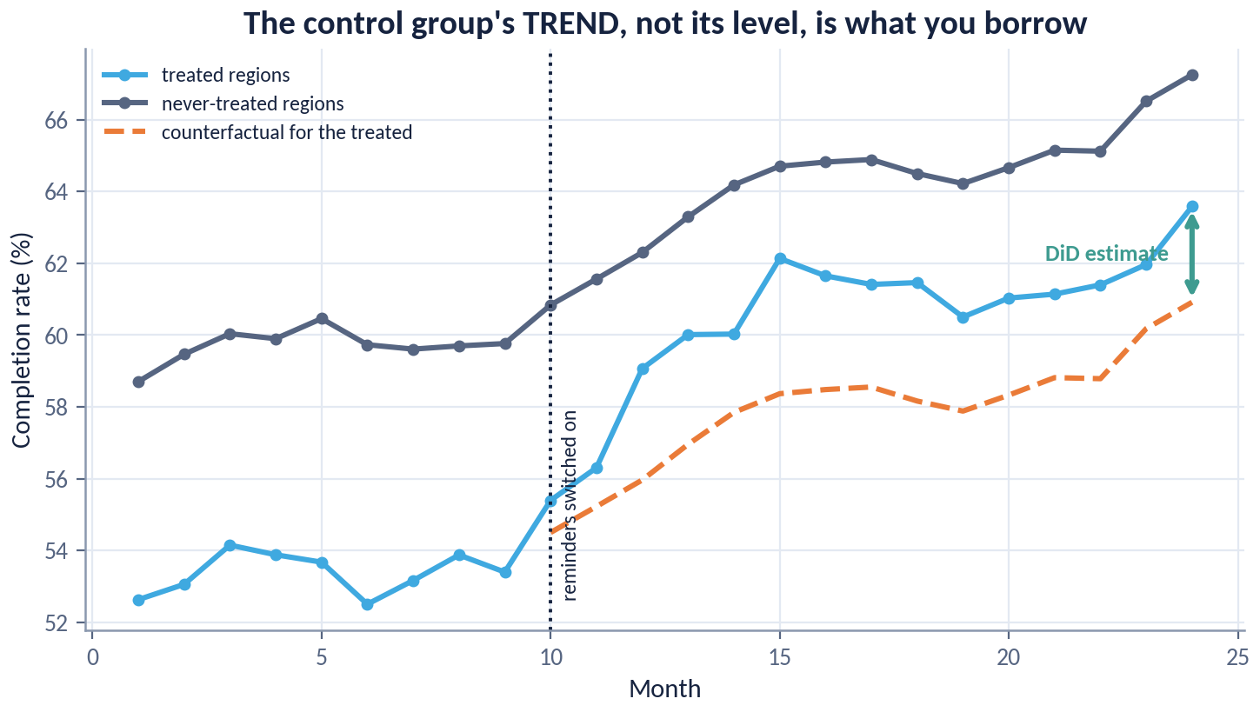
DAY 3 · HOUR 3
Difference-in-Differences on the Reminder Rollout
Treated regions against never-treated regions, with the counterfactual the method assumes.
TREND, NOT LEVEL
DiD does not require the two groups to be at the same level — regions differ, and the region fixed effect absorbs that.
It requires them to have MOVED THE SAME WAY absent the programme. The dashed orange line is that assumption drawn out, and the next slide is how you interrogate it.
ACADEMY OF EXCELLENCE · DAY 3 · DID
127 / 268
Notes:
4 min · figure; the assumption drawn out.
Walk it in three moves. First the pre-period, where the two lines sit at different levels but move together, because DiD needs a statement about slope rather than height. Second activation and the divergence that follows. Third the dashed counterfactual line, and say clearly that it is not data, it is the assumption, drawn. The gap between that line and the observed treated line is the entire estimate, so the credibility of the number is the credibility of the dashed line.
ASK: What evidence do we actually have that the dashed line is right? Steer to: only the pre-period, and only indirectly, which is why the event study comes next.
WATCH FOR: reading the level gap as the effect; the effect is the change in the gap.
LINK: the two-panel event study later this hour.

Slide 128
DAY 3 · HOUR 3
Parallel Trends: The Load-Bearing Assumption
DiD is credible only if, absent treatment, the treated group's outcome would have moved parallel to the control group's.
CAUTION
Parallel pre-trends support but do not guarantee parallel counterfactual trends — a shock that coincides with treatment can still break identification.
It is counterfactual
The assumption is about the untreated potential outcome — unobservable after treatment, so never fully testable.
Probe with pre-trends
Plot both groups before treatment; visibly parallel pre-periods make the assumption more plausible (not proven).
Strengthen it
Add covariate-adjusted or conditional parallel trends, or use a comparison group chosen to match pre-trends.
ACADEMY OF EXCELLENCE · DAY 3 · DID
128 / 268
Notes:
5 min · the assumption slide, and the heart of the hour.
Be precise, because the sloppy version does real damage. The claim concerns the untreated potential outcome of the treated regions after activation, unobservable by construction and therefore never testable. Pre-trends are evidence about a different period; they support rather than prove. Give the two honest strengtheners, conditional parallel trends and a comparison group chosen for pre-trend similarity, and note both must be declared in advance.
ASK: The rollout coincided with a national awareness campaign in the same regions. Does the pre-trend check save you? Steer to: no, the shock starts exactly when treatment does and is invisible beforehand.
WATCH FOR: the pre-trends are flat, therefore the assumption holds, the most common overclaim in applied DiD.
LINK: the pretrend version of the regional panel deliberately breaks this in Lab 4.

Slide 129
DAY 3 · HOUR 3
Event Studies & Dynamic Effects
Replace the single before/after contrast with an effect estimated at each period relative to treatment.
Leads and lags
Estimate coefficients for periods before and after adoption; pre-period coefficients near zero support parallel trends.
Reading the plot
Flat pre-trends then a clear post-jump is the signature of a credible dynamic effect.
Staggered adoption warning
When units adopt at different times, naive two-way fixed effects can be badly biased by ‘forbidden’ comparisons.
ACADEMY OF EXCELLENCE · DAY 3 · DID
129 / 268
Notes:
3 min · the diagnostic upgrade.
A single before-and-after number hides both the diagnostic and the dynamics: leads test the assumption, lags describe the effect. Note that the reference period is a choice and every coefficient is relative to it, which is why people misread these plots. Then set up the staggered-adoption warning, because with activation in four different periods two-way fixed effects starts using already-treated regions as controls for later adopters.
ASK: The effect appears to grow for three periods after activation. Real or artefact? Steer to: either adoption dynamics or a ramp-in, and on our panel the deliberate two-month ramp-in is exactly why TWFE returns plus 2.6 pp against a true plus 3.0 pp.
WATCH FOR: treating one significant pre-period coefficient as fatal; read the shape, not a single dot.
LINK: the two-panel event study on the next slide.

Slide 130
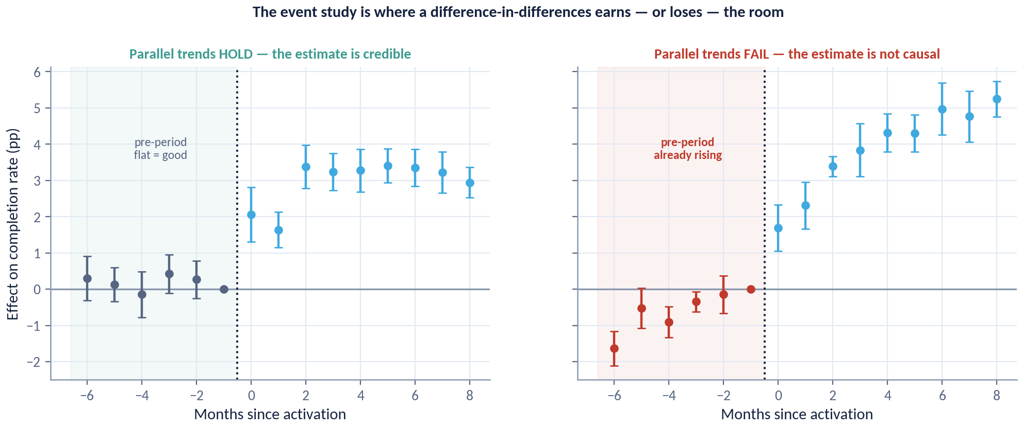
DAY 3 · HOUR 3
The Event Study Is Where DiD Earns the Room
The same estimator on two panels: one where parallel trends hold, one where treated regions were already pulling away before activation.
READ LEFT FIRST
Always read the pre-period before the post-period. On the right, the effect starts before the cause — which is not a small problem, it is a disqualifying one.
A flat, zero-centred pre-period does not prove parallel trends. It is simply the only check you have, and skipping it is indefensible.
ACADEMY OF EXCELLENCE · DAY 3 · DID
130 / 268
Notes:
4 min · figure; the most important diagnostic of the day.
Enforce the reading order from the panel, which is pre-period first, always. On the left the leads are flat and centred on zero and the effect appears only after activation. On the right the treated regions were already pulling away beforehand, so the effect starts before the cause. Say that phrase and let it sit, because it is disqualifying rather than a footnote. Point third at the confidence bands, since flatness must be judged against the precision available.
ASK: What would you do with the right-hand panel? Steer to: abandon DiD for this comparison group, or find a control group whose pre-trends match.
WATCH FOR: rescuing the right-hand panel by shortening the pre-window until the divergence disappears.
LINK: the pretrend panel in the course data generates the right-hand figure.

Slide 131
DAY 3 · HOUR 3
Modern DiD: Staggered Adoption
A wave of recent work shows the classic two-way fixed-effects estimator can mislead when treatment timing varies.
The problem
TWFE implicitly uses already-treated units as controls for later adopters, which can flip the sign of the estimate.
The diagnosis
Decompositions reveal how much weight comes from these problematic comparisons.
The fixes
Use heterogeneity-robust estimators (Callaway–Sant'Anna, Sun–Abraham, de Chaisemartin–D'Haultfœuille) that avoid bad contrasts.
ACADEMY OF EXCELLENCE · DAY 3 · DID
131 / 268
Notes:
4 min · the modern-methods slide.
This literature is recent enough that experienced practitioners have often not internalised it, so state the mechanism rather than citing papers. With activation in periods 10, 13, 16 and 19, two-way fixed effects forms comparisons where an already-treated region controls for a later adopter, and when effects change over time those contrasts enter with negative weights. Keep it grounded: the full effect is plus 3.0 pp, TWFE recovers plus 2.6 pp, and that attenuation traces to the deliberate two-month ramp-in.
ASK: Why does a two-month ramp-in attenuate TWFE here? Steer to: early post-periods carrying partial effects are used as control periods for later adopters.
WATCH FOR: treating the plus 2.6 pp as a bug in the lab; it is the teaching point.
LINK: Lab 4 compares TWFE with Callaway-Sant'Anna.

Slide 132
DAY 3 · HOUR 3
Synthetic Control
When there is one treated unit and many candidate controls, build a weighted blend of controls that tracks the treated unit before treatment.
USE CASE
1 vs many
The construction
Choose non-negative weights on control units so the synthetic unit matches the treated unit's pre-treatment path.
The estimate
Ideal for policy evaluation with a single treated region or firm and a donor pool of comparators — e.g. one province adopts a rule, others do not.
The post-treatment gap between the real and synthetic unit is the estimated effect.
Inference
Use placebo tests — apply the method to untreated units — to judge whether the observed gap is unusual.
ACADEMY OF EXCELLENCE · DAY 3 · DID
132 / 268
Notes:
3 min · the one-treated-unit design.
Position it by the data situation rather than the mathematics. With a single treated region there is no group to average over and DiD's comparison group becomes a judgement call; synthetic control makes that judgement explicit by choosing weights that reproduce the treated unit's pre-treatment path. Emphasise the two honesty constraints, non-negative weights summing to one, so there is no extrapolation beyond the donor pool. Then explain placebo inference, which is a permutation test in disguise.
ASK: The synthetic unit tracks the pre-period almost perfectly using fourteen donors. Reassuring? Steer to: be careful, since a long pre-period with few donors convinces while a perfect fit with many is often overfitting.
WATCH FOR: reporting a p-value from a standard regression; inference here comes from placebos.
LINK: Lab 4 offers this as the single-region extension.

Slide 133
DAY 3 · HOUR 3
Knowledge Check: DiD
Q1
The key identifying assumption of DiD is:
A) No confounders B) Parallel trends C) Perfect overlap D) A valid instrument
Q2
Near-zero pre-period event-study coefficients provide evidence for:
A) A strong instrument B) Parallel trends C) No effect D) Collider bias
Q3
With staggered adoption, classic two-way fixed effects can be biased because it uses:
A) Too few controls B) Already-treated units as controls C) Only pre-periods D) Random weights
ACADEMY OF EXCELLENCE · DAY 3 · DID
133 / 268
Notes:
5 min · knowledge check closing Hour 3.
Q1 is B, parallel trends. A is the strongest distractor because DiD does tolerate confounders, specifically time-invariant ones, so no confounders overstates the requirement in a way that sounds rigorous. Q2 is B; C is the tempting misreading, since near-zero pre-period coefficients say nothing about the effect and everything about the assumption. Q3 is B, already-treated units as controls, the forbidden comparison from the staggered-adoption slide.
ASK: How much evidence is a flat pre-period, really? Steer to: supportive but never conclusive, because the assumption concerns an unobservable post-period counterfactual.
WATCH FOR: participants choosing A on Q1; use it to restate what DiD absorbs for free against what it cannot touch.

Slide 134
DAY 3 · HOUR 4
Instrumental Variables & Regression Discontinuity
Two designs that recover causal effects from as-if-random variation: an instrument that shifts treatment, and a threshold that assigns it.
ACADEMY OF EXCELLENCE · DAY 3
134 / 268
Notes:
1 min · opens Day 3 Hour 4.
One sentence of framing, then move. Both designs in this hour give up on measuring confounders and instead hunt for variation that is as good as random, either an instrument that shifts treatment without touching the outcome or a threshold that assigns it. Flag the price up front: both estimate a local effect for a specific subpopulation, and both trade precision for credibility. Two-stage least squares recovers plus 7.8 pp here against a true local effect of plus 8.0 pp.
ASK: Why accept an interval three times wider than OLS? Steer to: because the narrow one is centred in the wrong place, since the biased OLS estimate is plus 10.9 pp.
WATCH FOR: the expectation that IV is a general fix for confounding; it answers a narrower question about compliers.
LINK: the online-filing example, instrument log_distance_km, first-stage F about 2,100.

Slide 135
DAY 3 · HOUR 4
Instrumental Variables: The Logic
When treatment is confounded, an instrument Z that affects Y only through T lets you isolate the causal effect.
THE ESTIMATOR
2SLS
Relevance
Z must actually shift treatment: Cov(Z, T) ≠ 0. Weak instruments give unstable, biased estimates.
Exclusion
Two-stage least squares: regress T on Z (first stage), then Y on the predicted T. The Wald ratio Cov(Z,Y)/Cov(Z,T) is its simplest form.
Z affects Y only through T — no direct path and no back-channel. This is an assumption, not a testable fact.
Independence
Z is as-good-as-randomly assigned with respect to the potential outcomes (no confounding of Z itself).
ACADEMY OF EXCELLENCE · DAY 3 · IV
135 / 268
Notes:
4 min - Day 3, Hour 4, opening the IV block after DiD.
IV is not a trick, it is a hunt for a lever the confounder cannot reach. Of the three conditions only relevance is testable; exclusion and independence are arguments you defend, which is why IV work lives or dies in the discussion section rather than the results table. Introduce the course instrument now: log distance to the nearest service centre, with a planted LATE of +8.0 pp against a confounded OLS of +10.9 pp.
ASK: Name a variable in your own work that moves uptake but has no other route to the outcome. Steer to administrative or geographic accidents, not user attributes.
WATCH FOR: Offering a strong predictor of the outcome as the instrument. Predictive power is exactly the wrong criterion.
LINK: The valve figure next; the 2SLS step in Lab 3.

Slide 136
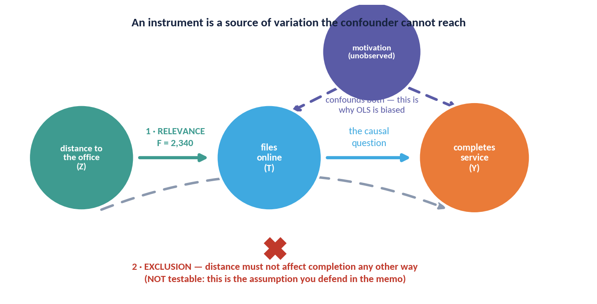
DAY 3 · HOUR 4
An Instrument Is a Valve the Confounder Cannot Reach
Distance to the nearest service centre shifts whether a citizen files online, but has no other route to completion.
TWO OF THREE ARE FREE
Relevance is testable — the first-stage F here is about 2,100.
Exclusion is NOT testable, ever. It is defended with domain knowledge and attacked by reviewers, and it is where most instruments die. And what you recover is the LATE: the effect among compliers, not the population.
ACADEMY OF EXCELLENCE · DAY 3 · IV
136 / 268
Notes:
4 min - Day 3, Hour 4, the visual anchor for IV.
Walk it in three beats. Point first at the confounder feeding both T and Y, which is what makes the naive comparison read +10.9 pp when the truth is +8.0. Point second at Z entering only through T, the valve, and note the first-stage F near 2,100 settles relevance and nothing else. Point third at the arrow that is not drawn, Z straight to Y: you drew that absence, and no test confirms it.
ASK: What would a direct distance-to-outcome path look like? Steer to rural connectivity or literacy that tracks distance and affects completion on its own.
WATCH FOR: Reading the huge F as proof the design is valid. Freeze there; F certifies relevance only.
LINK: Weak instruments next; the IV section of Lab 3.

Slide 137
DAY 3 · HOUR 4
What IV Actually Estimates: LATE
With imperfect compliance, IV recovers the effect for a specific, often invisible, subpopulation.
INTERPRETATION
‘The effect’ from IV is the effect on those the instrument nudges. A different instrument can yield a different, equally valid, LATE.
Compliers only
Under monotonicity, IV identifies the Local Average Treatment Effect — the effect for units whose treatment the instrument moves.
Not the ATE
It says nothing about always-takers or never-takers; generalise with care.
The four types
Compliers, always-takers, never-takers, and (ruled out by monotonicity) defiers.
ACADEMY OF EXCELLENCE · DAY 3 · IV
137 / 268
Notes:
4 min - Day 3, Hour 4, the interpretation slide participants skim.
IV changes the estimand, not just the estimator. The +7.8 pp that 2SLS recovers is the effect among citizens whose filing behaviour distance actually moves; it is silent about people who would file online from anywhere and about those who never would. Make the complier concrete before naming the acronym: the citizen who files online only because the office is far.
ASK: Who are the compliers here, in one sentence a minister would understand? Steer to citizens at the margin of convenience, not the eligible base.
WATCH FOR: Treating LATE as a slightly weaker ATE. It is a different quantity for a different group, and a policy aimed at always-takers is not informed by it at all.
LINK: Internal versus external validity on Day 4.

Slide 138
DAY 3 · HOUR 4
Weak Instruments & IV Pitfalls
IV is powerful and fragile in equal measure; the failure modes are specific and diagnosable.
Weak-instrument bias
A low first-stage F-statistic (rule of thumb: below ~10) signals bias toward OLS and unreliable inference.
Exclusion violations
Any direct Z→Y path, however small, contaminates the estimate — and cannot be tested from the data alone.
Defend the design
Report the first-stage strength, argue exclusion from domain knowledge, and probe robustness.
ACADEMY OF EXCELLENCE · DAY 3 · IV
138 / 268
Notes:
3 min - Day 3, Hour 4, the failure catalogue.
Emphasise the asymmetry: weak-instrument bias pulls 2SLS back toward the confounded OLS number, so a weak instrument hands you a confident wrong answer, not a noisy honest one. Contrast the course case, where an F near 2,100 makes weakness a non-issue, with the typical published instrument scraping past 10. Then name IV's price even when it works: the interval here is about three times wider than OLS.
ASK: Your first-stage F is 6. What do you report? Steer to reporting the weak first stage and reframing the claim, not cycling estimators until one turns significant.
WATCH FOR: Believing an over-identification test proves exclusion. It only checks whether instruments agree, and they can be jointly invalid.
LINK: Lab 3, step 5.

Slide 139
DAY 3 · HOUR 4
Regression Discontinuity: The Idea
When treatment is assigned by whether a running variable crosses a threshold, units just above and just below are comparable — a local experiment.
ESTIMAND
Local
As-if random at the cutoff
Just around the threshold, which side a unit lands on is essentially chance, so the two sides are comparable.
Sharp vs. fuzzy
RDD identifies the effect at the cutoff. Bandwidth choice trades bias (wide) against variance (narrow); report robustness to it.
Sharp: crossing the cutoff perfectly determines treatment. Fuzzy: it only changes the probability (IV at the boundary).
The estimate
The jump in the outcome at the cutoff is the local effect for units near the threshold.
ACADEMY OF EXCELLENCE · DAY 3 · RDD
139 / 268
Notes:
4 min - Day 3, Hour 4, the last design in the toolbox.
Sell RDD as the most credible observational design available, because the assignment rule is written down and auditable rather than assumed. The sentence to land: just around the cutoff, which side a unit falls on is close to a coin flip, so you buy a small randomised experiment and pay with an estimand covering only that window. Say bandwidth aloud as bias against variance.
ASK: Where in your own service delivery does a number decide who gets what? Steer to eligibility scores, headcount bands, income cutoffs, queue triggers.
WATCH FOR: Hearing fuzzy RDD as a broken design. Fuzzy is legitimate; it is IV at the boundary and identifies a LATE at the cutoff.
LINK: The training-subsidy case on Day 4, built on a headcount cutoff.

Slide 140
DAY 3 · HOUR 4
RDD Validity Checks
The design is credible only if units cannot precisely control which side of the cutoff they land on.
No manipulation
Test for bunching of the running variable at the threshold (a density test); a spike suggests gaming.
Covariate continuity
Pre-treatment covariates should be smooth through the cutoff — a jump signals a confounded discontinuity.
Bandwidth & functional form
Show the estimate is stable across sensible bandwidths and local polynomial orders.
ACADEMY OF EXCELLENCE · DAY 3 · RDD
140 / 268
Notes:
3 min - Day 3, Hour 4, the diagnostics that make an RDD defensible.
Frame all three as attempts to falsify your own design. The density test asks whether units saw the cutoff coming: if firms know the headcount rule they sit just under it, and the pile-up shows in the histogram. Covariate continuity is the RDD version of a balance table. Bandwidth robustness is where reviewers push hardest, so present a curve of estimates rather than one chosen number.
ASK: Which is worse, a small density spike or a jump in a pre-treatment covariate? Steer to the covariate jump, direct evidence something else changes at the threshold.
WATCH FOR: Picking the bandwidth after seeing which gives significance. That is Day 2's peeking problem in different clothes.
LINK: Lab 3, step 5.

Slide 141
DAY 3 · HOUR 4
IV vs. RDD
INSTRUMENTAL VARIABLES
REGRESSION DISCONTINUITY
Exploit a Nudge
Exploit a Threshold
Needs a variable that shifts treatment only.
Needs a cutoff rule on a running variable.
Estimates LATE for compliers.
VS
Estimates a local effect at the cutoff.
Fragile to weak instruments and exclusion.
Fragile to manipulation and bandwidth choice.
Powerful when a credible instrument exists.
Highly credible when the cutoff is real and unforeseeable.
ACADEMY OF EXCELLENCE · DAY 3 · QUASI-EXPERIMENTS
141 / 268
Notes:
3 min - Day 3, Hour 4, consolidation before the knowledge check.
Do not read the columns. Give the selection rule as one question: does this process contain a nudge or a threshold? A nudge that moves take-up gives IV and a LATE for compliers; a written rule on a running variable gives RDD and a local effect at the cutoff. Both are local estimands, the honest cost of credibility, and both die from an untestable assumption.
ASK: Distance could support either design. How would you turn it into an RDD? Steer to a catchment boundary where the assigned office flips discontinuously.
WATCH FOR: Ranking designs by strength in the abstract. Credibility comes from the institutional facts of the case, not the method's reputation.
LINK: The design-choice discussion later this hour.

Slide 142
DAY 3 · HOUR 4
Knowledge Check: IV & RDD
Q1
A first-stage F-statistic of 3 indicates:
A) A strong instrument B) A weak instrument C) A valid exclusion D) A sharp design
Q2
IV with imperfect compliance and monotonicity identifies the:
A) ATE B) ATT C) LATE D) ITT
Q3
A spike in the running-variable density at the cutoff suggests:
A) Valid RDD B) Manipulation / sorting C) Strong instrument D) Parallel trends
ACADEMY OF EXCELLENCE · DAY 3 · QUASI-EXPERIMENTS
142 / 268
Notes:
5 min - Day 3, Hour 4, closing the quasi-experimental block.
Vote by show of hands before revealing anything, and spend the time on wrong answers. Q1 is B: an F of 3 is far under the rule of thumb of 10, and the harm is bias toward OLS, not noise. C confuses relevance with exclusion, which no F can speak to. Q2 is C, LATE; ITT tempts anyone recalling Day 2's trigger dilution. Q3 is B, and A appeals to people who read any sharp feature at the cutoff as success.
ASK: On Q2, why is ITT wrong rather than merely different? Steer to ITT being the effect of assignment, which IV rescales onto compliers.
WATCH FOR: Silent agreement. Make at least one person defend a distractor aloud.

Slide 143
DAY 3 · HOUR 5
Lab 3 & Discussion
Estimate the same treatment effect four ways on one observational dataset — and reconcile what the disagreements reveal.
ACADEMY OF EXCELLENCE · DAY 3
143 / 268
Notes:
1 min - Day 3, Hour 5, divider into the lab.
Two sentences, then move. Set the expectation that the four estimates will not agree and that the disagreement is the learning objective: on the training data the naive difference is +11.5 pp against a truth of +6.0 pp, and every method lands somewhere in that gap for a nameable reason. The deliverable is the reconciliation paragraph, not the notebook.
ASK: What spread across four estimators would worry you? Steer away from a numeric threshold; what matters is whether you can explain the spread.
WATCH FOR: Treating this as a race to match ground truth. Real work has no answer key, which is why the assumption-naming discipline is what transfers.
LINK: lab3 notebook, injaz_users.csv.

Slide 144
DAY 3 · HANDS-ON LAB 3
Four Estimators, One Question
STEPS
OBJECTIVE
Draw a DAG for the dataset and select the adjustment set from it.
1
On a realistic observational dataset with known ground truth, estimate the effect with regression, propensity weighting, a doubly-robust learner, and a quasi-experimental design — then explain the spread.
2
Estimate the effect by outcome regression (g-formula).
3
Estimate by stabilised IPW; inspect the weight distribution and trim.
DELIVERABLE
4
Estimate by a doubly-robust learner with cross-fitting; report the interval.
A notebook comparing four estimates with intervals, overlap and balance diagnostics, and a written reconciliation naming the assumption each relies on.
5
Apply one quasi-experimental design (DiD or RDD) to the same question.
6
Tabulate all estimates against ground truth; explain each gap by its assumptions.
ACADEMY OF EXCELLENCE · DAY 3 · LAB
144 / 268
Notes:
5 min - Day 3, Hour 5, the lab brief; hold to five minutes.
Read the objective, then spend your time on the two steps people rush. In step 1 the adjustment set is digital_literacy and device_age; support_calls is a mediator, and controlling for it visibly destroys the estimate. In step 3 make them plot the weight distribution before trimming, because one weight of 400 explains more of the IPW answer than any coefficient. Cross-fitting is not optional in step 4.
ASK: Which two estimates should agree most closely, and why? Steer to regression and doubly-robust, which share an outcome model where overlap is good.
WATCH FOR: Groups debugging for forty minutes and never writing the reconciliation. Announce a hard checkpoint two-thirds through.
LINK: causal_utils, lab3, injaz_users.csv.

Slide 145
DAY 3 · HOUR 5
Lab 3 Debrief
Disagreement between methods is information, not noise.
Overlap drives it
Where overlap is thin, weighting and matching diverge; the doubly-robust estimate is usually the most stable.
Assumptions differ
Each method leans on a different premise — so agreement across methods is real evidence of robustness.
Report the ensemble
Presenting several estimates with their assumptions is more honest than a single confident number.
ACADEMY OF EXCELLENCE · DAY 3 · LAB
145 / 268
Notes:
4 min - Day 3, Hour 5, straight after the lab.
Collect three groups' tables on the board before saying anything; the spread across the room teaches better than any single table. The recurring story is that matching recovers the +6.0 pp ATT cleanly, landing at +6.5, worst absolute SMD falling from 0.57 to 0.03, while untrimmed IPW wanders and the doubly-robust estimate sits stable between them. Then land the honesty point: Rosenbaum Gamma is only about 1.2.
ASK: Two methods agree. Is that evidence, or shared bias? Steer to the fact that agreement counts only when the assumptions differ.
WATCH FOR: Crowning the doubly-robust estimate the winner. It forgives model form, not an unmeasured confounder.
LINK: Sensitivity analysis on Day 4.

Slide 146
DAY 3 · HOUR 5
Discussion: Choosing a Design
Given a scenario, groups argue for the most credible identification strategy.
Is there a threshold rule that assigns the treatment? → consider RDD.
Is there a variable that shifts uptake but not the outcome directly? → consider IV.
Did treatment switch on at a known time for some units? → consider DiD / synthetic control.
Is unconfoundedness plausible given rich covariates? → consider doubly-robust adjustment.
Always ask: which assumption is least implausible here, and how would I probe it?
ACADEMY OF EXCELLENCE · DAY 3 · DISCUSSION
146 / 268
Notes:
5 min - Day 3, Hour 5, small-group discussion closing the toolbox.
Give each table one scenario and three minutes, then force a fixed answer form: estimand, design, the one assumption it rests on, and the check that would break it. The value is in the last two items, so cut off any group that only names a method. Push back on unconfoundedness with rich covariates by asking what a caseworker used but never recorded.
ASK: Which assumption is least implausible here, and what evidence would change your mind? Steer to ranking by institutional facts, not prestige.
WATCH FOR: Method-first reasoning, where a group picks DiD because they enjoyed the panel exercise and then hunts for a start date. Design follows assignment.
LINK: The three real-world cases on Day 4.

Slide 147
DAY 3 · WRAP
Day 3 in One Slide
You now have a toolbox for causal questions when experiments are impossible.
TOMORROW
Day 4: uncertainty done right, the bias taxonomy, sensitivity and external validity, real-world cases, and your capstone.
Structure before statistics
A DAG and the backdoor criterion decide the adjustment set; fit does not.
Adjust robustly
Propensity, IPW, and especially doubly-robust methods with cross-fitting are the modern default.
Borrow randomization's logic
DiD, synthetic control, IV, and RDD each exploit a source of as-if-random variation.
Every design has one weak point
Parallel trends, exclusion, or no-manipulation — name it, probe it, report it.
ACADEMY OF EXCELLENCE · DAY 3 · SUMMARY
147 / 268
Notes:
3 min - Day 3 wrap, last slide of the day.
Compress rather than review. Every observational design borrows a piece of randomisation's logic from somewhere: DiD from timing, IV from a nudge, RDD from a rule, and adjustment methods simply assume they have it. Make the last box the memorable one, that each design has exactly one load-bearing assumption you must name before anyone asks. Cite the day's numbers once: +11.5 against +6.0, TWFE +2.6 against +3.0, 2SLS +7.8 against +8.0.
ASK: Which of today's designs would you defend most confidently to a skeptical director? Steer toward RDD when a real written rule exists.
WATCH FOR: Fatigue turning this into a reading exercise. Ask for the assumption, not the method name.
LINK: Day 4 opens with uncertainty.

Slide 148
DAY 4
Uncertainty, Bias, Limitations & Capstone
Quantifying uncertainty honestly, the taxonomy of bias and threats to validity, sensitivity and generalisation, real-world cases, and the capstone.
ACADEMY OF EXCELLENCE · DAY 4
148 / 268
Notes:
1 min - Day 4 opening divider.
Two sentences and move. Frame Day 4 as the day the course stops adding designs and starts asking how much any of it should be trusted; the first three days built estimates, today builds the case for or against them. Tell them the day ends in a capstone where the correct answer is deliberately not ship, so they should expect to defend a judgement rather than produce a number.
ASK: What is the most uncomfortable question a director could ask about your last analysis? Steer to assumptions and generalisation rather than code.
WATCH FOR: Assuming today is lighter because there is less mathematics. Estimand definition and sensitivity are where senior practitioners are separated from junior ones.
LINK: The capstone and injaz_autofill_ab.csv later today.

Slide 149
DAY 4 · OVERVIEW
Today's Five Hours
01
Hour 1 — Uncertainty Quantification
02
Hour 2 — Bias & Threats to Validity
Standard errors done right: analytic, robust, clustered, bootstrap, and design-based.
A taxonomy of bias, internal vs. external validity, and sensitivity analysis.
03
Hour 3 — Real-World Case Studies
04
Hour 4 — Capstone Lab
Tech experimentation, policy evaluation, and health — decisions under uncertainty.
Design, estimate, and report a defensible causal analysis on a provided dataset.
05
Hour 5 — Defense, Post-Test & Close
Present your capstone, take the summative assessment, and consolidate.
ACADEMY OF EXCELLENCE · DAY 4
149 / 268
Notes:
3 min - Day 4 overview, after the divider.
Set the day's rhythm rather than list contents. The first two hours are the professional standards hours, the third is where those standards meet real decisions, and the last two are assessed. The scheduling point that matters is that Hour 4 is a working block, not a demonstration, so anyone who drifts in Hours 1 and 2 will feel it. Flag that the post-test covers all four days.
ASK: Who has had an analysis rejected for its standard errors rather than its estimate? Steer to inference errors being the commonest reason good work is sent back.
WATCH FOR: Participants planning to start the capstone during Hour 3. The case studies contain the reasoning template the memo is graded against.
LINK: Capstone rubric, Hour 4.

Slide 150
DAY 4 · HOUR 1
Two Kinds of Uncertainty
A causal estimate has more sources of doubt than a single p-value admits.
THE TRAP
Most reported ‘uncertainty’ is only sampling error. For observational work, the uncertainty about whether the design is valid usually dominates.
Statistical (sampling) uncertainty
Would the estimate change under a different random sample or re-randomization? This is what standard errors capture.
Identification uncertainty
Would it change if the assumptions were slightly wrong? This is what sensitivity analysis captures — and it is usually larger.
Report both
A tight confidence interval around a poorly-identified estimate is false precision. Communicate both layers.
ACADEMY OF EXCELLENCE · DAY 4 · UNCERTAINTY
150 / 268
Notes:
4 min - Day 4, Hour 1, the frame for the whole day.
This is the most important idea of the day and it is not mathematical. Sampling uncertainty asks what happens under a different draw; identification uncertainty asks what happens if the design is wrong. Make it concrete with yesterday's data: the matched training estimate has a respectable interval around +6.5 pp, but a Rosenbaum Gamma near 1.2 says a modest hidden confounder overturns it, and no standard error reflects that. Pause on the trap box.
ASK: Which layer dominates in observational work, and which in a clean randomised test? Steer to identification and sampling respectively.
WATCH FOR: Believing a bigger sample fixes both. More data tightens the interval around a biased number, making false precision worse.
LINK: Sensitivity analysis in Hour 2.

Slide 151
DAY 4 · HOUR 1
Choosing the Right Standard Error
The standard error must match how the data were generated and assigned.
01
Classical / homoskedastic
Assumes constant error variance. Rarely defensible for real data; usually too optimistic.
02
Robust (Huber–White, HC2/HC3)
Allows heteroskedasticity. The sensible default for cross-sectional regression estimates.
03
Clustered
For grouped assignment or correlated units — cluster at the level of randomization or the treatment shock.
04
Design-based
Derived from the assignment mechanism itself; the natural choice for experiments.
ACADEMY OF EXCELLENCE · DAY 4 · UNCERTAINTY
151 / 268
Notes:
4 min - Day 4, Hour 1, the practical core of the hour.
Teach one rule with four applications: the standard error must mirror how treatment was assigned. Classical errors are rarely defensible on real service data and are systematically too small. Robust is the sane default for cross-sectional regression, but say clearly that robust does not solve grouping, which is the mistake people make when they think HC3 has covered them. Design-based is natural for the Injaz A/B tests, where the mechanism is known exactly.
ASK: You randomised users but stored one row per session. Which applies? Steer to clustered, and note robust alone would not save you.
WATCH FOR: Treating robust errors as strictly safer. They address heteroskedasticity only and leave within-cluster correlation untouched.
LINK: The session-clustering figure two slides on.

Slide 152
DAY 4 · HOUR 1
Clustering: Get the Level Right
The single most common uncertainty error in applied causal work is clustering at the wrong level — or not at all.
FAILURE MODE
√n
The rule
Cluster standard errors at the level at which treatment is assigned or the shock occurs — not finer.
Too few clusters
Ignoring within-cluster correlation makes you count correlated observations as if independent — the classic route to spuriously narrow intervals.
With a small number of clusters, standard asymptotics fail; use wild-cluster bootstrap or exact methods.
The consequence of ignoring it
Treating correlated observations as independent can shrink standard errors several-fold, manufacturing false significance.
ACADEMY OF EXCELLENCE · DAY 4 · UNCERTAINTY
152 / 268
Notes:
4 min - Day 4, Hour 1, the highest-yield slide of the hour.
State the rule, then make the consequence visceral. On the real Injaz session data the naive session-level standard error is 0.00166 against a user-clustered 0.00267, about 1.6 times wider, and that ratio alone flips borderline results out of significance. Then cover the opposite mistake: clustering correctly but with only eight or twelve clusters, where the usual asymptotics fail and you need a wild cluster bootstrap.
ASK: A reminder campaign rolls out region by region across 13 regions. What is the effective sample size for inference? Steer to 13, not the millions of citizens.
WATCH FOR: Clustering at the level of measurement instead of assignment. That is the wrong rule and it usually leaves the interval too narrow.
LINK: injaz_regions_panel.csv; the next figure.

Slide 153
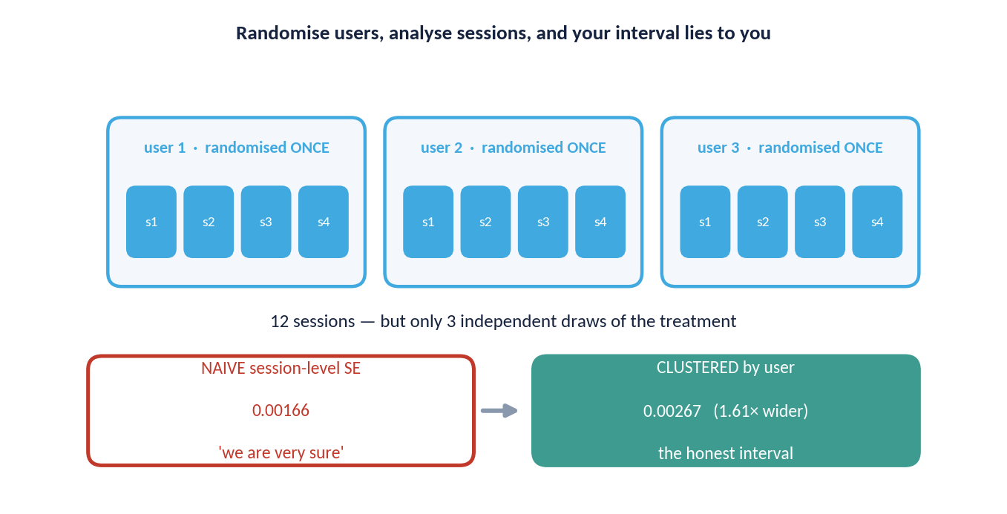
DAY 4 · HOUR 1
Randomise Users, Analyse Sessions, Get a Lie
Three users, twelve sessions — but only three independent draws of the treatment.
COUNT THE DRAWS
The sample size that governs your standard error is the number of times the coin was flipped, not the number of rows in the table.
On the real Injaz session data, clustering widens the interval by a factor of 1.6. The point estimate does not move; your entitlement to be confident does.
ACADEMY OF EXCELLENCE · DAY 4 · UNCERTAINTY
153 / 268
Notes:
4 min - Day 4, Hour 1, the figure that makes clustering physical.
Walk it slowly. Point first at the twelve session rows and ask how many numbers the analysis appears to have. Point second at the three users: the coin was flipped three times, so there are three independent draws and nine rows of repetition. Point third at the two intervals, where the point estimate is identical and only the width moves, 0.00166 to 0.00267. Clustering changes what you may claim, not what you found.
ASK: If each user had 100 sessions instead of four, would the clustered interval keep shrinking? Steer to no; precision is bounded by the number of users.
WATCH FOR: Wanting to average sessions per user and move on. That works for a simple mean and breaks with covariates or unequal counts.
LINK: Capstone diagnostics.

Slide 154
DAY 4 · HOUR 1
The Bootstrap
When an analytic standard error is hard to derive, resample the data to approximate the estimator's sampling distribution.
How it works
Resample units with replacement many times, recompute the estimate each time, and read uncertainty from the spread.
Respect the design
Resample at the unit of independence — the block bootstrap for time series, the cluster bootstrap for grouped data.
Know its limits
The naive bootstrap can fail for matching estimators and extreme quantiles; use the method matched to the estimator.
ACADEMY OF EXCELLENCE · DAY 4 · UNCERTAINTY
154 / 268
Notes:
3 min - Day 4, Hour 1, after the analytic standard errors.
Position the bootstrap as the fallback when the analytic formula is hard, not as a universally safer option. The rule carrying the weight is the second box: resample at the unit of independence, so for session data you resample users and take all their sessions along, reproducing the same 1.6 times widening. Be honest about limits, since the naive bootstrap is invalid for the matching estimators half the room used yesterday.
ASK: How would you bootstrap the regional panel? Steer to resampling whole regions with all 24 months attached, not individual region-months.
WATCH FOR: Thinking more replicates rescue an invalid bootstrap. Replicates cut Monte Carlo noise only; they cannot repair the wrong resampling unit.
LINK: Lab 3 matching; capstone step 4.

Slide 155
DAY 4 · HOUR 1
Confidence Intervals, Interpreted Correctly
Intervals communicate more than tests — if read precisely.
The frequentist meaning
Across many repetitions, 95% of such intervals would contain the true effect — a property of the procedure, not this one interval.
Width is the message
A wide interval spanning zero says ‘underpowered / uncertain’, not ‘no effect’.
Compatibility framing
Read the interval as the range of effect sizes reasonably compatible with the data and model.
ACADEMY OF EXCELLENCE · DAY 4 · UNCERTAINTY
155 / 268
Notes:
4 min - Day 4, Hour 1, the bridge from inference to decisions.
Give the frequentist definition once, correctly, then move to how intervals are actually used. Width is the message, and a wide interval crossing zero means underpowered, not null. Make it concrete with Day 2's power numbers: at a 55% baseline you need roughly 9,700 per arm for +2.0 pp and about 155,000 for +0.5 pp, so most inconclusive results were guaranteed by the sample size before launch.
ASK: A test returns +0.4 pp with an interval from -1.1 to +1.9. What do you tell the product owner? Steer to saying it could not have detected a plausible effect.
WATCH FOR: Reading non-significance as evidence of no effect. Ask what the interval rules out; usually almost nothing.
LINK: The decision figure next.

Slide 156
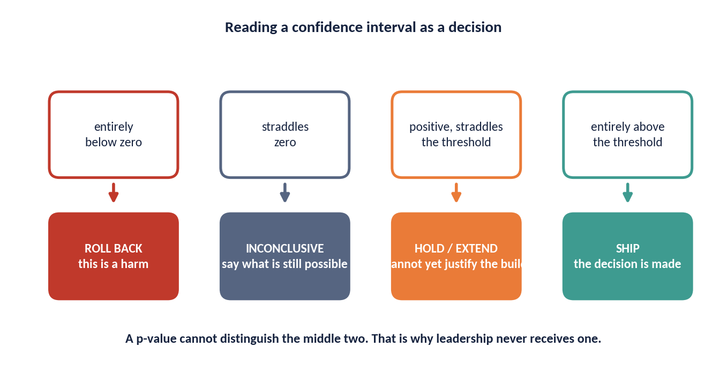
DAY 4 · HOUR 1
Reading an Interval as a Decision
A confidence interval maps onto four decisions. A p-value cannot distinguish the middle two, which is why leadership never receives one.
THE HARD CASE
'Positive, significant, and straddling the threshold' is the case that separates a specialist from an analyst.
The honest sentence is: the effect is real, and the data cannot yet tell us whether it is large enough to justify the build. That is a HOLD, not a ship.
ACADEMY OF EXCELLENCE · DAY 4 · UNCERTAINTY
156 / 268
Notes:
4 min - Day 4, Hour 1, the figure the capstone is built to test.
Walk the four bands in order. Dismiss the clearly-below and clearly-above cases quickly, since nobody needs a specialist for those. Point next at the interval sitting wholly under the practical threshold, a real but too-small effect. Spend your time on the fourth, the interval straddling the threshold: this is the capstone geometry exactly, a true lift of +1.4 pp against a 1.0 pp threshold with an interval built to cross it.
ASK: Significant, and the interval crosses your threshold. Ship or hold? Steer firmly to hold or extend, and make them justify it in one sentence.
WATCH FOR: Sliding from statistically significant to therefore ship. Plant the flag here.
LINK: injaz_autofill_ab.csv, capstone Hour 4.

Slide 157
DAY 4 · HOUR 1
Uncertainty: A Practitioner's Checklist
Before reporting any effect, run down this list.
Does the standard error match the assignment mechanism (robust / clustered / design-based)?
Is clustering at the correct level, with enough clusters for the method used?
Have you reported an interval, not just a point and a p-value?
Have you separated sampling uncertainty from identification uncertainty?
For a decision, have you translated the interval into expected value and downside risk?
ACADEMY OF EXCELLENCE · DAY 4 · UNCERTAINTY
157 / 268
Notes:
3 min - Day 4, Hour 1, checklist before the knowledge check.
Do not read the five items. Tell them this is the list a reviewer runs on their memo, and work one item hard: separating sampling from identification uncertainty is the one almost nobody does and the one that most marks out a senior analysis. Add that translating an interval into expected value and downside risk is the difference between a report that is read and one that is acted on.
ASK: Which of these five did you actually do in your last piece of work? Steer to an honest count; in most rooms it is two or three.
WATCH FOR: Treating the list as compliance to append at the end. Every item is a design decision made before data collection.
LINK: The rubric weights diagnostics and sensitivity at 20 percent.

Slide 158
DAY 4 · HOUR 1
Knowledge Check: Uncertainty
Q1
A regional policy is assigned per region, but you have person-level data. Cluster SEs at the level of:
A) Person B) Region C) Household D) Do not cluster
Q2
A 95% CI of [−0.2, 3.4] on a lift means:
A) No effect B) Effect is exactly 1.6 C) Data can't rule out a wide range D) The null is true
Q3
For a matching estimator, the naive bootstrap is:
A) Always valid B) Potentially invalid C) The only option D) Design-based
ACADEMY OF EXCELLENCE · DAY 4 · UNCERTAINTY
158 / 268
Notes:
5 min - Day 4, Hour 1, closing the uncertainty hour.
Vote first, discuss after. Q1 is B: treatment is assigned per region, so that is the level of the shock, and A attracts anyone reasoning from where the rows sit rather than where randomisation happened. D tempts people who have heard that few clusters are problematic, but the answer to that is a wild cluster bootstrap, never no clustering. Q2 is C; B is the classic misread of the midpoint as the answer. Q3 is B, which surprises yesterday's bootstrappers.
ASK: On Q1, how many clusters do we have, and does that change the method? Steer to 13 regions, few enough to require the wild cluster bootstrap.
WATCH FOR: Overconfidence on Q3. The failure of the naive bootstrap for matching is genuinely counter-intuitive.

Slide 159
DAY 4 · HOUR 2
Bias, Validity & Sensitivity
A working taxonomy of bias, internal vs. external validity, sampling limitations, and how to stress-test a causal claim.
ACADEMY OF EXCELLENCE · DAY 4
159 / 268
Notes:
1 min - Day 4, Hour 2 divider.
Two sentences. Frame the hour as giving names to failures they have already met: the collider demo where a correlation moved from 0.00 to -0.20 under conditioning, the roughly +14 pp of selection bias in the uploader simulator, and the support_calls mediator trap. Naming a bias precisely tells you where in the pipeline to fix it, which is the point of a taxonomy.
ASK: What separates a bias you can adjust away from one you cannot? Steer to the line between measured confounding and everything else.
WATCH FOR: Expecting a list to memorise. The hour is about diagnosis, so push them to map each bias onto a stage of their own data pipeline.
LINK: collider_sim.parquet from Day 3.

Slide 160
DAY 4 · HOUR 2
A Taxonomy of Bias
Name the bias precisely and you know where in the pipeline to fix it.
01
Confounding bias
A common cause of treatment and outcome distorts the association. Fixed by design or valid adjustment.
02
Selection bias
How units enter (or stay in) the sample is related to treatment and outcome — including collider conditioning and attrition.
03
Measurement bias
Systematic error in T, Y, or X — misclassification, proxy metrics, and differential measurement across arms.
04
Interference / spillover
One unit's treatment changes another's outcome, breaking SUTVA and biasing the contrast.
ACADEMY OF EXCELLENCE · DAY 4 · BIAS
160 / 268
Notes:
4 min - Day 4, Hour 2, the organising slide for the bias hour.
Walk the pipeline rather than the list, because where each bias enters is the teaching point. Confounding enters at assignment and is the only one design or adjustment reliably fixes. Selection enters at sampling and retention, with collider conditioning its subtlest form. Measurement enters at instrumentation, and the differential-across-arms version is what actually breaks experiments. Interference lives in the units, where covariate adjustment cannot help at all.
ASK: Which of these four does randomisation not fix? Steer to measurement and interference, both of which survive a perfect coin flip.
WATCH FOR: The reflex that more controls address all four. Controlling a collider or mediator actively creates bias, the commonest own goal in applied work.
LINK: The threats-to-validity review closing this hour.

Slide 161
DAY 4 · HOUR 2
Internal vs. External Validity
Two separate questions: is the estimate right for this sample, and does it transfer beyond it?
DO NOT CONFLATE THEM
A perfectly identified effect at a threshold (RDD) or for compliers (IV) can be exactly right internally and still not answer the population question you care about.
Internal validity
Does the estimate correctly reflect the causal effect within the study? Threatened by confounding, attrition, and non-compliance.
External validity
Does the effect generalise to other populations, settings, times, or treatment versions? A separate, often harder, claim.
The tension
Tightly controlled designs (RCTs, RDD) buy internal validity but can narrow external validity — the local effect may not travel.
ACADEMY OF EXCELLENCE · DAY 4 · VALIDITY
161 / 268
Notes:
4 min - Day 4, Hour 2, the distinction that closes Day 3.
Make it land by replaying yesterday. The RDD estimate is internally excellent and externally narrow, describing only units at the cutoff. The IV estimate of +7.8 pp is the effect on compliers, correct and local. Both can be exactly right and still fail the question a director is asking, which is what happens if we roll this out to everyone. Repeat the callout: they fail for different reasons and need different fixes.
ASK: Your RCT ran on volunteers in three urban regions. Which validity is threatened? Steer to external; randomisation fully protects the internal claim.
WATCH FOR: Using external validity as a general word for anything shaky. Force the precise question: which population, which setting, which version of the treatment.
LINK: Transport and reweighting next.

Slide 162
DAY 4 · HOUR 2
Sampling Limitations & Generalisation
Who is in your data determines who your conclusion is about.
Coverage
Convenience samples, opt-in panels, and platform data can systematically exclude the populations a decision must serve.
Effect transport
If the effect varies with covariates (CATE) and the target population's mix differs, the sample ATE will not transport.
Reweighting to target
Post-stratify or reweight the estimate to the target population's covariate distribution — and state the assumptions that licenses it.
ACADEMY OF EXCELLENCE · DAY 4 · VALIDITY
162 / 268
Notes:
3 min - Day 4, Hour 2, the practical follow-through on external validity.
The line to deliver is that who is in your data determines who your conclusion is about, and platform data systematically under-covers exactly the citizens a public service most needs to reach. Then give the condition for transport: the sample effect travels only if the effect does not vary with covariates, or if it does and you reweight to the target's mix. Say the assumption aloud.
ASK: A test run on app users is being used to justify a national rollout. What is the coverage gap? Steer to citizens who never installed the app.
WATCH FOR: Treating reweighting as a fix rather than a new assumption. It trades one untestable claim for another and cannot recover an absent subgroup.
LINK: The estimand step in the capstone.

Slide 163
DAY 4 · HOUR 2
Sensitivity Analysis for Unmeasured Confounding
Since unconfoundedness is untestable, quantify how strong a hidden confounder would need to be to overturn your result.
E-VALUE
≥ ?
The question it answers
‘How much unmeasured confounding would explain away the effect?’ — a bound, not a point.
Tools
The minimum strength of association an unmeasured confounder would need with both treatment and outcome to nullify the estimate. Bigger E-values mean more robust claims.
E-values, Rosenbaum bounds, and partial-R² / Cinelli–Hazlett benchmarks against observed covariates.
Reporting
State the tipping point and benchmark it: ‘a confounder as strong as X would be needed — and none such is plausible.’
ACADEMY OF EXCELLENCE · DAY 4 · SENSITIVITY
163 / 268
Notes:
4 min - Day 4, Hour 2, the technical heart of the bias hour.
Open by conceding the problem: unconfoundedness cannot be tested, so the professional response is to quantify what being wrong would take. Explain the logic once, then benchmark it against a covariate you did measure. Ground it in the course data, where a Rosenbaum Gamma near 1.2 on the training estimate means a confounder shifting treatment odds by only 20 percent overturns +6.5 pp. That is a fragile result.
ASK: Is a Gamma of 1.2 good or bad, and compared to what? Steer to bad, and to benchmarking against digital literacy rather than an abstract cutoff.
WATCH FOR: Reading an E-value as a p-value renamed. It bounds required confounding strength and makes no probability statement.
LINK: The health case, where a small E-value blocks a decision.

Slide 164
DAY 4 · HOUR 2
Placebo Tests & Negative Controls
Falsification checks that would fail if your design were invalid.
Negative-control outcome
An outcome the treatment cannot plausibly affect; a ‘detected effect’ there reveals residual confounding.
Negative-control exposure
A pseudo-treatment that should show no effect; if it does, the design is suspect.
Placebo timing / units
Apply the method where no effect can exist (pre-period, untreated units); a null there supports validity.
ACADEMY OF EXCELLENCE · DAY 4 · SENSITIVITY
164 / 268
Notes:
3 min - Day 4, Hour 2, the cheap checks nobody runs.
Sell these as the highest return per line of code in the course. The framing is falsification: run your method where the answer must be zero, and if it is not, the design is broken. Point to the pretrend version of the regional panel, where a placebo on the pre-period fires and correctly kills a DiD that would otherwise have reported a clean effect. A passed placebo is weak evidence; a failed one is decisive.
ASK: What is a good negative-control outcome for the reminder rollout? Steer to a service the campaign never touched, same users, same months.
WATCH FOR: Choosing a control the treatment could plausibly affect. Then a detected effect teaches you nothing.
LINK: The pretrend panel from Day 3.

Slide 165
DAY 4 · HOUR 2
A Threats-to-Validity Review
The checklist to run on any causal claim before you act on it.
Confounding — is every backdoor blocked, and could an unmeasured confounder remain?
Selection / attrition — who dropped out or was excluded, and is it related to treatment?
Measurement — are T, Y, and X measured the same way across arms?
Interference — could treated units affect controls?
External validity — does the estimand match the population and setting of the decision?
Robustness — do sensitivity, placebo, and negative-control checks hold up?
ACADEMY OF EXCELLENCE · DAY 4 · VALIDITY
165 / 268
Notes:
3 min - Day 4, Hour 2, the consolidation checklist.
Tell the room this is the review structure to use on each other's capstones. Work items four and five, since they are the ones skipped: a reminder campaign that spreads by word of mouth breaks SUTVA, and an estimand that quietly answers a different question than the decision is the most expensive error here because it is invisible in every diagnostic.
ASK: Which item would catch a mediator control? Steer to the first, since conditioning on a mediator opens a path rather than blocking a backdoor.
WATCH FOR: Running the list only on other people's work. Ask each participant which item their own most recent analysis would fail.
LINK: The capstone pitfalls slide in Hour 4.

Slide 166
DAY 4 · HOUR 2
Knowledge Check: Bias & Validity
Q1
An RDD estimate is unbiased at the cutoff but may not generalise. This is a limit of:
A) Internal validity B) External validity C) Measurement D) Power
Q2
A large E-value indicates the finding is:
A) Fragile to confounding B) Robust to confounding C) Underpowered D) Biased
Q3
Detecting an ‘effect’ on a negative-control outcome suggests:
A) Strong design B) Residual confounding C) High power D) Good overlap
ACADEMY OF EXCELLENCE · DAY 4 · VALIDITY
166 / 268
Notes:
5 min - Day 4, Hour 2, closing the bias and validity hour.
Vote, then unpack distractors. Q1 is B: the RDD estimate is unbiased where it applies, so A appeals to anyone hearing does not generalise as a synonym for wrong. Q2 is B, and A is picked by those who map large numbers onto large problems; the E-value is the confounding strength needed to destroy the result, so bigger is safer. Q3 is B, while A tempts people who read any detectable signal as good power.
ASK: On Q2, what E-value would you demand before a clinical rollout? Steer away from a magic number, toward benchmarking against the strongest measured covariate.
WATCH FOR: Argument on Q1 that is really about the word bias. Settle it by asking for whom the estimate is unbiased.

Slide 167
DAY 4 · HOUR 3
Real-World Case Studies
Three worked cases across technology, public policy, and health — from question to estimand to design to decision.
ACADEMY OF EXCELLENCE · DAY 4
167 / 268
Notes:
1 min - Day 4, Hour 3 divider.
Two sentences. The three cases come from different worlds because the reasoning chain is identical while the constraints differ: the tech case can randomise, the policy case cannot but has a threshold and a start date, and the health case cannot randomise at all and carries the highest stakes. Their job is to watch four steps repeat, question to estimand to design to decision.
ASK: Which constraint is closest to your own working reality? Steer to the honest answer in most government contexts, which is the middle case.
WATCH FOR: Dismissing the tech case as irrelevant to public sector work. Novelty effects and interference appear in any service rollout with users.
LINK: The capstone memo follows the same four steps.

Slide 168
CASE STUDY 1 · TECHNOLOGY
How a Rigorous Analyst Proceeds
Did the New Ranking Model Grow Engagement?
ESTIMAND
ATE of the new ranker on session time for the eligible user base — not the observed exposed-vs-unexposed gap.
CONTEXT
THREATS
A platform ships a re-ranked feed. Observational logs show +9% session time for exposed users. Leadership wants to attribute it to the model and roll out globally.
Exposure correlated with app version and power-user status (confounding); ranking changes the marketplace others see (interference).
DESIGN
Cluster-randomize by user with a hold-back; use CUPED on the pre-period metric; guardrail on latency and revenue.
DECISION
Ship only if the randomized lift is positive, guardrails hold, and the effect persists past the novelty window.
ACADEMY OF EXCELLENCE · DAY 4 · CASES
168 / 268
Notes:
4 min - Day 4, Hour 3, the first case study.
Run this as a demonstration of estimand discipline. The +9% from logs is wrong for a familiar reason: exposure tracks power-user status and app version, the same structure that inflated +5.0 pp into +19.3 pp in the uploader case. Then make the interference point, which separates this from a routine A/B test: a ranking change alters the marketplace everyone else sees, so SUTVA is not automatic. Note CUPED buys about 13.5 percent variance reduction here.
ASK: Why is user-level randomisation not sufficient? Steer to the shared marketplace, which cluster randomisation by market or region addresses.
WATCH FOR: Accepting guardrails as a formality. Latency and revenue guardrails are what stop a genuine engagement win being a net loss.
LINK: Case 2 next.

Slide 169
CASE STUDY 1 · TECHNOLOGY
Reading a Decaying Effect
The Novelty-Effect Trap
DIAGNOSIS
A short-lived spike as users react to change, then reversion — the classic novelty (or primacy) effect.
CONTEXT
WHAT TO TRUST
The randomized test shows +6% in week one, decaying to +1.5% by week four. Which number should govern the rollout decision?
The steady-state effect after the curve flattens, not the launch-week peak that would justify the ship.
DESIGN RESPONSE
Run long enough to reach steady state; pre-register the evaluation window; consider a staged holdback to measure long-run impact.
LESSON
Time is part of the estimand. ‘Effect at week one’ and ‘effect at steady state’ are different quantities.
ACADEMY OF EXCELLENCE · DAY 4 · CASES
169 / 268
Notes:
4 min - Day 4, Hour 3, the trap inside a correct experiment.
A clean randomised test still gives the wrong answer if the estimand ignores time. Walk the decay: +6% in week one falling to +1.5% by week four is not noise but reversion, and a rollout justified on launch week underdelivers fourfold. Say the design response plainly, that you pre-register the window before launch, because choosing it after seeing the curve is the peeking problem that ran false positives from 5 to 25 percent across 1 to 20 looks.
ASK: How long is long enough? Steer to a domain answer, one or two full usage cycles, fixed in advance.
WATCH FOR: Assuming decay always means novelty. Learning effects grow over time, and only a longer test distinguishes them.
LINK: The pre-registration discussion on Day 2.

Slide 170
CASE STUDY 2 · PUBLIC POLICY
Choosing the Identification Strategy
Did the Training Subsidy Raise Employment?
TWO NATURAL DESIGNS
A threshold rule (headcount cutoff) invites RDD; a known start date with comparison regions invites DiD / synthetic control.
CONTEXT
RDD CHECK
A region introduces an employment-training subsidy for firms above a headcount threshold, starting in a known year. Employment rose 4 points among adopters.
Test for firms bunching just above the cutoff (manipulation) and covariate continuity through it.
DID CHECK
Inspect pre-trends via an event study; consider staggered-adoption-robust estimators if timing varies.
TRIANGULATE
Report both designs; agreement across independent assumptions is the strongest evidence available without an experiment.
ACADEMY OF EXCELLENCE · DAY 4 · CASES
170 / 268
Notes:
4 min - Day 4, Hour 3, the public policy case.
This is the triangulation slide, so spend the time on why two designs beat one. The headcount threshold gives RDD and the known start year gives DiD, and crucially they fail for unrelated reasons: RDD from firms managing headcount under the cutoff, DiD from divergent pre-trends. Connect it to the panel exercise, where TWFE gave +2.6 pp against a true ATT of +3.0 pp purely from a two-month ramp-in, so a small gap can be mechanical.
ASK: The two designs disagree by a factor of two. What now? Steer to diagnosing which assumption failed, never averaging.
WATCH FOR: Believing agreement proves validity. Two designs sharing an unmeasured confounder agree and are both wrong.
LINK: injaz_regions_panel.csv, adoption in periods 10, 13, 16, 19.

Slide 171
CASE STUDY 3 · HEALTH
Confounding by Indication
Does the New Protocol Reduce Readmissions?
THE CORE THREAT
Confounding by indication — severity drives both who gets the protocol and the outcome, biasing the naive comparison.
CONTEXT
IF RANDOMIZATION IS BARRED
A hospital adopts a discharge protocol. Observational data show treated patients readmit less — but sicker patients were less likely to receive it.
Use doubly-robust adjustment on rich clinical covariates; check overlap and balance carefully.
LOOK FOR A NATURAL EXPERIMENT
Staggered ward rollout (DiD) or a clinical eligibility threshold (RDD) can strengthen identification.
SENSITIVITY
Report an E-value; a small one here (weak robustness) should block a high-stakes clinical decision.
ACADEMY OF EXCELLENCE · DAY 4 · CASES
171 / 268
Notes:
4 min - Day 4, Hour 3, the highest-stakes case.
Confounding by indication is the cleanest real confounder in the course, and it runs in the direction that flatters the treatment: sicker patients were less likely to receive the protocol, so the treated group readmits less even if the protocol does nothing. Make the stakes explicit, because this is where sensitivity earns its place: a small E-value should block the decision outright, as a Gamma of 1.2 should have unsettled everyone yesterday.
ASK: If severity is fully recorded in the clinical notes, is adjustment enough? Steer to the gap between what a clinician judged and what the record captured.
WATCH FOR: Confidence that rich covariates solve it. Richness is not sufficiency, and unrecorded clinical judgement is precisely the unmeasured confounder.
LINK: E-values and Rosenbaum bounds from Hour 2.

Slide 172
DAY 4 · HOUR 3
Decision-Making Under Causal Uncertainty
The analyst's job ends not at an estimate but at a defensible decision.
PROFESSIONAL STANDARD
A good causal report lets a reader see exactly which assumption the recommendation rests on — and how the decision would change if it failed.
From effect to expected value
Combine the effect distribution with payoffs and costs to compute expected value and downside risk, not just significance.
Value of information
When uncertainty is decision-relevant, quantify what a further experiment would be worth before running it.
Communicate honestly
State the estimand, the key assumption, the interval, and the sensitivity — so decision-makers own the risk knowingly.
ACADEMY OF EXCELLENCE · DAY 4 · CASES
172 / 268
Notes:
4 min - Day 4, Hour 3, the professional standard slide.
Here the course states what the job actually is. Significance is not a decision rule, because it says nothing about payoff size or the cost of being wrong: a significant +0.3 pp lift on an expensive build is a bad decision, and a non-significant +2 pp on a free config change may be a good one. Introduce value of information as a real tool, and if extra precision would change no decision, do not run the test.
ASK: What would you need beyond the effect size to make the call? Steer to build cost, the threshold that matters, and the downside at the interval's lower end.
WATCH FOR: Analysts treating the decision as somebody else's problem. A bare number transfers no risk, it hides it.
LINK: The capstone decision memo.

Slide 173
DAY 4 · HOUR 3
Cross-Case Lessons
Patterns that recur across every domain.
The naive observational number is almost always the wrong number — and usually too large.
The estimand includes time; short-run and steady-state effects differ.
When you cannot randomize, triangulate across designs with different assumptions.
High-stakes decisions demand sensitivity analysis, not just a tight interval.
The deliverable is a decision with owned risk, not a p-value.
ACADEMY OF EXCELLENCE · DAY 4 · CASES
173 / 268
Notes:
3 min - Day 4, Hour 3, closing the case studies.
Compress three cases into one habit. The naive observational number is both wrong and too large in every case in this course: +19.3 against +5.0 in the uploader simulator, +11.5 against +6.0 in the training programme, +10.9 against +8.0 in the filing IV. The direction is no coincidence, since the people who select into a treatment tend to be those already succeeding.
ASK: Can anyone give a case where self-selection biases the estimate downward? Steer to remediation programmes, where the struggling users are the ones who enrol.
WATCH FOR: Learning the rule as always subtract some bias. The lesson is to identify the selection mechanism and reason about its sign, not to apply a fixed haircut.
LINK: The capstone brief in Hour 4.

Slide 174
DAY 4 · APPLIED TRANSFER
Open-Data Case Studio
Six real datasets turn the course methods into reusable practice — each case ends with an estimand, a diagnostic, and a decision.
ACADEMY OF EXCELLENCE · DAY 4 · CASE STUDIO
174 / 268
Notes:
Use this optional studio after the existing cross-case lessons or distribute the cases across Days 1–4.
[Sources]
- https://ailab.criteo.com/criteo-uplift-prediction-dataset/
- https://ailab.criteo.com/ressources/
- https://rdrr.io/cran/AER/man/STAR.html
- https://CRAN.R-project.org/package=AER
- https://cran.univ-lyon1.fr/CRAN/web/packages/MatchIt/vignettes/assessing-balance.html
- https://cran.univ-lyon1.fr/CRAN/web/packages/MatchIt/vignettes/MatchIt.html
- https://bcallaway11.github.io/did/
- https://rdrr.io/cran/did/man/mpdta.html
- https://www.nber.org/oregon
- https://www.nber.org/research/data/oregon-health-insurance-experiment-data
- https://www.nber.org/programs-projects/projects-and-centers/oregon-health-insurance-experiment/oregon-health-insurance-experiment-documents
- https://github.com/synth-inference/synthdid/blob/master/R/data.R
- https://github.com/synth-inference/synthdid

Slide 175
CASE STUDIO · FACILITATION
Run Every Case Through the Same Cycle
Transfer comes from repeating the reasoning pattern, not memorising another estimator.
TRANSFER RULE
First plant and recover a known effect on Injaz. Then use the real dataset, where the truth is hidden, and defend the assumption that replaces ground truth.
Frame before opening the file
Name the decision, treatment, outcome, target population, estimand, and plausible counterfactual.
Diagnose before estimating
Draw the assignment story; state the identifying assumption; choose the diagnostic that could expose failure.
Decide before celebrating
Translate the effect and interval into a ship, scale, hold, or redesign call — with one condition that would change it.
ACADEMY OF EXCELLENCE · OPEN-DATA CASE STUDIO
175 / 268
Notes:
The cycle mirrors the instructor package: simulation first, application second, decision last.
[Sources]
- https://ailab.criteo.com/criteo-uplift-prediction-dataset/
- https://ailab.criteo.com/ressources/
- https://rdrr.io/cran/AER/man/STAR.html
- https://CRAN.R-project.org/package=AER
- https://cran.univ-lyon1.fr/CRAN/web/packages/MatchIt/vignettes/assessing-balance.html
- https://cran.univ-lyon1.fr/CRAN/web/packages/MatchIt/vignettes/MatchIt.html
- https://bcallaway11.github.io/did/
- https://rdrr.io/cran/did/man/mpdta.html
- https://www.nber.org/oregon
- https://www.nber.org/research/data/oregon-health-insurance-experiment-data
- https://www.nber.org/programs-projects/projects-and-centers/oregon-health-insurance-experiment/oregon-health-insurance-experiment-documents
- https://github.com/synth-inference/synthdid/blob/master/R/data.R
- https://github.com/synth-inference/synthdid

Slide 176
CASE STUDIO 1 · DIGITAL
Assignment, exposure, and uplift
Did the Ad Cause Conversion?
ESTIMAND
Start with ITT: the effect of assignment to targeting on conversion or visit probability.
OPEN DATA
COMPLIANCE
Criteo assembled randomized incrementality tests into an anonymized uplift dataset. The unbiased release has about 14 million user rows and distinguishes assignment, exposure, visits, and conversions.
Exposure is post-assignment. Comparing exposed users with controls breaks randomization; use assignment as the instrument.
HETEROGENEITY
Estimate CATE only after the average effect and multiplicity plan are fixed.
DECISION
Target only if incremental conversions exceed delivery cost and the uplift survives honest validation.
ACADEMY OF EXCELLENCE · OPEN-DATA CASE STUDIO
176 / 268
Notes:
Download the unbiased release listed on the official Criteo AI Lab page; use a sampled extract for classroom speed.
[Sources]
- https://ailab.criteo.com/criteo-uplift-prediction-dataset/
- https://ailab.criteo.com/ressources/

Slide 177
CASE STUDIO · TEAM ACTIVITY
Criteo: Measure Incrementality, Not Response
STEPS
OBJECTIVE
Load a stratified sample; verify treatment coding, outcome rates, missingness, and the planned allocation ratio.
1
Estimate the randomized effect of ad assignment, then show why an exposed-only comparison answers a different and biased question.
2
Estimate ITT for visits and conversions with risk differences and confidence intervals.
3
Measure the first stage: how strongly assignment changes actual exposure.
DELIVERABLE
4
Compare ITT with the naive exposed-vs-control difference; explain the selection mechanism.
A one-page experiment readout: planned allocation check, ITT with CI, exposure first stage, and one guarded targeting recommendation.
5
Optional: estimate a simple CATE model with honest train/test separation and subgroup correction.
6
Recommend target, hold, or redesign; state the minimum incremental value needed to ship.
ACADEMY OF EXCELLENCE · OPEN-DATA CASE STUDIO
177 / 268
Notes:
Suggested timing: 50 minutes in pairs. Provide a 200k-row sample if memory is constrained.
[Sources]
- https://ailab.criteo.com/criteo-uplift-prediction-dataset/
- https://ailab.criteo.com/ressources/

Slide 178
CASE STUDIO 2 · EDUCATION
A randomized design with hierarchy
Do Smaller Classes Improve Learning?
ESTIMAND
Define the ITT of assignment to a small class on the combined reading and mathematics score.
OPEN DATA
DESIGN
Project STAR randomly assigned students and teachers within participating schools to small, regular, or regular-with-aide classes. AER distributes the public-access data with 11,598 rows and 47 variables.
Schools act as blocks; pupils, teachers, and classrooms create a multilevel dependence structure.
DIAGNOSTIC
Check arm counts, baseline balance, attrition, and treatment switching before estimating effects.
INFERENCE
Match standard errors to the assignment and clustering structure; do not treat every pupil-year as independent.
ACADEMY OF EXCELLENCE · OPEN-DATA CASE STUDIO
178 / 268
Notes:
The AER documentation describes the public-access STAR data, three class conditions, and the 11,598-row format.
[Sources]
- https://rdrr.io/cran/AER/man/STAR.html
- https://CRAN.R-project.org/package=AER

Slide 179
CASE STUDIO · TEAM ACTIVITY
Project STAR: Respect the Randomization
STEPS
OBJECTIVE
Create the treatment contrast: small class versus regular class; document exclusions before seeing outcomes.
1
Estimate the small-class effect while preserving the school-blocked, hierarchical design that generated the data.
2
Build the combined test-score outcome and report missingness by assignment arm.
3
Check balance within schools and flag treatment switching across grades.
DELIVERABLE
4
Estimate the ITT with school-block indicators and a design-appropriate uncertainty method.
An estimate table comparing naive, school-adjusted, and clustered/design-aware inference, plus an attrition and switching note.
5
Compare with a naive pupil-level standard error; explain why certainty changes.
6
Write the policy conclusion and one limit on transport beyond participating schools.
ACADEMY OF EXCELLENCE · OPEN-DATA CASE STUDIO
179 / 268
Notes:
Suggested timing: 50 minutes. Advanced groups can reshape the four grades to long format and study persistence.
[Sources]
- https://rdrr.io/cran/AER/man/STAR.html
- https://CRAN.R-project.org/package=AER

Slide 180
CASE STUDIO 3 · WORKFORCE
A benchmark for observational adjustment
Can Matching Recover Training Impact?
ESTIMAND
Target the ATT on 1978 earnings: the effect for people who actually received training.
OPEN DATA
THREAT
The MatchIt LaLonde file combines 185 treated National Supported Work participants with 429 PSID comparison units. Pre-treatment demographics and 1974–75 earnings make selection bias visible.
Programme participants and comparison units differ sharply before treatment; regression alone can extrapolate.
DIAGNOSTIC
Inspect propensity overlap and standardized mean differences before looking at the outcome estimate.
LIMIT
Balance on measured covariates does not prove ignorability; sensitivity to hidden bias remains essential.
ACADEMY OF EXCELLENCE · OPEN-DATA CASE STUDIO
180 / 268
Notes:
The MatchIt vignette documents 614 observations, the ATT target, and the standard balance workflow.
[Sources]
- https://cran.univ-lyon1.fr/CRAN/web/packages/MatchIt/vignettes/assessing-balance.html
- https://cran.univ-lyon1.fr/CRAN/web/packages/MatchIt/vignettes/MatchIt.html

Slide 181
CASE STUDIO · TEAM ACTIVITY
LaLonde: Balance Before Effect
STEPS
OBJECTIVE
State the ATT and freeze age, education, race, marriage, degree, and 1974–75 earnings as pre-treatment covariates.
1
Build a matched comparison for job training and decide whether the adjusted estimate is credible enough for a funding recommendation.
2
Estimate propensity scores; plot treated and control support before matching.
3
Match or weight; iterate only on balance, never on the treatment-effect result.
DELIVERABLE
4
Require absolute SMD below 0.10 or explain any residual imbalance and estimand change.
A love plot, common-support decision, matched ATT with uncertainty, and a two-sentence hidden-confounding caveat.
5
Estimate the ATT with an uncertainty method that accounts for the matched design.
6
Stress-test one unmeasured confounder and issue a fund, hold, or collect-more-data verdict.
ACADEMY OF EXCELLENCE · OPEN-DATA CASE STUDIO
181 / 268
Notes:
Suggested timing: 50 minutes. Hide re78 until the balance gate passes.
[Sources]
- https://cran.univ-lyon1.fr/CRAN/web/packages/MatchIt/vignettes/assessing-balance.html
- https://cran.univ-lyon1.fr/CRAN/web/packages/MatchIt/vignettes/MatchIt.html

Slide 182
CASE STUDIO 4 · POLICY
Staggered adoption changes the comparison
Do Wage Floors Change Teen Employment?
ESTIMAND
Estimate group-time ATT values, then aggregate only after inspecting heterogeneity across cohorts and years.
OPEN DATA
ASSUMPTION
The did package includes 2,500 county-year rows: 500 U.S. counties observed from 2003–2007, with staggered timing of state minimum-wage increases and log teen employment.
Parallel trends must hold for each treatment cohort against a valid not-yet-treated or never-treated comparison.
TRAP
Two-way fixed effects can use already-treated units as controls and mix effects with negative weights.
DECISION
Report dynamic effects and pre-trend evidence; avoid a single pooled number when timing matters.
ACADEMY OF EXCELLENCE · OPEN-DATA CASE STUDIO
182 / 268
Notes:
The official did documentation describes the 500-county, 2003–2007 teaching subset and group-time ATT workflow.
[Sources]
- https://bcallaway11.github.io/did/
- https://rdrr.io/cran/did/man/mpdta.html

Slide 183
CASE STUDIO 5 · HEALTH POLICY
A lottery creates an encouragement design
What Did Medicaid Coverage Change?
ITT
Lottery selection identifies the effect of being offered the chance to apply — a policy-relevant assignment effect.
OPEN DATA
FIRST STAGE
In 2008, Oregon used a lottery to allocate limited chances to apply for Medicaid. The study publishes public-use data, replication code, and archived analysis plans under a non-commercial data agreement.
Selection increased insurance coverage, but not every selected person enrolled; compliance is incomplete.
LATE
Use selection as an instrument for coverage only with relevance, exclusion, independence, and monotonicity defended.
DISCIPLINE
Separate utilization, financial strain, and health outcome families; respect the archived analysis plan.
ACADEMY OF EXCELLENCE · OPEN-DATA CASE STUDIO
183 / 268
Notes:
Review NBER's data-use terms before distribution. The materials are public-use but restricted to non-commercial use.
[Sources]
- https://www.nber.org/oregon
- https://www.nber.org/research/data/oregon-health-insurance-experiment-data
- https://www.nber.org/programs-projects/projects-and-centers/oregon-health-insurance-experiment/oregon-health-insurance-experiment-documents

Slide 184
CASE STUDIO · TEAM ACTIVITY
Minimum Wage: Modern DiD Under Staggered Timing
STEPS
OBJECTIVE
Profile first-treatment year and identify never-treated and not-yet-treated county groups.
1
Compare a conventional two-way fixed-effects estimate with cohort-aware group-time effects on teen employment.
2
Plot raw mean trends by cohort before fitting a model.
3
Estimate a conventional TWFE coefficient and record the implicit comparison concern.
DELIVERABLE
4
Estimate group-time ATT values with the did workflow and aggregate by event time.
A cohort timing map, event-study plot, TWFE comparison, and a credibility verdict on parallel trends.
5
Inspect pre-treatment coefficients and add a placebo treatment date.
6
Explain any disagreement between estimators before making the policy recommendation.
ACADEMY OF EXCELLENCE · OPEN-DATA CASE STUDIO
184 / 268
Notes:
Suggested timing: 50–75 minutes. Use the package vignette for the supported estimator sequence.
[Sources]
- https://bcallaway11.github.io/did/
- https://rdrr.io/cran/did/man/mpdta.html

Slide 185
CASE STUDIO · TEAM ACTIVITY
Oregon: Put the Instrument on Trial
STEPS
OBJECTIVE
Read the archived analysis plan; freeze one outcome family and denominator.
1
Use the lottery to estimate assignment effects, then decide whether a coverage effect is identified and for whom.
2
Estimate the ITT of lottery selection with the randomization unit respected.
3
Estimate the first stage from selection to insurance coverage and report its strength.
DELIVERABLE
4
Compute 2SLS; describe the compliers represented by the LATE.
An ITT table, first-stage estimate, 2SLS/LATE result, and a written defence of exclusion and monotonicity.
5
Run an instrument courtroom: one team defends exclusion, another constructs a direct path to the outcome.
6
Write separate conclusions for the offer policy and for Medicaid coverage itself.
ACADEMY OF EXCELLENCE · OPEN-DATA CASE STUDIO
185 / 268
Notes:
Suggested timing: 75–90 minutes. Use only under the NBER public-use agreement and keep the exercise non-commercial.
[Sources]
- https://www.nber.org/oregon
- https://www.nber.org/research/data/oregon-health-insurance-experiment-data
- https://www.nber.org/programs-projects/projects-and-centers/oregon-health-insurance-experiment/oregon-health-insurance-experiment-documents

Slide 186
CASE STUDIO 6 · PUBLIC HEALTH
Build the missing California
Did Proposition 99 Reduce Smoking?
ESTIMAND
Estimate California's post-1989 effect on per-capita cigarette packs relative to its untreated counterfactual.
OPEN DATA
DESIGN
The synthdid package distributes a 1,209-row panel for 39 U.S. states from 1970–2000. California is treated from 1989, after Proposition 99 raised tobacco taxes and funded control efforts.
Choose donor-state weights that reproduce California's pre-treatment trajectory; prediction quality is visible.
DIAGNOSTIC
Inspect pre-period RMSPE, placebo-in-space gaps, leave-one-out stability, and donor concentration.
LIMIT
Synthetic control identifies one treated unit under a stable donor pool; uncertainty is design- and placebo-based.
ACADEMY OF EXCELLENCE · OPEN-DATA CASE STUDIO
186 / 268
Notes:
The synthdid data documentation reports 1,209 rows, 39 states, 1970–2000, and treatment from 1989.
[Sources]
- https://github.com/synth-inference/synthdid/blob/master/R/data.R
- https://github.com/synth-inference/synthdid

Slide 187
CASE STUDIO · TEAM ACTIVITY
Proposition 99: Build a Credible Counterfactual
STEPS
OBJECTIVE
Plot California and candidate donors; justify exclusions before optimizing weights.
1
Construct a synthetic California, measure the post-treatment gap, and test whether the result is exceptional among placebo states.
2
Fit donor weights on the pre-1989 period and report pre-treatment RMSPE.
3
Plot the observed-minus-synthetic gap through 2000 and summarize the post-period effect.
DELIVERABLE
4
Run placebo-in-space estimates and compare post/pre RMSPE ratios.
A pre/post fit plot, donor-weight table, placebo distribution, and a sensitivity-based tobacco-policy verdict.
5
Repeat after removing the largest donor weight; explain any instability.
6
Compare with a simple DiD and state which assumptions drive the difference.
ACADEMY OF EXCELLENCE · OPEN-DATA CASE STUDIO
187 / 268
Notes:
Suggested timing: 50–75 minutes. Advanced groups can compare synthetic control and synthetic DiD.
[Sources]
- https://github.com/synth-inference/synthdid/blob/master/R/data.R
- https://github.com/synth-inference/synthdid

Slide 188
CASE STUDIO · OPEN DATA
Open Datasets You Can Reuse
Dataset | Design & scale | Best teaching use
Criteo Uplift | Randomized; 13.98M rows | ITT, exposure, uplift, CATE
AER::STAR | Blocked RCT; 11,598 × 47 | Units, hierarchy, attrition
MatchIt::lalonde | Observational; 614 × 9 | Matching, overlap, ATT
did::mpdta | Panel; 2,500 × 6 | Staggered DiD, event study
NBER Oregon HIE | Lottery; public-use files | ITT, IV/LATE, preregistration
synthdid::Prop99 | Panel; 1,209 × 4 | Synthetic control, placebos
ACADEMY OF EXCELLENCE · OPEN-DATA CASE STUDIO
188 / 268
Notes:
Access note: Criteo has dataset terms; Oregon HIE requires agreement to non-commercial public-use conditions; confirm terms before each cohort.
[Sources]
- https://ailab.criteo.com/criteo-uplift-prediction-dataset/
- https://ailab.criteo.com/ressources/
- https://rdrr.io/cran/AER/man/STAR.html
- https://CRAN.R-project.org/package=AER
- https://cran.univ-lyon1.fr/CRAN/web/packages/MatchIt/vignettes/assessing-balance.html
- https://cran.univ-lyon1.fr/CRAN/web/packages/MatchIt/vignettes/MatchIt.html
- https://bcallaway11.github.io/did/
- https://rdrr.io/cran/did/man/mpdta.html
- https://www.nber.org/oregon
- https://www.nber.org/research/data/oregon-health-insurance-experiment-data
- https://www.nber.org/programs-projects/projects-and-centers/oregon-health-insurance-experiment/oregon-health-insurance-experiment-documents
- https://github.com/synth-inference/synthdid/blob/master/R/data.R
- https://github.com/synth-inference/synthdid

Slide 189
CASE STUDIO · FACILITATION
Scale Any Case to the Time Available
Protect the reasoning gates even when code time is short.
15 min · Assumption hunt — name the estimand, draw the assignment story, and identify the load-bearing assumption.
30 min · Diagnostic sprint — inspect balance, overlap, pre-trends, first stage, or pre-fit; issue a credibility gate.
50 min · Core analysis — estimate one effect with correct uncertainty and write a decision paragraph.
90 min · Decision lab — add falsification or sensitivity, reconcile a second method, and present to a skeptical board.
Debrief rule — teams state the estimand and identifying assumption before revealing the estimate.
ACADEMY OF EXCELLENCE · OPEN-DATA CASE STUDIO
189 / 268
Notes:
Recommended placement: Criteo/STAR on Day 2; LaLonde/mpdta on Day 3; Oregon/Prop99 on Day 4 or as extensions.
[Sources]
- https://ailab.criteo.com/criteo-uplift-prediction-dataset/
- https://ailab.criteo.com/ressources/
- https://rdrr.io/cran/AER/man/STAR.html
- https://CRAN.R-project.org/package=AER
- https://cran.univ-lyon1.fr/CRAN/web/packages/MatchIt/vignettes/assessing-balance.html
- https://cran.univ-lyon1.fr/CRAN/web/packages/MatchIt/vignettes/MatchIt.html
- https://bcallaway11.github.io/did/
- https://rdrr.io/cran/did/man/mpdta.html
- https://www.nber.org/oregon
- https://www.nber.org/research/data/oregon-health-insurance-experiment-data
- https://www.nber.org/programs-projects/projects-and-centers/oregon-health-insurance-experiment/oregon-health-insurance-experiment-documents
- https://github.com/synth-inference/synthdid/blob/master/R/data.R
- https://github.com/synth-inference/synthdid

Slide 190
CASE STUDIO · CAPSTONE BRIDGE
Offer an Open-Data Capstone Path
Keep Injaz as the default assessment; use these alternatives for transfer, make-up work, or advanced cohorts.
NON-NEGOTIABLE EVIDENCE
Every pathway submits the same spine: frozen question → estimand → design → estimate + CI → diagnostic → assumption risk → what would change the decision.
Experiment pathway
Criteo or STAR: design-aware ITT, integrity checks, correct uncertainty, and an operational decision.
Quasi-experiment pathway
LaLonde, mpdta, or Prop99: explicit identification, diagnostic gate, sensitivity or placebo, and bounded claim.
Encouragement pathway
Oregon HIE: ITT, first stage, LATE, instrument defence, and separate recommendations for offer and receipt.
ACADEMY OF EXCELLENCE · OPEN-DATA CASE STUDIO
190 / 268
Notes:
The instructor package's Injaz capstone remains the primary assessment. These alternatives preserve the same reasoning-first rubric.
[Sources]
- https://ailab.criteo.com/criteo-uplift-prediction-dataset/
- https://ailab.criteo.com/ressources/
- https://rdrr.io/cran/AER/man/STAR.html
- https://CRAN.R-project.org/package=AER
- https://cran.univ-lyon1.fr/CRAN/web/packages/MatchIt/vignettes/assessing-balance.html
- https://cran.univ-lyon1.fr/CRAN/web/packages/MatchIt/vignettes/MatchIt.html
- https://bcallaway11.github.io/did/
- https://rdrr.io/cran/did/man/mpdta.html
- https://www.nber.org/oregon
- https://www.nber.org/research/data/oregon-health-insurance-experiment-data
- https://www.nber.org/programs-projects/projects-and-centers/oregon-health-insurance-experiment/oregon-health-insurance-experiment-documents
- https://github.com/synth-inference/synthdid/blob/master/R/data.R
- https://github.com/synth-inference/synthdid

Slide 191
DAY 4 · HOUR 4
Capstone Project
Integrate the whole course: define an estimand, choose and defend a design, estimate with valid uncertainty, and report a decision.
ACADEMY OF EXCELLENCE · DAY 4
191 / 268
Notes:
1 min - Day 4, Hour 4 divider into the capstone.
Two sentences, then move to the brief, because they need the working time. Say only that the capstone is scored on the reasoning chain rather than on hitting a number, and that the dataset is built so the defensible answer is not the obvious one. The memo matters as much as the notebook, and they will defend it aloud in Hour 5.
ASK: What is the first thing you will write, before touching the data? Steer to the estimand and the decision it serves, not to loading the CSV.
WATCH FOR: Groups opening the notebook during this slide. Hold them, since the two highest-weighted rubric criteria are decided before any code runs.
LINK: injaz_autofill_ab.csv; capstone_starter.

Slide 192
DAY 4 · CAPSTONE
Design, Estimate, Defend
STEPS
OBJECTIVE
State the decision and translate it into a precise estimand and target population.
1
On a provided realistic dataset with a business or policy question, deliver an end-to-end causal analysis that a decision-maker could act on — with every assumption made explicit.
2
Draw the DAG; justify the identification strategy (experiment, adjustment, or quasi-experiment).
3
Run overlap, balance, and pre-trend / placebo diagnostics appropriate to the design.
DELIVERABLE
4
Estimate the effect with a design-matched standard error and an honest interval.
A notebook + a two-page decision memo: estimand, DAG, design, estimate with interval, diagnostics, sensitivity analysis, and a clear recommendation.
5
Perform a sensitivity analysis (E-value or bounds) and a robustness check.
6
Write the decision memo: recommendation, the key assumption, and how the call would change if it failed.
ACADEMY OF EXCELLENCE · DAY 4 · CAPSTONE
192 / 268
Notes:
5 min - Day 4, Hour 4, the capstone brief; hold to five minutes.
Read the deliverable, then be explicit about the geometry without giving the answer away. The autofill test has a true lift of +1.4 pp against a practical threshold of 1.0 pp, and the interval is built to straddle that threshold, so a correct analysis yields a significant result that still does not justify shipping. Insist they write the threshold down in step 1, since one chosen after seeing the interval is worthless.
ASK: What decision does this analysis serve, and what is the smallest effect that would change it? Steer to a number stated in advance on cost grounds.
WATCH FOR: Teams that reach p under 0.05 and stop. That is the exact failure this dataset is engineered to expose.
LINK: capstone_starter, injaz_autofill_ab.csv.

Slide 193
DAY 4 · CAPSTONE
Capstone Rubric
Scored against five weighted criteria; the memo and the diagnostics carry as much weight as the estimate.
Criterion | What excellence looks like | Weight
Estimand & question | Precise, decision-relevant, correct population | 15%
Identification & design | Assumptions explicit; design fits the constraints | 25%
Estimation & inference | Correct estimator; design-matched, honest uncertainty | 25%
Diagnostics & sensitivity | Overlap/balance/placebo + sensitivity reported | 20%
Communication & decision | Clear memo; risk owned; assumption-linked call | 15%
ACADEMY OF EXCELLENCE · DAY 4 · CAPSTONE
193 / 268
Notes:
4 min - Day 4, Hour 4, straight after the brief.
Walk the weights, not the descriptions, because the weights are the message: identification and estimation carry 25 percent each, so half the score is settled before any recommendation is written, and diagnostics and sensitivity add 20 percent. Say plainly that a correct point estimate with no diagnostics scores badly, while a well-diagnosed analysis reaching a cautious hold scores well. The estimand row is the cheapest 15 percent in the rubric.
ASK: Where does a notebook that ships on p under 0.05 lose marks? Steer to communication and to diagnostics, since the estimation itself may be fine.
WATCH FOR: Reading the rubric as a checklist for the end. Identification choices in the first ten minutes determine most of the score.
LINK: The pitfalls slide next.

Slide 194
DAY 4 · CAPSTONE
Common Capstone Pitfalls to Avoid
The mistakes that most often cost points — and credibility.
Reporting a naive comparison without naming the identifying assumption.
Adjusting for a post-treatment variable (mediator or collider).
A standard error that does not match the design (unclustered grouped data).
A confident recommendation with no sensitivity analysis behind it.
An estimand that quietly differs from the decision the stakeholder must make.
ACADEMY OF EXCELLENCE · DAY 4 · CAPSTONE
194 / 268
Notes:
3 min - Day 4, Hour 4, the pre-mortem before they start work.
Give each pitfall a name from earlier in the course so it is recognisable. The post-treatment control is the support_calls mediator from the DAG exercise. The mismatched standard error is the session-level mistake, worth 1.6 times in width. The confident recommendation with no sensitivity is the training estimate with its Gamma of 1.2. The quiet estimand mismatch is trigger dilution, which turned +2.2 pp into +1.3 pp.
ASK: Which of these five have you personally shipped? Steer to a show of hands; the mediator control is nearly universal.
WATCH FOR: Adjusting for anything correlated with the outcome because it improves fit. Fit is not evidence about which variables belong in the model.
LINK: The adjustment set digital_literacy and device_age.

Slide 195
DAY 4 · CAPSTONE
What a Great Deliverable Looks Like
Aim for a report a skeptical reviewer could not easily dismiss.
Transparent
The DAG, the assumptions, and the code are all visible; nothing load-bearing is hidden.
Diagnosed
Overlap, balance, and design-specific checks are shown, not asserted.
Honest about uncertainty
Both sampling and identification uncertainty are communicated, with a sensitivity bound.
Actionable
It ends in a decision, with the risk explicitly owned by the reader.
ACADEMY OF EXCELLENCE · DAY 4 · CAPSTONE
195 / 268
Notes:
3 min - Day 4, Hour 4, the last slide before the working block.
Frame the four qualities as one test: could a skeptical reviewer find the load-bearing assumption without asking you? If yes the report is transparent; if not it is a sales document. Stress the word both in the third box, since reporting sampling uncertainty alone is the standard omission that makes a fragile estimate look settled.
ASK: What separates honest uncertainty from hedging? Steer to specificity: honest uncertainty names the assumption and the tipping point, while hedging is vague everywhere.
WATCH FOR: Confusing length with rigour. A two-page memo that names one assumption clearly beats twenty pages that bury it.
LINK: Capstone defense format in Hour 5.

Slide 196
DAY 4 · HOUR 5
Defense, Post-Test & Close
Present and defend the capstone, complete the summative assessment, and consolidate the course into durable judgment.
ACADEMY OF EXCELLENCE · DAY 4
196 / 268
Notes:
1 min - Day 4, Hour 5 divider.
Two sentences. The hour has three parts: defenses first while the analysis is fresh, then the post-test, then consolidation. Set the tone for the defense explicitly, that the challenge questions are not hostile but exactly what a stakeholder review asks, and that the expected answer to which assumption is doing the work is a specific one rather than a general reassurance.
ASK: What is the question you least want to be asked about your capstone? Steer them to prepare that answer first; it is almost always the assumption question.
WATCH FOR: Teams still coding through the defenses. Close laptops, because the value of the hour is hearing five other reasoning chains.
LINK: The post-test covers all four days.

Slide 197
DAY 4 · HOUR 5
Capstone Defense Format
A short, high-signal defense that mirrors a real stakeholder review.
Five-minute presentation: question, estimand, design, estimate, decision.
Peer and facilitator challenge: ‘which assumption is doing the work, and how do you know?’
Defend your sensitivity analysis and the robustness of the recommendation.
Reflect: what would you measure next to reduce the residual uncertainty?
ACADEMY OF EXCELLENCE · DAY 4 · CLOSE
197 / 268
Notes:
4 min - Day 4, Hour 5, setting up the defenses.
Explain the format, then say what you are listening for: whether the five minutes follow question, estimand, design, estimate, decision without detouring into code. Enforce the second bullet by asking every presenter the same question, which assumption is doing the work and how do you know, because that is the whole course compressed. Warn them the honest answer on the autofill data usually ends in hold or extend.
ASK: What would you measure next to reduce the residual uncertainty? Steer to extending the test toward a threshold-clearing interval, not adding covariates.
WATCH FOR: Presenters spending three of five minutes on data cleaning. Cut them at two minutes and ask for the estimand.
LINK: The rubric weights communication and decision.

Slide 198
DAY 4 · HOUR 5
Post-Test: Sample Items
A preview of the summative post-test's style; the full test has 20 items across the course.
Q1
You have grouped assignment, thin overlap, and a threshold rule. Which design is most defensible?
A) Naive comparison B) RDD at the threshold C) Unclustered OLS D) Peeked A/B
Q2
An observational effect with E-value 1.1 should be treated as:
A) Robust B) Fragile to confounding C) Randomized D) Design-based
Q3
The single best summary of causal-inference craft is:
A) Maximise R² B) Design and identify before you estimate C) Always add more controls D) Trust the p-value
ACADEMY OF EXCELLENCE · DAY 4 · CLOSE
198 / 268
Notes:
5 min - Day 4, Hour 5, sample items before the full post-test.
Use these to calibrate rather than to teach. Q1 is B, since a real written rule beats thin overlap and C tempts anyone who forgot that grouped assignment demands clustering. Q2 is B: an E-value of 1.1 means a very weak confounder overturns the result, and A is chosen by people who have not internalised the direction of the scale. Q3 is B, the thesis of the four days. Note all three answers are B, so reshuffle if you reuse them.
ASK: On Q3, why is adding controls actively dangerous rather than merely unhelpful? Steer to colliders and mediators, where a control creates bias.
WATCH FOR: Acing these and then rushing the real test, which spans all four days including power and SRM.

Slide 199
DAY 4 · WRAP
The Whole Course in One Slide
Four days, one discipline.
YOUR STANDARD
You are now equipped to turn ‘what is associated’ into ‘what happens if we act’ — and to say exactly how much to trust the answer.
Potential outcomes
Every effect is a contrast of counterfactuals; the missing one is the problem to solve.
Design & identification first
Randomize when you can; when you cannot, borrow its logic and name your assumption.
Estimate then stress-test
Match the estimator and the standard error to the design; quantify uncertainty at both layers.
Decide, honestly
End in a recommendation whose risk the reader can see and own.
ACADEMY OF EXCELLENCE · DAY 4 · SUMMARY
199 / 268
Notes:
4 min - Day 4 wrap, the last content slide of the core curriculum.
Close on the arc rather than the contents. The four boxes are the four days in order, so state each as a claim: every effect is a missing counterfactual, design carries the credibility, estimator and standard error must match the design, and the deliverable is a decision. Then give the numbers that made it real, +19.3 against +5.0, +11.5 against +6.0, +2.2 diluted to +1.3, and a significant capstone result that is still a hold.
ASK: What one habit will you take back on Sunday? Steer to writing the estimand before touching the data, the cheapest high-yield change available.
WATCH FOR: A rushed close. Budget the full time; consolidation is what makes four days durable.
LINK: The reference toolkit that follows.

Slide 200
“
The credibility of a causal estimate is set before you fit a model. Design and identification carry the weight; estimation is bookkeeping.
The discipline of causal inference
The core stance of this course
ACADEMY OF EXCELLENCE · DAY 4 · CLOSE
200 / 268
Notes:
1 min - Day 4 close, the pull-quote slide.
Say nothing for a beat, then read it once. This is the sentence the course exists to install, so resist elaborating; the labs, the numbers and the capstone were all arguments for it and the room has already accepted them. If you want one line, note that estimation is bookkeeping is a deliberate provocation to a room of skilled modellers, true precisely because their modelling was never the binding constraint.
ASK: Does anyone want to argue with this? Steer disagreement toward heterogeneous effects, where the estimator does matter, and concede design still comes first.
WATCH FOR: The urge to fill the silence with a recap. Let the slide work.
LINK: This is the stance the capstone memo is graded against.

Slide 201
CORE CURRICULUM COMPLETE
What Follows: Advanced Topics & Reference
The four core days are complete. The remaining sections are supplementary: advanced deep-dives facilitators can weave in, and a standalone reference toolkit to keep after the course.
ACADEMY OF EXCELLENCE · TRANSITION
201 / 268
Notes:
1 min - transition out of the core curriculum.
Be explicit about status so nobody thinks they missed assessed material: everything from here is supplementary. Tell facilitators the advanced deep-dives are modular and can be woven into a longer delivery or dropped entirely, and tell participants the reference toolkit is theirs to keep, written to be used at a desk rather than taught from.
ASK: Which advanced topic would be most useful in your own work? Steer them to name one, since it guides which deep-dives you run if time allows.
WATCH FOR: Disengagement now the assessed portion is over. The advanced material is where the recurring problems in their own teams usually live.
LINK: The reference toolkit at the end of the deck.

Slide 202
ADVANCED TOPICS
Deep-Dives for the Expert Practitioner
Selected advanced topics facilitators can weave into the four days or run as extension sessions: adaptive and interference-aware experimentation, advanced identification, and long-run effects.
ACADEMY OF EXCELLENCE · ADVANCED
202 / 268
Notes:
1 min - divider opening the advanced-topics reservoir; nothing after it is scheduled
Say plainly that this block is a menu, not a syllabus: none of it is examinable and none of it has a fixed slot. You pull from it when a cohort finishes a lab early, or when a team genuinely runs marketplace, sequential or long-horizon problems the core days only touch. Name the three you would actually use for this room rather than promising all of them, and move on inside a minute.
ASK: Which of these headings describes a problem you are living with this quarter? Steer to interference, which shared-capacity public services hit more often than teams realise.
WATCH FOR: Participants treating the advanced block as the real course and discounting the four days of fundamentals they just did.
LINK: Extension sessions attach after Day 2 hour 4 and Day 3 hour 4.

Slide 203
ADVANCED · EXPERIMENTATION
Beyond the Basic A/B Test
Adaptive designs, interference-robust experiments, and the subtle statistical traps in production testing.
ACADEMY OF EXCELLENCE · ADVANCED
203 / 268
Notes:
1 min - sub-divider for the experimentation extensions, best run as a Day 2 add-on
Frame the next ten slides as the gap between running an A/B test and running an experimentation programme. Everything here assumes participants can already size, randomise and analyse a fixed-horizon test; these are the failures that appear at scale, once you have hundreds of tests, shared inventory, or a metric that moves for reasons other than the treatment. Say you are deliberately going wide and shallow.
ASK: How many experiments does your organisation run in a year? Steer to the point that under about ten a year this block is premature, and over a hundred all of it is urgent.
WATCH FOR: Experts assuming these are exotic edge cases. Simpson reversals and novelty decay are routine.
LINK: Builds on Day 2 and the peeking result on injaz_experiment_results.csv.

Slide 204
ADVANCED · EXPERIMENTATION
Simpson's Paradox in Experiments
An aggregate result can reverse within every subgroup when group mix differs across arms — a live risk with uneven traffic.
WATCH FOR
Reversal
The mechanism
If arms have different mixes of a strong covariate, pooling can flip the sign relative to every stratum.
Why experiments are not immune
When the pooled effect and every subgroup effect disagree in sign, the pooled number is a mix artifact — trust the design-consistent, stratified estimate.
Imbalanced randomization, ramped rollouts, or mid-test traffic shifts can induce it even under nominal randomization.
The guard
Stratify or block the design, verify balance, and inspect effects within key strata before pooling.
ACADEMY OF EXCELLENCE · ADVANCED · EXPERIMENTATION
204 / 268
Notes:
4 min - advanced extension, best placed after the Day 2 segmentation discussion
The point not on the slide is that randomisation does not immunise you; participants believe Simpson is an observational disease. Walk the concrete route: a ramped rollout where the treated share differs by region, or a mid-test traffic shift, and the pooled number now mixes composition into effect. The defence is structural and cheap - block on the one or two covariates that dominate the metric, and report strata before pool.
ASK: If every region shows a positive lift but the pooled lift is negative, which number goes to the steering committee? Steer to the stratified estimate, matching the level you randomised at.
WATCH FOR: Someone will say a large sample fixes it. Size is irrelevant - this is a weighting artifact.
LINK: The figure next, and the 13-region Injaz panel, which is exactly this kind of uneven mix.

Slide 205
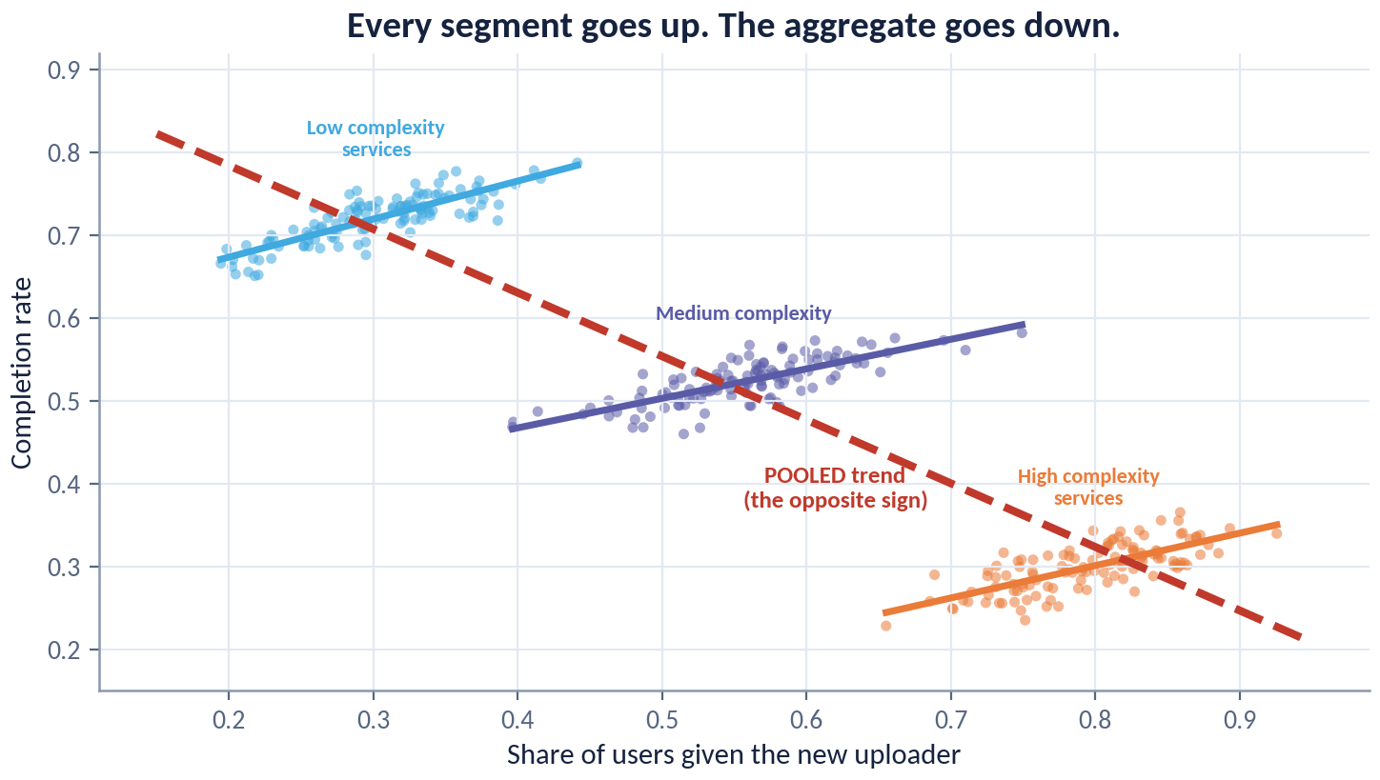
ADVANCED · EXPERIMENTATION
Simpson's Paradox, Drawn
Every segment trends upward. The pooled line trends downward. Both are arithmetically correct.
WHY IT HAPPENS
The segments differ in both their baseline and their share of the treated. Pooling mixes the composition change into the effect.
The defence is structural: analyse at the level of randomisation, and be suspicious of any aggregate whose sign disagrees with all of its parts.
ACADEMY OF EXCELLENCE · ADVANCED · EXPERIMENTATION
205 / 268
Notes:
3 min - figure slide, walk it straight after the mechanism slide
Walk it in three moves. Point first at any single segment line and get agreement that it slopes up. Point second at the pooled line and get agreement that it slopes down. Only then point at the segment sizes and treated shares, where the paradox actually lives - the pooled line traces a composition change, not an effect. Say explicitly that both lines are arithmetically correct; nothing here is a computational error.
ASK: Which of these two contradictory pictures is the causal one? Freeze there. Neither by itself - the design decides, and here it says analyse within stratum.
WATCH FOR: The instinct to call the pooled line wrong. It is not wrong; it answers a different and useless question.
LINK: Pairs with the mechanism slide and with the Day 4 clustering discussion, where the level of analysis again decides the answer.

Slide 206
ADVANCED · EXPERIMENTATION
Reading an A/A Test
Running two identical arms is the cheapest, most under-used integrity check in experimentation.
What it validates
Assignment fairness, logging correctness, and the calibration of your significance procedure — all before a real test.
What ‘failure’ means
Frequent ‘significant’ A/A results signal a broken pipeline, a sample-ratio issue, or an invalid variance estimate.
Cadence
Keep a continuous A/A running as a canary; a sudden A/A alarm often precedes a bad ship decision.
ACADEMY OF EXCELLENCE · ADVANCED · EXPERIMENTATION
206 / 268
Notes:
3 min - advanced extension; also worth showing on Day 2 before the first live test brief
The argument is economic, not statistical. An A/A test costs only traffic and it tests the whole machine at once - assignment, logging, joins, the variance estimator, the dashboard. Most broken platforms are discovered by a real test that produced a plausible false result months later. Push the canary idea: keep one A/A running permanently, so a pipeline break surfaces before a ship decision rides on it.
ASK: If you ran twenty A/A tests, how many should come out significant at 5 percent? Steer to about one, and to the fact that four or five means the pipeline, not bad luck.
WATCH FOR: Reading a single significant A/A as proof of a broken system. The signal is the rate over many, or an SRM alongside it.
LINK: The SRM demo, where dropping 3 percent of one arm gives chi-squared near 16.5 and p about 5e-5.

Slide 207
ADVANCED · EXPERIMENTATION
A/B Testing vs. Multi-Armed Bandits
FIXED A/B
BANDIT
Learn, Then Ship
Earn While You Learn
Fixed allocation until a pre-set horizon.
Allocation adapts toward better-performing arms.
Clean, unbiased effect estimates for all arms.
VS
Minimises regret; maximises reward during the test.
Best when you need a defensible causal number.
Best for many variants and continuous optimisation.
‘Wastes’ traffic on losing arms while running.
Adaptive allocation complicates unbiased inference.
ACADEMY OF EXCELLENCE · ADVANCED · EXPERIMENTATION
207 / 268
Notes:
3 min - advanced extension, Day 2 add-on; a comparison slide, keep it brisk
Do not let this become religious. The two designs optimise different objectives: fixed A/B minimises error on an effect estimate, a bandit minimises regret while learning. A platform that must justify a policy change in writing needs the first; a ranking surface with forty candidates and no reporting duty is better served by the second. Most teams who ask for bandits actually want faster fixed tests, which is a variance problem.
ASK: Your minister's office asks how much the new uploader flow improved completion. Which design answers that? Steer to fixed A/B - a bandit gives a winner, not a defensible number.
WATCH FOR: The belief that bandits are strictly better because they waste less traffic. They buy reward at the cost of clean inference on losing arms.
LINK: Feeds the adaptive-inference slide; contrast with CUPED's 13.5 percent variance reduction as the cheaper route to speed.

Slide 208
ADVANCED · EXPERIMENTATION
Adaptive Designs & Their Inference Cost
Adapting allocation as data arrive improves efficiency but breaks naive analysis.
RULE OF THUMB
Use bandits to optimise a decision; use fixed A/B when you must report a trustworthy effect size. Do not analyse bandit data with fixed-horizon formulas.
The benefit
Bandits and response-adaptive designs cut the cost of exploration and speed up finding the best arm.
The catch
Because allocation depends on interim outcomes, standard errors and effect estimates need adaptive-aware corrections.
The remedy
Use inference designed for adaptivity (e.g. adaptively-weighted estimators) when you still need a valid effect, not just a winner.
ACADEMY OF EXCELLENCE · ADVANCED · EXPERIMENTATION
208 / 268
Notes:
4 min - advanced extension following the bandit comparison
Here the cost of adaptivity becomes concrete. Because allocation at time t depends on outcomes before t, the observations are no longer draws from a fixed design, and a standard t-test on bandit data computes the wrong variance. Make the rule vivid: paste bandit arm means into a significance calculator and the reported number is not an effect estimate, and no sample size repairs it. Adaptively-weighted estimators exist to buy the estimate back.
ASK: A team ran a four-arm bandit and reports the winner beat control by 3 percent, p equals 0.01. What is wrong? Steer to a fixed-horizon formula applied to adaptively collected data.
WATCH FOR: Conflating adaptive allocation with sequential stopping. Different problems - boundaries do not rescue adaptive weighting.
LINK: The sequential slide two ahead, and the Day 4 peeking result of 5, 9, 14, 19, 25 percent at 1, 2, 5, 10, 20 looks.

Slide 209
ADVANCED · EXPERIMENTATION
Interference: Switchback & Cluster Designs
In marketplaces and networks, treating some units changes the environment for others — breaking SUTVA. The design must absorb the spillover.
MARKETPLACE
Time
Switchback experiments
Alternate the whole system between treatment and control over time windows; the unit becomes a time slice, containing spillover.
Cluster / ego-network designs
When users share supply, randomizing by time (switchback) or by market cluster is often the only way to get an unbiased effect.
Randomize connected groups together so interference stays within, not across, arms.
Exposure modelling
Define an exposure mapping (how much treatment a unit is effectively exposed to) and estimate effects against it.
ACADEMY OF EXCELLENCE · ADVANCED · EXPERIMENTATION
209 / 268
Notes:
4 min - advanced extension; the highest-value slide in this block for most cohorts
Lead with the failure, not the taxonomy. If a capacity-constrained service is treated for half its users, control users experience a different system than they otherwise would - shorter queues, or longer - and SUTVA is gone, with a bias you cannot sign without a model. The design absorbs the spillover: make the unit big enough to contain it, a time slice for shared capacity or a whole cluster where the network lives.
ASK: In a national appointment-booking service, why would a user-level A/B on a faster booking flow overstate the effect? Steer to control users being displaced from slots by faster treated users.
WATCH FOR: Assuming interference only matters in social networks. Shared staff, inventory and queues cause it far more often in public services.
LINK: The Day 4 clustering result, session-level SE 0.00166 versus user-clustered 0.00267 - the same lesson about units.

Slide 210
ADVANCED · EXPERIMENTATION
Sequential Testing, Quantified
A concrete look at how continuous monitoring inflates error — and how boundaries restore validity.
The inflation
Checking a nominal-5% test daily for a month can push the true false-positive rate toward 20–30%.
Alpha spending
Group-sequential boundaries allocate the 5% budget across looks; O'Brien–Fleming is strict early, generous late.
Always-valid
Confidence sequences and e-values hold at every sample size and any stopping time — look as often as you like.
ACADEMY OF EXCELLENCE · ADVANCED · EXPERIMENTATION
210 / 268
Notes:
4 min - advanced extension; the numeric companion to the Day 4 peeking demo
Say the number the room resists: a nominal 5 percent test checked daily for a month runs a true false-positive rate in the twenties. Then separate the two families cleanly. Alpha spending fixes the number of looks in advance and rations the budget across them, suiting a scheduled review cadence. Confidence sequences and e-values hold at any sample size and stopping rule - which is what a dashboard anyone can refresh actually requires.
ASK: Who here can stop your own running test today without asking anyone? Steer to the conclusion that if so, you need always-valid inference, not a promise not to peek.
WATCH FOR: Treating Bonferroni over the number of days as a substitute. The looks are correlated, so it is both wrong and needlessly conservative.
LINK: The Day 4 peeking simulation: 5, 9, 14, 19 and 25 percent false positives at 1, 2, 5, 10 and 20 looks under a true null.

Slide 211
ADVANCED · EXPERIMENTATION
Bayesian A/B Testing
A complementary framework that reports probabilities decision-makers find intuitive — with its own discipline.
The outputs
P(variant better), the posterior effect distribution, and expected loss from shipping the wrong arm.
The appeal
Decision-relevant statements and coherent early stopping via expected loss, if priors and rules are pre-set.
The caution
Priors and the decision rule must be fixed in advance; ‘Bayesian’ is not a licence to peek without a plan.
ACADEMY OF EXCELLENCE · ADVANCED · EXPERIMENTATION
211 / 268
Notes:
3 min - advanced extension; goes down well with stakeholder-facing cohorts
Sell the real advantage first: a decision-maker can act on a 92 percent probability that the variant is better and an expected loss of 0.1 points in a way they never can on a p-value. Then close the loophole, because someone always tries it. If the prior, the loss function and the stopping rule are not written down before launch, the operating characteristics are unknown and the analysis is exploratory whatever framework it wears.
ASK: Does switching to Bayesian analysis solve the peeking problem? Steer to no - it changes what you report, not whether an unplanned stopping rule inflates error.
WATCH FOR: The claim that Bayesian methods have no multiplicity problem. Optional stopping on a posterior threshold still produces false ships.
LINK: Contrast with the always-valid confidence sequences on the previous slide.

Slide 212
ADVANCED · EXPERIMENTATION
The Winner's Curse & Shrinkage
The variant that clears the bar to ship tends to have an over-estimated effect — selection acts on the estimate itself.
EXPECTATION MANAGEMENT
Report a shrunk, de-biased estimate for planning. The raw ‘winning’ lift is an optimistic ceiling, not a forecast.
Why it happens
Among many tested ideas, those that reach significance are disproportionately those that got lucky upward.
The consequence
Realised production lift routinely underperforms the test estimate that justified the launch.
The fix
Shrink effect estimates toward the prior mean (empirical-Bayes / hierarchical models), especially across many experiments.
ACADEMY OF EXCELLENCE · ADVANCED · EXPERIMENTATION
212 / 268
Notes:
4 min - advanced extension; strongest with a cohort that already ships many tests
This explains why an experimentation programme reliably over-promises. Selection acts on the estimate, not the idea: among many equivalent variants, those clearing the bar are disproportionately those whose noise pointed upward. The consequence is a portfolio whose promised gains never sum to the observed annual metric movement, which is the credibility problem that kills programmes. Empirical-Bayes shrinkage across the whole test history is the fix and costs nothing but a hierarchy.
ASK: Your team shipped twelve wins totalling 8 points of conversion last year, but the metric moved 3. Where did the rest go? Steer to the winner's curse plus novelty decay, not fraud.
WATCH FOR: Hearing this as an argument for a stricter alpha. A stricter bar makes surviving estimates more inflated, not less.
LINK: Feeds the meta-analysis slide later, and the capstone verdict where the honest answer is hold, not ship.

Slide 213
ADVANCED · EXPERIMENTATION
A Guardrail-Metric Framework
Guardrails turn ‘the primary metric won’ into ‘shipping is safe’.
01
Quality guardrails
Latency, error rate, crash rate — a win that degrades reliability does not ship.
02
Business guardrails
Revenue, cost, and unit economics must not silently regress behind an engagement lift.
03
Trust & safety guardrails
Complaints, policy violations, and fairness metrics protect users and reputation.
04
Counter-metrics
Metrics that would move if the primary metric is being gamed rather than genuinely improved.
ACADEMY OF EXCELLENCE · ADVANCED · EXPERIMENTATION
213 / 268
Notes:
3 min - advanced extension; worth pulling forward into Day 2 hour 4 for any production team
The argument is governance, not statistics. A single primary metric makes a test decidable; guardrails make shipping safe. Insist they are named and their thresholds fixed before launch, or they become post-hoc excuses in either direction. Spend the time on box four, counter-metrics, because it is the one teams skip: more completed uploads is a win only if support calls and resubmissions did not rise alongside it.
ASK: Your uploader variant lifts completions 2.2 points and raises median latency 400 milliseconds. Ship? Steer to the pre-set threshold deciding, not the room's instinct on the day.
WATCH FOR: Guardrails treated as a second set of success metrics, so a favourable move gets claimed as a bonus win. They are one-sided safety checks.
LINK: The pre-flight checklist later in this deck, and the +2.2 pp uploader lift in injaz_experiment_results.csv.

Slide 214
ADVANCED · IDENTIFICATION
Advanced Identification
Front-door adjustment, mediation, time-varying treatments, and the modern machine-learning toolkit for effects.
ACADEMY OF EXCELLENCE · ADVANCED
214 / 268
Notes:
1 min - divider for the advanced identification block, a Day 3 extension
Position this as the fourth rung of the ladder. Day 3 taught identification when confounders are measured or a design supplies the variation; these slides are what you reach for when neither holds - an unmeasured confounder with an observed mechanism, a question about how rather than whether, treatments that repeat over time, and flexible ML used without destroying inference. Warn that each buys power by spending assumptions.
ASK: Which is harder to defend, a total effect or a mechanism? Steer to the mechanism, and use it to set expectations for the mediation slide.
WATCH FOR: Experts assuming these are simply better methods. They are methods for harder questions, and are less robust, not more.
LINK: Extends Day 3 hour 4 and the DAG work on collider_sim.parquet.

Slide 215
ADVANCED · IDENTIFICATION
The Front-Door Criterion
When a confounder is unmeasured but a fully-mediating mechanism is observed, the effect can still be identified.
The structure
T → M → Y with unmeasured U confounding T and Y, but U not affecting M except through T.
The two-step logic
Identify T→M (unconfounded) and M→Y (adjusting for T), then chain them to recover the total effect of T on Y.
When it helps
Rare but powerful — a credible, fully-observed mediating mechanism can rescue an otherwise-confounded question.
ACADEMY OF EXCELLENCE · ADVANCED · IDENTIFICATION
215 / 268
Notes:
4 min - advanced extension after the Day 3 backdoor material
Teach this as the mirror image of the backdoor criterion. Backdoor needs the confounders measured; front-door needs the mechanism measured instead and lets the confounder stay invisible. Draw the structure rather than reading it. The reason it is rare is the last clause - the confounder must not touch the mediator except through treatment, and almost every real mediator is touched, at which point the chaining fails.
ASK: Name a mechanism in your own service that fully carries an effect and is untouched by whatever confounds the treatment. Steer to the discovery that almost nobody can.
WATCH FOR: Confusing this with mediation. Front-door uses the mediator to identify the total effect; mediation decomposes an effect the mediator only partly carries.
LINK: Contrast with the Injaz uploader DAG, where support_calls is a mediator and must never be adjusted for.

Slide 216
ADVANCED · IDENTIFICATION
Mediation: Direct vs. Indirect Effects
Sometimes the question is not ‘does it work’ but ‘how’ — how much of the effect runs through a mechanism.
MECHANISM ≠ FREE
Mechanism questions are valuable but demand more assumptions than total-effect questions. Be explicit that you are climbing to a harder rung.
The decomposition
The total effect splits into a direct effect and an indirect (through-mediator) effect.
The extra assumptions
Mediation needs stronger, often untestable, no-confounding assumptions on the mediator–outcome link.
The caution
Do not ‘control for the mediator’ to get a direct effect naively — that reintroduces bias; use proper mediation estimators.
ACADEMY OF EXCELLENCE · ADVANCED · IDENTIFICATION
216 / 268
Notes:
4 min - advanced extension; the natural pairing with the front-door slide
Nail one thing: the innocent move of putting the mediator in the regression to get a direct effect is wrong, and wrong for two reasons at once. Conditioning on a mediator blocks part of the causal path you wanted, and opens a collider path if anything confounds mediator and outcome. Mediation needs an untestable no-confounding assumption on that link, and a decision-maker who only needs to know whether to ship does not need this rung.
ASK: Your uploader regression includes support_calls and the effect drops from 5 points to 1. What did you learn? Steer to nothing causal - you conditioned on a mediator.
WATCH FOR: Reading the shrunken coefficient as evidence the effect was fake. It is evidence you controlled away the mechanism.
LINK: The uploader adjustment set {digital_literacy, device_age}, and the true simulator ATE of +5.0 pp this mistake erases.

Slide 217
ADVANCED · IDENTIFICATION
Time-Varying Treatments & g-Methods
When treatment and confounders evolve over time and influence each other, standard regression fails — even with the ‘right’ controls.
The trap
A time-varying confounder that is also affected by past treatment is a confounder and a mediator at once; adjusting for it biases the effect either way.
The tools
g-computation, marginal structural models with IPW, and g-estimation handle the feedback correctly.
Where it matters
Sequential decisions — dynamic treatment regimes, repeated interventions, longitudinal policy — need g-methods, not plain regression.
ACADEMY OF EXCELLENCE · ADVANCED · IDENTIFICATION
217 / 268
Notes:
4 min - advanced extension; the hardest slide in the block, budget the full four minutes
Make the trap concrete before naming any g-method. Take a repeated reminder programme: last month's reminder changes this month's engagement, and this month's engagement decides whether another reminder is sent. That variable confounds the current treatment and mediates the previous one simultaneously. Adjust and you block the path you want; omit and you leave a backdoor open. No choice of controls in a single regression escapes it.
ASK: Is there any adjustment set that solves this in one regression? Steer to no, and let the room sit with it - that is the point of the slide.
WATCH FOR: Assuming more time-lagged controls fix it. Each additional lag reproduces the same simultaneous confounder-mediator problem.
LINK: Relevant to the Injaz reminder rollout in injaz_regions_panel.csv if a cohort asks about repeated rather than one-off activation.

Slide 218
ADVANCED · IDENTIFICATION
Double / Debiased Machine Learning
How to use flexible ML for nuisance functions without contaminating the effect estimate.
WHY IT WORKS
⊥ + split
Neyman orthogonality
Build the estimator so small errors in the nuisance models do not, to first order, bias the effect.
Cross-fitting
Orthogonal scores plus cross-fitting are what let modern ML power causal estimates without the usual regularisation bias.
Estimate nuisances on one fold and the effect on another, breaking the over-fitting that would invalidate inference.
The payoff
Gradient boosting, forests, or neural nets can model E[Y|X] and e(x) while the effect keeps valid confidence intervals.
ACADEMY OF EXCELLENCE · ADVANCED · IDENTIFICATION
218 / 268
Notes:
4 min - advanced extension; the slide most expert cohorts actually want
Answer the question this room has held all week: can I just use gradient boosting? Yes, but only inside a specific structure. Orthogonality makes the effect insensitive to first-order errors in the nuisance models. Cross-fitting means the flexible model never scores rows it saw, so regularisation bias does not leak into inference. Both are required; a boosted propensity score dropped into IPW without cross-fitting is worse than logistic regression, not better.
ASK: What breaks if you fit the nuisance models and the effect on the same rows? Steer to over-fitted residuals producing intervals that are far too narrow.
WATCH FOR: Treating double ML as a way to skip identification. It solves estimation under ignorability and does nothing about an unmeasured confounder.
LINK: Sits on top of the Day 3 doubly-robust estimator and the estimator cheat-sheet later in this deck.

Slide 219
ADVANCED · IDENTIFICATION
Causal Forests for Heterogeneity
A principled way to estimate how the effect τ(x) varies — with honest uncertainty for each subgroup.
Honest splitting
Separate the data used to choose splits from the data used to estimate effects, avoiding over-fit CATEs.
Local effects
Each leaf yields a locally near-randomized comparison, giving an effect estimate conditioned on covariates.
Uses
Targeting policies, identifying who benefits or is harmed, and surfacing effect modifiers to test next.
ACADEMY OF EXCELLENCE · ADVANCED · IDENTIFICATION
219 / 268
Notes:
3 min - advanced extension, follows double ML naturally
Explain honest splitting as cross-fitting applied to tree structure: the rows that chose the splits are not the rows that estimate the leaf effect, which is what makes a per-leaf interval mean anything. Without it the forest finds where noise looked like heterogeneity and reports that noise as an effect. Be candid that causal forests need a lot of data, and that with a few thousand users a flat surface is the honest output.
ASK: Your forest says the effect is 9 points for users with old devices and 1 point elsewhere. What next? Steer to pre-registering that subgroup in the next experiment, not a targeted rollout.
WATCH FOR: Reading leaf-level effects as confirmed subgroup results. The forest generates candidates; it does not confirm them.
LINK: Extends the CATE material from Day 2 hour 3; feeds the policy slide next.

Slide 220
ADVANCED · IDENTIFICATION
From CATE to Policy
Estimating heterogeneous effects is a means; the end is a decision rule about whom to treat.
TARGETING INSIGHT
Ranking users by predicted outcome and ranking by predicted uplift give different lists. Only the uplift list improves the decision.
Policy learning
Turn τ(x) into a treatment rule that maximises total benefit subject to budget or fairness constraints.
Uplift, not response
Target those the treatment changes (high uplift), not those with high outcomes regardless — a common, costly confusion.
Evaluate the policy
Estimate the value of a learned rule with a held-out set or a follow-up experiment before deploying it.
ACADEMY OF EXCELLENCE · ADVANCED · IDENTIFICATION
220 / 268
Notes:
4 min - advanced extension closing the identification block
The uplift-versus-response distinction is the payload and worth the whole four minutes. Ranking by predicted outcome finds people who will complete anyway; ranking by predicted uplift finds people the intervention actually changes. These are near-disjoint lists, and targeting the first buys a beautiful campaign with zero incremental effect. Then insist on box three: a learned policy is a new intervention and its value must be estimated out of sample before deployment.
ASK: You can send the uploader prompt to 20 percent of users. Do you pick the most likely to complete, or the most movable? Steer firmly to the second.
WATCH FOR: Confusing high baseline with high uplift. The users most likely to convert are often the ones your treatment cannot move at all.
LINK: Uses the CATE work from Day 2 hour 3; the 62 percent uploader trigger rate is a natural targeting example.

Slide 221
ADVANCED · MEASUREMENT
Long-Run Effects & Measurement
Surrogates, novelty, regression to the mean, and combining evidence across studies.
ACADEMY OF EXCELLENCE · ADVANCED
221 / 268
Notes:
1 min - divider for the measurement block, a Day 4 extension
Frame the last advanced block as the problems that appear after the estimate is correct. Everything here concerns time and the gap between what you measured and what the decision cares about: proxies standing in for outcomes you cannot wait for, effects that decay, apparent effects that were never there. This block matters most to whoever owns the roadmap, because these failures surface as a credibility gap six months after a successful test.
ASK: How long after a ship decision does anyone re-check the effect? Steer to the uncomfortable answer of never, and use it to justify long-run holdbacks.
WATCH FOR: Treating this as soft material. Novelty decay and regression to the mean invalidate more shipped decisions than any inference error.
LINK: Extends Day 4 hour 2; the communication slide at the end pairs with the capstone memo.

Slide 222
ADVANCED · MEASUREMENT
Short-Term Proxies & Surrogate Metrics
Decisions are often about long-run outcomes we cannot wait to measure — so we lean on surrogates, at our peril.
The temptation
Use an early, fast-moving proxy (clicks) to predict a slow, real goal (retention, lifetime value).
The surrogacy condition
A valid surrogate fully mediates the treatment's effect on the true outcome — a strong, checkable-in-part assumption.
The risk
Optimising a broken surrogate can move the proxy while harming the real goal (proxy gaming).
ACADEMY OF EXCELLENCE · ADVANCED · MEASUREMENT
222 / 268
Notes:
4 min - advanced extension, Day 4 add-on
The argument is that a surrogate is an identification assumption wearing a metric's clothes. For clicks to substitute for retention, the treatment's entire effect on retention must flow through clicks; if any part does not, you are optimising something that can move opposite to the goal. An interstitial that raises clicks by annoying people into tapping is a surrogate win and a retention loss. The partial check is whether past experiments moved both together.
ASK: Which of your dashboard metrics is a surrogate you have never validated? Steer to the realisation that most teams' primary metric is one.
WATCH FOR: Validating a surrogate by correlation in observational data. Cross-sectional correlation says nothing about whether treatments move both together.
LINK: The guardrail framework earlier, and the capstone, where a 1.0 pp practical threshold forces the same conversation.

Slide 223
ADVANCED · MEASUREMENT
Novelty & Primacy Effects
Users react to change itself, not only to the treatment — and those reactions fade.
ESTIMAND INCLUDES TIME
‘Effect at week one’ and ‘effect at steady state’ are different quantities. Decide which the decision needs before you launch.
Novelty effect
A transient boost as users engage with something new; it decays toward the true steady-state effect.
Primacy effect
A transient dip as users adjust to a change; the true effect emerges only after adaptation.
The design response
Run to steady state, pre-register the evaluation window, and consider a long-run holdback to measure durable impact.
ACADEMY OF EXCELLENCE · ADVANCED · MEASUREMENT
223 / 268
Notes:
4 min - advanced extension; pairs with the sequential and long-run material
Land the line that time is part of the estimand, not a nuisance. An effect at week one and an effect at steady state are different quantities, and a team that measures the first and forecasts with the second will systematically over-promise. Novelty inflates, primacy deflates, and both decay, so the shape of the weekly curve is diagnostic. Push the long-run holdback as the only way to measure durable effect after the variant becomes default.
ASK: Your lift is 4 points in week one, 2.5 in week two, 2.2 in week three. What do you report? Steer to the asymptote near 2.2, and to extending rather than averaging.
WATCH FOR: Averaging the whole test window as if the effect were constant. That answers no question and is biased upward under novelty.
LINK: The +2.2 pp uploader lift is a steady-state number; contrast it with what a week-one readout would have claimed.

Slide 224
ADVANCED · MEASUREMENT
Regression to the Mean
Selecting units because they were extreme, then re-measuring, guarantees apparent improvement — with no treatment at all.
The mechanism
Extreme observations contain extreme noise; on re-measurement, the noise averages out and values move toward the mean.
The false story
Targeting ‘worst performers’ for an intervention then seeing them improve can be pure regression to the mean.
The control
A randomized control group experiences the same regression, so the between-arm difference remains a valid effect.
ACADEMY OF EXCELLENCE · ADVANCED · MEASUREMENT
224 / 268
Notes:
3 min - advanced extension; also a strong Day 1 callback if the room needs one
This is the cheapest false causal story in the world and it fools senior audiences constantly. Selecting units because they were extreme guarantees improvement on re-measurement, because extremity is partly noise and noise does not repeat. Give the administrative version: pick the ten worst-performing offices, intervene, re-measure, declare success. The fix is not a better pre-post analysis but a control group selected by the same extreme rule, which regresses by the same amount.
ASK: The bottom decile of branches improved 8 points after the training. Is that an effect? Steer to no, until you know what the bottom decile of untrained branches did.
WATCH FOR: Believing a large pre-post sample settles it. Regression to the mean is systematic, not random, so it does not average away.
LINK: Same structure as the naive +11.5 pp difference on injaz_users.csv against the true +6.0 pp ATT.

Slide 225
ADVANCED · MEASUREMENT
Combining Evidence Across Experiments
One experiment is a data point; a programme of experiments is knowledge — if combined correctly.
Meta-analysis
Pool effects across studies with proper weighting; model between-study heterogeneity rather than assuming one true effect.
Hierarchical shrinkage
Partial pooling stabilises noisy individual estimates and tempers the winner's curse across many tests.
Institutional memory
A searchable experiment repository turns scattered results into compounding organisational learning.
ACADEMY OF EXCELLENCE · ADVANCED · MEASUREMENT
225 / 268
Notes:
3 min - advanced extension; the programme-level slide, good for managers in the room
Make the institutional argument. One experiment answers one question badly; fifty with a searchable repository answer the next question before it is asked, because you already know the prior on effect sizes in that surface. Hierarchical shrinkage is where this pays statistically - partial pooling stabilises small tests and simultaneously corrects the winner's curse. Between-study heterogeneity should be modelled, not assumed away, when tests span regions or seasons.
ASK: What was the median lift of every test your team ran last year? Steer to the fact that almost nobody can answer, which is why estimates are never shrunk.
WATCH FOR: Pooling results across tests with different estimands or randomisation units as if they replicated one effect.
LINK: Follows the winner's-curse slide; both feed the honest reporting expected in the capstone memo.

Slide 226
ADVANCED · MEASUREMENT
A Catalogue of Causal Fallacies
Named errors are easier to catch. Keep this list at hand during reviews.
Post hoc ergo propter hoc — ‘after, therefore because of’; sequence mistaken for cause.
Confounding by indication — who gets treated is driven by the very risk that drives the outcome.
Collider / selection bias — conditioning on a common effect invents association.
Survivorship bias — analysing only the units that remained, ignoring those that dropped out.
Immortal time bias — mis-classifying a period during which the outcome could not occur.
Ecological fallacy — inferring individual effects from group-level correlations.
ACADEMY OF EXCELLENCE · ADVANCED · MEASUREMENT
226 / 268
Notes:
not taught - reference; a review prop in the Day 4 case-study hour and a handout
Do not read the list. Its purpose is to give the room names, because a named error can be raised in a design review without sounding obstructive. Use it as a lookup: when a Day 4 case study goes wrong, stop and ask which of the six it is. Two deserve a sentence - immortal time bias, invisible unless you draw the timeline, and the ecological fallacy, a live risk wherever administrative data arrives aggregated to region.
ASK: Which of these six have you personally shipped? Steer to an honest show of hands on confounding by indication, which almost everyone has done.
WATCH FOR: Treating collider bias and confounding as the same thing. One is created by adjusting, the other by failing to; the remedies are opposite.
LINK: collider_sim.parquet, where correlation moves 0.00 to -0.20 on conditioning, and the pitfalls master list later.

Slide 227
ADVANCED · MEASUREMENT
Communicating a Causal Result
The last mile: turning a defensible estimate into a decision a stakeholder can own.
THE TEST OF A REPORT
A skeptical reader should be able to find, in under a minute, the estimand, the interval, the key assumption, and the sensitivity. If they cannot, rewrite it.
Lead with the decision
State the recommendation and the effect in the metric's real units before any methodology.
Show the interval and the assumption
Pair the estimate with its interval and the single load-bearing assumption, in plain language.
Make the risk visible
Say how the decision would change if the key assumption failed — so the reader owns the residual risk.
ACADEMY OF EXCELLENCE · ADVANCED · MEASUREMENT
227 / 268
Notes:
4 min - taught; Day 4 hour 3, immediately before the capstone brief
This slide decides whether any of the four days survives contact with an organisation. Argue the inversion explicitly: technical writing builds up to the conclusion, decision writing leads with it and defends afterwards. Recommendation and effect in real units first, in a metric a director already tracks. Interval and the single load-bearing assumption second, one sentence each. Sensitivity third, phrased as what would have to be true for this to be wrong.
ASK: In your last analysis memo, what line number was the recommendation on? Steer to the admission that it was near the end, under a methods section nobody read.
WATCH FOR: Hedging read as rigour. Listing every caveat equally forces the reader to guess which assumption is load-bearing.
LINK: Sets up the capstone memo and defence, and the decision figure next.

Slide 228
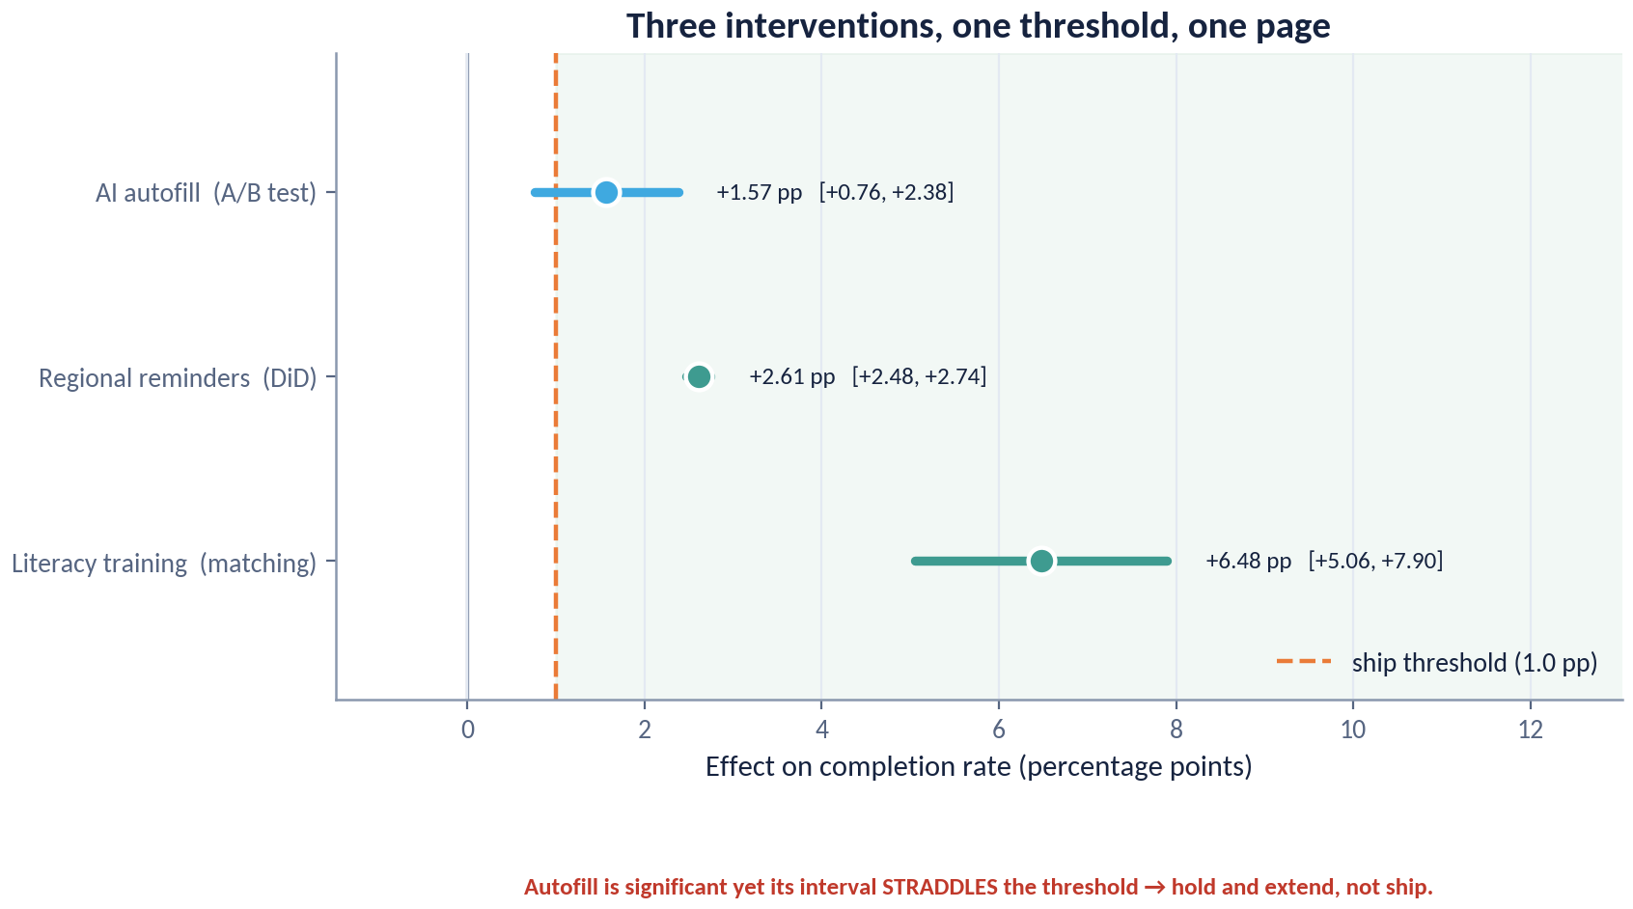
ADVANCED · MEASUREMENT
One Page, Three Interventions, One Threshold
The chart a decision-maker can actually act on: effects in business units, intervals, and the line that defines 'worth doing'.
THE CENTREPIECE
Zero answers 'is there an effect'. The threshold answers 'is it worth it'. The interval answers 'how sure are we'. A point estimate answers none of the three.
Autofill is significant yet its interval straddles the threshold — so the recommendation is hold and extend, not ship.
ACADEMY OF EXCELLENCE · ADVANCED · MEASUREMENT
228 / 268
Notes:
4 min - figure slide; closes Day 4 hour 3 and models the capstone deliverable
Walk it deliberately. Point first at the zero line and say it answers only whether there is an effect. Point second at the practical threshold, the line the organisation actually cares about. Point third at the intervals, not the dots. Then land on autofill: significant, interval straddling the 1.0 point threshold, so the recommendation is hold and extend. Say out loud that p below 0.05 plus ship it is the failure mode the capstone exists to expose.
ASK: Which of these three interventions would you fund? Freeze on autofill and make someone defend hold rather than ship.
WATCH FOR: Reading significance as sufficiency. A significant effect whose interval spans the threshold has not shown it is worth doing.
LINK: injaz_autofill_ab.csv, 70,000 users, true lift +1.4 pp against a 1.0 pp threshold - the capstone dataset.

Slide 229
“
Every method in this course is a different answer to one question: how do we see the outcome that did not happen?
The through-line of causal inference
From potential outcomes to policy
ACADEMY OF EXCELLENCE · ADVANCED
229 / 268
Notes:
1 min - quote slide; the closing beat of the advanced block or of Day 4
Say it once, slowly, and do not explain it. This is the sentence that ties potential outcomes, randomisation, matching, difference-in-differences, instrumental variables and regression discontinuity into one idea rather than six techniques. If the room takes nothing else away, this is the line still there in a year. Pause, then move on rather than adding commentary - the slide loses its force the moment you gloss it.
ASK: Which method in this course builds that missing outcome most convincingly, and what does it cost? Steer to randomisation being cheapest in assumptions and dearest in feasibility.
WATCH FOR: The urge to fill the silence. Instructors talk over this slide and dissolve the effect it is designed to have.
LINK: Callback to Day 1 and the fundamental problem of causal inference.

Slide 230
PART 5
Reference, Toolkit & Extended Examples
A working reference: extended numerical walkthroughs, cheat-sheets, checklists, professional-practice notes, glossary, and facilitator materials.
ACADEMY OF EXCELLENCE · REFERENCE
230 / 268
Notes:
1 min - divider opening Part 5; not taught, but announce it exists at the Day 1 wrap
Show this once, early, so participants know a reference section exists and stop copying formulas off content slides. Tell them explicitly where they will be sent: the worked examples during Labs 1 to 3, the cheat-sheets during any design discussion, and the checklists before the capstone. Everything from here to the glossary is designed to be read alone at a desk, not delivered from the front of the room.
ASK: Who is planning to run one of these designs within a month? Steer them to the checklists rather than to their lecture notes.
WATCH FOR: Participants who skip this announcement, then re-derive the sample-size formula from memory during Lab 2.
LINK: The checklists are pre-work for the Day 4 capstone.

Slide 231
REFERENCE · WORKED EXAMPLES
Extended Numerical Walkthroughs
Six estimators, each carried through concrete numbers you can reproduce in the labs.
ACADEMY OF EXCELLENCE · REFERENCE
231 / 268
Notes:
1 min - divider for the worked examples; not taught, flagged during labs
Point out that these six walkthroughs use small hand-checkable numbers on purpose, so a participant lost inside a notebook can recover the logic without the data. The intended use is mid-lab: when someone's IPW weights blow up or their difference-in-differences sign flips, send them here rather than debugging line by line. Name the six in one breath so people can find the right one later.
ASK: Which of these six do you expect to get wrong first? Steer to IPW, because extreme weights are the most common silent lab failure.
WATCH FOR: Learners assuming these numbers come from the Injaz datasets. They are deliberately clean illustrations, not lab outputs.
LINK: Used during Labs 1 to 3 and while sizing the capstone test.

Slide 232
WORKED EXAMPLE · MATCHING
Propensity Matching, Step by Step
Estimating the ATT by matching each treated unit to its nearest control on the propensity score.
BALANCE TARGET
SMD<0.1
1 · Fit the propensity model
Model e(x)=P(T=1|X) (e.g. logistic or gradient boosting) using only pre-treatment covariates.
2 · Match on the score
Matching is judged by the balance it achieves, not by the propensity model's accuracy. Report a love-plot of SMDs before and after.
For each treated unit, find the nearest control by |ê(xᵢ) − ê(xⱼ)| within a caliper (e.g. 0.2 × SD of the logit).
3 · Check balance
Compute standardized mean differences after matching; all should fall below 0.1 for a credible comparison.
4 · Estimate the ATT
Average the within-pair outcome differences; get the SE by a matching-appropriate method (not the naive bootstrap).
ACADEMY OF EXCELLENCE · REFERENCE · EXAMPLES
232 / 268
Notes:
not taught - reference; the lookup card for the Day 3 matching lab on injaz_users.csv
When a participant is stuck in the matching lab, send them to step three, where the misunderstanding almost always sits. The slide's real content is the boxed line: matching is judged by the balance it achieves, not by how well the propensity model predicts treatment. A high-AUC propensity model usually means poor overlap and worse matching, the opposite of what a machine-learning reflex expects. The love-plot is the deliverable, not the model summary.
ASK: Your propensity model gets 0.92 AUC. Is that good news? Steer to no - near-perfect separation means treated and control units barely overlap.
WATCH FOR: Optimising the propensity model rather than the balance, and reporting a naive bootstrap standard error, which is invalid for matching.
LINK: injaz_users.csv, where worst absolute SMD falls 0.57 to 0.03 and matching recovers +6.5 pp against a naive +11.5 pp.

Slide 233
WORKED EXAMPLE · IPW
Inverse-Probability Weights, Numerically
How a propensity score becomes a weight — and why extremes are dangerous.
DIAGNOSTIC
Always print the max and 99th-percentile weight. A handful of weights above ~10 means your effective sample is a few units — revisit overlap.
Treated unit, ê=0.8
Weight = 1/0.8 = 1.25. A treated unit that ‘looks treated’ gets modest weight.
Treated unit, ê=0.05
Weight = 1/0.05 = 20. A treated unit that ‘looks like a control’ dominates the estimate — a red flag.
Control unit, ê=0.9
Weight = 1/(1−0.9) = 10. Symmetrically, near-certain-treated controls get huge weight.
Stabilise
Multiply by the marginal treatment probability (stabilised weights) or trim/winsorise to tame the tail.
ACADEMY OF EXCELLENCE · REFERENCE · EXAMPLES
233 / 268
Notes:
not taught - reference; the diagnostic card whenever IPW misbehaves in the Day 3 lab
The four numbers do the teaching, so use this as a lookup rather than a lecture. What people get wrong is treating a large weight as a nuisance rather than a message: a treated unit with propensity 0.05 is telling you that covariate profile is essentially absent from the treated arm, so a handful of rows carry the estimate. Make printing the maximum and 99th-percentile weight non-negotiable before any effect is reported.
ASK: Your largest weight is 340 out of 5,000 units. What is your effective sample size? Steer to a few rows dominating, and to trimming or redefining the estimand.
WATCH FOR: Trimming quietly to make the estimate behave. Trimming changes the population you estimate for, and that must be stated.
LINK: The Day 3 adjustment lab; pairs with the positivity row of the assumptions cheat-sheet.

Slide 234
WORKED EXAMPLE · DID
A 2×2 Difference-in-Differences Table
The whole estimator in four numbers.
DID
12 − 6
The cells
Treated: 40 (pre) → 52 (post). Control: 38 (pre) → 44 (post).
First differences
Subtracting the control's change removes any shock common to both groups. The remaining +6 is causal only under parallel trends.
Treated change = 52 − 40 = 12. Control change = 44 − 38 = 6.
The double difference
DiD estimate = 12 − 6 = +6 — the effect, net of the common time trend of +6.
The assumption
Valid only if, absent treatment, the treated group would also have risen by +6 (parallel trends).
ACADEMY OF EXCELLENCE · REFERENCE · EXAMPLES
234 / 268
Notes:
not taught - reference; the card to send people to during the Day 3 panel lab
Use this when someone loses the thread inside the regression version of difference-in-differences. Four numbers, one subtraction, and the whole estimator is visible. The point people miss is in the last box: subtracting the control's change removes shocks common to both groups, and nothing else. If the treated group would have moved differently for its own reasons, no quantity of fixed effects supplies a defence. Parallel trends is a counterfactual claim and so never fully testable.
ASK: The pre-trends look parallel for eight periods. Does that prove the assumption? Steer to no - it is evidence about the past, not proof about the counterfactual.
WATCH FOR: Treating a passed pre-trend test as verification. The Injaz pretrend panel exists precisely to show a case where it fails.
LINK: injaz_regions_panel.csv, 13 regions over 24 months, full ATT +3.0 pp, and its _pretrend variant.

Slide 235
WORKED EXAMPLE · IV
The Wald Estimator
The simplest instrumental-variables estimate: a ratio of two differences.
READ CAREFULLY
A weak first stage (small denominator) makes the ratio explode and its inference unreliable — always report the first-stage strength.
The setup
A random encouragement Z raises uptake of treatment T; we want the effect of T on Y among compliers.
Reduced form
Effect of Z on Y = 0.9 percentage points (intention-to-treat on the outcome).
First stage
Effect of Z on T = 0.30 (the encouragement raised uptake by 30 points).
Wald ratio (LATE)
0.9 / 0.30 = 3.0 — the effect for compliers, scaling the ITT up by the compliance rate.
ACADEMY OF EXCELLENCE · REFERENCE · EXAMPLES
235 / 268
Notes:
not taught - reference; the card for the Day 3 IV lab
This makes IV arithmetic rather than mystical: divide the intention-to-treat effect by the compliance rate and you have the effect on compliers. Send participants here when the 2SLS output stops making sense. Flag the denominator - a first stage of 0.30 is healthy, but as it shrinks toward zero the ratio explodes and the standard errors with it. Scaling up the ITT also means estimating for a subpopulation you cannot identify individually.
ASK: If the encouragement moved uptake by 3 points rather than 30, what happens to the Wald estimate? Steer to a ten-fold larger and wildly unstable number.
WATCH FOR: Reading the LATE as if it applied to everyone. It is the effect on compliers, and the compliers are never listed by name.
LINK: The Injaz online-filing IV on log_distance_km: true LATE +8.0 pp, 2SLS +7.8 pp, first-stage F about 2,100, biased OLS +10.9 pp.

Slide 236
WORKED EXAMPLE · RDD
Estimating the Jump at a Cutoff
A sharp regression-discontinuity effect is the gap in fitted outcomes at the threshold.
LOCAL EFFECT
44 − 40
The running variable
Firms with a score ≥ 70 receive the subsidy; below 70 do not. The score is the running variable, 70 the cutoff.
Local fits
RDD identifies the effect for units at the cutoff. Its credibility rests on smoothness of everything else through the threshold.
Fit a flexible local regression just below and just above 70 within a chosen bandwidth.
The estimate
Predicted outcome at 70⁺ minus at 70⁻ — say 44 vs. 40 — gives a local effect of +4.
Robustness
Re-estimate across bandwidths and polynomial orders; run a density (McCrary) test for manipulation at 70.
ACADEMY OF EXCELLENCE · REFERENCE · EXAMPLES
236 / 268
Notes:
not taught - reference; the card for anyone attempting an RDD in the capstone
Use this as the structure check when a participant proposes a threshold design. The estimate is a gap between two local fits, and everything credible about it lives in the robustness box, not the point estimate. Say why the McCrary density test matters here: if applicants can see the rule and their own score, they will bunch just above 70 and the units either side stop being comparable. Vary bandwidth and polynomial order deliberately, and show the results.
ASK: Your effect is +4 at the default bandwidth and vanishes at half of it. What do you report? Steer to reporting both and treating the result as fragile.
WATCH FOR: Fitting a high-order global polynomial to make the jump look bigger. RDD is local; the fit far from the cutoff is irrelevant and often misleading.
LINK: Step two of the design-selection cheat-sheet is where a participant gets sent here from.

Slide 237
WORKED EXAMPLE · POWER
A Sample-Size Calculation
Sizing an A/B test for a conversion metric, end to end.
SANITY CHECK
If the required runtime exceeds a few weeks at your traffic, either accept a larger MDE, add variance reduction, or reconsider the test.
Baseline & target
Baseline conversion 10%; we want to detect a relative lift of 5% (absolute +0.5 pt) at α = 0.05, power 0.8.
Per-arm formula
n per arm ≈ (z_{0.025}+z_{0.20})² · 2·p(1−p) / δ² with p≈0.10, δ = 0.005.
The number
≈ (1.96+0.84)² · 2(0.09) / 0.000025 ≈ 56,400 per arm — about 113k total.
Lever
CUPED or a lower target lift changes this sharply: n scales with 1/δ² and with residual variance.
ACADEMY OF EXCELLENCE · REFERENCE · EXAMPLES
237 / 268
Notes:
not taught - reference; the arithmetic card for Lab 2 and for sizing the capstone test
Send people here when a power calculator gives an answer they do not believe. The value is the scaling law rather than the specific 56,400: n scales with one over the squared effect size, so halving the detectable effect quadruples the sample. That sentence ends most unrealistic test proposals. Point at the sanity box last - past a few weeks of runtime, the honest choices are a larger MDE, variance reduction, or not running the test.
ASK: Your team wants to detect a 0.2 point lift on a 10 percent baseline. How long at your traffic? Steer to years, and to the test not being worth running.
WATCH FOR: Confusing relative and absolute lift. A 5 percent relative lift on a 10 percent baseline is 0.5 points absolute; mixing them misses the sample size badly.
LINK: Course figures: at a 55 percent baseline, +2.0 pp needs about 9,700 per arm, +1.0 pp about 38,800, +0.5 pp about 155,000; CUPED at rho 0.37 buys 13.5 percent.

Slide 238
REFERENCE · CHEAT-SHEETS
Decision & Method References
One-glance tables for estimands, assumptions, estimators, standard errors, and design selection.
ACADEMY OF EXCELLENCE · REFERENCE
238 / 268
Notes:
1 min - divider for the cheat-sheets; not taught, point at it during design discussions
Tell participants these five tables are the pages to print. They are built for a design review, not for reading in sequence: estimand, assumptions, estimators, standard errors, and the design-selection path. The habit worth naming is using them in that order - decide the estimand before the estimator, because a team that picks a method first discovers halfway through that it answers a different question.
ASK: In your last project, which came first, the method or the estimand? Steer to the honest admission that it was the method, usually because a library existed.
WATCH FOR: Reading the cheat-sheets as a taxonomy to memorise rather than a sequence to work through.
LINK: These are the tables to have open during the capstone design step.

Slide 239
REFERENCE · SELECTION
Which Design Should I Use?
A quick decision path from constraints to a credible design.
1
Can you randomize?
Yes → run an experiment (Day 2). It is the gold standard; everything else approximates it.
2
Is there a threshold rule?
A cutoff on a running variable → regression discontinuity (sharp or fuzzy).
3
A nudge that shifts uptake only?
A valid instrument → IV / 2SLS, estimating the LATE for compliers.
4
A known switch-on time + comparisons?
Difference-in-differences or synthetic control, checking pre-trends.
5
Rich covariates, plausibly no hidden confounder?
Doubly-robust adjustment with cross-fitting, plus a sensitivity analysis.
ACADEMY OF EXCELLENCE · REFERENCE · CHEAT-SHEETS
239 / 268
Notes:
not taught - reference; the first thing to open in any capstone or real design discussion
Use this as a script for the first ten minutes of a design conversation. The order is load-bearing: ask whether you can randomise before anything else, because if the answer is yes the other four rows are irrelevant, and teams routinely reach for a clever quasi-experimental design when a small randomised pilot was available. Step five, rich covariates and no hidden confounder, is the weakest rung and needs sensitivity analysis attached as a condition of use.
ASK: Why is can you randomise the first question rather than the fourth? Steer to every other design being an attempt to approximate what randomisation gives you for free.
WATCH FOR: Jumping to difference-in-differences because panel data exists. Having the data is not the same as having the design.
LINK: The figure next is the same logic as a flowchart; both feed the capstone design step.

Slide 240
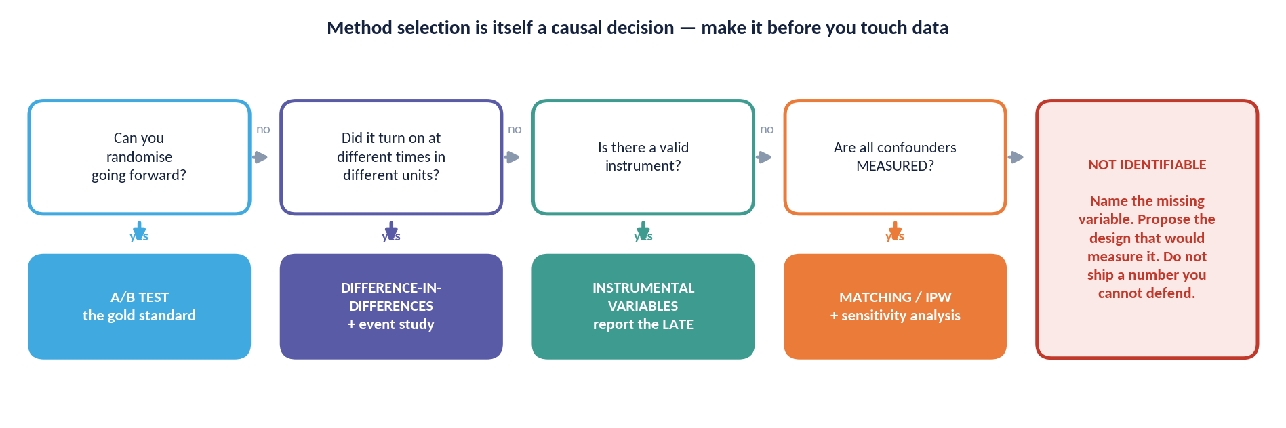
REFERENCE · SELECTION
Which Design Should I Use?
Four questions, asked in this order, before any data is touched. Method selection is itself a causal decision.
THE LAST BOX — Notice that 'not identifiable' is on the flowchart. It is a legitimate destination, not a dead end you route around.
ACADEMY OF EXCELLENCE · REFERENCE · CHEAT-SHEETS
240 / 268
Notes:
3 min - figure slide; walk it once on Day 3 and leave it as the reference version
Walk the flowchart in the order the arrows go, not the order the boxes sit. Point first at the randomisation question, second at the branch where most of this room's work falls, and third - spend your time here - at the box marked not identifiable. Say explicitly that this is a legitimate destination. A question the data cannot answer should end with saying so and proposing what would need to change, not with the least implausible method plus caveats.
ASK: When did you last write that a question was not identifiable with the data available? Freeze on the silence; that is the point of the slide.
WATCH FOR: Reading the last box as a failure state to route around. Routing around it is how unfalsifiable analyses get published.
LINK: Pairs with the previous decision path and with the sensitivity toolkit later in this section.

Slide 241
REFERENCE · CHEAT-SHEETS
Estimand Cheat-Sheet
Estimand | Definition | When to target it
ATE | E[Y(1) − Y(0)] | Population-wide ‘treat everyone vs. no one’ decisions
ATT | E[Y(1) − Y(0) | T=1] | Value of a treatment for those who actually received it
ATC | E[Y(1) − Y(0) | T=0] | Whether to extend treatment to the currently untreated
CATE | E[Y(1) − Y(0) | X=x] | Targeting, personalisation, fairness, heterogeneity
ITT | Effect of assignment | Realistic rollout impact under imperfect compliance
LATE | Effect on compliers | IV / encouragement designs with partial compliance
ACADEMY OF EXCELLENCE · REFERENCE · CHEAT-SHEETS
241 / 268
Notes:
not taught - reference; the table to open at the start of the capstone design step
This is the first table participants should touch, because the estimand decides everything downstream. Drill the two contrasts people actually confuse: ATT versus ATE, which differ whenever the treated are not a random slice, and ITT versus LATE, which differ whenever compliance is imperfect. Point out that ATC is the row nobody uses and the one answering should we extend this to people who do not have it - the usual government policy question.
ASK: The Injaz training programme served volunteers. Which row answers a should-we-expand-it question? Steer to ATC or ATE, not the ATT that matching gives you.
WATCH FOR: Reporting an ATT and letting the reader assume it is population-wide. That gap is where most quiet misreadings of a memo happen.
LINK: The +6.0 pp training ATT on injaz_users.csv, and the +1.3 versus +2.2 pp dilution in the A/B data.

Slide 242
REFERENCE · CHEAT-SHEETS
Assumptions Cheat-Sheet
Assumption | Statement | Testable? | Fix / probe
SUTVA | No interference; one treatment version | Partly | Cluster-randomize; model spillovers
Ignorability | {Y(1),Y(0)} ⊥ T | X | No | Randomize; sensitivity analysis
Positivity | 0 < e(x) < 1 | Yes | Trim; common-support; redefine estimand
Consistency | Y = Y(T) | No | Define the intervention precisely
Parallel trends | Equal counterfactual trends (DiD) | Partly | Event study; matched comparison
Exclusion | Z affects Y only via T (IV) | No | Argue from domain; over-ID tests
ACADEMY OF EXCELLENCE · REFERENCE · CHEAT-SHEETS
242 / 268
Notes:
not taught - reference; run down this table before any observational analysis is signed off
Send people here for the third column, the one that matters and the one they have not thought about: which assumptions can be tested at all. Ignorability and consistency cannot, positivity can be checked directly, parallel trends can only be probed. An untestable assumption is not a weaker assumption - it is one that must be argued in prose and stress-tested by sensitivity analysis rather than by a diagnostic plot.
ASK: Which assumption here is doing the most work in your current project? Steer to ignorability in nearly every observational case, then to what sensitivity analysis is attached to it.
WATCH FOR: Treating a passed diagnostic as a verified assumption. Balance after matching says nothing about the unmeasured covariates.
LINK: The sensitivity toolkit slide, and the Rosenbaum gamma of about 1.2 that makes the training result moderately fragile.

Slide 243
REFERENCE · CHEAT-SHEETS
Estimator Cheat-Sheet
Estimator | Models | Fails when | Notes
Outcome regression | E[Y|T,X] | Outcome model wrong | The g-formula; simple, extrapolates
Matching | Distance on X / e(x) | Poor overlap | Transparent; changes estimand
IPW | e(x) | Extreme propensities | Stabilise / trim weights
Doubly-robust | Both (either right) | Both wrong | AIPW / TMLE; default choice
Double ML | Both, cross-fit | Both wrong | Uses flexible ML safely
ACADEMY OF EXCELLENCE · REFERENCE · CHEAT-SHEETS
243 / 268
Notes:
not taught - reference; the method-choice table for the Day 3 lab and the capstone
Point participants at the fails-when column rather than the models column, because that is what should decide the choice. Emphasise the doubly-robust row: it is the default not because it is sophisticated but because it gives two chances to be right and fails only when both models are wrong. Double ML is the same idea with flexible learners and cross-fitting. Matching stays for its transparency, but it silently changes the estimand to the ATT.
ASK: Why is doubly robust the default rather than the fanciest option available? Steer to the two-chances argument, and to it costing almost nothing over plain outcome regression.
WATCH FOR: Believing doubly robust means robust to unmeasured confounding. It is robust to model misspecification only; identification is a separate problem.
LINK: The Day 3 adjustment lab and the double-ML slide in the advanced block.

Slide 244
REFERENCE · CHEAT-SHEETS
Standard-Error Selection
Situation | Use | Why
Simple randomized experiment | Robust (HC2) / design-based | Matches complete randomization
Grouped / cluster assignment | Cluster-robust SEs | Accounts for within-cluster correlation
Few clusters (< ~40) | Wild-cluster bootstrap | Asymptotics unreliable
Complex / matching estimator | Estimator-specific / bootstrap | Naive analytic SE invalid
Time-series / panels | Newey–West / block bootstrap | Serial correlation
ACADEMY OF EXCELLENCE · REFERENCE · CHEAT-SHEETS
244 / 268
Notes:
not taught - reference; check this before reporting any interval, in every lab
The most-used and least-glamorous table in the deck, so tell people where it is and expect to point at it repeatedly. The row that catches teams is the second: grouped or repeated-measure data with unclustered standard errors, producing an interval that looks reassuringly tight and is simply wrong. The few-clusters row matters in a regional setting, where 13 regions sits well under the threshold at which cluster-robust asymptotics can be trusted.
ASK: You have one row per session and users appear many times. Which row applies? Steer to user-level cluster-robust, and to the point estimate not changing - only the interval does.
WATCH FOR: Assuming a wrong standard error biases the effect. It misstates uncertainty, which is how a null gets shipped as a win.
LINK: Session-level SE 0.00166 versus user-clustered 0.00267, about 1.6 times wider; and the 13-region panel.

Slide 245
REFERENCE · CHEAT-SHEETS
DAG Pattern Library
The recurring structures and what each demands.
‹
Confounder (fork)
T ← X → Y. Adjust for X to close the backdoor.
→
Mediator (chain)
T → M → Y. Do not adjust for M if you want the total effect.
›
Collider
T → C ← Y. Never condition on C (or its descendants).
∅
M-bias
Conditioning on a pre-treatment collider can open bias — not all pre-treatment controls are safe.
ACADEMY OF EXCELLENCE · REFERENCE · CHEAT-SHEETS
245 / 268
Notes:
not taught - reference; the card for any DAG dispute, especially during the Day 3 lab
Four structures cover most real disputes, so use this to adjudicate when a team argues about a control variable. The row that earns its place is M-bias, because it breaks the rule everyone in the room is carrying - that pre-treatment variables are always safe. Conditioning on a pre-treatment collider opens a path that was closed. This is why the adjustment set comes from the graph and the backdoor criterion, never from what improves fit.
ASK: Is it always safe to adjust for a variable measured before treatment? Steer to no, and to M-bias as the counterexample most people have never seen.
WATCH FOR: The fork and the chain look identical in a regression output. Only the assumed graph distinguishes them; the data will not.
LINK: The uploader DAG set {digital_literacy, device_age} with support_calls as mediator, and collider_sim.parquet moving 0.00 to -0.20.

Slide 246
REFERENCE · PRACTICE
Checklists & Pitfalls
The pre-flight lists and failure-mode catalogue to run on every analysis.
ACADEMY OF EXCELLENCE · REFERENCE
246 / 268
Notes:
1 min - divider for the checklists; not taught, assign as pre-work for the capstone
Announce these two checklists as the deliverable-grade material in the deck, the pages a participant will still be using next year. Tell the room to read them the evening before Day 4, because the capstone assumes them. The framing that makes them stick is that a checklist is not a memory aid for the expert, it is a device for making omission visible to a reviewer who was not in the room when the decisions were made.
ASK: Would your last analysis have passed the observational checklist? Steer to the sensitivity-analysis line, which is the step almost everyone skips.
WATCH FOR: Dismissing checklists as beneath an expert audience. Aviation and surgery made the same objection and were wrong.
LINK: Pre-work for Day 4 hour 4, the capstone lab.

Slide 247
REFERENCE · CHECKLISTS
A/B Testing Pre-Flight Checklist
Complete before launch, at analysis, and before ship.
Pre-launch: single primary metric, named guardrails, power/MDE computed, horizon fixed, randomization unit chosen.
Sanity: A/A test passes; sample-ratio matches the intended split.
Analysis: design-matched SE; CUPED / covariate adjustment applied; only pre-registered subgroups tested.
Integrity: no peeking (or valid sequential method used); multiplicity controlled.
Ship: primary metric positive AND all guardrails held AND effect stable past novelty window.
ACADEMY OF EXCELLENCE · REFERENCE · PRACTICE
247 / 268
Notes:
not taught - reference; hand out at the Day 2 wrap and require it before the capstone test
Use this as a gate, not as reading. The three-phase structure is the point: pre-launch, analysis and ship are separate commitments made at separate times, and the value comes from the earliest ones being written down before any data exists. The line people quietly skip is the last, effect stable past the novelty window, because by then everyone has moved on. The sanity row catches failures no later analysis can undo.
ASK: Which of these lines have you skipped most recently, and what did it cost? Steer to fixing the horizon in advance, which is the one that makes peeking possible.
WATCH FOR: Ticking power computed without recording the MDE it was computed for. A power number without an MDE is meaningless.
LINK: The SRM check on the sanity line: a 3 percent loss in one arm gives chi-squared about 16.5, p about 5e-5, and invalidates the test.

Slide 248
REFERENCE · CHECKLISTS
Observational Study Checklist
The order matters; do not skip steps.
Define estimand (ATE vs. ATT) and target population first.
Draw the DAG; choose the adjustment set by the backdoor criterion, not by fit.
Confirm every confounder is measured; flag plausible unmeasured ones.
Check overlap; trim or restrict to common support.
Verify post-adjustment balance (SMD < 0.1).
Estimate with a doubly-robust / cross-fit method; report a proper interval.
Run a sensitivity analysis (E-value / bounds) and placebo / negative-control checks.
ACADEMY OF EXCELLENCE · REFERENCE · PRACTICE
248 / 268
Notes:
not taught - reference; the running order for the Day 3 lab and the observational capstone
Say the thing the slide only implies: this order is not stylistic, it is causal. Choosing the adjustment set from the DAG before looking at fit is what stops the analysis being tuned toward an answer, and defining the estimand first stops a team computing an ATT while answering an ATE question. The step dropped under time pressure is the last one, and a result with no sensitivity analysis is provisional however tight its interval.
ASK: Where in this order does the temptation to skip ahead first appear? Steer to jumping to estimation the moment the data loads, before the DAG is drawn.
WATCH FOR: Selecting covariates by whether they improve fit or shift the coefficient. That is variable selection for prediction and it produces bias here.
LINK: injaz_users.csv end to end: naive +11.5 pp, matched +6.5 pp, worst SMD 0.57 to 0.03, Rosenbaum gamma about 1.2.

Slide 249
REFERENCE · PITFALLS
Pitfalls Master List (1 of 2)
Design and identification failures.
Interpreting a conditional (observational) comparison as a causal effect.
Adjusting for a post-treatment variable (mediator or collider bias).
‘Controlling for everything’ — including colliders — to look thorough.
Assuming randomization guarantees balance in every single sample.
Randomizing at the wrong level relative to interference.
Ignoring an unmeasured confounder because ‘the model fits well’.
ACADEMY OF EXCELLENCE · REFERENCE · PRACTICE
249 / 268
Notes:
not taught - reference; the review card for Day 4 hour 2 and for peer review of capstone designs
Use this as a scoring sheet during capstone peer review rather than reading it aloud. All six are design and identification failures, which means none can be fixed at the analysis stage - that is the organising idea to state. The one that generates most argument is the third, controlling for everything to look thorough, because it is what a careful analyst instinctively does and it is exactly how colliders get into models.
ASK: Which of these six is most common in your organisation? Steer to interpreting an observational comparison as causal, the default in most dashboards.
WATCH FOR: The belief that randomisation guarantees balance in every sample. It guarantees balance in expectation, which is why you still check.
LINK: Continues on the next slide; pairs with the causal-fallacies catalogue in the advanced block.

Slide 250
REFERENCE · PITFALLS
Pitfalls Master List (2 of 2)
Estimation, inference, and communication failures.
Peeking at a fixed-horizon test and stopping on the first significant look.
Unclustered standard errors on grouped or repeated-measure data.
Extreme IPW weights left untrimmed, driven by a few units.
Reporting the most significant of many unplanned subgroups.
A tight confidence interval presented as if identification were certain.
An estimand that quietly differs from the decision at hand.
ACADEMY OF EXCELLENCE · REFERENCE · PRACTICE
250 / 268
Notes:
not taught - reference; the second half of the review card, same use as the previous slide
These six are recoverable in principle, which is the contrast to draw: each is a decision made after the data exists, so each can be undone by re-analysing correctly. Spend your attention on the last two. A tight interval presented as if identification were certain is the most sophisticated failure in the deck, and an estimand that quietly differs from the decision produces confidently wrong memos that survive review.
ASK: Which of these two lists is more dangerous? Steer to the previous one, because design errors cannot be repaired after the fact.
WATCH FOR: Reporting the most significant of many unplanned subgroups, then calling it exploratory in a footnote while the headline treats it as a finding.
LINK: The peeking sequence 5 to 25 percent; the clustering contrast 0.00166 versus 0.00267; and the capstone, built on the estimand-versus-decision failure.

Slide 251
REFERENCE · SENSITIVITY
Sensitivity & Falsification Toolkit
Ways to stress-test a causal claim.
01
E-value
Minimum confounding strength (with T and Y) needed to nullify the estimate. Bigger is more robust.
02
Rosenbaum bounds
How large a hidden bias in assignment odds would overturn a matched result.
03
Partial-R² benchmarks
Cinelli–Hazlett: benchmark an unobserved confounder against observed covariates.
04
Negative controls & placebos
Outcomes/exposures/periods where no effect can exist; a detected effect exposes bias.
ACADEMY OF EXCELLENCE · REFERENCE · PRACTICE
251 / 268
Notes:
not taught - reference; open it whenever an unmeasured confounder is raised, in the lab or capstone
The framing that makes this useful is that sensitivity analysis converts an unanswerable objection into a quantitative one. Nobody can prove there is no hidden confounder, but you can state how strong one would have to be and let the room judge whether such a thing plausibly exists in this domain. Point at box four as the cheapest and most under-used: a negative-control outcome the treatment cannot affect, where a detected effect proves bias.
ASK: A reviewer says you may have missed a confounder. What is your answer? Steer away from we controlled for a lot, towards an E-value or Rosenbaum bound with a named benchmark covariate.
WATCH FOR: Reading a large E-value as proof of no confounding. It quantifies fragility; it never shows the required confounder does not exist.
LINK: The training result on injaz_users.csv, where gamma of about 1.2 makes the matched +6.5 pp moderately fragile.

Slide 252
REFERENCE · PROFESSIONAL PRACTICE
Reproducibility, Ethics & Tooling
Standards that separate a defensible analysis from a plausible-looking one.
ACADEMY OF EXCELLENCE · REFERENCE
252 / 268
Notes:
1 min - divider for the professional-practice slides; the two that follow are taught
Flag that this short block is the difference between an analysis that is defensible and one that merely looks careful. Two of the three slides behind it are genuinely taught rather than reference: pre-registration and ethics both belong in the Day 4 discussion, especially with a public-sector cohort where an experiment acts on citizens who did not opt in. Keep the divider to a sentence and move straight into pre-registration.
ASK: Who here has ever pre-registered an analysis? Steer to the observation that clinical trials made this standard decades ago and product analytics still has not.
WATCH FOR: Treating this block as compliance boilerplate to be skimmed on the way to the glossary.
LINK: Sits in Day 4 hour 2, before the case studies.

Slide 253
PRACTICE · REPRODUCIBILITY
Pre-Registration & Reproducibility
The strongest defence against p-hacking and hindsight is committing to the analysis before seeing outcomes.
Pre-register
Fix the primary metric, the estimand, the analysis, and the stopping rule before data collection ends.
Separate exploration from confirmation
Label exploratory findings honestly; confirm them on fresh data before acting.
Reproducible pipelines
Version data and code, seed randomness, and script the full analysis so a reviewer can re-run it.
ACADEMY OF EXCELLENCE · REFERENCE · PRACTICE
253 / 268
Notes:
3 min - taught; Day 4 hour 2, alongside the peeking and multiplicity material
The argument is that pre-registration is not bureaucracy, it is what makes a p-value mean anything. Every degree of freedom exercised after seeing outcomes - metric, window, subgroup, exclusion rule - inflates the error rate silently, and the analyst rarely experiences any of it as cheating. State the practical minimum: primary metric, estimand, analysis method and stopping rule, timestamped where a colleague can find them. Exploration stays legitimate; it just has to be labelled.
ASK: If you fix the metric and the stopping rule in advance, what is left to p-hack? Steer to exclusions and subgroup definitions, which is why those get pre-registered too.
WATCH FOR: Hearing this as a ban on exploratory analysis. The rule is labelling, not prohibition; unlabelled exploration sold as confirmation is the problem.
LINK: The peeking result of 5 to 25 percent across 1 to 20 looks, and the capstone, which is pre-registered by design.

Slide 254
PRACTICE · ETHICS
The Ethics of Experimentation
Experiments act on real people; credibility and responsibility are inseparable.
GOVERNANCE
In a national and enterprise context, align experimentation with data-protection rules and an ethics-review process — responsible AI and responsible experimentation share the same spine.
Do no harm
Guardrails protect users from being harmed by a variant; some interventions must never be randomized.
Equipoise & consent
Randomize only under genuine uncertainty about which arm is better; respect consent and applicable regulation.
Fairness of effects
Check that a positive average effect is not achieved by harming a subgroup; report distributional impact.
ACADEMY OF EXCELLENCE · REFERENCE · PRACTICE
254 / 268
Notes:
4 min - taught; Day 4 hour 2, and the discussion that runs longest with a government cohort
This needs real discussion time, not recitation. Anchor on equipoise: randomising is ethical when you genuinely do not know which arm is better, and unethical when you do. Then push the fairness box, where a technically correct experiment does harm - a positive average can be assembled from a large gain for digitally confident users and a real loss for elderly or low-literacy ones, and only a distributional readout will show it. Keep it on principles, not specific policies.
ASK: Which interventions on a public-service platform should never be randomised? Steer to anything affecting eligibility, entitlement or access to a benefit someone is owed.
WATCH FOR: Assuming a small variant needs no ethical review. Small changes to a mandatory service still act on people who cannot opt out.
LINK: Pairs with the guardrail framework; distributional impact is the Day 2 CATE work put to an ethical use.

Slide 255
PRACTICE · TOOLING
Python Toolkit
A practical, open-source stack for the labs and for production work.
Task | Libraries | Notes
Data & modelling | pandas, NumPy, statsmodels, scikit-learn | Foundations for estimation and inference
Causal estimation | DoWhy, EconML, CausalML | Adjustment, DR/ML learners, CATE
Diagnostics / matching | causalinference, dowhy refuters | Balance, overlap, refutation tests
Panel / quasi-experiment | linearmodels, differences, pysyncon | IV/2SLS, modern DiD, synthetic control
Experimentation | scipy.stats, statsmodels.power | Power, tests, sequential analysis
ACADEMY OF EXCELLENCE · REFERENCE · PRACTICE
255 / 268
Notes:
not taught - reference; issue with the Day 1 environment setup and point back to it in labs
Use it as a lookup, and add the thing the table cannot say: pick the smallest tool that answers the question. Most of what the labs need is statsmodels and scipy, and reaching for a causal library before understanding the estimator hides exactly the choices this course is trying to make visible. Note that DoWhy is most useful for its refutation tests rather than its estimators, which is the opposite of how most people first use it.
ASK: Which row would you use to size a test, and which to estimate an ATT? Steer to statsmodels.power for the first and a doubly-robust learner for the second.
WATCH FOR: Assuming a causal library validates the identification. These packages estimate what you ask for; the graph and assumptions remain yours.
LINK: The course library causal_utils wraps several of these; setup is on the materials slide near the end of this section.

Slide 256
REFERENCE · NOTATION
Notation Reference
Symbol | Meaning
T (or D) | Treatment / exposure indicator
Y, Y(1), Y(0) | Observed outcome; potential outcomes under treatment / control
X | Pre-treatment covariates
τᵢ, ATE, ATT | Individual effect; average effects (population / on treated)
e(x) | Propensity score P(T=1 | X=x)
Z | Instrument; ⊥ denotes statistical independence
do(·) | The intervention operator (setting a variable)
ACADEMY OF EXCELLENCE · REFERENCE · PRACTICE
256 / 268
Notes:
not taught - reference; point at it once on Day 1, then let people return to it as needed
Show this for fifteen seconds at the start of Day 1 so nobody spends hour two decoding symbols instead of following the argument. It matters more than usual with a mixed cohort, where econometrics-trained participants read D for treatment and biostatistics-trained ones read T, and each quietly assumes the other is wrong. The row worth naming aloud is do(x), because conditioning versus intervening is the whole conceptual content of Day 1.
ASK: What is the difference between P(Y given X equals x) and P(Y given do(X equals x))? Steer to seeing versus setting - observation versus intervention.
WATCH FOR: Reading the do-operator as notation rather than a different quantity. If those two expressions were equal there would be no course.
LINK: Day 1 hour 2 on potential outcomes; the glossary slides that follow.

Slide 257
REFERENCE · GLOSSARY
Glossary (1 of 3)
Term | Definition
Potential outcome | The outcome a unit would have under a specific treatment value
Counterfactual | The unobserved potential outcome under the treatment not received
Estimand / estimator / estimate | Target quantity / procedure / resulting number
SUTVA | No interference and a single well-defined treatment version
Ignorability | Treatment independent of potential outcomes given covariates
Positivity / overlap | Every covariate profile has a chance of either treatment
ACADEMY OF EXCELLENCE · REFERENCE · GLOSSARY
257 / 268
Notes:
not taught - reference; the glossary participants read alone, most useful in Arabic delivery
Mention it exists and move on; do not read glossary rows from the front. Its real function is bilingual delivery - when the course runs in Arabic, these English terms are the ones participants will meet in papers and library documentation, so the table is the bridge. The three-way distinction between estimand, estimator and estimate (المقدَّر المستهدف والمُقدِّر والتقدير) is worth saying aloud once, because collapsing them lets a team optimise a number instead of answering a question.
ASK: In one sentence, what is the difference between an estimand and an estimate? Steer to target quantity versus the number the procedure produced.
WATCH FOR: Using estimand and estimate interchangeably in a memo, which hides the fact that the target quantity was never defined.
LINK: Day 1 hour 2; the estimand cheat-sheet earlier in this section.

Slide 258
REFERENCE · GLOSSARY
Glossary (2 of 3)
Term | Definition
Confounder | A common cause of treatment and outcome
Collider | A common effect of two variables; conditioning opens bias
Propensity score | Probability of treatment given covariates, e(x)
IPW | Inverse-probability weighting to rebalance the sample
Doubly robust | Consistent if the outcome OR the treatment model is correct
CUPED | Variance reduction using a pre-treatment covariate
ACADEMY OF EXCELLENCE · REFERENCE · GLOSSARY
258 / 268
Notes:
not taught - reference; second glossary page, used the same way as the first
This page carries the Day 3 vocabulary, so point participants at it before the adjustment lab rather than during it. If you say anything about it, say that confounder and collider sit adjacent on the table and are exact opposites in what they demand - adjust for one, never touch the other, and the data cannot tell you which you have. The doubly-robust row also invites people to think it protects against more than misspecification.
ASK: Which of these two, a confounder or a collider, is dangerous to control for? Steer to the collider, and to the fact that only the assumed graph distinguishes them.
WATCH FOR: Reading doubly robust as robust to unmeasured confounding rather than to a wrong model.
LINK: Day 3 hours 1 and 2; the DAG pattern library earlier in this section.

Slide 259
REFERENCE · GLOSSARY
Glossary (3 of 3)
Term | Definition
DiD | Difference-in-differences; compares before/after changes across groups
Parallel trends | Groups would have moved together absent treatment
Synthetic control | A weighted blend of controls matching the treated unit's history
IV / LATE | Instrumental variables; the local effect on compliers
RDD | Regression discontinuity; the local effect at a threshold
E-value | Confounding strength needed to explain away an effect
ACADEMY OF EXCELLENCE · REFERENCE · GLOSSARY
259 / 268
Notes:
not taught - reference; third glossary page, the quasi-experimental vocabulary for Day 3
This page covers the Day 3 afternoon, so flag it before difference-in-differences and instrumental variables rather than after. The row that repays a sentence is parallel trends, because the definition here is deliberately counterfactual - groups would have moved together absent treatment - and that wording is what stops participants thinking a pre-trend plot verifies it. The E-value row connects the glossary to the sensitivity toolkit, where most participants first meet the term.
ASK: What does an E-value of 1.3 tell you? Steer to a fairly weak unmeasured confounder being enough to explain the result away, so the finding is fragile.
WATCH FOR: Treating synthetic control as a fancier difference-in-differences. It builds a weighted comparison unit with its own fit and inference requirements.
LINK: Day 3 hours 3 and 4; the regional panel where the true ATT is +3.0 pp and TWFE recovers +2.6 pp because of a deliberate ramp-in.

Slide 260
REFERENCE · DELIVERY
Course Toolkit & Facilitator Notes
Competency mapping, assessment blueprint, timing, and delivery guidance for instructors.
ACADEMY OF EXCELLENCE · REFERENCE
260 / 268
Notes:
1 min - divider for the facilitator section; instructor-facing, not shown to participants
Everything after this divider is for whoever delivers the course, so hide these slides in the participant deck or move them behind the closing slide. Read the mapping and timetable pages during preparation, before Day 1, not on the day. The most useful are the two timetables, the only place the five-hour structure of each day is written down whole, and the facilitation notes, which encode how this deck is meant to be run.
ASK: No participant-facing question; if a learner sees this section, explain it is the instructor's own reference and move to the closing slide.
WATCH FOR: Facilitators skimming this section on the morning of Day 1. These decisions need making a week ahead, while labs can still be swapped.
LINK: Read alongside the materials and environment slide, which lists the pre-work.

Slide 261
DELIVERY · MAPPING
Outcomes → Competency → Content
Traceability from each learning outcome to the DSC-C04 competency and the day that delivers it.
Outcome | DSC-C04 element | Primary day(s)
LO1 Formalise questions | Potential outcomes, estimands | Day 1
LO2 Defend assumptions | Identification, SUTVA, ignorability | Day 1, Day 3
LO3–LO4 Experiments & A/B | Design, randomization, testing | Day 2
LO5 Observational effects | Adjustment, DR estimation | Day 3
LO6 Quasi-experiments | DiD, IV, RDD, synthetic control | Day 3
LO7–LO8 Uncertainty & bias | Inference, sensitivity, validity | Day 4
ACADEMY OF EXCELLENCE · REFERENCE · DELIVERY
261 / 268
Notes:
not taught - reference; instructor preparation, and the slide to show a sponsor asking about coverage
This is the traceability document. Use it in two situations: while preparing, to check that nothing you plan to cut orphans a learning outcome, and when a programme sponsor asks how the course maps to DSC-C04. The structure worth noticing is that LO2, defending assumptions, is the only outcome delivered across two separate days - deliberate, because assumptions are the spine of the course and are met formally on Day 1 and concretely on Day 3.
ASK: No participant question; ask yourself instead which outcome your planned cuts would leave uncovered.
WATCH FOR: Cutting Day 3 hour 4 for time, which is the only place LO6 quasi-experimental designs are delivered.
LINK: Pairs with the assessment blueprint next, which weights the same outcomes.

Slide 262
DELIVERY · ASSESSMENT
Assessment Blueprint
Instrument | Items / form | Weight | Aligned outcomes
Pre-test | 10 MCQ (diagnostic) | 0% | Baseline across LO1–LO8
Daily checks | 4 sets, MCQ + applied | 20% | LO of that day
Labs 1–4 | Rubric-scored notebooks | 30% | LO3–LO7
Capstone | Design + memo + defense | 40% | LO1–LO8 integrated
Post-test | 20 MCQ (summative) | 10% | LO1–LO8
ACADEMY OF EXCELLENCE · REFERENCE · DELIVERY
262 / 268
Notes:
not taught - reference; instructor preparation, and useful when learners ask how they are graded
Read this before Day 1 so you can answer the assessment question accurately on the first morning, because an expert cohort will ask. The shape to point at is that the capstone alone is 40 percent and the labs another 30, so seventy percent of the grade is applied work rather than recall - which is also why participants should not be optimising for the post-test. The pre-test carries zero weight and is purely diagnostic; say so explicitly.
ASK: No participant question; if learners ask, tell them the capstone defence carries more weight than every multiple-choice item combined.
WATCH FOR: Letting the pre-test feel like an exam. If it is treated as graded, learners guess strategically and you lose the diagnostic signal.
LINK: The capstone on injaz_autofill_ab.csv, where design plus memo plus defence is the 40 percent instrument.

Slide 263
DELIVERY · TIMING
Master Timetable (Days 1–2)
Hour | Day 1 | Day 2
1 | Causal thinking & workflow | Design of experiments
2 | Potential outcomes | Inference for experiments
3 | Identification assumptions | Regression, CUPED, CATE
4 | Randomization & inference | A/B testing in production
5 | Lab 1 + discussion + wrap | Lab 2 + discussion + wrap
ACADEMY OF EXCELLENCE · REFERENCE · DELIVERY
263 / 268
Notes:
not taught - reference; instructor preparation, keep it by the podium for Days 1 and 2
The number to internalise is that each hour is fifty minutes of content, which is why an hour that runs long steals from a lab rather than from a break. Both days end with a lab in hour five - that is the buffer, and the only real one. If hour three overruns on Day 2, cut the CUPED discussion to its headline result rather than shortening the lab, because the notebook is where the material lands with this audience.
ASK: No participant question; ask yourself before each day which single segment you would cut if you were fifteen minutes down.
WATCH FOR: Letting Day 1 hour 3, identification assumptions, expand. It is the most discussable hour in the course and will consume the lab.
LINK: Lab 1 in Day 1 hour 5; Lab 2 in Day 2 hour 5 on injaz_experiment_results.csv.

Slide 264
DELIVERY · TIMING
Master Timetable (Days 3–4)
Hour | Day 3 | Day 4
1 | Confounding & DAGs | Uncertainty quantification
2 | Adjustment estimators | Bias, validity & sensitivity
3 | DiD & synthetic control | Real-world case studies
4 | IV & RDD | Capstone lab
5 | Lab 3 + discussion + wrap | Defense + post-test + close
ACADEMY OF EXCELLENCE · REFERENCE · DELIVERY
264 / 268
Notes:
not taught - reference; instructor preparation, the companion timetable for Days 3 and 4
Day 3 is the densest day in the course - four identification strategies in four hours - so decide in advance which of difference-in-differences, instrumental variables and regression discontinuity you teach at full depth and which you compress to its worked example. Day 4 carries a different risk: hour four is the capstone lab and hour five the defence, so any overrun in hours one to three compresses the assessment, the one thing that cannot be shortened.
ASK: No participant question; decide before Day 3 which quasi-experimental method gets the full treatment for this cohort.
WATCH FOR: Running the Day 4 case studies long. They are the most enjoyable hour to teach and sit directly in front of the graded capstone.
LINK: Lab 3 in Day 3 hour 5; capstone lab and defence in Day 4 hours 4 and 5.

Slide 265
DELIVERY · FACILITATION
Facilitator Delivery Notes
How to run this deck for maximum retention with an expert audience.
Lead with the failure
Open each method by showing where the naive approach breaks; the fix then feels necessary, not academic.
Code every concept
Move to the notebook within minutes of each idea; abstract discussion loses expert practitioners fast.
Make assumptions the star
Return relentlessly to ‘which assumption is doing the work?’ — it is the course's throughline.
Debate, do not lecture
Use the discussions to surface disagreement; expert cohorts learn most by defending design choices.
ACADEMY OF EXCELLENCE · REFERENCE · DELIVERY
265 / 268
Notes:
not taught - reference; read during preparation; it is the operating manual for this deck
This encodes the pedagogy the deck was built around, so read it before planning any day. Lead with the failure is the most important of the four and the hardest to hold under time pressure: every method is introduced by showing where the naive approach breaks, which is why the naive +19.3 point uploader estimate comes before the randomised +5.0. With an expert cohort, an idea explained before its failure is heard as review.
ASK: No participant question; ask yourself, for each hour you teach, what the failure is that opens it.
WATCH FOR: Presenting the correct method first and the failure as a caveat afterwards. That inversion is what makes expert audiences disengage.
LINK: The paired numbers throughout: +19.3 naive versus +5.0 true; +11.5 versus +6.0 ATT; +10.9 OLS versus +8.0 LATE.

Slide 266
DELIVERY · LOGISTICS
Materials & Environment
What learners and facilitators need in place before Day 1.
Compute: Python 3.11+ with the toolkit libraries, or a hosted notebook environment (Colab / JupyterHub).
Datasets: four lab datasets plus one capstone dataset with a documented data dictionary and known ground truth where used.
Access: pre-test link, daily-check forms, lab notebooks (starter + solution), and the capstone rubric.
Delivery: remote-friendly; discussions run in breakout groups with a shared review at the end of each hour.
Pre-work: confirm SF-3 and DS-1 prerequisites; share a 30-minute Python/stats refresher for borderline learners.
ACADEMY OF EXCELLENCE · REFERENCE · DELIVERY
266 / 268
Notes:
not taught - reference; a logistics checklist to run a week before Day 1
Work through this in the week before delivery, not the night before. Two items actually derail a cohort: the environment and the prerequisites. A participant who spends Day 1 hour five installing libraries has lost the lab that anchors everything after it, and a learner short of the SF-3 and DS-1 prerequisites disengages silently by Day 3. Send the refresher to anyone borderline and keep a hosted notebook fallback ready.
ASK: No participant question; before Day 1, ask every learner to run one import cell and report the result.
WATCH FOR: Assuming a hosted notebook makes the check unnecessary. Access, authentication and dataset availability still fail, at the worst moment.
LINK: The four lab datasets plus the capstone dataset injaz_autofill_ab.csv, with documented ground truth used by Labs 1 to 3.

Slide 267
REFERENCE · FURTHER STUDY
Canonical References for Deeper Study
Where to go after the course, by theme (author-level pointers, not required reading).
Foundations & potential outcomes — Imbens & Rubin; Hernán & Robins (‘What If’).
Graphical causal models — Pearl; Pearl, Glymour & Jewell primer.
Applied / econometric designs — Angrist & Pischke; Cunningham (‘Causal Inference: The Mixtape’).
Experimentation — Gerber & Green (field experiments); Kohavi, Tang & Xu (online experiments).
Modern ML for effects — double/debiased ML and causal forests literature (Chernozhukov et al.; Athey & Wager).
ACADEMY OF EXCELLENCE · REFERENCE · DELIVERY
267 / 268
Notes:
not taught - reference; leave it up during the Day 4 close while questions run
Show it at the end while people pack up, and say which two you would actually start with, because a list of ten pointers gets read as a list of none. For a practitioner returning to product experimentation, Kohavi, Tang and Xu is immediately useful. For someone facing observational government data, Hernan and Robins is free online and will still be open on their desk in a year. Make clear this is optional depth.
ASK: Which of these five themes matches the work waiting for you on Monday? Steer people to one book, not five.
WATCH FOR: Participants photographing the slide and reading none of it. Naming two starting points is what converts this into action.
LINK: Closes the Day 4 wrap, before the thank-you slide.

Slide 268
SDAIA ACADEMY
Thank You
You can now formalise causal questions, design and analyse experiments, draw effects from observational data, quantify uncertainty at both layers, and communicate a decision whose risk is owned.
Experimentation & Causal Inference · P6.1.04 · DSC-C04 · SDAIA Academy
Notes:
2 min - closing slide; the final two minutes of Day 4, after the post-test
Close on capability, not gratitude. Read the outcome sentence back as a claim about what they can now do, and pause on its last clause - communicate a decision whose risk is owned - because that is what separates this cohort from someone who has merely learned the methods. Then name the single habit you want to survive the week: ask which assumption is doing the work, every time, before touching the data.
ASK: What is the first causal question you will re-open when you get back to your desk? Take two or three answers aloud; it is the strongest possible close.
WATCH FOR: Ending with a summary of the four days. The room has just done the post-test and will not absorb a recap.
LINK: Callback to the through-line quote and to the capstone verdict of hold and extend rather than ship.

