Slide 1
Bent-pipe RTT and Rain
Is there a relation between rain and the Starlink bent-pipe latency?
WetLinks traceroute data · Osnabrück · Sep 2023 – Mar 2024
Notes:
This study uses the WetLinks dataset (Laniewski et al., 2024). The paper shows that rain lowers the download throughput. Here we ask whether rain also changes the bent-pipe RTT, using the Osnabrück traceroute data.

Slide 2
Objective: does rain change the bent-pipe RTT?
radio links (Ku/Ka-band): rain can weaken the signal here
Measurement
client
Dish
Satellite
Ground
station
Starlink gateway
100.64.0.1 (hop 1)
Internet →
server Osnabrück
bent-pipe RTT = RTT to hop 1 (contains the whole radio part)
Question
Approach
Is there a relation between rain at the dish and the bent-pipe RTT? The paper found that rain lowers the download throughput; latency was not analysed against rain.
Data: net_traceroute.csv of Osnabrück
First neutralise other factors (time of day, change over the months)
Then relate the remaining RTT to rain
Notes:
The dish, the satellite and the ground station are not visible in a traceroute, because they forward the signal without routing it. The first router after the radio part is the Starlink gateway 100.64.0.1, which is hop 1 at Osnabrück. Its RTT is the bent-pipe RTT.

Slide 3
net_traceroute: one MTR run about every 6 minutes
MTR (Matt's traceroute, v0.94) finds every router between the measurement client and the server 131.173.23.81 in Osnabrück, and measures the round-trip time to each of them.
~6 min
15
13
hop 1
between two runs
(median 5.9 min in the data)
probe packets sent
to every hop per run
hops on the Osnabrück path
= 13 rows per run
100.64.0.1 = the only
row used in this study
The RTT columns of a row are statistics over the 15 probes to that hop (mean, best, worst, standard deviation).
Notes:
The paper says MTR runs every 6 minutes with 15 report cycles. In the Osnabrück file the median time between two runs is 5.9 minutes, and packets_send is 15 for every hop.

Slide 4
The Osnabrück file: first 26 rows = 2 runs × 13 hops
Run | Start (UTC) | hop | hop_id | asn | loss % | sent | avg | best | worst
1 | 15:13:03 | 1 | 100.64.0.1 | AS??? | 0.0 | 15 | 29.35 | 18.65 | 49.82
1 | 15:13:03 | 2 | 172.16.250.140 | AS??? | 0.0 | 15 | 29.82 | 23.23 | 44.19
1 | 15:13:03 | 3 | 206.224.65.194 | AS14593 | 0.0 | 15 | 26.19 | 19.62 | 34.51
1 | 15:13:03 | 4 | 206.224.65.178 | AS14593 | 0.0 | 15 | 28.36 | 18.75 | 35.27
1 | 15:13:03 | 5 | ffm-b11-link.ip.twelve99.net | AS1299 | 0.0 | 15 | 28.61 | 19.61 | 38.33
1 | 15:13:03 | 6 | ??? | AS??? | 100.0 | 15 | 0.0 | 0.0 | 0.0
1 | 15:13:03 | 7 | hbg-bb2-link.ip.twelve99.net | AS1299 | 26.67 | 15 | 38.88 | 29.08 | 53.47
1 | 15:13:03 | 8 | hbg-b2-link.ip.twelve99.net | AS1299 | 0.0 | 15 | 38.74 | 25.39 | 51.86
1 | 15:13:03 | 9 | dfn-ic-373396.ip.twelve99-cust.net | AS1299 | 0.0 | 15 | 44.08 | 35.05 | 68.46
1 | 15:13:03 | 10 | cr-ham1-be8.x-win.dfn.de | AS680 | 0.0 | 15 | 51.33 | 40.91 | 67.27
1 | 15:13:03 | 11 | kr-uniosn11.x-win.dfn.de | AS680 | 0.0 | 15 | 61.4 | 49.05 | 85.04
1 | 15:13:03 | 12 | r0001g94rB05-xe0-0-7-u91.net.uni-osnabrueck.de | AS680 | 0.0 | 15 | 55.72 | 47.01 | 67.82
1 | 15:13:03 | 13 | vm952.rz.uni-osnabrueck.de | AS680 | 0.0 | 15 | 57.09 | 45.41 | 70.85
2 | 15:18:53 | 1 | 100.64.0.1 | AS??? | 0.0 | 15 | 31.88 | 19.88 | 41.64
2 | 15:18:53 | 2 | 172.16.250.140 | AS??? | 0.0 | 15 | 30.55 | 19.5 | 40.56
2 | 15:18:53 | 3 | 206.224.65.194 | AS14593 | 0.0 | 15 | 31.69 | 23.62 | 43.49
2 | 15:18:53 | 4 | 206.224.65.178 | AS14593 | 0.0 | 15 | 31.28 | 18.71 | 37.93
2 | 15:18:53 | 5 | ffm-b11-link.ip.twelve99.net | AS1299 | 0.0 | 15 | 34.51 | 23.77 | 42.72
2 | 15:18:53 | 6 | ffm-bb2-link.ip.twelve99.net | AS1299 | 66.67 | 15 | 36.74 | 31.36 | 42.71
2 | 15:18:53 | 7 | hbg-bb2-link.ip.twelve99.net | AS1299 | 13.33 | 15 | 36.7 | 30.52 | 46.5
2 | 15:18:53 | 8 | hbg-b2-link.ip.twelve99.net | AS1299 | 0.0 | 15 | 36.56 | 30.53 | 43.75
2 | 15:18:53 | 9 | dfn-ic-373396.ip.twelve99-cust.net | AS1299 | 0.0 | 15 | 48.82 | 38.18 | 64.6
2 | 15:18:53 | 10 | cr-ham1-be8.x-win.dfn.de | AS680 | 0.0 | 15 | 52.26 | 42.37 | 61.55
2 | 15:18:53 | 11 | kr-uniosn11.x-win.dfn.de | AS680 | 0.0 | 15 | 59.14 | 51.39 | 68.33
2 | 15:18:53 | 12 | r0001g94rB05-xe0-0-7-u91.net.uni-osnabrueck.de | AS680 | 0.0 | 15 | 61.77 | 47.78 | 91.44
2 | 15:18:53 | 13 | vm952.rz.uni-osnabrueck.de | AS680 | 0.0 | 15 | 59.59 | 54.69 | 72.88
Each run writes one row per hop: 13 rows
Runs start 5 min 50 s apart
Highlighted: hop 1 (100.64.0.1), the bent-pipe row we keep
Not shown: site_name, target, ip_protocol (constant), timestamp_end, ping_stddev, hops
Notes:
These are the first 26 data rows of Raw_Data/Osnabrück/net_traceroute.csv. Two traceroute runs, at 15:13:03 and 15:18:53, each with 13 rows. Only the hop-1 rows are used. Hop 6 of run 1 did not answer (???, 100% loss).

Slide 5
15 columns per row
site_name
measurement site (uos-rz = Osnabrück)
packet_loss
% of the 15 probes lost
timestamp_start
start of the run, same for all hops (UTC)
packets_send
probes sent to this hop (15)
timestamp_end
end of the run (~20–25 s later)
ping_avg
mean RTT of the probes [ms]
hop
position of the router on the path
ping_best
fastest probe [ms]
target
destination (measurement server)
ping_worst
slowest probe [ms]
ip_protocol
IP version (v4)
ping_stddev
spread of the probe RTTs [ms]
hop_id
router name/IP; ??? = no answer
hops
number of hops in this run (13)
asn
network operator (AS number)
Teal names: the columns used to find and describe the bent-pipe hop.
Notes:
Every row describes one hop of one run. The bent-pipe values come from the row where hop_id is 100.64.0.1.

Slide 6
Later hops can show a lower RTT
hop 3 (26.19 ms) < hop 1 (29.35 ms)
hop 12 (55.72) < hop 11 (61.40)
hop 6: no answer (???, 100% loss)
Not discussed in the paper. Standard reasons:
Replies come from the router's CPU, which treats them as low priority and rate-limits them
Each hop is probed with different packets at different moments; Starlink delay changes from moment to moment
The reply can return over a different path
Some routers ignore probes but still forward traffic
Notes:
The WetLinks paper does not explain this effect. A traceroute reply (ICMP time exceeded) is generated by the router's control processor, with low priority and rate limiting, so the reply delay includes processing time. The probes to different hops are sent at different times, and over Starlink the delay varies from moment to moment. The reply may take a different return path. Consequence for the analysis: intermediate hop RTTs are noisy, so we use medians over many runs.

Slide 7
How the paper neutralised the time of day
1
Remove outliers (IQR rule, factor 1.5)
2
Overall median download throughput of all non-rainy samples (both sites together)
3
Median of the non-rainy samples in each of the 24 hours
4
c_dt = overall median − hourly median
5
Add c_dt to every sample of that hour, then group by rain
Example: a sample at 19h gets +30.70 Mbit/s added, because 19h is the slowest hour.
Limitation (paper): one factor per hour for all 6 months; no variation between days.
Notes:
Section V-E-1 of the paper. The correction is a single value per hour for the whole dataset, computed from non-rainy samples of both sites together. The paper itself notes that it does not account for inter-day variance.

Slide 8
This study: one bent-pipe RTT every ~6 minutes
1. Extract
2. Attach weather
3. Neutralise
4. Relate to rain
keep only the hop-1 row of every traceroute run
rain rate (mm/h) and other values from the station next to the dish
remove time-of-day and month-to-month effects
compare rainy and dry runs, test the correlation
37,579
All traceroute runs
38,703
− outages (no reply from 100.64.0.1)
7
− no weather data at that time
962
runs used (≈ 37k)
Sep 14 2023 – Mar 12 2024
− rare routes
155
Script: preprocessing/bentpipe_merger.py → Preprocessed_Data/bentpipe_Osnabrück.csv
Notes:
For each run the preprocessed file stores the bent-pipe RTT (mean, best, worst, std), the route label, the rain rate at the time of the run, rain in the 15 and 60 minutes before, other weather values, and hour and date.

Slide 9
Why we also record the hops after 100.64.0.1
100.64.0.1 is the same address for every Starlink customer: it does not identify a specific machine
The next hops (Starlink internal + PoP routers) change when Starlink moves our traffic to other equipment
Other gateway or ground station → other fibre distance between ground station and gateway → bent-pipe RTT can change without any weather change
So the next 3 hops are stored as a route label; their RTT is not used
Route | Hops 2–4 | Period | Median RTT
R1 | 172.16.250.140 > 206.224.65.194 > 206.224.65.178 | Sep 14 – Dec 7 | 32.3 ms
R2 | 172.16.250.140 > 206.224.65.206 > 206.224.65.184 | Dec 5 – Dec 7 | 31.9 ms
R3 | 172.16.250.34 > 206.224.65.198 > 206.224.65.182 | Dec 19 – Mar 12 | 28.5 ms
Three routes at Osnabrück
18,711 runs on R1, 477 on R2, 18,391 on R3. The route changed twice; between Dec 7 and Dec 19 there is no data. R3 has a lower median RTT — next slide: is that the route or the month?
Notes:
The gateway 100.64.0.1 is most likely located near the PoP in Frankfurt, while the ground station is probably in Aerzen. The fibre between them is part of the bent-pipe RTT. A change of gateway or ground station can therefore change the bent-pipe RTT.

Slide 10
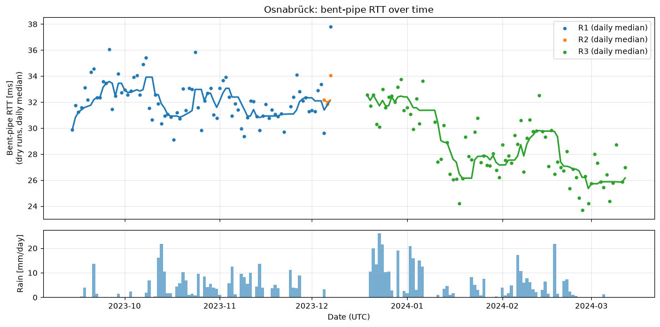
Lower RTT in the later months: route or month?
Open question
Autumn ≈ 32 ms, March ≈ 26 ms
R3 starts at ≈ 32.5 ms, the same as R1
The drop comes later, in steps (mid-Jan, late Feb), while the route label stays R3
Cause unknown: hidden network change or seasonal effect
Daily median bent-pipe RTT of dry runs per route, 7-day rolling median; daily rain below (notebook Step 2a).
Notes:
Whatever the cause, the RTT level changes over time. The correction therefore has to follow the time, not only the route.

Slide 11
Idea: estimate the dry RTT, keep the difference
Learn from the dry runs (no rain now and none in the previous 60 min) what the RTT normally is at a given day and hour:
dry_run_function(day, hour) → estimated RTT if there were no rain
34 ms
−
31 ms
=
3 ms
measured RTT
day 23, hour 3
dry_run_function
(23, 3)
excess_rtt
excess_rtt is calculated for every run, dry and rainy; day and hour effects are already inside the estimate, so they drop out
Then: is there a correlation between excess_rtt and rain? If rain slows the bent-pipe, rainy runs have a larger excess_rtt
Notes:
The numbers on this slide are an illustration. For dry runs, excess_rtt is about 0 on average.

Slide 12
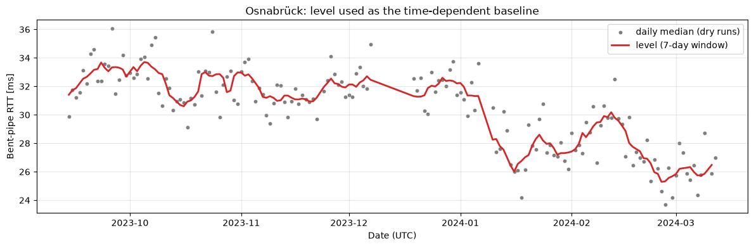
The estimation function: level + hour correction
level(day)
hour_correction(period, hour)
Median RTT of all dry runs from 3 days before to 3 days after the day. Follows the change over the months.
Median of (RTT − level) of dry runs at that hour, separately before/after the December gap. Night ≈ +2 ms, morning ≈ −1.5 ms.
Real run: 2023-10-11, 15:53
level 32.19
hour_correction −0.67
estimate 31.52
measured 41.77
excess_rtt +10.25 ms
Daily dry medians (grey) and level(day) (red), notebook Step 4a.
Check: std of daily medians 2.71 → 1.15 ms
Notes:
The paper's correction uses one value per hour for the whole period. Here the level follows the change over the months, and the hour correction is computed separately for the two periods because the day/night swing was 4.4 ms in autumn and 2.8 ms in winter.

Slide 13
Next: correlate excess_rtt with rain
37,491 runs with excess_rtt · compare median excess_rtt of rainy vs dry runs by rain rate · test the correlation
Notes:
88 runs next to the December gap have no level and therefore no excess_rtt.

