Slide 1
Energy Efficient Routing Schemes in Sensor Networks
Maleq Khan
April 24, 2003

Slide 2
Sensor Networks Vs. Wireless Ad-Hoc Networks
Similarities
Wireless
Multi-hop
Energy constraint
Differences
Communications: sources to single sink
Data collected by sensors based on
common phenomena,
Data redundancies, aggregation possible
Usually NOT mobile,
nature of dynamics is different
Energy constraint is critical, unattended
The power-aware routing protocols developed for ad-hoc network is not suitable for Sensor networks.

Slide 3
Modes of Operation
The sensor nodes are the sources of data.
The are one or more sinks which collects ddata from the sources
Continuous update
Query driven
Event driven

Slide 4
AC & DC Protocol
Address-Centric Protocol (AC): Each source independently sends data to the sink (“end-to-end routing”).
Data-Centric Protocol (DC): Nodes enroute aggregate data (hence, reduce volume of the data), then forward the aggregated data.
S S
Aggregation
C C
A B A B
AC Protocol DC Protocol

Slide 5
Query/Event Routing Algorithms
Directed Diffusion (John Heidmann et al. 2001)
Rumor Routing (David Braginsky et al. 2002)
Multipath Routing (Deepak Gansean et al. 2002)
GEAR (Yan Yu et al. 2001)
SPIN (Wendi Heinzelman et al. 99)
No structure/Begin with flooding/Some optimization

Slide 6
Configuring Network Structures
Most envisioned scenario is that source-nodes sends data to the sink without waiting for queries.
For efficient data collection, paths need to be established from each source to the sink. These paths forms a tree, called data aggregation tree.
Pre-configuration of the data aggregation tree is not possible due to
  environmental dynamics
  large number of nodes
  unexpected positions of the nodes

Slide 7
Configuring Network Structures (cont.)
Manual configuration
- nodes are manually positioned and connections are preconfigured
Self-configuration
Nodes are randomly distributed in the area of interest.
without centralized control, the nodes cooperate with themselves to build network structure

Slide 8
Research Questions
Which tree?
- many different trees can be formed
How to self-configure to form the tree?
- without centralized control, the nodes cooperate with themselves
Keeping in mind: the critical energy constraint
and perhaps transmission latency

Slide 9
Data Aggregation Trees
Cluster-Based Tree (CBT): Cluster-heads aggregate data, then sends to the sink
Algorithms for self-configuring clusters
- LEACH (Heinzelman et al. 2000)
- Localized (Estrin et al. 1999)
How many cluster heads? Which nodes should be selected as cluster head?
sink

Slide 10
Other Aggregation Trees
Krishnamachari et al. (INFOCOM 2002) provided a list of optimal and suboptimal data aggregation trees
- Minimum Steiner Tree
- Center at Nearest Source (CNS)
- Shortest Path Tree (SPT)
- Greedy Incremental Tree (GIT)
CNS SPT
So far, no analysis or algorithm
to build such trees is given.
MST

Slide 11
Tradeoffs in choosing DA Tree
Number of transmission steps = height of the tree
CNS < CBT < SPT < MST
Energy consumption in data transmission
MST < SPT < CBT < CNS
Time and energy consumption in self-configuration process
Implementation of security mechanisms (such as authentication)
Considering security, seems CBT is the best candidate.

Slide 12
Questions…
To minimize energy consumptions:
How the nodes need to be positioned (if manual configuration possible)?
How many nodes are needed to deploy?
What is the expected energy consumptions when the nodes are positioned randomly?
Which routing scheme requires minimum energy?

Slide 13
The Model
Definition 1. Transmission Step - the time duration in which a node begins and completes transmitting data to the next hop.
Definition 2. Transmission Phase - a collection of the successive transmission steps that begins with the steps when the sources start sending data and ends with the step when the sink receives data from all of the sources.
Assumption 1. Each node waits until it receives data from all of its descendants and upon receiving, aggregates into one unit of data, then sends to the next hop.
Assumption 2. In each transmission phase, each source sends data to the sink exactly once.

Slide 14
Analysis
Lemma 1. If n be the number of sensors nodes, the total number of transmissions in each transmission phase is n.

Slide 15



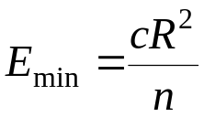
Simple Linear Network
R
sink
n nodes
sink receive data from a distance R using n hops in a straight line.
Theorem 1. In a simple linear network, the total transmission energy consumption is minimal when nodes are equally spaced, and the minimum energy consumption,

Slide 16
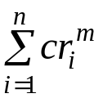
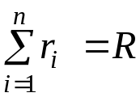
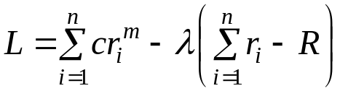
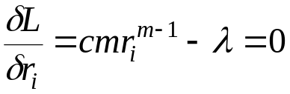
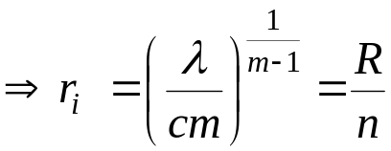
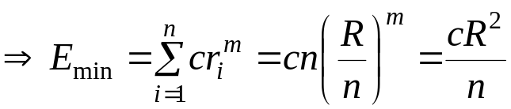
Simple Linear Network (cont.)
Proof:
minimize with the constraint
where λ is a Lagrange’s multiplier
(with m = 2)

Slide 17
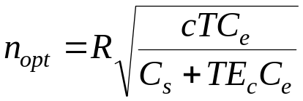
Simple Linear Network (cont.)
Theorem 2. To minimize the total cost, the optimal number of sensors nodes in a simple linear network is
C_{s} – cost per sensor node
C_{e} – cost per unit energy
T – the estimated number of transmissions phases
E_{c} – Energy dissipated by radio electronics per transmission.

Slide 18
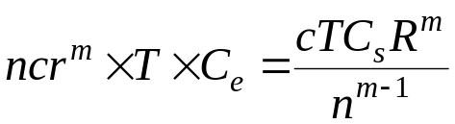
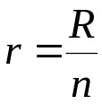


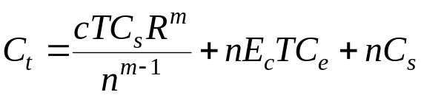
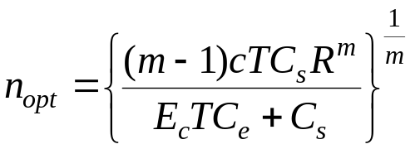
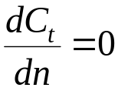
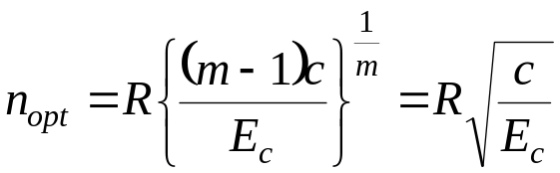
Simple Linear Network (cont.)
Proof:
Radiated energy = (using )
Radio electronics energy =
Cost of the sensor nodes =
Total cost,
Solving ,
With m = 2,
Corollary 1. Ignoring the cost of the sensor nodes,

Slide 19
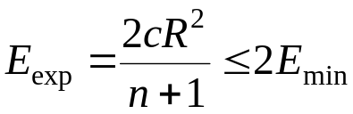
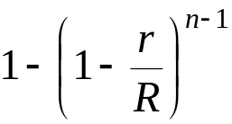
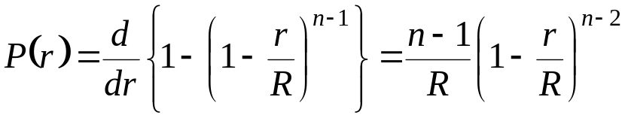
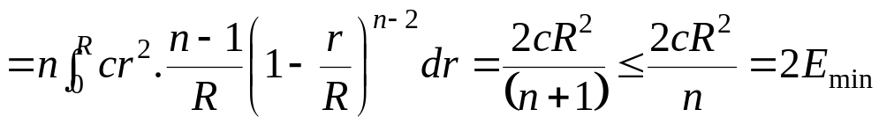
Simple Linear Network (cont.)
Theorem 3. The expected energy consumption in one transmission phase in a simple linear network with randomly distributed n nodes is
Proof:
The probability that the next hop N′ is within distance r
=
Density function,
Energy

Slide 20
Routing in Two Dimensional Networks
Manual Configuration (must satisfy coverage requirement)
Triangular
Hexagonal
Square

Slide 21
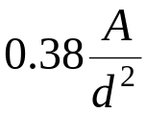



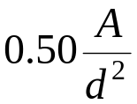



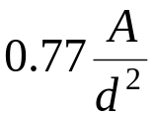
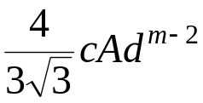


Manual Configuration
Sensor coverage, d: there is a sensor node within distance d from every point in the region of deployment.
n – number of nodes
A – area of the region
Satisfying coverage d:
Arrangement | Required n | Energy, e_{m} | Energy, m = 2 | Energy, m = 3
Triangular
Square
Hexagonal

Slide 22
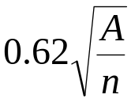

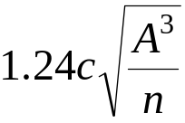
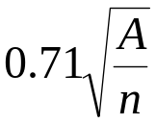

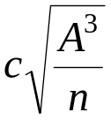
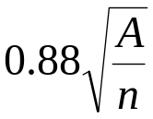

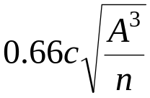
Manual Configuration (cont.)
Keeping n constant:
Arrangement | Coverage, d | Energy, e_{m} | Energy, m = 2 | Energy, m = 3
Triangular
Square
Hexagonal

Slide 23



Random Distribution
Assumption 3. A node can be connected to (can communicate with) the other nodes, which are within a specified distance.
Definition 3. Connectivity Graph. A connectivity graph, , is the graph where
- V is the set of sensor nodes
- the distance between u and v if u and v can communicate with each other, otherwise .

Slide 24





Random Distribution (cont.)
Theorem 4. Let be the connectivity graph of the sensor nodes. A data aggregation tree with minimum energy consumption is a minimum spanning tree on G.
Proof:
is the distance between node u and v in graph G.
Energy required for one transmission from u to v =
Let be the graph with

Slide 25


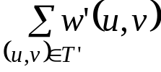
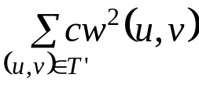










Random Distribution (cont.)
A minimum spanning tree on minimizes , which is
, that is, minimizes energy consumption.
Now we show that for all u and v, if and only if
that is, the both set of weights produce the same sorted order of the edges. As a result, the set of edges in is equal to the set of edges in . Since minimizes energy consumption, hence, T does so.
,

Slide 26

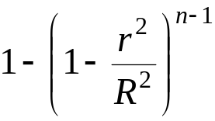
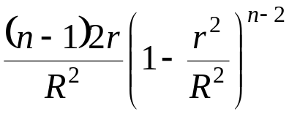
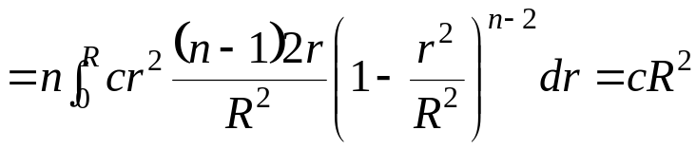
A Lower Bound
Theorem 5. A lower bound on the Expected energy consumption in one transmission phase is , R is the radius of the area.
Consider each node send to the nearest neighbor (even if cycle)
A particular node has its nearest neighbor within distance r with probability .
Probability density function =
Energy

Slide 27
Nearest Neighbor Routing
Distributed algorithm to build MST takes 5nlogn message passing.
An Approximation:
- Each node set a timer proportional to number of neighbors and remaining energy.
- Upon timer expiration, a node selects its available nearest neighbor to get connected to.
- As soon as node u get connected to some node v, u is no longer available for connection.
- dead end: when a node have no available neighbor – release all connections.

Slide 28
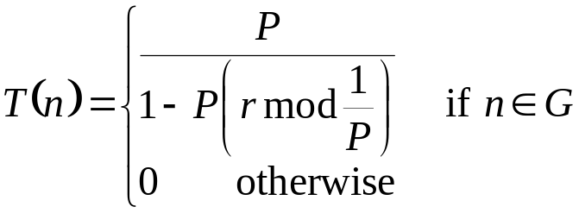
Self-Configuring Clusters
The Low Energy Adaptive Clustering Hierarchy (LEACH):
- Select cluster-heads randomly
- Other nodes select the nearest cluster-head
Poor quality clusters
Consume lower energy in cluster formation phase
There may be some isolated nodes

Slide 29
Localized Algorithm
All sensors start by sending advertisements to sensors within specified radius.
Set a promotion timer inversely proportional to the sensor’s remaining energy and the number of other sensors from whom the advertisement were received.
When timer expires, it promotes and advertises itself as a cluster head.
The nodes who hear the advertisement, drops out of the election process.
Other nodes select the nearest cluster-head.
Cluster quality is good
No isolated node
High energy consumption in configuration phase

Slide 30
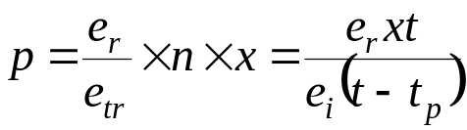
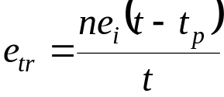
Low Energy Localized Algorithm (LLC)
Select x percent candidates randomly,
each with probability
Estimated remaining energy in the system,
The candidates compete to be cluster-head according to Localized algorithm
Good quality cluster as well as low energy consumption
Control parameter: candidate ratio, x.

Slide 31
Performances
200 sensor nodes are randomly (uniform distribution) distributed in a square area 200m×200m.
data-sink is at 200m from the center of the sensor field
every measured parameter is computed by averaging 50 different random distributions of the nodes.
Parameters Value
Digital Electronics 11 mW
Radio Receiver Electronics 13.5 mW
Radio Idle Listening 13.5 mW
Radio Trans. Electronics 24.8 mW
Radio Sleep Mode 15 μW
Radio Path Loss 200 pJ/bit/m³

Slide 32
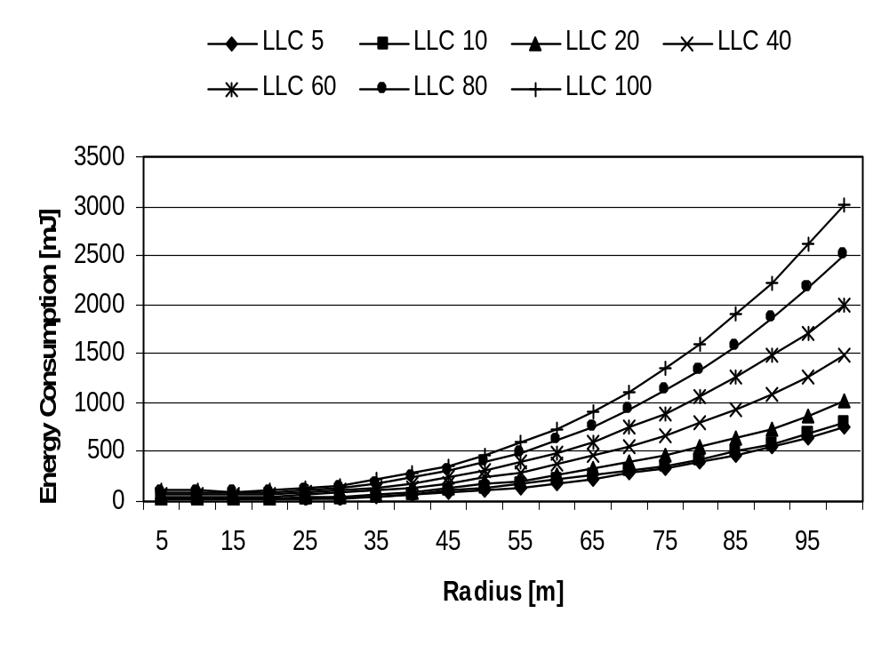
Energy Consumption (LLC)

Slide 33
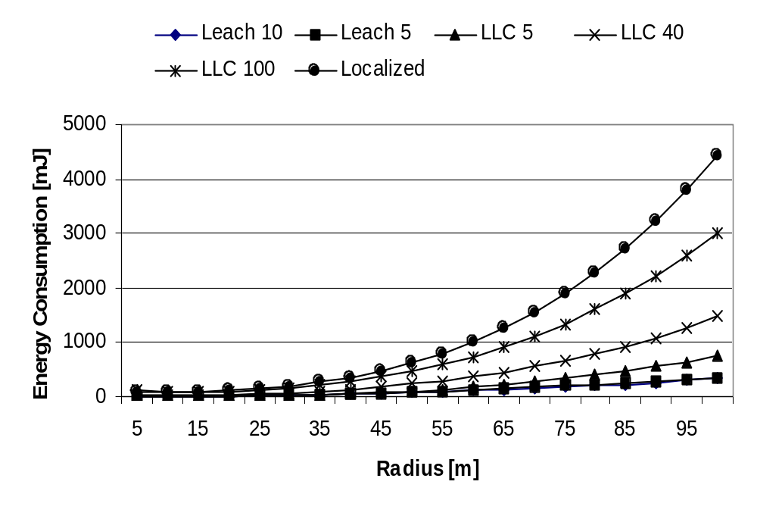
Energy Consumption

Slide 34
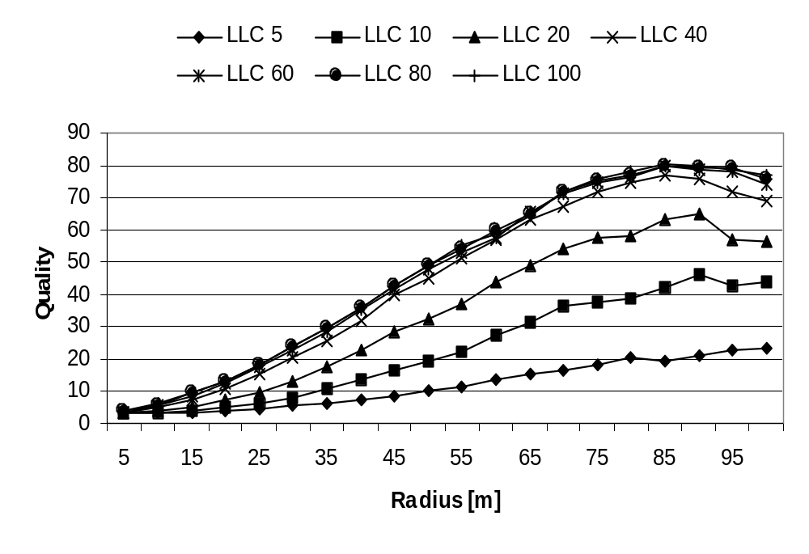
Cluster Quality (LLC)

Slide 35
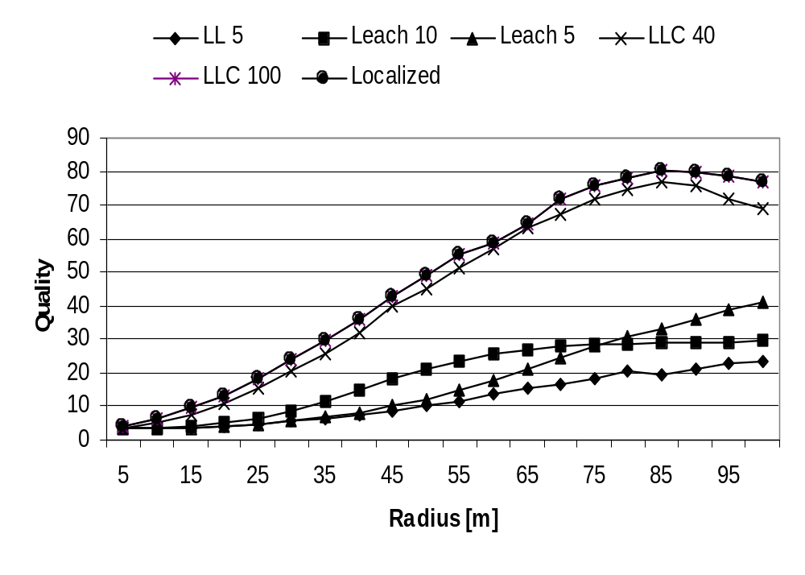
Cluster Quality

Slide 36
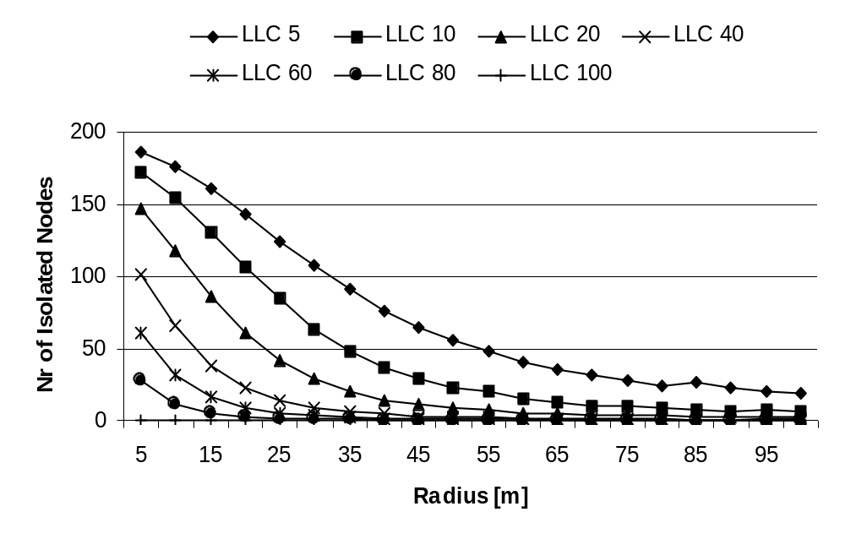
Number of isolated node (LLC)

Slide 37
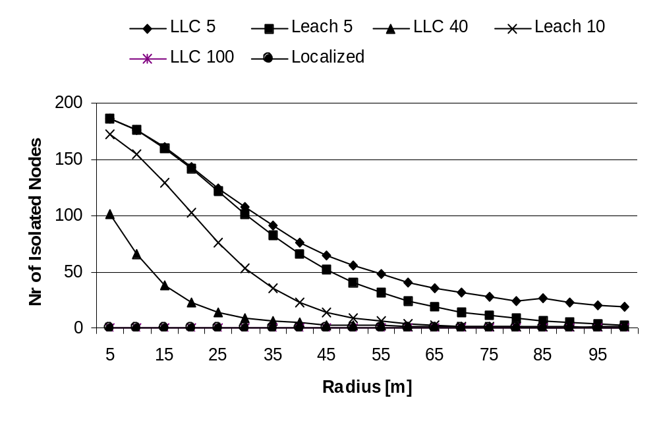
Number of isolated node

Slide 38
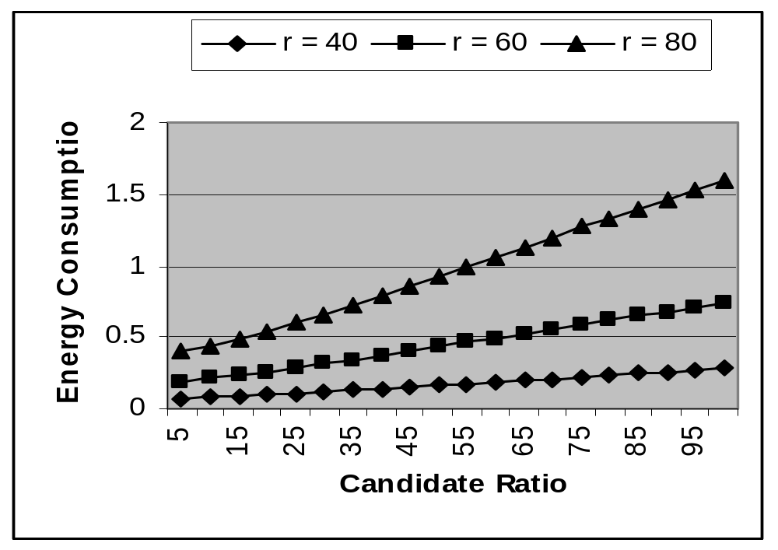
Energy of LLC with Varying Candidate Ratio

Slide 39
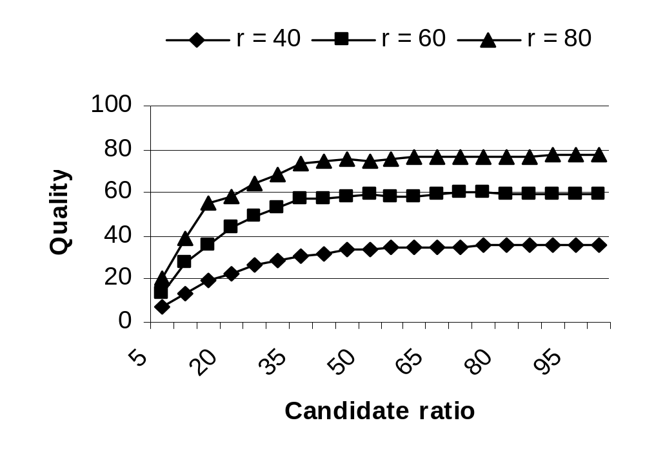
Quality of LLC with Varying Candidate Ratio

Slide 40
Simulation Results for MST/NNT
Theorem 3. Expected energy consumption in linear network
calculated: 7.96 Micro Joule, Simulation: 7.93 (10000 repetation)
R = 2000, n = 200
Theorem 5. Expected energy consumption in two 2-d network
R = 100, n = 200
calculated: 2.0 Micro Joule, Simulation: 2.14 (10000 repetation)
Quality:
MST: 602.77 with same parameters (10 repetations)
NNT: 369.41 with same parameters (50 repetations)

Slide 41
Conclusions
LLC can be superior to both LEACH and Localized saving energy in cluster formation as well as producing good quality clusters
MST is the data-aggregation tree that consumes minimum energy in data-centric routing
NNT is an approximation of MST consuming twice as energy as MST in data-centric routing

