Slide 1
Energy-Efficient Local Distributed Algorithms for Wireless Ad Hoc Networks
Maleq Khan
July 19, 2004

Slide 2
Introduction & Motivation
Local Distributed Algorithms
  Well known and common for wireless ad hoc networks
  Each node knows its local neighbors and local information
Energy is critical in wireless ad hoc networks
  Battery powered
  Sometimes unattended (e.g., sensor networks)
  Algorithms need to be energy-efficient
To save energy
  Keep time and number of messages low
  Use information available locally
Tradeoff optimality of the solution to the energy-cost
  Design energy-efficient algorithm for near-optimal solution
  To our best knowledge, we are the first to address this energy-quality tradeoffs for fundamental distributed algorithms.
Today, we specifically focus on distributed algorithms for MST

Slide 3
Outline of this Presentation
Energy model and work complexity
Problem Statement – Distributed algorithm for Minimum Spanning Tree
A near-optimal solution – nearest neighbor trees (NNT)
  What is NNT
  Quality of NNT – Analysis
An efficient distributed protocol to construct NNT
  Description of the protocol
  Analysis – work, message and time complexities
Work complexities of an message-optimal MST algorithm
Simulation results
  Random uniform distribution of the nodes
  Experimental results on a set of real data
Some preliminary results on k-connected graphs.

Slide 4
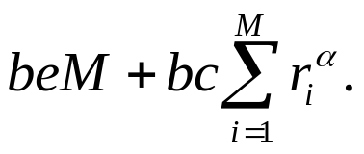
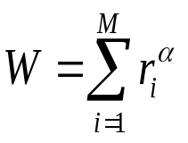

Energy Model & Work Complexity
Energy consumption in a wireless device
  in digital unit (for processing data and signal, network protocols)
    energy = npT, p – power, T - running time, n - # of nodes.
  in transceiver
    radiation energy ∝ r^{α} to transmit to distance r. Typically, α = 2.
      Work function, f(r) = r^{α}.
    radio electronics: a constant energy e for each data unit.
    for M messages of size b, energy = .
  Work complexity
  Total Energy .
radio electronics
digital electronics
radiation energy

Slide 5
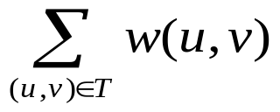

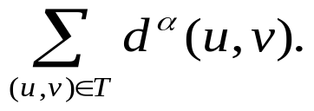
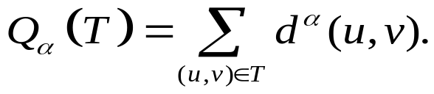
Minimum Spanning Tree
Important primitive for data and communication networks
  Optimal broadcast tree
  Optimal data aggregation tree (finding min, max, avg, count, etc)
We study MST for geometric setting – points on a plane
Minimum spanning tree (MST), T, minimizes
  Euclidian MST:
  Our objective function is
  Thus we define quality of tree T,
    For α = 1, it gives Euclidian MST.

Slide 6


Previous Works
Distributed algorithms to find the exact MST
  Cycle detection is complicated
  requires huge bookkeeping and synchronizations
  Not suitable for energy-constraint wireless ad hoc networks
So far best results
  Number of messages: (Gallager et al. 1983)
    Shown to be optimal
  Time: (Elkin, 2004)
We propose a new approximation algorithm called nearest neighbor tree (NNT)
  significant improvement on efficiency
  while the quality of the results are close to optimal.

Slide 7
Nearest Neighbor Trees (NNT)
Simple local algorithm
Avoid cycle detection by using unique ranks of the nodes
Work, message and time complexities are very low
Construction of NNT
  Each node u chooses a unique rank, rank(u).
  Find and connect to the nearest node v, such that rank(u) < rank(v)

Slide 8

Rank Choosing Schemes
Two interesting and promising ranking schemes
Random rank (Random-NNT)
  Assumption: Each node given a unique ID.
  Each node, u, generate an independent random number R_{u} ∈ [0,1].
  rank(u) < rank(v), iff (R_{u} < R_{v}) or (R_{u} = R_{v} and Id_{u} < Id_{v})
Directional rank (Dir-NNT)
  Assumption: Each node knows its coordinates.
  Let (x_{u}, y_{u}) be the coordinates of u.
  rank(u) < rank(v), iff (x_{u} < x_{v}) or (x_{u} = x_{v} and y_{u} < y_{v})
Next we analyze these NNTs for a popular model for wireless ad hoc networks
  uniform distribution of nodes in

Slide 9











Quick Comparison
Algorithm | Quality Q₁ (for α = 1) | Quality Q₂ (for α = 2) | Work (for α = 2) | Messages | Time
Random-NNT
Dir-NNT
MST
MST on Yao Graph

Slide 10
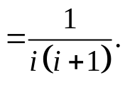
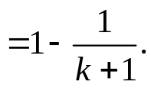


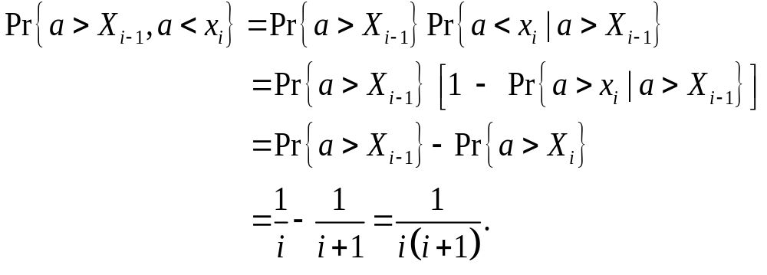
Analysis – Random NNT
Lemma 1: In random NNT, probability that a node connects to i^{th} nearest neighbor (NN) is Probability that a nodes connects within k NN
Proof: Let a and x_{i} be the random number of node N and its i^{th} NN.
Define and

Slide 11
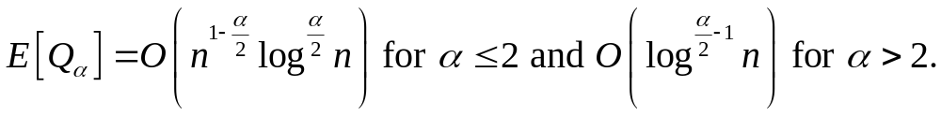
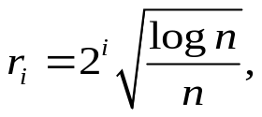
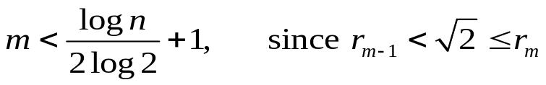
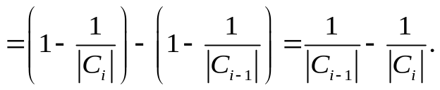
Analysis – Random-NNT
Theorem 2: Quality of Random-NNT,
Proof: Consider an arbitrary node u and circles centered at u
with radius i = 1, 2, …, m
Let C_{i} = set of nodes in the circle of radius r_{i}.
Let R_{i} = C_{i} – C_{i-1}
If u connects to v ∈ R_{i}, d(u,v) ≤ r_{i}
Pr{ u connects to v ∈ R_{i} }

Slide 12
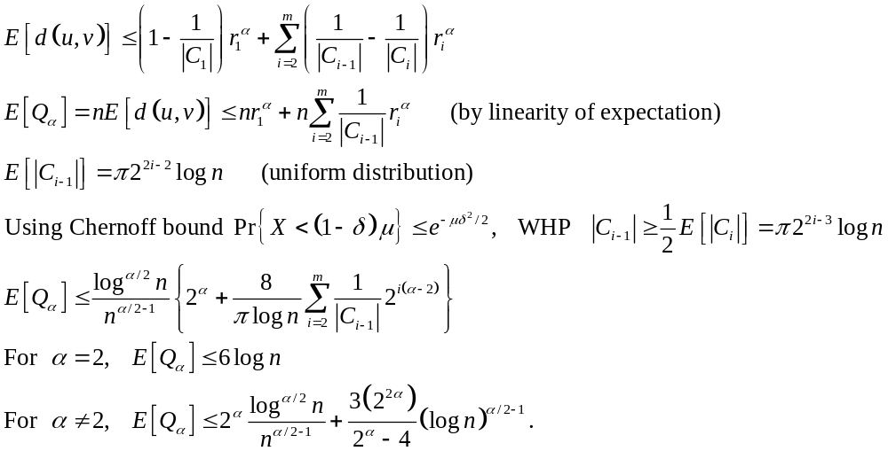
Analysis – Random-NNT

Slide 13

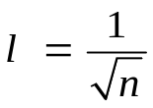


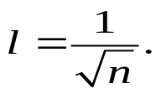
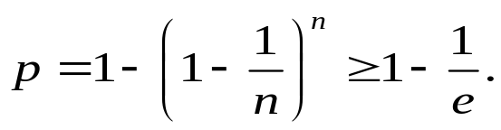
Analysis – Dir-NNT
small square cells
Length of each cell,
Rearrange the cells in a one row as shown
Each node connects to nearest node on its right
Probability that a particular cell has at least one node

Slide 14
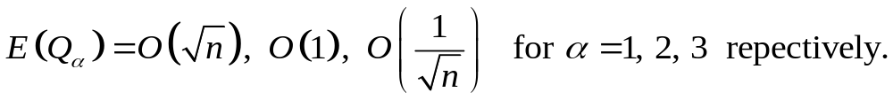
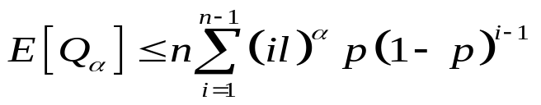
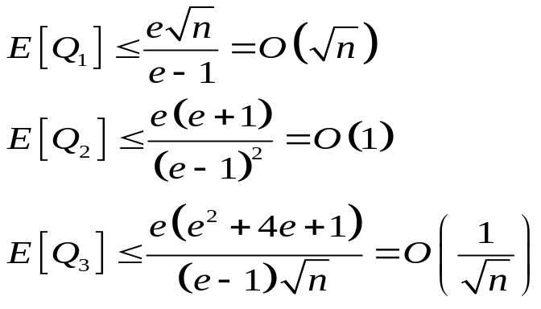
Analysis – Dir-NNT (cont)
Theorem 3: Quality of Dir-NNT,
Proof:
Probability that a connect to i^{th} next cell = p(1 – p)^{i-1}.

Slide 15

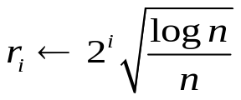
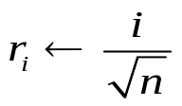


An Efficient Distributed NNT Protocol
Repeat
Set transmission range to for Random-NNT
for Dir-NNT
if
Broadcast <request, u, rankinfo> up to distance r_{i}.
Until receipt of an “available” message or r_{i} = l.
Upon receipt of <request, v, rankinfo> from v
if rank(v) < rank(u)
set transmission radius to d(u,v)
send <available, u, v> to v
Upon receipt of available messages
select the nearest node v from the senders
send <connect, u, v> to v

Slide 16
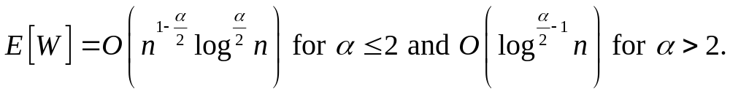
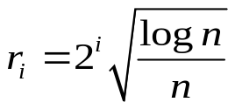





Analysis – Random-NNT
Theorem 4: Work complexity of Random-NNT,
Proof: For any node u,
Maximum number of request message
Let C_{i} = set of nodes in the circle of radius r_{i}.
Let R_{i} = C_{i} – C_{i-1}
Using Chernoff bound and
WHP,

Slide 17
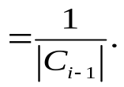
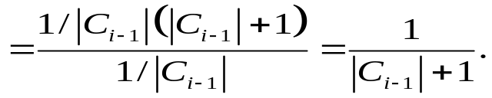
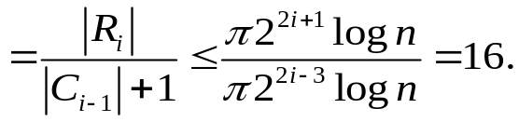
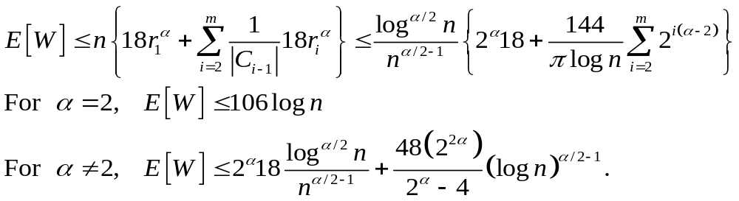
Analysis – Random-NNT (cont.)
Pr{u needs i^{th} transmission}
For an arbitrary v ∈ R_{i},
Pr{ rank(u) < rank(v) | u does not connect in C_{i-1}}
Expected number of reply (“available” message)

Slide 18
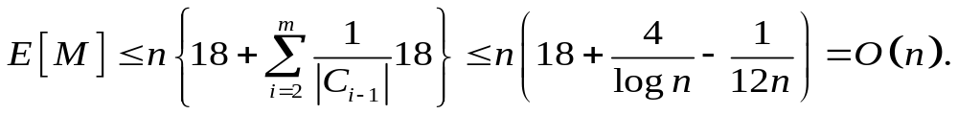
Analysis – Random-NNT (cont.)
Theorem 5: Message complexity of Random-NNT, E[M] = O(n).
Proof: Counting the messages
Number of messages =

Slide 19
Analysis – Random-NNT (cont.)
Theorem 6: Time complexity of Random-NNT, T = O(log² n).
Proof: Assume that 1) each message take one unit of time,
2) while a node transmit to distance r, no other node within this distance can transmit at the same time.
In the first phase of “request” message:
O(log n) nodes within r₁ distance.
A node replies at most O(log n) “available” and one “request” messages.
Thus time for first phase: O(log² n).
In the subsequent phases:
At most one unconnected node in any circle of radius r_{i-1}.
Mumber of unconnected nodes within distance r_{i} is constant.
Thus time is constant.
Total O(log n) time for O(log n) phases.

Slide 20
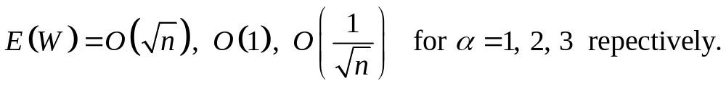
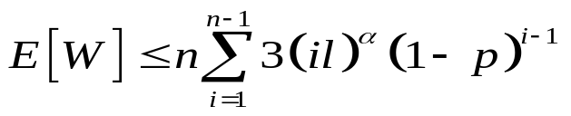
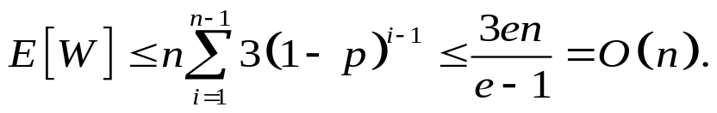
Analysis – Dir-NNT (cont)
Theorem 7: Work complexity of Dir-NNT,
Proof: Probability that a node need i^{th} transmission = (1 – p)^{i-1}.
Expected number of messages in i^{th} phase = 3 (1 request, one reply, one connect)
Theorem 7: Message complexity:
Theorem 8: Time complexity: no more than Random-NNT and thus O(log² n).

Slide 21


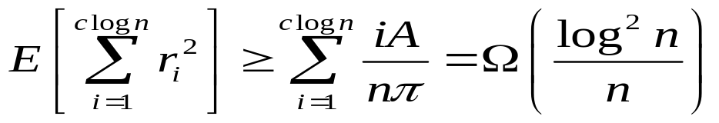
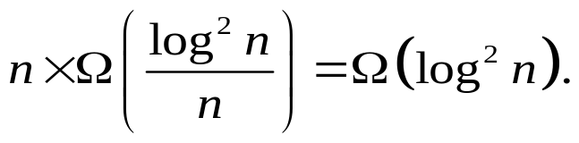
Work Complexity – GHS Algorithm
Theorem 8: Work complexity of GHS algorithm is
Proof: Number of neighbors of a node =
Each node sends test/accept/reject messages through each adjacent edge.
Expected work by each node is at least
For n nodes, by linearity of expectation,

Slide 22
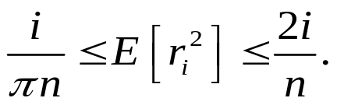

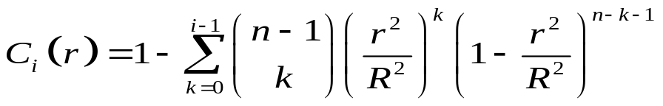
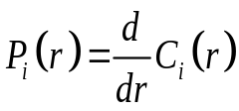
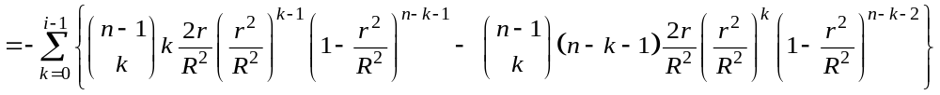
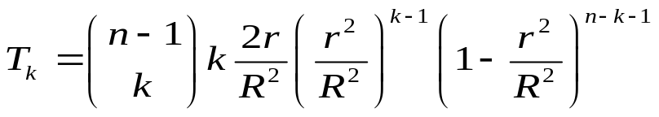
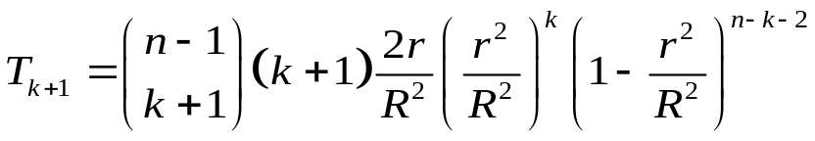
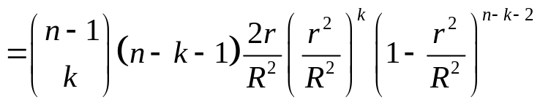
A Technical Lemma – Distance Lemma
Distance Lemma: r_{i} be the distance to the i ^{th} nearest neighbor.
Proof: Consider a node at the center and
The probability that at least i nodes within distance r is

Slide 23
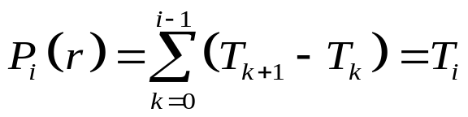
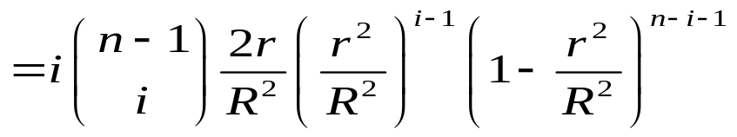
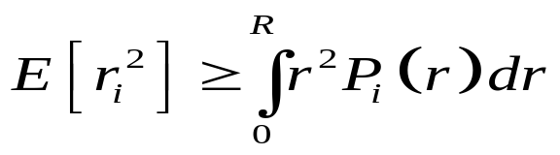
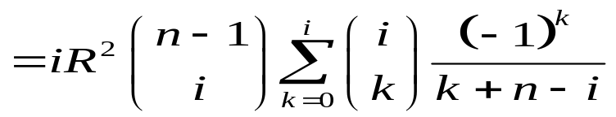
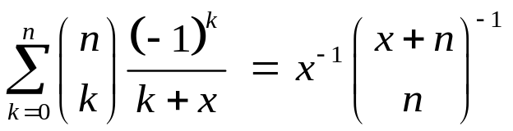
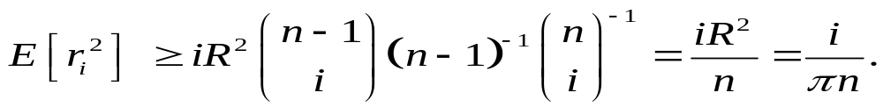

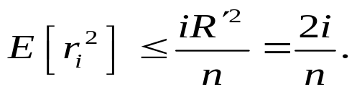
Distance Lemma (cont.)
Using the identity (Concrete Math, Knuth et al.)
For an upper bound, consider a node at the corner,

Slide 24
Yao Graph
Each node keeps edges to only the nearest node in each 60° wedge.
  degree ≤ 6.
Preserves edges of MST
Reduces communication cost for GHS.
Finding Yao graph is itself costlier than finding Dir-NNT.

Slide 25


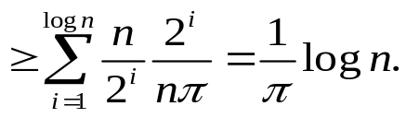
Analysis – GHS on Yao Graph
Theorem 9: Work complexity of GHS on Yao Graph is Ω(log n).
Proof:
Consider report and initiate messages.
θ(n log n) messages: log n levels
θ(n) messages in each levels costs θ(1) work.
Total work for these two types of messages: θ(log n).
Even if initiate message is broadcasted (not possible for report messages):
fragments in i^{th} level and nodes in each fragment
broadcasts by leaders.
work

Slide 26
Quick Comparison
Algorithm | Quality Q₁ (for α = 1) | Quality Q₂ (for α = 2) | Work (for α = 2) | Messages | Time
Random-NNT
Dir-NNT
MST
MST on Yao Graph

Slide 27
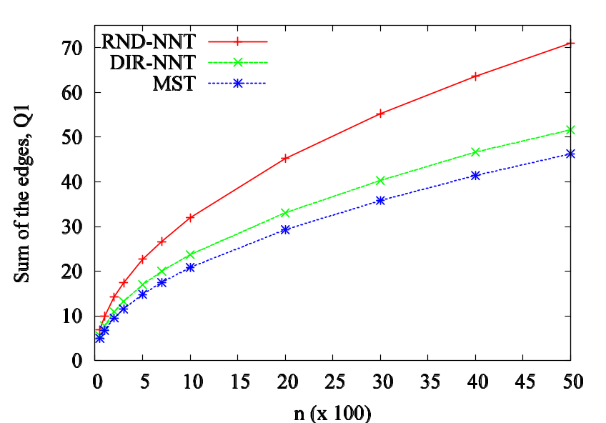
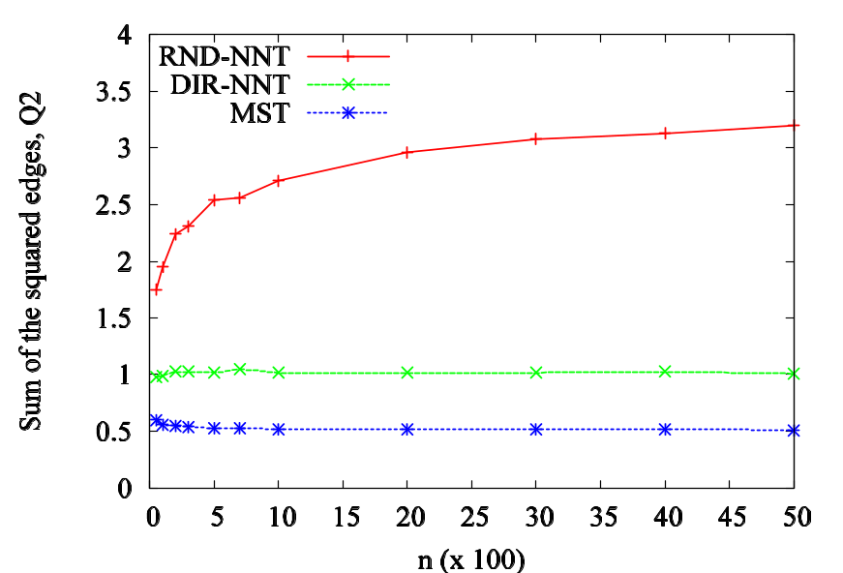
Simulation Results – Quality
Uniform random distribution in [0,1]²
Number of nodes: 50 – 5000
Number of runs: 50
Q₁(T), α = 1. Q₂(T), α = 2.

Slide 28


Simulation Results – Work & Messages
Work for α = 2. # of messages

Slide 29

Experiments on Real Data
Points are in a realistic urban setting (cars in a section of Portland downtown, OR.)
Area: 2.9 × 2.9 sq. KM.
Data obtained from TRANSIMS.
Results for two snapshots
Points at one snapshot
 | Q1 | Q2 | Work | Msg
Dir-NNT | 38.72 | 6.77 | 90.54 | 4832
Random-NNT | 50.75 | 14.13 | 131.42 | 5241
GHS Yao | 33.16 | 3.72 | 1271.11 | 20592
 | Q1 | Q2 | Work | Msg
Dir-NNT | 38.72 | 6.77 | 90.54 | 4832
Random-NNT | 50.75 | 14.13 | 131.42 | 5241
GHS Yao | 33.16 | 3.72 | 1271.11 | 20592

Slide 30

NNT for Metric Instances
Theorem 1: For any NNT, Q₁(NNT) ≤ O(log n) Q₁(MST).
Proof: Node orders from a depth first search in MST: v₁, v₂, …, v_{n}.
Construct a hamiltonian path S = <v₁, v₂, …, v_{n}>
c(S) ≤ 2c(MST)
Let S[i,j] = <v_{i}, v_{i+1}, …, v_{j}> and V[i,j] = {v_{i}, v_{i+1}, …, v_{j}}
Induction hypothesis: c( NNT(V[i,j]) ) ≤ 2 c(S[i,j]) log |V[i,j]|, for |V[i,j]| < n.
Consider an interval [i,j] such that |V[i,j]| = n.
Let
Edge connecting T₁ and T₂ has cost at most c(S[i,j]).

Slide 31

k-Connected Graphs
Increased connectivity
k-vertex (edge) connected graph G:
  After removing any k - 1 vertices (edges) from G,
  the resulting graph is still connected.
By k-connected, we refer to k-vertex connected.
Quality of graph G,
Traditional measure for optimality:
  Number of edges (α = 0)
  Sum of the edge lengths or weights (α = 1)

Slide 32



k-Connected Graph Algorithm
Each node u connects to k nearest nodes v_{i}
where, rank(u) < rank(v_{i}), for 1 ≤ i ≤ k.
Let G is the resulting graph.
An enumeration of the nodes w₁, w₂, …, w_{n} (highest rank to lowest).
Let w_{i} is connected to C_{G}(w_{i}) higher ranked nodes in G.
Theorem 10: G is k-connected.
Proof: Induction hypothesis:
G is (k-1)-connected if
Let G′ is the graph by deleting w_{j} from G.
G′ is (k-1)-connected. Thus G is k-connected.
Let G' is formed by deleting node w_{j}.

Slide 33




Analysis – k-Connect Graph
Lemma 3: Probability of j^{th} connection to i^{th} NN
Theorem 11: Using random rank,
Proof:
Expected cost for j^{th} connection

Slide 34




Analysis – k-Connect Graph
Theorem 12: For optimal k-connected graph G_{opt},
Proof:
In the best case, each node is connected to k nearest neighbors.
Cost of such k edges
Theorem 13: Approximation factor for E[Q₂(G)] is

Slide 35
Future Works
Lower bound on work complexity for any distributed MST algorithm.
Comparative study of work complexity of NNT for arbitrary setting.
Analysis for k-connected graphs using directional rank.
Work, message, and time complexity of k-connected graph algorithms.
Energy-efficient distributed algorithms for dominating sets.

