Slide 1
Utah Social Networks
Utah-1: Original state extracted from our national “proto-population” with no modifications (not included in these analyses)
Utah-2: Modified version of Utah-1 that included updated information on schools and their locations as well as improved techniques for allocating children to these schools
Utah-3: Modification on Utah-2 that included “between class mixing” at the schools. 20% of the duration of a school activity is done in a communal sublocation, forcing “inter-sublocation” mixing
Utah-4: Same as Utah-3 but with only 10% of school activities allocated to “inter-sublocation” mixing

Slide 2
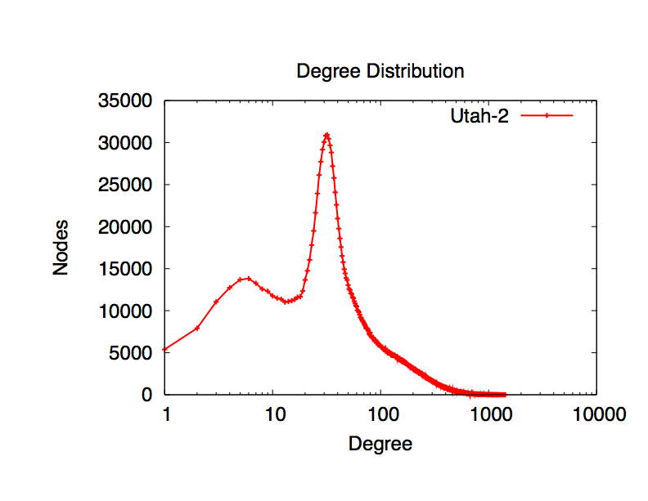
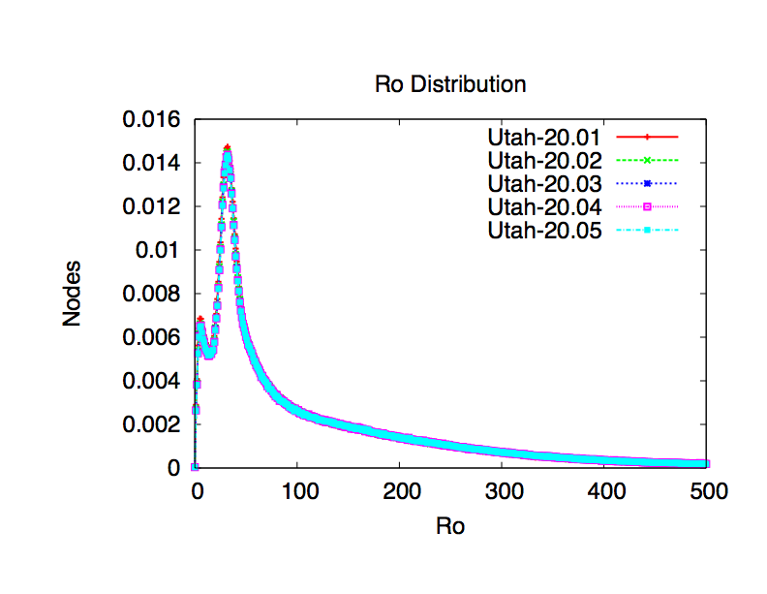
Degree and R0 plots

Slide 3
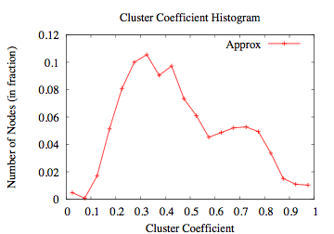
Clustering Coefficient Distribution
clustering coefficient of node v = (#triangles amongst nbrs of v)/ (maximum # triangles possible)
Clustering coefficient distribution: frequency distribution of clustering coefficient values of all nodes

Slide 4
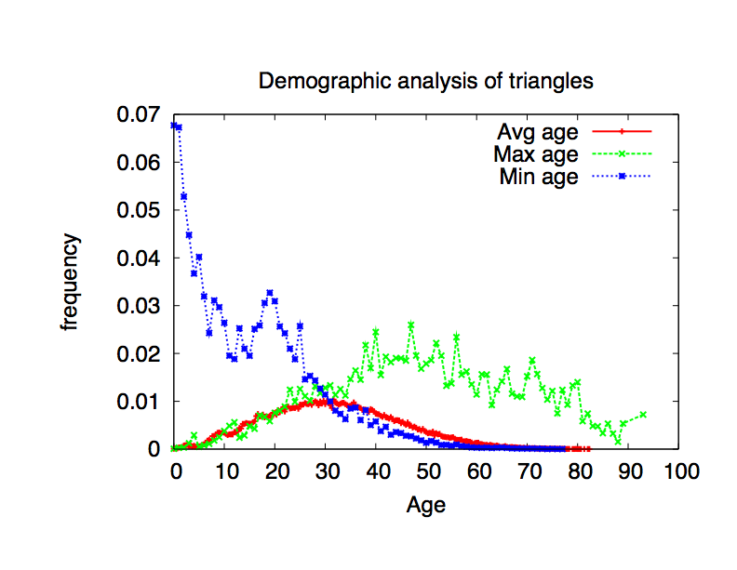
Demographic analysis of age labels of triangles
7
2
9
For this triangle:
labels are ages of end-points
avg = 6
max = 9
min = 7
Frequency distribution of the avg/max/min
over all triangles

Slide 5
Vulnerability analysis
Vulnerability: likeliness of an individual to be infected in an epidemic
Protocol:
  Generate social network
  Run many simulations over this network
  Count the number of times each individual was infected
  Vul = times infected / num iterations
This series was done with 100 iterations randomly seeded with 5 individuals per day and with 4 different values for “transmissibility” (infection probability parameter)

Slide 6
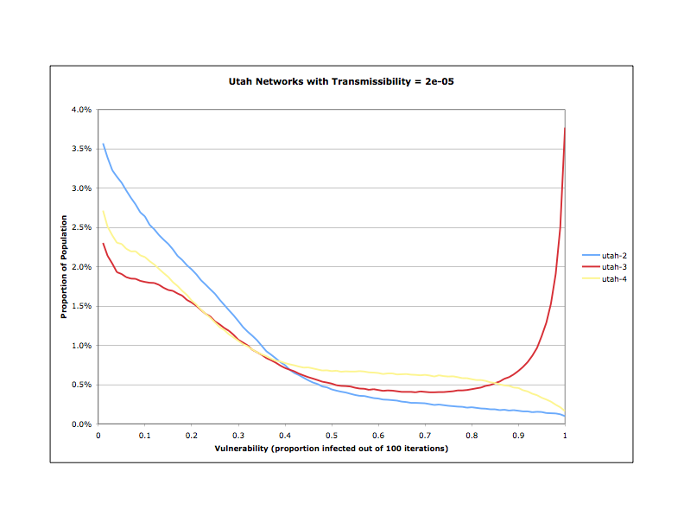
Utah networks by transmissibility
Transmissibility = 2e-05

Slide 7
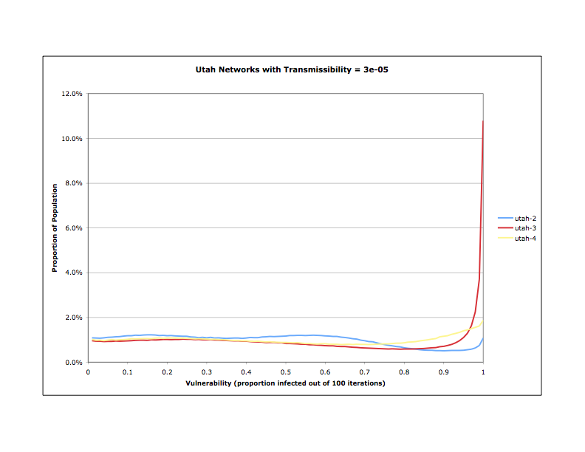
Utah networks by transmissibility
Transmissibility = 3e-05

Slide 8
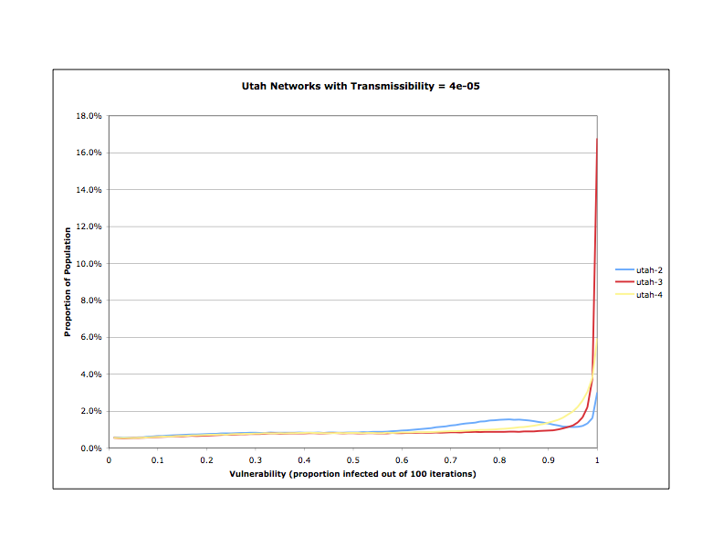
Utah networks by transmissibility
Transmissibility = 4e-05

Slide 9
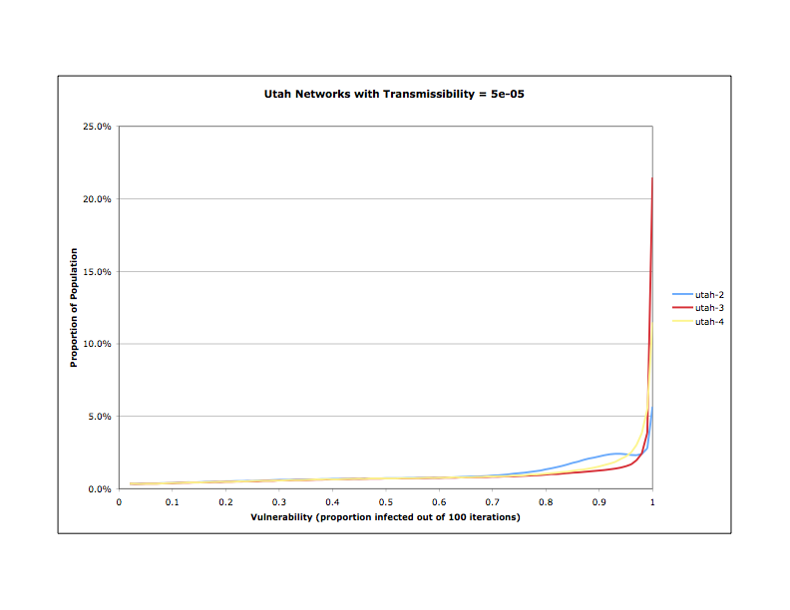
Utah networks by transmissibility
Transmissibility = 5e-05

Slide 10
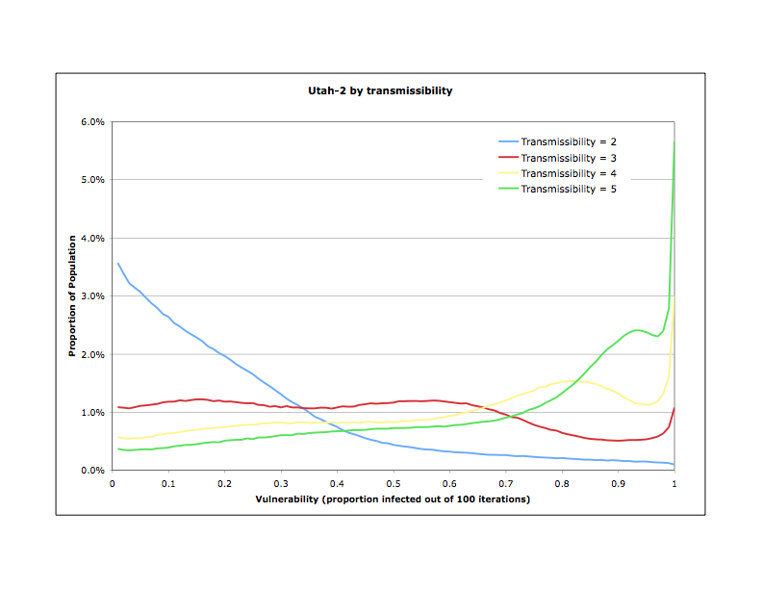
Utah-2 by transmissibility

Slide 11
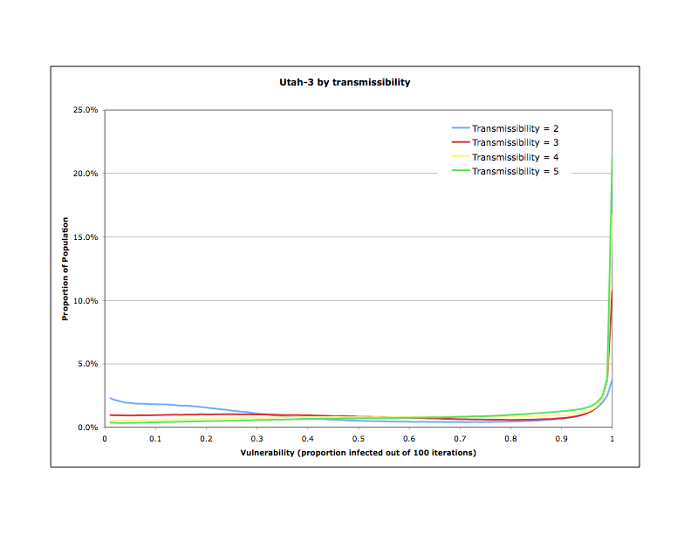
Utah-3 by transmissibility

Slide 12
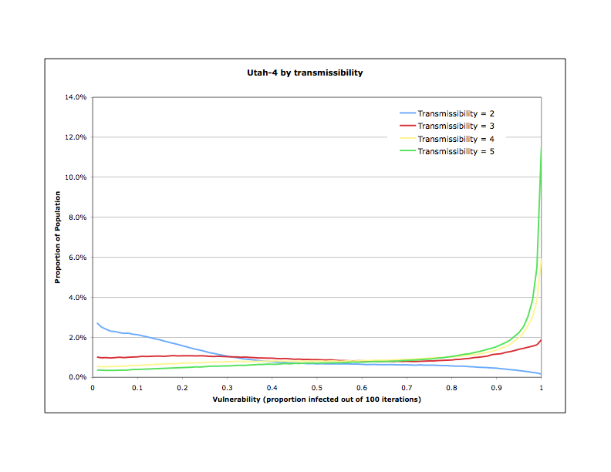
Utah-4 by transmissibility

