Slide 1
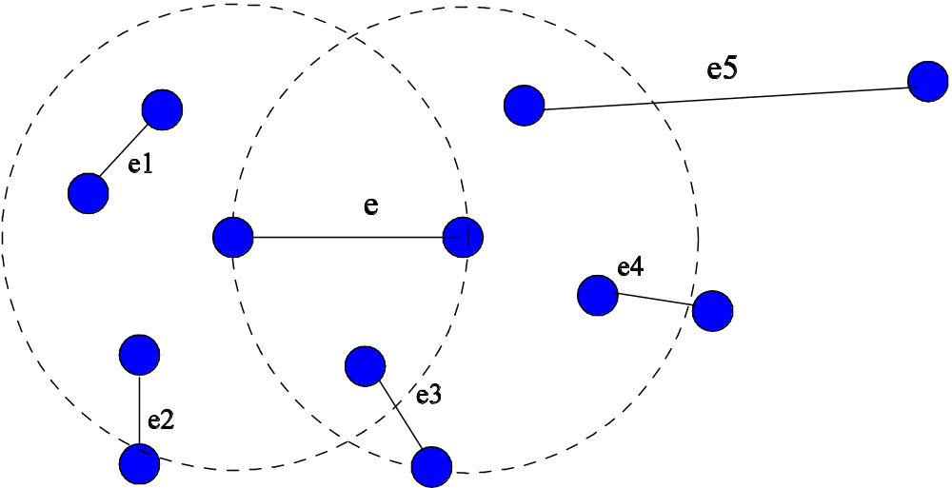
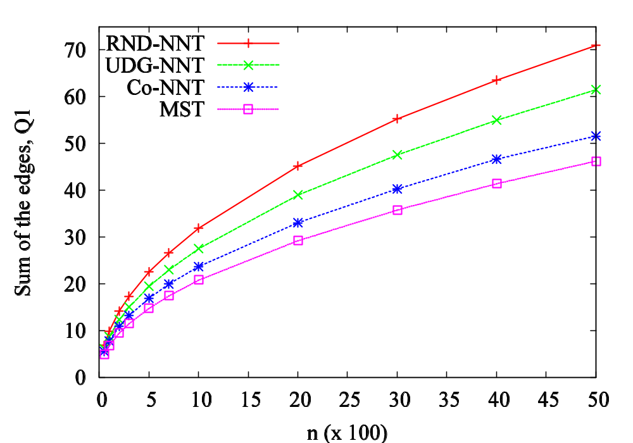
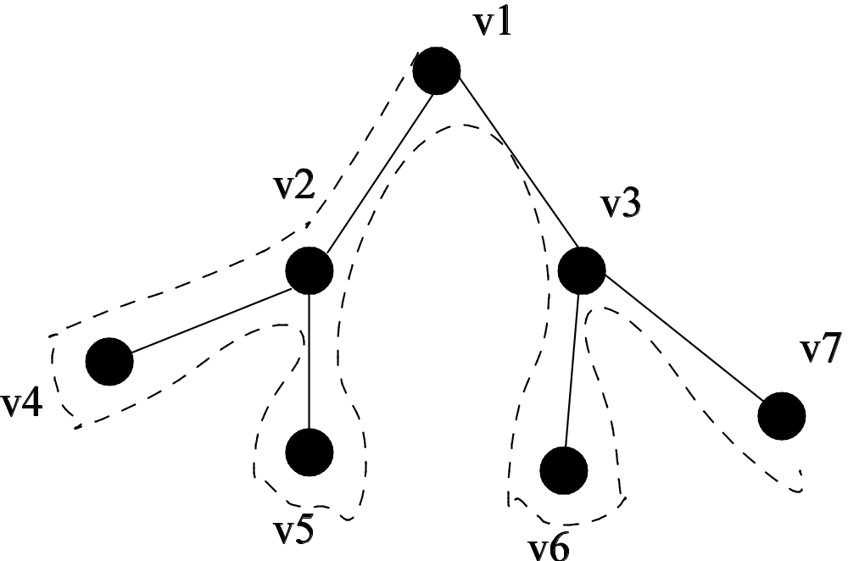
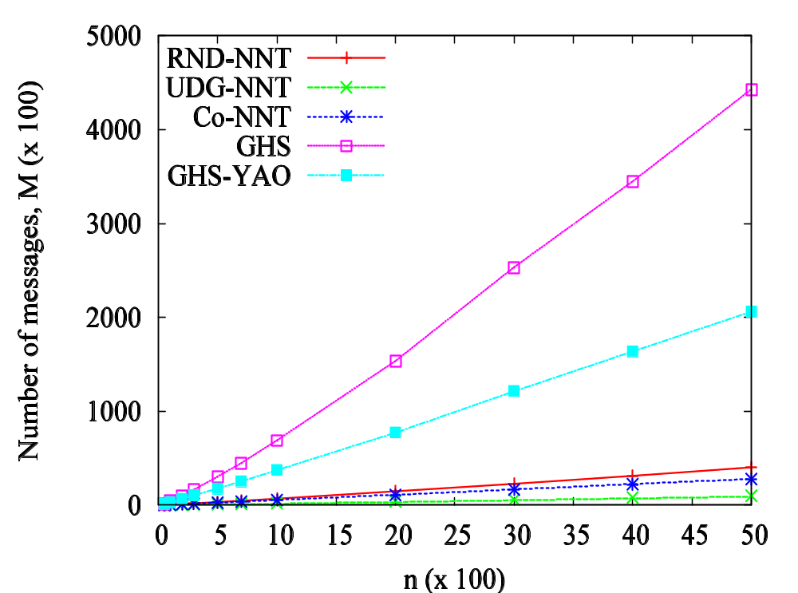
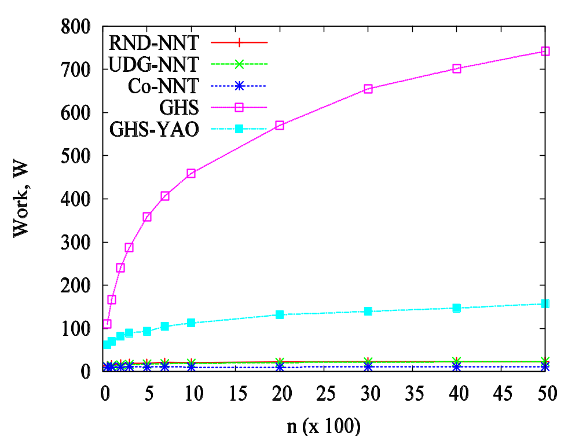
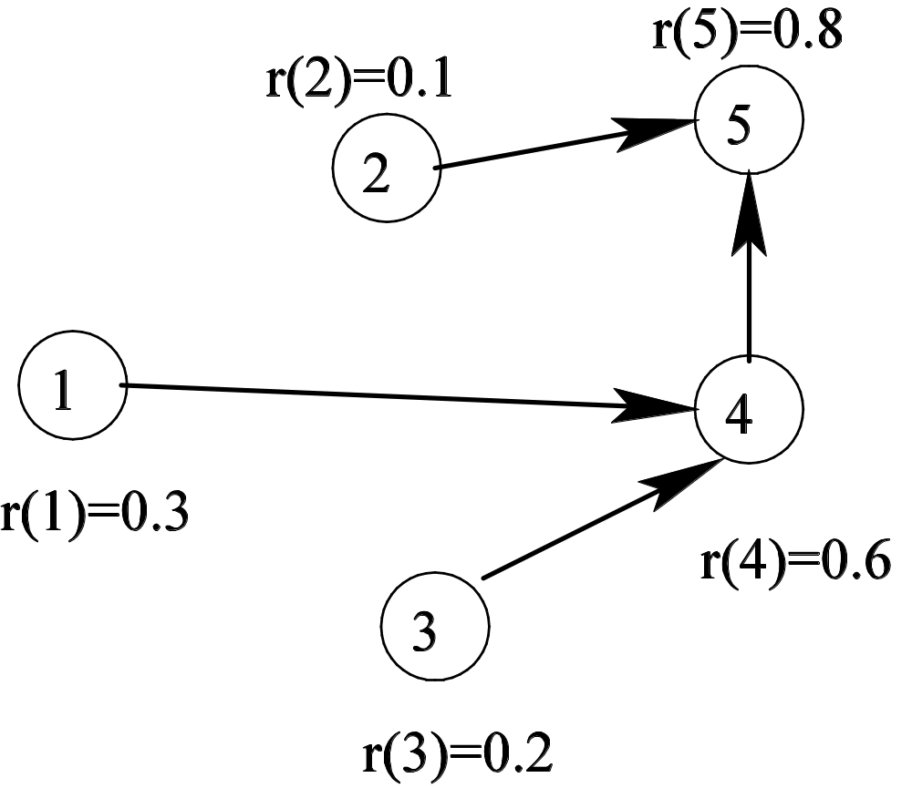
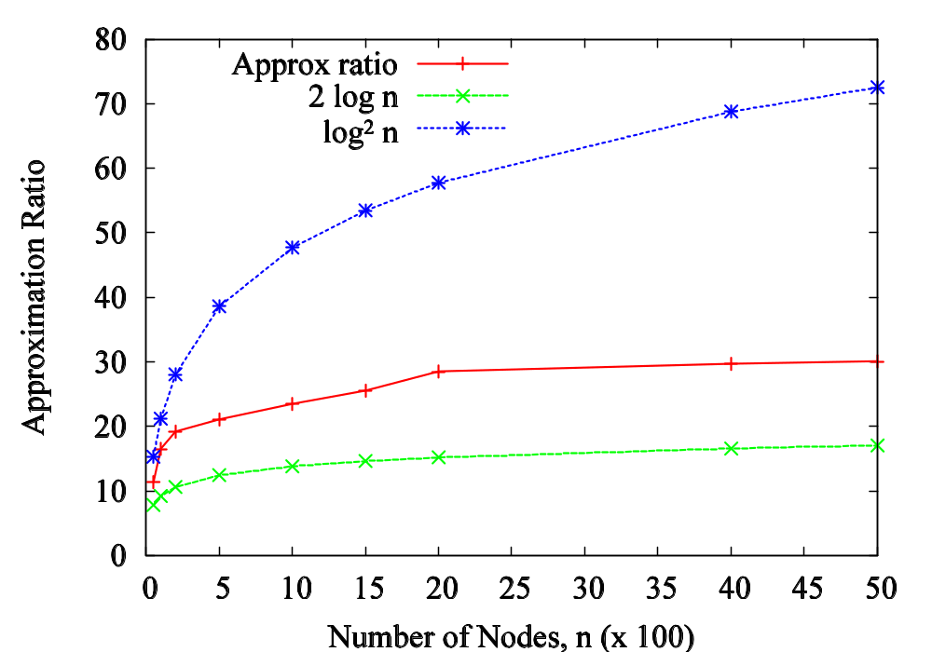
Efficient Distributed Approximation Algorithms for Some Network Connectivity Problems
Maleq Khan, V.S. Anil Kumar, Madhav Marathe, Gopal Pandurangan, and S.S. Ravi
Network Dynamics and Simulation Science Laboratory (NDSSL), Virginia Bioinformatics Institute, Virginia Tech
Summary
Distributed computing became an important paradigm with the advent of various networking technologies such as Internet, grid computing, cluster computing, local area networks, etc.
One of the main purposes of distributed computing is to provide an infrastructure connecting many computers, cluster nodes, or processors to facilitate high performance computing (HPC).
We present efficient distributed algorithms for some fundamental network connectivity problems such as the minimum spanning tree problem, k-connected subgraph problem, and topology control problem.
Distributed Approximation
Ad hoc wireless sensor networks and Peer-to-peer networks operate under inherent resource constraints such as energy, bandwidth etc. Topology can also change dynamically.
Efficient distributed algorithms, with low communication complexity and fast running time, are preferred even at the cost of reduced quality of the solution.
Distributed Computation Model
We are given a weighted graph G = (V, E, w) with set of nodes V, set weights E, and for each edges e, a non-negative weight w(e).
Each node is a processor and only knows the weights of the adjacent edges.
In each time step (round), a node can communicate only with its neighbors by exchanging message along the adjacent edges and can perform local computation.
Size of a message: O(log n).
For a given distributed problem, the object is to develop an algorithm that terminates in minimum time steps and exchanges minimum number of messages.
Minimum Spanning Tree (MST) Problem
The problem: Find a subset E' of edges E such the resulting graph G' = (V, E', w) is connected and the weight w(MST) = ∑_{e∈ E‘} w(e) is minimized.
The Basic Algorithm:
The spanning tree produced by the above algorithm is called Nearest Neighbor Tree (NNT). It gives (log n)-approximation to MST:
w(NNT) ≤ (log n) w(MST)
Implementation in a Complete Metric Graph:
In round i, each node probes its next 2^{i-1} nearest neighbors if it didn’t succeed in the previous round.
  It takes O(log n) time and expected O(n log n) messages.
Implementation in a General Graph:
  Each node connect to the nearest node of higher via the shortest paths.
  Implementation need to be done carefully to avoid
    Congestion
    Cycle formation
Wireless Networks:
In a wireless network, energy is a critical resource. Thus, to evaluate performance of an algorithm, we also consider energy complexity, in addition to the time and message complexities.
Energy complexity: Energy complexity is the sum of the radiation energy required by all messages. To transmit a message over a distance r, the required radiation energy is proportional to r^{2.}.
We assume that the nodes are uniformly distributed in a unit square.
When the nodes are uniformly distributed, NNT gives an expected constant approximation to the MST.
  In many graphs, this algorithm can be very fast. In unit disk graph or graphs with random edge weights it takes O(D + log²n) time.
  Whereas algorithms for computing exact MST takes Ω(D + √n) time.
Distributed NNT algorithm for wireless networks:
Performance (Analytical bounds and Simulations):
Approximation: O(1)
Time: O(log²n)
Messages: O(n)
Energy: O(log n)
(a) Weight of the trees
(b) Number of messages (c) Energy complexity
k-Connected Subgraph Problem
k-Connected Graph: A graph is k-connected if it remains connected after removing any (k-1) nodes and their adjacent edges.
k-Connected Subgraph Problem: Find a minimum weight subgraph which is k-connected.
The NNT algorithm can be extended to find a low-weight k-connected subgraph as follow:
The above algorithm produces a k-connected subgraph with approximation ratio O(k log n).
Our algorithm is the first distributed algorithm for this problem.
Topology Control in Wireless Networks
In a wireless network, the topology control problem is to choose transmission radii (power levels) for the nodes so that the resulting graph is connected and some function of the radii, such as the sum of the radii or power levels, is minimized.
Although the topology control problem, in general is well studied, we are the first to study this problem under stochastic node failures, where a node any node can fail (or leave the network) with a given probability. Formally, we study the following problem.
The problem: Choose transmission radii for the nodes such that the graph remain connected after each node fails with probability p and simultaneously the sum of the power levels and the interference among the edges are minimized.
Interference:
For each edge, interference is measured as the number of other edges that intersects its communication range. For example, in the figure below, interference for edge e is 6.
Our algorithm for topology control:
First each node choose its rank as below:
Then each node choose transmission radius as below:
The maximum interference in the topology constructed by the above algorithm is at most O(log² n) times the optimum interference.
The sum of the power level is at most O(log⁴ n) times the optimum. In practice, this approximation ratio can be much better as shown in the following simulation.
Each node v chooses a random rank rank(v).
Set initial transmission radius, r = 2/√n
Repeatedly broadcast a find message (containing it rank) to a distance r, 2r, 4r, …, etc. until a node of higher rank is found.
Send a connect message to the nearest node of higher rank.
Node with higher rank (than v)
4r
2r
r
Each node chooses a unique random rank as follow: each node v chooses a random number p(v) from [0,1]. For any u and v,
rank(u) < rank(v) iff p(u) < p(v) or p(u) = p(v) and ID(u) < ID(v)
Each node connects to its nearest node of higher rank via a shortest path.
Construct a minimum spanning tree T
Select an arbitrary node r as the root of T
Traverse T in depth-first order starting at r. Let the discovery order of the nodes be v₁, v₂, …, v_{n}.
Rank of node v is rank(v) = n + 1 – i.
Each node v finds (c log n) nearest nodes u_{i} of higher rank
For each u_{i}, include the edge (v, u_{i}) to the desired topology
Each node sets its transmission radius to the length of the longest adjacent edge in this resulting topology
Each node chooses a unique random rank.
Then connects to the k nearest nodes of higher rank.

