Slide 1
Graph and Relational Mining to Support Public Health Informatics
NDSSL, VBI
Network Dynamics and Simulation Science Laboratory

Slide 2
Mining subgraphs
Social contact graph
pattern
3 occurrences
of pattern as subgraph
Basic Questions
How many occurrences of any given pattern as subgraph?
Which are most common subgraph patterns (cascades)?
Network Dynamics and Simulation Science Laboratory

Slide 3
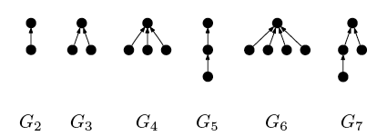
Graph Mining (cascades): Previous work
[Leskovec et al., 2007]
Ranking of frequent subgraphs
in a blog network
Goal: understand dynamics of information propagation
Mining subgraphs in recommendation system networks [Leskovec et al. 2006]
Mining subgraphs in biological graphs to identify motifs [Karypis et al., 2005]
Network Dynamics and Simulation Science Laboratory

Slide 4
Why subgraph mining in Public Health Informatics:1
Characterize graph structure by means of subgraph statistics
  Clique distribution: frequency distribution of maximal cliques
  Cycle Distribution: frequency distribution of maximal cycles
  Compare realistic social networks with random graphs
Charcaterize networks using important Structural parameters
  Community Structure
  Betweeness, Cuts and expansion
  How similar is Portland and Salt Lake?
Understand dynamics of disease transmission by
  subgraph mining of dendograms
    Computing R₀ is to find stars of certain kind in the dendogram
    Can be refined by label types (e.g. age groups)
    Chains (long paths) with same age-group labels are potentially interesting
Network Dynamics and Simulation Science Laboratory

Slide 5
Why subgraph mining in Public Health Informatics
Efficacy of Interventions to control disease propagation
  Interventions → modify social network, efficacy → measured on dendograms
    Which contacts to remove in order to control transmission
    Which contacts do not have to be removed
Recipe
      Run Simdemics,
      analyze dendogram,
      Use it to design a new interventions
      Study its efficacy using Simdemics …
Use the tool to guide policies and interventions
  Can providing new kinds of measures change the way public health official makes decision
Network Dynamics and Simulation Science Laboratory

Slide 6
Variation on Basic Questions
Count when ignoring the automorphisms of the template
Count exact matches
Given G and G_{s} find number of copies of G_{s} in G when overlaps are allowed between vertices/edges
4
2
2
2
3
3
3
1
1
1
2
2
3
1
1
3
Top: G, Bottom G_{s}Overlapping patterns but only 1 non-overlapping pattern
automorphism of template
Network Dynamics and Simulation Science Laboratory

Slide 7
New challenges
Very large graphs (millions of nodes)
  Do not or barely fit in memory
  Portland Network has 1.6 million nodes and ~50 Million edges
  Labels on edges and vertices need additional memory
Labeled graphs
  Node labels: demographics of people
  Edge labels: activity type, nature of contact
#P-complete
Methods in literature do not scale easily
Network Dynamics and Simulation Science Laboratory

Slide 8
Experiments
Contact graphs:
Portland, OR (~1.6 million)
Random graphs obtained by shuffling 50% edges (preserve degree and label distributions)
  intermediate between structured and random graphs
Patterns:
Size varied from
3 to 10
Star
Cycle
Clique
Chain
Main Questions
Relative statistics of patterns in contact graph
Variation with labels of nodes
Variation with edge shuffling
Labeled subgraph frequency in dendograms
Network Dynamics and Simulation Science Laboratory

Slide 9
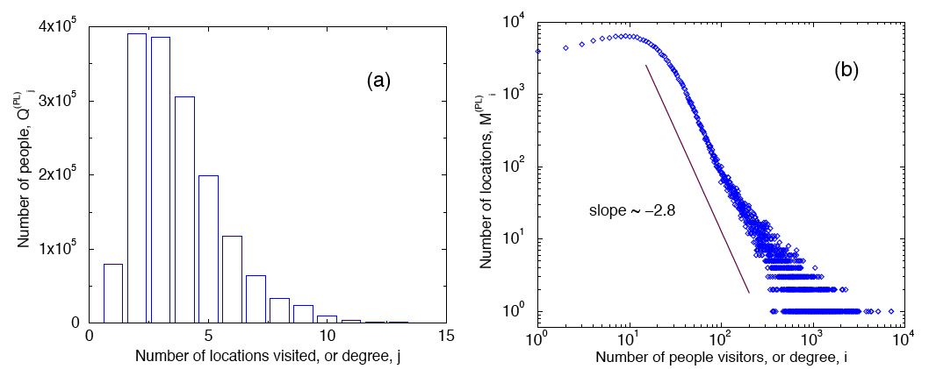
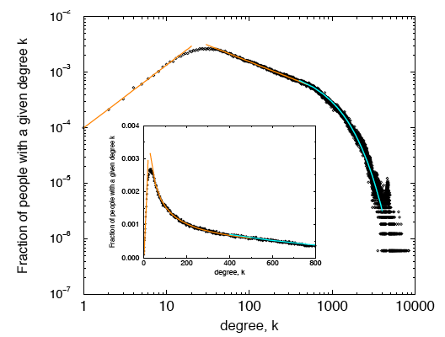
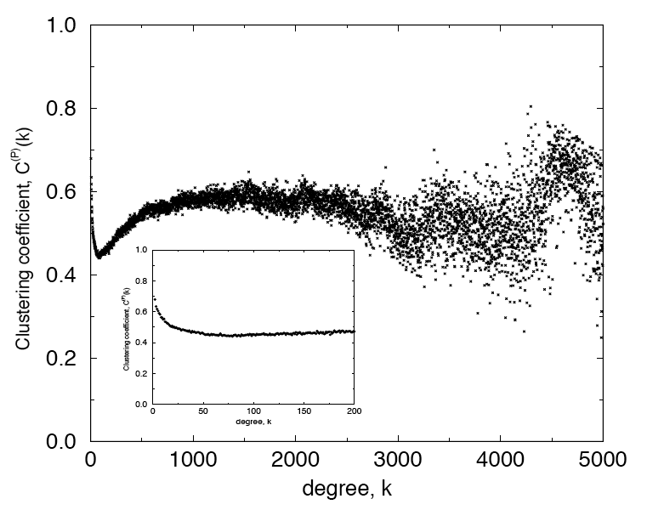
Some structural properties for Portland graph
#locations
visited by
people
Location sizes
People and location degree dist
Clustering coefficient distribution
Network Dynamics and Simulation Science Laboratory

Slide 10
Experiments - Vertex Labels
In these experiments vertices of the main graph G are labeled based on their ages as follow
Label / Age group Age range
0 0 - 19
1 20 - 39
2 40 - 59
3 60 - 79
4 80 - 100
In the template graph G_{s},we made all vertices of the same age group.

Slide 11
Shuffling the Edges in G
We randomly pick a pair of edges (u₁, v₁) and (u₂, v₂) in G and switch their end points are follow:
Remove the edges (u₁,v₁) and (u₂,v₂), and add the edges (u₁,v₂) and (u₂,v₁).
We repeat the above procedure until 50% of the edges are shuffled.
This shuffle makes the main graph G more like a random graph keeping the degree of each node as before.
The purpose is to observe if there is any difference in the subgraph counts before and after shuffling.

Slide 12
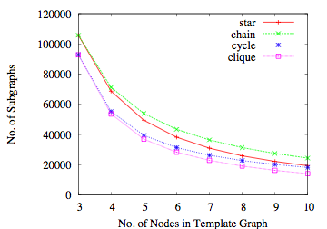
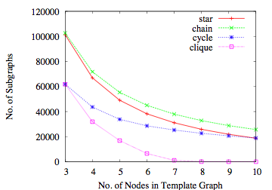
Results: Relative frequencies of patterns
a) Before shuffle b) after shuffle
Fig.: Non-overlapping subgraphs where all nodes in G_{s} are in age group 0[0-19].
a) As we are counting non-overlapping subgraphs, no. of subgraphs goes down with size. Number of cliques and cycles are less as they are harder to match.
b) After shuffling 50% of the edges, the edges among a closely connected group of people becomes dispersed. Thus the number of cliques goes down.

Slide 13
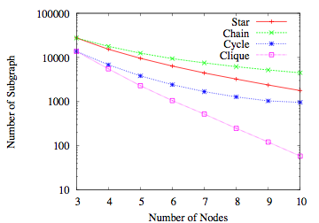
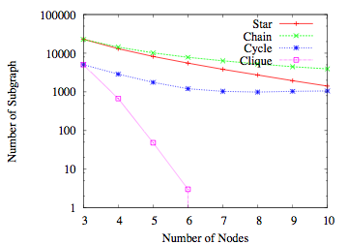
Results: Relative frequencies of patterns
a) Before shuffle b) after shuffle
Fig.: Non-overlapping subgraphs where all nodes in G_{s} are in age group 3[60-79].
Network Dynamics and Simulation Science Laboratory

Slide 14
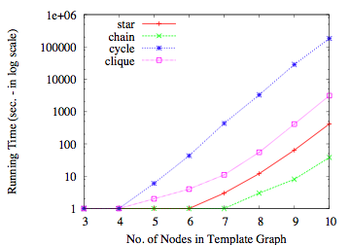
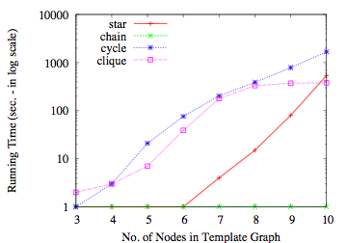
Experimental Results - Time
a) Before shuffle b) after shuffle
Fig.: Running time (in log scale) to count the non-overlapping subgraphs.
a) Running to count the cycles is the largest. While matching a cycle, in the many cases, the search fails at the last step (while matching the last edge) after it finds that the cycle cannot be closed with the last edge.
b) After shuffling 50% of the edges, the running time is more than 10 times faster. For cliques, search terminates early as edges are dispersed. For chain and cycle, before shuffling (due to densely cluster people), many paths go back to already visited node forcing to backtrack.

Slide 15
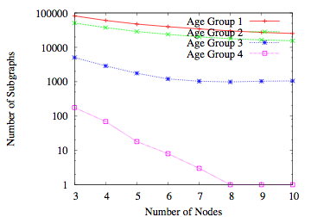
Cycles with uniform node labels
Pattern: cycle with same
label on all nodes
Network Dynamics and Simulation Science Laboratory

Slide 16
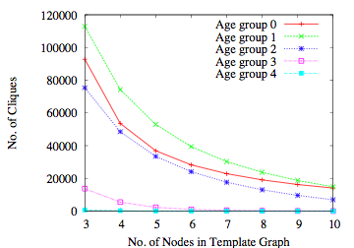
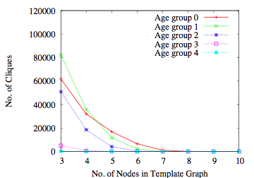
Experimental Results - Cliques
a) Before shuffle b) After shuffle
Fig.: Number of non-overlapping cliques for different age groups.
a) Age group 1 (age 20-39) shows the most number of cliques. That is, people in this group are highly connected to each other.
b) After shuffling the edges, the number of cliques for each age group goes down.

Slide 17
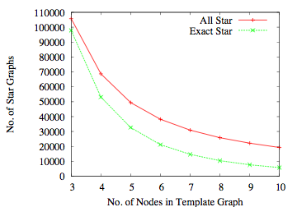
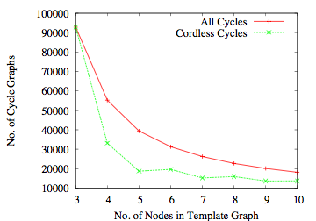
Experimental Results - Exact Match
a) Star Graph b) Cycle Graph
Fig.: Comparison of exact matching with all non-overlapping matching of star and cycle graphs for the age group 0 (0-19).

Slide 18
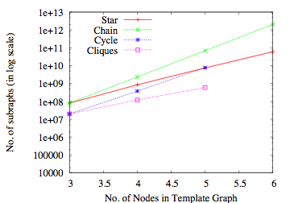
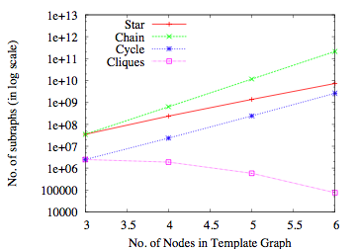
Experimental Results - Overlapping Subgraphs
a) Before shuffle b) After shuffle
Fig.: Number of overlapping subgraphs for Age Group 0. Note that the y-axis is in log scale.
a) The number of overlapping subgraphs are significantly larger than non-overlapping ones. And unlike non-overlapping subgraphs, this number is grows with n, at least for these smaller values of n.
b) After shuffling the edges, the number for all of these subgraphs went down. Interestingly, the number of cliques is decreasing with n, as it became harder to find a larger clique after diversifying the edges.

Slide 19
Clique Distribution
A clique C is a set of nodes where there is an edge between any two nodes in C.
Age(v) denotes the age of the person represented by vertex v.
MaxAge(C) = Max_{v∈C} Age(v)
MinAge(C) = Min_{v∈C} Age(v)
AgeGap(C) = MaxAge(C) - MinAge(C)
Clique Distribution:
In the given graph G, let Y_{k} be the total number of k-cliques, and Y_{k}(x) be the number of k-cliques with age gap x.
Y_{k}(x) shows the cliques distribution with respect to age gap. In the following figures, we plotted normalized clique distribution, Y_{k}(x) / Y_{k}, with respect to age gap x for k = 2, 3, and 4.

Slide 20
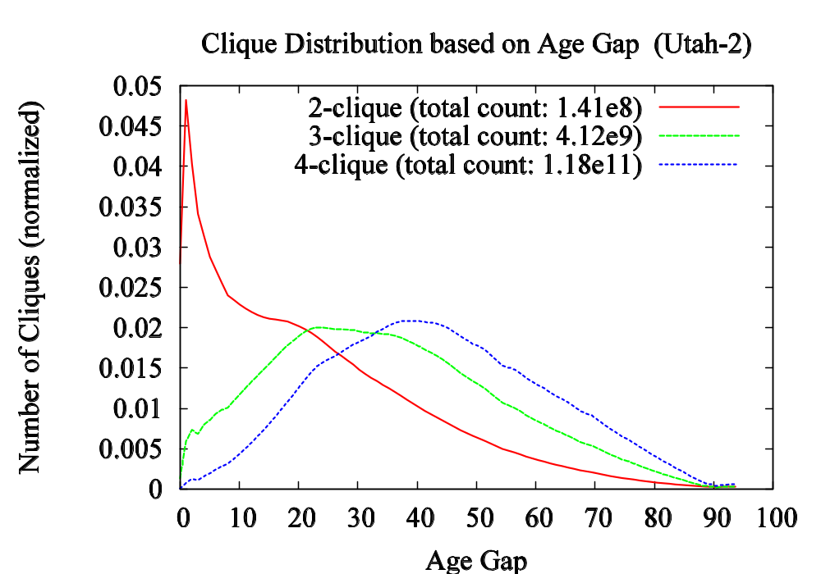
Clique Distribution for Utah-2

Slide 21
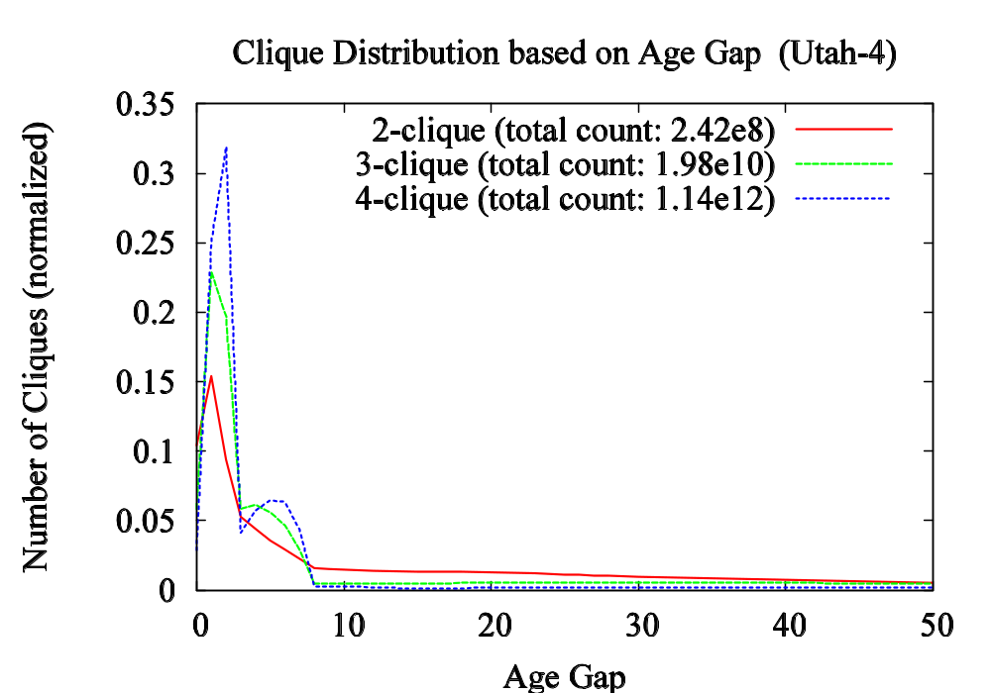
Clique Distribution for Utah-4

Slide 22
Future Work
Detailed analysis of patterns in dendograms
  Comparison with frequency in contact graph
Comparison between frequent subgraphs in different contact graphs
  Generative model for random graph with given subgraph characteristization
Change in frequent subgraph as a result of interventions
Parallel implementation to scale to larger graphs
Network Dynamics and Simulation Science Laboratory

Slide 23
Additional Slides
(Provides more details on definitions and algorithms)
Network Dynamics and Simulation Science Laboratory

Slide 24
Counting Subgraph Embeddings
Count the number of embeddings of a graph G_{s} (template) in another larger graph G.
Formally:
We consider labeled graphs where each vertex v is associated with label L(v).
Two graphs G₁ = (V₁, E₁, L₁) and G₂ = (V₂, E₂, L₂) (called the template) are isomorphic if there is a bijection f : V₁→ V₂ such that for all v ∈ V₁, L₁(v) = L₂(f(v)), and (u,v) ∈ E₁ if and only if (f(u), f(v)) ∈ E₂.
Now, the problem is to count the number of subgraphs of G that are isomorphic to G_{s}.

Slide 25
Counting Subgraph Embeddings
Example:
Template G_{s} G
G_{s} matches with two different subgraphs of G. Thus the count is 2.

Slide 26
The Algorithm for Counting Subgraph Embeddings
The basic idea behind the algorithm is simple:
Fix a vertex u in the template G_{s}.
See if u can be matched with a vertex u′ in G.
If it does then recursively try and match G_{s}\{u} (template without u) and G\u′.
When matching a vertex, it is ensured that all the incident edges to the graph seen so far are also present in both graphs.

Slide 27
The Algorithm for Counting Subgraph Embeddings
Let d_{x}(v) be the number of neighbors of v with label x. L(v) denotes label of v
The algorithm consist of the following procedure to find the number of embeddings of G_{s} in G.
MatchVertex(v_{s}, v)
  // v_{s} is a node in G_{s} and v is a vertex in G.
  If L_{s}(v_{s}) = L(v) and for all label x, d_{x}(v_{s}) ≤ d_{x}(v)
  return true
  Else
  return false
081209
.<number>

Slide 28
The Algorithm for Counting Subgraph Embeddings
CountSubgraphs(G_{s}, G)
Perform a breadth-first search (BFS) on G_{s}. Let u₁, u₂, … be the nodes of G_{s} in the order of their discovery in BFS.
FOR each v ∈ V(G) DO
IF MatchVertex(u₁, v)
MatchSubgraph(2)

Slide 29
The Algorithm for Counting Subgraph Embeddings
Let N(v) be the set of neighbors of v
MatchSubgraph(i) // try to match u_{i}
if i = |V_{s}| +1 // all nodes in G_{s} have been matched
count ← count + 1 // increment the subgraph counter
return
Find M = {f(v_{s}) | v_{s} ∈ N(u_{i}) and v_{s} has already been matched}
Compute candidate set C = ∩_{v∈M} N(v)
FOR each unmached v ∈ C DO
IF MatchVertex(u_{i}, v)
MatchSubgraph(i+1)

Slide 30
Adjusting for Automorphism in Template
Automorphism: is isomorphism from G_{s} to itself. For example, the following template G_{s} has 2 automorphisms.
The count returned by CountSubgraph should be adjusted by dividing by the number of automorphism in G_{s}.
The number of automorphism of G_{s} can be computed by running the same CountSubgraph with G_{s} against itself.
A
B
D
D
B
C
A
C

Slide 31
Improvements over Prev. Algorithms
Matching nodes in BFS order (of the nodes in G_{s}) guaranties that so far matched part of the graph grows in a connected manner. Matching the vertices in a connected manner is important to reduce the fruitless search branches. Because of BFS order, we do not need to keep track of the frontier nodes.
To match with vertex u_{i} in G_{s}, the way we generate candidate set C, all vertex in C satisfy structural constraint, thus
  -- it does not require explicit checking for structural consistency
  -- it produces less number of candidates

Slide 32
Non-Overlapping Embeddings
The above algorithm computes all embeddings of G_{s} in G (regardless overlapping or non-overlapping)
Template G_{s} G
1
2
A
B
C
3
4
F
D
E
In this example, G_{s} has two embeddings in G: ABED and BCFE
But they overlap on vertices B and E.
When we count non-overlapping embeddings, if we include ABED, we exclude BCFE (or vice versa). So the count is one.

Slide 33
Non-Overlapping Embeddings
To count the non-overlapping embeddings of G_{s} in G
When we find a match of G_{s} in G, we mark matched vertices in G.
Then when try to find the next match, we ignore the marked vertices of G.
By counting both overlapping and non-overlapping embeddings, we can have a better idea about the structure of the social network.

Slide 34
Exact Matching
A matching of G_{s} in G is exact if there is no additional edges among the matched vertices in G.
Template G_{s} G
1
2
A
B
C
3
4
F
D
E
In this example, BCFE is an exact matching, but ABED is not since there is an additional edge (B, D).

Slide 35
Finding the Exact Matches
Let M_{s} = {u₁, u₂, …, u_{i-1}}, the set of so-far matched vertices in G_{s}.
M′_{s} = M_{s} \ N(u_{i}), the set of matched vertices that are not neighbors of u_{i}.
M′ = {f(u) | u ∈ M′_{s}}, the image of M′_{s}.
Now when we try to match u_{i} with a candidate v ∈ C, we impose an additional constraint:
it can be matched with v only if M′ ∩ N(v) = φ.

Slide 36
Cordless Cycles
A cycle is cordless if there is no edges among the nodes other than the edges that are on the cycle.
a cordless cycle: A cycle with cord:
1
2
A
B
3
4
D
E
We can find the cordless cycles in G by our algorithm for EXACT matching with G_{s} be a cycle.

Slide 37
Experiments
In the following experiments, we count the number of non-overlapping embeddings in the network Portland for four types of subgraphs: star, chain, cycle, and clique.
The number of nodes in the template G_{s} vary from 3 to 10.
The figures in the following slides show the number of subgraph embeddings and time required to compute them.
We also repeat the experiments for the following variations
-- overlapping subgraphs
-- exact matches (including cordless cycles)
-- with shuffling 50% edges of G.

Slide 38
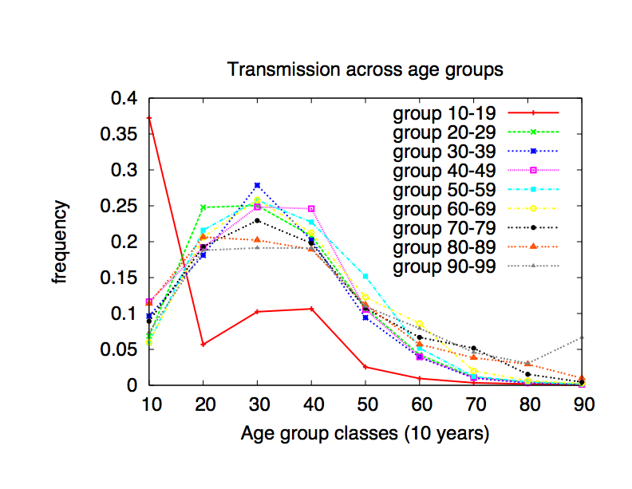
Subgraphs in Dendograms
Pattern:
(with different combinations of labels of end points)
Curve for given group L: one end point has label L, and other end point label varies
Network Dynamics and Simulation Science Laboratory

