Slide 1
Distributed Approximation Algorithms for Minimum Spanning Trees and Other Related Problems
Maleq Khan
Department of Computer Science
Purdue University
Joint work with Gopal Pandurangan and V.S. Anil Kumar
Notes:
In this talk we focus on distributed approximation algorithms for a fundamental network optimization problem, namely the MST problem.
This is joint work with Ph.D student Maleq Khan and V.S. Anil Kumar.

Slide 2
Distributed Approximation Algorithms
Ad hoc wireless sensor networks and Peer-to-peer networks operate under inherent resource constraints such as energy, bandwidth etc.
Topology can also change dynamically.
Efficient distributed algorithms are preferred.
Low communication complexity and fast running time, possibly at the cost of reduced quality of solution :
Distributed approximation algorithms.
Notes:
Why distibuted approximation algorithms? There is a practical motivation for the relatively new area of distributed approximation.
Emerging technologies such as ad hoc wireless networks and p2p networks operate …
The topology of these networks change dynamically. Thus it is even more important to design efficient distributed algorithms for various network
Optimization problems --- that have
Low communication and time complexity even at the cost of reduced quality of solution.
For example, there is not much point in having an optimal algorithm if it takes too much time, since the topology could have changed by the time
The optimal is computed.

Slide 3
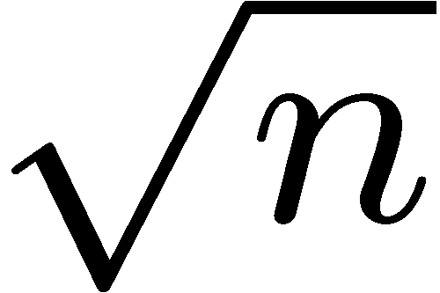
Distributed Minimum Spanning Tree (MST) Problem
Distributed algorithms for (exact) MST are well-known:
    ---- Message: Ω(|E| + n log n)
    ---- Time: Ω( )
    ---- Relatively complex.
Motivates simple, efficient, approximate MST algorithms.
Tradeoff optimality of MST for low communication and time complexity.
Notes:
MST is, of course, the smallest wieghted set of edges necessary for network connectivity. It is a communication primitive that is
Useful for various fundamental talks such as efficient broadcasting, aggregation etc.
Distributed MST algorithms have been very well studied for well over 25 years.
Thus these algorithms may not be well-suited for emerging networks. Thus there is a good theoretical and practical motivation for design
of simple and efficient approximate MST algorithms. That is algorithms that produces a spanning tree
Whose cost is not very much greater than that of the MST. The idea is to tradeoff opimtlaity for better communication and time complexity.
Although, MST is not a NPc-omplete problem, it makes snese in the distributed context to explore efficient approximate algorithms.

Slide 4
Nearest Neighbor Tree (NNT) Scheme
Given: A (connected) undirected weighted graph G.
Each node chooses a unique rank.
Each node connects to its nearest node (via
a shortest path) of higher rank.
Notes:
The rest of this talk is the focus of this simple scheme.

Slide 5
NNT Construction: Metric Graph
D, 3
B, 6
A, 2
E, 4
C, 5
F, 1
Output is a spanning tree called NNT.
Notes:
We don’t have to worry about cycles since the graph is a complete metric graph – all shortest paths are of length 1.

Slide 6
NNT Construction: Arbitrary Graph
4
C,3
10
A,1
D,4
7
2
100
5
E,5
B,2
Produces a spanning subgraph --- can contain cycles.
Output is a spanning tree of this subgraph ---NNT.
Notes:
We consider next an arbitrary graph --- graph is either not complete or not metric or both.
Please note that I put directions in the edges just to show who is connecting to whom. The spanning tree itlsef is unidrected.

Slide 7
NNT Theorem
Theorem 1:
On any graph G, c(NNT) ≤ ⎡log n⎤ c(MST).
Proof:
First assume G is complete metric graph.
Let d(p, q) is the weight of the edge (p, q) and l_{p} is a mapping satisfying
(a) d(p, q) ≥ min(l_{p}, l_{q}), for all nodes p and q
(b) l_{p} ≤ ½⎡log n⎤ c(TSP)
Then Σ_{p∈V} l_{p} ≤ ½ (⎡log n⎤ + 1) c(TSP).
Now, define l_{p} = d(p, nnt(p)) and for highest ranked node, l_{po} = ½ c(TSP).
Assume, rank(p) < rank(q).

Slide 8
NNT Theorem
Proof (cont.):
Then, d(p, q) ≥ d(p, nnt(p)) = l_{p} ≥ min(l_{p}, l_{q})
Let S₁ and S₂ be the two distinct path in TSP from p to nnt(p).
Then c(S₁) + c(S₂) = c(TSP),
l_{p} = d(p, nnt(p)) ≤ c(S₁),
and l_{p} = d(p, nnt(p)) ≤ c(S₂)
Thus, l_{p} ≤ ½ c(TSP)
We have
c(NNT) = Σ_{p∈V} l_{p} - l_{po} ≤ ½ ⎡log n⎤ c(TSP) ≤ ⎡log n⎤ c(MST)

Slide 9
NNT Theorem
Proof (cont.):
If G is not a complete metric graph:
From original graph G(V, E) construct complete graph H(V_{H}, E_{H})
with V_{H} = V, and
Weight of edge (u, v) in H is the weight of the shortest path from u to v in G.
Then, H is a complete metric graph.
c(NNT_{H}) ≤ ⎡log n⎤ c(MST_{H}).
further, c(NNT_{G}) ≤ c(NNT_{H})
c(MST_{G}) ≥ c(MST_{H})

Slide 10
Choosing Ranks
Random NNT:
each node v chooses a random number p(v) from [0,1].
For any u and v, rank(u) < rank(v) iff
p(u) < p(v) or
p(u) = p(v) and ID(u) < ID(v)
Coordinate NNT (geometric setting): use (x,y) coordinates
each node v has coordinates (x(v), y(v)).
For any u and v, rank(u) < rank(v) iff
x(u) < x(v) or
x(u) = x(v) and y(u) < y(v)
Notes:
For efficient implementation it is better to choose ranks in a certain way.

Slide 11
Road Map
Proof of NNT Theorem
Distributed algorithm for a complete network
Distributed algorithm for a general network
Applications to Wireless Sensor Networks
Further Work
Notes:
First I want to talk a bit about the scheme in a complete network.This is simple and immedeitaly shows the benefits that
NNT algorithms can offer.

Slide 12
Distributed Computation Model
Given a undirected weighted network G = (V, E, w) :
  Node knows only the weights of the adjacent edges
  Communication is synchronous. Occurs in discrete time steps.
  If (u, v) ∈ E, u can send a message to v at the beginning of a time step. Node v receives the message by the end of the same time step.
  Each node has unique ID.
  Size of a message: O(log n).
  Weight of an edge O(n^{k}).
  This is called CONGEST(log n) or simply CONGEST model.
Notes:
Say that we consider the following model that is now standard in distributed computing.

Slide 13

Distributed Algorithm for a Clique
Complete network with metric weights.
Lower bound on Messages : Ω( ) messages needed for MST. (Korach et al., SICOMP 1987 )
Best known distributed MST algorithm takes O(log log n) time. (Lotker et al., SICOMP 2005)
Random-NNT can be implemented in
  O(1) time and O( ) messages.
  O(log n) time and expected O(n log n) messages.
Notes:
It is easy to obtain an O(1) time algorithm --- each node simply obtains the ranks of all its neighbors and connects to the nearest neighbor of higher rank.
However, we can reduce the message complexity significantly at the cost of slight increase in time.

Slide 14
Distributed Implementation of Random NNT
(Khan, Pandurangan, and Kumar. Theoretical Computer Science, to
appear.)
Consider the following implementation of Random NNT:
  In round i, each node probes its next 2^{i-1} nearest neighbors if it didn’t succeed in the previous round.
Theorem:
The above protocol takes expected O(n log n) messages and O(log n) time.
Notes:
This algorithm runs in O(log n) rounds. Instead of exploring all the edges at once, in round I we explore the 2^{i-1} nearest neighbors and check whether is a node of higher rank.

Slide 15
Generalized Scheme to Construct k-Connected Subgraph
Each node connects to k nearest higher ranked nodes.
Theorem: This scheme construct a k-connected subgraph.
Theorem: Using any ranking, this scheme gives O(k log n) approximation to minimum-cost k-connected subgraph.
Theorem: When nodes are uniformly distributed in [0,1]², using random ranking, we have O(k) approximation.
Theorem: For a graph with random edge weights U(0,1), using random ranking, we have (log n/k) approximation.
Notes:
This algorithm runs in O(log n) rounds. Instead of exploring all the edges at once, in round I we explore the 2^{i-1} nearest neighbors and check whether is a node of higher rank.

Slide 16
Generalized Scheme to Construct k-Connected Subgraph (cont.)
Implementation:
  In round i, each node probes its next k2^{i-1} nearest neighbors if it didn’t succeed in the previous round.
Theorem:
The above protocol takes expected O(kn log n/k) messages and O(log n/k) time.
Notes:
This algorithm runs in O(log n) rounds. Instead of exploring all the edges at once, in round I we explore the 2^{i-1} nearest neighbors and check whether is a node of higher rank.

Slide 17
Road Map
NNT Theorem
Distributed algorithm for a clique
Distributed algorithm for a general network
Applications to Wireless Sensor Networks
Further Work

Slide 18
NNT Implementation in a General Network
Challenges:
Efficiently finding the nearest node of higher rank in a distributed fashion.
Controlling congestion.
Avoiding cycle formation.

Slide 19



Previous Dist. MST Algorithms
Gallager, Humblet, & Spira ’83: O(n log n) running time
    message: O(|E| + n log n) (optimal)
Chin & Ting ’85: O(n log log n) time
Gafni ’85: O(n log*n)
Awerbuch ’87: O(n), existentially optimal
Garay, Kutten, & Peleg ’98: O(D + n^{0.61}), Diameter D
Kutten & Peleg ’98:
Elkin ’04: , μ is called MST radius
        Cannot detect termination unless μ is given as input.
Peleg & Rabinovich (’99) showed a lower bound of for running time.

Slide 20
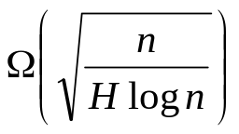
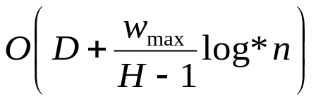
Approximation Algorithms for MST
Peleg & Rabinovich (FOCS 99) first raised the question of approximation algorithm for MST
  “To the best of our knowledge nothing nontrivial is known about this problem”
An important hardness result by Elkin (STOC ’04): lower bound on running time for any H-approx. algorithm of
An approx. algorithm by Elkin (STOC ’04) with running time
  , w_{max} is max-weight/min-weight
  depends on edge weights
Notes:
Main results should come next. Then define L etc.

Slide 21

Our Results
(Khan and Pandurangan. 20th International Symposium on Distributed
Computing (DISC), 2006, Best Student Paper Award). Invited to Distributed Computing Journal .
An O(log n)-approximation algorithm for MST
Running time: Ο(D + L log n)
  D is the diameter of the network
  L is called the local shortest path diameter (LSPD) of the network
  1 ≤ L ≤ n - 1
  Typically, L can be much smaller than
  Independent of edge weights
Message complexity: Ο(|E| log L log n)
Notes:
This should come immediately after previous work. Say that we present the *first* distributed approx algo that is independent of edge weights.
Here you are giving bounds for L --- that is fine. Say that I will define precisely in a short while. Put sqrt{n} in blue.

Slide 22
Our Results (cont.)
  First known non-trivial distributed approximation algorithm
  L is not arbitrary - captures the hardness quite precisely
    there is a family of graphs, for which any distributed algorithm needs Ω(D + L) time to compute H-approximate MST for any H∈[1, log n].
  Existentially time optimal approximation algorithm
  Exponential time gap between exact and approximate MST
  Almost time optimal approximation algorithms for unit-disk graphs and random weighted networks

Slide 23
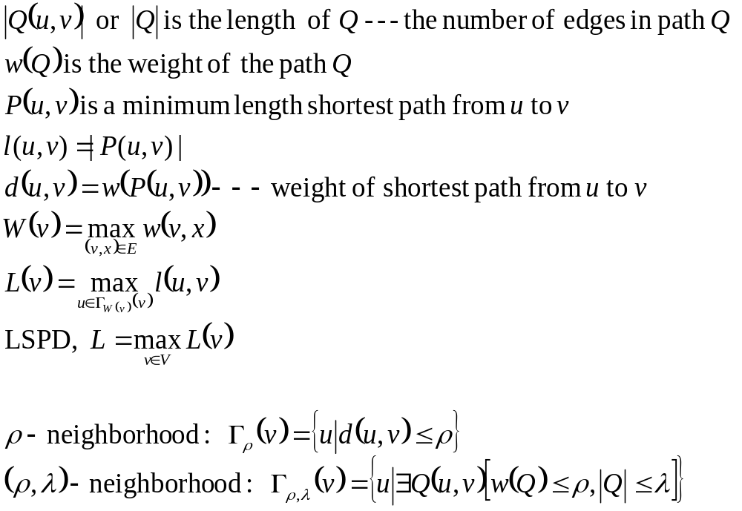
Notations and Definitions
Notes:
Move this after stating the main results. Youwill use this to explain L more precisely.

Slide 24
Local Shortest Path Diameter, L
9
y
3
7
5
7
3
2
v
1
2
3
z
5
x
For node v,
Max of the adjacent edge weights, W(v) = 7
Weight of the paths, w(<v, x, y, z>) = 6 and w(<v, x, z>) = 6
L(v) = 2
L is the max of L(v)’s for all v
Notes:
This should come after main results.

Slide 25
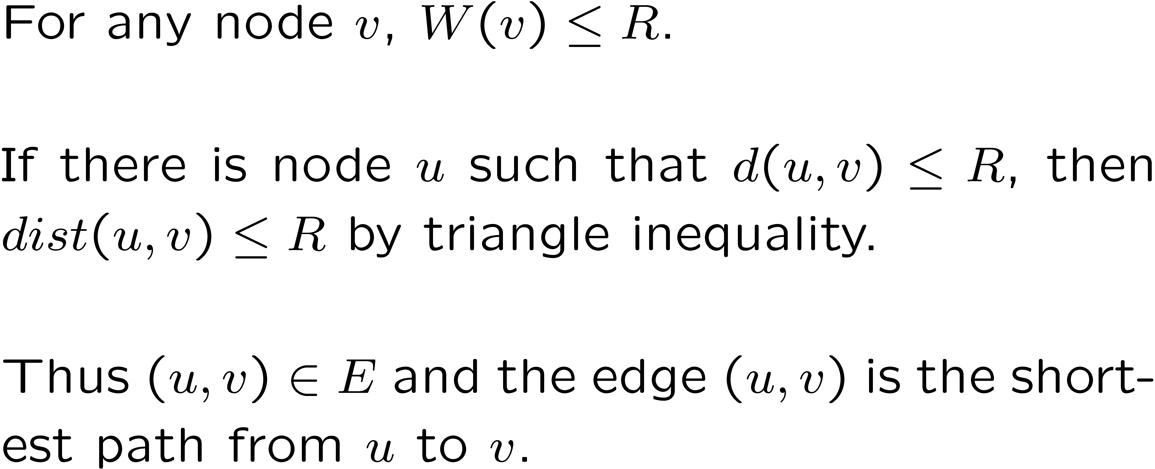
L in Unit Disk Graphs
Unit disk graphs (UDG) : Euclidean graphs where (u,v) ∈ E iff dist(u, v) ≤ R
Lemma: For a UDG, L = 1
Proof :
Notes:
This should come after main results.

Slide 26
L in Random Weighted Graphs
Graphs with random edge weights:
  Arbitrary topology
  Edge weights are independently and chosen randomly from any arbitrary distribution in [0,1]
Theorem 1: For the above network,
L = O(log n) W.H.P.

Slide 27
Distributed NNT Algorithm
Each node executes the same algorithm
simultaneously:
  Rank selection.
  Finding the nearest node of higher rank.
  Connecting to the nearest node of higher rank.

Slide 28
Rank Selection
Elect a leader s using a leader election algorithm
s selects a number p(s) from [b-1, b]
s sends ID(s) and p(s) to all of its neighbor in one time step.
Any other node u after receiving the first message with ID(v) and p(v) from a neighbor v:
  Selects a number p(u) from [p(v)-1, p(v))
  Sends ID(u) and p(u) to all of its neighbors
s
u
Notes:
Say that b is some arbitrary number chosen by the leader.

Slide 29
Defining Rank
For any u and v, r(u) < r(v) iff
  p(u) < p(v)
  or p(u) = p(v) and ID(u) < ID(v)
A node with lower random number p() has lower rank.
Ties are broken using ID()

Slide 30
Rank Selection (cont.)
At the end of the rank selection procedure
  Each node knows the rank of all of its neighbors
  The leader s has the highest rank among all nodes in the graph
  For every node (except s), there is a neighbor with higher rank.

Slide 31
Finding a higher ranked node
w(v) = 7
Nodes with red circle are in Γ_{w(v)}(v)
L(v) = 2
9
y
3
7
5
7
3
2
v
1
2
3
z
5
x
v needs to explore only the nodes in Γ_{w(v)}(v).
In principle, we can hope to do in O(L) time.
Notes:
This should come after main results.

Slide 32
Finding a higher ranked node
v executes the algorithm in one or more phases
  In the first phase, v sets ρ = 1
  In the subsequent phases, ρ is doubled. In i^{th} phase, ρ = 2^{i-1}
  In each phase, v explores the nodes in Γ_{ρ}(v)
  ρ needs to be increased to at most W(v)
    There is a node u∈ Γ_{W(v)}(v) with r(u) > r(v)
Notes:
Something is missing in the The last sentence --- “in two successive rounds is the same” --- check it.

Slide 33
Finding a higher ranked node
Each phase consists of one or more rounds
  In the first phase, λ = 1
  In each subsequent phase, λ is doubled
  Phase ρ, round λ: v explores the nodes in Γ_{ρ,λ}(v)
  by sending explore messages to all of its neighbors and the neighbors forward the messages
  If a higher ranked node is found, exploration is finished.
  If the (total) number of nodes explored in the two successive rounds are the same, move to the next phase.
Notes:
Something is missing in the The last sentence --- “in two successive rounds is the same” --- check it.

Slide 34
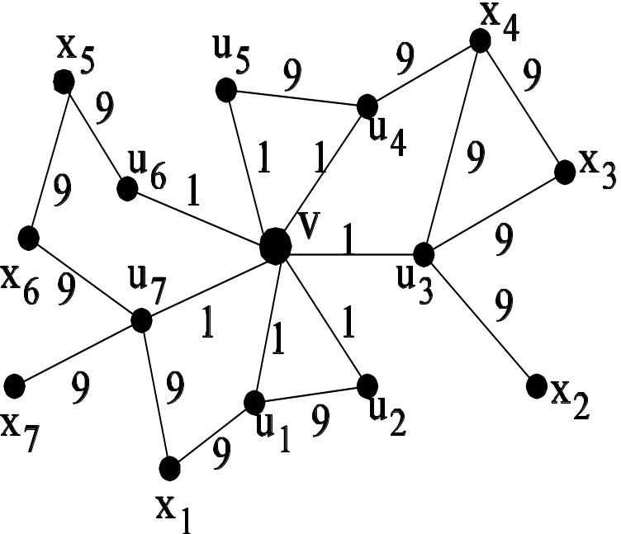
Controlling Congestion
Many nodes may have overlapping ρ-neighborhood and create congestions by the explore messages : can be as much as θ(n).
We keep the congestion bounded by O(1).
When v receives explore messages for several originators u_{i,} v forwards only one of them.
Notes:
Last sentence --- somehting wrong with grammar. “v forwards only one of them”

Slide 35
Controlling Congestion (cont.)
  If r(u_{i}) < r(u_{j}) and ρ_{i} ≥ ρ_{j,} v sends a found message to u_{i}
  From the rest of the u_{j}, let u_{k} be the lowest ranked node. Then ρ_{k} < ρ_{t}
  Forward the message of u_{k} and send wait message back to the rest
Lemma 1: Let, during exploration, v found a higher ranked node u and the path Q(v, u). If v's nearest node of higher rank is u', then w(Q(v,u)) ≤ 4d(v,u').
Notes:
U_i has found u_j, a higher ranked node, which is nor more than twice its current exploration radius.
This means that u_k is progressing slower than the rest. We don’t lose anything in slowing down.

Slide 36
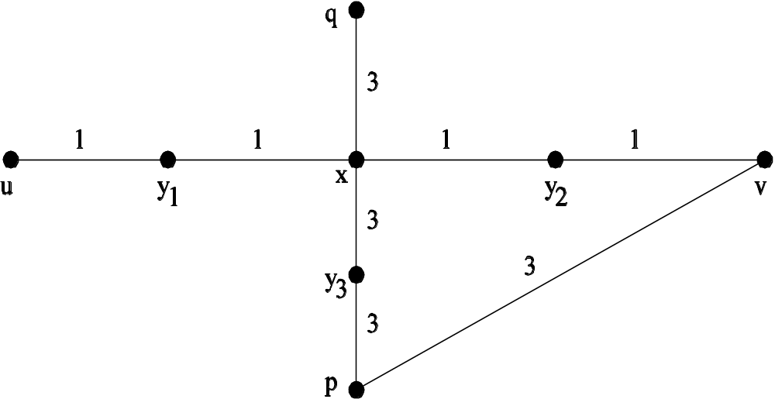
Making Connection
Select the nearest node if more
than one node of higher rank is found.
Let u found higher ranked node v through the
  Path Q = <u, …, x, y, …, v>
u sends a connect message though this path to v
All the edges in this path are added to NNT
Any intermediate node, say x,
  If not already connected, it uses (x, y) as the connecting edge and stops exploration
  If it is already connected, removes the previous connecting edge from NNT
All nodes in this path upgrade their rank to r(v)

Slide 37
Making Connection
If in between exploration and connection, any node in path Q gets a higher rank than r(v), connection ends at that node.
Let u found path Q to v
Then before u sends its connect message, p sends a connect message to q
Let r(q) > r(p) > r(v)
New rank of x is r(q) which is larger than r(v)
u’s connection ends at x.
x does not forward

Slide 38
Correctness
Lemma 3: The algorithm adds exactly n - 1 edges to the NNT.
Lemma 4: The edges in the NNT added by the given distributed algorithm does not create any cycle.
Theorem 3: The above algorithm produces a tree spanning all nodes in the network.

Slide 39
Running Time and Message Complexities
Theorem 4: The running time of the above algorithm is O(D + L log n)
Theorem 5: The message complexity of the algorithm is O(|E| log L log n)

Slide 40
Road Map
Approximation bound for metric instances
Distributed algorithm for a clique
Distributed algorithm for a general network
Application to wireless sensor networks
Further work

Slide 41
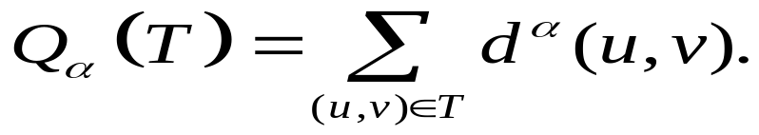
Geometric Setting: Wireless Sensor Networks
Khan, Pandurangan, and Kumar. IEEE Transactions on Parallel and Distributed Systems, to appear.)
N points uniformly distributed in a unit area.
Find a spanning tree T, that minimizes the cost
Energy requirements in a wireless communication paradigm: to transmit a signal over a distance r, the required radiation energy is proportional to r^{α.}

Slide 42
Related Work
Distributed algorithms for construction of low-weight connected subgraphs (motivated by topology control and energy-efficient routing). (X. Li et al., INFOCOM, 2004)
    not a tree
    Nodes need to know their coordinates
    O(1) approx to MST, only for α = 1
    O(n) messages
    Uses two hop information
    Localized MST algorithm is not possible
``Local MST” (N. Li et al., INFOCOM, 2003)
    Connected, bounded degree, but not low weight

Slide 43
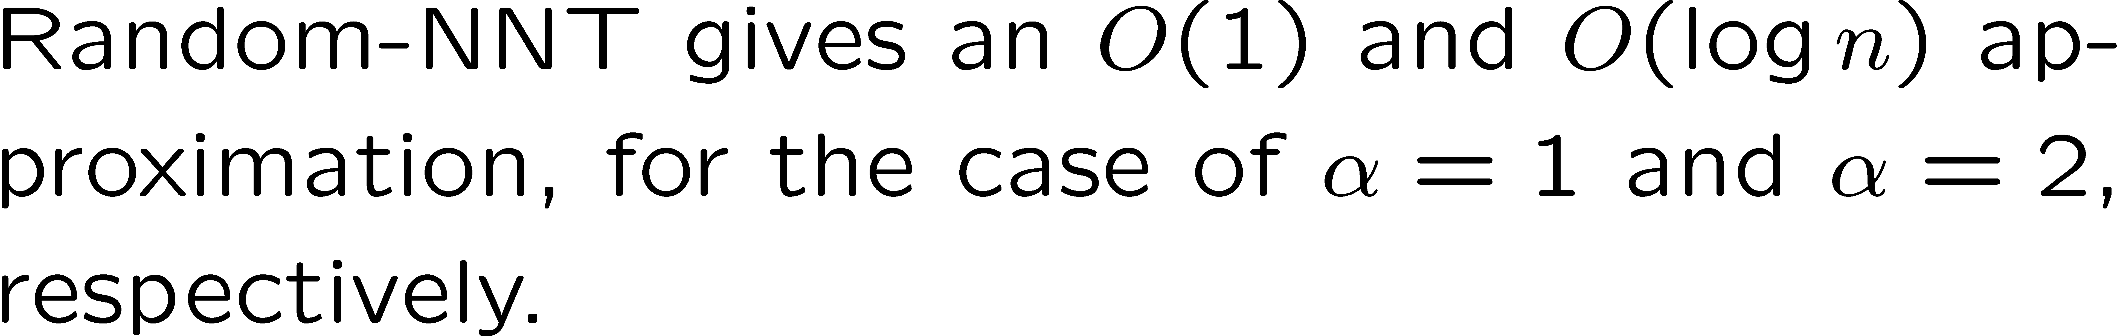
Cost of NNT
  Maximum degree of NNT is bounded by O(log n) WHP.

Slide 44
Quality of Random NNT
Theorem: When nodes are uniformly distributed in a unit square, expected cost of NNT,
E[Q_{α}(T)] = O(n^{1- α/2}) for α < 2
= O(lg n) for α = 2
= O(1) for α > 2
Proof: consider an arbitrary node u
C_{i} be the set of nodes in the circles with center at u and radius r_{i} = 2^{i}/√n
i = 1, 2, …, m
m < ½ lg n + 3/2

Slide 45
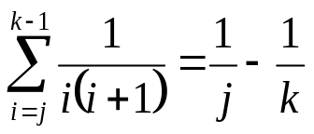
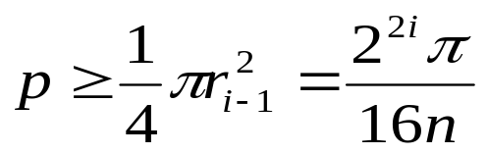
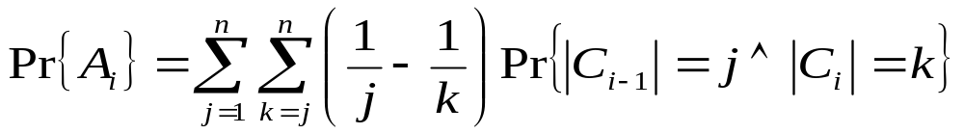
Quality of Random NNT (cont.)
The probability that u connects to any node between j^{th} and (k-1)^{st} nearest neighbor is
Probability that a particular node is in C_{i} is
Let R_{i} = C_{i} – C_{i-1} for i > 1, and R₁ = C₁
A_{i} be the event that u connects to a node v∈R_{i}

Slide 46
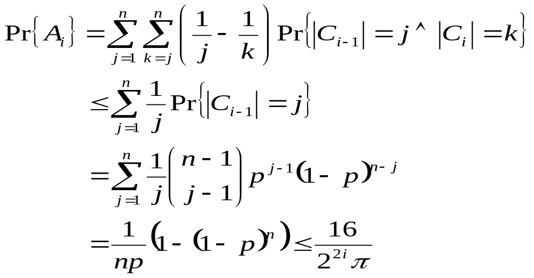
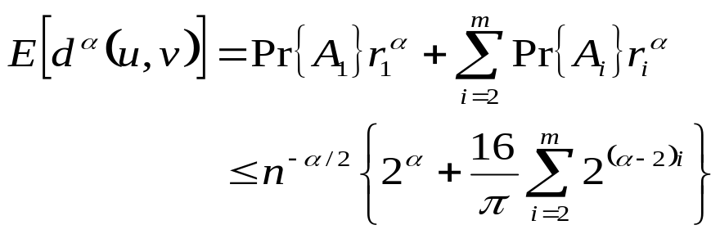
Quality of Random NNT (cont.)
By linearity of expectation, E[Q_{α}] = nE[d^{α}(u,v)]. This gives the result stated in the theorem.

Slide 47
Wireless Network Model
Local broadcasting: A node can broadcast a message that can be received by any node within its vicinity (a disk of appropriate radius centered at the node).
Each message takes one unit of time,
When a node transmits to distance r, no other node within this distance can transmit at the same time.
Each node can communicate directly with all other nodes.

Slide 48
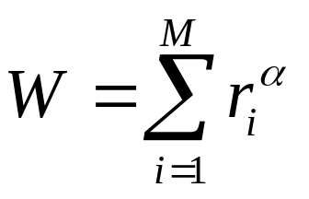
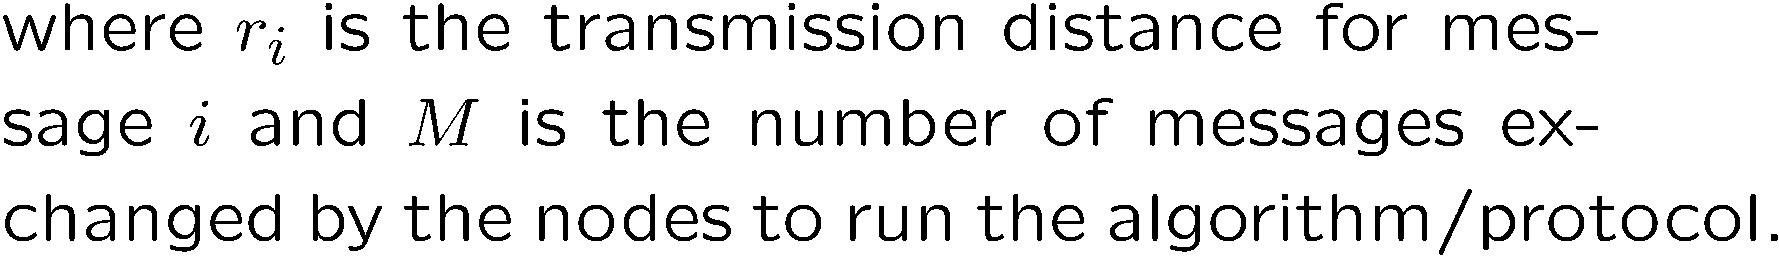
Work Complexity
Work complexity is a measure of the energy needed by
the distributed algorithm to construct a MST :

Slide 49

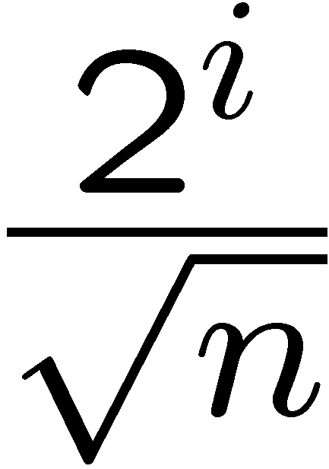


Distributed NNT Algorithm for Wireless Networks
Repeat
Set transmission radius to
if
Broadcast <request, u, rankinfo> up to distance r_{i}.
Until receipt of an “available” message or r_{i} = l.
For all v upon receipt of <request, v, rankinfo>
if rank(v) < rank(u)
set transmission radius to d(u,v)
send <available, u, v> to v
Upon receipt of available messages
select the nearest node v from the senders
send <connect, u, v> to v
Available message
connect message
u

Slide 50
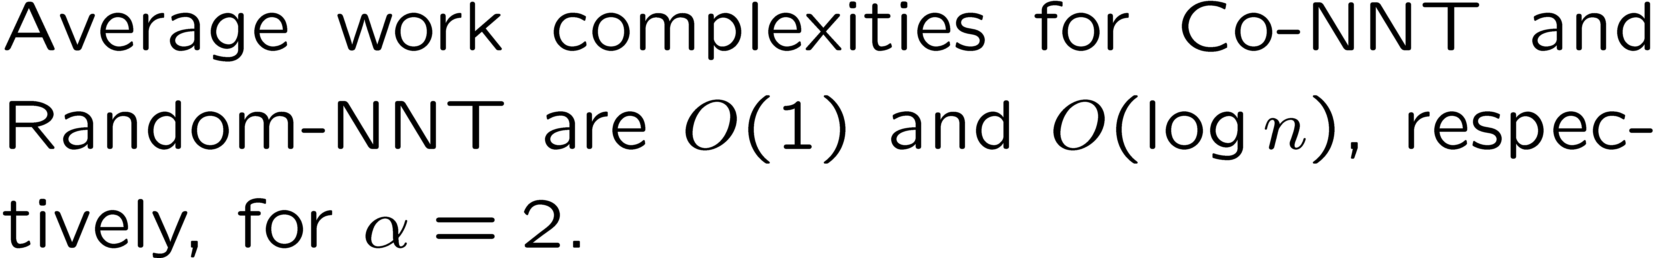

Work Complexity

Slide 51
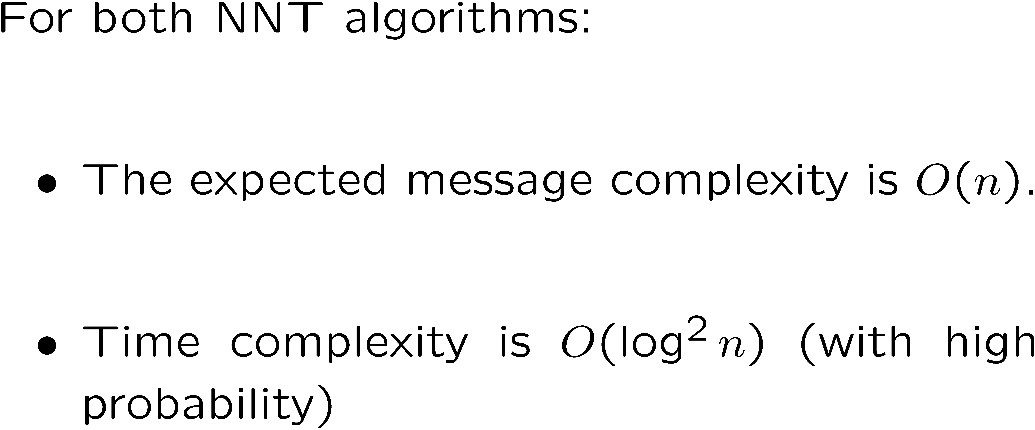
Message and Time Complexity

Slide 52
Time Complexity
Theorem: Time complexity of Random NNT is O(log² n) W.H.P.
Proof:
We assume that each message transmission takes one unit of time.
When a node is transmitting, no other node within its transmission range are allowed to transmit.
Consider the first phase: r₁ = 2 / √n and E[|C₁|] = πr₁²n = 4π.
Using standard Chernoff bound, we can show that |C₁| = O(log n) WHP.
Now, consider i^{th} phase phase: r_{i} = 2^{i} / √n
The distance between two unconnected node is at least r_{i-1}
Thus, the number of unconnected nodes in C_{i} is O(1)

Slide 53
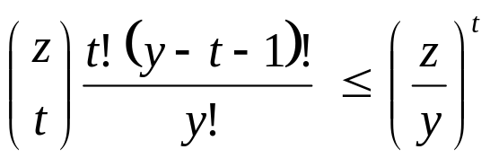
Time Complexity (cont.)
Now we show that any node u receives O(log n) available messages WHP.
Let |C_{i}| = y and assume y ≥ 60 log n.
If y < 60 log n, u receives O(log n) messages with probability 1.
Let |C_{i-1}| = x. Then for any v, Pr{v∈C_{i-1} | v∈C_{i}} ≥ ¼.
Thus, E[x] ≥ y/4 ≥ 15 log n
Using Chernoff bound, we can show that Pr{x < y/8} < 1/n^{2.3}
Let z = |R_{i}| = y – x. Then Pr{z ≥ 7y/8} < 1/n^{2.3}
Now, u has the largest rank among x nodes in C_{i-1}.
The probability that exactly t nodes have higher rank than u in R_{i} is

Slide 54
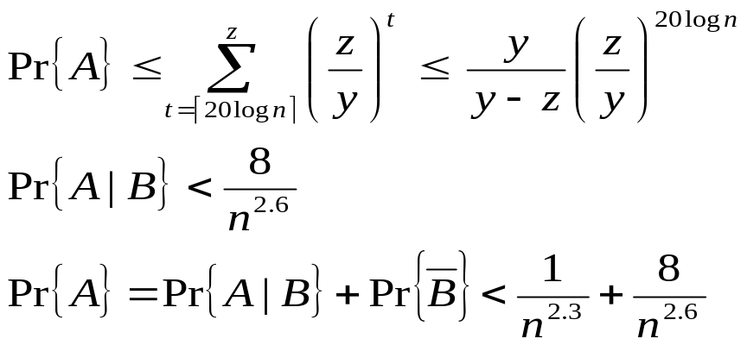
Time Complexity (cont.)
A be the event that u receives more than 20 log n available messages,
B be the event that z < 7y=8.
That is, u receives O(log n) available messages WHP.
Using union bound, this also holds for all n nodes simultaneously WHP.
There are O(log n) phases.
Thus, time for all O(log n) phases is O(log² n) WHP.

Slide 55
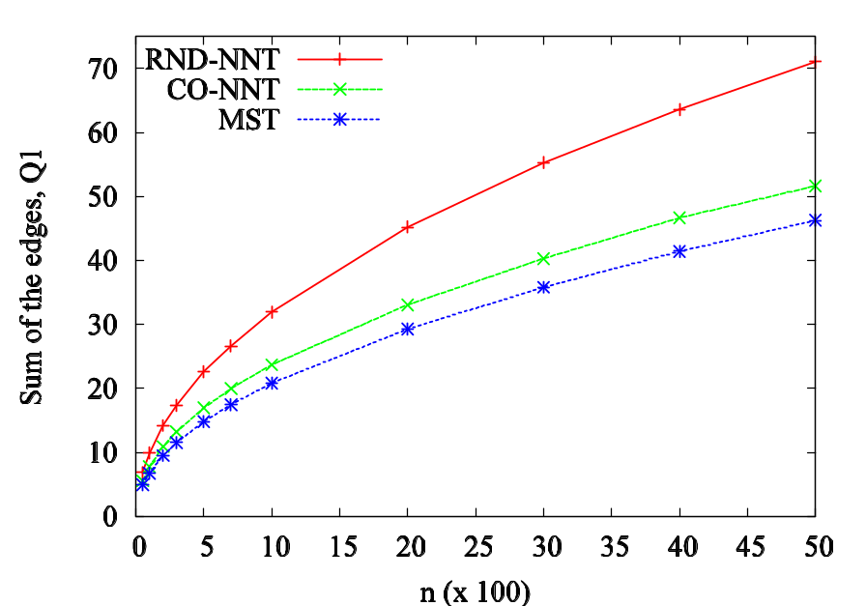
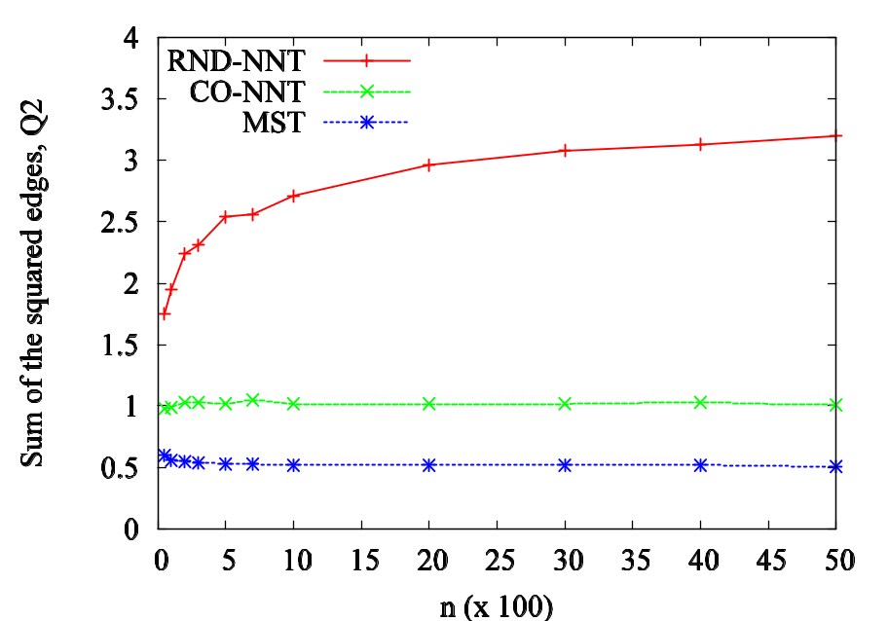
Simulation Results – Cost of NNT
Uniform random distribution in [0,1]²
Number of nodes: 50 – 5000
Number of runs: 50
Q₁(T), α = 1. Q₂(T), α = 2.

Slide 56
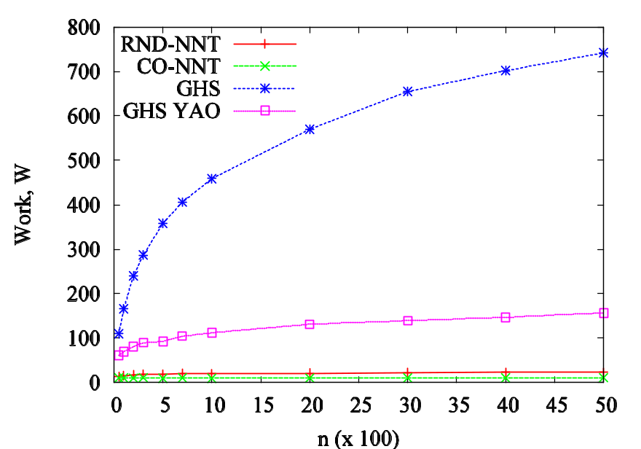
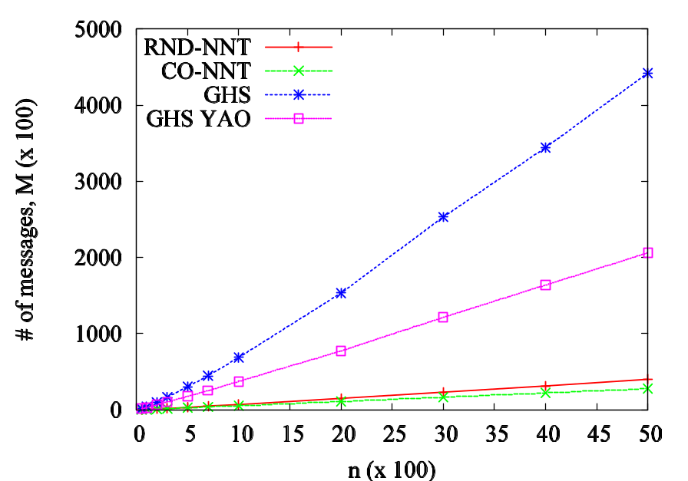
Simulation Results – Work & Messages
Work (α = 2) # of messages

Slide 57
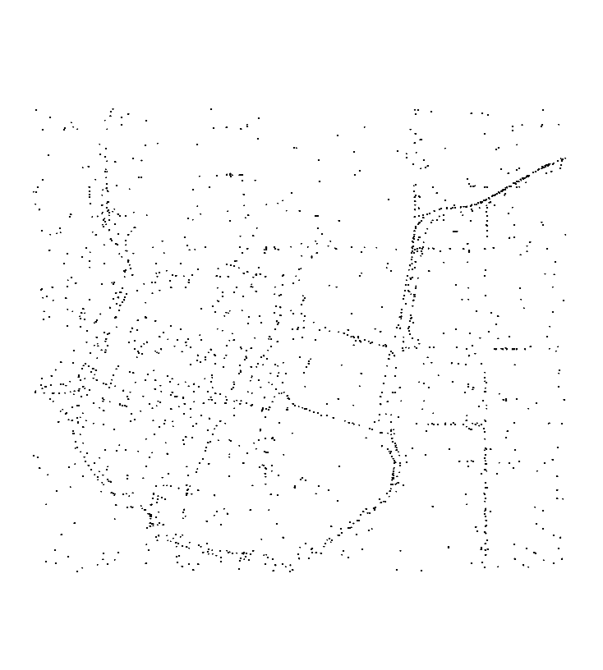
Experiments on Real Data
Points correspond to cars in a section of Portland downtown, OR.
Area: 2.9 × 2.9 sq. KM.
Data obtained from TRANSIMS.
 | Q1 | Q2 | Work | Msg
Co-NNT | 38.72 | 6.77 | 90.54 | 4832
Random NNT | 50.75 | 14.13 | 131.42 | 5241
GHS-Yao | 33.16 | 3.72 | 1271.11 | 20592

Slide 58
Further Work
Distributed MST
    Efficient H-approximation algorithms
    Optimizing both time and message complexity
    Better lower bounds
Efficient distributed dynamic algorithms.
Wireless Sensor Networks: Lower bounds on energy, messages, time for exact and approximate MST.

Slide 59
Publications
M. Khan and G. Pandurangan. A Fast Distributed Approximation Algorithm for Minimum Spanning Trees, in 20th International Symposium on Distributed Computing (DISC), 2006 (Best Student Paper Award).
M. Khan, G. Pandurangan, and V.S.A. Kumar. A Simple Randomized Scheme for Constructing Low-Cost Spanning Subgraphs with Applications to Distributed Algorithms, Theoretical Computer Science, to appear.
M. Khan, G. Pandurangan, and V.S.A. Kumar. Distributed Algorithms for Constructing Approximate Minimum Spanning Trees with Applications to Wireless Sensor Networks, IEEE Transactions on Parallel and Distributed Systems, to appear.
M. Khan and G. Pandurangan. A Fast Distributed Approximation Algorithm for Minimum Spanning Trees, Full version of DISC 2006 paper. Invited submission to Distributed Computing Journal.

