Slide 1
Efficient Distributed Approximation Algorithms via Probabilistic Tree Embeddings
Maleq Khan, Fabian Kuhn, Dahlia Malkhi,
Gopal Pandurangan, and Kunal Talwar

Slide 2
Summary
A uniform approach to design efficient distributed approximation algorithms
  randomized approach
  based on a probabilistic tree embedding
Expected O(log n)-approximate distributed algorithms for
  generalized Steiner forest problem
  minimum routing cost spanning tree problem
  k-source shortest paths problem
The time complexities are within a polylogarithmic factor of the optimum.

Slide 3
Summary (cont.)
The tree embedding is based on the computation of least elements lists (LE-list)
Computation of LE-list leads to a leader election algorithm.

Slide 4
Distributed Approximation
Intersection of distributed computing and approximation algorithms
Trade-off quality of the solution for resources (messages, time)
Theoretical interests in understanding algorithmic complexity of distributed approximation
There are also practical motivations:
  wireless ad hoc and sensor networks or peer-to-peer networks operate under inherent resource constraints such as energy, bandwidth, etc.
  topology of such networks often changes dynamically

Slide 5
Previous Distributed Approximation Algorithms
Shortest path (Elkin, PODC 01)
Minimum spanning tree (Elkin, STOC 04; Khan & Pandurangan, DISC 06)
Dominating set (Kuhn & Moscibroda, SPAA 07; Jia et al, Dist. Comp. 02)
Vertex cover (Grandoni et al, PODC 05)
Maximal matching (Kuhn et al, PODC 04)

Slide 6
Distributed Approximation (cont.)
One approach to approximation is:
  embed the given metric space into a tree metric
  Then solve the problem in the tree
Tree embedding was never used before in a distributed setting.
We use a randomized tree embedding due to Fakcharoenphol, Rao, and Talwar (FRT embedding).
In FRT embedding, the expected stretch of any edge is O(log n).
Other approaches:
Primal dual method (Grandoni et al, PODC 05)
Randomized rounding LP (Kuhn et al, SODA 06)

Slide 7
Model for Distributed Computation
CONGEST Model:
Undirected weighted network
Each node has unique ID
Node knows only the weights of the adjacent edges
Communication is synchronous.
  Occurs in discrete time steps.
  In each time step, a node can send a message along each adjacent edge
Size of a message: O(log n).
Weight of an edge O(n^{k}).
Notes:
Say that we consider the following model that is now standard in distributed computing.

Slide 8

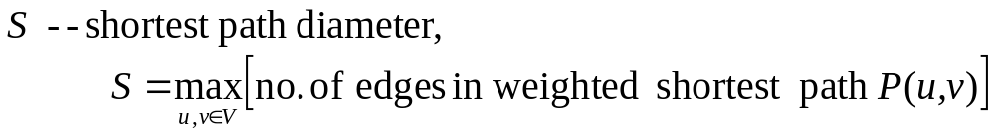
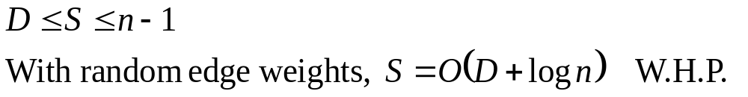
Notations

Slide 9
Generalized Steiner Forest (GSF) Problem
The main application of distributed FRT embedding is a fast distributed GSF algorithm.
Problem: Given k disjoints subsets V₁, … V_{k} of the nodes, find a minimum weight subgraph G' such that each pair of nodes in each V_{j} are connected in G'.
GSF problem is a generalization of Steiner tree problem, which is a generalization of MST problem.
No previous distributed algorithm for the GSF problem is known
Our algorithm: expected O(log n)-approximation
Time : O(S log² n) rounds

Slide 10

Distributed GSF Problem
Best known distributed MST algorithm takes O(D + √nlog*n) time (Kutten & Peleg)
Elkin showed H-approximating MST requires time
This lower bound applies to general GSF problem as well
For Steiner tree problem, Chalermsook et al. gave a 2-approximation algorithm (based on well-known GHS algorithm), which is not time-efficient and cannot be generalized to GSF problem.
Khan and Pandurangan gave a fast O(log n)-approximate MST algorithm
  This algorithm can easily be modified to obtain O(log n)-approximation to Steiner tree problem.
  This approach can only give a O(k log n)-approximation to the GSF problem. Getting an O(log n)-approximation to the GSF problem is the motivation for the new approach in this work.

Slide 11
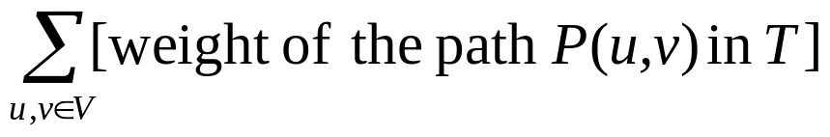
Routing Cost Spanning Tree Problem
Find a spanning tree T that minimizes
Expected O(log n)-distributed approximation
  time: O(S log² n)

Slide 12
k-Source Shortest Paths
Given k source nodes:
  Find shortest path from each source to all other nodes.
Our algorithm: O(log n) approximation.
time: O(kS log n)
Elkin’s algorithm: (1+c) approximation
time: O(w_{max} n^{1+ a/2} + kD)
Run time depends on weight w_{max} (the maximum edge weight)

Slide 13


Least Element List (LE-List)
Each node is given a random rank
The least element is the node with the lowest rank
LE-list of v is
with
Set of the nodes within distance ρ from node v

Slide 14
LE-List of Node v
v₉
v₇
1
6
10
3
v₅
v₄
v₆
7
5
3
v₀
3.5
2
7
3.5
v₃
v₈
2
1
Nodes sorted based on their distance from v₀
5
v₂
v₁
Node: v₀ v₁ v₂ v₃ v₄ v₅ v₆ v₇ v₈ v₉
Rank: (4) (7) (6) (10) (2) (8) (5) (1) (9) (3)
Distance: 0.0 1.0 2.0 4.5 4.5 5.0 5.0 6.0 7.0 11.0
{ ⟨v₀, 0⟩, }
⟨v₄, 4.5⟩,
⟨v₇, 6.0⟩
LE-list of v₀, L(v₀) =

Slide 15
Overview of the technique
Connection between LE-lists and FRT embedding leads to an efficient technique for distributed approximation.
The main steps:
Choose random ranks for the nodes
Compute the LE-lists
Find an FRT embedding.
Solve a problem giving an O(log n)-approximation algorithm.

Slide 16
Overview of the technique
Choose random ranks for the nodes
Compute the LE-lists
Find an FRT embedding.
Solve a problem giving an O(log n)-approximation algorithm.

Slide 17
LE-Dist Algorithm to Compute the LE-lists
The basic strategy is: each node u floods its rank (using a rank message).
Any other node v after receiving this message
  Discard the message if it already received a message with lower rank at a closer distance
  Otherwise, v updates it LE-list and forward the message
Two issues we need to take care:
  Controlling congestion -- by coordinating “message exchanges” in phases
  Detecting termination -- by acknowledging the rank messages (using echo messages)

Slide 18
Time and Message Complexities
Theorem: For LE-Dist algorithm, Time complexity: O(S log n)
Ω(S) time is necessary to compute the LE-lists.
Theorem: There is a graph where LE-Dist algorithm takes Ω(S log n) time.

Slide 19
LE-Dist as Leader Election Algorithm
In unweighted graphs, time complexity: O(D) (deterministically) message complexity: O(|E|·min{D, log n}) W.H.P.
Thus, we have a synchronous randomized leader election algorithm with
O(D) time (deterministically)
O(|E| · min{D, log n}) messages WHP.
The best known deterministic algorithm (due to Peleg):
O(D) time
O(|E|·D) message

Slide 20
Overview of the technique
Choose random ranks for the nodes
Compute the LE-lists
Find an FRT embedding.
Solve a problem giving an O(log n)-approximation algorithm.

Slide 21
Probabilistic Tree Embedding
u₂
4β
Least element
β-list
The leader chooses a random β∈[0.5, 1]
Broadcast β using the BFS tree
From LE-list, each node constructs
β-list: (u₀, u₁, u₂, … )
  where u_{i} is the least element in 2^{i}β-neighborhood
u₁
u₀
2β
v
β

Slide 22
Probabilistic Tree Embedding
The β-lists defines a hierarchical clustering and the FRT tree
u_{i} is called level-i cluster center for v

Slide 23
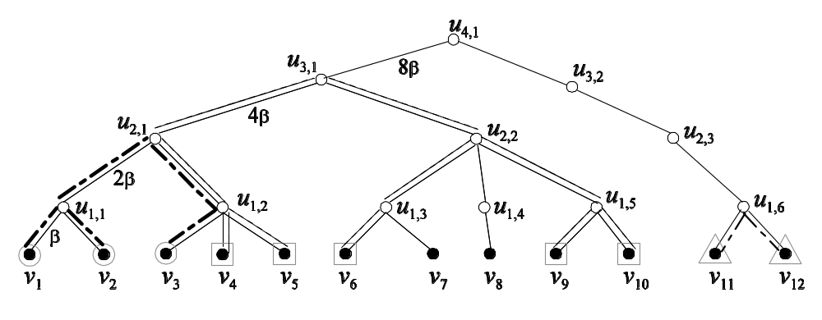
FRT Tree Construction
Root: cluster containing all nodes
Level-i cluster is decomposed
into level-(i-1) clusters
(based on level-(i-1) cluster center)
Level 0
leaf nodes (level-0) are singleton clusters
corresponds to the nodes in the original graph G
E[d_{FRT}(v_{i},v_{j})] ≤ O(log n) d_{G}(v_{i},v_{j}) and d_{FRT}(v_{i},v_{j}) ≥ d_{G}(v_{i},v_{j})

Slide 24
FRT Tree in a distributed Setting
We do not construct the FRT tree explicitly
FRT tree is implicitly defined by the LE-lists and β-lists
The cluster centers represents corresponding internal nodes of FRT tree
The LE-lists serve as routing tables
An edge of FRT tree could be replaced by the shortest path

Slide 25
Overview of the technique
Choose random ranks for the nodes
Compute the LE-lists
Find an FRT embedding.
Solve a problem giving an O(log n)-approximation algorithm.

Slide 26
k-Source Shortest Paths
Problem:
Given k source nodes:
  Find shortest path from each source to all other nodes.
Algorithm:
1. Each source constructs a BFS tree rooted at itself
2. Then broadcasts its β-list to all nodes using the edges of this BFS tree.

Slide 27
k-Source Shortest Paths
3. Each v determines the lowest common ancestor u of itself and each source s from the two β-lists.
A path Q(v, s) = P(v, u) ∪ P(u, s)
can be found using the LE-lists as routing tables.
Lowest common ancestor, u
can be constructed in reverse direction only.
so, s sends a dummy message
to all of its cluster centers
Source s
a node v

Slide 28
Generalized Steiner Forest (GSF) Problem
Given k disjoints subsets V₁, … V_{k} of the nodes, find a minimum weight subgraph G' such that each pair of nodes in each V_{j} are connected in G'.

Slide 29
Generalized Steiner Forest Algorithm
Group 1
Group 2
Group 3

Slide 30
Generalized Steiner Forest Algorithm
Group 1
Group 2
Group 3
To avoid congestion:
1. messages need to be merged (with special care)
2. run in phases
3. Synchronize the phases

Slide 31
Conclusion
Presented a uniform approach to develop fast distributed approximation algorithms and solved:
  k-source shortest path problem
  General Steiner forest problem
  Minimum routing cost spanning tree problem
Distributed LE-list can be of independent interest
What other problems can be solved using this approach?

Slide 32
Thank you!

Slide 33
Choosing Random Ranks
Each node v choose randomly p(v) ∈ [1, n^{c}].
Then rank, R(v) = (p(v), ID(v)).
Notes:
Say that we consider the following model that is now standard in distributed computing.

Slide 34
Detecting Termination
Each node gets its final LE-list after S phases (no more updates).
But, S is not known to the nodes.
Use echo messages:
  If a rank message is ignored, send an echo back to the sending neighbor
  If a rank message is forwarded, wait until echo comes back from the neighbors
  That is, echo messages travel back in reverse direction (as convergecast)
When the lowest ranked node receives its echoes back,
it can determine it is the lowest ranked node and becomes leader

Slide 35
Termination Protocol
A nodes enter in done status after receiving its echo back
The leader broadcast a leader message, building a breadth first tree (BFT).
Leader waits for done messages from the other nodes. The done message are collected as convergecast using the BFT.
The leader sends a termination signal using the BFT.

Slide 36
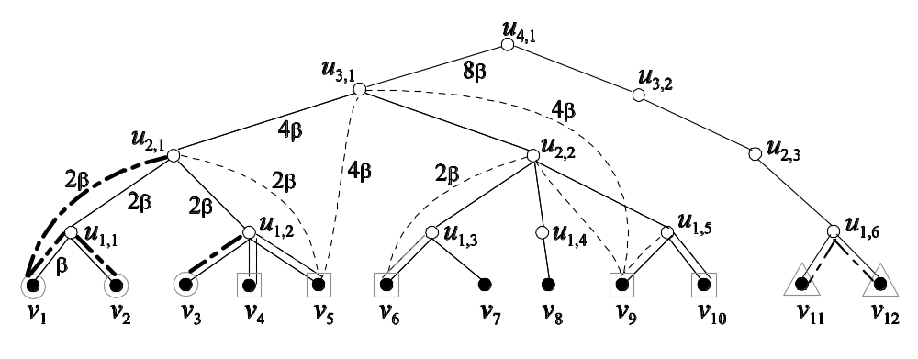
Generalized Steiner Forest Algorithm

Slide 37



Generalized Steiner Forest Algorithm
-- level of lowest common ancestor (lca) of the nodes in V_{j}
For each v∈V_{j}, define
The algorithm consists of two parts
  Discovery part: each v finds
  Construction part: Determine the edges of GSF

Slide 38
GSF Algorithm – Discovery Part
In Phase i = 1, 2, …, δ:
  Let i′ = δ - i -1
  Send a find-lca message to level i′ cluster center u_{i′}. A find-lca message contains level-(i′-1) cluster center and group ID
  u_{i′} replies NO if all nodes with same group ID have same level-(i′-1) cluster center. Otherwise reply YES.

Slide 39
GSF Algorithm – Discovery Part
Controlling congestion
  if two or more find-lca messages merges, only one of them is forwarded
  Thus, congestion is at most k. (k is the number of groups.)
Synchronizing the phases
  A messages takes at most kS round to reach destination
  A cluster center waits for kS rounds before responding
  Each node waits for another kS rounds before starting next phase

Slide 40


GSF Algorithm – Construction Part
Difficulty: if two groups share an edge in FRT tree, we can add only one corresponding shortest path to connect to a higher level cluster center. Thus, messages from different groups cannot be treated independently.
Initially, v consider itself selected if
In Phase i = 0, 1, 2, …, δ:
  Each selected v ∈V_{j} sends a connection-request message ⟨v, u_{i}, u_{i+1}, j⟩ to u_{i}
  u_{i} picks one arbitrary sender from each group V_{j} and sends a selected-for-next-phase message.
  u_{i} picks one v from the messages with same u_{i+1} and sends a chosen-to-connect message.
  If v gets a chosen-to-connect message, it sends a connect message to u_{i+1} to include the edges (along this path) to the GSF.
  If v gets a selected-for-next-phase message and

Slide 41
GSF Algorithm
Congestion control and phase synchronization in construction part are done in a similar way as in discovery part.
Theorem: Distributed GSF algorithm gives O(log n) approximation in
O(kS log² n) time and O(Sn log n) messages.

