Slide 1
Airbnb investment in Austin, TX market analysis and income modeling
DSI course
Feb 2024
By: Masoud Alfi

Slide 2
Problem statement
How is the current Airbnb market in Austin?
How to maximize income in this market?
What are investment opportunities for short term rentals in Austin?
Main objectives?
Who benefits?
Why is it important?
Notes:
In this work, we are analyzing the airbnb market data for the city of Austin, with a focus on 2023 data.
Main objectives:
- To provide an insight towards the airbnb market and latest trends, with an emphasis on identifying best investment opportunities in different areas.
- To deliver a modeling tool (with a user interface) to help the user estimate the average yearly income for their property of interest.
Who benefits?
The primary stake holders for this project are investors (both for the current home owners and also for the ones who are looking for new investment opportunities. ) who are looking for some airbnb market insights (for their current or future homes) with properties in the mid range price (outstanding properties like mansions or very specific cases). Because of this, we tailored our model to best align with this group of stakeholders.
Why important:
we have provided some suggestions for what regions in Austin present the highest potential for airbnb rentals,
Additionally, this work provides some data-driven suggestions for what factors have the most effect on airbnb income and what actions hosts could take to boost their airbnb income without having to spend too much extra.

Slide 3
Our data
Quarterly scraped Airbnb data
(insideairbnb.com)
Home price information (Zillow.com\data)
How did we deal with missing/unavailable info?
Data extracted from details, descriptions, and texts
Looked at previously scraped data

Slide 4

Our approach
Objective:
Estimate yearly (or quarterly) income
How?
Income = price × occupancy rate × days
Target variables:
Listing price
Occupancy rate
Notes:
Listing price is readily available from Airbnb. But we need occupancy rate to calculate the income.
The curious case of occupancy rate
Not publicly available
Occupancy rate was estimated based on number of reviews

Slide 5
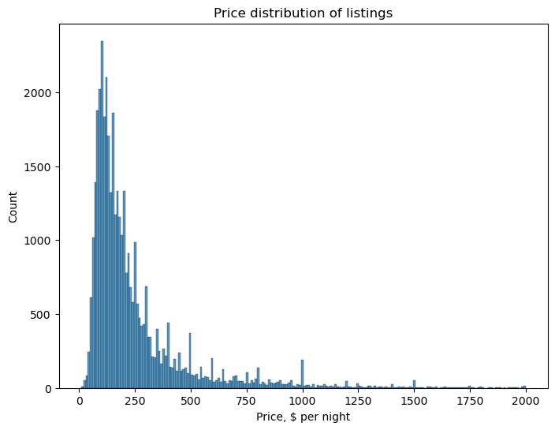
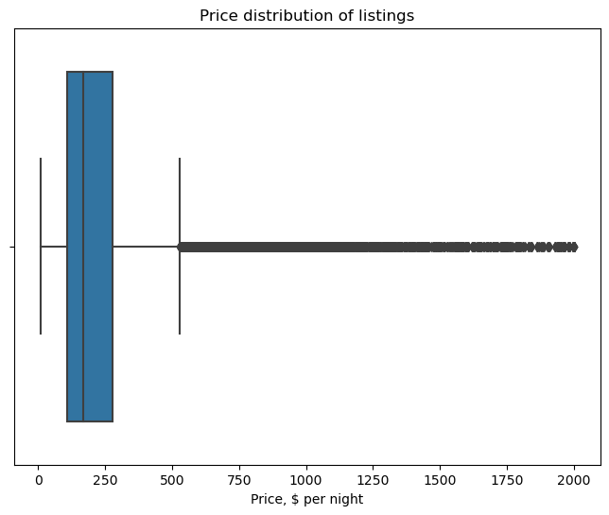
Listing price
Average = $280/night
Min = 1
Max = $65k
Cut-off value: $2000/night

Slide 6
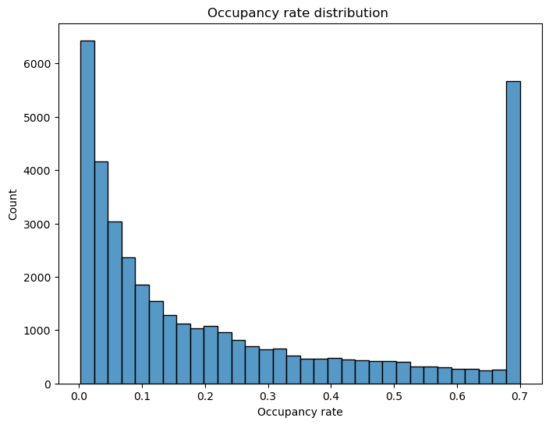
Occupancy rate
We estimated it (how?)
Max set to be 0.7 (why?)
Average = 0.25
Challenges:
Hard to verify
Hard to model (hardly correlated with our features)

Slide 7
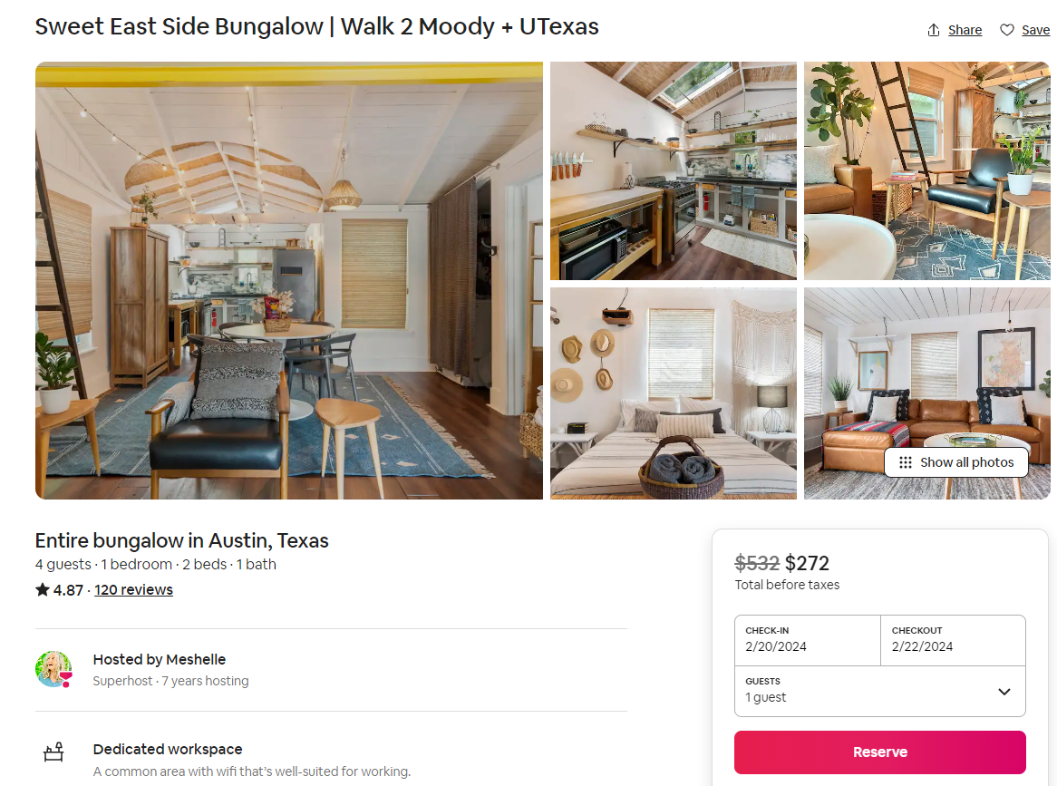
What features to use?
Neighborhood
Typical home price
Number of bedrooms
Number of beds
Number of baths
Amenities:
Pool
Workspace
Free Parking
Gym
Pet Friendly
Reviews
Host experience
Time of the listing

Slide 8
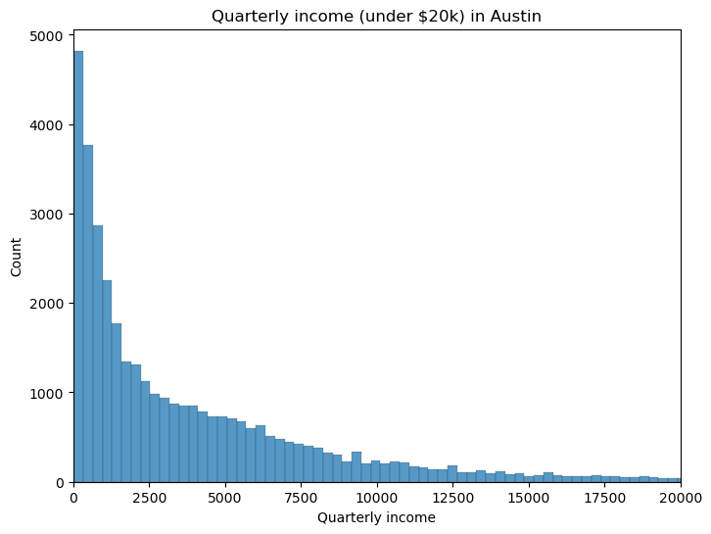
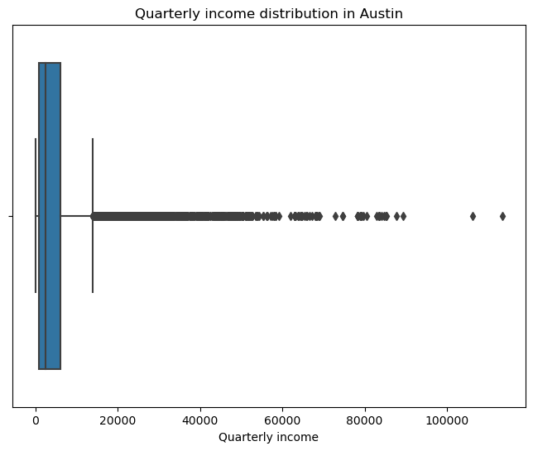
Quarterly income
Very right-skewed
Mean: $4600/quarter
Median: $2400/quarter
Notes:
Let’s look at some of the observations from market analysis

Slide 9
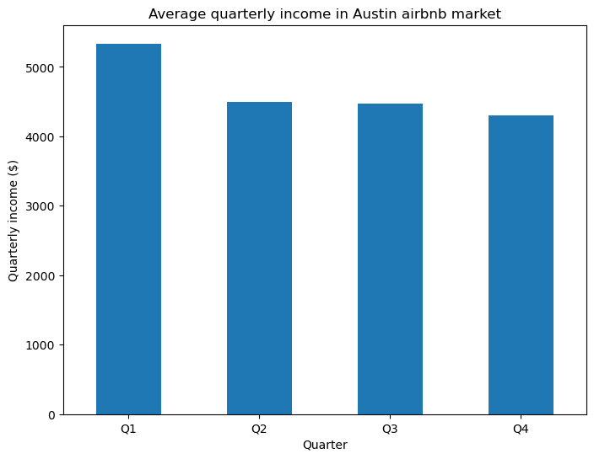
Quarterly income
Highest income in Q1
Higher occupancy rate
Higher prices
Holiday time!

Slide 10
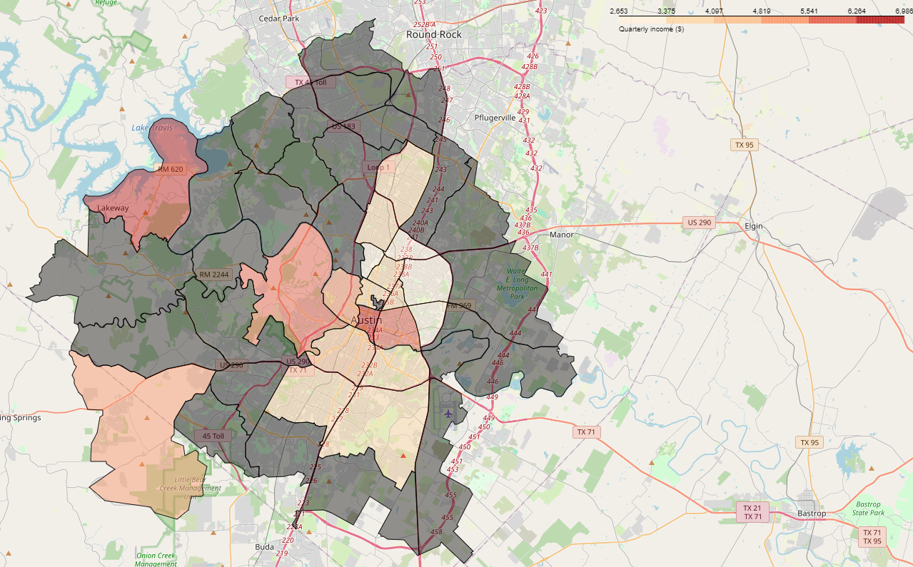
Highest income regions
Neighborhoods with 125 + homes
Highest income:
Downtown area
Lake Travis area

Slide 11
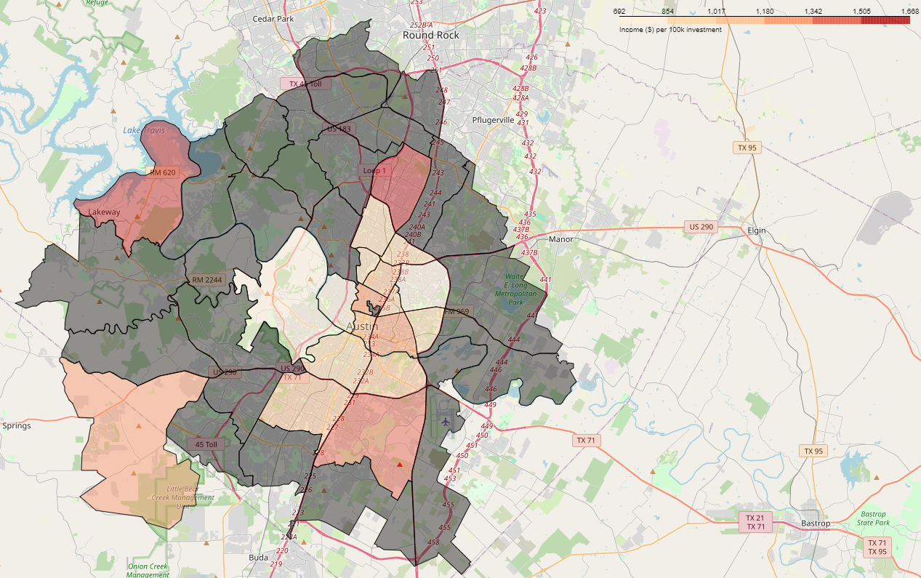
Best investment regions
Income per 100k investment
Best for new investors
Some regions are very expensive
Away from the center!
Notes:
Let us look at it from investment perspective.

Slide 12
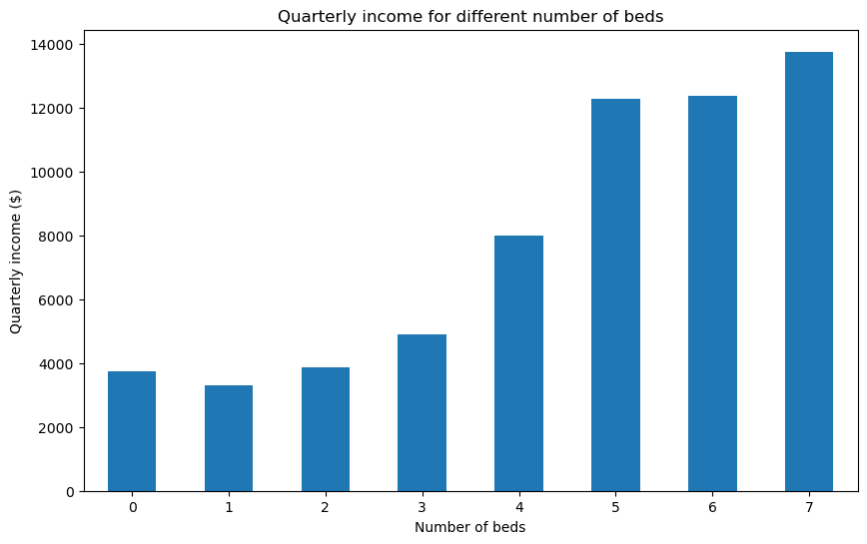
Income vs. number of bedrooms
Income jumps for 4+ bedrooms

Slide 13
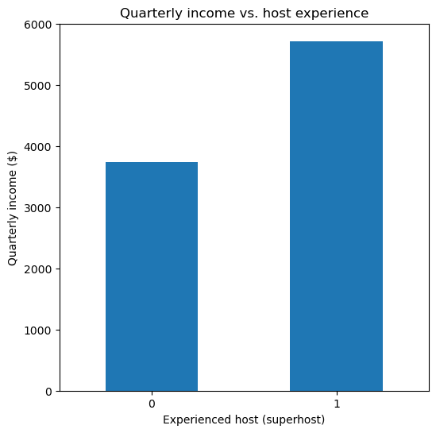
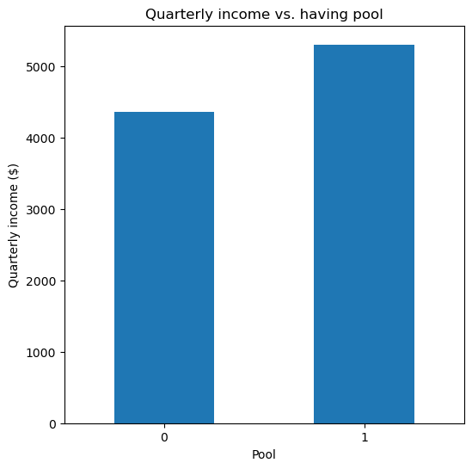
Other important features
Host’s experience impacts income
Having pool bumps up the income (for 2+ bedroom houses)
Notes:
During our investigations, we figured out there are a number of factors that play role in the income for each listing.

Slide 14
‘Listing price’ modeling
Linear regression, Neural Network, and XGBoost
Regressor | Specifics | R2 score (train data) | MAE (train data) | R2 score (test data) | MAE (test data)
Linear regression | Polynomial features, Ridge | 0.56 | $93 | 0.52 | $97
Neural Network | 4 hidden layers (32-256 nodes) | 0.71 | $73 | 0.58 | $88
XGBoost | BayesSearchCV for hyperparameters | 0.90 | $42 | 0.71 | $72

Slide 15
‘Occupancy rate’ modeling
Very challenging modeling and poor performance
Linear regression and XGBoost
Regressor | Specifics | R2 score (train data) | MAE (train data) | R2 score (test data) | MAE (test data)
Linear regression | Polynomial features, Ridge | 0.17 | 0.18 | 0.13 | 0.19
XGBoost | BayesSearchCV for hyperparameters | 0.66 | 0.11 | 0.45 | 0.14

Slide 16
Demo Time!

Slide 17
Conclusions
The average quarterly income from airbnb in the city of Austin is $4600.
First quarter of the year usualy generates more income than other times.
Houses with 4+ bedrooms show a jump in the income, compared to smaller properties.
Being an experienced host (a.k.a. superhost) significantly impacts the yearly income of listings.
Future work?

