Slide 1
Reddit listing classification focus on emotional listings
DSI course
Jan 2024
By: Masoud Alfi

Slide 2
Problem statement
Human language into numbers
Interpret language and predict the context (subreddit classification)
Challenges?
Why is it important?
Who benefits?
Notes:
Chanllenges:
human language has complicated structure and a lot of words should be investigated in the context of the sentence
Things are not separable by natures
Why important:
Helps companies make informed and targeted decisions
Spam classifications
Virtual assistants
Urgency detection
Translation and summarization
Who benefits?
- Companies and service providers for services tailored to customers needs

Slide 3
Outlines
Out data
Exploratory data analysis
Model benchmarking
Model comparison
Balanced vs. imbalanced data
Conclusions

Slide 4
Our data
Subreddits:
r/offmychest
r/relationship_advice
No severe imbalance
Why these options?
Reddit API’s used
16,000+ listings
Information extracted:
Listing and title
urls and media
Date and time
Notes:
offmychest subreddit mostly contains listings about personal issues, emotional hardships, life problems, and also issues in peoples relationships. The subreddit usually does have a sad tone because people use it as a way to express their feelings, unburden some thoughts, or to confess about things. relationship_advice subreddit focuses more on relationships and the ups and downs in it. The reasons these two subreddits were used for our investigation is that while these two subreddits represent two topics that could be distinguishable from each other, they do have common points that could make the classification process challenging. Although offmychest includes a wide variety of subjects, it often includes topics which are related to relationship and the problems around it as well. This overlap can cause our model to struggle since we are mainly relying on the words that used in each listing and having a similar context in both subreddits results in the use of similar vocabularies.

Slide 5
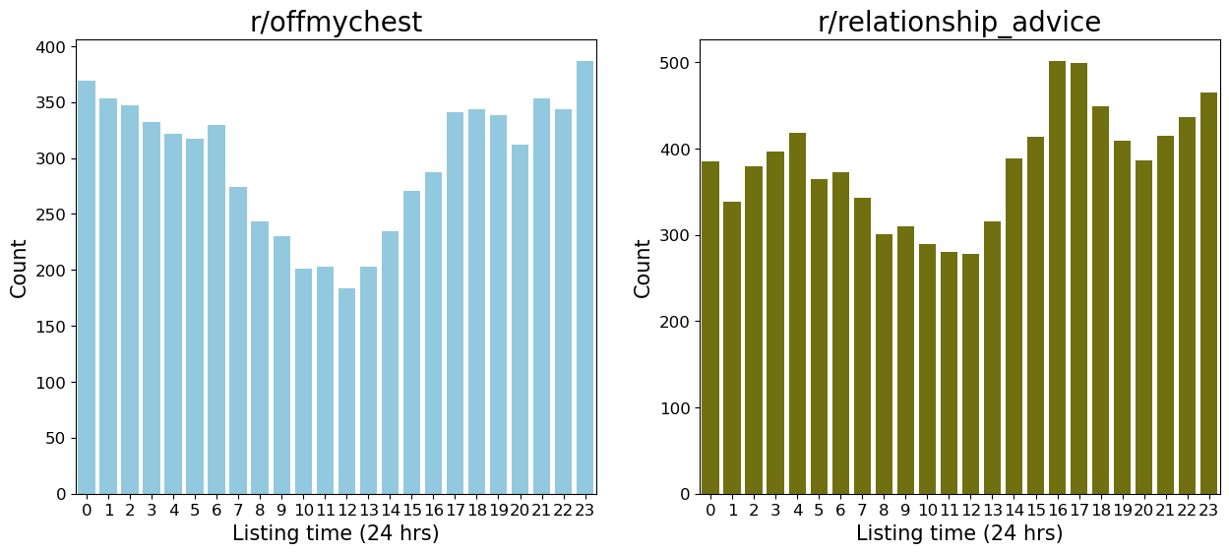
EDA-Listing Time
Needs data collection in longer time spans

Slide 6
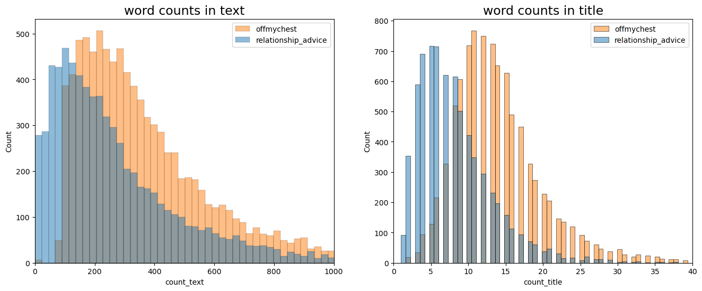
EDA-Word Counts
Clear differences in words counts

Slide 7
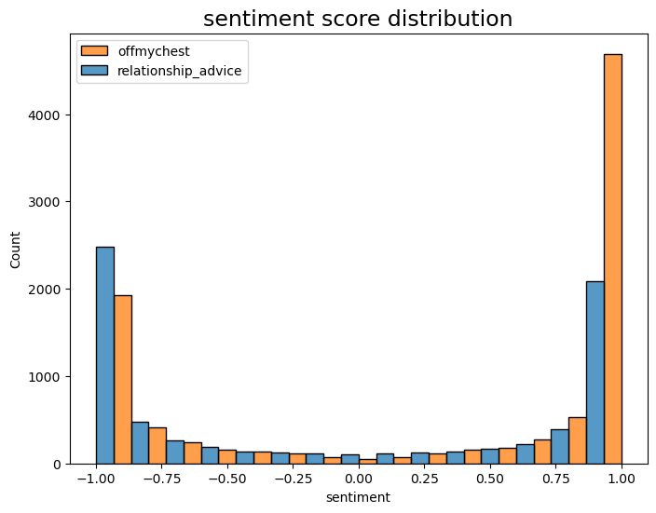
EDA-Sentiment Scores
r/offmychest has a higher positive ratio

Slide 8
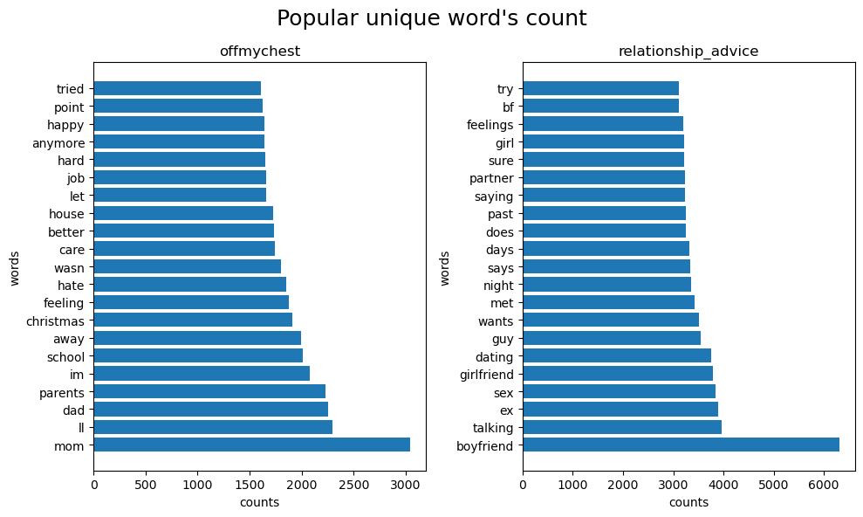
EDA-Exclusive Popular Words
75% overlap in popular words

Slide 9
Model Benchmarking
Null model
Model based on numeric features
Sentiment
Word counts
Base NLP model
CountVectorizer
Logistic Regression (Regularized)
Why accuracy score?
Model | Accuracy score
Null model | 0.56
Numeric model | 0.65
Base NLP model | 0.88
Notes:
Our data are quite balanced
There is no preferences on which category carries a higher weight for us

Slide 10
Model Comparison
Logistic Regression
KNN
Naïve Bayes
Random Forest
The odd case of high variance
Model | Accuracy score
Log Reg | 0.88
Naïve Bayes | 0.85
Random Forest | 0.84
KNN | 0.76

Slide 11
Balanced vs. Imbalanced Data
LogReg (with class weighting)
LogReg (no class weighting)
Data imbalance ratio (94 to 6)
Score | Balanced data | Imbalanced data
Accuracy | 0.89 | 0.92
Precision | 0.9 | 0.5
Recall | 0.9 | 0.28
f1-score | 0.9 | 0.36
Score | Imbalanced data
Accuracy | 0.91
Precision | 0.4
Recall | 0.6
f1-score | 0.48

Slide 12
Conclusions
Best model showed 88% ‘accuracy’ in classification.
Logistic regression outperformed other estimators.
Classifiers could easily go into the overfitting territory.
Imbalanced classes pose challenges for our classifiers.
Future work
Consider words in the context of sentences and relations (LM)

Slide 13
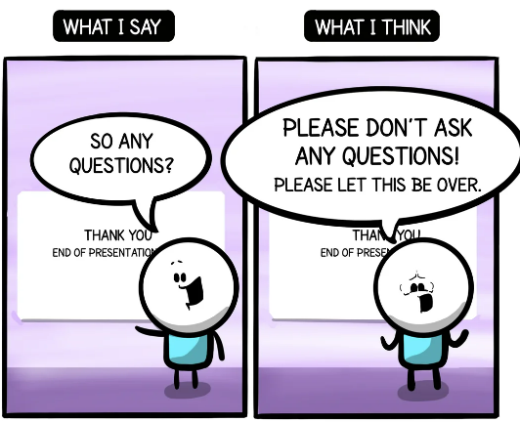
from reddit.com

