Slide 1
Migrated to huggingface
PromptBuilder Object
LLM Object

Slide 2
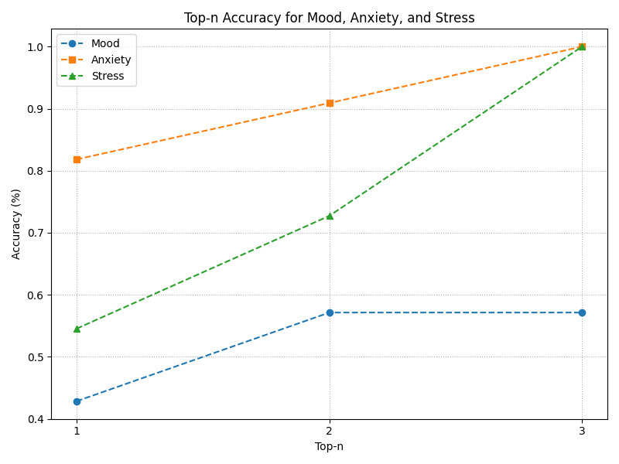
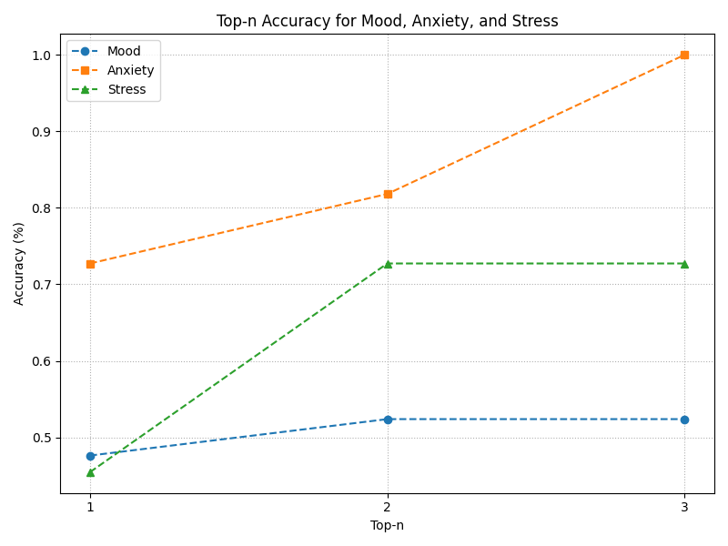
Results with Huggingface
llama31
llama32

Slide 3
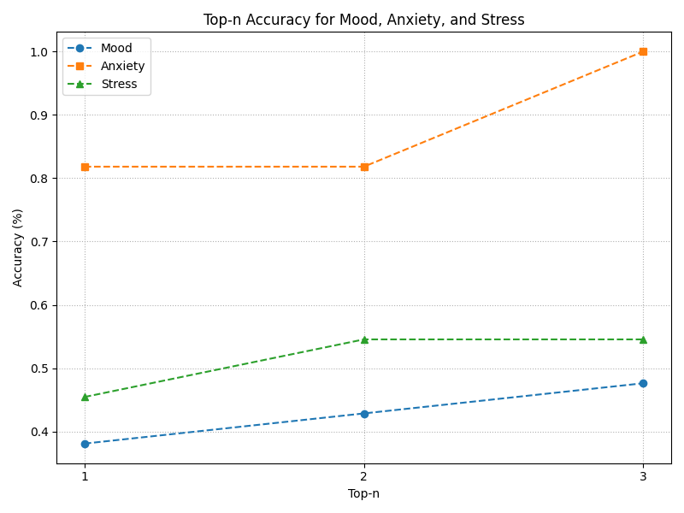
Results with Huggingface
llama31
mistral

Slide 4
Results with Huggingface – updated labels
Potential anxiety-related diagnoses (ICD11):
- Generalized Anxiety Disorder
- Generalized Anxiety Disorder AND Panic Disorder
- Panic Disorder
- Agoraphobia
- Agoraphobia AND Panic Disorder
- Specific Phobia
- Specific Phobia AND Panic Disorder
- Social Anxiety Disorder
- Social Anxiety Disorder AND Panic Disorder
- Separation Anxiety Disorder
- Separation Anxiety Disorder AND Panic Disorder
- Selective Mutism
- Other Anxiety and Fear-Related Disorder
- Unspecified Anxiety and Fear-Related Disorder
- A different diagnosis
- No Diagnosis
Potential mood-related diagnoses (ICD11):
- Single Episode Depressive Disorder
- Recurrent Depressive Disorder
- Dysthymic Disorder
- Mixed Depressive and Anxiety Disorder
- Bipolar Type I Disorder
- Bipolar Type II Disorder
- Cyclothymic Disorder
- Other Mood Disorder
- Generalized Anxiety Disorder
- Prolonged Grief Disorder
- Adjustment Disorder
- A different diagnosis not listed above
- No Diagnosis; symptoms and behaviours are within normal limits

Slide 5
Results with Huggingface – updated labels
Potential stress-related diagnoses (ICD11):
- Post-Traumatic Stress Disorder (PTSD)
- Complex Post-Traumatic Stress Disorder (CPTSD)
- Prolonged Grief Disorder
- Adjustment Disorder
- Other Disorder Specifically Associated with Stress
- Acute Stress Reaction
- A diagnosis from a different diagnostic area (e.g. mood disorders, psychotic disorders, personality disorders)
- No Diagnosis; normal reaction to stressful event(s)
General notes:
Each clinician sees only 2 vignettes
Initial selection of disorders is the same across both

Slide 6
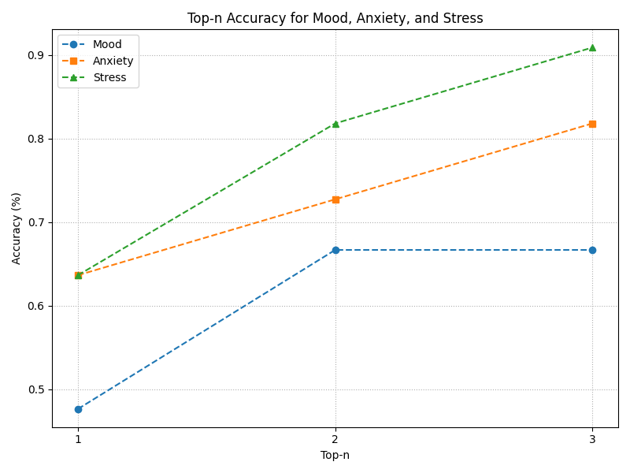
Results with HuggingFace & updated labels
Llama31 – updated labels
Llama31 - old

Slide 7
Questions / Next steps
Model now also predicts “No diagnosis”
Qualtrics:
please share anxiety again (messed up logic..)
Did not fully mimic Qualtrics with regards to the specific question
Classification:
In Mood: additional labels made classification more complicated
Bipolar I and II messed up
Now also predicting “No diagnosis”
Next steps:
Make code even more dynamic
Evaluation more automated
Run on HPC with 70B model

Slide 8
Overview results

Slide 9
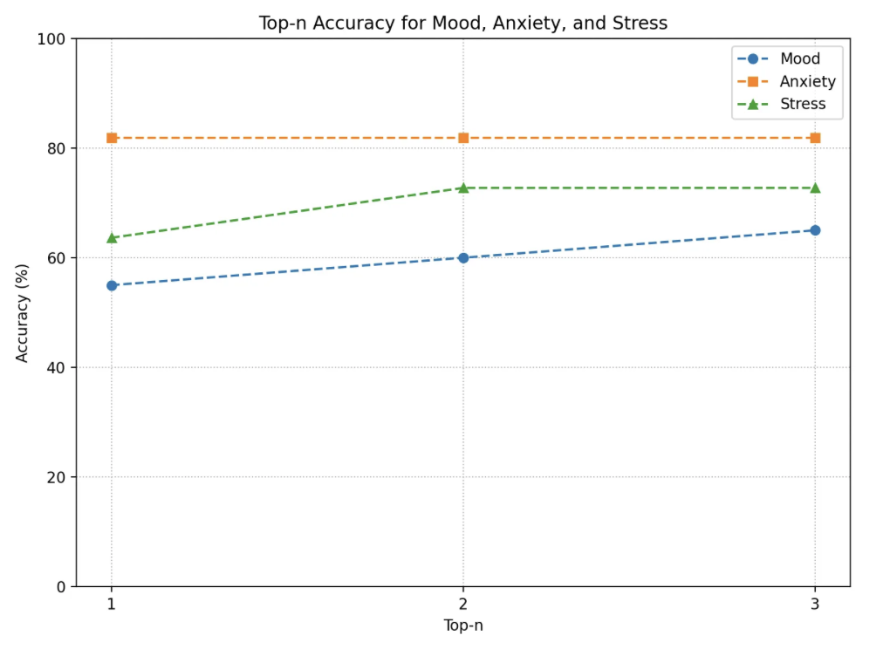
Old results with Ollama

