Slide 1

Employee Attrition

Slide 2
Indexes
Slide.No | Components
4. | Introduction
5. | Abstract
6. | Project Profile
7. | Statement Of The Problem
8. | Objectives Of The Study
9. | Organization Of Data
10. | First Five Record Of Data
13. | Last Five Record Of Data
16. | Data Source
17. | Data Category
19. | Data Discreption
23. | Data Volume
24. | Data Summary
28. | Empty Value For Each Column
29. | Count Plot Chart For No. Of Employee Stayed And Lived
31. | Count Plot Chart For Reason To Leave Company
33. | Box Plot For Attried And Non-Attried Employee

Slide 3
Slide.No | Components
35. | Box Plot For No. Of Year In Company
37. | Heat Map
39. | Bar Graph For Importance Of Data
46. | Conclusion

Slide 4
Introduction
The term “attrition” refers to the “unpredictable and uncontrollable, but normal, reduction of workforce due to resignations, retirement, sickness, or death; loss of material or resource due to obsolescence or spoilage.”
Employees are the most valuable assets of an organization.
It’s important to know whether their employees are dissatisfied or there any other reasons for leaving the job.
It’s important to know whether their employees are dissatisfied or there any other reasons for leaving the job.
Employee retention is the effort by employers to encourage current employees to remain employed with the organization.
It is better to retain the existing talent than to hire continuously.
Retaining good employees has always been an issue of utmost importance.
It is one of the key challenges faced by chemical industries in India.

Slide 5
Abstract
Employee attrition is one of the most important issues faced by organizations today. Different organizations employ different strategies to minimize employee attrition. There have been many studies which relate employee attrition to various variables including demographic and behavioral variables. Various models have been used to predict the employee attrition. Many of these models use classification techniques such as classification trees and artificial neural networks. The variables used in many of the models are either demographic or behavioral variables. This study used classification models using work-place related variables to predict employee attrition.
Keywords: Employee Attrition; Work-place related Variables; Classification Techniques; Prediction Accuracy

Slide 6
Project Profile
Submitted in the Partial fulfilment of the requirement for awarding
the degree of
Master Of Computer Application(MCA)
SEM 4,Year 2020
By
Name RNo
1)Mansuri Malhan A34
2)Mansuri Sohel A35
3)Mansuri Ahtesham A33
Under the Guidance of
Prof Lajja Chokshi

Slide 7
Statement Of The Problem
The aim of the present report is to study factors like salary, superior – subordinate relationship, growth opportunities, facilities, policies and procedures, recognition, appreciation, suggestions, co- workers by which it helps to know the Attrition level in the organizations and factors relating to retain them.

Slide 8
Objectives Of The Study
The study covers the following objectives:
To identify the factors of attrition in the organizations.
To study the importance of Retention in the organizations.
To suggest innovative measures for how to reduce the employee attrition and increase employee retention in the organizations.

Slide 9
Organization Of Data
Here, import some Libraries that will be used throught this project.
import pandas as pd
import seaborn as sns
import matplotlib.pyplot as plt
import numpy as np
After,
Load the data from CSV(employee.csv) file into the dataframe(df).
df = pd.read_csv('employee.csv')

Slide 10
print the first five(5) row’s of the data
df.head()
Age | Attrition | BusinessTravel | DailyRate | Department | DistanceFrom Home | Education | EducationField | JobRole
41 | Yes | Travel_Rarely | 1102 | Sales | 1 | 2 | Life Sciences | Sales Executive
49 | No | Travel_Frequently | 279 | Research & Development | 8 | 1 | Life Sciences | Research Scientist
37 | Yes | Travel_Rarely | 1373 | Research & Development | 2 | 2 | Other | Laboratory Technician
33 | No | Travel_Frequently | 1392 | Research & Development | 3 | 4 | Life Sciences | Research Scientist

Slide 11
Environment Satisfaction | Gender | HourlyRate | JobInvolvement | JobLevel | Job Satisfaction | Marital Status | Monthly Income | Monthly Rate
2 | Female | 94 | 3 | 2 | 4 | Single | 5993 | 19479
3 | Male | 61 | 2 | 2 | 2 | Married | 5130 | 24907
4 | Male | 92 | 2 | 1 | 3 | Single | 2090 | 2396
4 | Female | 56 | 3 | 1 | 3 | Married | 2909 | 23159
OverTime | Percent SalaryHike | Performance Rating | Relationship Satisfaction | StockOption Level | TotalWorking Years | TrainingTimes LastYear | WorkLife Balance | YearsAt Company
Yes | 11 | 3 | 1 | 0 | 8 | 0 | 1 | 6
No | 23 | 4 | 4 | 1 | 10 | 3 | 3 | 10
Yes | 15 | 3 | 2 | 0 | 7 | 3 | 3 | 0
Yes | 11 | 3 | 3 | 0 | 8 | 3 | 3 | 8

Slide 12
YearsInCurrent Role | YearsSince LastPromotion | YearsWith CurrManager
4 | 0 | 5
7 | 1 | 7
0 | 0 | 0
7 | 3 | 0

Slide 13
Print the last five(5) row’s of the data.
df.tail()
Age | Attrition | BusinessTravel | DailyRate | Department | DistanceFrom Home | Education | EducationField | JobRole
36 | No | Travel_Frequently | 884 | Research & Development | 23 | 2 | Medical | Laboratory Technician
39 | No | Travel_Rarely | 613 | Research & Development | 6 | 1 | Medical | Healthcare Representative
27 | No | Travel_Rarely | 155 | Research & Development | 4 | 3 | Life Sciences | Manufacturing Director
49 | No | Travel_Frequently | 1023 | Sales | 2 | 3 | Medical | Sales Executive

Slide 14
Environment Satisfaction | Gender | HourlyRate | JobInvolvement | JobLevel | Job Satisfaction | Marital Status | Monthly Income | Monthly Rate
3 | Male | 41 | 4 | 2 | 4 | Married | 2571 | 12290
4 | Male | 42 | 2 | 3 | 1 | Married | 9991 | 21457
2 | Male | 87 | 4 | 2 | 2 | Married | 6142 | 5174
4 | Male | 63 | 2 | 2 | 2 | Married | 5390 | 13243
OverTime | Percent SalaryHike | Performance Rating | Relationship Satisfaction | StockOption Level | TotalWorking Years | TrainingTimes LastYear | WorkLife Balance | YearsAt Company
No | 17 | 3 | 3 | 1 | 17 | 3 | 3 | 5
No | 15 | 3 | 1 | 1 | 9 | 5 | 3 | 7
Yes | 20 | 4 | 2 | 1 | 6 | 0 | 3 | 6
No | 14 | 3 | 4 | 0 | 17 | 3 | 2 | 9

Slide 15
YearsInCurrent Role | YearsSince LastPromotion | YearsWith CurrManager
2 | 0 | 3
7 | 1 | 7
2 | 0 | 3
6 | 0 | 8

Slide 16
Data Source
https://www.kaggle.com/pavansubhasht/ibm-hr-analytics-attrition-dataset
Tools And Techniques
Tool:- Jupyter Notebook.
Language:- Python.

Slide 17
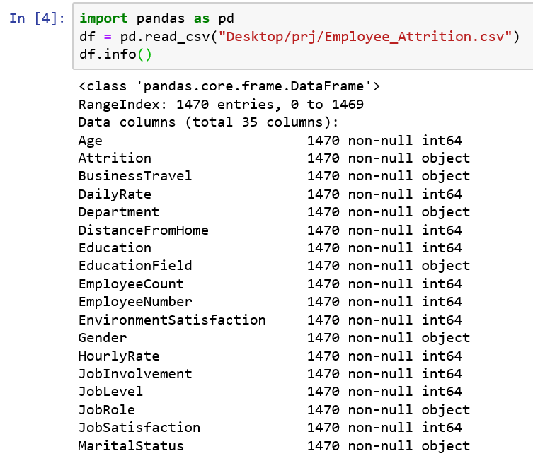
Data Category

Slide 18
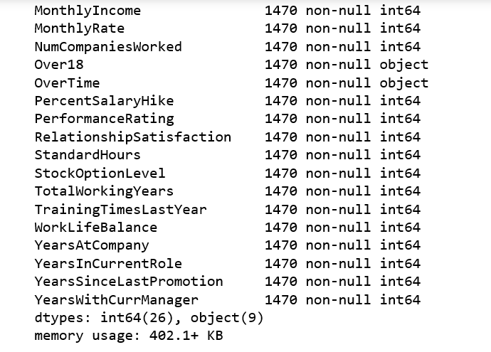

Slide 19
Data Description
FILED | DESCRIPTION
Age | It’s describe employee’s age.
Attrition | It’s describe Attrition of employee. In boolean value(yes/no).
BusinessTravel | It’s describe how much employee travel for company. (Travel_Rarely\Travel_Frequently\Non-Travel)
DailyRate | It’s describe dailyRate of employee.(102 to 1500)
Department | It’s describe employee department.
DistanceForHome | It’s describe employee distance from home in KM.
Education | It’s describe the employee education in numeric value. (1)’below college’ (2)’college’ (3)’Bachelor’ (4)’master’ (5)’doctor’
EducationField | It’s describe the education field of employee.
EmployeeCount | it’s describe the employee count.

Slide 20
FILED | DESCRIPTION
Gender | It’s describe employee gender.(male,female)
HourlyRate | it’s describe hourly rate of employee.
JobInvolvement | It’s represent in numeric value. (1)’low’(2)’medium’(3)’high’(4)’very high’
JobLevel | It’s describe the joblevel in numeric value(1 to 5)
JobRole | It’s describe the job role of each employee.
JobSatisfaction | It’s represent in numeric value. (1)’low’(2)’medium’(3)’high’(4)’very high’
MaritalStatus | It’s describe employee marital status (single\married)
MonthlyIncome | It’s describe employee monthly income.
MonthlyRate | It’s describe monthly rate of employee.
NumCompaniesWorked | It’s describe the employee’s experience of work in the number of company.

Slide 21
FILED | DESCRIPTION
OverTime | It’s describe Employee overtime work or not.(yes\no)
PercentSalary Hike | it’s describe the salaryHike in a percent.
Performance Rating | It’s represent performance of employee in numeric value. (1)’low’(2)’good’(3)’excellent’ (4)’outstanding’
Relationship Satisfaction | It’s describe the employee relationship with company in numeric value. (1)’low’(2)’medium’(3)’high’(4)’very high’
StandardHours | It’s display the company standard hour.
StockOption Level | It’s describe if any employee attrition than other employee available for that particular role.
TotalWorkingYears | It’s describe the employee how many years work in specific role.
TrainingTimesLastYear | It’s describe employee training in hour of last year.

Slide 22
FILED | DESCRIPTION
WorkLife Balance | It’s describe the employee work life balance company in numeric value. (1)’bad’(2)’good’(3)’better’(4)’best’
YearsAt Company | It’s describe the employee how many years work in this company.
YearsIn CurrentRole | It’s describe years in this role.
YearsSince LastPromotion | employee last promotion.
YearsWith CurrManager | how old cur. Manager.
Environment Satisfaction | It’s represent in numeric value. (1)’low’(2)’medium’(3)’high’(4)’very high’
EmployeeNumber | It’s describe employee unique no.
Over18 | : It’s describe employee age is above 18 or not. If above 18 than yesotherwise no(yes\no).

Slide 23
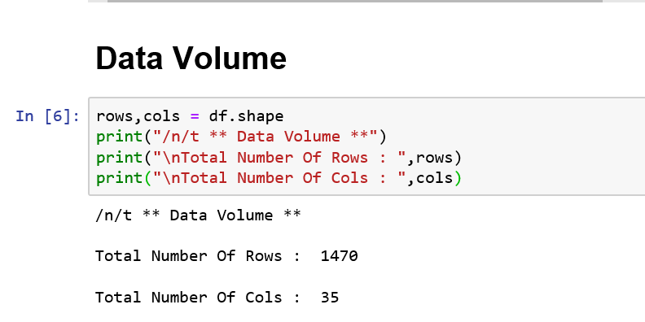
Data Volume

Slide 24
Data Summary
df.describe()
Heading | Age | Daily Rate | DistanceFrom Home | Education | Employee Count | Employee Number
Count | 1470.000000 | 1470.000000 | 1470.000000 | 1470.000000 | 1470.0 | 1470.000000
Mean | 36.923810 | 802.485714 | 9.192517 | 2.912925 | 1.0 | 1024.865306
Std | 9.135373 | 403.509100 | 8.106864 | 1.024165 | 0.0 | 602.024335
Min | 18.000000 | 102.000000 | 1.000000 | 1.000000 | 1.0 | 1.000000
25% | 30.000000 | 465.000000 | 2.000000 | 2.000000 | 1.0 | 491.250000
50% | 36.000000 | 802.000000 | 7.000000 | 3.000000 | 1.0 | 1020.500000
75% | 43.000000 | 1157.000000 | 14.000000 | 4.000000 | 1.0 | 1555.750000
Max | 60.000000 | 1499.000000 | 29.000000 | 5.000000 | 1.0 | 2068.000000

Slide 25
Heading | Environment Satisfaction | HourlyRate | JobInvolvement | JobLevel
Count | 1470.000000 | 1470.000000 | 1470.000000 | 1470.000000
Mean | 2.721769 | 65.891156 | 2.729932 | 2.063946
Std | 1.093082 | 20.329428 | 0.711561 | 1.106940
Min | 1.000000 | 30.000000 | 1.000000 | 1.000000
25% | 2.000000 | 48.000000 | 2.000000 | 1.000000
50% | 3.000000 | 66.000000 | 3.000000 | 2.000000
75% | 4.000000 | 83.750000 | 3.000000 | 3.000000
Max | 4.000000 | 100.000000 | 4.000000 | 5.000000

Slide 26
Heading | Relationship Satisfaction | Standard Hours | StockOption Level | TotalWorking Years | TrainingTimes LastYear | WorkLife Balance
Count | 1470.000000 | 1470.0 | 1470.000000 | 1470.000000 | 1470.000000 | 1470.000000
Mean | 2.712245 | 80.0 | 0.793878 | 11.279592 | 2.799320 | 2.761224
Std | 1.081209 | 0.0 | 0.852077 | 7.780782 | 1.289271 | 0.706476
Min | 1.000000 | 80.0 | 0.000000 | 0.000000 | 0.000000 | 1.000000
25% | 2.000000 | 80.0 | 0.000000 | 6.000000 | 2.000000 | 2.000000
50% | 3.000000 | 80.0 | 1.000000 | 10.000000 | 3.000000 | 3.000000
75% | 4.000000 | 80.0 | 1.000000 | 15.000000 | 3.000000 | 3.000000
Max | 4.000000 | 80.0 | 3.000000 | 40.000000 | 6.000000 | 4.000000

Slide 27
Heading | YearsAtCompany | Years In Current Role | YearsSince Last Promotion | YearsWith Curr. Manager
Count | 1470.000000 | 1470.000000 | 1470.000000 | 1470.000000
Mean | 7.008163 | 4.229252 | 2.187755 | 4.123129
Std | 6.126525 | 3.623137 | 3.222430 | 3.568136
Min | 0.000000 | 0.000000 | 0.000000 | 0.000000
25% | 3.000000 | 2.000000 | 0.000000 | 2.000000
50% | 5.000000 | 3.000000 | 1.000000 | 3.000000
75% | 9.000000 | 7.000000 | 3.000000 | 7.000000
Max | 40.000000 | 18.000000 | 15.000000 | 17.00000

Slide 28
Get a count of the empty values for each column
df.isna().sum()
Age 0 Attrition 0 BusinessTravel 0 DailyRate 0 Department 0 DistanceFromHome 0 Education 0 EducationField 0 EmployeeCount 0 EmployeeNumber 0 EnvironmentSatisfaction 0 Gender 0 HourlyRate 0 JobInvolvement 0 JobLevel 0 JobRole 0 JobSatisfaction 0 MaritalStatus 0 | MonthlyIncome 0 MonthlyRate 0 NumCompaniesWorked 0 Over18 0 OverTime 0 PercentSalaryHike 0 PerformanceRating 0 RelationshipSatisfaction 0 StandardHours 0 StockOptionLevel 0 TotalWorkingYears 0 TrainingTimesLastYear 0 WorkLifeBalance 0 YearsAtCompany 0 YearsInCurrentRole 0 YearsSinceLastPromotion 0 YearsWithCurrManager 0

Slide 29
Get a count of the number of employee that stayed and left the company.
df['Attrition'].value_counts()
No | 1233
Yes | 237
A count of employee attrition
Visualize the number of employee that stayed and left the company.
plt.figure(figsize=(14,4))
sns.countplot(df['Attrition'])
plt.xlabel('Attrition',fontsize=20)
plt.ylabel('Count',fontsize=20)
plt.xticks(fontsize=12)
plt.yticks(fontsize=12)
plt.savefig('Desktop/Attrition.jpeg')

Slide 30
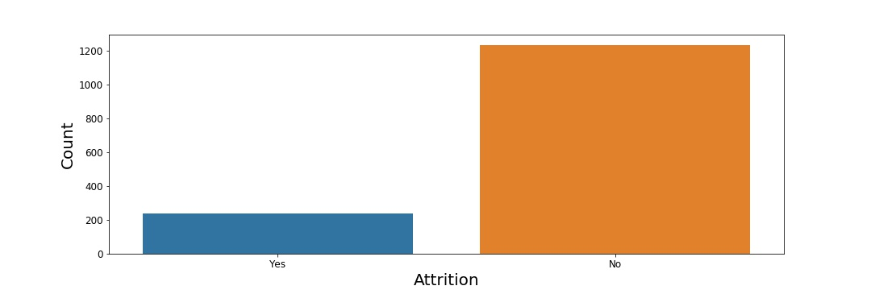

Slide 31
There are many reasons causing Attrition, from personal related (eg. age,family) to job related(eg. Salary,bored in position)
First is about to find Age(maybe old enough to retire)
plt.figure(figsize=(15,5))
sns.countplot(x='Age', hue='Attrition',data = df)
plt.xlabel('Age',fontsize=20)
plt.ylabel('Count',fontsize=20)
plt.xticks(fontsize=12)
plt.yticks(fontsize=12)

Slide 32
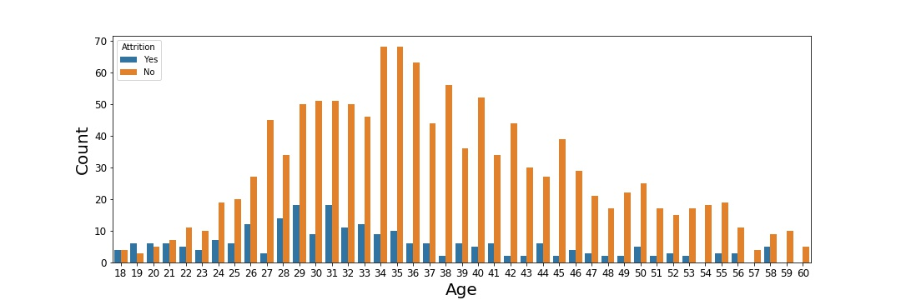
What’s intresting here is that you can see the
In average ,attrited employees are younger then non-attrited employees

Slide 33
Second is Salary (Unsatisfactory in Salary ??) So DailyRate in a data.
plt.figure(figsize=(13,5))
sns.boxplot(x='Attrition', y= 'DailyRate', data=df)
plt.xlabel(‘DailyRate',fontsize=20)
plt.ylabel('Count',fontsize=20)
plt.xticks(fontsize=12)
plt.yticks(fontsize=12)
plt.savefig('Desktop/AttritionDrate.jpeg')

Slide 34
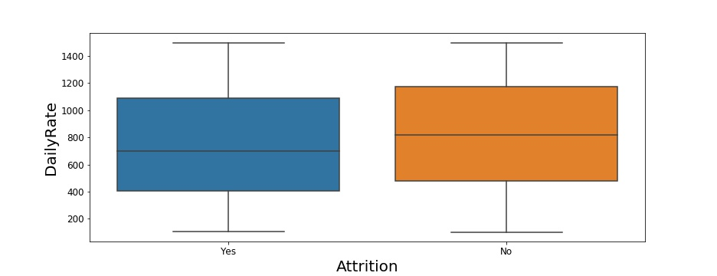
There is less diffrence for DailyRate between attrited and non-attrited employees then Age.

Slide 35
Next is duration of work in company (Bored, No further Excitment from work ? )
plt.figure(figsize=(13,5))
sns.boxplot(x='Attrition', y= 'YearsAtCompany', data=df)
plt.xlabel('Attrition',fontsize=20)
plt.ylabel('Years At Company',fontsize=20)
plt.xticks(fontsize=12)
plt.yticks(fontsize=12)

Slide 36
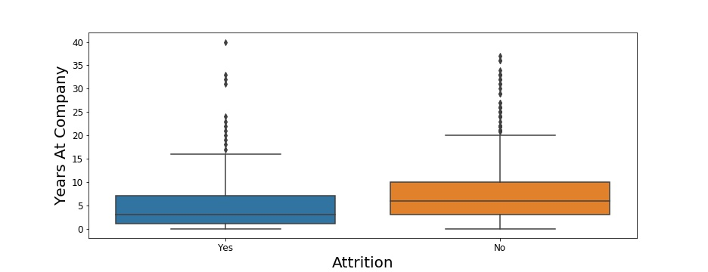

Slide 37
Let’s get a better visual of the correlation by using a heat map
plt.figure(figsize=(26,12))
sns.heatmap(df.corr(),annot=True, fmt='.0%')

Slide 38
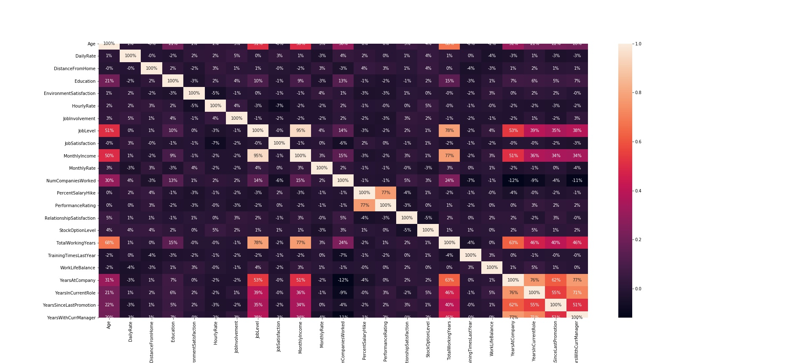

Slide 39
Now let’s prepare the data for the model. We will first transform
non-numeric columns to numerical columns.
from sklearn.preprocessing import LabelEncoder
for column in df.columns:
if df[column].dtype == np.number:
continue
df[column] = LabelEncoder().fit_transform(df[column])df[column]
Next I am going to create a new column to store the age values in. This is only to put the age values at the end of the data set. Then I will remove the column age from the front of the data set so that the target column is first.

Slide 40
Create a new Colum at the end of the dataframe that contains the same value
df['Age_Years'] = df['Age']
#Remove the first column called Age
df = df.drop('Age',axis = 1)
Split the data into independent ‘X’ and dependent ‘Y’ data sets.
X = df.iloc[:,1:df.shape[1]].values
Y = df.iloc[:,0].values

Slide 41
Just so you know you can look at the code here and the data here. Now I want to split the data set into 75% training and 25% testing data sets
from sklearn.model_selection import train_test_split
X_train,X_test,Y_train,Y_test=
train_test_split(X,Y,test_size = 0.25,random_state = 0)
Now let’s use the Random Forest Classifier to learn from the training data and see how accurate it is on that data
from sklearn.ensemble import RandomForestClassifier
forest = RandomForestClassifier(n_estimators=10,criterion='entropy',
random_state=0)
forest.fit(X_train,Y_train)

Slide 42
Now get the accuracy of the model
forest.score(X_train,Y_train)
0.9782214156079855
The Model is about 97.9 % accurate on the training data
from sklearn.metrics import confusion_matrix
cm = confusion_matrix(Y_test,forest.predict(X_test))
TN = cm[0][0]
FN = cm[1][0]
TP = cm[1][1]
FP = cm[0][1]

Slide 43
print(cm)
print('Model Testing Accuracy = {}'.format((TP + TN)/(TP+TN+FP+FN)))
[[309 1]
[ 49 9]]
Model Testing Accuracy = 0.8641304347826086
The model correctly identified 86.41%.
Let’s see what the model thinks are the important features.
importances = pd.DataFrame({'feature':df.iloc[:,1:df.shape[1]].columns,
'importance':np.round(forest.feature_importances_,3)})
#The target column is at pos. 0
importances = importances.sort_values('importance',
ascending =False).set_index('feature')

Slide 44
Their are a lot of features to look at, maybe it is best to see a visualization of the data.
importances.plot(kind = 'barh',figsize=(18,10),fontsize=12)
plt.xlabel("feature",fontsize=16)
plt.ylabel("importance",fontsize=16)

Slide 45
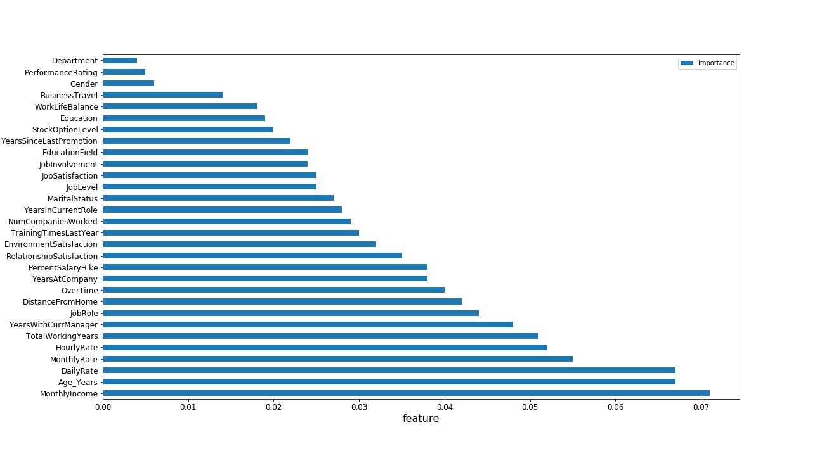

Slide 46
Conclusion
Monthly income appears to be the most important feature followed by the persons age, daily rate, and monthly rate. Seeing this result makes me want to see if people with a higher income are less likely to leave than someone with a lower income.

Slide 47
Thank You

