Slide 1

A PROJECT REPORT ON
“ Online CCTV Camera Selling & Security Solutions ”
SUBMITTED TO GUJARAT UNIVERSITY
For Partial Fulfillment of Degree Of Bachelor of Computer Application(BCA) SEM – 6 System Development Project-2
Submitted by Malhan Mansuri Sohel Mansuri
Internal Guide Prof. Maulik Patel
NAVGUJARAT COLLEGE OF COMPUTER APPLICATIONS ASHRAM ROAD , AHMEDABAD-380014
Website:-www.navgujaratbca.com Contact:-079-27542859
Year 2018-19

Slide 2
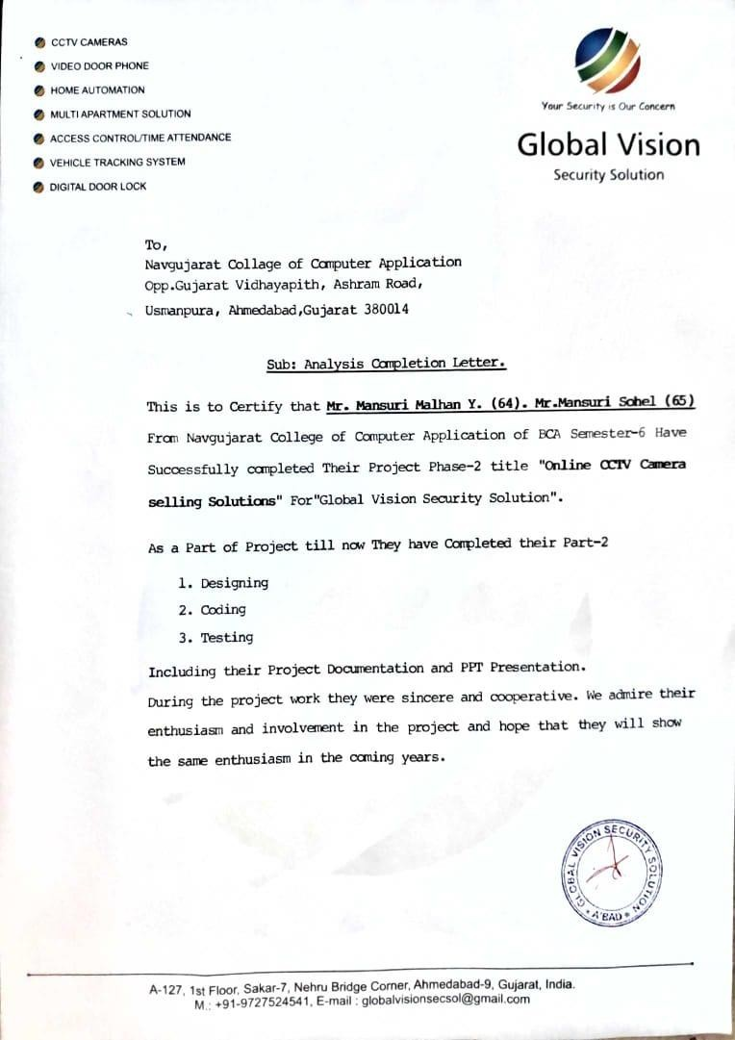

Slide 3


Certificate of Completion
This is to Certify that Software Development Project On
“Online CCTV Camera Selling & Security Solutions”
For
“Global Vision Security Solutions”
Is Submitted to Gujarat University by:
1 . Malhan Mansuri 2.Sohel Mansuri
They Have Successfully Completed The Project For The Duration Of Six Months (Sem-6) Towards The Partial Fulfillment For The Award Of “Bachelors In Computer Applications”[B.C.A]
In Year Of 2018-19.
This Is The Original Work Carried Out Under Our Guidance And Supervision. We Further Certify That The Details Are Best To Our Knowledge And Believe That The Matter Presented In This Project Is Bonafied. We Appreciate Their Enthusiasm And Dedication Towards Work Submitted.
Best Wishes For Their Future Endeavors.

Slide 4
ACKNOWLEDGEMENT
We Express Our Heart Gratitude To A Number Of People Who Extended Their Full Support And Cooperation In Developing This Project . Firstly , We Would Like To Take This Opportunity To Thank Our College “ Navgujarat College Of Computer Application ” For Giving Us This Opportunity And A Platform For Discovering And Developing Our Potential , The King Of Experience That We Have Received While Making This Project Report Is So Immense That Narrating That In Few Word Is Difficult .
After Putting In Such A Hard-work We Have Realized That Takes To Work In Company And Do A Project . Our Company “ Global Vision” And Colleagues Have Been Great Source Of Help Without Them We Were Unable To Do This Project . Therefore Our Project As If Small Drop Of Water Of Sea . We Have Learnt Many Things From Being A Part Of Concept Family .
After That Our Heartiest Thanks To Our Internal Guide As Well As Respected Faculty “ Prof . Maulik Patel” For Entrusting Upon Us The Responsibility And Acting As Ray Of Light In Darkness . We Find Our Self-Short Of Words To Describe Our Feeling For The Role She Played Of Friend , A Philosopher And Guide , Whenever We Were In Need .
Lastly , We Are Thank Full To Our Parents Without Their Blessing , Love , And Support We Are Unable To Traverse Through This Most Significant Stage Of Life. And Also We Would Like To Take This Opportunity To Express Our Regards To All Friends And Faculties Who Have Helped Us Directly Or Indirectly During The Execution Of The Project. We Are Privileged And Thankful To All In Bringing Out Errors And Shortcoming.
Thanking You, Sohel Mansuri Malhan Mansuri

Slide 5
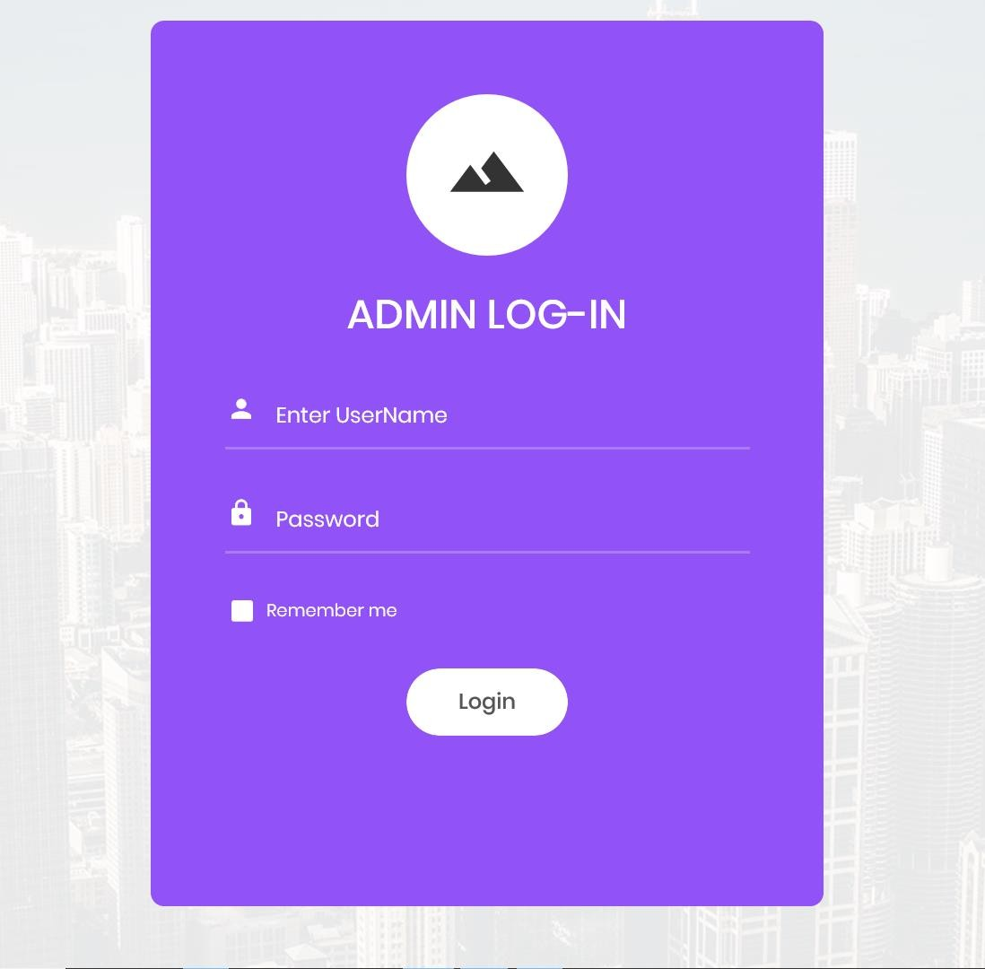
ADMIN
LOGIN
FIRST ADMIN NEED TO LOGIN FOR ACCESS THE ADMIN PANEL.

Slide 6
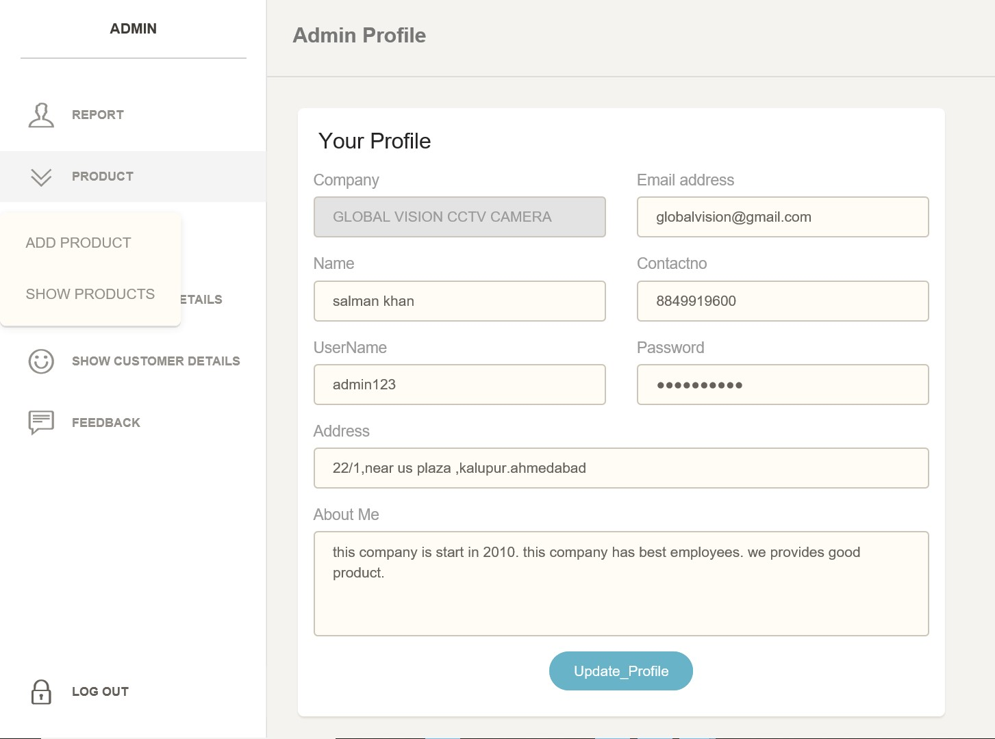
1.2 PROFILE
HERE, ADMIN CAN SEE ADMIN PROFILE AND ALSO CAN UPDATE THE PROFILE.

Slide 7
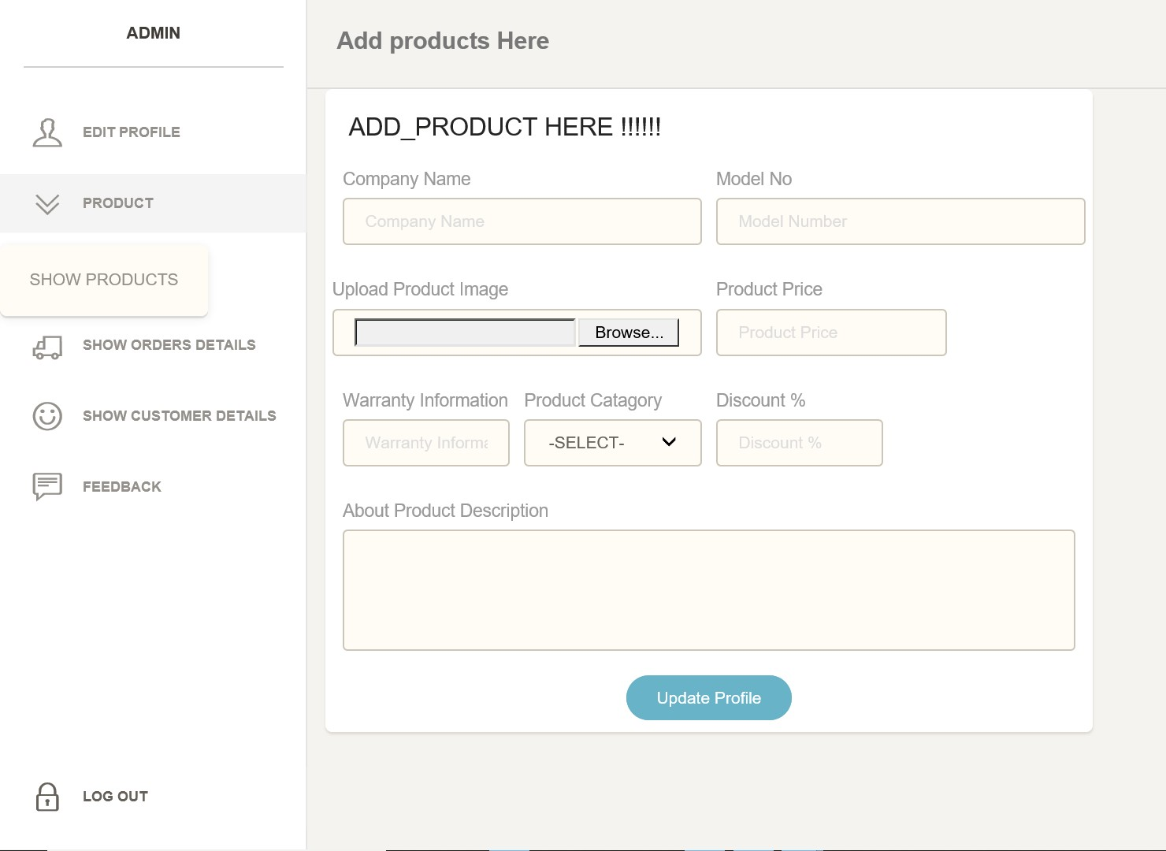
1.3 ADD_PRODUCT
ADMIN CAN ADD A NEW PRODUCT HERE.

Slide 8
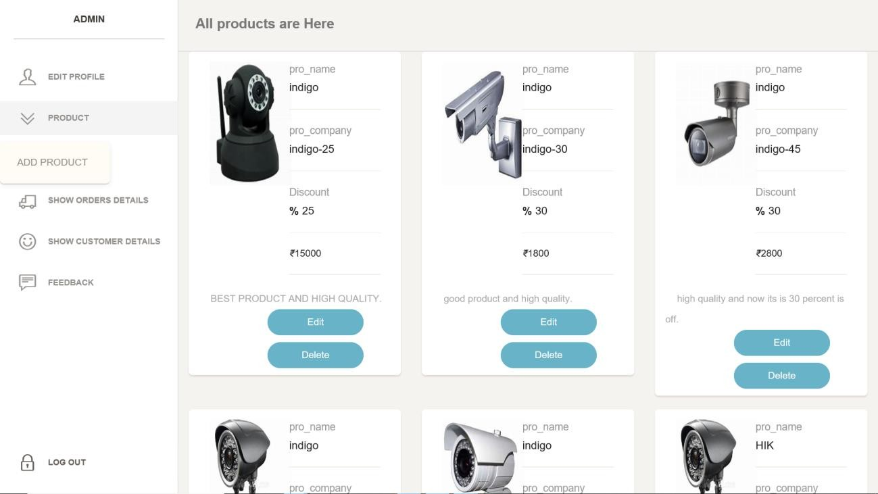
1.4 SEE _PRODUCT
ADMIN CAN SEE ALL THE PRODUCT FROM HERE.
ADMIN CAN EDIT OR REMOVE PRODUCT FROM HERE.

Slide 9
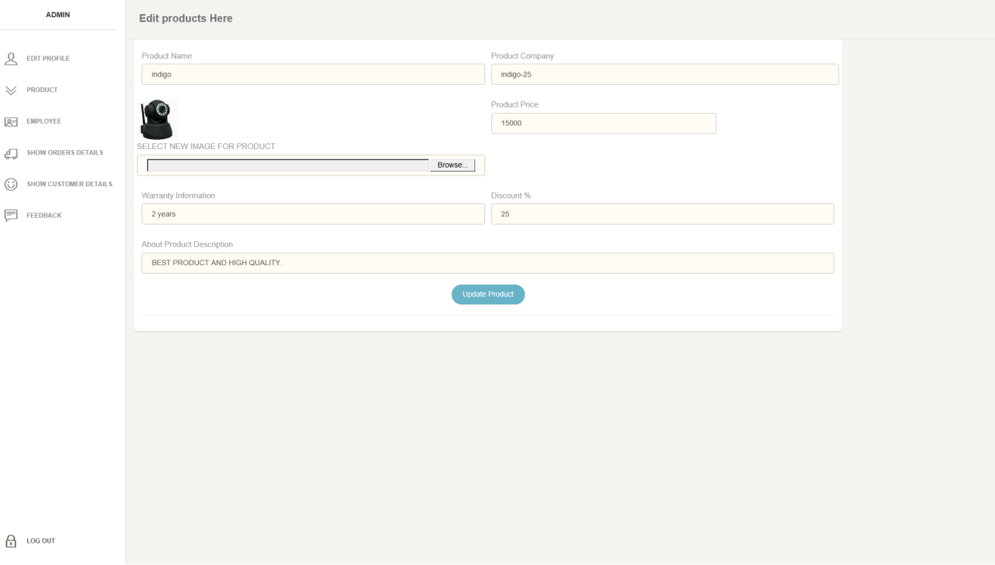
1.5 EDIT_PRODUCT

Slide 10
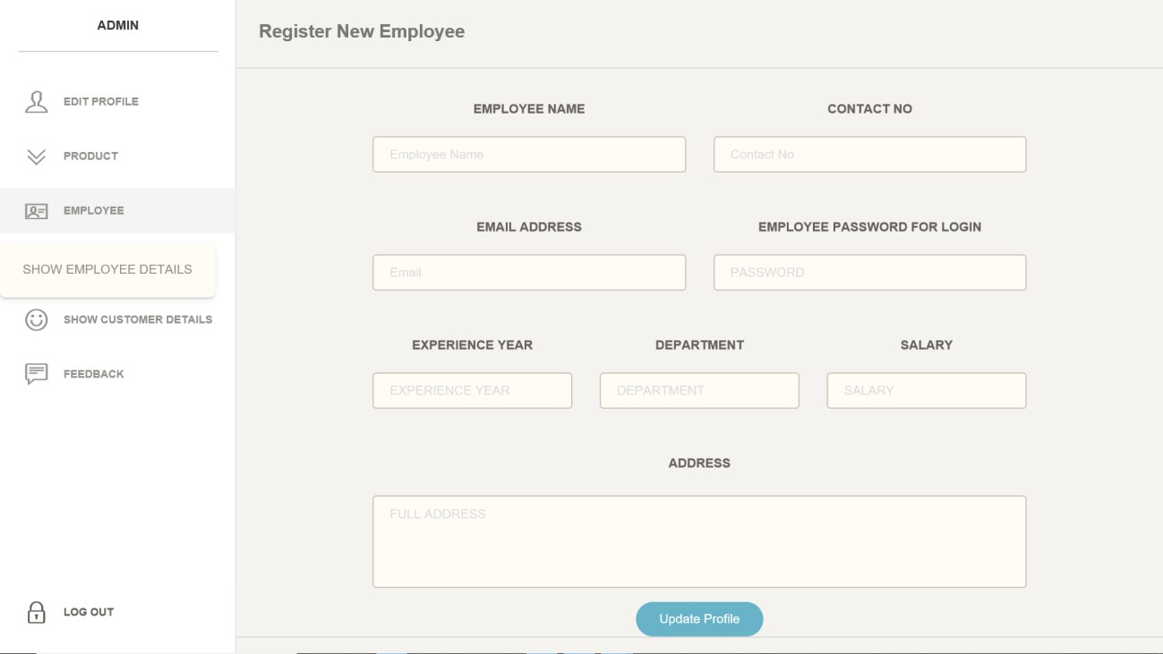
1.6 ADD_EMPLOYEE
ADMIN CAN ADD THE NEW EMPLOYEE FROM HERE.

Slide 11
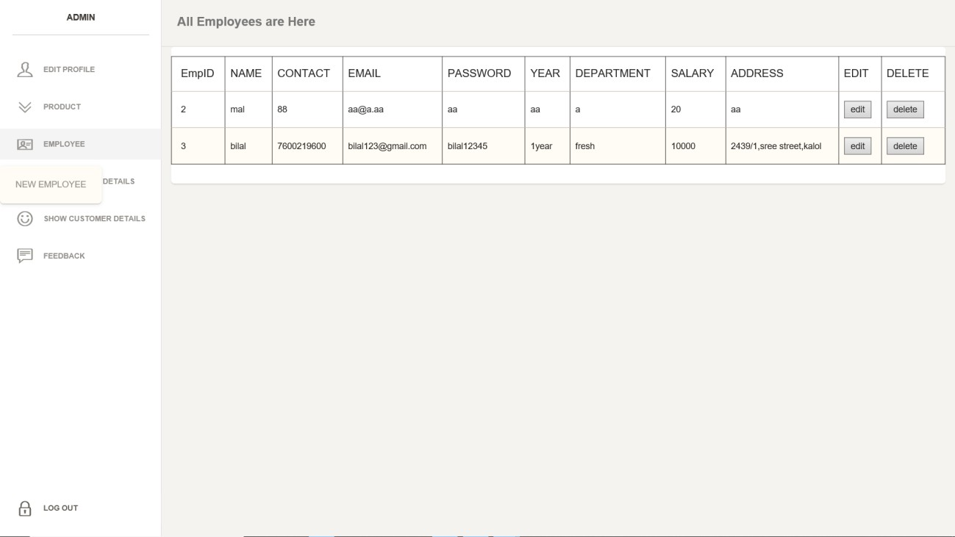
1.7 SEE_EMPLOYEE
ADMIN CAN SEE ALL THE EMPLOYEE DETAILES FROM HERE.
ADMIN CAN EDIT EMPLOYEE DETAILS FROM HERE.

Slide 12
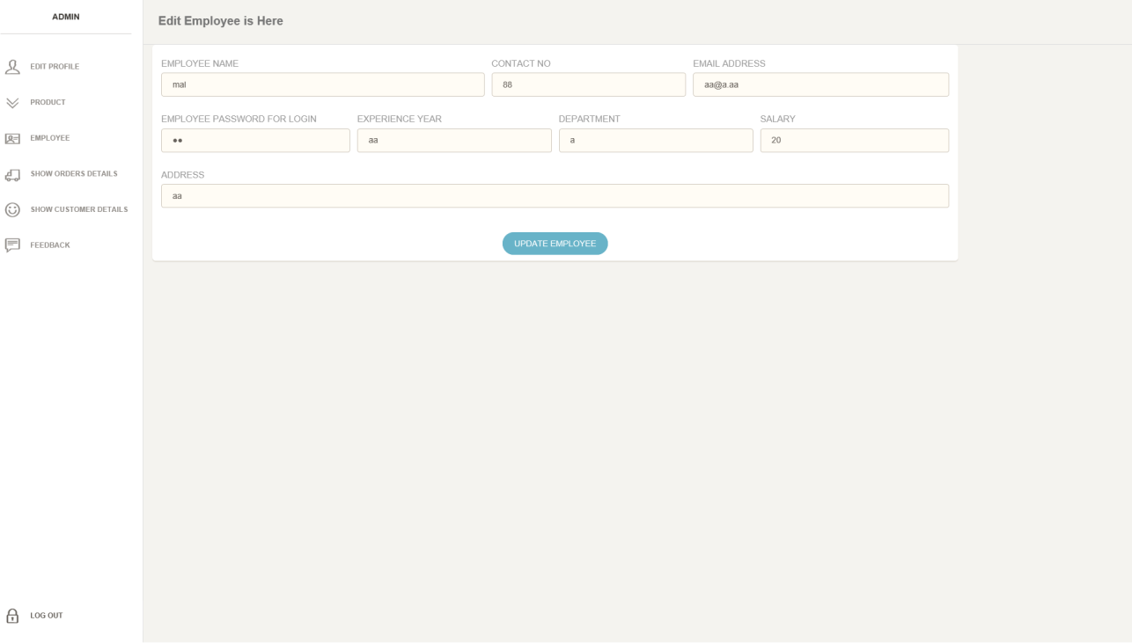
1.8 EDIT_EMPLOYEE

Slide 13
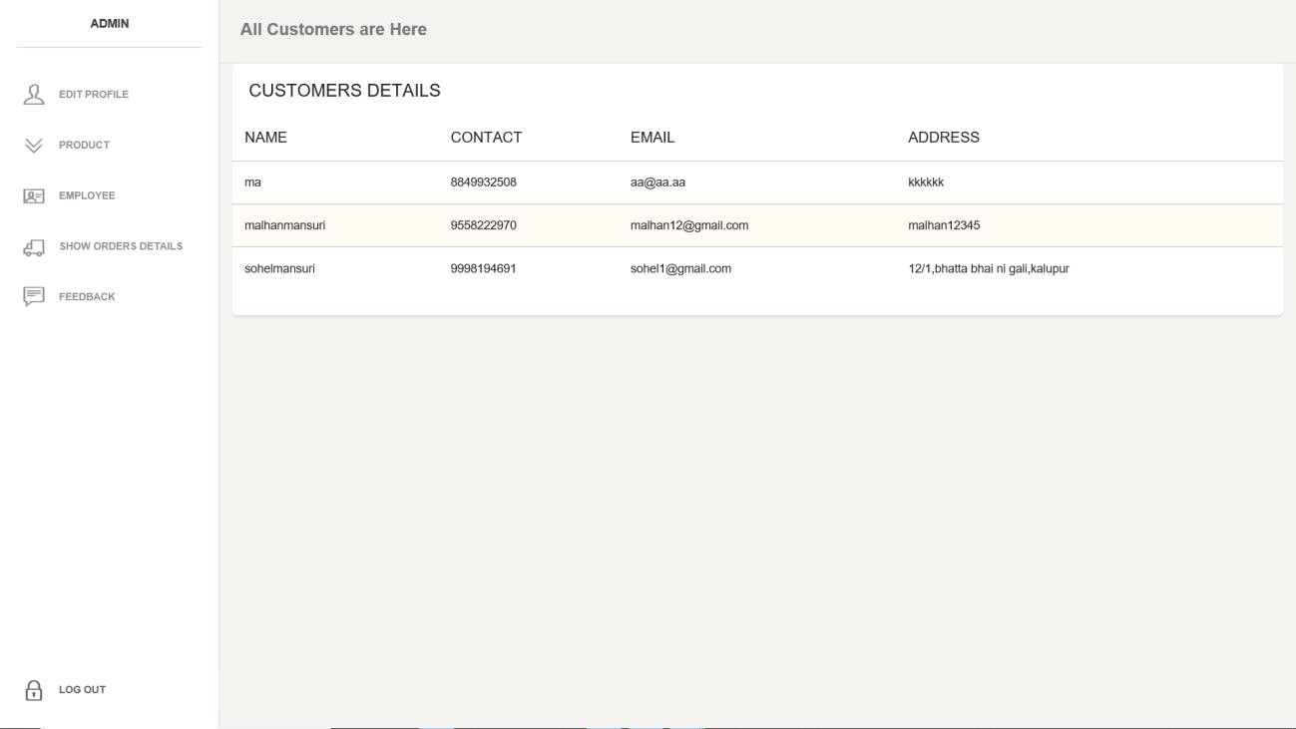
1.9 SEE_CUSTOMERS_DETAILS
ADMIN CAN SEE ALL THE CUSTOMERS DETAILS
(NAME,CONTACT,EMAIL,ADDRESS) FROM HERE.

Slide 14
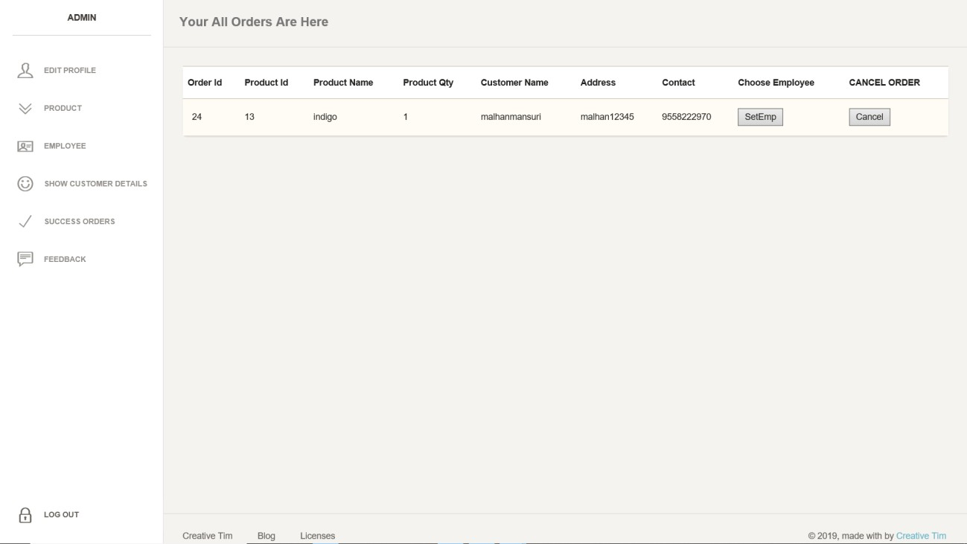
1.10 NEW_ORDERS
ADMIN CAN SEE ALL NEW ORDERS FROM HERE AND ALSO
SET THE EMPLOYEE FOR PRODUCT DELIVER.

Slide 15
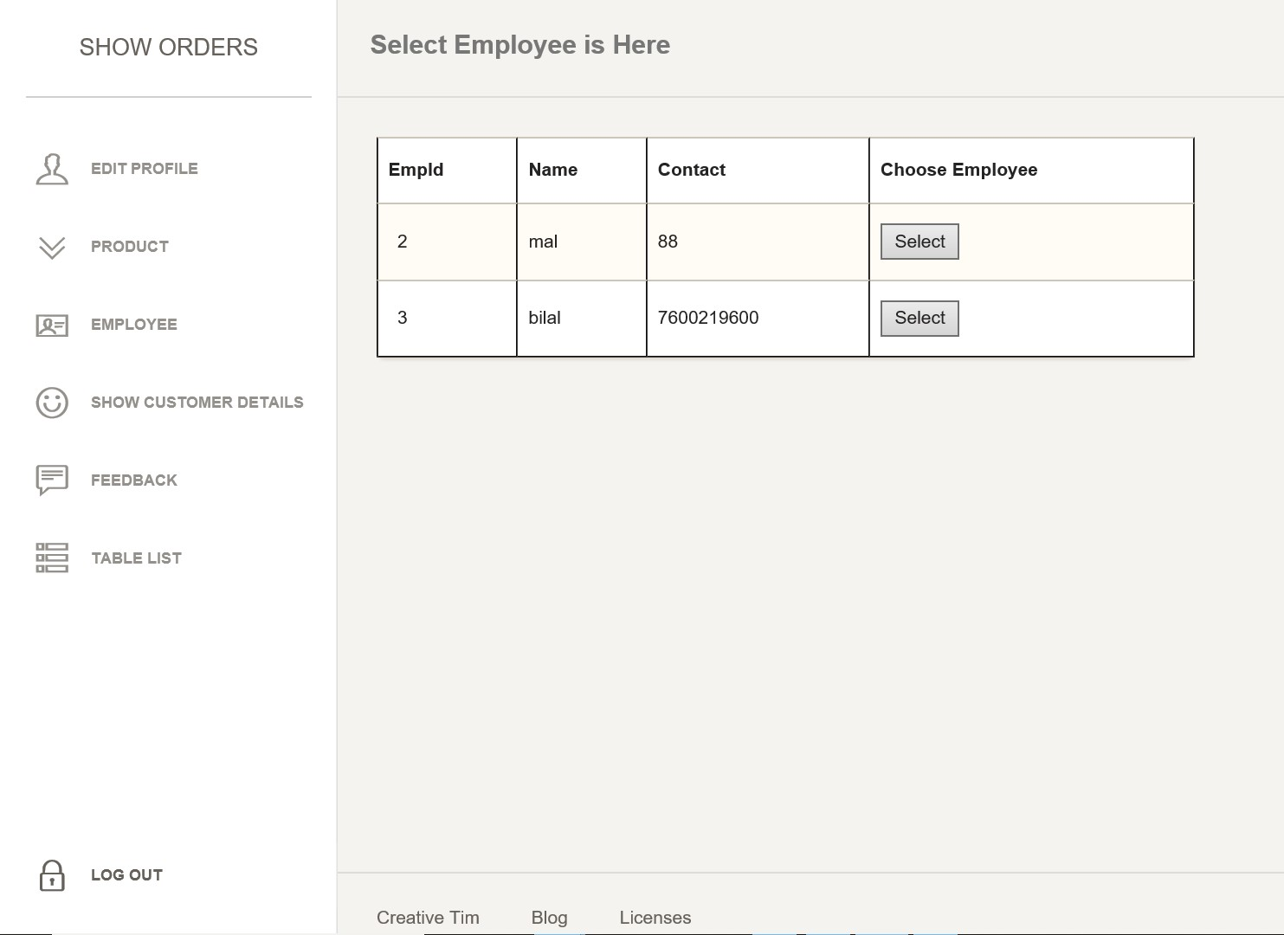
1.11 SELECT_EMPLOYEE
SELECT EMPLOYEE FOR DELIVER PRODUCTS FROM HERE.

Slide 16
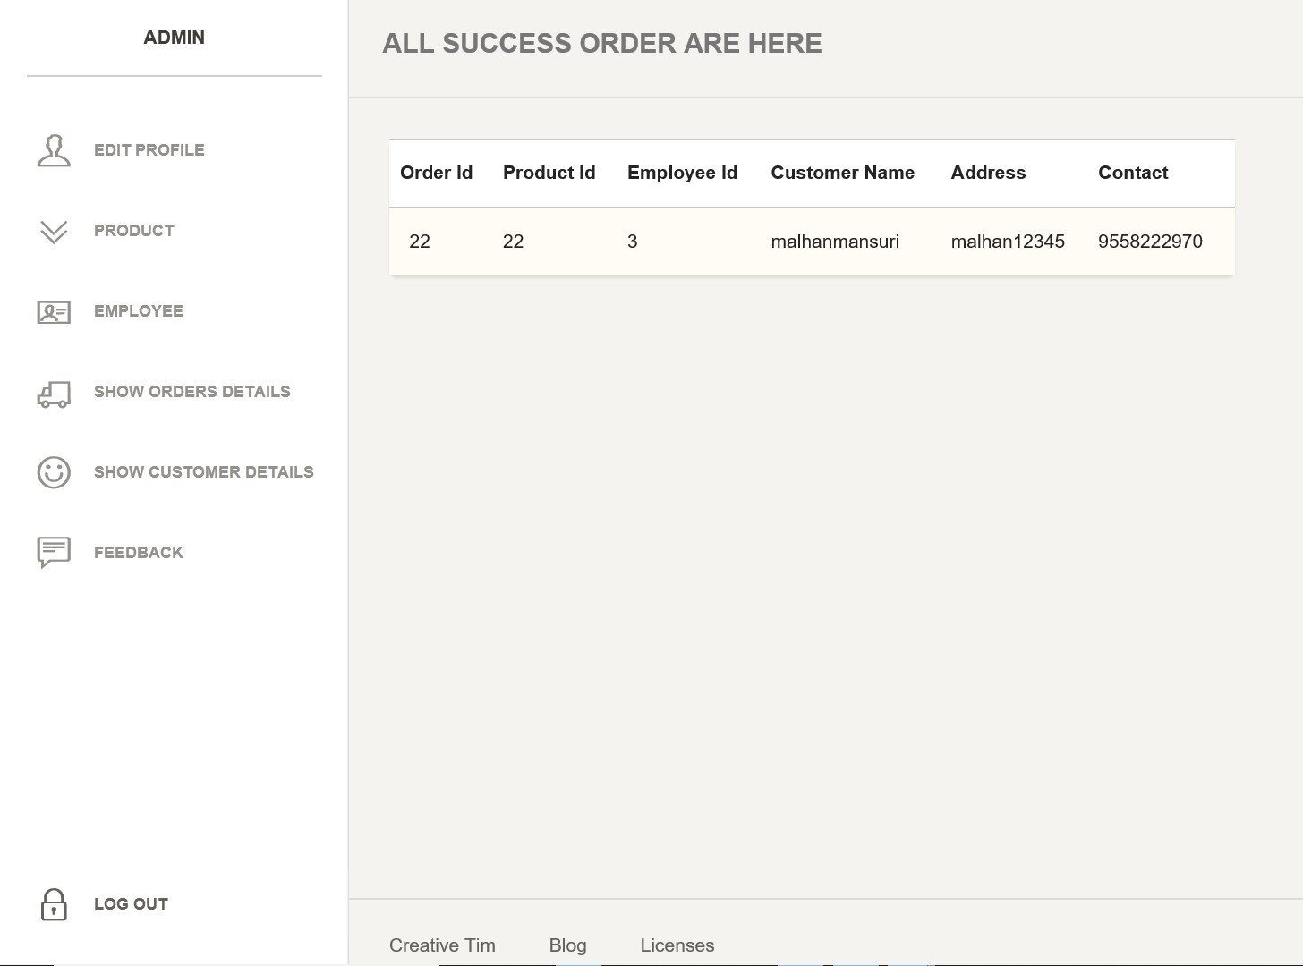
1.12 COMPLITED ORDERS
ADMIN CAN SEE ALL COMPLITE ORDERS.

Slide 17
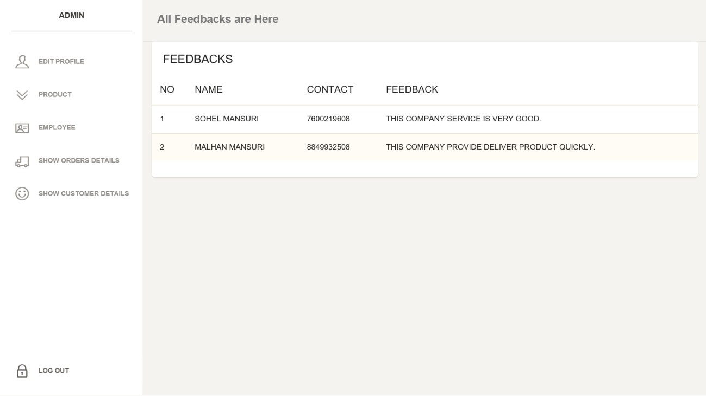
1.13 FEEDBACK
ADMIN CAN VIEW ALL FEEDBACKS FROM HERE.

Slide 18
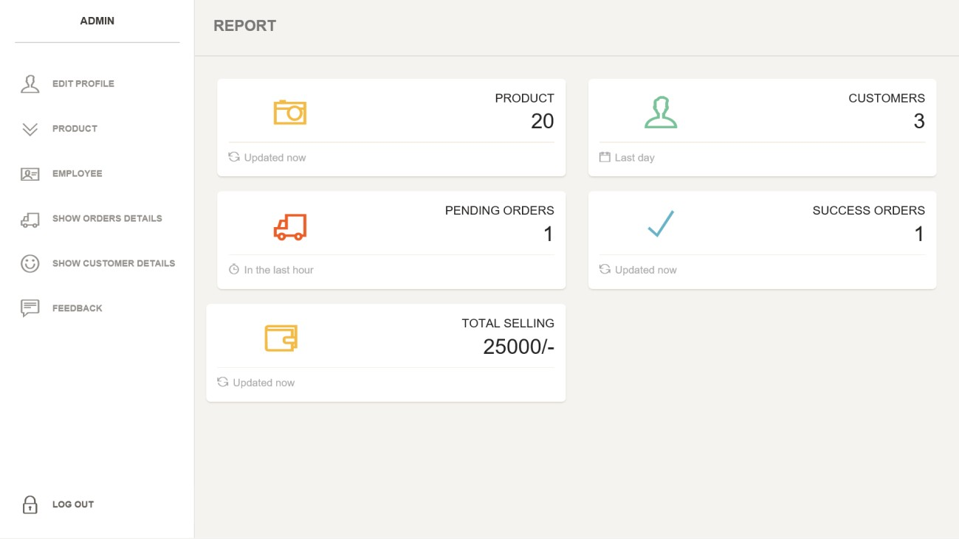
1.12 REPORT
ADMIN CAN VIEW ALL DETAILS ABOUT THE COMPANY.
(TOTAL_PRODUCTS,TOTAL_EMPLOYEE,TOTAL_SELLING, TOTAL_PENDING_ORDERS,TOTAL_COMPLITE_ORDERS, TOTAL_CUSTOMERS).

Slide 19
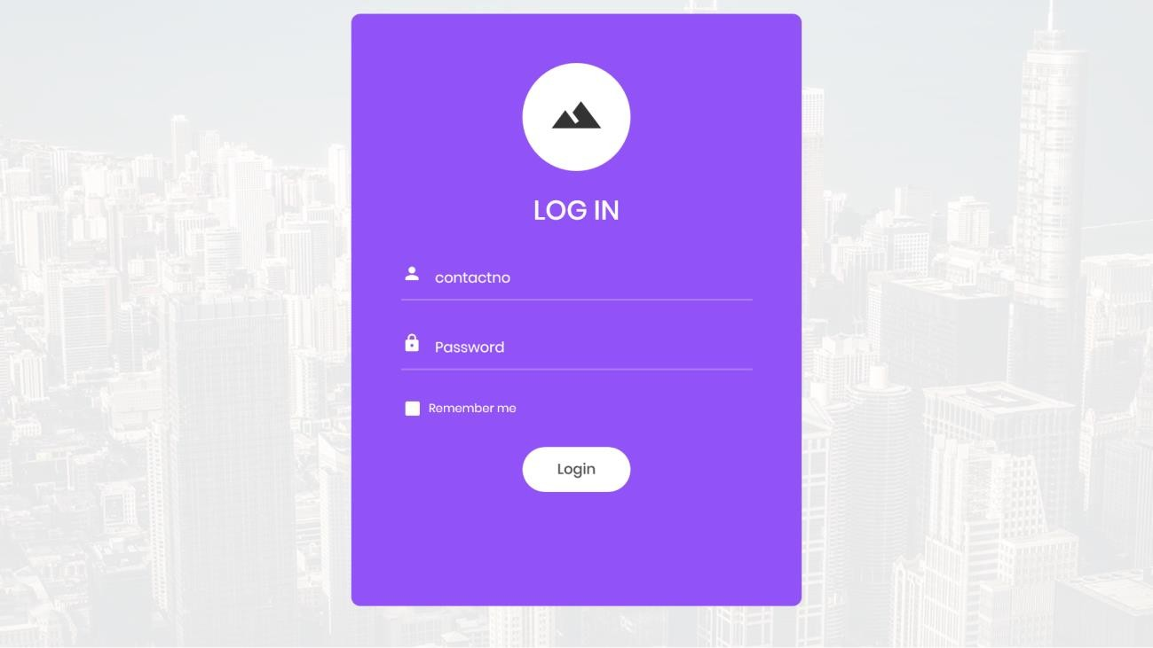
EMPLOYEE
LOGIN
TO ACCESS THE EMPLOYEE PANEL EMPLOYEE NEED TO FIRST
LOGIN.

Slide 20
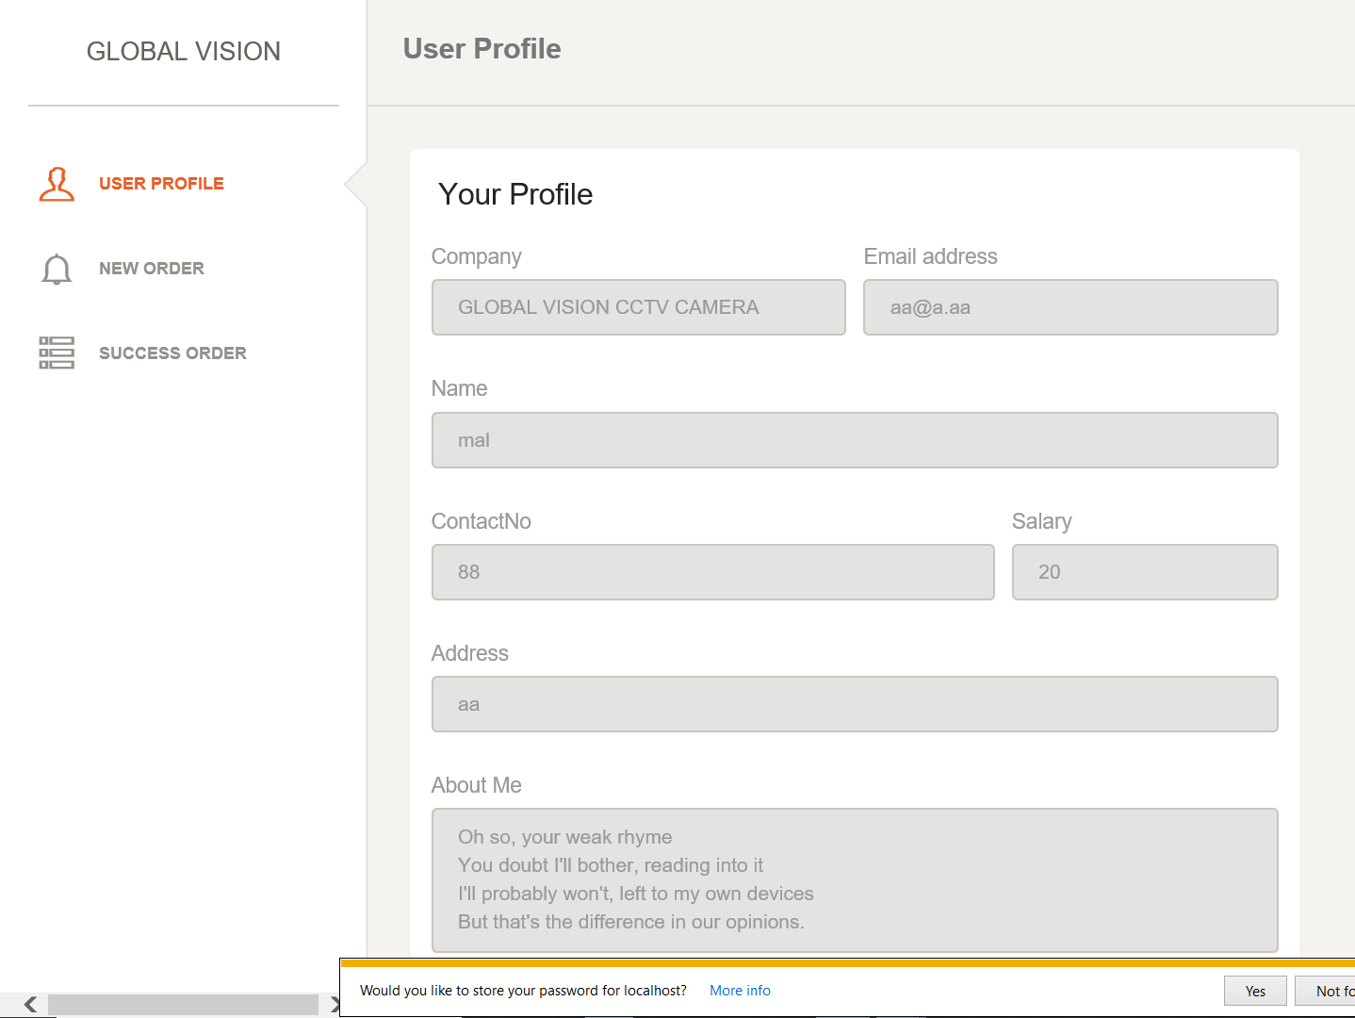
2.2 EMPLOYEE_PROFILE
EMPLOYEE CAN VIEW THE HIS PROFILE HERE.

Slide 21
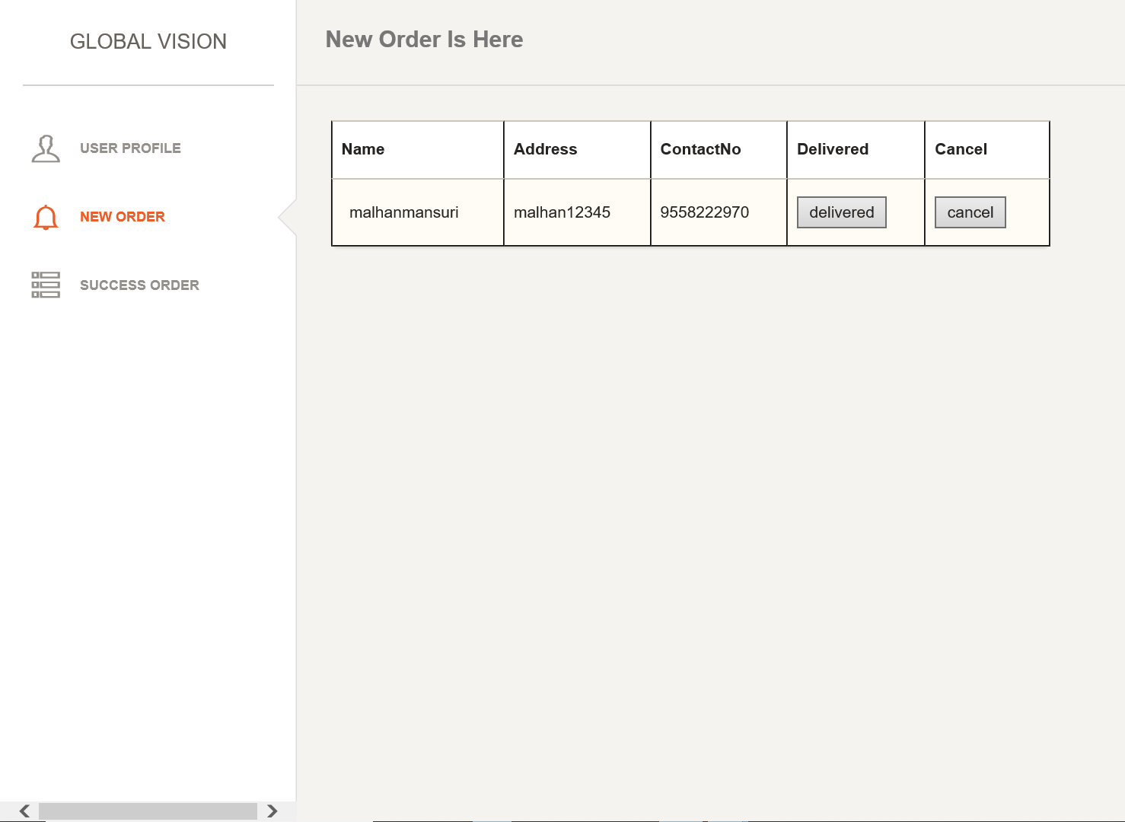
2.3 NEW_ORDER
NEW ORDER FOR DELIVER THE PRODUCT EMPLOYEE CAN VIEW
OR GET HERE.

Slide 22
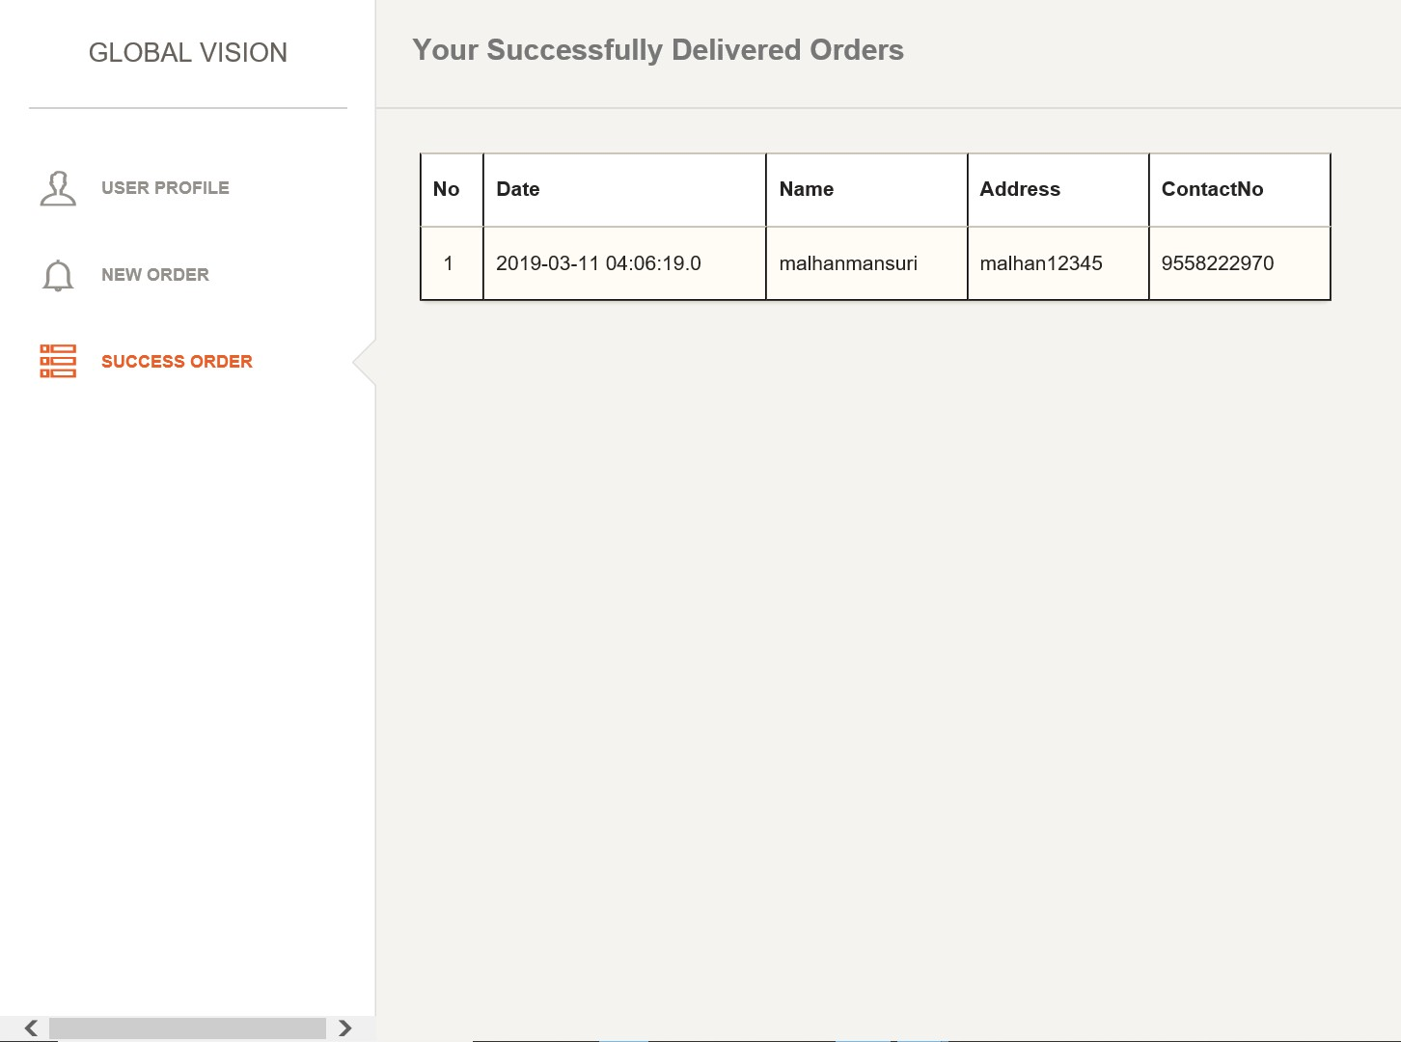
2.4 SUCCESSFULLY_DELIVER_ORDERS
EMPLOYEE CAN VIEW ALL COMPLITE ORDER OF HIM.

Slide 23
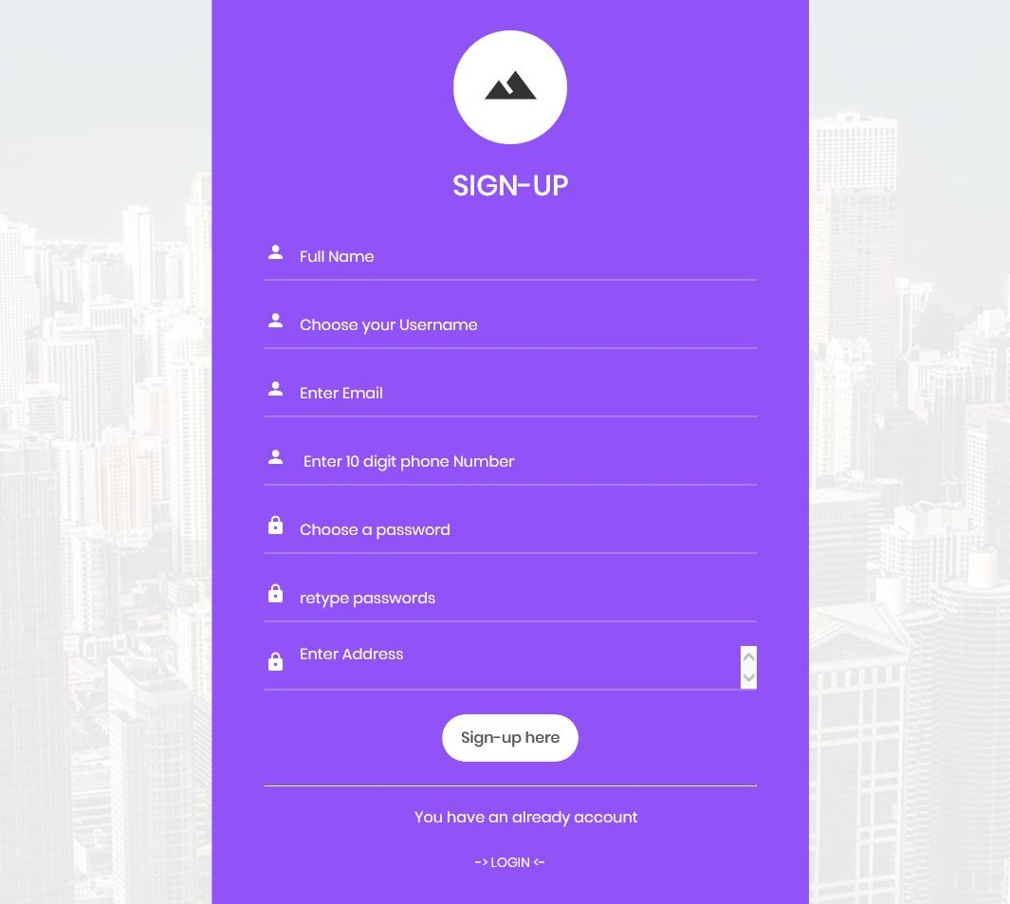
CUSTOMER
SIGN-UP
FIRST NEW CUSTOMER TO NEED SING-UP.
3.2 LOGIN

Slide 24
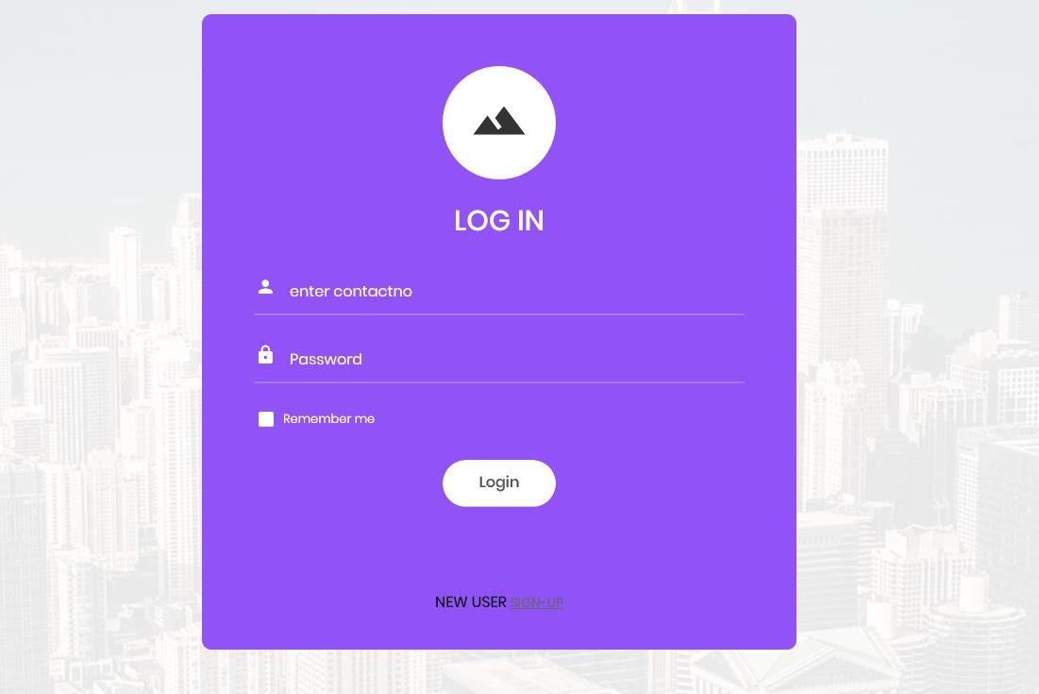
IF CUSTOMER SIGN-UP PROCESS IS COMPLITE AFTER HE CAN
LOGIN WITH HIS CONTACTNO AND PASSWORD WHICH HE SET SIGN-UP TIME.
3.3 HOMEPAGE

Slide 25
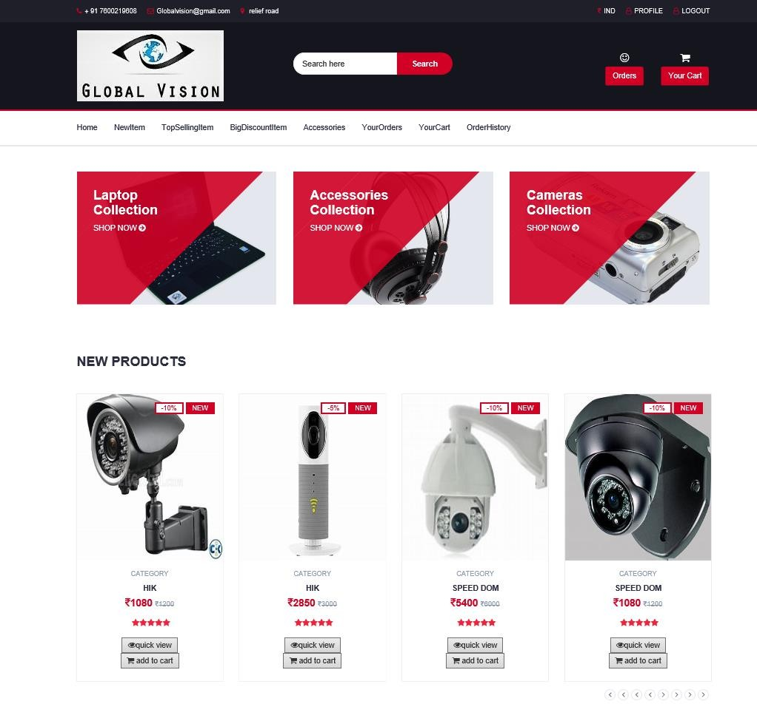
CUSTOMER AND VISITOR BOTH ARE CAN VIEW THIS PAGE. IF
VISITOR WANT TO ORDER PRODUCT OR ADD_TO_CART PRODUCT THAN VISITOR NEED TO (SIGN-UP OR LOGIN).

Slide 26
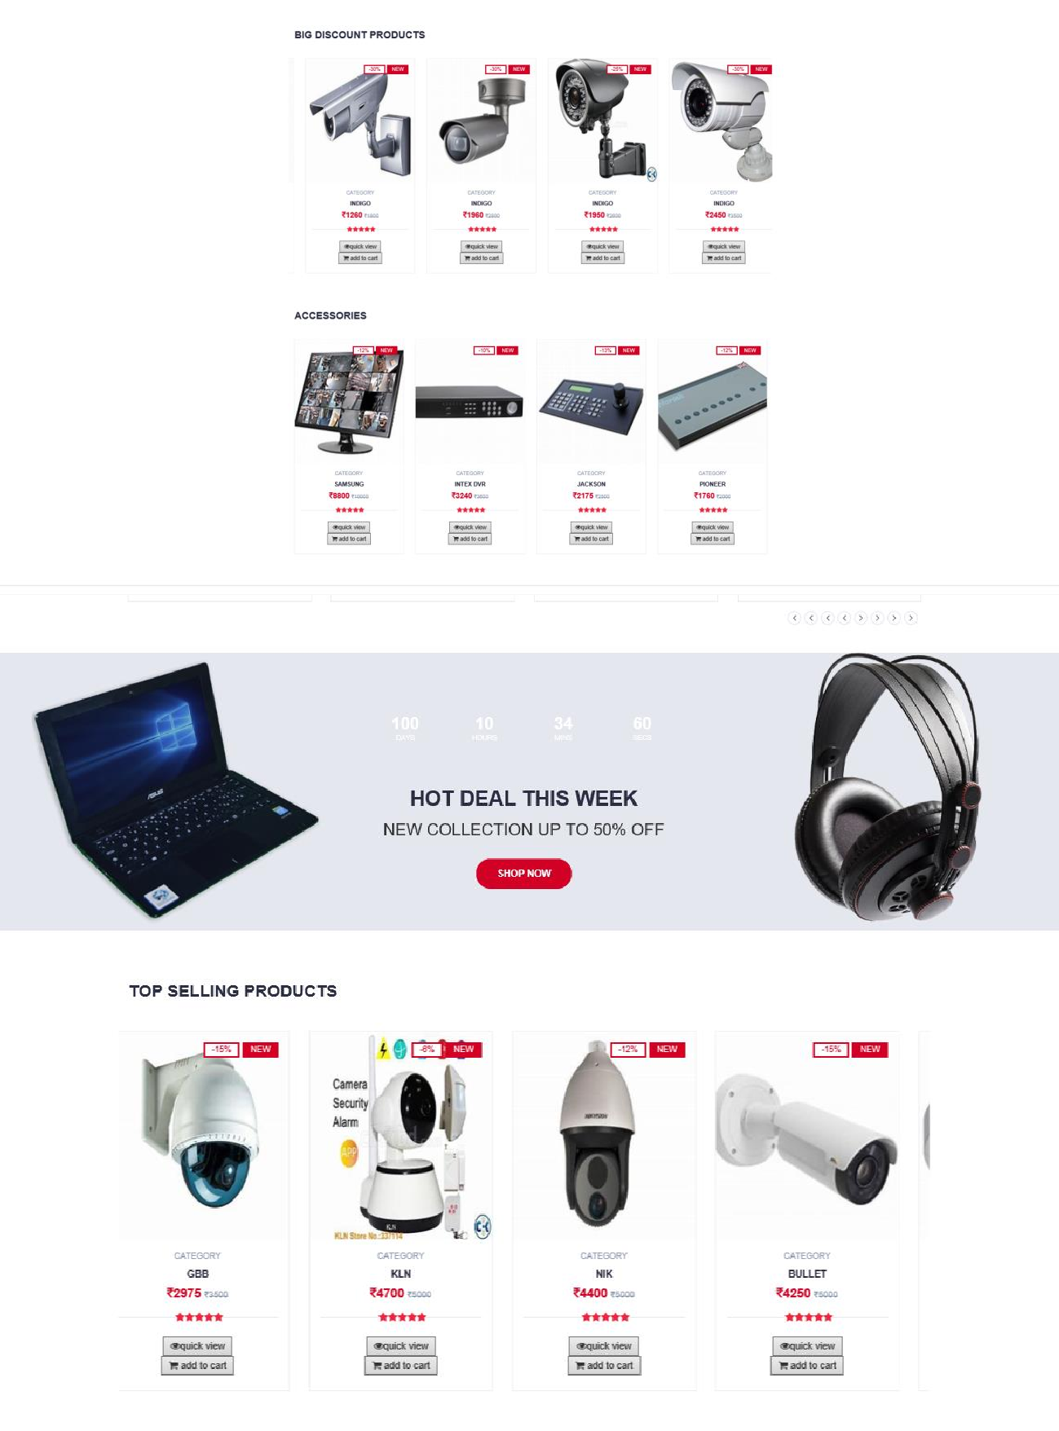

Slide 27
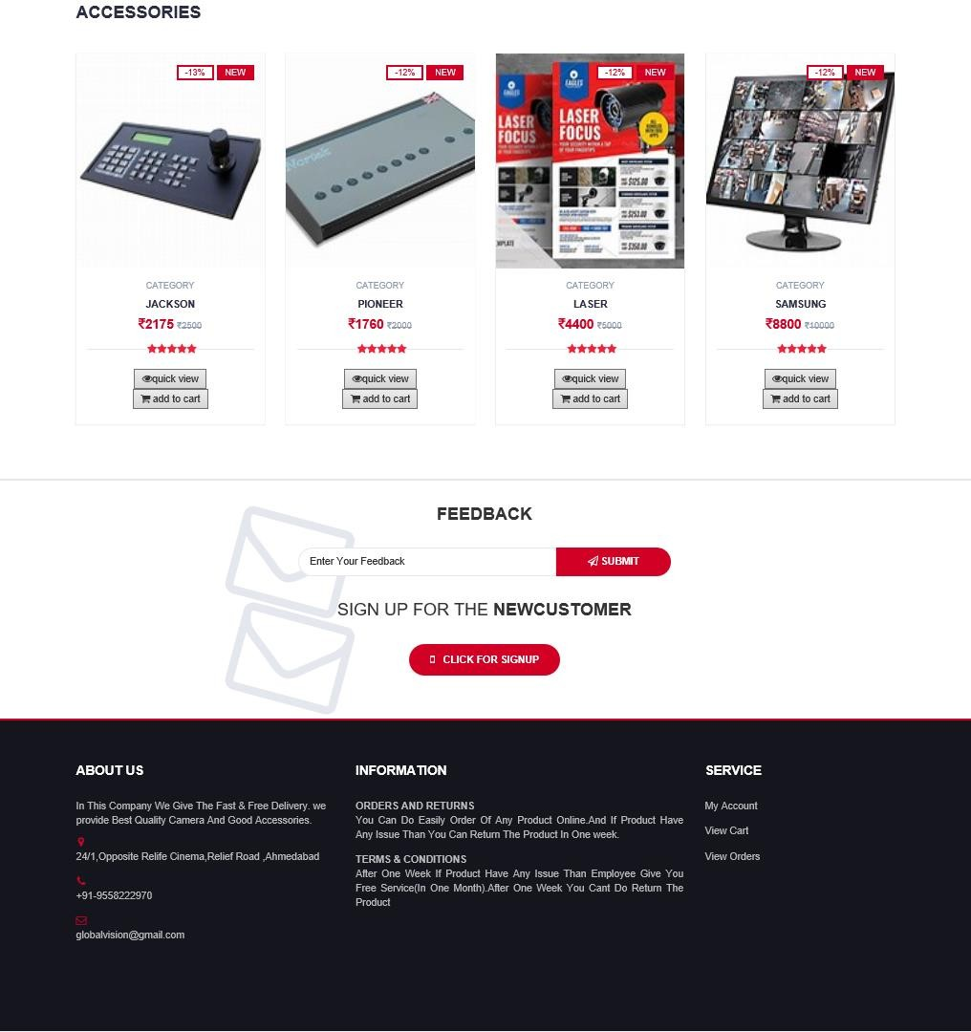

Slide 28
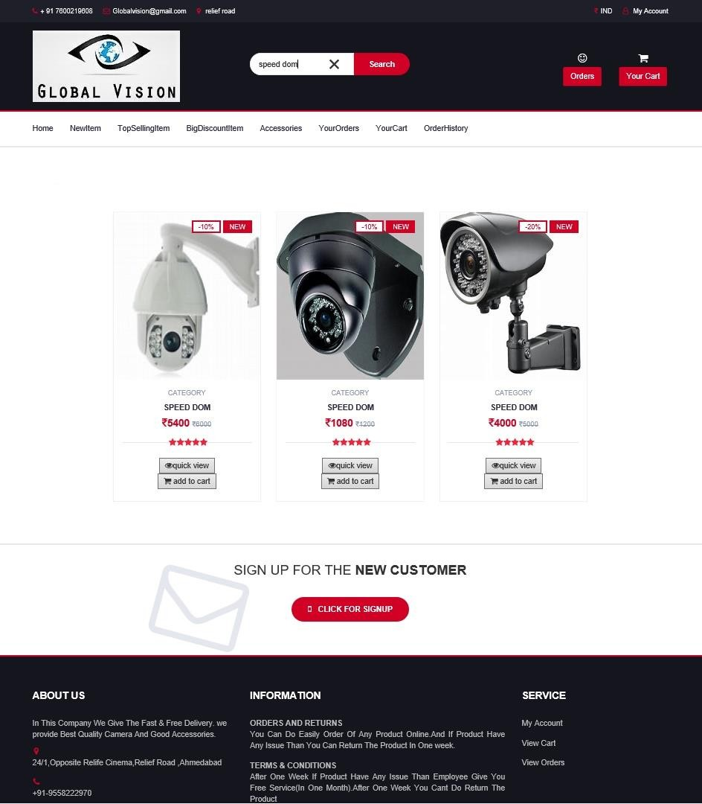
3.4 SEARCH_PRODUCT
CUSTOMER CAN SEARCH THE PRODUCT HERE.AND GET THE RESULT OF SEARCH ITEM.

Slide 29
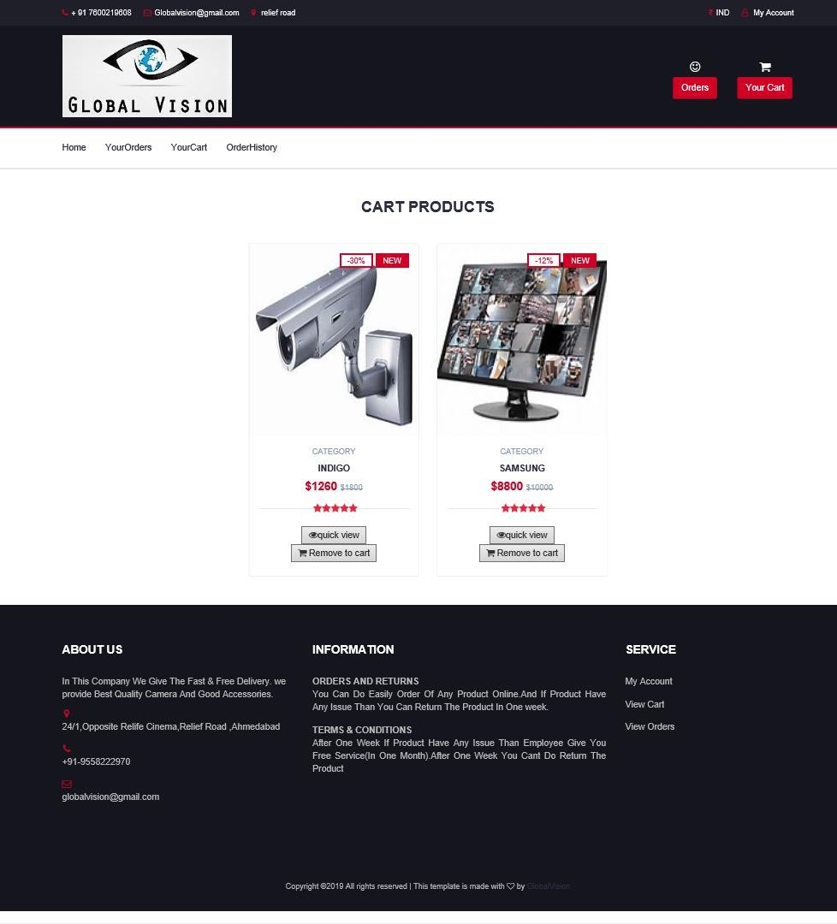
3.5 VIEW_CART
CUSTOMER CAN VIEW PRODUCT WHICH CUSTOMER ADD INTO CART.

Slide 30
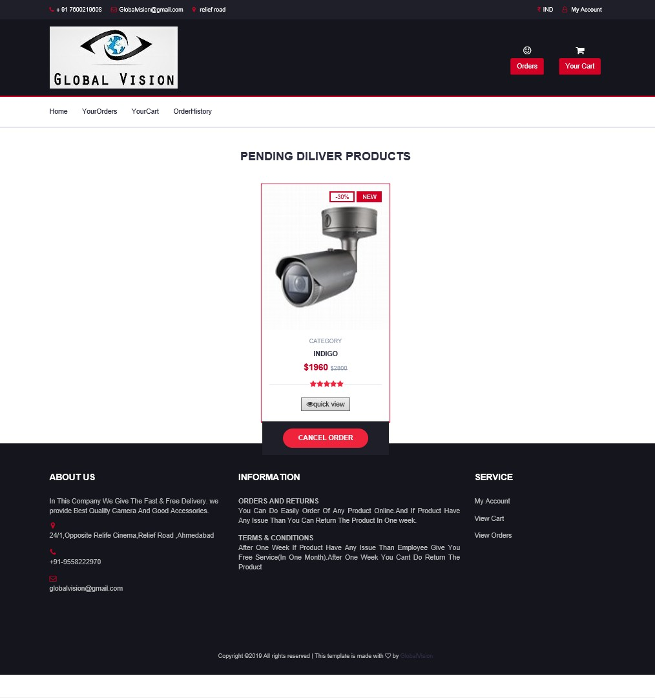
3.6 PENDING_ORDERS
CUSTOMER CAN VIEW THE PENDING ORDERS.PENDING ORDERS THOSE WHO CUSTOMER DO ORDER BUT TILL NOT DELIVER(GET).

Slide 31
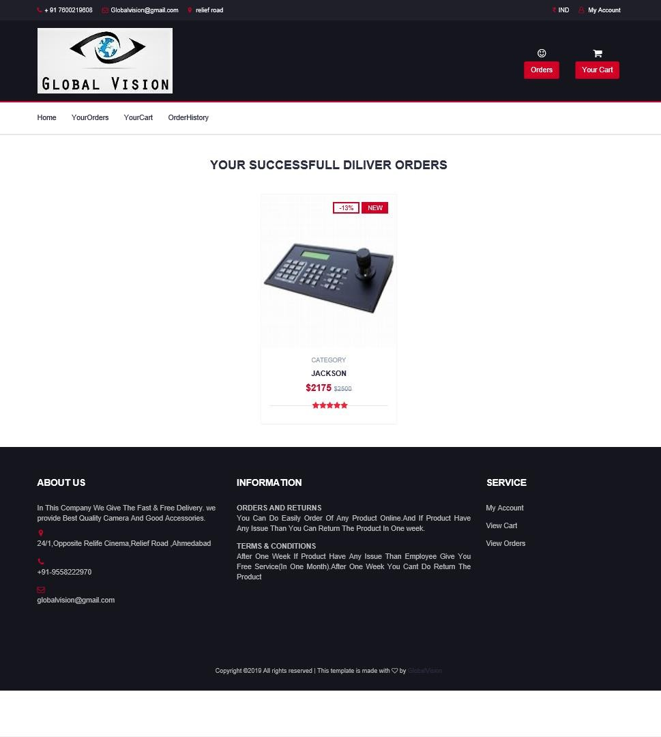
3.7 COMPLITE_ORDERS
CUSTOMER CAN VIEW HIS SUCCESSFULL(COMPLITE) ORDER LIST.

Slide 32
4. BIBLIOGRAPHY:-
REFERRED APPLICATION:
AMAZON
FLIPKART
CONCLUSION
THUS WE CONCLUDE THAT WE ENJOYED VERY MUCH WORKING ON THE PROJECT “ONLINE CCTV CAMERA SELLING & SECURITY SOLUTION”.OUR INTERNAL GUIDE “PRO.MAULIK PATEL”.
HELP US LOT IN IMPROVING THE QUALITY OF OUR PROJECT.
THIS IS THE RESULT OF OUR BEST EFFORT IN MAKING JAVA WEB APPLICATION FOR “ONLINE CCTV CAMERA SELLING & SECURITY SOLUTION”,WORKING VERY SIMPLE,RELIABLE & EFFICIENT.

