Slide 1
Tick-it hub
TANYA MALHOTRA
Northeastern University
malhotra.t@husky.neu.edu

Slide 2
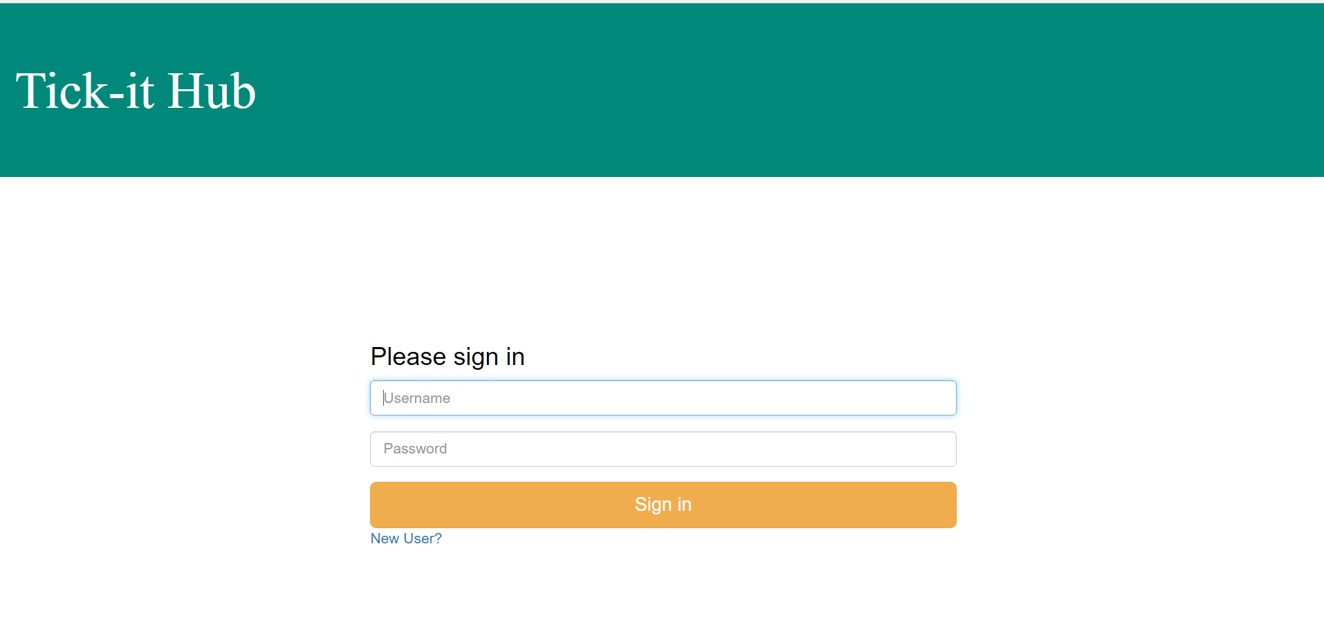
LOGIN PAGE
Allows sign in using username and password.
After successful login, redirected to the home page as per user’s role.
Also, provides link for New User signup page

Slide 3
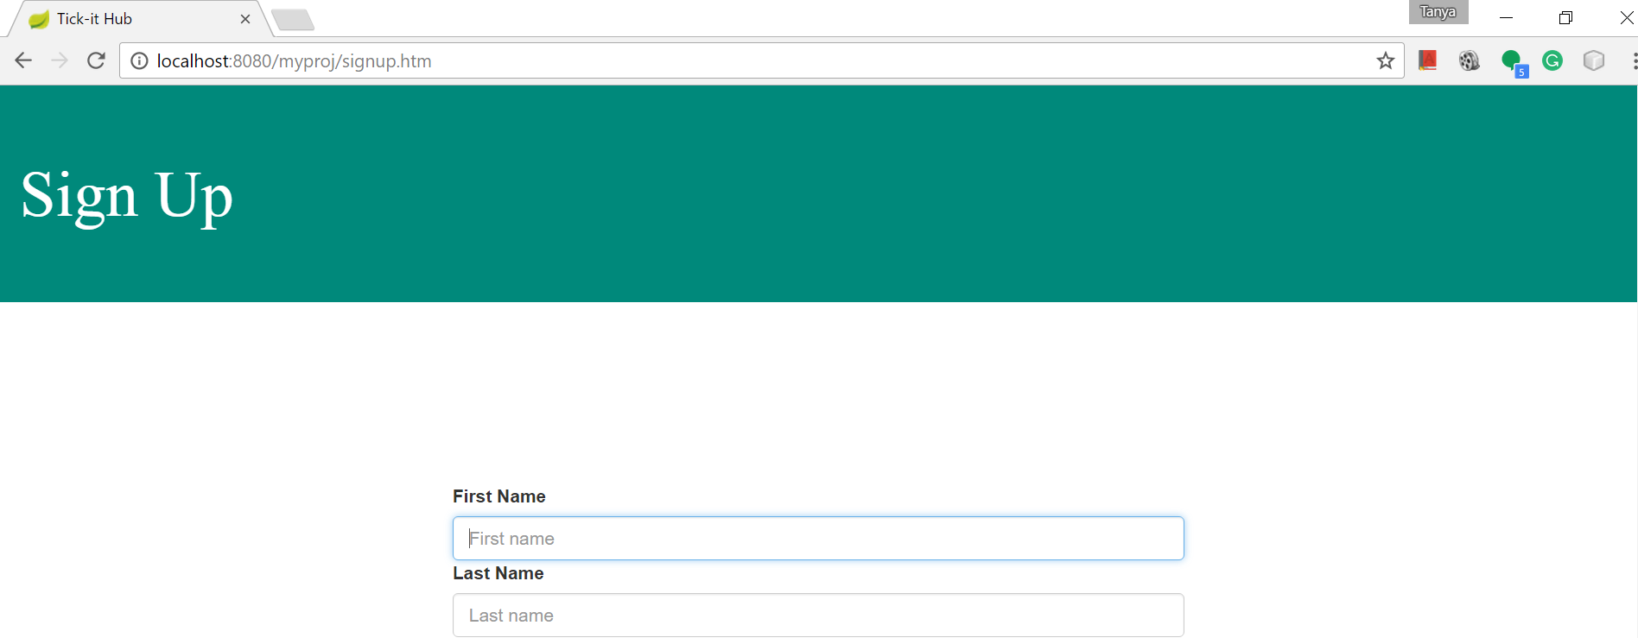
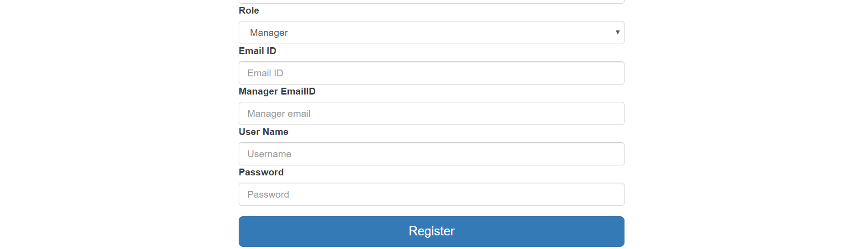
SIGN UP PAGE
Allows New User to sign up for the website.
Requests go to the admin for approval.

Slide 4
Role - ADMIN
Handles New User register/sign up requests.

Slide 5
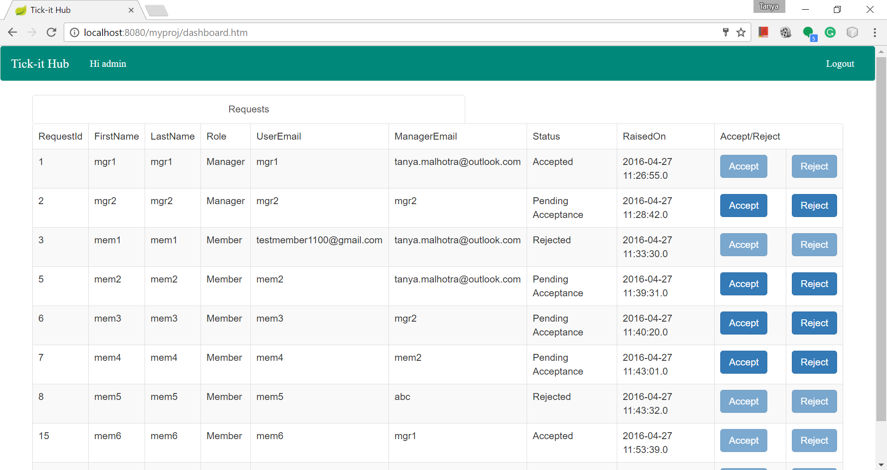
ADMIN – DASHBOARD
Allows New User requests to be accepted or rejected.

Slide 6
ROLE - Team member
Handles “Incidents” – occurrence of a disruption in service or concern with product quality

Slide 7
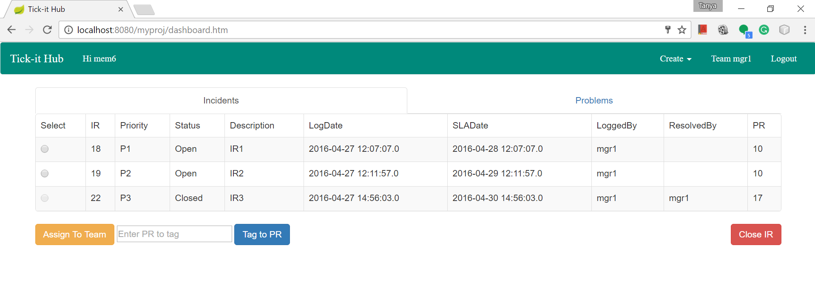
TEAM MEMBER – DASHBOARD
Allows closing individual Incident tickets.
Allows assigning the ticket to another team.
Allows tagging/tracking the ticket to a Problem ticket.

Slide 8
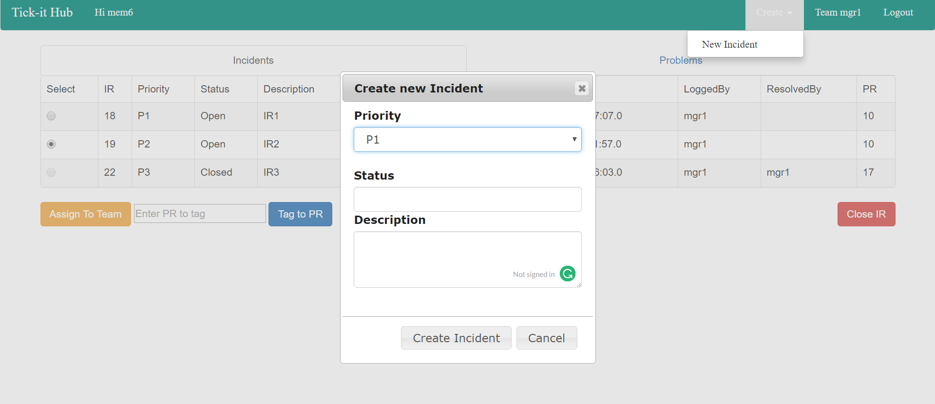
TEAM MEMBER – DASHBOARD (Continued)
Allows creation of new Incident tickets.

Slide 9
Role - MANAGer
Handles “Problems” – collection of incidents having a similar nature or root cause.

Slide 10
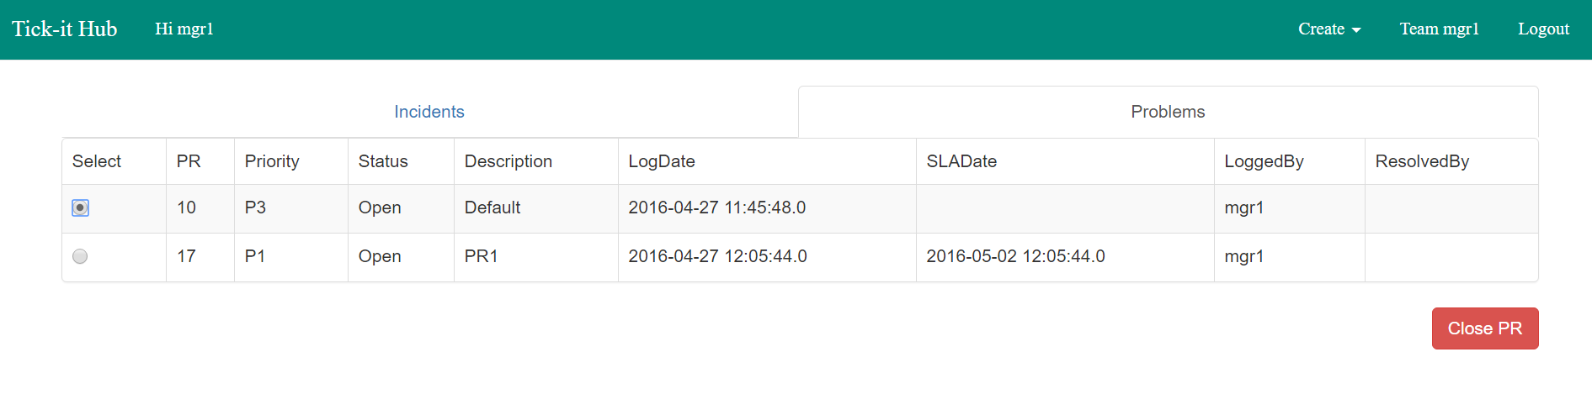
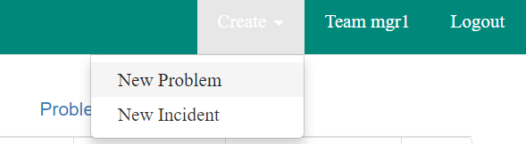
MANAGER – DASHBOARD
Allows closing Problem (collection of incidents) and Incident tickets.
Allows creation of new Problem and Incident tickets.

