Slide 1
Cervical Cancer Diagnosis Using Random Forest Classifier With SMOTE and Feature Reduction Techniques SHERIF F. ABDOH , MOHAMED ABO RIZKA, AND FAHIMA A. MAGHRABY Department of Computer Science, Arab Academy for Science, Technology and Maritime Transport, Cairo 1029, Egypt Corresponding author: Sherif F. Abdoh (sherif.fayz@outlook.com) IEEE ACCESS ( ISSN / eISSN : 2169-3536 ) Received August 29, 2018, accepted September 26, 2018, date of publication October 5, 2018, date of current version October 31, 2018. Digital Object Identifier 10.1109/ACCESS.2018.2874063
By: 1806064 – Anant Malhotra

Slide 2
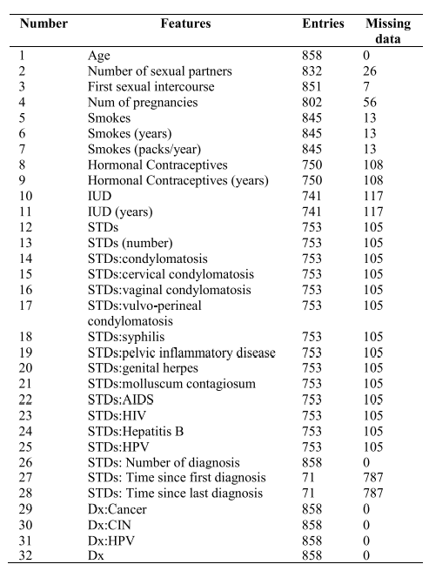
CERVICAL CANCER DATASET
The used dataset was published on the repository of University of California at Irvine (UCI) collected at Hospital Universitario de Caracas in Caracas, Venezuela.
The dataset comprises historical medical records, habits and demographic information for 858 cases with 32 features for each case.
The features - Age, STDs: Number of diagnosis, Dx:Cancer, Dx:CIN, Dx:HPV, Dx are of Integer type; rest all are of String type.
4 target variables : Hinselmann, Schiller, Cytology and Biopsy.
From given table it is found that there are a lot of missing values in features 27 and 28, so feature 27 and 28 are removed.

Slide 3


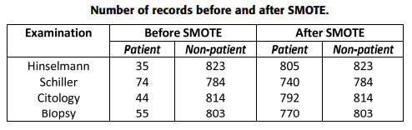
PRE PROCESSING AND SMOTE OVERSAMPLING
The mean equation is used to handle the missing values.
Dataset is unbalanced as the number of negative class records is larger than the positive class. So, SMOTE oversampling technique is used to solve the unbalanced problems.
SMOTE is used to synthetically increase the minority class based on k-nearest neighbours.
SMOTE technique uses the following equation to synthetically increase the minority class.
The given table shows that before SMOTE the dataset was imbalanced and after the implementation of SMOTE algorithm it ends up with almost balancing the dataset.

Slide 4
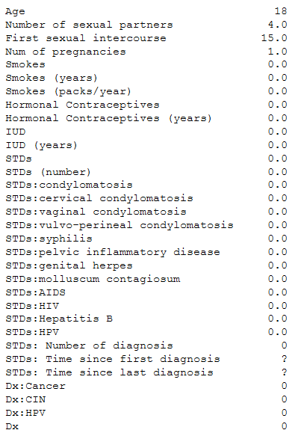
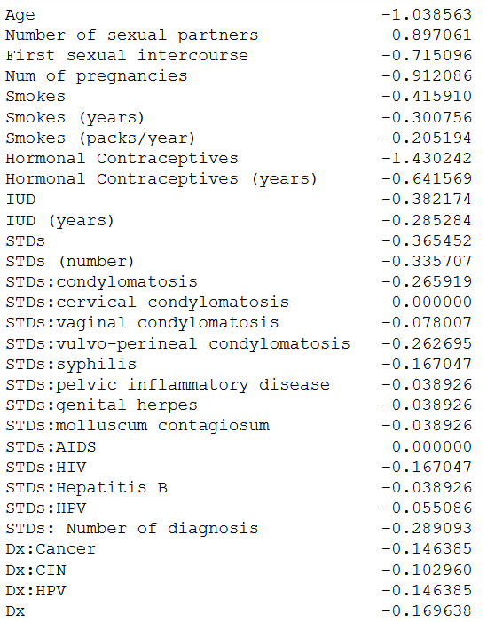
SAMPLE ROW BEFORE & AFTER PREPROCESSING AND SCALING

Slide 5
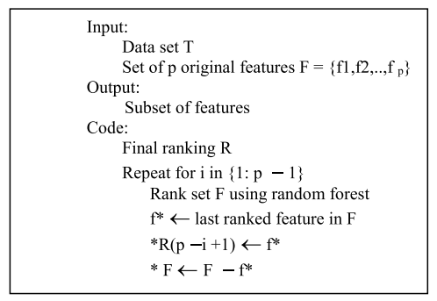
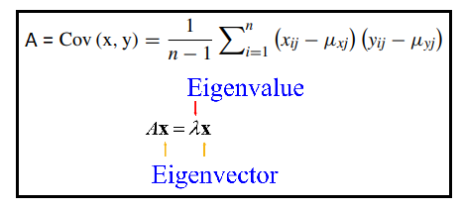
FEATURE SELECTION
The model uses two feature selection (dimensionality reduction) methods which are Principle Component Analysis (PCA) and Recursive Feature Elimination (RFE).
The main idea of PCA is to map the n-dimension feature space into k-dimension which is also known as principle component where k < n.
The covariance matrix is computed whereby the result is used to calculate the eigenvectors and eigen values. The eigen vector with the highest eigen value is chosen as the principle component of the dataset as it exhibits the most significant relationship between the data set attributes.
RFE is basically a backward selection of the predictors. This technique begins by building a model on the entire set of predictors and computing an importance score for each predictor. The least important predictor(s) are then removed, the model is re-built, and importance scores are computed again.

Slide 6
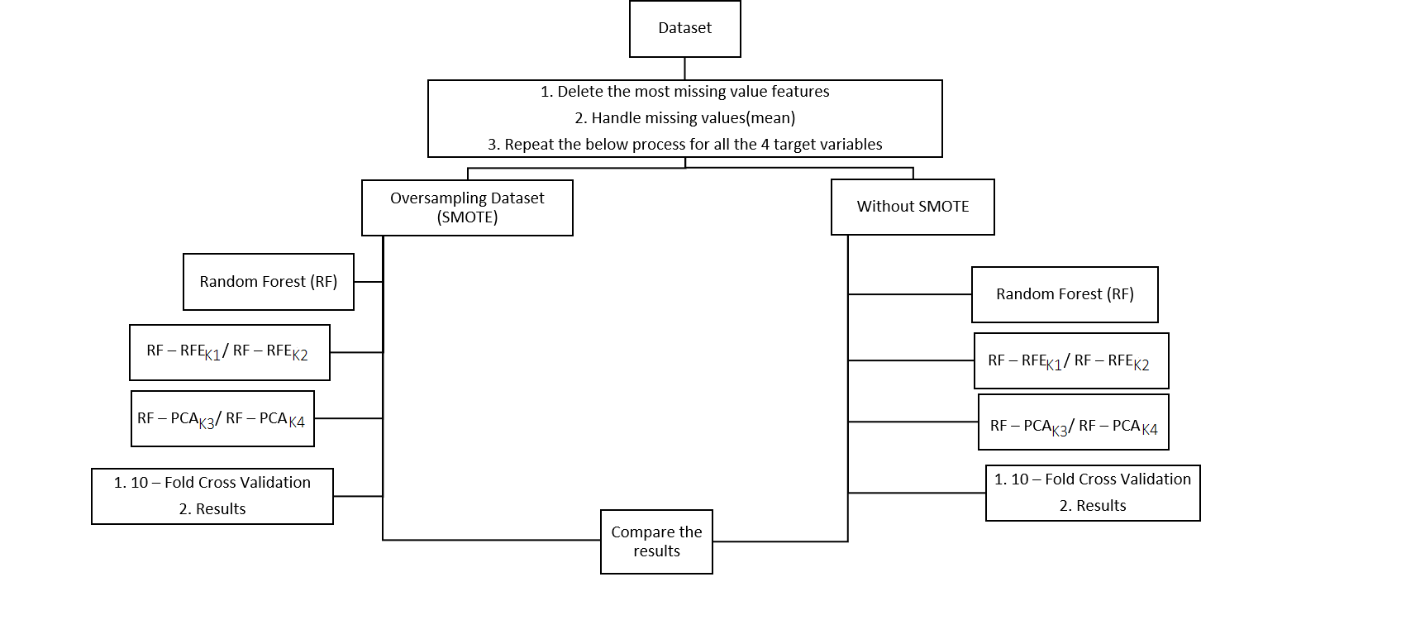
PROPOSED MODEL
The main idea of our model is to diagnose cervical cancer using random forest with SMOTE and two feature reduction techniques.
The variables K1, K2, K3 and K4 represent the number of selected features. (Their values are taken from the paper)

Slide 7
RANDOM FOREST CLASSIFIER
Random Forest (RF) is a supervised classification technique that works on the principle of using group of weak learners to form a strong learner.
The construction of RF can be described in the following steps.
Generates N number of bootstrap samples from the dataset.
Each node takes a random sample of attributes of size m where m < M. (M refers to the total number of attributes).
Constructs a split using the m attributes selected in Step 2 and calculates the k node using the best split point. (‘‘k’’ refer to next node).
Repeats splitting the tree until only 1 leaf node is reached and the tree is completed.
The algorithm is trained on each bootstrapped separately.
Uses the trees classification voting to collect the prediction data from the (n) trained trees.
Uses the highest voted features to build the final RF model.

Slide 8
PERFORMANCE COMPARISON (PROPOSED vs IMPLEMENTED)
Hinselmann (Proposed Model)
 | RF | RF-RFE |  | RF-PCA |  | SMOTE-RF | SMOTE-RF-RFE |  | SMOTE-RF-PCA
#Features | 30 | 5 | 15 | 5 | 11 | 30 | 5 | 15 | 5 | 11
Accuracy | 95.92 | 95.33 | 95.80 | 96.03 | 95.92 | 97.60 | 95.14 | 95.88 | 97.42 | 97.48
Hinselmann (Implemented Model)
Accuracy | 95.68 | 95.45 | 95.68 | 95.57 | 95.45 | 97.39 | 96.41 | 97.45 | 89.97 | 94.10
Schiller (Proposed Model)
 | RF | RF-RFE |  | RF-PCA |  | SMOTE-RF | SMOTE-RF-RFE |  | SMOTE-RF-PCA
#Features | 30 | 7 | 18 | 6 | 12 | 30 | 7 | 18 | 6 | 12
Accuracy | 91.49 | 90.79 | 91.25 | 90.56 | 90.91 | 95.01 | 91.73 | 92.91 | 94.49 | 94.88
Schiller (Implemented Model)
Accuracy | 90.55 | 90.79 | 90.32 | 90.09 | 90.20 | 94.83 | 94.32 | 94.58 | 89.41 | 92.92

Slide 9
Citology (Proposed Model)
 | RF | RF-RFE |  | RF-PCA |  | SMOTE-RF | SMOTE-RF-RFE |  | SMOTE-RF-PCA
#Features | 30 | 8 | 15 | 8 | 11 | 30 | 8 | 15 | 8 | 11
Accuracy | 94.52 | 93.47 | 94.17 | 94.52 | 94.63 | 96.94 | 92.52 | 95.89 | 96.39 | 96.89
Citology (Implemented Model)
Accuracy | 94.40 | 94.87 | 94.52 | 94.75 | 94.40 | 96.00 | 94.96 | 95.94 | 92.25 | 92.93
Biopsy (Proposed Model)
 | RF | RF-RFE |  | RF-PCA |  | SMOTE-RF | SMOTE-RF-RFE |  | SMOTE-RF-PCA
#Features | 30 | 6 | 18 | 8 | 11 | 30 | 6 | 18 | 8 | 11
Accuracy | 93.70 | 93.12 | 93.24 | 93.24 | 93.24 | 96.06 | 95.23 | 95.87 | 95.55 | 95.74
Biopsy (Implemented Model)
Accuracy | 93.70 | 93.24 | 93.35 | 93.47 | 93.12 | 97.01 | 95.58 | 96.32 | 91.90 | 93.34

