Slide 1
Joint Encryption and Watermarking Scheme for Security of Medical Images
Mentored by:
Dr. Amit Kumar Singh
Assistant Professor
Computer Science and Engineering Department
National Institute of Technology Patna
Presented by:
Anant Malhotra (1806064)
Kalpesh Kumar Singh (1806059)
Smriti Pal (1806191)

Slide 2
Introduction
Due to Advancement of Information and Communications Technologies (ICT) large volume of multimedia data are transmitted through the internet [5,6].
Significant medical data is stored on the server and cloud platforms [2].
Broadened attack surface due to Major expansion of telehealth services during COVID-19 pandemic.
Serious Security Issue – Ease of copying, storage, deletion or modification of digital data.
Notable mechanism is needed to fulfil the following security requirements - Confidentiality, Authenticity, and Integrity.
Digital Imaging and Communications in Medicine (DICOM) - standard for transmitting EPR data over the internet [2].
Issues – management of the attached header file, extra bandwidth, data loss

Slide 3
Joint Cryptography and Watermarking
Cryptographic techniques fulfill confidentiality but fail to provide Integrity and Authenticity.
Digital Watermarking imperceptibly embeds secret data into the cover media - fulfilling Authenticity and Integrity properties.
Fusion of cryptography and watermarking to achieve higher levels of security.
Tradeoff between robustness, imperceptibility and payload.
Novel Applications – Healthcare, Copyright Protection, Tamper Proofing, Covert Communication, etc.

Slide 4
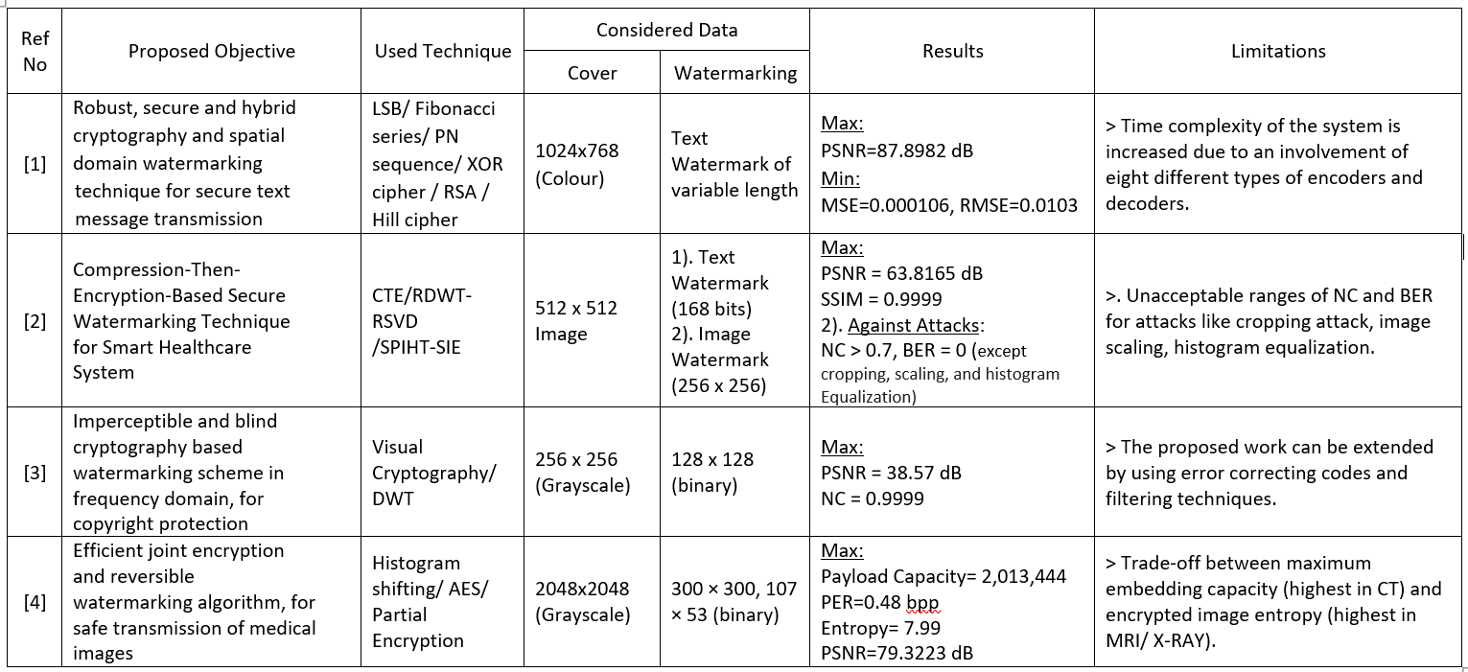
Literature Review

Slide 5
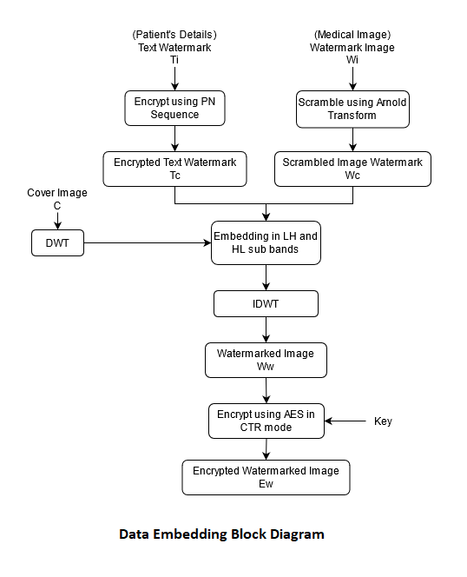
Proposed Algorithm – Data Embedding

Slide 6
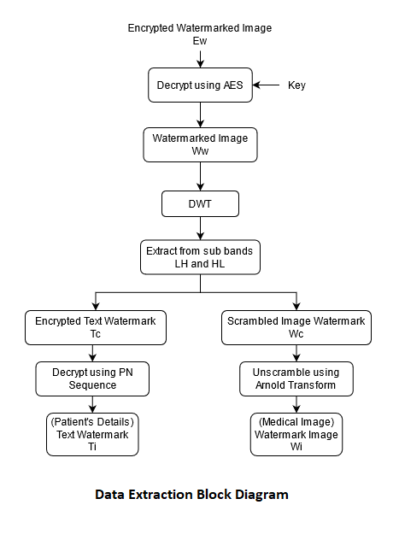
Proposed Algorithm – Data Extraction

Slide 7
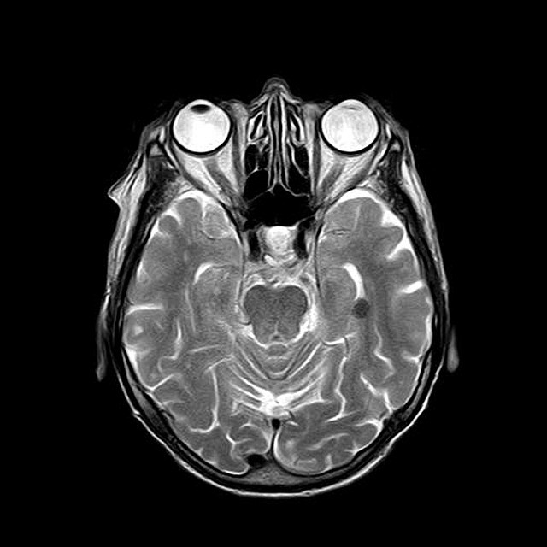
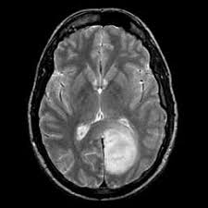
Sample of Images and Text Data
This is a Test Message for patient 1245789 details
Cover Image
512 x 512 Grayscale
Image Watermark
256 x 256 Grayscale
Text Watermark
Encrypted and Watermarked Image
512 x 512 Grayscale
Image Source - https://pixabay.com/illustrations/

Slide 8
Experimental Analysis and Results
Number of Changing Pixel Rate (NPCR), and Unified Averaged Changed Intensity (UACI) helps in describing the efficiency of the encryption scheme.
The acceptable value = 36.7% (>33%) of UACI is obtained along with NPCR of 100% (>99%) for AES – CTR Encryption.
We evaluated our work by varying the gain factor (α) (At fixed character length = 22) and the results obtained are illustrated in Table 1.
Table 1. Performance analysis at varying gain.
Gain Factor (α) | MSE | PSNR (dB) | SSIM | NC
0.001 | 0.0015 | 76.12 | 0.9999 | 0.9960
0.005 | 0.0396 | 62.15 | 0.9995 | 0.9960
0.01 | 0.1586 | 56.13 | 0.9981 | 0.9961
0.05 | 3.9661 | 42.15 | 0.9565 | 0.9961
0.1 | 15.864 | 36.13 | 0.8553 | 0.9961
0.5 | 396.61 | 22.15 | 0.3450 | 0.9962

Slide 9
To further validate the suggested work, it is tested for text watermarks of different sizes (At fixed gain factor α = 0.005). The results for the same are produced in Table 2.
Table 2. Performance analysis for various length of text watermark.
Text Size | MSE | PSNR (dB) | SSIM | NC
10 | 0.0396 | 62.15 | 0.9995 | 0.9960
22 | 0.0396 | 62.15 | 0.9995 | 0.9960
34 | 0.0396 | 62.14 | 0.9995 | 0.9960
50 | 0.0397 | 62.14 | 0.9995 | 0.9960
101 | 0.0398 | 62.13 | 0.9995 | 0.9960
Furthermore, the work is subjected to various attacks for testing the robustness and the values of standard metrics along with the visual displays are displayed in Table 3.

Slide 10
Table 3. Performance parameters for different attacks.
Attack | Noise Density | NC | BER (%)
Salt & Pepper Noise | 0.0001 | 0.9955 | 0
 | 0.001 | 0.9791 | 0
 | 0.01 | 0.8863 | 0
Gaussian Noise | Mean = 0, Var = 0.0005 | 0.9574 | 0
 | Mean = 0, Var = 0.005 | 0.9406 | 0
 | Mean = 0, Var = 0.05 | 0.9031 | 0.25
 | Mean = 0, Var = 0.5 | 0.7353 | 0.50
 | Mean = 1, Var = 0.0005 | 0.9559 | 0
 | Mean = 1, Var = 0.005 | 0.9409 | 0
 | Mean = 1, Var = 0.05 | 0.9008 | 0.25
 | Mean = 1, Var = 0.5 | 0.7395 | 0.50
Speckle Noise | Mean = 0, Var = 0.0001 | 0.9361 | 0
 | Mean = 0, Var = 0.001 | 0.8887 | 0
 | Mean = 0, Var = 0.0025 | 0.8465 | 0.25
 | Mean = 0, Var = 0.01 | 0.7626 | 0.25
 | Mean = 0, Var = 0.025 | 0.7043 | 0.50
 | Mean = 0, Var = 0.25 | 0.6337 | 1.00
JPEG Compression | QF = 10 | 0.8957 | 0.25
 | QF = 50 | 0.9246 | 0
Rotation | 1º | 0.7361 | 2.25

Slide 11
Conclusion
In this project, we have developed a dual watermarking technique to protect the EPR data.
We used a combination of DWT, Arnold Transform, PN Sequence and AES-CTR to ensure the robustness and security of EPR.
The results show good performance in terms of imperceptibility, robustness, and security.
In future, we can implement machine learning, deep learning, and other optimization techniques to further improve the performance.
We can also test the proposed work for some other practical applications.

Slide 12
References
[1]. A Kaur and S Singh, “A hybrid technique of cryptography and watermarking for data encryption and decryption”, IEEE, 2016.
[2]. A Anand, A Singh, Z Lv, G Bhatnagar, “Compression-then-Encryption based Secure Watermarking Technique for Smart Healthcare System”, IEEE Multi-Media, pp 1–10 , 2020.
[3]. P Kulkarni and G Kulkarni, "Visual Cryptography based Grayscale Image Watermarking in DWT domain“, Second International Conference on Electronics, Communication and Aerospace Technology (ICECA), Coimbatore, pp. 1443-1446 , 2018.
[4]. H Abdel-Nabi and A Al-Haj, “Efficient Joint Encryption and Data Hiding Algorithm for Medical Images Security”, Proc. 8th Int. Conf. Inf. Commun. Syst. (ICICS), pp. 147–152, Apr. 2017.
[5]. A Anand, and A Singh, “Joint watermarking-encryption-ECC for patient record security in wavelet domain”, IEEE MultiMedia, pp. 1–10, Apr. 2020.
[6]. C Kumar, A Singh, P Kumar, “A Recent Survey on Image Watermarking Techniques and Its Applications in e-governance”, Multimed. Tools Appl. 77(3):3597–3622, 2017.

