Slide 1
Nintendo DS
Notes:
更多模板请关注：https://haosc.taobao.com

Slide 2
MEET OUR GREAT TEAM
Damian Youm
Mena Ayad
Rahul Malhotra
Dekan Zeng

Slide 3
Analysis Processes
1
2
3
4
Data Audit
Create Data Variable
Split Analytical File
Correlation Test
5
6
7
8
Stepwise Regression
Create Data Variables
Model Validation
Data Prediction

Slide 4
Target Data Variables
Frequency distribution of classes of expected cannabis usage (in $)
Class | Class Bound Expected Unsage | Number of DA | Avg Number of Adults (19+)
1 | 0.0 – 6.0 | 4 | 608.934908
2 | 6.0 – 13.0 | 21 | 732.430203
3 | 13.0 – 20.0 | 22 | 555.031588
4 | 20.0 – 26.0 | 3 | 826.214856

Slide 5
Split Analytical Data
Development File
Validation File

Slide 6
Correlation Test
The top 10 correlated predictive variables
Predictive Variable Name | Coefficient | P-value
Single (Never Legally Married) | 0.417465 | 0.000000
Debt : Asset Ratio | 0.507592 | 0.000000
Spent on - Men (aged 15 and over): Jewellery | -0.552820 | 0.000000
Social Value - Importance of Spontaneity | 0.443115 | 0.000000
Automotive Services/Supplies/Products - Where Bought [Pst Yr] - Auto/Car Dealership Service | -0.448391 | 0.000000
Donations - Canadian - $ Donated [Pst Yr] - Incidence (P) | -0.443141 | 0.000000
Stocks/Bonds - Have - Yes (P) | -0.534905 | 0.000000
Happened [Pst Yr] - Start Your Own Business (P) | 0.451128 | 0.000000
Motivation - Family life is the most important thing - Agree (P) | -0.442090 | 0.000000
PRIZM5 Segment Code 20 ( South Asian Achievers) | 0.570437 | 0.000000
Multicollinearity

Slide 7
Stepwise Regression
Key characteristics comprising the solution
Final model variables report
Model variable | Impact on response | Contribution to overall equation
PRIZM5 Segment Code 20 ( South Asian Achievers) | Positive | 32.54%
Single (Never Legally Married) | Positive | 19.01%
Spent on - Men (aged 15 and over): Jewellery | Negative | 10.71%
Debt:Asset Ratio | Positive | 5.26%
Household Population 30 To 34 | Positive | 2.45%
Spent on - Alcoholic beverages | Negative | 1.83%
Social Value - Importance of Spontaneity | Positive | 1.03%
Social Value - Ethical Consumerism | Positive | 0.37%
Happened [Pst Yr] - Start Your Own Business (P) | Positive | 0.29%
Motivation - Family life is the most important thing - Agree (P) | Negative | 0.17%
Social Value - Pursuit of Intensity | Negative | 0.19%
Spent on - fuel for heating and cooking for rented principal residence | Positive | 0.14%
Donations - Canadian - $ Donated [Pst Yr] - Incidence (P) | Positive | 0.10%
Stocks/Bonds - Have - Yes (P) | Negative | 0.22%
Where Bought [Pst Yr] - Auto/Car Dealership Service Department (P) | Negative | 0.15%

Slide 8
Create Data Variable
Exploratory Data Analysis
V0564
HSCM001F
Range | Quantile | # of Das | DEPVAR7
12.131 –19.527 | 0.25 | 13 | 16.91026
19.527-22.238 | 0.5 | 12 | 12.84271
22.238 -24.626 | 0.75 | 12 | 11.35727
24.626- 29.289 | 1 | 13 | 8.980186
Range | Quantile | # of DAs | DEPVAR7
0.0138 - 0.284 | 0.25 | 13 | 14.9592
0.284 - 0.49 | 0.5 | 12 | 11.32108
0.49 - 0.77 | 0.75 | 12 | 12.30282
0.77 – 1.339 | 1 | 13 | 11.46302

Slide 9
Model Validation
Decile Report
Decile | Number of Records | Predictive Score | Observed Mean of Target
0 % - 10 % | 376 | 5.127080 | 5.382606
10 % - 20 % | 376 | 7.137613 | 7.274335
20 % - 30 % | 375 | 8.135439 | 8.201920
30 % - 40 % | 376 | 9.003434 | 9.081888
40 % - 50 % | 375 | 9.830600 | 9.443733
50 % - 60 % | 376 | 10.662608 | 10.241250
60 % - 70 % | 375 | 11.768880 | 11.507307
70 % - 80 % | 376 | 13.576807 | 14.374335
80 % - 90 % | 375 | 16.109573 | 16.400853
90 % - 100 % | 376 | 22.856775 | 22.662394

Slide 10
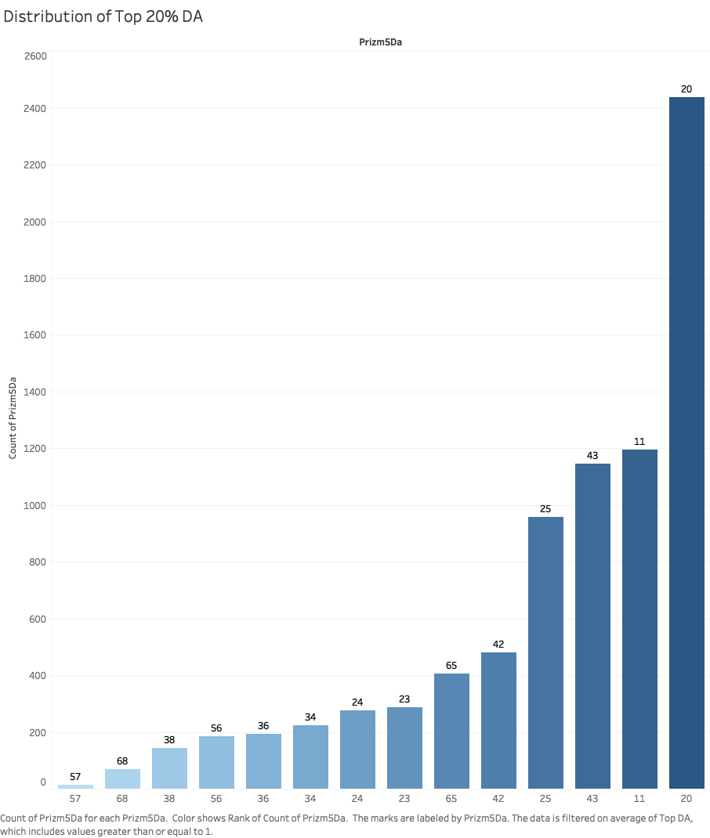
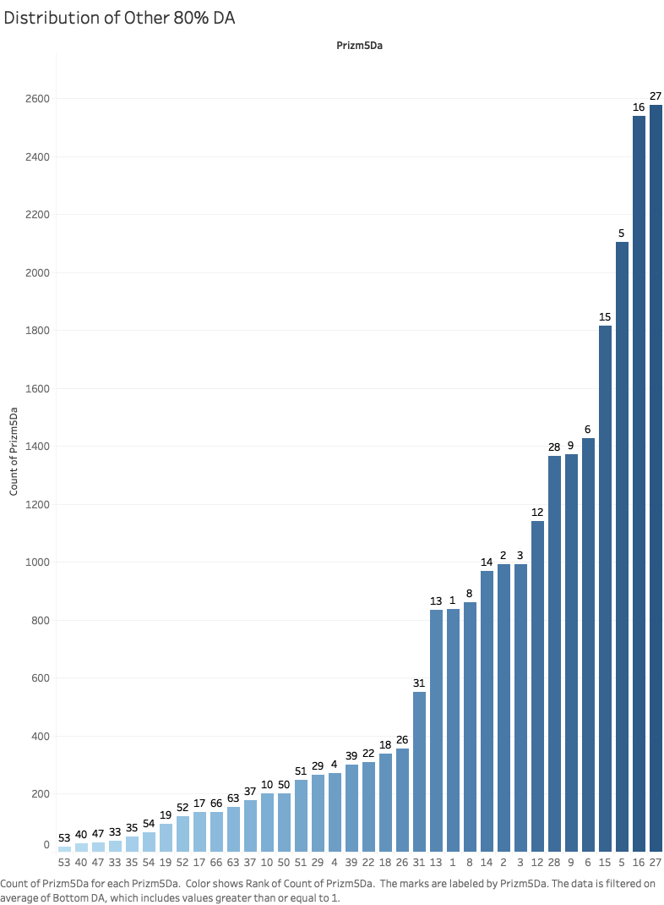
Data Prediction
Distribution of PRIZM5 segments (DA) and Lifestage Groups (LS);
Top 20% vs 80% And Practical implications of this analysis

Slide 11
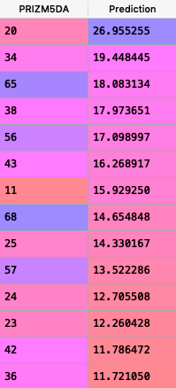
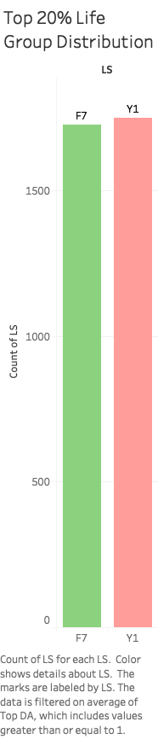
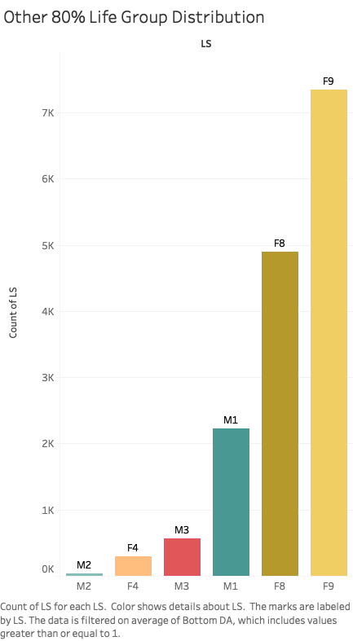
Data Prediction

Slide 12
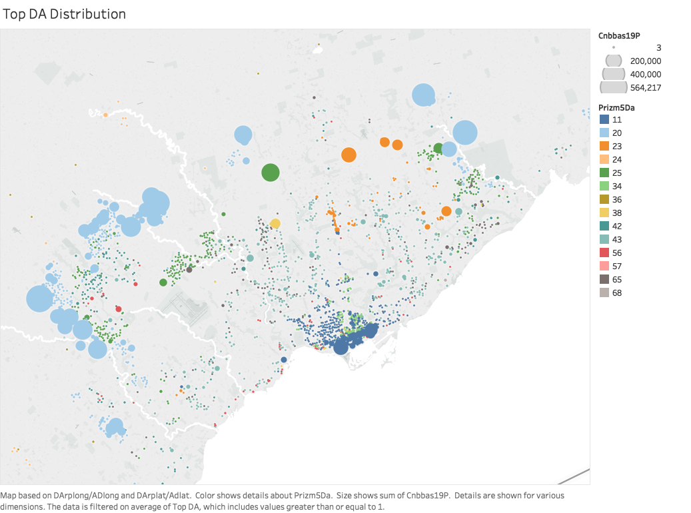
Data Prediction

Slide 13
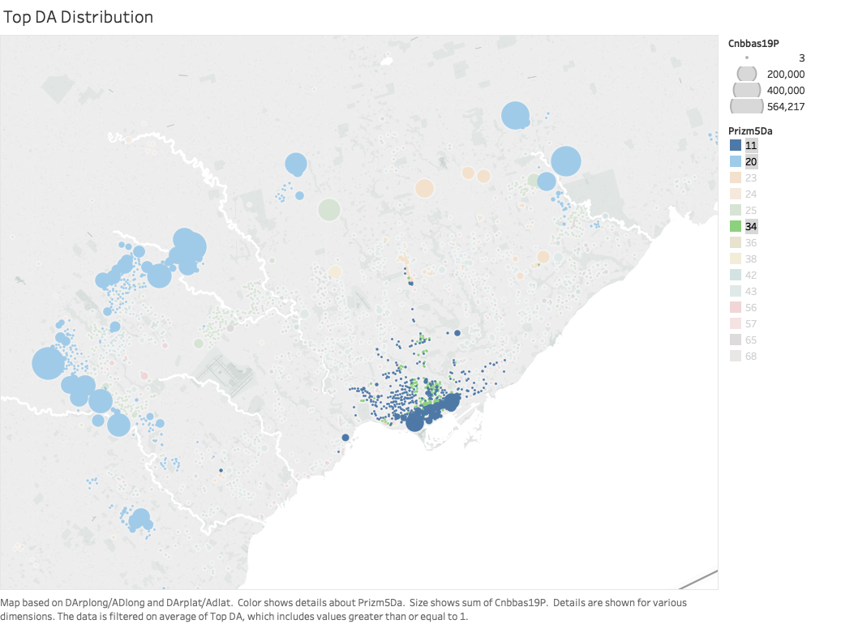
Data Prediction

Slide 14
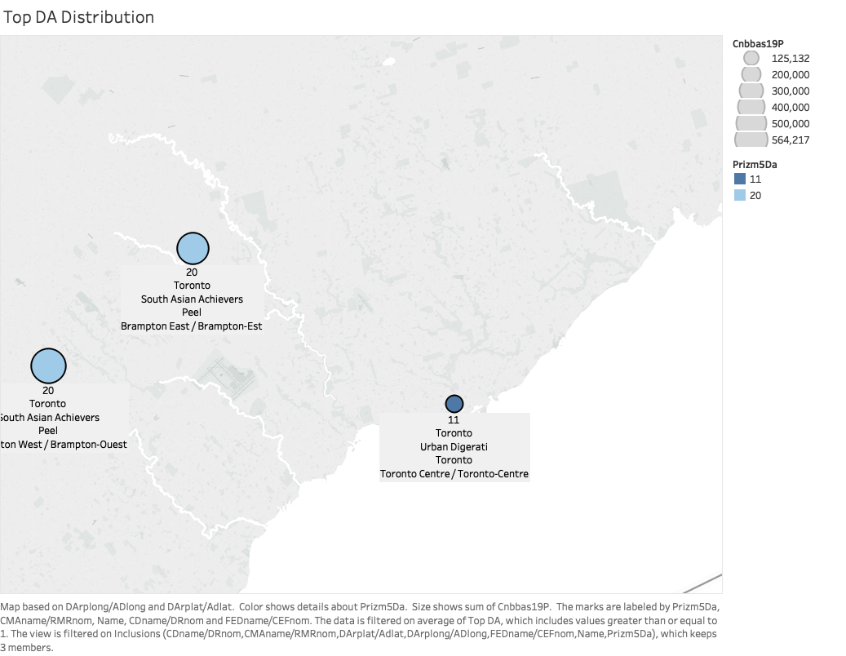
Data Prediction

Slide 15
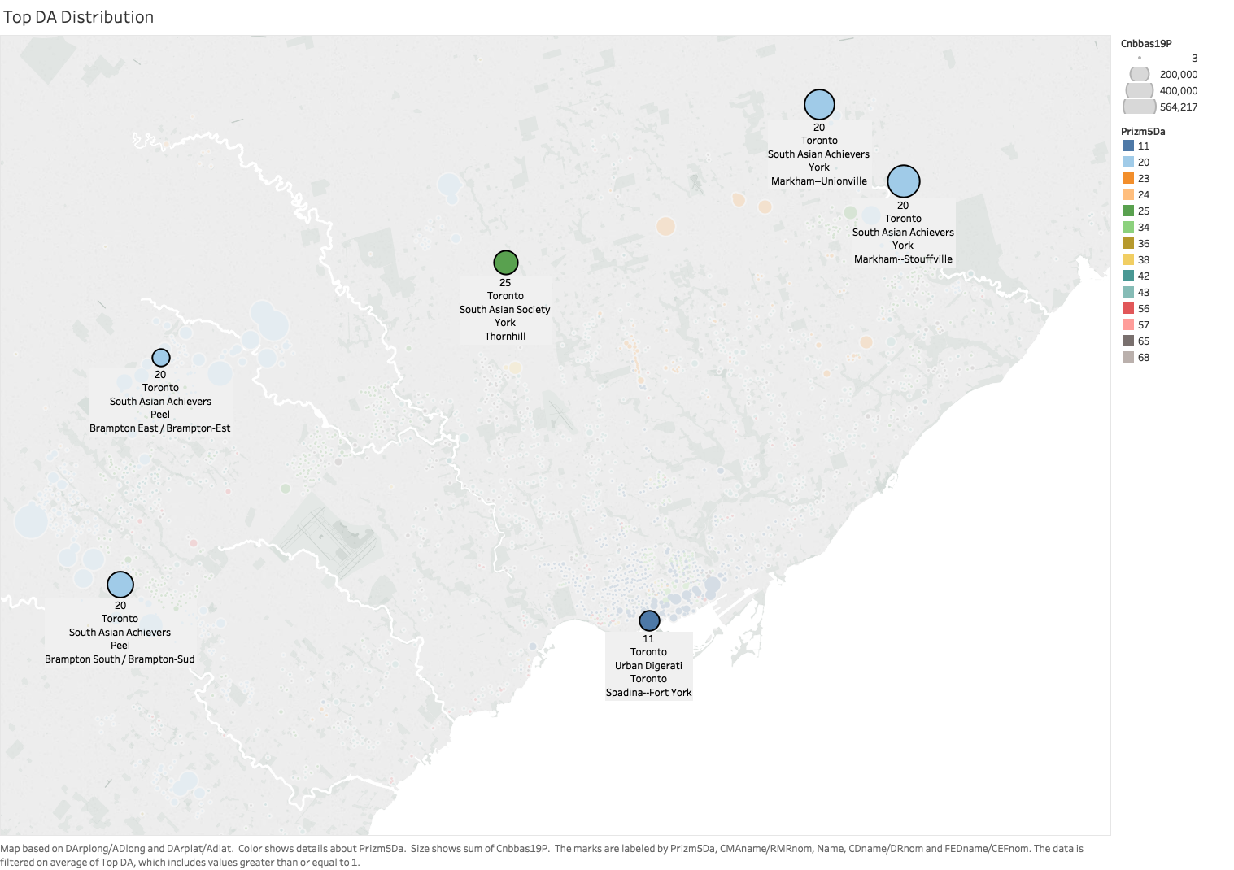
Data Prediction

Slide 16
Financial Analysis
Revenue Projections for the first 3 years
Store 1
Store 2
Store 3
Total
Year 1 | $27*M1.5*P 0.05 | $2.03 |  |  |  |  | $2.03
Year 2 | Last year * 1.15 | $2.33 | $19.4*M1.5*P0.05 | $ 1.46 |  |  | $3.78
Year 3 | Last year *1.15 | $2.68 | Last year*1.15 | $1.67 | $16*M1.5*P0.05 | 1.2 | $5.55
With assumptions of initial market penetration (P) of 5% of total population (M)
in the target area and annual compounded growth rate of 15% .

Slide 17
Financial Analysis
Expense Projections for the first 3 years
Fix Cost & Rent
Wages
COGS
Total
Year 1 | $0.04 | $0.60 | $1.01 | $1.65
Year 2 | $0.10 | $1.20 | $1.89 | $ 3.19
Year 3 | $0.15 | $1.90 | $2.78 | $4.83
With the assumption of 50% profit margin on the sold goods.Wages are
calculated for 20 full time worker in the first year and grow as we add more stores

Slide 18
Financial Analysis
Cash Flow Projections
Year 1 | $ 0.37
Year 2 | $ 0.59
Year 3 | $ 0.73

Slide 19
Thank you!
Nintendo DS

