Slide 1
Machine Learning Driven Credit Risk Assessment
Author: Megha Malhotra

Slide 2
Business Problem
Challenge
Can we identify high-risk borrowers before extending credit?
Objectives
• Reduce loan losses
• Improve risk assessment
• Support credit decision-making
• Enable explainable analytics

Slide 3
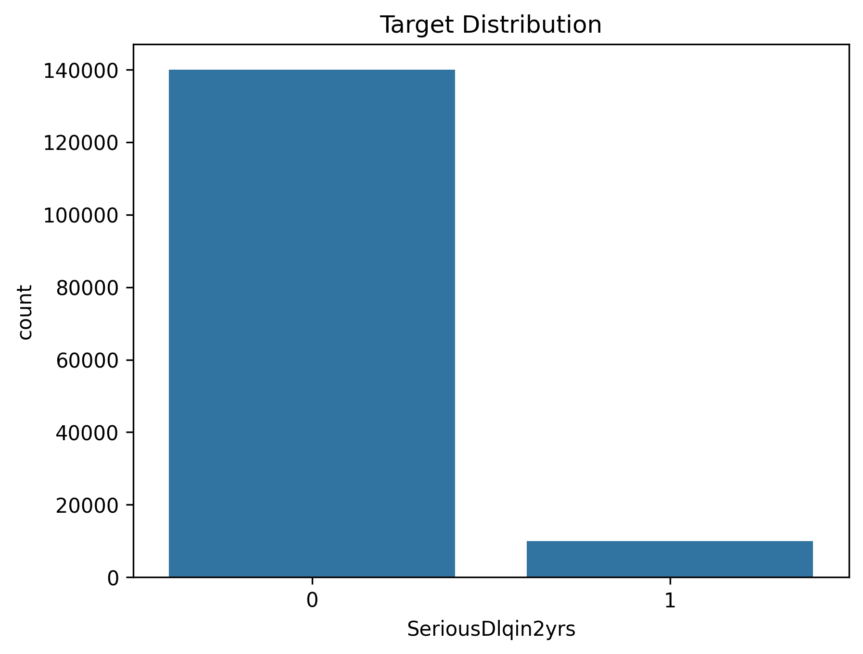
Dataset Overview
Dataset: Give Me Some Credit
Records: 150,000
Target Variable:
SeriousDlqin2yrs
Features:
• Credit Utilization
• Debt Ratio
• Monthly Income
• Delinquency History
• Open Credit Accounts

Slide 4
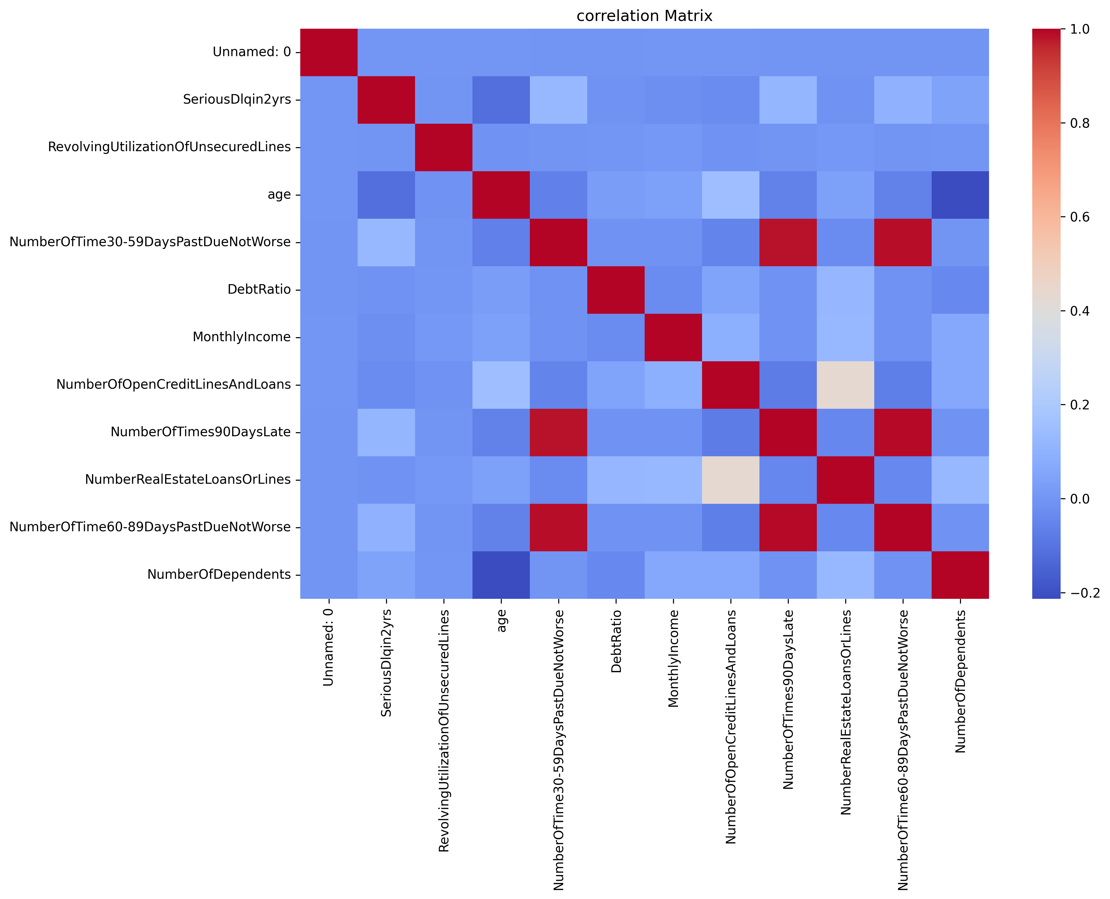
Exploratory Data Analysis
Major Observations
• Strong class imbalance
• Delinquency variables associated with default
• Significant financial outliers detected

Slide 5
Model Comparison
Model | ROC-AUC
Logistic Regression | 0.716
Random Forest | 0.850
XGBoost | 0.869
XGBoost delivered the strongest predictive performance and was selected for deployment.

Slide 6
Key Findings and Recommendations
Findings:
• Historical delinquency is the strongest risk indicator
• Credit utilization significantly impacts risk
• Debt-related metrics contribute to default behaviour
Recommendations:
• Deploy XGBoost
• Use SHAP explainability
• Implement automated borrower risk flags
• Monitor model performance quarterly

