Slide 1
Sprint 1
Regression

Slide 2
Sprint 1: Regression
Task: making predictions from data
Core concepts
Algorithms and models
Implementation on real dataset
Assessing a model performance
Overfitting
Bias-variance tradeoff
K-fold cross validation
Simple regression (covered in Statistics sprint)
Gradient descent
Multiple regression
Ridge regression
Lasso regression
Coordinate descent
Wine quality dataset
Sprint 1 - Regression

Slide 3
Sprint 1: Day 1
Task: making predictions from data
Core concepts
Algorithms and models
Implementation on real dataset
Assessing a model performance
Overfitting
Bias-variance tradeoff
Simple regression (covered in Statistics sprint)
Gradient descent
Multiple regression
Wine quality dataset
Sprint 1 - Regression

Slide 4
Sprint 1: Day 2
Task: making predictions from data
Core concepts
Algorithms and models
Implementation on real dataset
Assessing a model performance
Overfitting
Bias-variance tradeoff
K-fold cross validation
Simple regression (covered in Statistics sprint)
Multiple regression
Gradient descent
Ridge regression
Lasso regression
Coordinate descent
Wine quality dataset
Sprint 1 - Regression

Slide 5
Task : making predictions from data
Sprint 3 - Retrieval

Slide 6


Task description
Predicting wine quality (red and white vinho verde wine) from various physicochemical tests
These two datasets were published in [Cortez et al., 2009] and are freely accessible at http://archive.ics.uci.edu/ml/datasets/Wine+Quality
@A. Ponsero
@V. Ponsero
Information about physicochemical property of the wine
Can I predict the wine quality score?
Sprint 1 - Regression

Slide 7
Algorithm: Regression fundamentals
Sprint 3 - Retrieval

Slide 8

Regression fundamentals
Predicting wine quality (red and white vinho verde wine) from various physicochemical tests
These two datasets were published in [Cortez et al., 2009] and are freely accessible at http://archive.ics.uci.edu/ml/datasets/Wine+Quality
x₁ = acidity, y₁= quality
x = input variable
y = output that needs to be predicted
Model = expected relationship between x and y
x₂ = acidity, y₂= quality
y
f(x)=w₀ + w₁ x
x₃ = acidity, y₃= quality
with :
w₀ the interception
w₁ the slope and
ε the error
y_{i}= w₀ + w₁ x_{i} + ε_{i}
Regression coefficients
…
x
Sprint 1 - Regression

Slide 9
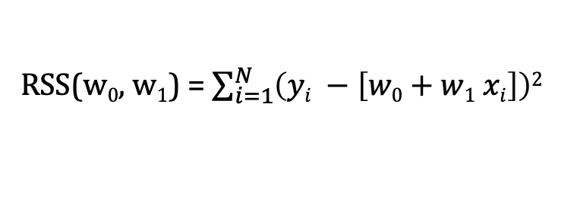
Fitting a line to data
There is a « cost » of using a given line : Residual sum of squares (RSS)
RSS(w₀, w₁) = $\sum_{i=1}^{N}{\left(yi −\left[w0+w1 xi\right]\right)2}$
The « best » line is the one minimizing the cost over w₀ and w₁
X
Sprint 1 - Regression

Slide 10
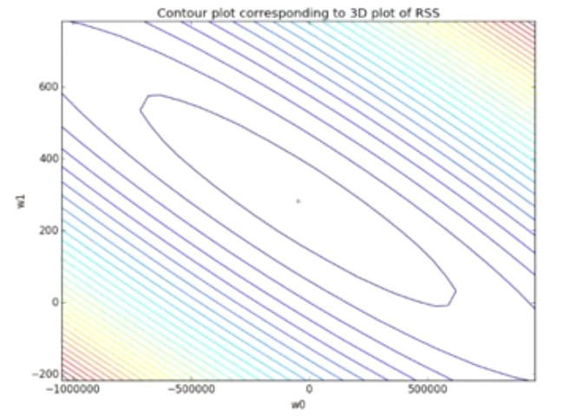
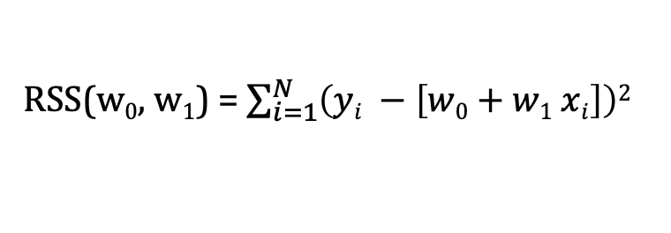
RSS optimization – Gradient descent algorithm
How to find the w₀ and w₁ that minimize the RSS ?
RSS(w₀, w₁) = $\sum_{i=1}^{N}{\left(yi −\left[w0+w1 xi\right]\right)2}$
The gradient descent algorithm allows to find the minima of RSS(w0, w1)
Sprint 1 - Regression

Slide 11
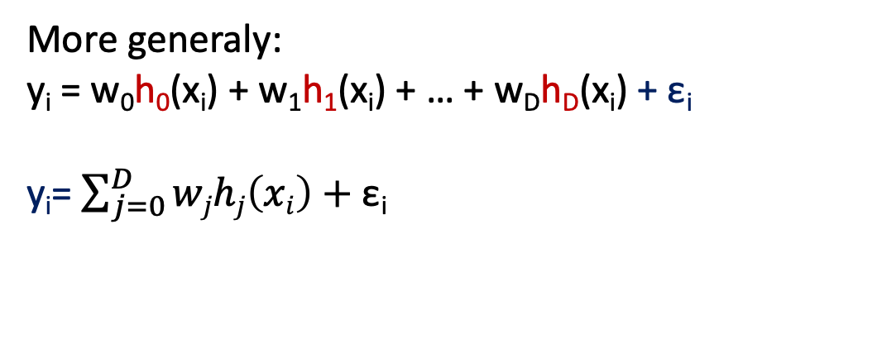
Polynomial regression
Model:
y_{i} = w₀ + w₁ x_{i} + w₂ x_{i}² + … + w_{D} x_{i}^{D} + ε_{i}
y
Treat as different features
(function of the input x)
x
In this example :
Feature 1 = 1 (const)
Feature 2 = x
Feature 3 = x²
…
Feature D+1 = x^{D}
More generaly:
y_{i} = w₀h₀(x_{i}) + w₁h₁(x_{i}) + … + w_{D}h_{D}(x_{i}) + ε_{i}
y_{i}= $\sum_{j=0}^{D}{wjhj\left(xi\right)+\text{ε}\text{i}}$
h_{j} = j^{th} feature
W_{j} = weight associated with the j^{th} feature
Sprint 1 - Regression

Slide 12
Machine learning and regression
Training dataset
x
Feature extraction
h(x)
ML model
w
ML algorithm
y
Quality metric
Sprint 1 - Regression

Slide 13
Algorithm: Multiple regression
Sprint 3 - Retrieval

Slide 14
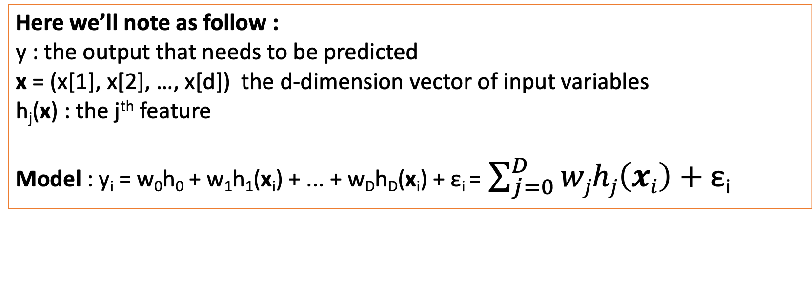
Multiple regression
In order to improve prediction, we may need to take into account multiple input variables
x₁ = acidity, x₂=chlorides, x₃ = residual sugars …
y₁= quality
Here we’ll note as follow :
y : the output that needs to be predicted
x = (x[1], x[2], …, x[d]) the d-dimension vector of input variables
h_{j}(x) : the j^{th} feature
Model : y_{i} = w₀h₀ + w₁h₁(x_{i}) + ... + w_{D}h_{D}(x_{i}) + ε_{i} = $\sum_{j=0}^{D}{wjhj\left(xi\right)+\text{ε}\text{i}}$
Similarly as simple regression, gradient descent on RSS allows to find the best fit
Sprint 1 - Regression

Slide 15
Implementation: Predicting wine quality
Sprint 3 - Retrieval

Slide 16
Task description
Compute a simple and multiple regression to predict the wine quality
-> Open Jupyter notebook
@A. Ponsero
@V. Ponsero
Information about physicochemical property of the wine
Can I predict the wine quality score?
Sprint 1 - Regression

Slide 17
Concepts: Document representation
Sprint 3 - Retrieval

