Slide 1
Sprint 4
Clustering and topic modeling

Slide 2
Module overview
Task:
Discover groups (clusters) of related articles
Topic modeling
Core concepts
Algorithms and models
Implementation on real dataset
Unsupervised learning
Cluster heterogeneity
K-means
LDA
Wikipedia
metagenomes
Sprint 4 – Clustering and topic modeling

Slide 3
Task : Clustering documents without labels
Sprint 4 – Clustering and topic modeling

Slide 4
Clustering
No labels provided, we want to uncover the cluster structure from input alone
Input: Wikipedia articles as vectors x_{i}
Output: Cluster labels z_{i}
Feature 2
Unsupervised learning task
Feature 1
Sprint 4 – Clustering and topic modeling

Slide 5
Concepts: Unsupervised learning
Sprint 4 – Clustering and topic modeling

Slide 6
What defines a Cluster?
Clusters defined by a center (centroid), shape and a spread
Once the clusters are defined, we can calculate a score to assign observations x_{i} to the closest cluster k
Feature 2
x_{i}
Feature 1
Sprint 4 – Clustering and topic modeling

Slide 7
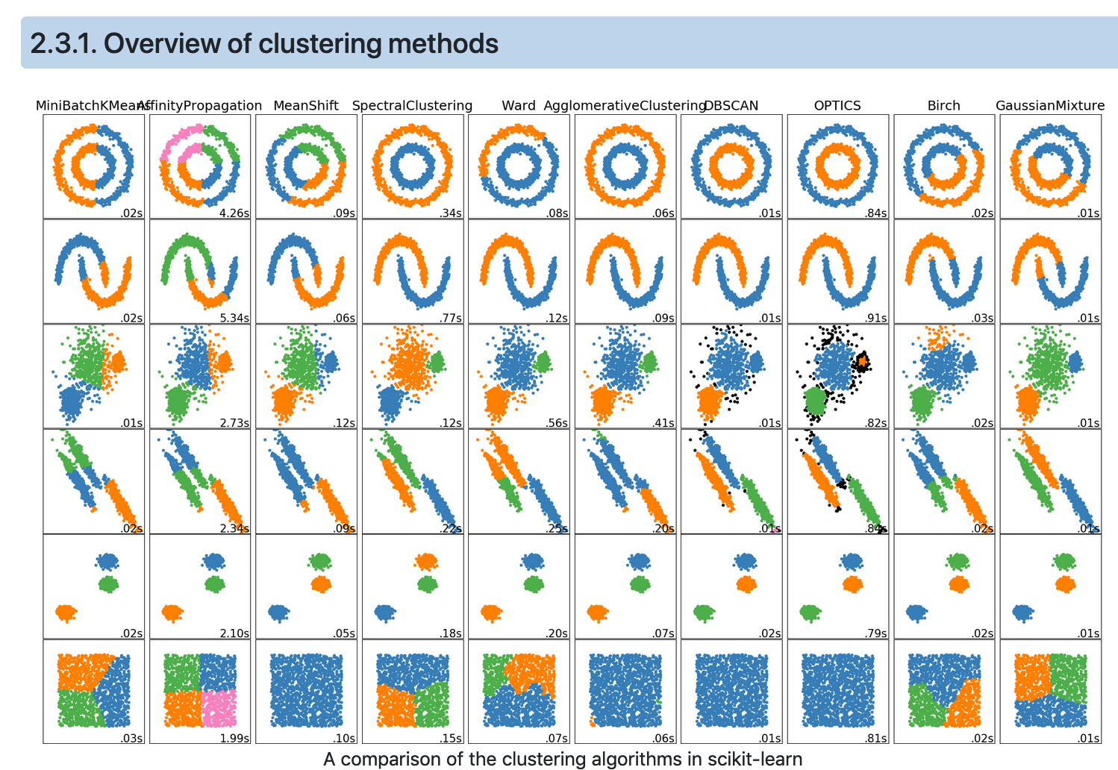
Cluster shapes and clustering algorithms
Sprint 4 – Clustering and topic modeling

Slide 8
Algorithm: k-means
Sprint 4 – Clustering and topic modeling

Slide 9
K-means
1- Initialize cluster centers (μ1, …, μk)
Feature 2
Feature 1
Sprint 4 – Clustering and topic modeling

Slide 10
K-means
1- Initialize cluster centers (μ1, …, μk)
Feature 2
k=3
Feature 1
Sprint 4 – Clustering and topic modeling

Slide 11
K-means
1- Initialize cluster centers (μ1, …, μk)
2- Assign observations to the closest cluster center
z_{i} <- arg min || μ_{j} – x_{i}||
3- Revise cluster centers as mean of assigned observations
μ_{j} = (1/N) ∑ x_{i}
4- Repeat 1-2 until convergence
Feature 2
k=3
i:z_{i} = j
Feature 1
Sprint 4 – Clustering and topic modeling

Slide 12
K-means
1- Initialize cluster centers (μ1, …, μk)
2- Assign observations to the closest cluster center
z_{i} <- arg min || μ_{j} – x_{i}||
3- Revise cluster centers as mean of assigned observations
μ_{j} = (1/n_{j}) ∑ x_{i}
4- Repeat 1-2 until convergence
Feature 2
k=3
i:z_{i} = j
Feature 1
Sprint 4 – Clustering and topic modeling

Slide 13
K-means
1- Initialize cluster centers (μ1, …, μk)
2- Assign observations to the closest cluster center
z_{i} <- arg min || μ_{j} – x_{i}||
3- Revise cluster centers as mean of assigned observations
μ_{j} = (1/n_{j}) ∑ x_{i}
4- Repeat 1-2 until convergence
Feature 2
k=3
i:z_{i} = j
Feature 1
Sprint 4 – Clustering and topic modeling

Slide 14
K-means
1- Initialize cluster centers (μ1, …, μk)
2- Assign observations to the closest cluster center
z_{i} <- arg min || μ_{j} – x_{i}||
3- Revise cluster centers as mean of assigned observations
μ_{j} = (1/n_{j}) ∑ x_{i}
4- Repeat 1-2 until convergence (local optimum)
Feature 2
k=3
i:z_{i} = j
Feature 1
Coordinate descent :
2 -> Minimizing z given μ
3 ->Minimizing μ given z
Sprint 4 – Clustering and topic modeling

Slide 15
K-means
The cluster centers’ initialization critical to quality of the local optima found
1- Initialize cluster centers (μ1, …, μk)
2- Assign observations to the closest cluster center
z_{i} <- arg min || μ_{j} – x_{i}||
3- Revise cluster centers as mean of assigned observations
μ_{j} = (1/n_{j}) ∑ x_{i}
4- Repeat 1-2 until convergence (local optimum)
Feature 2
k=3
i:z_{i} = j
Feature 1
Coordinate descent :
2 -> Minimizing z given μ
3 ->Minimizing μ given z
Sprint 4 – Clustering and topic modeling

Slide 16
K-means++
Smart initialization:
Choose first cluster center uniformly at random from data point
For each xi, compute the distance d(x_{i}) to the nearest cluster center
Choose new luster center among the remaining datapoints, with probability of x_{i} being chosen proportional to d(x_{i})²
Feature 2
Feature 1
Sprint 4 – Clustering and topic modeling

Slide 17
K-means++
Smart initialization:
Choose first cluster center uniformly at random from data point
For each xi, compute the distance d(x_{i}) to the nearest cluster center
Choose new luster center among the remaining datapoints, with probability of x_{i} being chosen proportional to d(x_{i})²
Feature 2
Feature 1
Sprint 4 – Clustering and topic modeling

Slide 18
K-means++
Smart initialization:
Choose first cluster center uniformly at random from data point
For each xi, compute the distance d(x_{i}) to the nearest cluster center
Choose new luster center among the remaining datapoints, with probability of x_{i} being chosen proportional to d(x_{i})²
When the number of cluster k is reached, run k-means as previously described
Feature 2
Feature 1
Sprint 4 – Clustering and topic modeling

Slide 19
Concepts: Cluster heterogeneity
Sprint 4 – Clustering and topic modeling

Slide 20
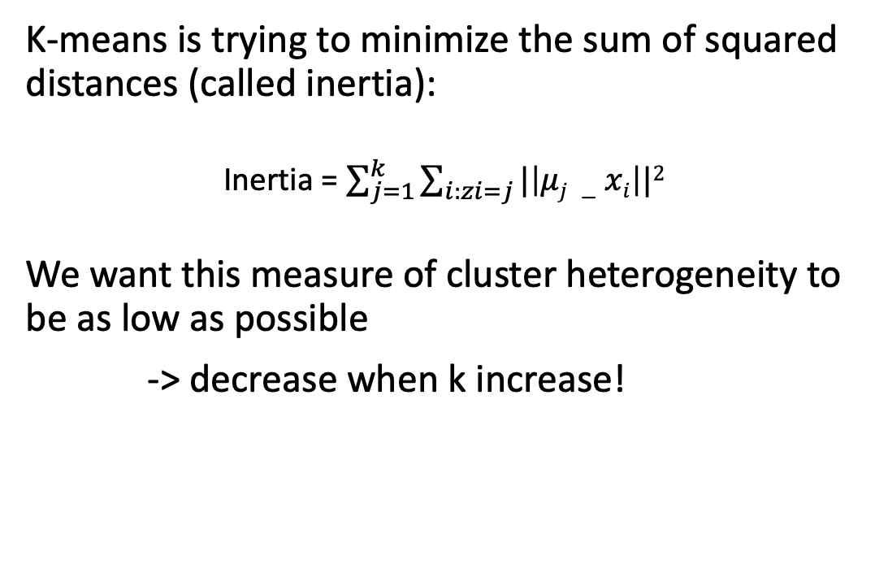
Assessing the quality of clusters
K-means is trying to minimize the sum of squared distances (called inertia):
Inertia = $\sum_{j=1}^{k}{\sum_{i:zi=j}{|\left|μj −xi\right||2}}$
We want this measure of cluster heterogeneity to be as low as possible
-> decrease when k increase!
Feature 2
Feature 1
Sprint 4 – Clustering and topic modeling
Notes:
Minimize the the sum of squared distances from points to their centroid

Slide 21
How to choose k ?
Inertia
Choose this k!
There is no right answer, this is just a heuristic
k
Importantly :
Because k-means aims to reduce the inertia -> k-means makes the assumption that clusters are convex and isotropic. It responds poorly to elongated clusters, or manifolds with irregular shapes.
Inertia is not a normalized metric: we just know that lower values are better and zero is optimal. But in very high-dimensional spaces, Euclidean distances tend to become inflated ( “curse of dimensionality”). Running a dimensionality reduction algorithm such as PCA prior to k-means clustering can alleviate this problem and speed up the computations.
Sprint 4 – Clustering and topic modeling
Notes:
Minimize the the sum of squared distances from points to their centroid

Slide 22
Implementation: wikipedia pages
Sprint 4 – Clustering and topic modeling

Slide 23
task1
Needs to have -> kmeans ++
Selections of k
Sprint 4 – Clustering and topic modeling
Notes:
Minimize the the sum of squared distances from points to their centroid

