Slide 1
Sprint 1
Regression

Slide 2
Sprint 1: Regression
Task: making predictions from data
Core concepts
Algorithms and models
Implementation on real dataset
Assessing a model performance
Overfitting
Bias-variance tradeoff
K-fold cross validation
Simple regression (covered in Statistics sprint)
Gradient descent
Multiple regression
Ridge regression
Lasso regression
Coordinate descent
Wine quality dataset
Sprint 1 - Regression

Slide 3
Sprint 1: Day 1
Task: making predictions from data
Core concepts
Algorithms and models
Implementation on real dataset
Assessing a model performance
Overfitting
Bias-variance tradeoff
Simple regression (covered in Statistics sprint)
Gradient descent
Multiple regression
Wine quality dataset
Sprint 1 - Regression

Slide 4
Sprint 1: Day 2
Task: making predictions from data
Core concepts
Algorithms and models
Implementation on real dataset
Assessing a model performance
Overfitting
Bias-variance tradeoff
K-fold cross validation
Simple regression (covered in Statistics sprint)
Multiple regression
Gradient descent
Ridge regression
Lasso regression
Wine quality dataset
Sprint 1 - Regression

Slide 5
Algorithm: Polynomial regression
Sprint 3 - Retrieval

Slide 6
Polynomial regression
y
Model:
y_{i} = w₀ + w₁ x_{i} + w₂ x_{i}² + … + w_{D} x_{i}^{D} + ε_{i}
Treat as different features
(function of the input x)
x
Sprint 1 - Regression

Slide 7
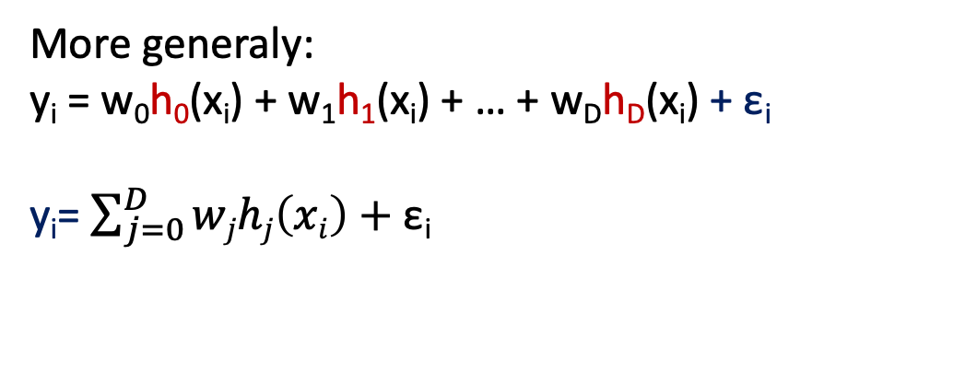
Polynomial regression
y
Model:
y_{i} = w₀ + w₁ x_{i} + w₂ x_{i}² + … + w_{D} x_{i}^{D} + ε_{i}
Treat as different features
(function of the input x)
x
In this example :
Feature 1 = 1 (const)
Feature 2 = x
Feature 3 = x²
…
Feature D+1 = x^{D}
More generaly:
y_{i} = w₀h₀(x_{i}) + w₁h₁(x_{i}) + … + w_{D}h_{D}(x_{i}) + ε_{i}
y_{i}= $\sum_{j=0}^{D}{wjhj\left(xi\right)+\text{ε}\text{i}}$
h_{j} = j^{th} feature
W_{j} = weight associated with the j^{th} feature
Sprint 1 - Regression

Slide 8
Machine learning and regression
Training dataset
x
Feature extraction
h(x)
ML model
w
ML algorithm
y
Quality metric
Sprint 1 - Regression

Slide 9
Concepts: 3 sources of error
Sprint 3 - Retrieval

Slide 10
3 sources of error
In forming predictions, there are 3 sources of error:
Noise
Bias
Variance
Sprint 1 - Regression

Slide 11
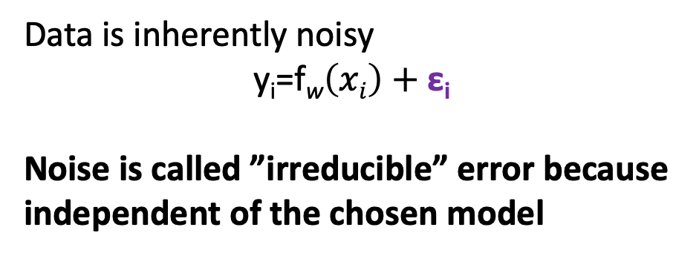
3 sources of error
In forming predictions, there are 3 sources of error:
Noise
Bias
Variance
y
Data is inherently noisy
y_{i}=f_{w}$\left(xi\right)+\text{ε}\text{i}$
Noise is called ”irreducible” error because independent of the chosen model
True fit
x
Sprint 1 - Regression

Slide 12
3 sources of error
In forming predictions, there are 3 sources of error:
Noise
Bias
Variance
Bias contribution:
assessment of how well the model can fit the relationship between x and y.
y
True fit
Low complexity
=
high bias
x
Sprint 1 - Regression

Slide 13
3 sources of error
In forming predictions, there are 3 sources of error:
Noise
Bias
Variance
Bias contribution:
assessment of how well the model can fit the relationship between x and y.
y
True fit
Uniform model
Low complexity
=
high bias
x
Sprint 1 - Regression

Slide 14
3 sources of error
In forming predictions, there are 3 sources of error:
Noise
Bias
Variance
Linear model
Bias contribution:
assessment of how well the model can fit the relationship between x and y.
y
True fit
Uniform model
Low complexity
=
high bias
x
Sprint 1 - Regression

Slide 15
3 sources of error
In forming predictions, there are 3 sources of error:
Noise
Bias
Variance
High complexity model
Variance contribution:
How much do specific fits vary from the expected fit?
y
True fit
High complexity
=
High variance
x
Sprint 1 - Regression

Slide 16
Bias – variance tradeoff
Overfit
Underfit
Variance
Best model possible
There is no way to compute the real bias or variance (we don’t have the true model).
But there are ways to optimize the tradeoff.
Bias
Model complexity
Sprint 1 - Regression

Slide 17
Concepts: Symptoms of overfitting in polynomial regression
Sprint 3 - Retrieval

Slide 18
Overfitting?
Symptom: Overfit model tends to have large parameters w
Sprint 1 - Regression

Slide 19
Implementation: overfitting on a polynomial regression
Sprint 3 - Retrieval

Slide 20
Algorithm: Ridge regression
Sprint 3 - Retrieval

Slide 21
Machine learning and regression
Training dataset
x
Feature extraction
h (x)
ML model
^
y
w
ML algorithm
y
Quality metric
Sprint 1 - Regression

Slide 22
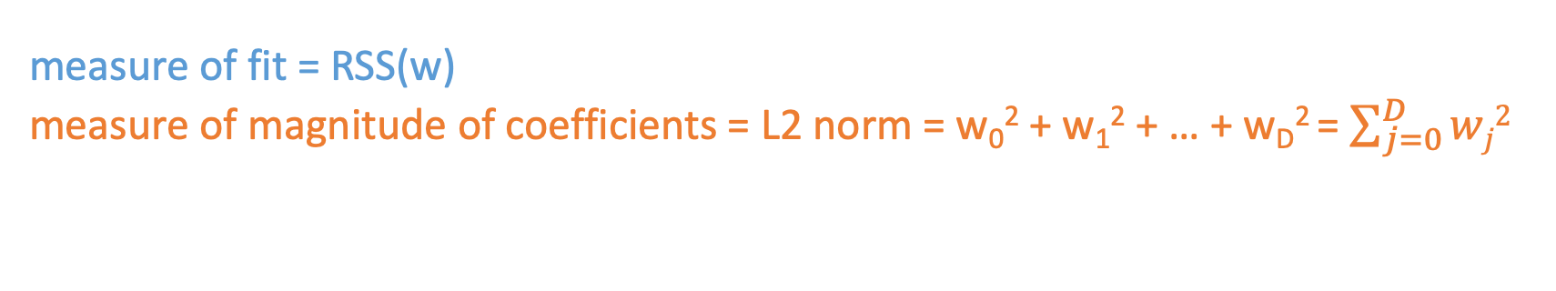
Designing a new total cost format
Instead of using simply the RSS to assess the fit, we want to balance:
How well the function fits the data
The magnitude of coefficients
Total cost = measure of fit + measure of magnitude of coefficients
We want to balance
measure of fit = RSS(w)
measure of magnitude of coefficients = L2 norm = w₀² + w₁² + … + w_{D}² = $\sum_{j=0}^{D}{wj2}$
Sprint 1 - Regression

Slide 23
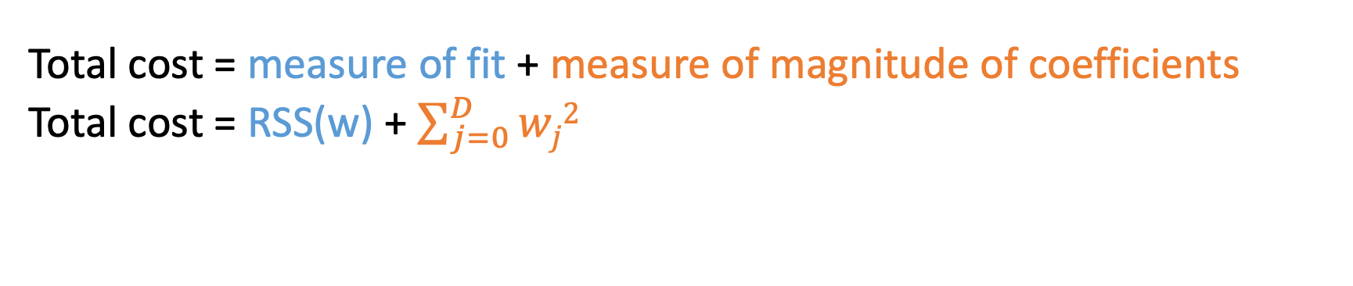
Ridge regression objective
Total cost = measure of fit + measure of magnitude of coefficients
Total cost = RSS(w) + $\sum_{j=0}^{D}{wj2}$
Sprint 1 - Regression

Slide 24
Ridge regression objective
Total cost = measure of fit + measure of magnitude of coefficients
Total cost = RSS(w) + $\sum_{j=0}^{D}{wj2}$
Sprint 1 - Regression

Slide 25
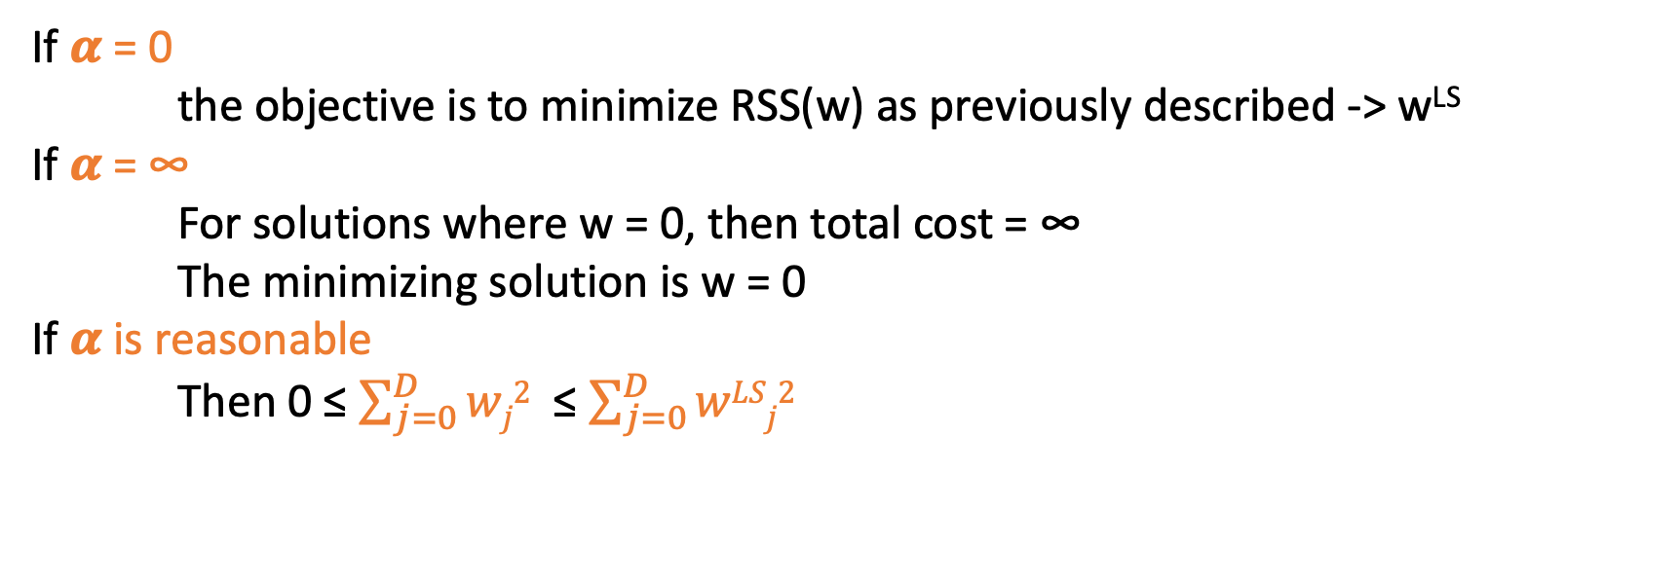
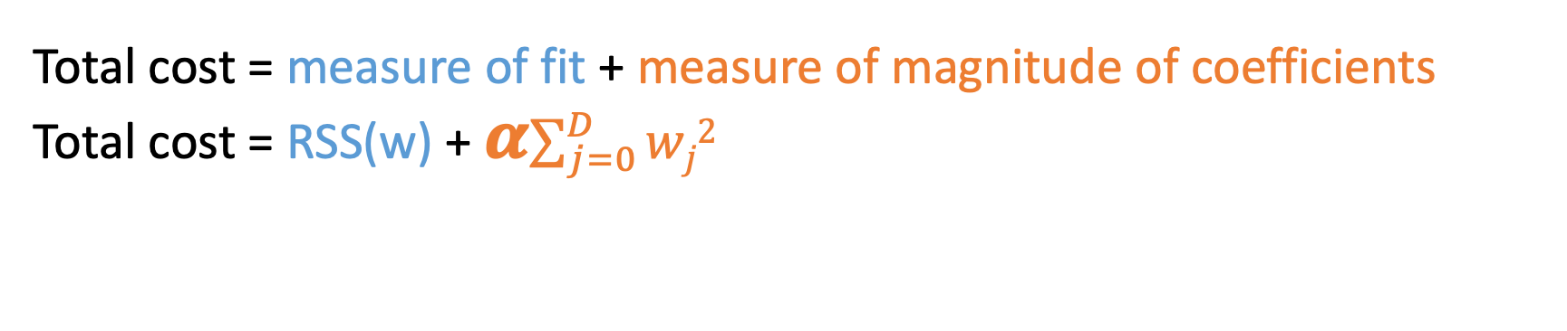
Ridge regression = L₂ regularization
Total cost = measure of fit + measure of magnitude of coefficients
Total cost = RSS(w) + 𝜶$\sum_{j=0}^{D}{wj2}$
Tuning parameter allowing the balance between fit and magnitude
If 𝜶 = 0
the objective is to minimize RSS(w) as previously described -> w^{LS}
If 𝜶 = ∞
For solutions where w = 0, then total cost = ∞
The minimizing solution is w = 0
If 𝜶 is reasonable
Then 0 ≤ $\sum_{j=0}^{D}{wj2}$ ≤ $\sum_{j=0}^{D}{wLSj2}$
Sprint 1 - Regression

Slide 26
Bias – variance tradeoff
Large 𝜶
High bias, low variance
e.g w=0 if ƛ = ∞
Small 𝜶
Low bias, high variance
e.g just computing RSS(w) when ƛ = 0
Sprint 1 - Regression

Slide 27
Implementation: Ridge regression
Sprint 3 - Retrieval

Slide 28
Task : feature selection
Sprint 3 - Retrieval

Slide 29
Why feature selections?
Efficiency :
- If size(w) is very large, each prediction is expensive
- If w sparse, the computational cost only depends on the # of non-zero w
Interpretability:
- Which features are relevant for prediction?
Sprint 1 - Regression

Slide 30
Algorithm: Lasso regression
Sprint 3 - Retrieval

Slide 31
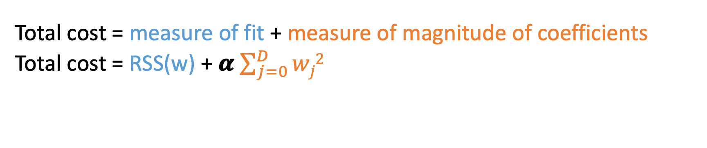
Ridge regression: L₂ regularized regression
Total cost = measure of fit + measure of magnitude of coefficients
Total cost = RSS(w) + 𝜶 $\sum_{j=0}^{D}{wj2}$
Encourage small weights w
But not exactly 0 !
w_{j}
Feature 1
Feature 2
Feature 3
Feature 4
Could we use feature regularization to shrink some coefficients to 0 ?
(removing certain features from the model)
0
ƛ
Sprint 1 - Regression

Slide 32
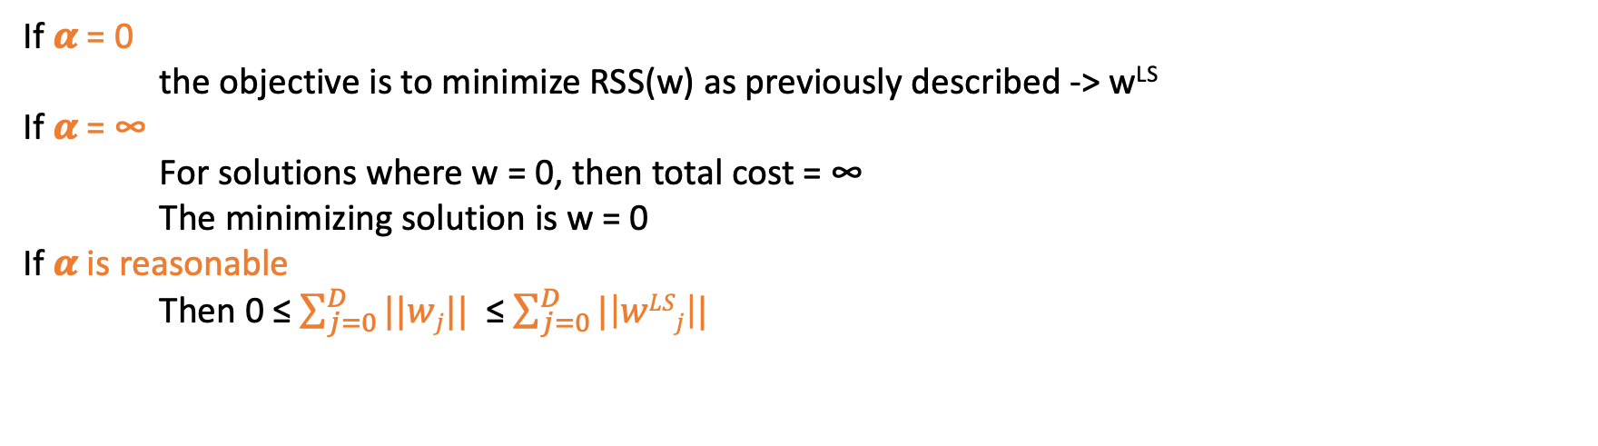
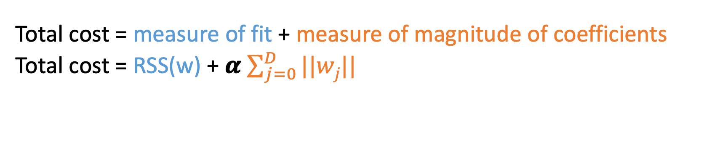
Lasso regression : L₁ regularized regression
Total cost = measure of fit + measure of magnitude of coefficients
Total cost = RSS(w) + 𝜶 $\sum_{j=0}^{D}{||wj||}$
Tuning parameter
Leads to sparse solutions!
If 𝜶 = 0
the objective is to minimize RSS(w) as previously described -> w^{LS}
If 𝜶 = ∞
For solutions where w = 0, then total cost = ∞
The minimizing solution is w = 0
If 𝜶 is reasonable
Then 0 ≤ $\sum_{j=0}^{D}{||wj||}$ ≤ $\sum_{j=0}^{D}{|\left|wLSj\right||}$
Sprint 1 - Regression

Slide 33
Lasso regression : L₁ regularized regression
Ridge regression
w_{j}
Feature 1
Feature 2
Feature 3
Feature 4
0
𝜶
Lasso regression
w_{j}
Feature 1
Feature 2
Feature 3
Feature 4
0
𝜶
Sprint 1 - Regression

Slide 34
Implementation: Lasso implementation
Sprint 3 - Retrieval

Slide 35
Concepts: How to choose 𝜶 ? K-fold cross validation
Sprint 3 - Retrieval

Slide 36
If sufficient amount of data :
Training set
Validation set
Test set
Fit w parameters
Test performance of the chosen w and select 𝜶
Assess generalization error of the model
But if the validation set is too small : it won’t give you a good view on the performance !
Sprint 1 - Regression

Slide 37
If not enough data :
Training set
Test set
Preprocessing :
Randomly assign data to K groups
Sprint 1 - Regression

Slide 38
If not enough data :
1
2
3
4
5
Test set
error₁ (𝜶)
W⁽¹⁾
1. Choose a 𝜶
2. For k = 1…K
Estimate w ^{(k)} on the training block
Compute error on validation block error_{k}(𝜶)
Sprint 1 - Regression

Slide 39
If not enough data :
1
2
3
4
5
Test set
error₂ (𝜶)
W⁽²⁾
1. Choose a 𝜶
2. For k = 1…K
Estimate w ^{(k)} on the training block
Compute error on validation block error_{k}(𝜶)
Sprint 1 - Regression

Slide 40
If not enough data :
1
2
3
4
5
Test set
error₃ (𝜶)
W⁽³⁾
1. Choose a 𝜶
2. For k = 1…K
Estimate w ^{(k)} on the training block
Compute error on validation block error_{k}(𝜶)
Sprint 1 - Regression

Slide 41
If not enough data :
1
2
3
4
5
Test set
error₄ (𝜶)
W⁽⁴⁾
1. Choose a 𝜶
2. For k = 1…K
Estimate w ^{(k)} on the training block
Compute error on validation block error_{k}(𝜶)
Sprint 1 - Regression

Slide 42
If not enough data :
1
2
3
4
5
Test set
error₅ (𝜶)
W⁽⁵⁾
1. Choose a ƛ
2. For k = 1…K
Estimate w ^{(k)} on the training block
Compute error on validation block error_{k}(ƛ)
Sprint 1 - Regression

Slide 43
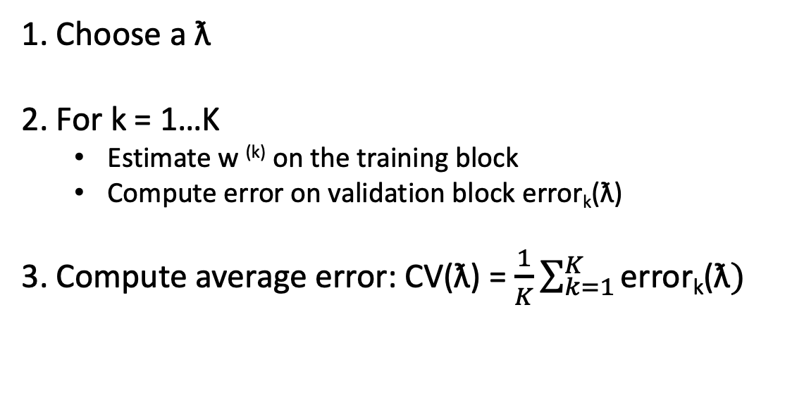
If not enough data :
1
2
3
4
5
Test set
error₅ (𝜶)
W⁽⁵⁾
1. Choose a ƛ
2. For k = 1…K
Estimate w ^{(k)} on the training block
Compute error on validation block error_{k}(ƛ)
3. Compute average error: CV(ƛ) = $\frac{1}{K}\sum_{k=1}^{K}{\text{error}\text{k}\text{(ƛ})}$
Sprint 1 - Regression

Slide 44
K-fold cross validation:
1
2
3
4
5
Test set
→ Repeat procedure for each choice of 𝜶
Choose 𝜶 to minimize CV(𝜶)
Formally the best approximation occurs for validation sets of size 1 -> Leave-one-out CV
But computationally intensive !
… Typically people choose k=5 or 10 -> 5-fold CV or 10-fold CV
Sprint 1 - Regression

Slide 45
Implementation: Everything together!
Sprint 3 - Retrieval

Slide 46

The Boston housing price dataset
Standard dataset preloaded in SciKit Learn. Contains 506 houses from the Boston area and their selling prices.
Input variables
Predictions
Localization characteristics (crime rates…)
House characteristics (nb of rooms…)
Selling price
Sprint 1 - Regression

