Slide 1
Sprint 1
Regression

Slide 2
Sprint 1: Regression
Task: making predictions from data
Core concepts
Algorithms and models
Implementation on real dataset
Assessing a model performance
Overfitting
Bias-variance tradeoff
K-fold cross validation
Simple regression (covered in Statistics sprint)
Gradient descent
Multiple regression
Ridge regression
Lasso regression
Coordinate descent
Wine quality dataset
Sprint 1 - Regression

Slide 3
Sprint 1: Day 1
Task: making predictions from data
Core concepts
Algorithms and models
Implementation on real dataset
Assessing a model performance
Overfitting
Bias-variance tradeoff
Simple regression (covered in Statistics sprint)
Gradient descent
Multiple regression
Wine quality dataset
Sprint 1 - Regression

Slide 4
Sprint 1: Day 2
Task: making predictions from data
Core concepts
Algorithms and models
Implementation on real dataset
Assessing a model performance
Overfitting
Bias-variance tradeoff
K-fold cross validation
Simple regression (covered in Statistics sprint)
Multiple regression
Gradient descent
Ridge regression
Lasso regression
Coordinate descent
Wine quality dataset
Sprint 1 - Regression

Slide 5
Concepts: Symptoms of overfitting in polynomial regression
Sprint 3 - Retrieval

Slide 6
Overfitting?
Symptom: Overfit model tends to have large parameters w
Sprint 1 - Regression

Slide 7
Implementation: Polynomial regression and overfitting
Sprint 3 - Retrieval

Slide 8
Algorithm: Ridge regression
Sprint 3 - Retrieval

Slide 9
Machine learning and regression
Training dataset
x
Feature extraction
h (x)
ML model
^
y
w
ML algorithm
y
Quality metric
Sprint 1 - Regression

Slide 10
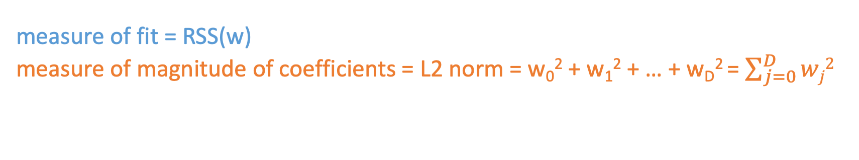
Designing a new total cost format
Instead of using simply the RSS to assess the fit, we want to balance:
How well the function fits the data
The magnitude of coefficients
Total cost = measure of fit + measure of magnitude of coefficients
We want to balance
measure of fit = RSS(w)
measure of magnitude of coefficients = L2 norm = w₀² + w₁² + … + w_{D}² = $\sum_{j=0}^{D}{wj2}$
Sprint 1 - Regression

Slide 11
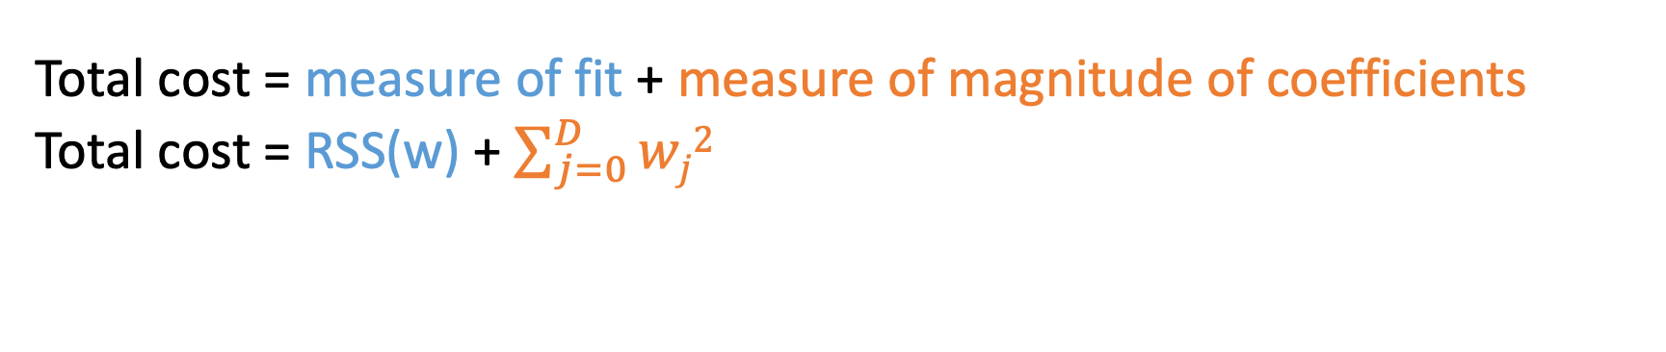
Ridge regression objective
Total cost = measure of fit + measure of magnitude of coefficients
Total cost = RSS(w) + $\sum_{j=0}^{D}{wj2}$
Sprint 1 - Regression

Slide 12
Ridge regression objective
Total cost = measure of fit + measure of magnitude of coefficients
Total cost = RSS(w) + $\sum_{j=0}^{D}{wj2}$
Sprint 1 - Regression

Slide 13
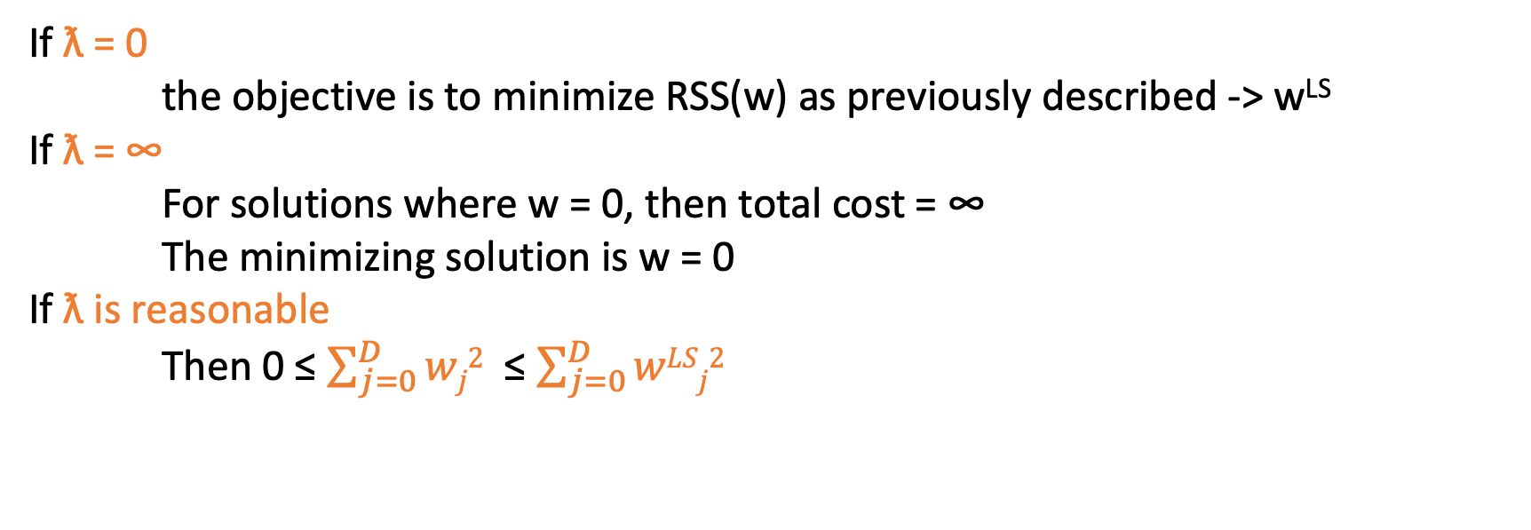
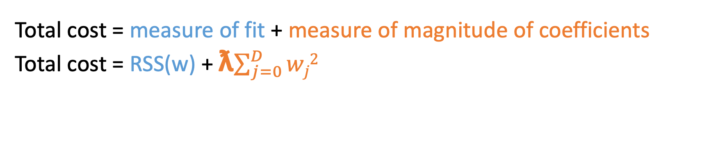
Ridge regression == L₂ regularization
Total cost = measure of fit + measure of magnitude of coefficients
Total cost = RSS(w) + ƛ$\sum_{j=0}^{D}{wj2}$
Tuning parameter allowing the balance between fit and magnitude
If ƛ = 0
the objective is to minimize RSS(w) as previously described -> w^{LS}
If ƛ = ∞
For solutions where w = 0, then total cost = ∞
The minimizing solution is w = 0
If ƛ is reasonable
Then 0 ≤ $\sum_{j=0}^{D}{wj2}$ ≤ $\sum_{j=0}^{D}{wLSj2}$
Sprint 1 - Regression

Slide 14
Bias – variance tradeoff
Large ƛ
High bias, low variance
e.g w=0 if ƛ = ∞
Small ƛ
Low bias, high variance
e.g just computing RSS(w) when ƛ = 0
Sprint 1 - Regression

Slide 15
Implementation: Ridge regression
Sprint 3 - Retrieval

Slide 16
Concepts: How to choose ƛ ? K-fold cross validation
Sprint 3 - Retrieval

Slide 17
If sufficient amount of data :
Training set
Validation set
Test set
Fit w parameters
Test performance of the chosen w and select ƛ
Assess generalization error of the model
But if the validation set is too small : it won’t give you a good view on the performance !
Sprint 1 - Regression

Slide 18
If not enough data :
Training set
Test set
Preprocessing :
Randomly assign data to K groups
Sprint 1 - Regression

Slide 19
If not enough data :
1
2
3
4
5
Test set
error₁ (ƛ)
W⁽¹⁾
1. Choose a ƛ
2. For k = 1…K
Estimate w ^{(k)} on the training block
Compute error on validation block error_{k}(ƛ)
Sprint 1 - Regression

Slide 20
If not enough data :
1
2
3
4
5
Test set
error₂ (ƛ)
W⁽²⁾
1. Choose a ƛ
2. For k = 1…K
Estimate w ^{(k)} on the training block
Compute error on validation block error_{k}(ƛ)
Sprint 1 - Regression

Slide 21
If not enough data :
1
2
3
4
5
Test set
error₃ (ƛ)
W⁽³⁾
1. Choose a ƛ
2. For k = 1…K
Estimate w ^{(k)} on the training block
Compute error on validation block error_{k}(ƛ)
Sprint 1 - Regression

Slide 22
If not enough data :
1
2
3
4
5
Test set
error₄ (ƛ)
W⁽⁴⁾
1. Choose a ƛ
2. For k = 1…K
Estimate w ^{(k)} on the training block
Compute error on validation block error_{k}(ƛ)
Sprint 1 - Regression

Slide 23
If not enough data :
1
2
3
4
5
Test set
error₅ (ƛ)
W⁽⁵⁾
1. Choose a ƛ
2. For k = 1…K
Estimate w ^{(k)} on the training block
Compute error on validation block error_{k}(ƛ)
Sprint 1 - Regression

Slide 24
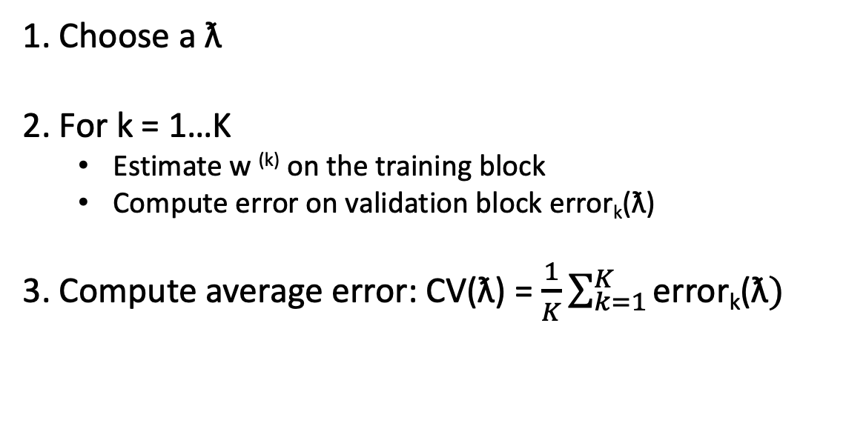
If not enough data :
1
2
3
4
5
Test set
error₅ (ƛ)
W⁽⁵⁾
1. Choose a ƛ
2. For k = 1…K
Estimate w ^{(k)} on the training block
Compute error on validation block error_{k}(ƛ)
3. Compute average error: CV(ƛ) = $\frac{1}{K}\sum_{k=1}^{K}{\text{error}\text{k}\text{(ƛ})}$
Sprint 1 - Regression

Slide 25
K-fold cross validation:
1
2
3
4
5
Test set
→ Repeat procedure for each choice of ƛ
Choose ƛ to minimize CV(ƛ)
Formally the best approximation occurs for validation sets of size 1 -> Leave-one-out CV
But computationally intensive !
… Typically people choose k=5 or 10 -> 5-fold CV or 10-fold CV
Sprint 1 - Regression

Slide 26
Implementation: k-Fold cross validation
Sprint 3 - Retrieval

Slide 27
Task : feature selection
Sprint 3 - Retrieval

Slide 28
Why feature selections?
Efficiency :
- If size(w) is very large, each prediction is expensive
- If w sparse, the computational cost only depends on the # of non-zero w
Interpretability:
- Which features are relevant for prediction?
Sprint 1 - Regression

Slide 29
Algorithm: Lasso regression
Sprint 3 - Retrieval

Slide 30
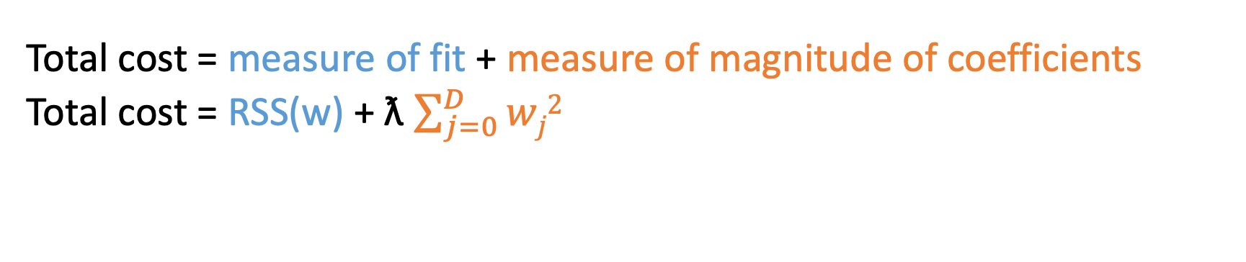
Ridge regression: L₂ regularized regression
Total cost = measure of fit + measure of magnitude of coefficients
Total cost = RSS(w) + ƛ $\sum_{j=0}^{D}{wj2}$
Encourage small weights w
But not exactly 0 !
w_{j}
Feature 1
Feature 2
Feature 3
Feature 4
Could we use feature regularization to shrink some coefficients to 0 ?
(removing certain features from the model)
0
ƛ
Sprint 1 - Regression

Slide 31
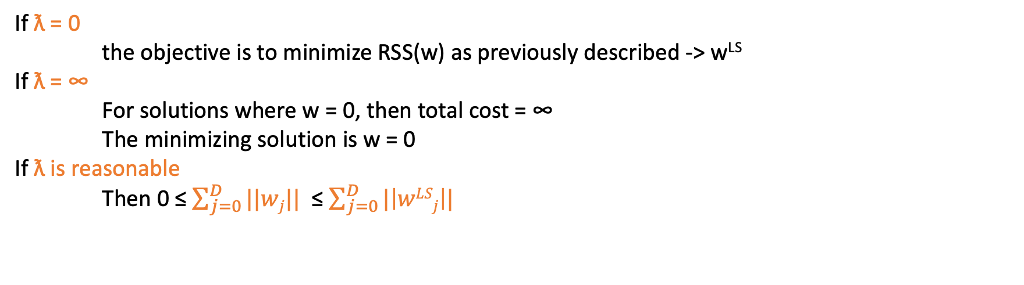
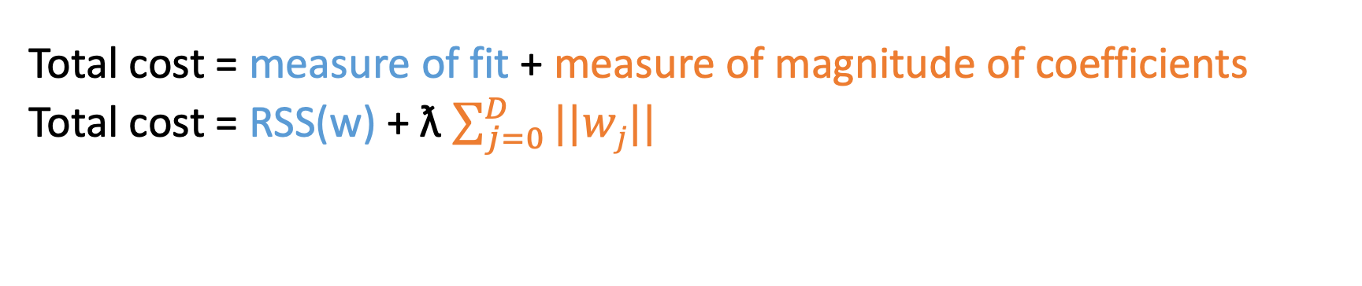
Lasso regression : L₁ regularized regression
Total cost = measure of fit + measure of magnitude of coefficients
Total cost = RSS(w) + ƛ $\sum_{j=0}^{D}{||wj||}$
Tuning parameter
Leads to sparse solutions!
If ƛ = 0
the objective is to minimize RSS(w) as previously described -> w^{LS}
If ƛ = ∞
For solutions where w = 0, then total cost = ∞
The minimizing solution is w = 0
If ƛ is reasonable
Then 0 ≤ $\sum_{j=0}^{D}{||wj||}$ ≤ $\sum_{j=0}^{D}{|\left|wLSj\right||}$
Sprint 1 - Regression

Slide 32
Lasso regression : L₁ regularized regression
Ridge regression
w_{j}
Feature 1
Feature 2
Feature 3
Feature 4
0
ƛ
Lasso regression
w_{j}
Feature 1
Feature 2
Feature 3
Feature 4
0
ƛ
Sprint 1 - Regression

Slide 33
Implementation: Lasso implementation
Sprint 3 - Retrieval

