Slide 1
ZotFeed
Ali Aijaz, Sara Dadafshar, Henry Hoang, Natalie Kassir, Chirag Samtani

Slide 2



Where we left off...
Original Goals From Sprint 1:
Include several more use cases to account for different types of users
Create user stories for major features of the application
Create a UML diagram that connects the UML diagrams KUCI, Anteater TV and New U together
Set up meeting with main stakeholder and present prototypes, get input, refactor and rebuild prototypes
Get in touch with other stakeholders from KUCI and The New University and get them more involved
Meet with the main stakeholder and go over requirements of the application once more in case they want to add more or remove requirements and confirm that all the requirements listed are correct.
Discuss system architecture more in depth
Discuss types of technology (languages, APIs, etc.) that we plan on implementing in development
RE-ORG!

Slide 3
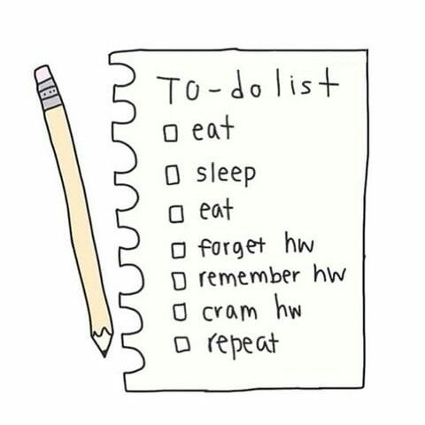
Sprint 2 Objectives:
Official Sprint 2 Goals:
Set up meeting with the main stakeholder and present the prototypes so we can get input
Get in touch with other stakeholders from each specific organization (KUCI, Anteater TV and New U) involved in the app to get more implementation information
Finalize requirements before beginning development phase
Discuss system architecture
Discuss types of technology we plan to use
Prep for coding!

Slide 4
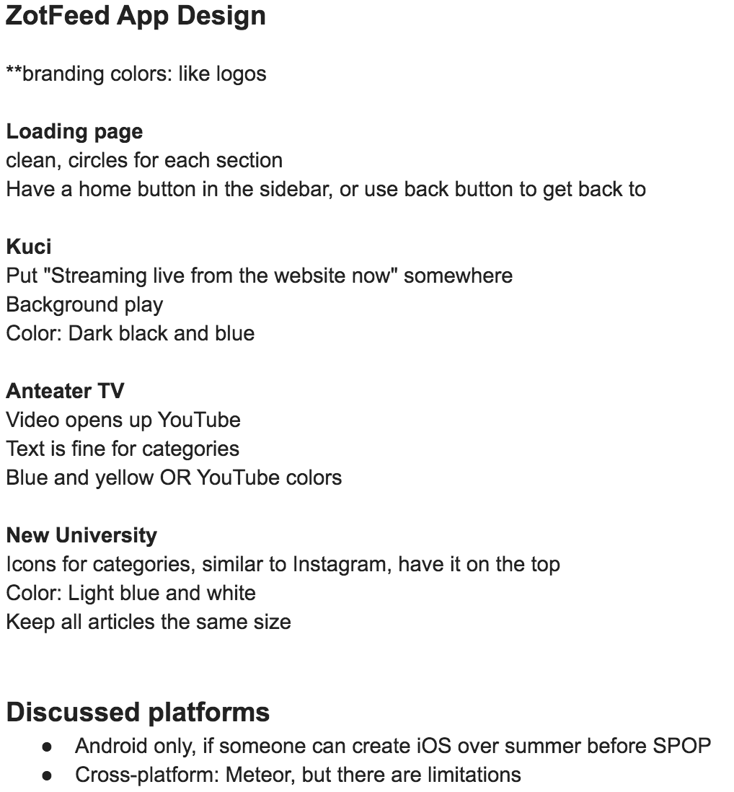
Completed Tasks:
Prototype Critique Meeting
Met with primary stakeholder (Michaela, President of Anteater TV) and went over changes/improvements that should be made to our current prototypes
Discussed pros/cons of current design
Ended up discussing complications:
Agreed on creating an Android application with all features asked for
Will be using Android Studio
Will find a team to translate our handed down code so it could be compatible for iOS before SPOP
Meeting
Notes

Slide 5
Completed Tasks:
Coding Started
KUCI Stream - SUCCESS
Has a now playing feature (data extracted from a JSON file)
Basically finished the KUCI Screen but still needs performance-tuning

Slide 6
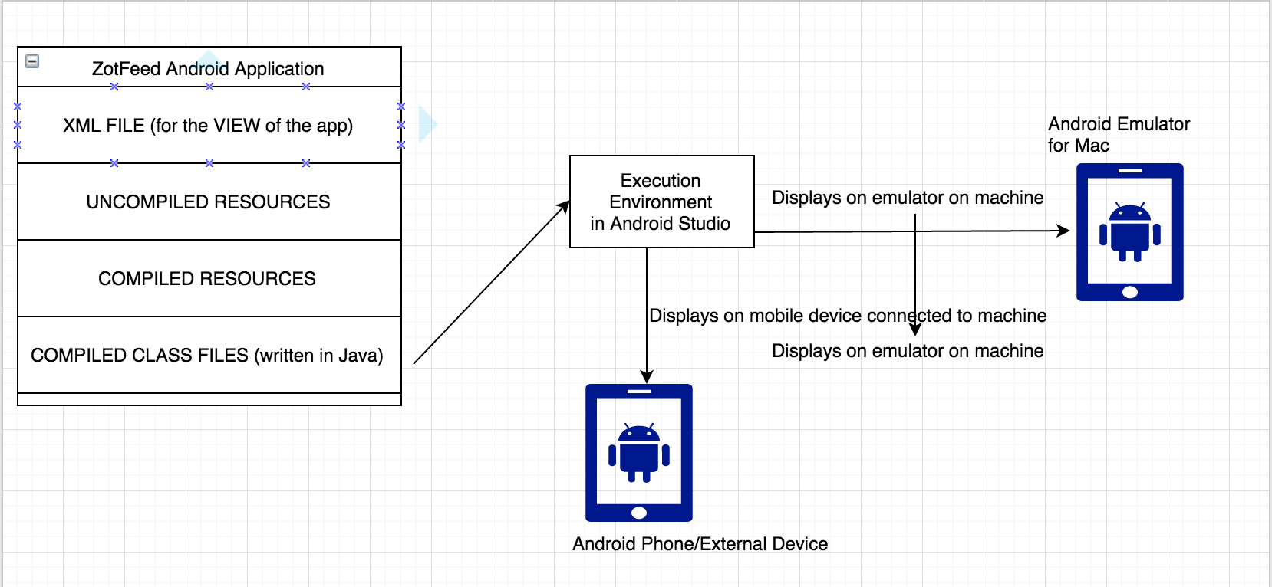
Completed Tasks:
Additional UML Diagram Created
Created UML diagram for high level architecture of the Android version of the ZotFeed app

Slide 7
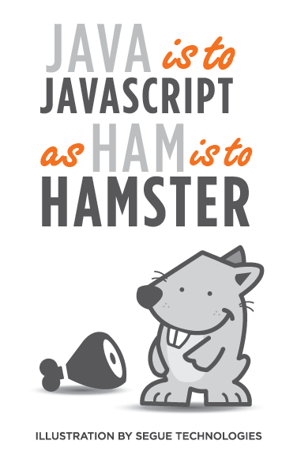

Completed Tasks:
Decided on Technology - What’s next?
Languages
Android - using Java, XML + APIs
May be creating a webservice using Java and MySQL (Tentative)
Web-service may run on AWS server deployed with Tomcat

Slide 8
Completed Tasks:
Research! Research! Research!
(Get resources to make our job easier!)
Contacted members from KUCI and New University to get more information for building the app.
Received information on how to access KUCI live radio stream and options for accessing the web schedule.
Received RSS feed information from New University.

Slide 9
Not Completed:
Dropped - Refactor and Rebuild prototypes based off of feedback from stakeholder
From the meeting we organized all the changes in a doc
Since changes were so minor (ie. colors and icons) we decided not to rebuild the prototypes but to refer to the document for specifics pertaining to the layout

Slide 10
Sprint 3 Goals:
Begin coding up one screen at a time
Goal is to have one medium completed by the next sprint
Start with KUCI
Next Anteater TV
Last New U
Get information on color codes and branding icons from stakeholders
implement them in the layout for each screen
Get feedback on the screen we created and test it out for flaws
Refactor/rebuild

