Slide 1
MS DATA SCIENCE PROJECT
Detection of Financial Crimes Leveraging Artificial Intelligence
Credit Card Fraud Detection Using Neural Networks
Muhammad Ali Tahir
SU92-MSDSW-F25-004
Supervisor: Mr. Talha Nadeem
Superior University, Lahore | January 2026

Slide 2
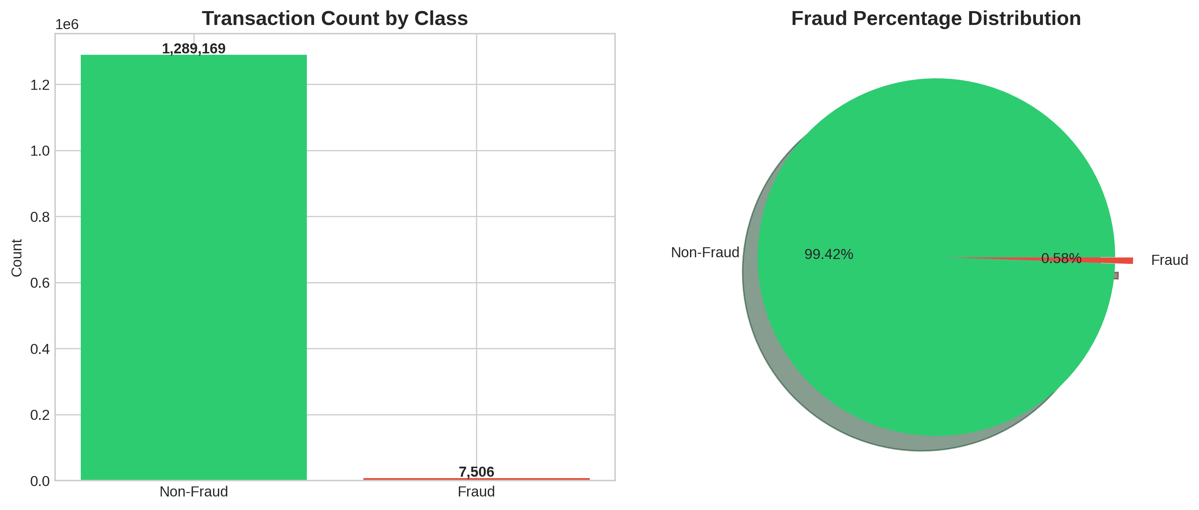
1. Introduction
The Problem: Global card fraud losses reached $32.34 billion in 2023
The Challenge: Extreme class imbalance with 1:172 fraud-to-legitimate ratio
The Gap: Most datasets use anonymized features (V1...V28), preventing interpretation of fraud patterns
Our Solution: Deep learning on interpretable features enabling explainable fraud detection
Figure: Class Distribution (99.42% legitimate vs 0.58% fraud)

Slide 3
2. Project Objectives
Primary Objectives
Technical Objectives
1
Develop neural network achieving ROC-AUC > 0.99
1
Handle extreme class imbalance (1:172 ratio)
2
Create FraudShield Analytics Dashboard for real-time analysis
2
Achieve Precision > 85%, Recall > 75%
3
Implement interpretable feature engineering pipeline
3
Enable millisecond-level predictions
4
Optimize decision thresholds for business requirements
4
Support batch and single transaction analysis

Slide 4
3. Alignment with UN Sustainable Development Goals
SDG 8: Decent Work & Economic Growth
SDG 9: Industry, Innovation & Infrastructure
• Protects financial institutions from fraud losses
• Supports sustainable economic growth
• Enables secure digital commerce
• Applies cutting-edge deep learning technology
• Builds resilient financial infrastructure
• Promotes technological innovation in fintech
SDG 16: Peace, Justice & Strong Institutions
Project Impact
• Combats financial crime and fraud
• Strengthens institutional integrity
• Supports transparent, accountable systems
• ~$611K estimated savings per 500K transactions
• 77% fraud detection rate with 0.04% false positives
• Interpretable results for regulatory compliance

Slide 5
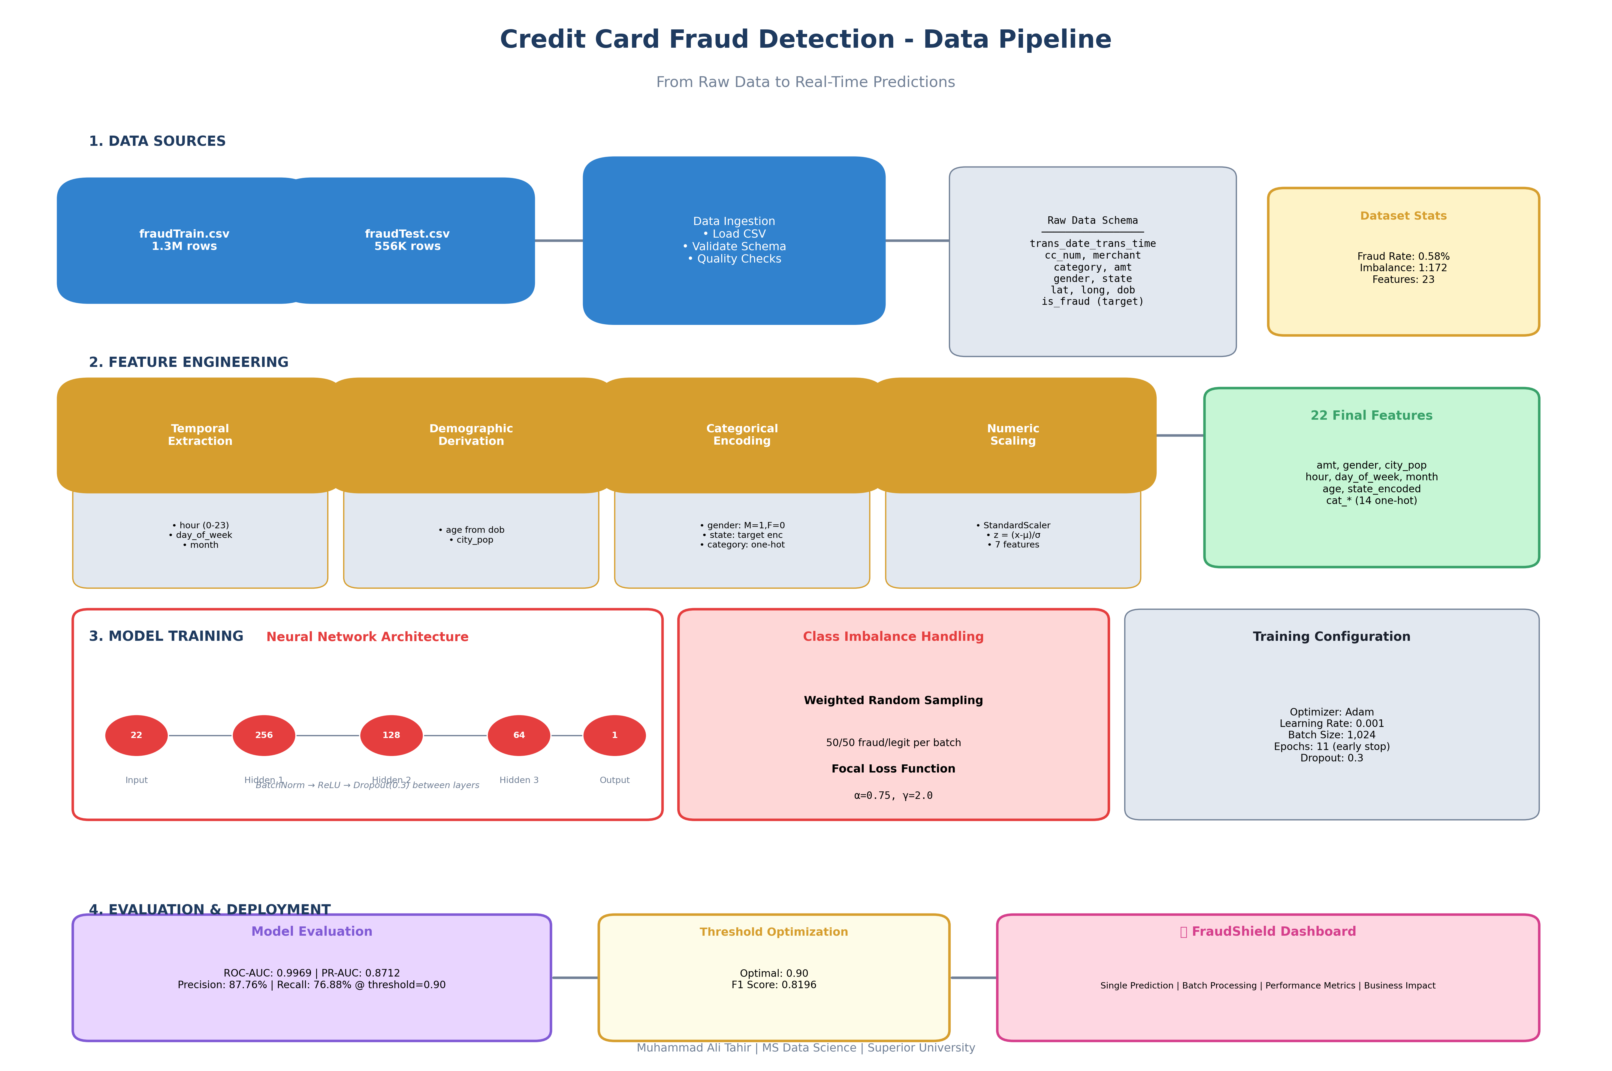
4. Methodology

Slide 6
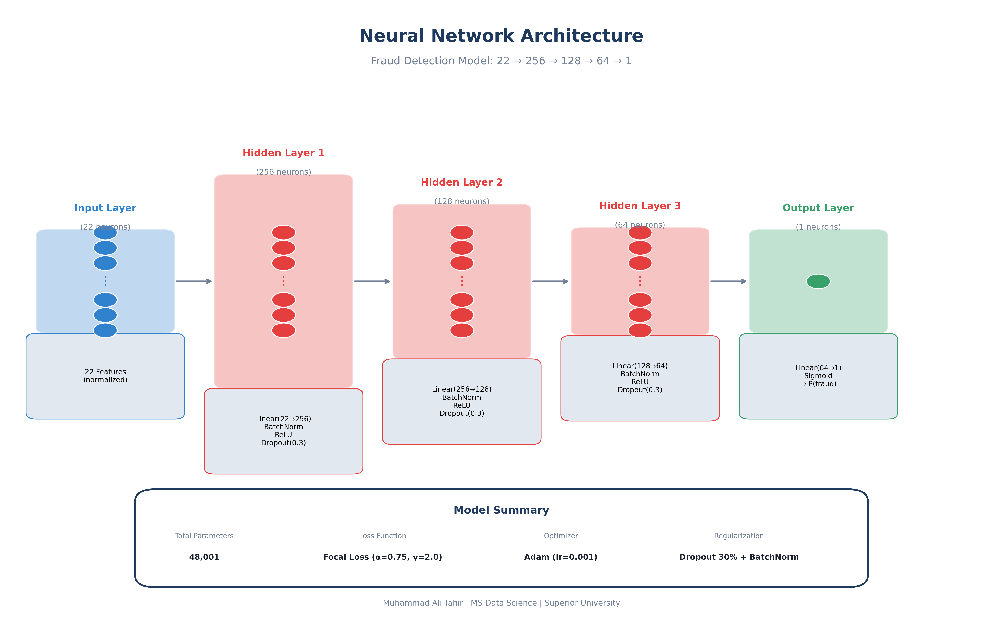
5. Neural Network Architecture

Slide 7
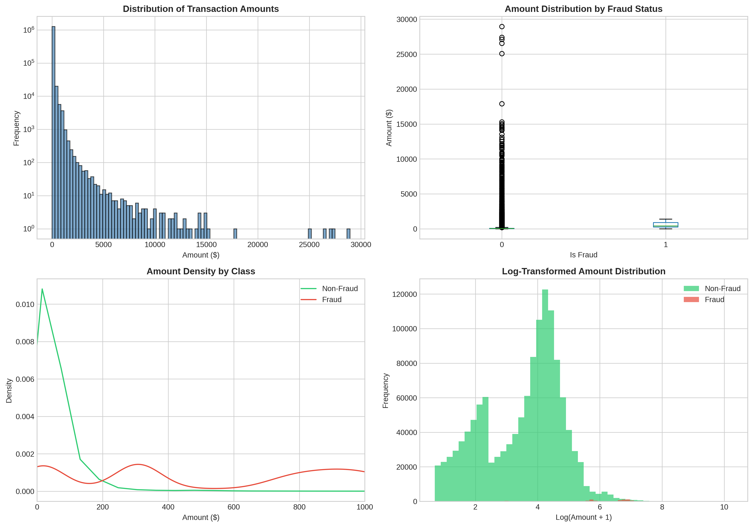
6. Results: Transaction Amount Analysis
Key Finding: Fraudulent transactions average $531.32 vs $67.67 for legitimate (8x higher)

Slide 8
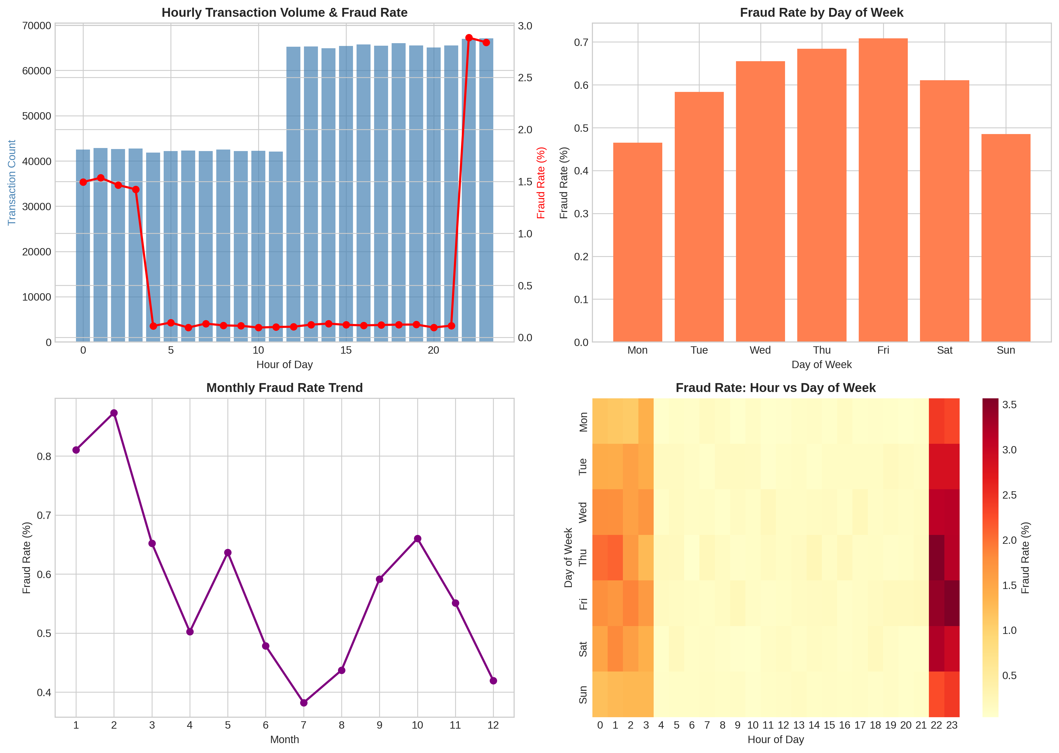
7. Results: Temporal Patterns
Key Finding: Late-night hours (10PM-12AM) show 5x higher fraud rates (2.84% vs 0.58% average)

Slide 9
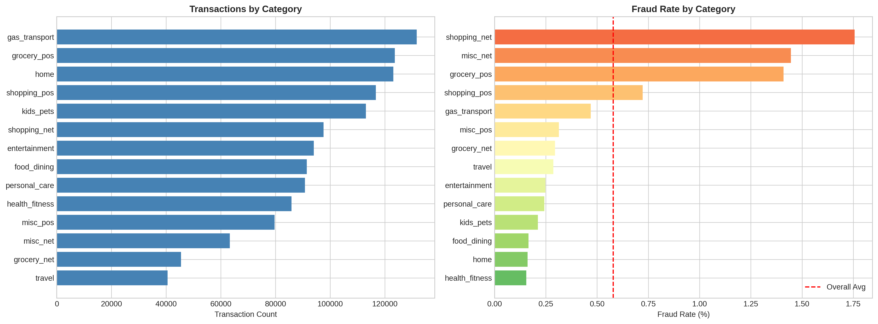
8. Results: Category Analysis
Key Finding: Online shopping categories show 3x higher fraud rates (shopping_net: 1.76%)

Slide 10
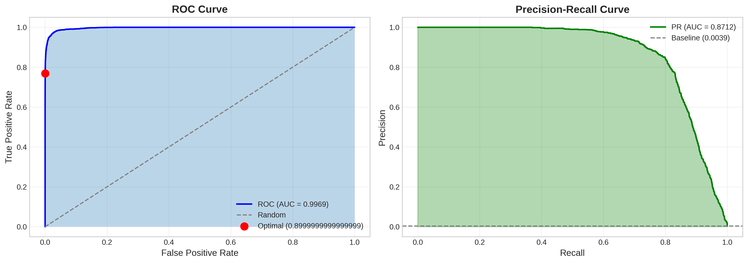
9. Model Performance: ROC & PR Curves
ROC-AUC: 0.9969
PR-AUC: 0.8712

Slide 11
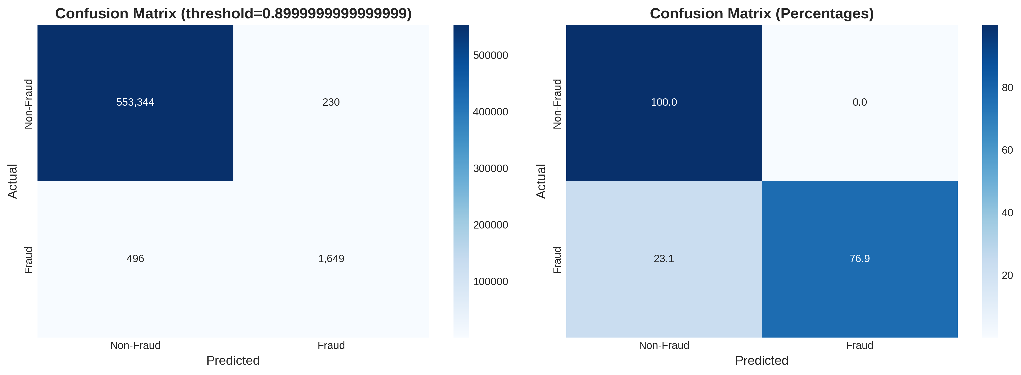
10. Model Performance: Confusion Matrix
At Threshold = 0.90:
• True Positives: 1,649 frauds caught (76.88% recall)
• False Positives: Only 230 false alarms (0.04% FPR)
• Precision: 87.76% of flagged transactions are actual fraud
• F1 Score: 0.8196 (optimal balance)

Slide 12
11. Business Impact Analysis
Metric | Value | Impact
Fraud Prevented (TP × $531) | 1,649 × $531.32 | +$876,147
Fraud Missed (FN × $531) | 496 × $531.32 | -$263,535
Investigation Cost (Flagged × $5) | 1,879 × $5 | -$1,150
NET BENEFIT |  | $611,462
Metric
Value
Impact
Net Benefit: $611,462
Per 555,719 test transactions

Slide 13
12. Key Results Summary
0.9969
0.8712
87.76%
ROC-AUC
PR-AUC
Precision
76.88%
0.8196
0.04%
Recall
F1 Score
FPR
Key Insights:
• Fraudulent transactions 8x larger than legitimate ($531 vs $68)
• Late-night hours show 5x higher fraud rates
• Online shopping categories most vulnerable
• Estimated $611,462 net benefit per 500K transactions

Slide 14
13. Conclusion
Achievements
Future Work
✓ Near-perfect discrimination (ROC-AUC 0.9969)
→ LSTM/Transformer for sequential patterns
✓ Interpretable features enabling business insights
→ Graph Neural Networks for fraud rings
✓ Practical deployment with FraudShield Dashboard
→ SHAP/LIME for explainability
✓ Comprehensive threshold optimization for flexibility
→ Real-time concept drift detection
"Interpretable transaction features can support fraud detection performance competitive with anonymized alternatives - achieving 0.9969 ROC-AUC while enabling genuine understanding of fraud mechanisms."

Slide 15
Thank You
Questions?
Muhammad Ali Tahir
MS Data Science | Superior University
Supervisor: Mr. Talha Nadeem

