Slide 1
Connect-N
An Urgent Game of Dire Consequences
Fanuel Mammo, Audrey Zheng, Malick Gaye

Slide 2
Overview
Our project is characterized by a decision-making agent that utilizes quantum computing routines to beat a user in Connect-4 (or its closely related variants)
This agent uses the board’s positions encoded in qubits, as well as the knowledge of the current game state to pick the next best state
We use Quantum Approximate Optimization Algorithm (QAOA) to quickly evaluate the best move for the agent to make
Relevant factors such as the amount of contacting pieces that the agent has, the amount of contacting pieces that the human player has, possible wins & losses, etc. are all taken into consideration.
The project is presented in a neatly packaged GUI that gives the impression of a proper, non-terminal-based application

Slide 3
Design Philosophy
Reformulate a well-known game such that any user could play against a machine making decisions in an atypical fashion
Classical computing + quantum computing hybrid approach
Classically implemented game loops & mechanics
No inherently quickly-growing structures to exploit here
Generalize board size and number of qubits used such that the size of a board number of states on a given board can increase if necessary
Develop a user-friendly interface through which the game is played, as using a Jupyter Notebook as an environment to host a game is not typical

Slide 4
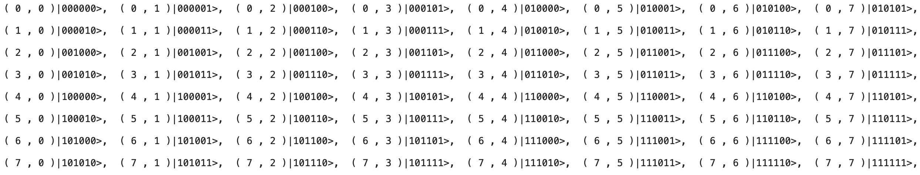
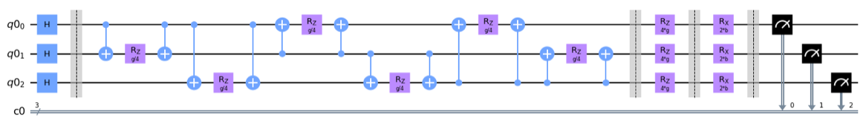
Quantum Speedup
The above is our encoding scheme for spots on an 8x8 board. You may notice that it does not follow the standard mapping for a 2D array – it is organized in a quadrant-like fashion, in which allows for us to perform a binary search (using a qubit for a step) for a given state – this search can be done in logarithmic time
The circuit below is an example of a simplified cost circuit (3-qubit state) that implies interaction between qubits, which our cost Hamiltonians are extremely dependent on (especially in the context of a connection game)

Slide 5
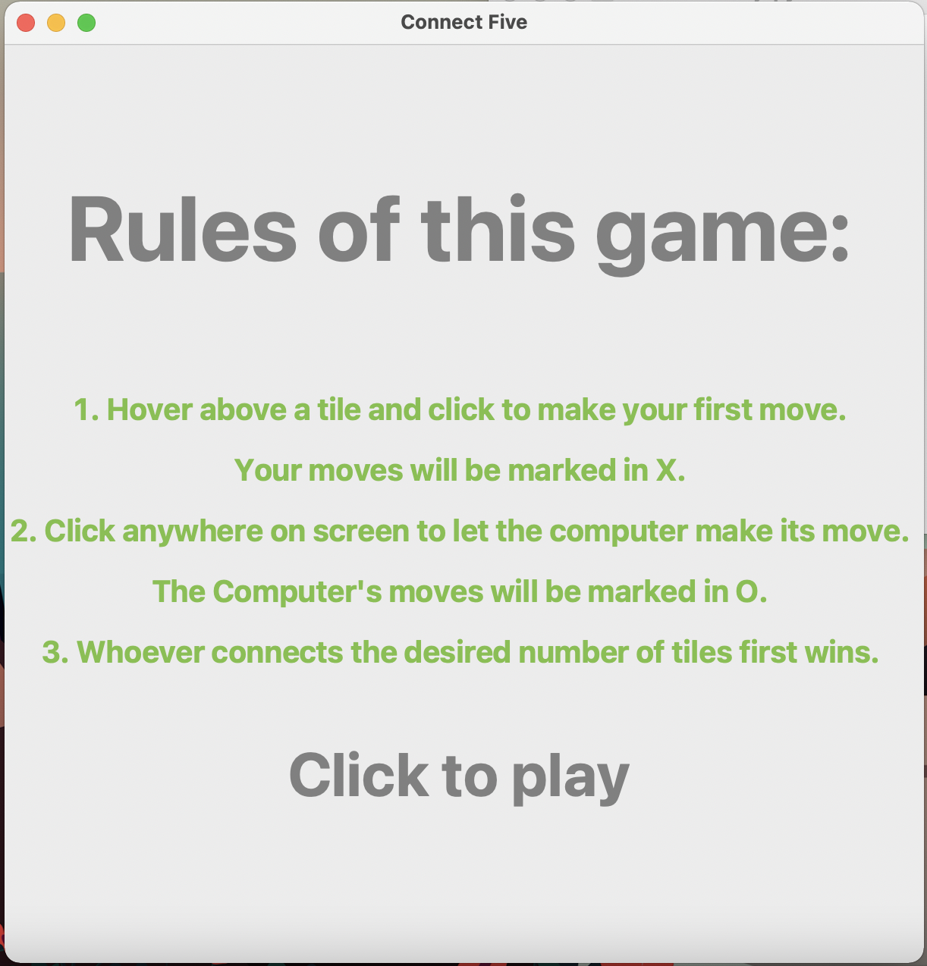
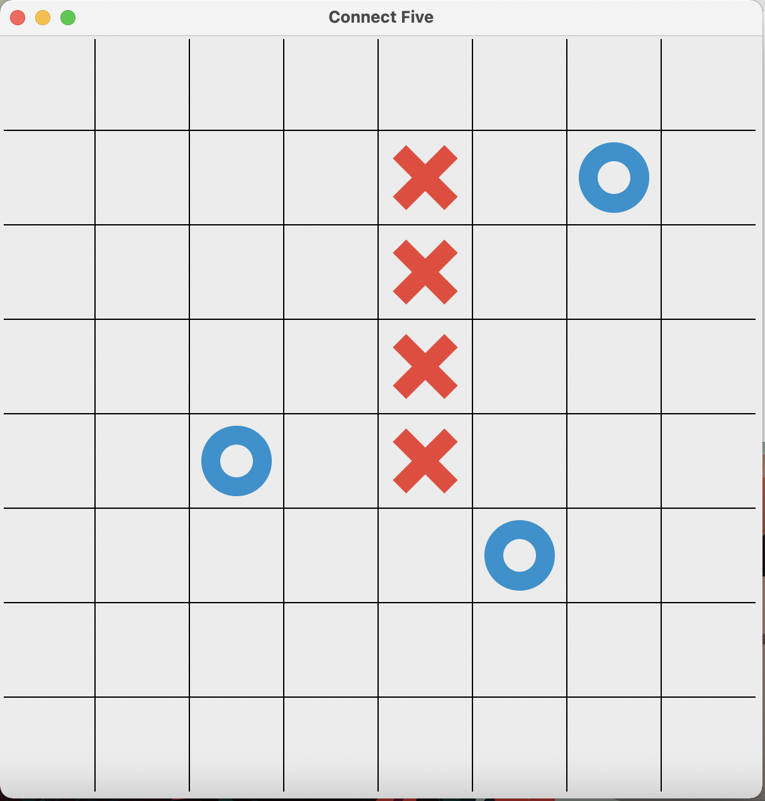
Gameplay Interface
Who plays video games in a Jupyter Notebook?
For IO and graphical representation of the board, we employ Tkinter

Slide 6
Challenges
Some major challenges we faced along the way:
Defining game states (boards) in a way such that future states could easily traversed without needing to use extra basis states
Classical implementations of decision-making agents often involve creating a map of a board, where positions are laid sequentially – encoding the board using qubits was a challenge, but we overcame this by going with a non-sequential ordering
Creating a cost function that effectively takes win conditions, loss conditions, & boundary conditions into account
Win conditions & loss conditions should be weighed much more dramatically – for example, if the machine can make a decision to take it to a win immediately, it should
Programming & debugging – 3 people working simultaneously on a single project with a 24 hour time limit presented logistical hurdles, that we have since been able to overcome

