Slide 1
Maliha Momtaz
Campus ID: QH77172
IS733 Homework 1

Slide 2
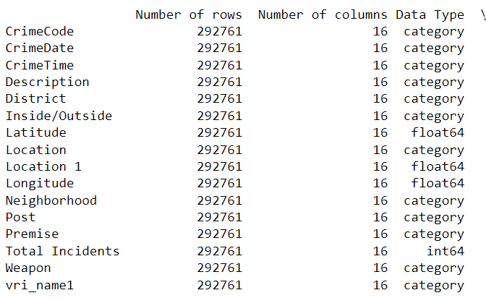
Q1. Create a dataset profile table that gives an overview of the dataset.
It can be noticed from the profile table that, the dataset has 292761 rows and 16 columns. The numeric attributes are Latitude, Location1, Longitude and Total_Incidents. All other variables are categorical / discrete type. Among the categorical variables, CrimeDate and CrimeTime are temporal variables. Latitude and Longitude are spatial variables.

Slide 3
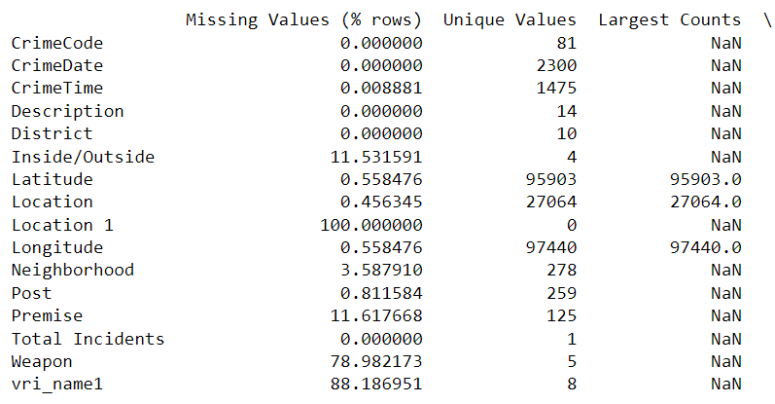
Q1. Create a dataset profile table that gives an overview of the dataset. (continued….)
“Location1” column has the highest level of missingness. The attributes with missing values 0 indicates that, the don’t have any missing values. “Latitude”, “Location” and “Longitude” have the highest number of unique values.

Slide 4
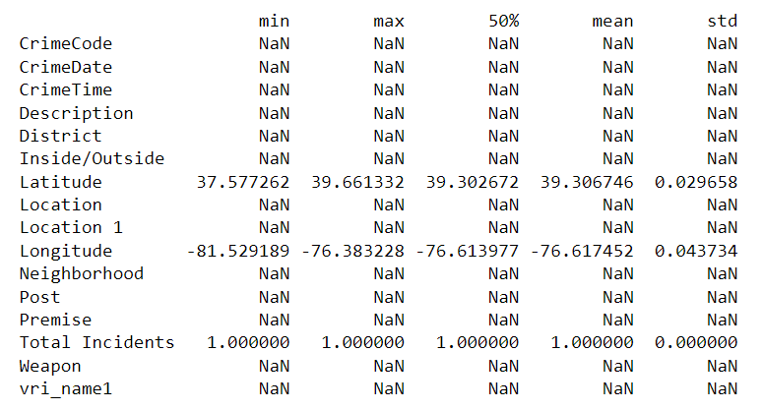
Q1. Create a dataset profile table that gives an overview of the dataset. (continued…)
In this figure, the column 50% indicates to median values. It is not possible to calculate min, max or other characteristics for string type variable. That’s why, they are showing NaN.

Slide 5
Q1. Create a dataset profile table that gives an overview of the dataset. (continued…)
Anything surprising/strange/unique I noted from the data profile:
Ans.
There is no data in the 'Location 1' column at all. It is surprising that why is the column is even in the dataset.

Slide 6
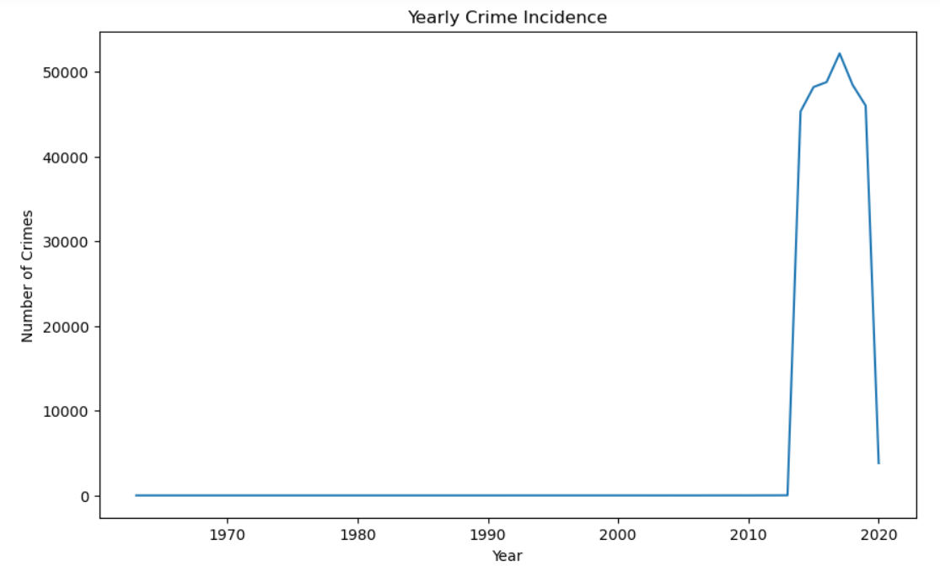
Q2. Generate a series of plots to describe the temporal pattern (year-to-year, monthly, and day-of-week) of the overall crime incidence aggregating from all geo-locations;
From this graph, it can be said that, there is not much crime data available in the dataset for the previous years of 2013.

Slide 7
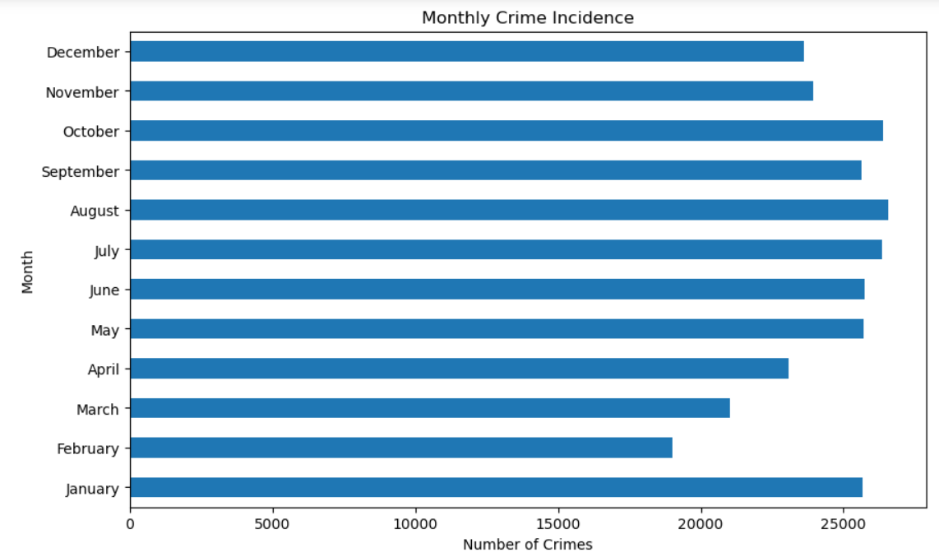
Q2. Generate a series of plots to describe the temporal pattern (year-to-year, monthly, and day-of-week) of the overall crime incidence aggregating from all geo-locations; (continued..)
This graph shows that, most number of crimes occurred in January, July, August and October. The least number of crimes occurred in February.

Slide 8
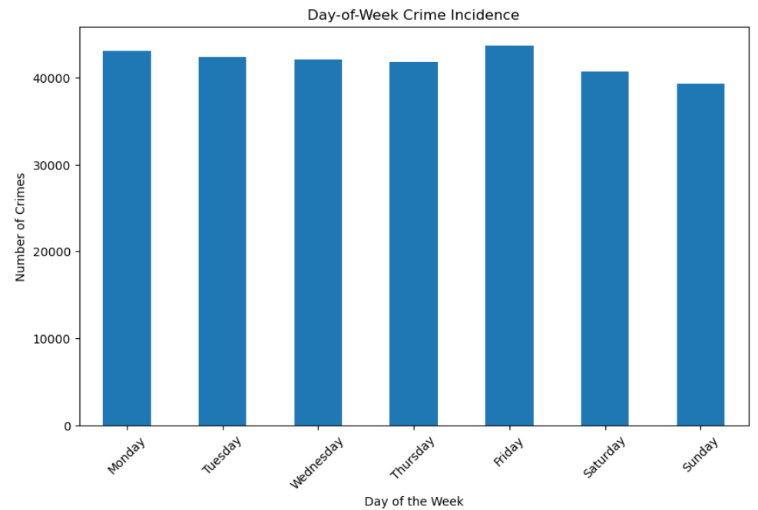
Q2. Generate a series of plots to describe the temporal pattern (year-to-year, monthly, and day-of-week) of the overall crime incidence aggregating from all geo-locations; (continued..)
It can be noticed that, number of crimes did not vary that much through the days of the week. Crimes occurred a little bit more on Mondays and Fridays than the other days. Crimes occurred a little bit less on Sundays.

Slide 9
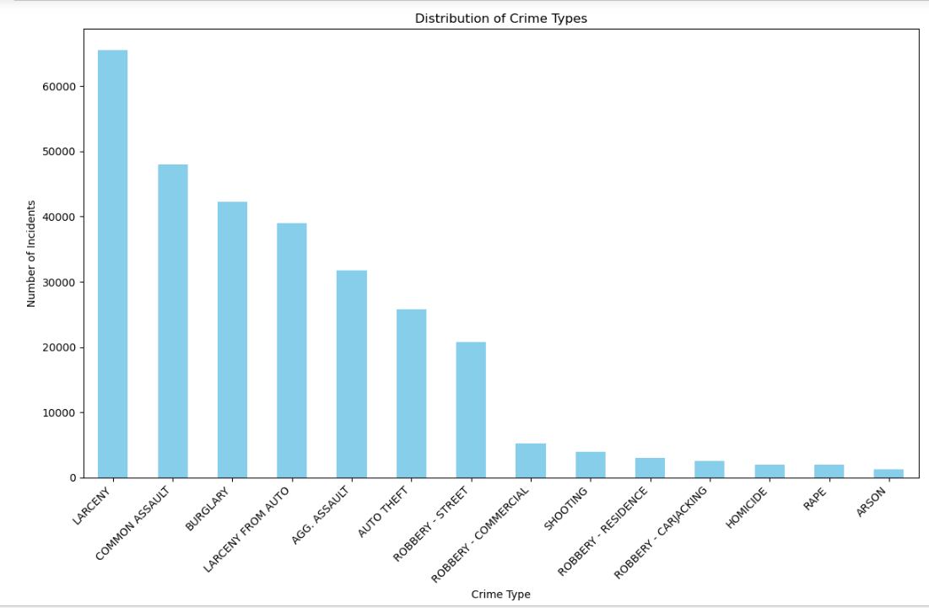
Q3. Generate a plot describing the distribution of crime type aggregating from all geo-locations and all time periods;
Larceny occurred the highest number of times followed by common assault, burglary etc. The least frequent crimes were homicide, rape and arson.

Slide 10
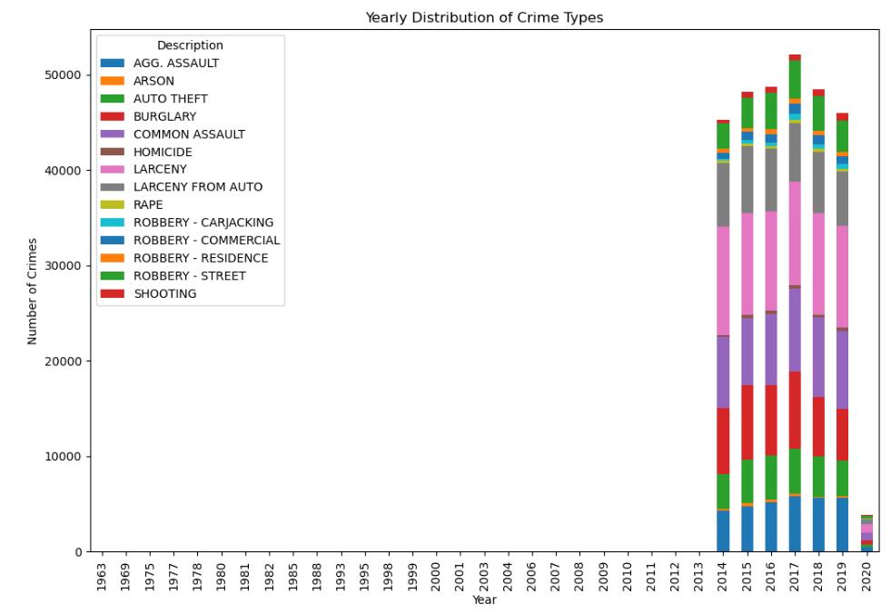
Q4. Generate a series of plots to illustrate how crime type distributions might vary from year-to-year, month-to-month, or by day-of-week aggregating across all locations.
It can be assumed from the graph that, larceny was the most frequent crime in almost every year. Common assault, burglary and robbery were also quite frequent during 2014 to 2019.

Slide 11
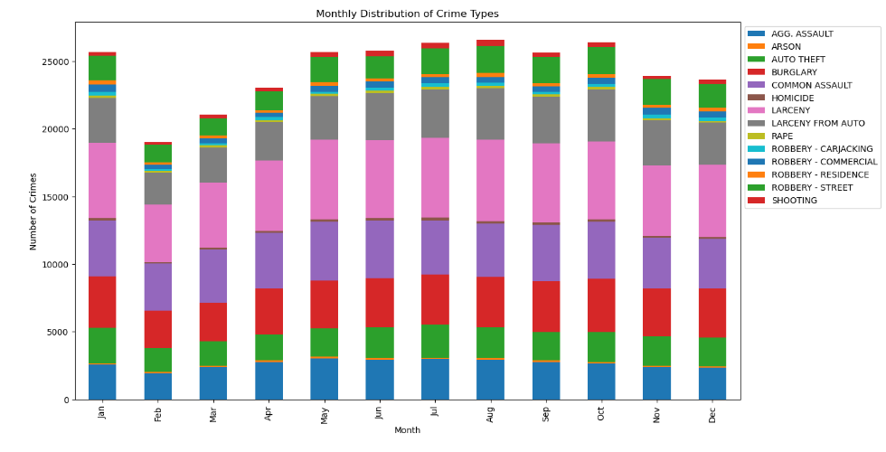
Q4. Generate a series of plots to illustrate how crime type distributions might vary from year-to-year, month-to-month, or by day-of-week aggregating across all locations. (continued…)
Larceny was the most frequent crime in almost every month of the year, followed by common assault and burglary. Shooting, arson, homicide occurred less frequently than other crimes.

Slide 12
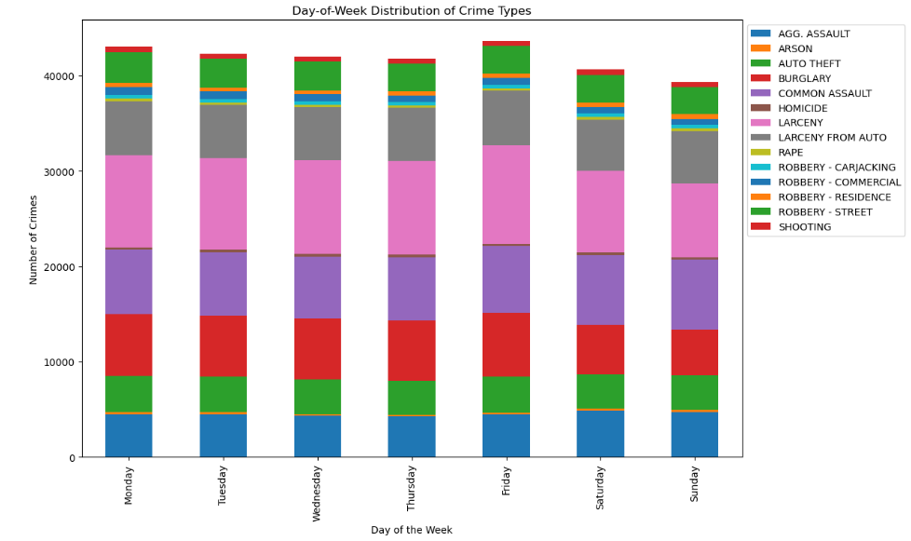
Q4. Generate a series of plots to illustrate how crime type distributions might vary from year-to-year, month-to-month, or by day-of-week aggregating across all locations. (continued…)
Larceny was the most frequent crime in each day of a week. Burglary, common assault and robbery also occurred a lot. Shooting, arson, homicide were the least frequent crimes.

Slide 13
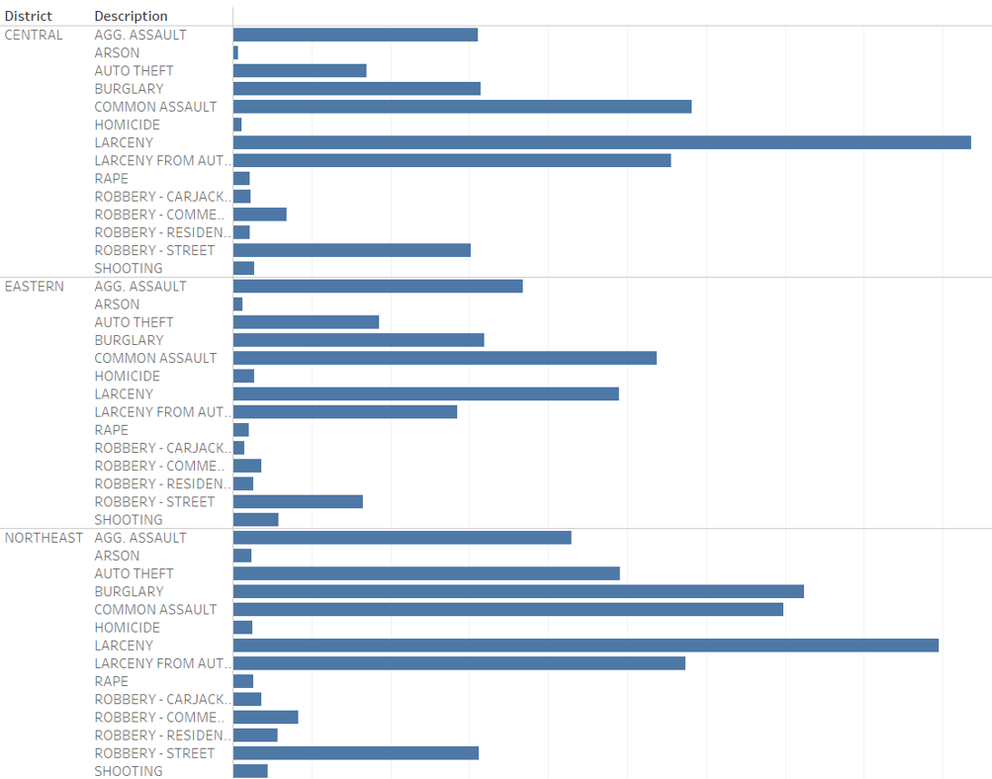
Q5. Design a dashboard that allows users like Gary to explore the spatial and temporal patterns of crime. You may get inspiration from tasks 2-4, but feel free to add insights
Larceny, common assault, agg. assault and burglary were more frequent than any other crimes in all the districts in Baltimore.

Slide 14
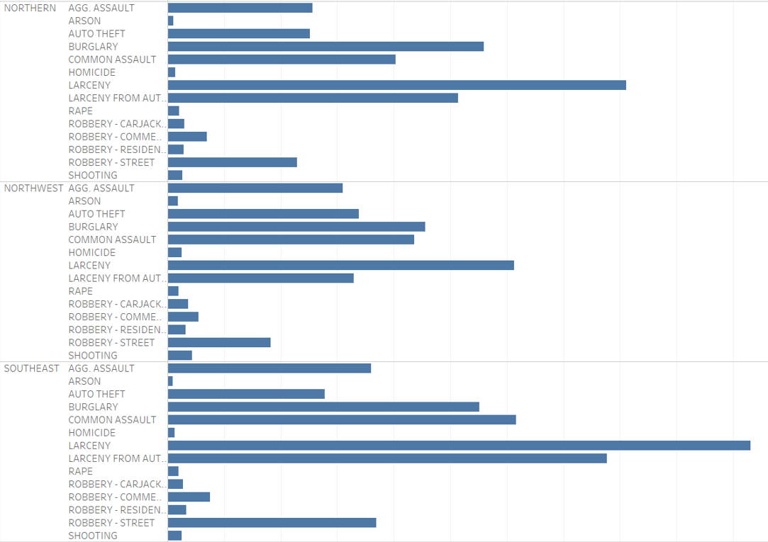
Q5. Design a dashboard that allows users like Gary to explore the spatial and temporal patterns of crime. You may get inspiration from tasks 2-4, but feel free to add insights. (continued…)
In some districts, robbery (specially street robbery) also occurred a high number of times.

Slide 15
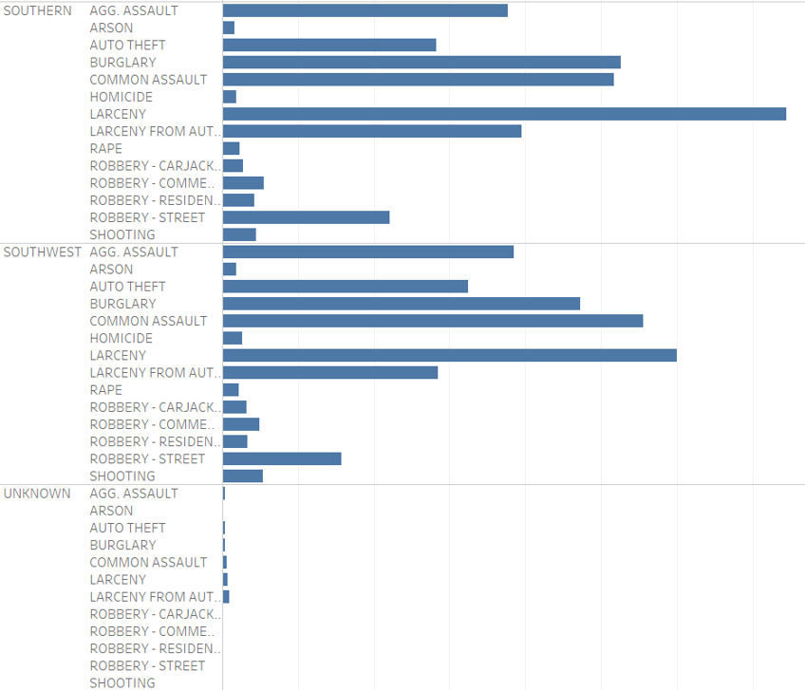
Q5. Design a dashboard that allows users like Gary to explore the spatial and temporal patterns of crime. You may get inspiration from tasks 2-4, but feel free to add insights. (continued…)

Slide 16
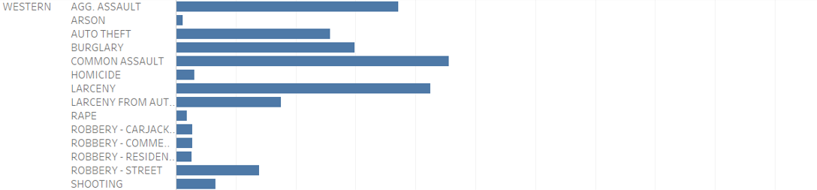
Q5. Design a dashboard that allows users like Gary to explore the spatial and temporal patterns of crime. You may get inspiration from tasks 2-4, but feel free to add insights. (continued…)

Slide 17
Q5. Design a dashboard that allows users like Gary to explore the spatial and temporal patterns of crime. You may get inspiration from tasks 2-4, but feel free to add insights. (continued…)
I did the graphs of questions 2, 3 and 4 using python and matplotlib. Only for Q5, I used tableau. While saving the image from tableau, it generated a long image and it was not possible to show the whole image in one slide. That’s why I broke the image into different pieces and used more than one slide to present it.
The whole interactive dashboard can be seen on tableau public in this link:
https://public.tableau.com/app/profile/maliha.momtaz/viz/IS733_HW1_Q5_Maliha_Momtaz/Sheet1

